Slide 1


感恩遇见，相互成就，本课件资料仅供您个人参考、教学使用，严禁自行在网络传播，违者依知识产权法追究法律责任。
更多教学资源请关注
公众号：溯恩英语
知识产权声明

Slide 2
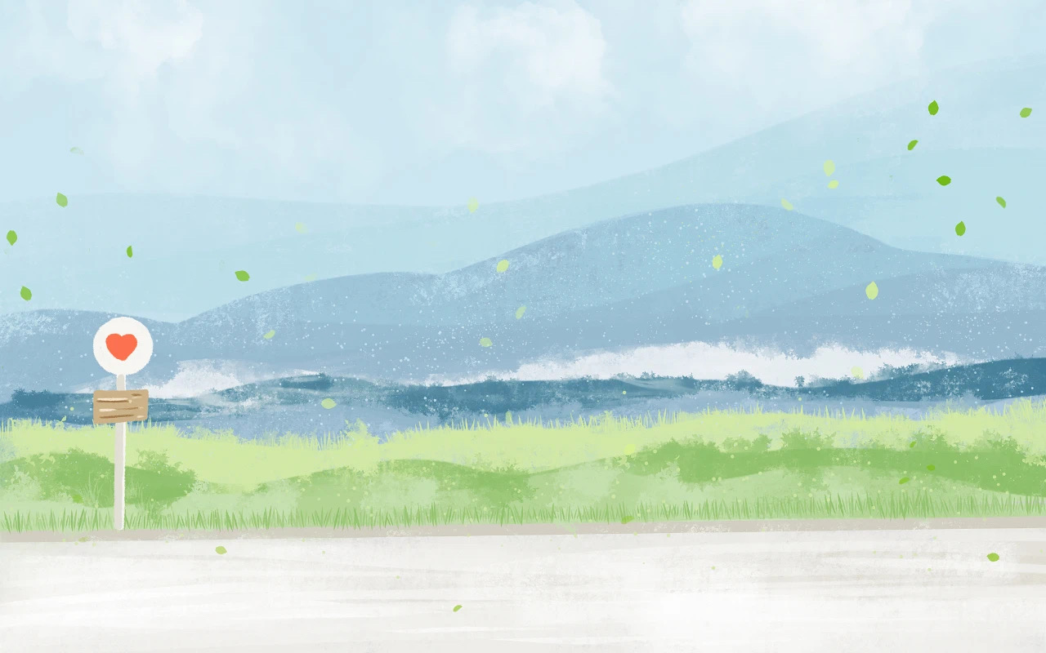
2025 New Year Resolution
Alicewu

Slide 3
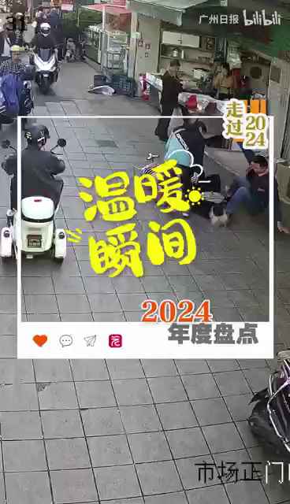
Share your most beautiful moment of your 2024
1.What special moment impressed you most ?
2.How did you feel at that moment?
3.Why did it make you feel it’s the most beautiful moment?

Slide 4

What do you want to achieve in 2025?
If you want to make it come true, what character do you need most?
Resolution
A story about resolution

Slide 5
What is New Year Resolution?
personal
A New Year’s resolution is a_______ (person) commitment or promise________( make) at the onset of a new year, typically intending ________( start) doing something good or stop doing something bad on the first day of the year, ________ brings about positive change or________________ (self-improve).
made
to start
which
self-improvement

Slide 6
How to make New Year Resolution
New Year’s resolutions(决心) usually are like some of those promises that are meant to be broken. The word “New” in the new year, puts a lot of pressure on starting over and turning a new leaf. But you must remember you cannot just become a different person overnight when the clock strikes 12. 1 . Instead of making resolutions that cause you stress, anxiety or more pain, set out this year by. Making resolutions that will encourage self-care.
To start fresh this New Year’s Day, here are a few tips setting realistic new years’ resolutions in order to avoid the burden of disappointment next year.
Choose a very specific goal
Unclear plans like “lose weight” “exercise more” or “write more” are goals with no teeth.
They are unclear plans and desires, and are very easy to explain away due to how unclear they are. 2 . Such goals with a certain task, are much more doable than unclear goals.
3
Once you have chosen your goals, make a very detailed plan of how you will reach that goal. Having a plan and a pathway can help you imagine your progress and won’t make you impatient for immediate results. That way you will have already imagined what progress would look like for you in say, 3 months, 5 months, 7 months or every day depending on your goals.

Slide 7
Get yourself a social group
In today’s social media world, it is easy to find a group of like-minded individuals interested in sharing your goal. Get yourself a social group like this. However, just as there is this bright side to having a social group, the problem is the pressure. Don’t get consumed by social media and what others are doing. 4
Accept failure and forgive yourself.
5 . Accept this failure; own it and forgive yourself. Being hard on yourself will only do you more harm, so instead learn from, what went wrong and instead of quitting the resolution at the end of next year, see it through until you reach your goal.
A．Make a plan to reach that goal
B．Be patient with your progress
C．Instead, set goals like “exercise 20 minutes every day“ or “lose 15 pounds”
D．Despite all your efforts, it is possible that you might fail or make a mistake.
E．Therefore, new year’s resolutions usually end up in failure
F．Change is a difficult process-the key words being “difficult“ and “process”
G．Remember you have this group only for support, not for comparison

Slide 8

Make specific New Year Resolution in 2025
Send a postcard to different seasons in 2025, picture what you will be doing at that moment.
What will you be doing at that moment?
How do you feel at that moment?
Why do you choose this moment?

Slide 9
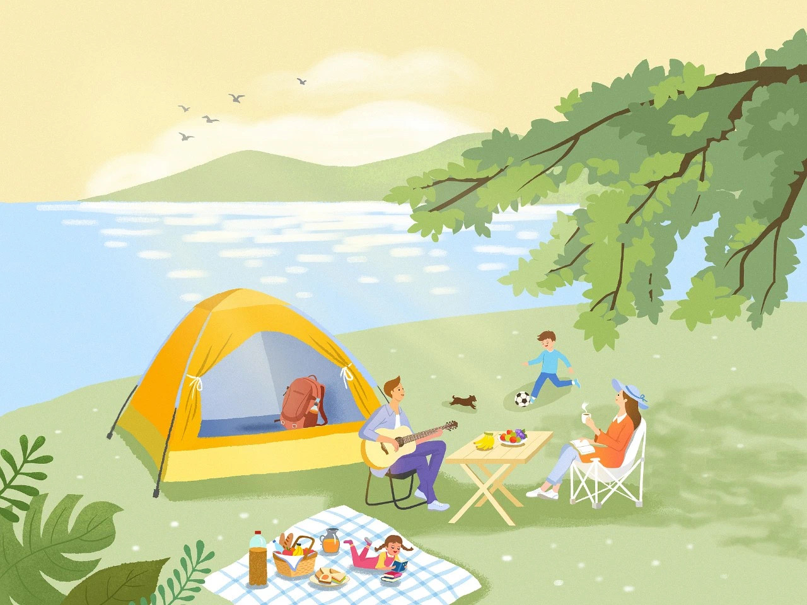
In the spring of 2025,my family enjoys a sunny day at the park, we set up a tent and lay out a picnic blanket on the grass.
My son is kicking a soccer ball around with enthusiasm, while my daughter lies on her stomach, absorbed in a book. I am sitting in a chair, sipping coffee and reading a book of my own. My husband plays the guitar, adding a melodic tune to our peaceful afternoon.
Everyone is happy and content, enjoying the simple pleasures of a family picnic in the springtime.
Sample

Slide 10


Slide 11

Basking in the spring sunshine beneath a blossoming tree, I will be lying on a picnic mat engrossed in a book, with sweet treats and a steaming cup of coffee by my side, feeling utterly content in spring of 2025.

Slide 12
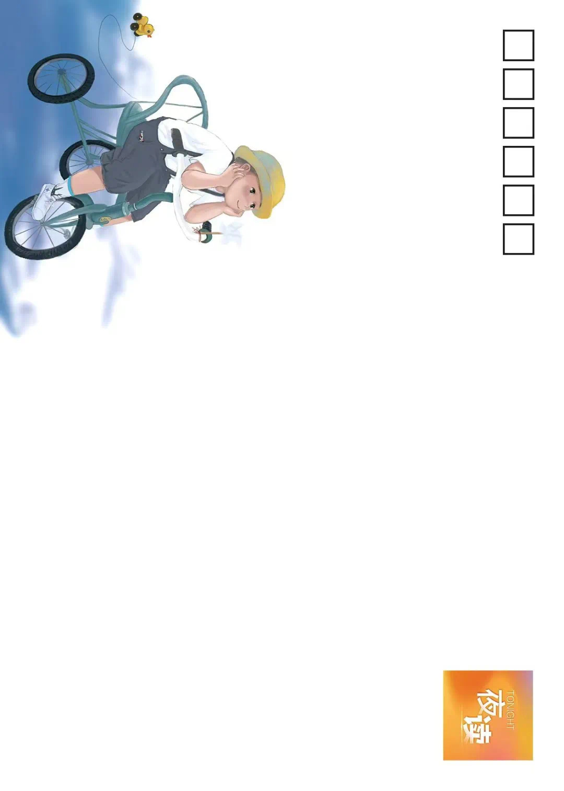

Slide 13

With our dog happily tucked in the bike basket, my friend and I will be cycling on the lawn, our faces glowing with joy in summer of 2025.

Slide 14


Slide 15

I will be reading by the seaside with a steaming cup of coffee on the table, seagulls soaring overhead, and sea breeze gently touching my face in autumn of 2025.

Slide 16
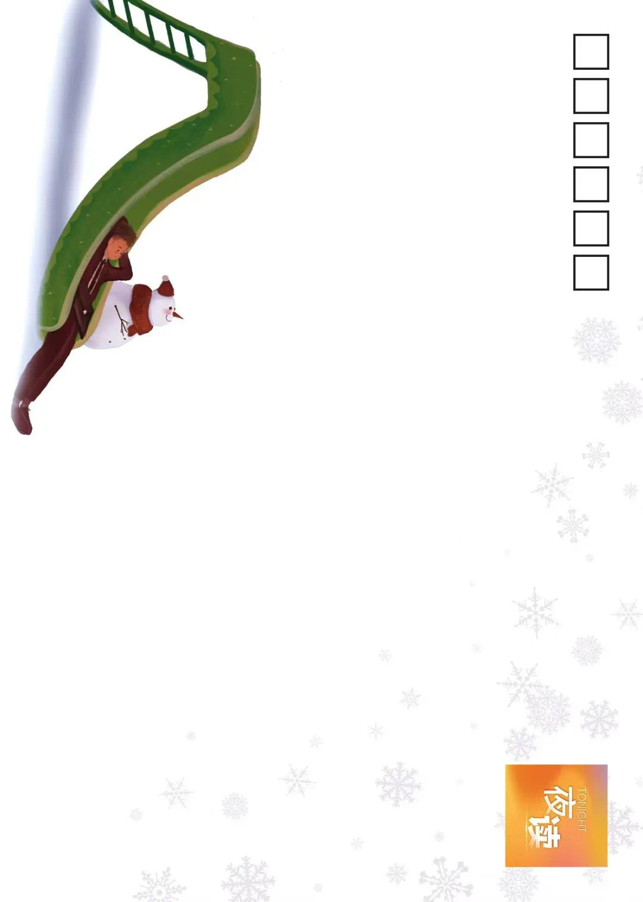

Slide 17
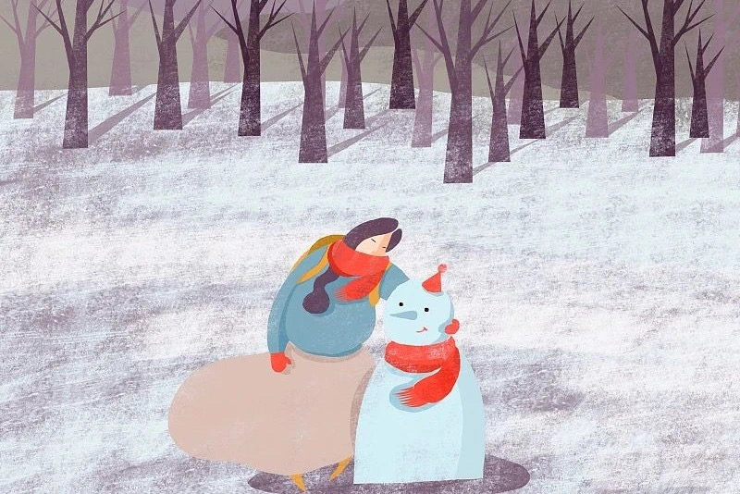
I will be taking a photo with my homemade snowman, both of us wearing red scarves, standing in the snow with joyful expressions.

Slide 18
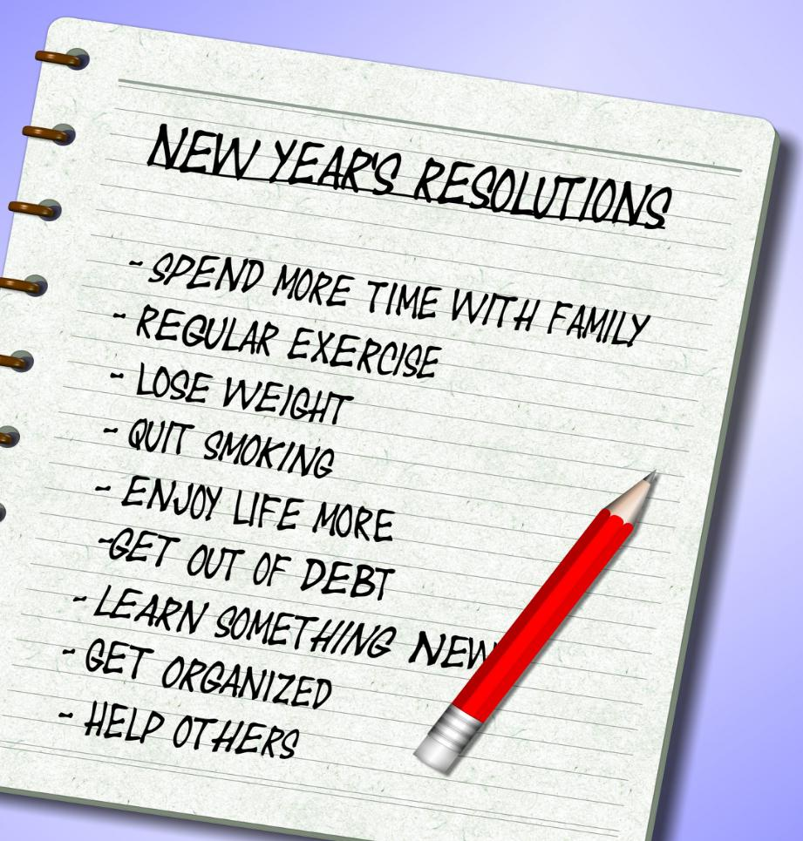
假定你是李华，新的一年到了，你的英国好友Jim来信说他去年的新年计划未能落实，感到苦恼，向你询问按时实施计划的方法。请你给Jim回信，内容包括：
1. 表示理解；
2. 你的建议。
注意：
1. 写作词数应为80左右；
2. 请按如下格式在答题卡的相应位置作答。
3. 参考词汇：新年计划 New Year resolution

Slide 19
Dear Jim,
I understand how you feel about not being able to fulfill your New Year resolution last year. It's a common struggle that many of us face. Here are a few suggestions that might help you stay on track this year.
Breaking down your goals into smaller, manageable tasks can make them seem less daunting and easier to achieve. Additionally, setting realistic deadlines for each task will give you a sense of urgency and help you stay focused. Lastly, celebrating small victories along the way is important to keep your morale high.
I hope these tips will help you make this year's resolution a success. Remember, it's never too late to start working towards your goals.
Best wishes,
Li Hua

Slide 20
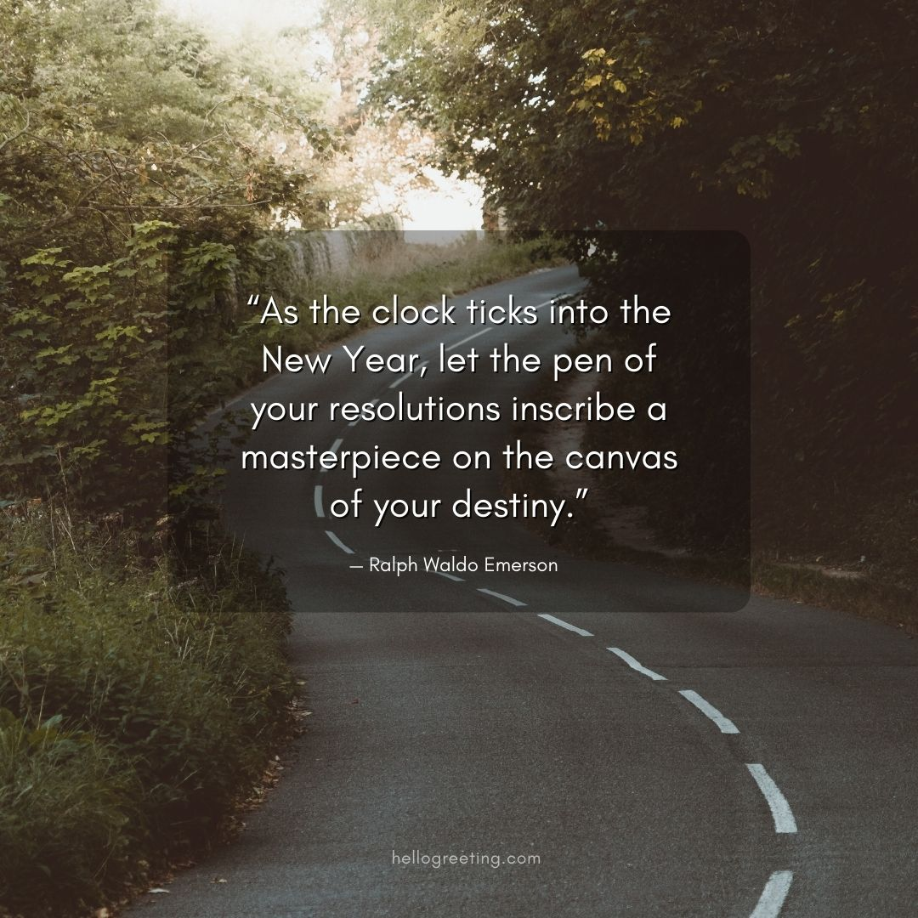

Slide 21
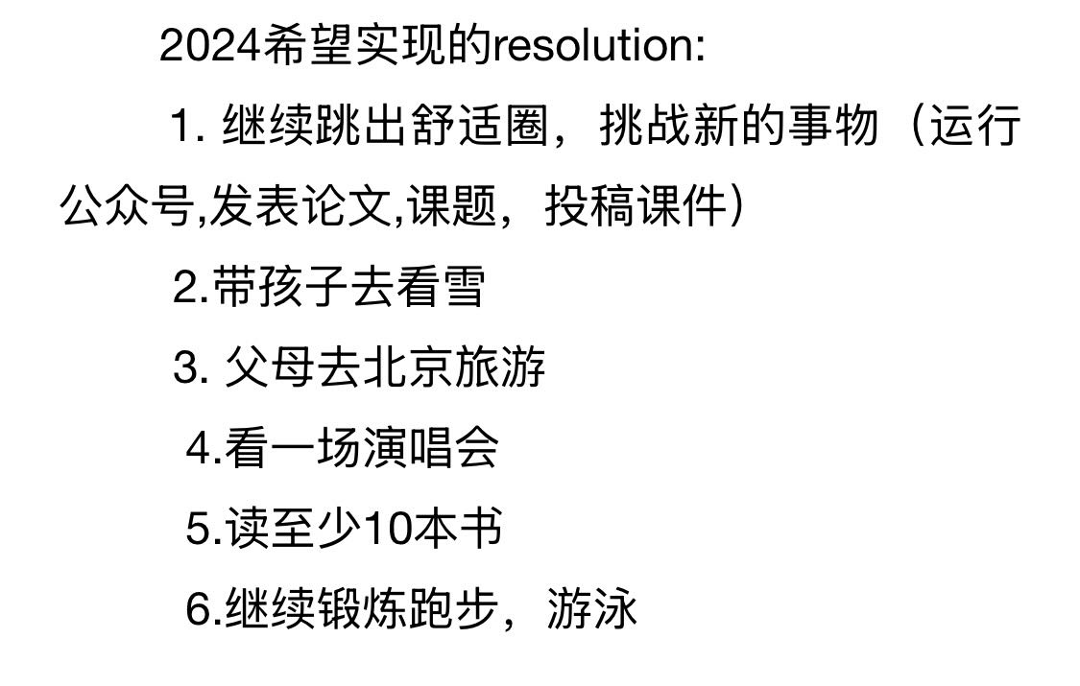
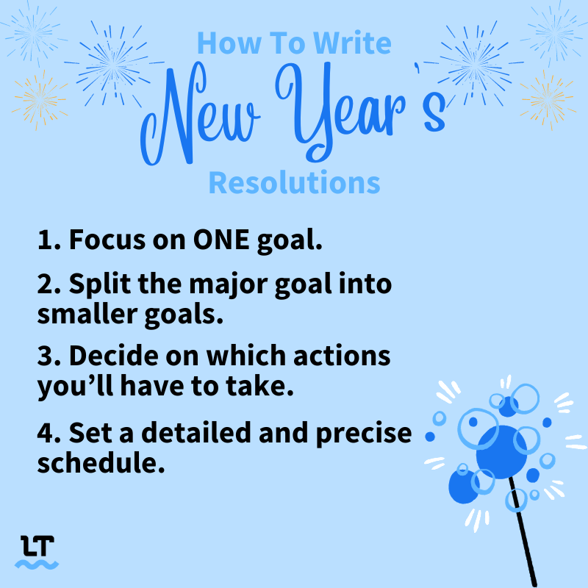
Homework :
Make your own 2025 Resolution.
List at least three goals you want to achieve.

