Slide 1



感恩遇见，相互成就，本课件资料仅供您个人参考、教学使用，严禁自行在网络传播，违者依知识产权法追究法律责任。
更多教学资源请关注
公众号：溯恩英语
知识产权声明

Slide 2


教材群文阅读突破
中国传统文化主题
华南师范大学附属惠阳学校：梁晓林

Slide 3

目录图解
Par 1: 课程标准解读
教材群文阅读突破中国传统文化主题
Part2:人教版教材有关中国传统文化的语篇链接高考真题解析
Para 3：有关中国传统文化主题历年高考真题汇编（应用文为主）

Slide 4
一．课程标准解读
文化知识涵盖物质和精神两个方面。物质方面主要包括饮食、服饰、建筑、交通等，以及相关的发明与创造；精神方面主要包括哲学、科学、教育、历史、文学、艺术，也包括价值观念、道德修养、审美情趣、社会规约和风俗习惯等。学习中外优秀文化，有助于学生在对不同文化的比较、鉴赏、批判和反思的过程中，拓宽国际视野，理解和包容不同文化，增强对中华优秀传统文化、革命文化和社会主义先进文化的认识，形成正确的价值观和道德情感，成为有文明素养和社会责任感的人。

Slide 5
普通高中英语文化知识内容要求摘录：
课程类别 | 文化知识内容要求
必修 | 1. 了解英美等国家的主要传统节日及其历史与现实意义；比较中外传统节日的异同，探讨中外传统节日对文化认同、文化传承的价值和意义； 2. 了解英美等国家的主要习俗；对比中国的主要习俗，尊重和包容文化的多样性； 3. 学习并初步运用英语介绍中国传统节日和中华优秀传统文化（如京剧、文学、绘画、园林、武术、饮食文化等），具有传播中华优秀传统文化的意识。
4. 选择性必修 | 1.使用英语简述中华文化基本知识，包括中华传统节日、中华优秀传统文化的表现形式（如京剧、文学、绘画、园林、武术、饮食文化等）及其内涵，主动传播和弘扬中华优秀传统文化。
5. 选修（提高类） | 1.运用中外典故和有代表性的文化标志表达意义和态度，有效进行跨文化沟通； 2.了解中国对外经济、政治、文化的积极影响，感悟中华文明在世界历史中的重要地位，树立中华文化自觉，坚定文化自信。

Slide 6
二．中国传统文化教材内容链接

Slide 7
人教版教材有关中国传统文化语篇汇总
所在单元主题内容 | 教材 | 语篇内容 | 文体
Festivals and Celebrations | 必修3U1 Reading for Writing | 1. My Amazing Naadam Experience | 记叙文
Art | 选择性必修3U1Reading—Using language | 2. Ancient Chinese Art on Show | 应用文（广告传单）
Food and Culture | 选择性必修2U3 | 3. Culture and cuisine | 议论文（夹叙夹议）
Languages Around the World | 必修1U5 Reading | 4. The Chinese Writing System:Connecting the Past and the Present | 说明文
Cultural Heritage | 必修2U1 Writing | 5. To write a news report about cultural heritage protection | 新闻报道

Slide 8
语篇一 必修3
U1 Reading for Writing

Slide 9
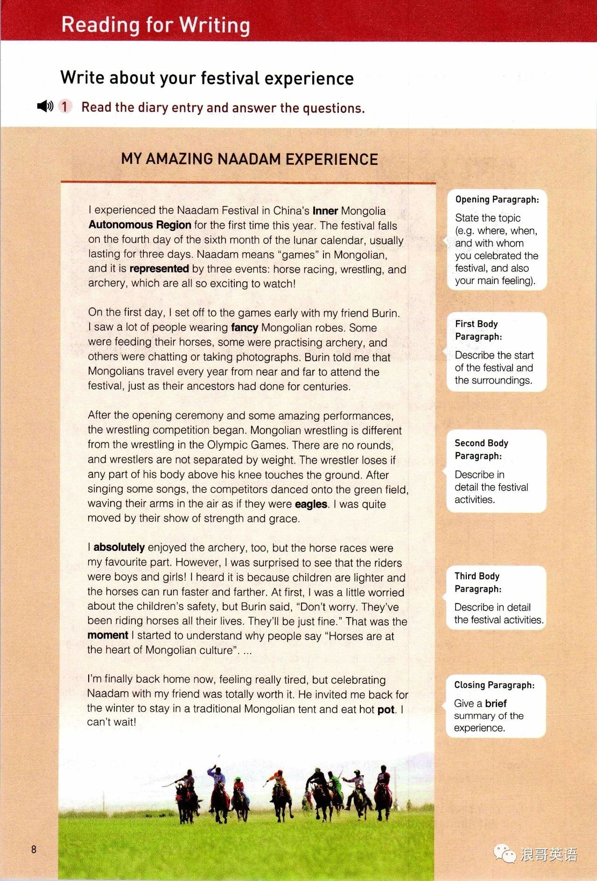
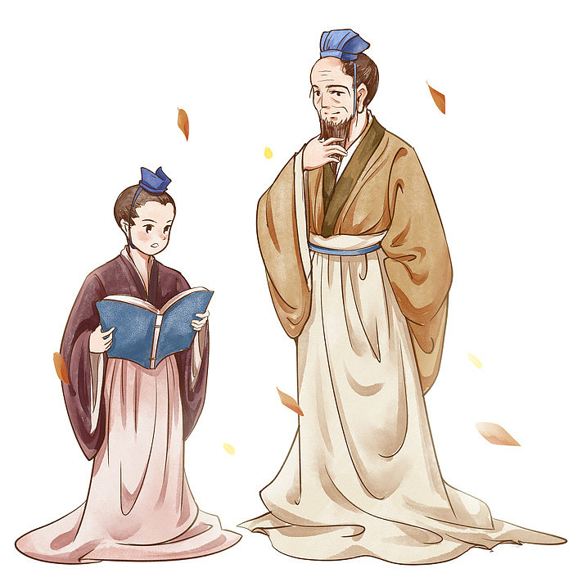
According to the left information，we can divide the passage into ________ parts.
3

Slide 10
Analyze the structure
Opening
para1. Brief introduction of Naadam Festival
Before the Naadam Festival
para2.What the author saw before the opening ceremony
My amazing Naadam Experience
Body
During the Naadam Festival
para3.The wrestling competition and rules about it
para4.The horse race
After the Naadam Festival
Closing
para5 Brief summary of Naadam Festival

Slide 11

Task 1 Review the important phrases and translate.
1.The festival falls on the fourth day of the six month of the lunar calendar, usually lasting for three days. | 这个节日在农历六个月的第四天，通常持续三天。
2.wear fancy Mongolian robes | 穿奇装异服
3.Some others were feeding their horses, some were practising archery, and others were chatting or taking photographs. | 一些人在喂马，一些人在练习射箭，还有一些人在聊天或拍照。
4.After the opening ceremony and some amazing performances, the wrestling competition began. | 在开幕式和一些精彩的表演之后，摔跤比赛开始了。
5.After singing some songs, the competitors danced onto the green field, waving their arms in the air as if they were eagles. | 唱了几首歌后，选手们在绿色的场地上跳舞，像老鹰一样在空中挥舞着手臂。
6.I’m finally back home now, feeling really tired, but celebrating Naadam with my friend was totally worth it. | 我现在终于回家了，感觉真的很累，但和朋友一起庆祝那达慕是完全值得的。

Slide 12
高考真题链接 2017年浙江卷
应用文写作（满分15分）

Slide 13
假定你是李华，得知外教Mr.Hall寒假不回国，想邀请他到你家过春节。请给他写一封信，内容包括：
1．时间；
2．一同过节的家人；
3．活动。
注意：
1．词数80左右；
2．可以适当增加细节，以使行文连贯。

Slide 14
语篇结构模仿:
春节前：贴春联、贴福字、放烟花；
除夕夜：全家人围在一起包饺子、吃大餐、看春晚、穿新衣
春节后：拜年、发红包、给小孩压岁钱、在街上看舞龙舞狮表演。
paste spring couplets/paste the charcter of Fu/set off fireworks
On the eve of the day, the whole family will get together, making dunplings, enjoying the family reunion dinner, watching the Spring Festival Gala and wearing new fancy clothes.
give New Year’s greetings/give red envelope with money /hand out lucky money to children/watch performances of dragon and lion dancing on the street

Slide 15
课文典句摘抄 （阅读课文文本并翻译句子）
1.这个节日在农历六个月的第四天，通常持续三天。
仿写：春节在农历1月1号
The festival falls on the fourth day of the six month of the lunar calendar, usually lasting for three days.
Spring Festival falls on the first day of the first month of the lunar calendar

Slide 16
2.一些人在喂马，一些人在练习射箭，还有一些人在聊天或拍照。
________________________________________________________
仿写：春节前一天，一些人贴春联、一些人贴福字，还有一些人放烟花。
Some others were feeding their horses, some were practising archery, and others were chatting or taking photographs.
On the day before the Spring Festival, some people will paste spring couplets, some people will paste the charcter of Fu and others will set off fireworks.

Slide 17
3.我现在终于回家了，感觉真的很累，但和朋友一起庆祝那达慕是完全值得的。
______________________________________________________________________________________________________
仿写：和我的家人一起过春节是完全值得的。
I’m finally back home now, feeling really tired, but celebrating Naadam with my friend was totally worth it.
Celebrating the Spring Festival with my family is totally worth it.

Slide 18
Dear Mr.Hall,
Knowing you will not go home and that you're interested in traditional Chinese culture, I'm sincerely writing to invite you to celebrate the Spring Festival with myfamily.
Falling on the first day of the first lunar month,the Spring Festival is when all my family members get together. On the day before the Spring Festival, some of us will paste spring couplets, some will paste the charcter of Fu and others will set off fireworks. On the eve of the day, my whole family will get together, making dunplings, enjoying the family reunion dinner, watching the Spring Festival Gala and wearing new fancy clothes. After that, on the morning of the Sring Festival, we will give friends and relatives New Year’s greetings, hand out lucky money to children andwatch performances of dragon and lion dancing on the street. I'm convinced you can have a better understandingof the traditional festival through the activities.
I'd appreciate it if you could confirm your coming at your earliest convenience.Hopefully,you’ll accept my invitation.
Yours,
Li Hua
1.写信目的
提出邀请
2.介绍活动内容和活动益处
3.表达邀请的愿望

Slide 19
语篇二选择性必修3
U1Reading—Using language
Ancient Chinese Art on Show

Slide 20
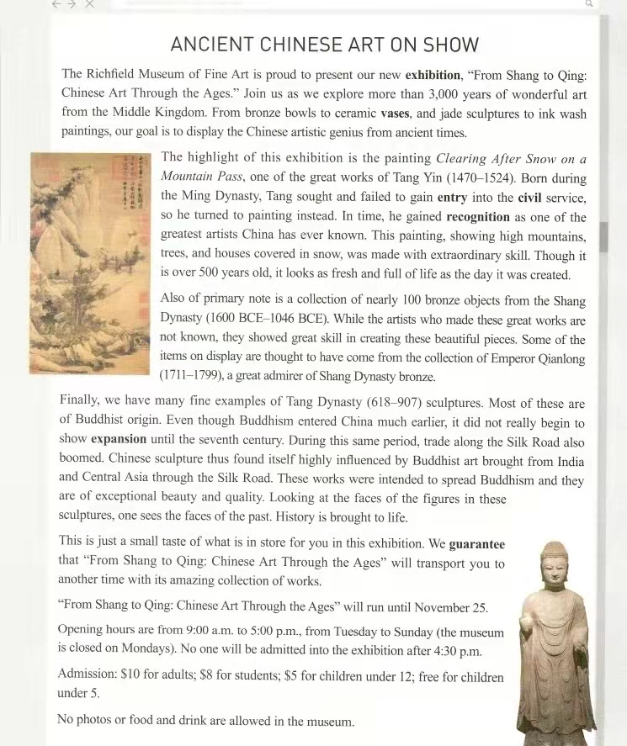
Task 1 Analyze the structure
General information: theme of the exhibition
Highlight 1
Highlight 2
Highlight 3
Significance
Details about the exhibition

Slide 21
Task 2Review the important phrases and translate.
1.“From Shang to Qing: Chinese Art Through the Ages.” | 从商代到清代：中国艺术的千年传承
2.From bronze bowls to ceramic vases, and jade sculptures to ink wash paintings our goal is to display the Chinese artistic genius from ancient times | 从青铜碗到陶瓷花瓶，从玉雕到水墨画，我们的目标是展现中国古代的艺术天赋。
3.In time, he gained recognition as one of the greatest artists China has ever known. This painting, showing high mountains, trees, and houses covered in snow, was made with extraordinary skill. Though it is over 500 years old, it looks as fresh and full of life as the day it was created. | 最终，他获得了认可，成为中国有史以来最伟大的艺术家之一。这幅画描绘了高山、树木和被雪覆盖的房屋，技艺超群。尽管它已有 500 多年的历史，但看起来依然如初，充满生机。
4. a collection of nearly 100 bronze objects from the Shang Dynasty | 近100件商代青铜器收藏品
5.They showed great skill in creating these beautiful pieces | 他们在创作这些美丽的作品时表现出了高超的技巧
6.Buddhist origin | 佛教起源

Slide 22
Task 2Review the important phrases and translate.
7.During this same period, trade along the Silk Road also boomed. Chinese sculpture thus found itself highly influenced by Buddhist art brought from India and Central Asia through the Silk Road. These works were intended to spread Buddhism and they are of exceptional beauty and quality. Looking at the faces of the figures in these sculptures, one sees the faces of the past. | 在同一时期，丝绸之路沿线的贸易也蓬勃发展。因此，中国雕塑发现自己深受通过丝绸之路从印度和中亚带来的佛教艺术的影响。这些作品旨在传播佛教，它们具有非凡的美感和质量。看着这些雕塑中人物的脸，人们看到了过去的面貌。
8. History is brought to life. | 历史被赋予了生命。
9. We guarantee that"From Shang to Qing: Chinese Art Through the Ages" will transport you to another time with its amazing collection of works. | 我们保证，“从商到清：中国艺术千古之旅”将带您走进另一个时代。
10. No one will be admitted into the exhibition after 4: 30 p. m. | 下午4:30以后，任何人不得进入展览会。
11. admission n. | 允许进入 /入场

Slide 23
高考真题链接 2021年 浙江卷
应用文写作（满分15分）

Slide 24
第一节 应用文写作（满分15分）
昨天你参观了学校举办的学生国画作品展。请给校英文报写一篇宣传稿，内容包括：
1．展览时间、地点；
2．观展感受；
3．推荐观展。
注意： 1．词数80左右；
2．可以适当增加细节，以使行文连贯。

Slide 25
从课文文本中学习描述观展感受和推荐观展
1.一些画描绘了高山、树木和白雪覆盖的房屋，是用非凡的技巧完成的。它们看起来鲜活和充满生机。
2.这些国画作品非常漂亮，质量上乘。看着这些国画作品中人物的脸，我看到了过去的面貌。
3.我保证这些惊艳的作品将带您走进另一个时代。
Some paintings, showing high mountains, trees, and houses covered in snow, are made with extraordinary skill. They look fresh and full of life .
These traditional Chinese painting are of exceptional beauty and quality. Looking at the faces of the figures in these works, I see the faces of the past.
I guarantee that these amazing works will transport you to another time.

Slide 26
The school hall witnessed an extraordinary Chinese painting exhibition yesterday organized by our school,which was intended to further our understanding of traditional Chinese culture.
A great many artworks created by our fellow students are being displayed, ranging from figure paintings to landscape ones. Some paintings, showing high mountains, trees, and houses covered in snow, are made with extraordinary skill. They look fresh and full of life .Some traditional Chinese figure paintings are of exceptional beauty and quality. Looking at the faces of the figures in these works, I see the faces of the past.
Moreover, what appealed to me was the combination of painting, poetry and calligraphy. The paintings on show held my attention through.
The exhibition will last for one week, and whoever wants to feast your eyes on the beauty of diverse Chinese culture definitely cannot miss it. I guarantee that these amazing works will transport you to another time.
1.（展览时间、
地点、目的）
2.详情介绍、观展感受
3.推荐观展

Slide 27
语篇三 选择性必修2
U3 Culture and cuisine

Slide 28
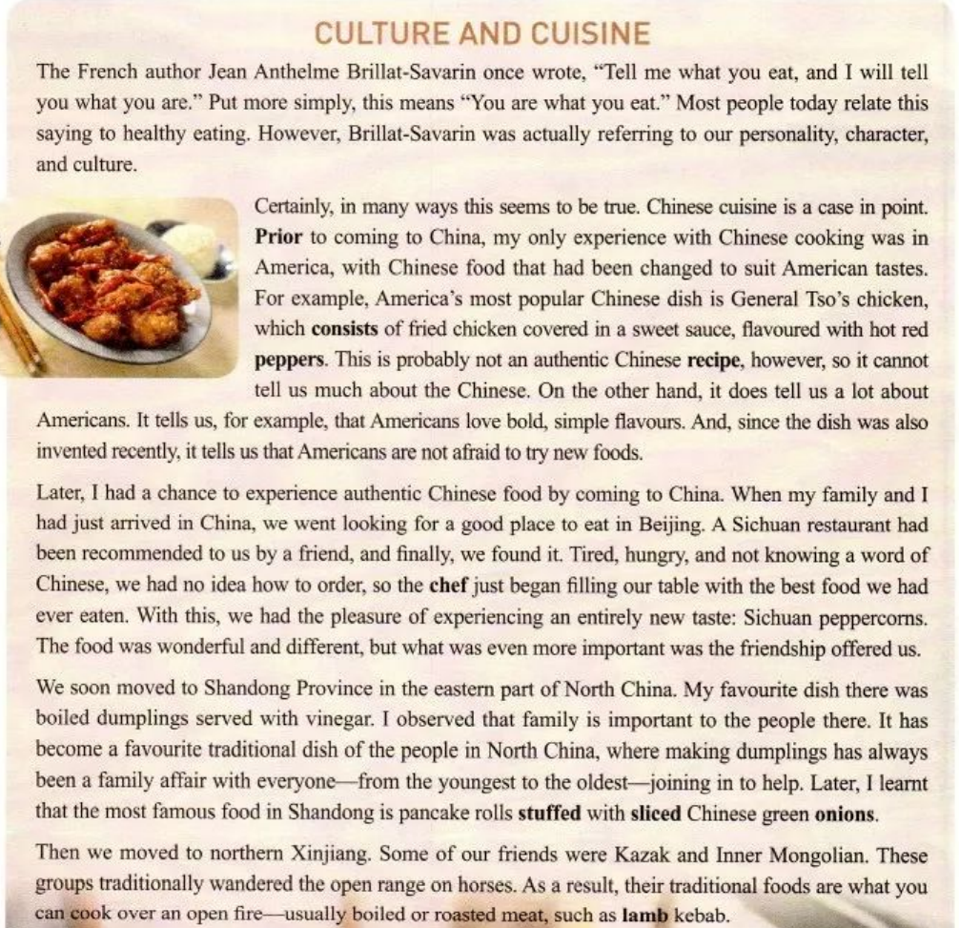
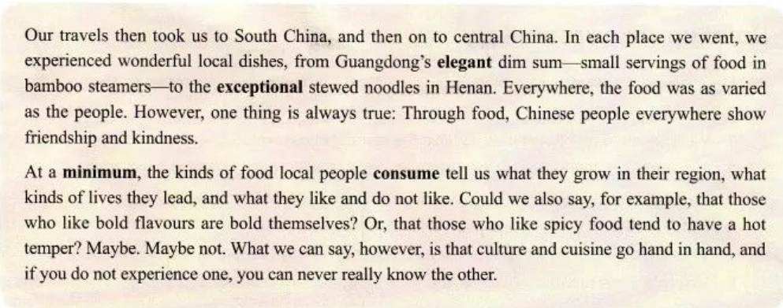
Analyze the structure
（课件摘选自维克多英语官网）
Topic (Para.1)
__________________
“You are what you eat.”
Body (Para.2 — Para.6 )
My _________________ with Chinese food.
different experiences
Conclusion (Para.7)
________________________________________
Culture and cuisine go hand in hand.

Slide 29
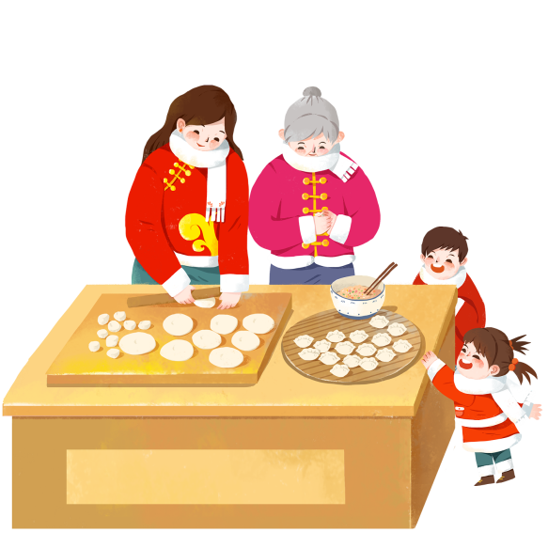
Analyze the structure
（课件摘选自维克多英语官网）
Para. 2 Chinese food in ____________
America
Para. 3 Chinese food in _________
Beijing
Para. 1 Topic: You are what you eat.
Para. 7 Culture and cuisine go hand in hand.
Para. 4 Chinese food in _______________
Shandong
Para. 5 Chinese food in _______________
Xinjiang
Para. 6 Chinese food in __________ and Henan
Guangdong

Slide 30
Task 2Review the important phrases and translate.
8.It has become a favourite traditional dish of the people in North China, where making dumplings has always been a family affair with everyone—from the youngest to the oldest—joining in to help. | 它已成为中国北方人最喜爱的传统菜肴，在那里，包饺子一直是一件家庭事务，从最小的到最大的，每个人都参与其中。
9.Later, I learnt that the most famous food in Shandong is pancake rolls stuffed with sliced Chinese green onions. | 后来，我才知道山东最有名的食物是葱油饼卷。
10.boiled or roasted meat | 煮或烤的肉
11.central China | 华中地区
12.we experienced wonderful local dishes, from Guangdong's elegant dim sum—small servings of food in bamboo steamers—to the exceptional stewed noodles In Henan. | 我们品尝了美妙的当地美食，从广东的优雅点心（竹制蒸笼里的小点心）到河南的特色炖面。
13. culture and cuisine go hand in hand. | 文化与美食密不可分。

Slide 31
Task 2Review the important phrases and translate.
1. Chinese cooking | 中国烹饪
2. Culture and cuisine | 文化和美食
3. America's most popular Chinese dish is General Tso's chicken, which consists of fried chicken covered in a sweet sauce, favoured with hot red peppers. | 美国最受欢迎的中国菜是左宗棠鸡，这道菜是用炸鸡蘸上甜酱，再配上红辣椒。
4.an authentic Chinese recipe | 地道的中国食谱
5.With this, we had the pleasure of experiencing an entirely new taste: Sichuan peppercorns. | 有了这个，我们很高兴地体验到一种全新的味道：花椒。
6.The food was wonderful and different, but what was even more important was the friendship offered us. | 食物是美妙的和不同的，但更重要的是我们之间的友谊。
7.My favourite dish there was boiled dumplings served with vinegar | 我最喜欢的菜是醋水饺。

Slide 32
Task 3 语法填空 （课件摘选自维克多英语官网）
Retell the text
According to the French author Jean Anthelme Brillat-Savarin,
_______ we eat can show our personality, character, and culture. Chinese cuisine is a good example. Prior to ________ (come) to China, I only experienced Chinese food that _________________ (change) to suit American tastes. America's most popular Chinese dish is General Tso's chicken, which tells us a lot about us Americans.
When I came to Beijing, a friend recommended a Sichuan restaurant where we had the ________ (please) of experiencing an entirely new taste: Sichuan peppercorns. What was even _______ important was the friendship offered us.
what
coming
had been changed
pleasure
more

Slide 33
Task 3 语法填空 （课件摘自维克多英语官网）
Retell the text
served
In Shandong, I liked boiled dumplings (serve) with vinegar best. I observed that family is important to the people there. In northern Xinjiang, I enjoyed boiled or roasted meat.
___________ we went, we experienced wonderful local dishes. Although the food was as (vary) as the people, Chinese people everywhere show friendship and (kind) through food. From my experiences, I know that culture and cuisine go hand in hand, and if you do not experience one, you can never (real) know the other.
Everywhere
varied
kindness
really

Slide 34
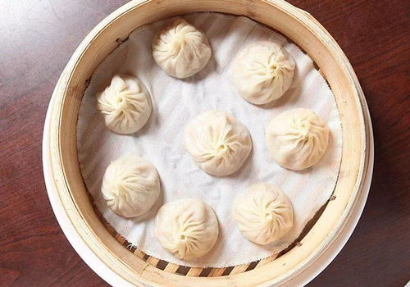
高考真题链接(试题1)饮食文化
2023年新课标I卷
中华美食“小笼包”

Slide 35
Task1 阅读下面短文，在空白处填入1个适当的单词或括号内单词的正确形式。
Xiao long bao (soup dumplings), those amazing constructions of delicate dumpling wrappers, encasing hot, 56 (taste) soup and sweet, fresh meat, are far and away my favorite Chinese street food. The dumplings arrive steaming and dangerously hot. To eat one, you have to decide whether 57
__________ (bite) a small hole in it first, releasing the stream and risking a spill (溢出)， 58 to put the whole dumpling in your mouth, letting the hot soup explode on your tongue.
Shanghai may be the 59 (recognize) home of the soup dumplings but food historians will actually point you to the neighboring canal town of Nanxiang as xiao long bao’s birthplace. There you will find them prepared differently — more dumpling and less soup, and the wrappers are pressed 60 hand rather than rolled.
tasty
to bite
or
recognized
by

Slide 36
Task1 阅读下面短文，在空白处填入1个适当的单词或括号内单词的正确形式。
Task 1阅读下面短文，在空白处填入1个适当的单词或括号内单词的正确形式。
Nanxiang aside, the best xiao long bao have a fine skin, allowing them 61 (lift) out of the steamer basket without tearing or spilling any of 62 (they) contents. The meat should be fresh with 63 touch of sweetness and the soup hot, clear and delicious.
No matter where I buy them, one steamer is64 (rare) enough, yet two seems greedy, so I am always left65 (want) more next time.
to be lifted
their
a
rarely
wanting

Slide 37
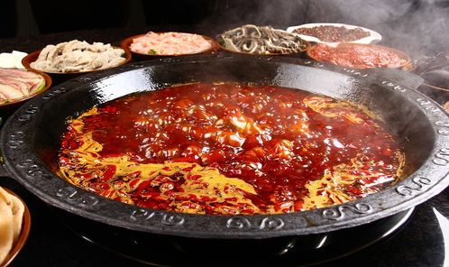
高考真题链接(试题2)饮食文化
2024年全国甲卷短文改错改编
吃重庆火锅的经历

Slide 38
Task1 阅读下面短文，在空白处填入1个适当的单词或括号内单词的正确形式。
Task 1阅读下面短文，在空白处填入1个适当的单词或括号内单词的正确形式。
Last week, I saw a program about Chongqing hotpot on TV. I was curious and planned a special one-day trip there with a friend of_____________(me). Our fast train was _____________(pack)with passengers. _________ attendant gave us some travel _______________(brochure) about Chongqing. When we arrived, we went straight_________ a famous restaurant and ordered dishes, _________ tasted great. The atmosphere here made the meal all the more ________________(enjoy). Hotpot is meant for families and friends _____________(sit) together, dip everything they like in one pot, ____________ share friendship and love.
mine
packed
An
brochures
to
which
enjoyable
to sit
and

Slide 39
语篇四人教版必修一
Unit 5 Reading and Thinking

Slide 40
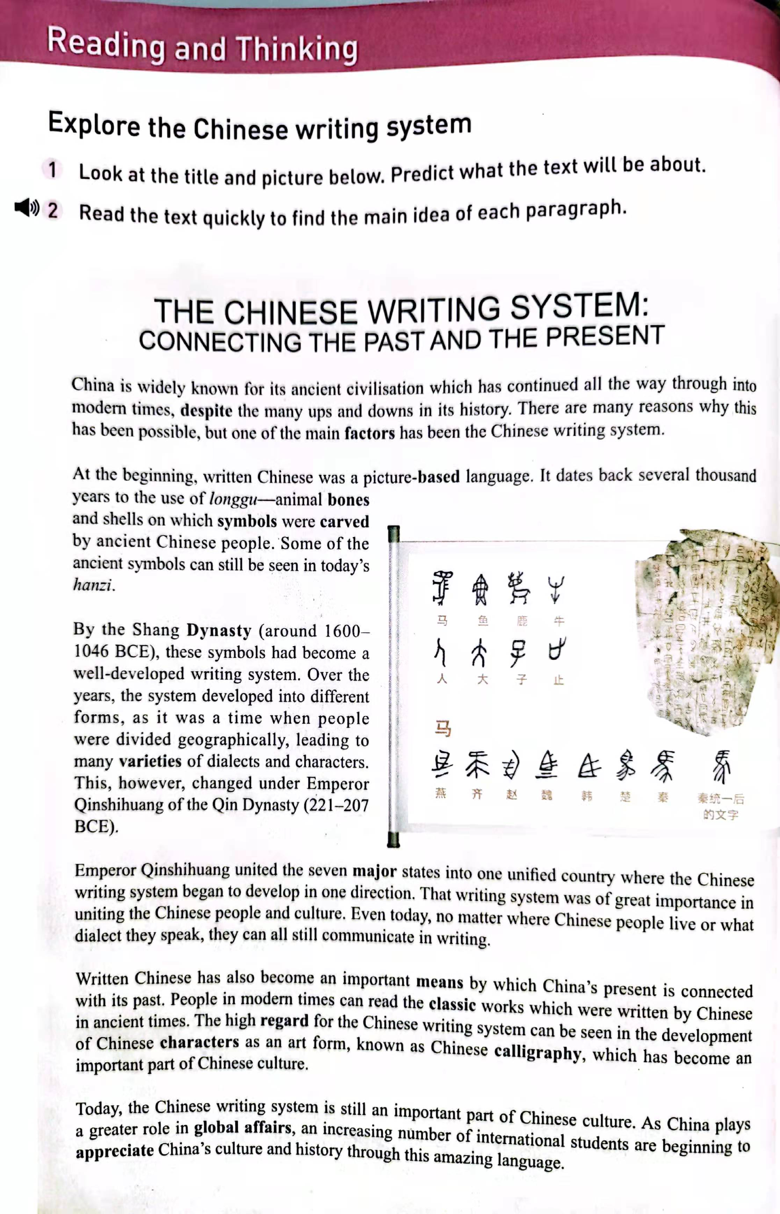
Look at the title and the picture below. Predict what the text will be about.
Topic
Focus
This text is probably about the ________________ of Chinese characters.
development history

Slide 41
Task 1
Read passage quickly and find the main idea of each paragraph
A
The writing system became well-developed, and later developed into different forms.
Para 1
Written Chinese was a pictured-based language at the beginning.
B
Para 2
The Chinese writing system is one of the reasons why Chinese civilization has continued all the way through into modern times.
C
Para 3
Written Chinese connects China’s present with its past, and has become an art form.
Para 4
D
Para 5
The Chinese language is helping to spread China’s culture and history to the world.
E
Para 6
F
The writing system began to develop in one direction.

Slide 42
Task 2 Analyze the structure.
Part1
Para_______
Part 2
Para________
Part 3
Para________
Para 1
Para 2-4
Para 5-6

Slide 43
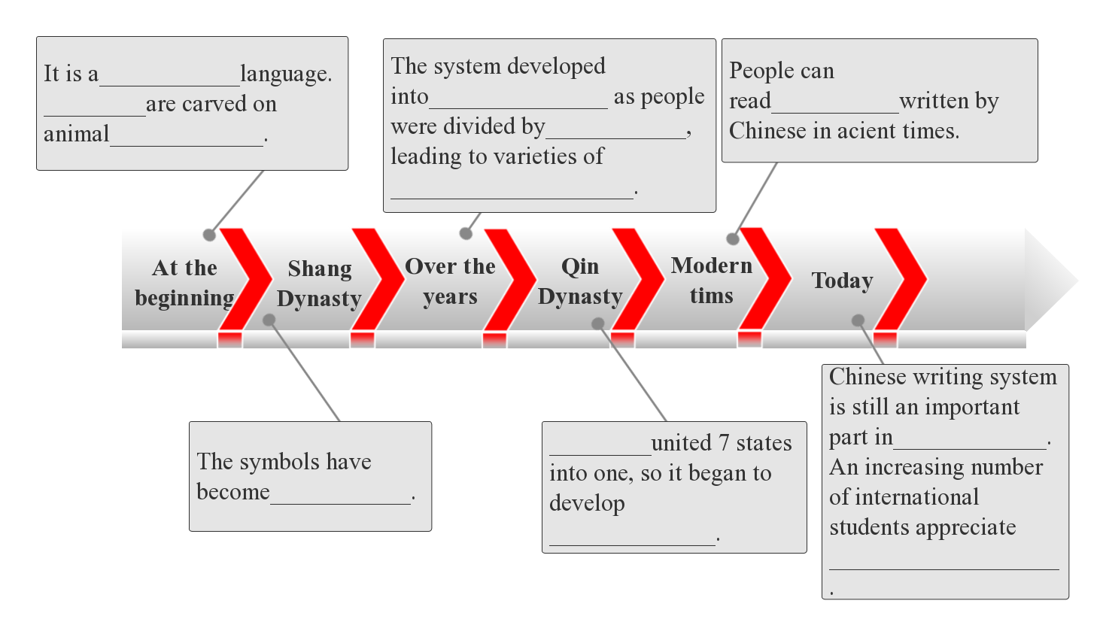
Scan the text again and try to finish a time line about the development of Chinese writing system.
picture-based
Symbols
different forms
classic works
geographically
bones and shells
dialects and characters
Qinshihuang
Chinese culture
well-developed
in one direction
China’s culture and history

Slide 44
Find the sentences that show the importance from the text(Para4 - Para6).
Activity 3
Chinese people
culture
Connect _____________________with_______________
A
That writing system was of great importance in uniting the Chinese people and culture.
Written Chinese has also become an important means by which China’s present is connected with China’s past.
the past
the present
Connect_______________with_______________
B
Connect_______________with_______________
The high regard for the Chinese writing system can be seen in the development of Chinese characters as an art form, known as Chinese calligraphy, which has become an important part of Chinese culture.
art
culture/language
C
Connect_______________with___________________
D
China
the world
The system of Chinese characters is still an important part of the Chinese culture.As China plays a greater role in global affairs, an increasing number of international students are beginning to appreciate China's culture and history through this amazing language.

Slide 45
Task 5 Review the important phrases and translate.
1 | connect the past and / with the present
2 | be widely known for
3 | ancient civilisation
4 | ups and downs
5 | at the beginning
6 | a picture-based language
7 | date back to
8 | a well-developed writing system
9 | many varieties of dialects
连接过去与现在
因……而闻名
古代文明
浮沉；兴衰；荣辱
起初；首先
以图片为基础的语言；象形语言
追溯到
一种发达的书写体系
种类繁多的方言

Slide 46
Task 5 Review the important phrases and translate.
将……合并 / 统一成……
10 | unite ... into ...
11 | in one direction
12 | be of great importance
13 | an important means
14 | the high regard for
15 | Chinese characters
16 | Chinese calligraphy
17 | global affairs
18 | an increasing number of
朝着一个方向
非常重要
一种重要的工具
对……的高度关注
汉字
中国书法
全球事务
越来越多的……

Slide 47
Task 5 Review the important phrases and translate.
19 | appreciate China’s culture
20 | specific information
21 | carve symbols onto bones and shells
22 | a beautiful art form
23 | be related to
24 | be known as
25 | increase your appreciation of Chinese culture
欣赏中国文化
具体信息
把符号刻在骨头和贝壳上
一种美妙的艺术形式
与……相关
作为……而闻名
加强你对中国文化的理解

Slide 48
The Chinese Writing system: Connecting the Past and the Present
China is __________ (wide) known for its ancient civilization which has continued all the way through into modern times, __________ the many ups and downs in its history. There are many reasons __________ this has been possible, but one of the main factors __________ (be) the Chinese writing system.
At the beginning, written Chinese was a picture-based language. It dates back several thousand years __________ the use of longgu — animal bones and shells on __________ symbols were carved by ancient Chinese people. Some of the ancient symbols can still __________ (see) in today’s hanzi.
人教版必修一Unit 5 Reading and Thinking
The Chinese Writing system: Connecting the Past and the Present
China is __________ (wide) known for its ancient civilization which has continued all the way through into modern times, __________ the many ups and downs in its history. There are many reasons __________ this has been possible, but one of the main factors __________ (be) the Chinese writing system.
At the beginning, written Chinese was a picture-based language. It dates back several thousand years __________ the use of longgu — animal bones and shells on __________ symbols were carved by ancient Chinese people. Some of the ancient symbols can still __________ (see) in today’s hanzi.
widely
despite
why
is
to
which
be seen

Slide 49
The Chinese Writing system: Connecting the Past and the Present
China is __________ (wide) known for its ancient civilization which has continued all the way through into modern times, __________ the many ups and downs in its history. There are many reasons __________ this has been possible, but one of the main factors __________ (be) the Chinese writing system.
At the beginning, written Chinese was a picture-based language. It dates back several thousand years __________ the use of longgu — animal bones and shells on __________ symbols were carved by ancient Chinese people. Some of the ancient symbols can still __________ (see) in today’s hanzi.
人教版必修一Unit 5 Reading and Thinking
By the Shang Dynasty (around 1600-1046 BCE), these symbols __________ (become) a well-developed writing system. Over the years, the system developed into different forms, as it was a time __________ people were divided geographically, __________ (lead) to many __________ (variety) of dialects and characters. This, __________, changed under Emperor Qinshihuang of the Qin Dynasty (221-207BCE). Qinshihuang united the seven major states into one unified country __________ the Chinese writing system began to develop __________ one direction. That writing system was of great __________ (important) in uniting the Chinese people and culture. Even today, no matter __________ Chinese people live or what dialect they speak, they can all still communicate in writing.
has become
when
leading
vareties
however
where
in
importance
where

Slide 50
The Chinese Writing system: Connecting the Past and the Present
China is __________ (wide) known for its ancient civilization which has continued all the way through into modern times, __________ the many ups and downs in its history. There are many reasons __________ this has been possible, but one of the main factors __________ (be) the Chinese writing system.
At the beginning, written Chinese was a picture-based language. It dates back several thousand years __________ the use of longgu — animal bones and shells on __________ symbols were carved by ancient Chinese people. Some of the ancient symbols can still __________ (see) in today’s hanzi.
人教版必修一Unit 5 Reading and Thinking
Today, the Chinese writing system is still an important part of Chinese culture. __________ China plays a greater role in global affairs, an __________ (increase) number of international students are beginning to appreciate China’s culture and history through this amazing language.
As
increasing

Slide 51
（2021八省新高考适应性测试考前猜题卷）假定你是李华，学校正在举行“用英语讲中国文化”设计大赛，你准备制作一张介绍中国书法的海报。
内容包括：1．书法的意义；
2．书法的作用。
注意：1．写作词数应为80左右；
2．可以适当增加细节，以使行文连贯。
假定你是李华，学校正在举行“用英语讲中国文化”设计大赛，你准备制作一张介绍中国书法的海报。
内容包括：
1．书法的意义；
2．书法的作用。
注意：1．写作词数应为80左右；
2．可以适当增加细节，以使行文连贯。

Slide 52
Chinese Calligraphy
Chinese calligraphy has developed along with China's civilization. It was first done by carving symbols onto bones and shells, but as it developed into a writing system, it also became a form of art done with a brush. It is believed that Chinese calligraphy dates back to at least the Han Dynasty. Soon after that, the idea developed that calligraphy was not only a beautiful art form but also a means of showing the character of the “man behind the brush”. As China plays a greater role in global affairs, an increasing number of international students are beginning to appreciate China’s culture and history through this art form.Today, everyone can enjoy practicing this classic art.
1.中国书法
历史简介
2.中国书法的意义和作用

Slide 53
语篇五B2U1Reading for Writing Promoting Culture through Digital Images

Slide 54
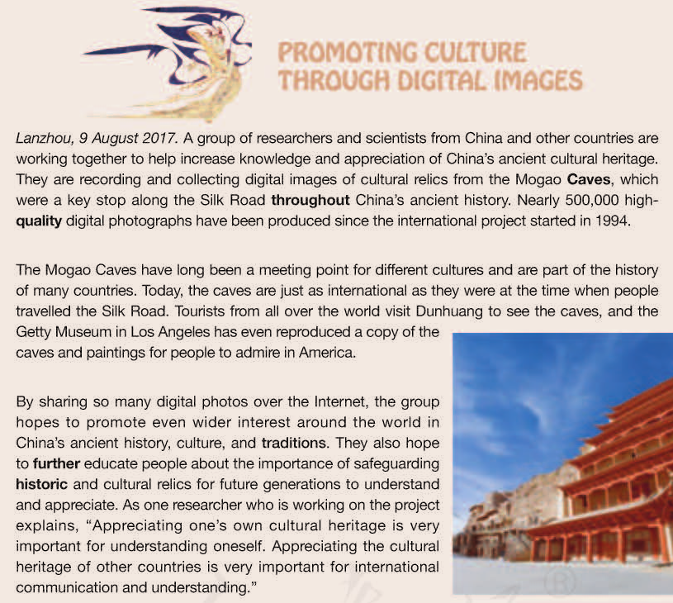

Slide 55
How to write a report
structure
content
Part1：
Lead Sentence（导语）
When; Where; Who; What; Why
It's a _______________ for different cultures.
It's part of _____________of many countries.
Background information
(背景信息)
meeting point
多元文化的交汇点
Part2:
Body
the history
多国历史的一部分
Detailed
information
(具体信息)
Direct quoter; reporting verbs
we can know the researcher values the work.
Part3：Ending
（结束语）
Write a short summary to help the readers remember the main idea.

Slide 56
Task 1 Review the important phrases and translate.
1.increase knowledge and appreciation of China’s ancient cultural heritage | 提高对中国古代文化遗产的认识和欣赏
2.cultural relics | 文化遗迹
3.the Mogao Caves | 莫高窟
4.a key stop along the Silk Road | 丝绸之路上的重要一站
5.throughout China’s ancient history | 贯穿中国古代史
6.promote even wider interest around the world in China’s ancient history, culture, and traditions | 促进世界对中国古代历史、文化和传统的更广泛兴趣
7.further educate people about the importance of safeguarding historic and cultural relics | 进一步教育人们保护历史文物的重要性
8.Appreciating the cultural heritage of other countries is very important for international communication and understanding. | 欣赏其他国家的文化遗产对国际交流和理解非常重要。

Slide 57
A group of researchers and scientists from home and abroad are working together 1. （record） and collect digital images of cultural relics from the Mogao Caves, in an effort to promote 2. （appreciate） of China’s ancient cultural heritage. Nearly 500,000 high-quality digital photographs 3.__________________（produce） since the international project started in 1994.
The Mogao Caves, as 4._________key stop along the Silk Road throughout China’s ancient history, have long been a meeting point for different cultures and now,they are just 5.________ international as they were at the time 6.________ people travelled the Silk Road.
to record
appreciation
have been produced
a
as
when

Slide 58
The group hopes to promote even 7. （wide） interest around the world in China’s ancient history，culture and traditions. They also hope to further educate people about the importance of 8. （safeguard） historic and cultural relics for future generations to understand and appreciate. As one researcher who is working 9. the project explains，“Appreciating one’s own cultural heritage is very important for understanding oneself. Appreciating the cultural heritage of other countries is very important for international 10. _____________
（communicate） and understanding.”
wider
safeguarding
on
communication

Slide 59
假如你是一名高中学生李华，在浏览网页时发现，世界上很多文化遗产遭到了人类活动、自然灾害等的破坏，对此你深感痛惜，决定给联合国教科文组织世界文化遗产中心的负责人写一封关于如何保护全球文化遗产的建议信。内容包括：
1．大力宣传保护文化遗产；
2．倡导环保旅游，避免破坏文化遗产；
3．筹集资金对遗产进行维修和维护。
注意：
1．词数80左右；
2．可以适当增加细节，以使行文连贯；
3．信的开头和结尾已写好，不计入总词数。

Slide 60
Dear Sir/Madam,
I'm sorry to see that so much cultural heritage in the world is being destroyed nowadays. As a senior high student, I want to offer you somesuggestions abou how to protect the world's cultural heritage effectively. Mysuggestions are as follows:
First of all, it is important to further educate people about the importance of safeguarding historic and cultural relics by using the modern technology and network. Secondly, tourism has caused much damage to the cultural heritage. Therefore, we must call on people to visit the cultural heritage in a friendly way. Finally, we should raise more money to repair and protect the cultural heritage.
I hope you can take my suggestions into consideration.
Yours sincerely,
Li Hua
1.引出话题
写作目的
2. 提出建议
3. 希望建议有用

Slide 61
“传统文化”是一个广义的概念，在应用文写作的考查中主要涉及传统节日、文学艺术、节日风俗及手工工艺等。这类写作往往要求介绍某种传统文化或者围绕某种传统文化而展开。该话题常见于邀请信、告知信、询问信、建议信、推荐信、活动报道、通知等文体。
“传统文化”是一个广义的概念，在应用文写作的考查中主要涉及传统节日、文学艺术、节日风俗及手工工艺等。这类写作往往要求介绍某种传统文化或者围绕某种传统文化而展开。该话题常见于邀请信、告知信、询问信、建议信、推荐信、活动报道、通知等文体。

Slide 62
中国传统文化主题应用文高考真题汇编
年份 | 试卷 | 体裁 | 语篇内容
2023年 | 全国甲卷 | 投稿 | 1向学校“用英文讲中国故事”主题征文活动投稿
2021年 | 浙江卷 | 宣传稿 | 2宣传学校举办的学生国画作品展
2021年 | 全国甲卷 | 邮件 | 3给外国朋友写邮件，了解哪些中国传统文化更吸引外国友人
2019年 | 全国I卷 | 邮件 | 4申请做中国画展览的志愿者
2017年 | 全国I卷 | 告知信 | 5告知英国朋友下次上课的计划
2017年 | 浙江卷 | 邀请信 | 6邀请外教一起过春节
2016年 | 北京卷 | 邮件 | 7介绍一位你喜欢的中国历史人物

Slide 63
题目一2023年全国甲卷
应用文（满分25分）

Slide 64
你们学校正举办主题为“用英文讲中国故事”的征文活动。请你以一位中国历史人物为题写一篇短文投稿，内容包括：
1. 人物简介及事迹；
2. 意义或启示。
注意：
1. 词数100左右；
2. 题目已为你写好。
The Historical Figure in China
____________________________________________________________________________________________________________________________________________________________________________________________________________

Slide 65
参考范文1
A Historical Figure in China
Confucius,the founder of Confucianism,was born in the stateof Lu,which is in present-day Qufu,Shandong Province. He was agreat thinker, educator and politician in the Spring and AutumnPeriod of China.
Confucius traveled throughout the country,and spread his wisdom.He believed in the importance of moral values such as respect andkindness. He valued education,which he believed would contributeto a harmonious society. His teachings were included in a bookcalled The Analects of Confucius,which is still studied by manypeople in the world today.
Confucius is one of the most important figures in Chinese history,whose thoughts have had a profound influence on Chinese cultureand society for over 2,000 years.
1.引出话题
生活时期+身份
2.突出事迹
3.影响

Slide 66
参考范文2
A Historical Figure in China
Countless historical figures have witnessed the passage of time, among whom Li Bai is one of China's most celebrated poets of all time. Li Bai is a legendary figure in China whose influence on literature has left an everlasting impact on our society for thousands of years.
Born in the Tang Dynasty,Li Bai was renowned for his remarkably unique romantic poetry.His famous poems,which can be appreciated in a collection called Three HundredTang Poems,were models for celebrating the pleasures of freedom, the affection for nature, and the joys of exploring the wonders of the ancient China.
Li Bai makes himself indispensable in Chinese history. Not only does his extraordinary talent in poem-composing inspire us to admire the beauty of nature,but his adventurous and free spirits always remind us to pursue our passions and follow our hearts.
1.引出话题
身份+总述
2.突出事迹
3.影响

Slide 67
题目三 2021年 全国甲卷
书面表达（满分25分）

Slide 68
假定你是李华。你校计划举办介绍中国传统文化的主题班会，并在英文网站展示。请你写一封邮件给外国朋友Chris，向他了解哪些中国传统文化更吸引外国友人。邮件内容包括：
1. 阐明写信事由；
2. 征求建议；
3. 表示感谢。
注意：
1. 词数100左右；
2. 可以适当增加细节，以使行文连贯。

Slide 69
Dear Chris,
How are you doing recently? Our school will hold a class meeting aimed at introducing traditional Chinese culture. Now I'm writing to you for some advice.
In order to attract foreign friends and deepen their understandingof traditional Chinese culture, we have prepared some related topics,such as traditional festivals,Peking Opera,traditional handicrafts,Chinese calligraphy and so on,which will be displayed on our website.I would appreciate it if you could share your thoughts with me and tell me which one you like best. Your advice will be helpful to us.
Thank you for giving me some suggestions. Looking forward to your earliest reply．
Best regards,
Li Hua
参考范文1
1.问候+提出主题+写作目的
2.列举中国传统文化
征询建议
3.感谢+期待回复

Slide 70
Dear Chris,
As you know,China is well-known for its profound cultures. Our school is planning to hold a theme class meeting to introduce traditional Chinese cultures, which will be posted on some English websites.I'm writing to ask for some advice.
Our current plan is to introduce traditional Chinese festivals, operas, poems, calligraphy and paper cutting. But that’s not our final decision. I’m wondering what kind of traditional Chinese culture attracts you foreigners most. Choosing the culture that most foreigners are interested in may encourage more people to learn about Chinese culture. Therefore, your advice is of great value to us.
Looking forward to your early reply and any suggestions are welcome. Thanks in davance.
Yours sincerely, Li Hua
参考范文 2
1.提出主题+写作目的
2.介绍计划
征询建议
3.感谢+期待回复

Slide 71
题目四 2019年 全国I卷
第二节 书面表达（满分25分）

Slide 72
假定你是李华，暑假在伦敦学习，得知当地美术馆要举办中国画展览。请写一封信申请做志愿者，内容包括：
1．写信目的；
2．个人优势；
3．能做的事情。
注意：
1．词数100左右；
2．可以适当增加细节，以使行文连贯；
3．结束语已为你写好。

Slide 73
Dear Sir or Madam,
I’m a student taking summer courses in London now. Learning volunteers are needed for the coming Chinese painting exhibition in your local art gallery, I can't wait to apply for the position.
Firstly，my fluent English enables me to communicate smoothly with British painting lovers. Moreover, with a wide knowledge of Chinese painting, I can introduce the art form better.Better yet, I've participated in several similar activities, which equipped me with relevant experience.
If accepted， I will spare no effort to introduce those
paintings on display and answer questions patiently. I'd appreciate it if you could consider my application.
Yours,
Li Hua
1.说明工作信息+提出申请
2.详述个人优势和能做的事情
3.表决心+期待回复

Slide 74
题目五 2017年全国I卷
书面表达 (满分25分)

Slide 75
假定你是李华，正在教你的英国朋友Leslie学习汉语。请你写封邮件告知下次上课的计划。内容包括：
1．时间和地点；
2．内容：学习唐诗；
3．课前准备：简要了解唐朝的历史。
注意：
1．词数100左右；
2．可以适当增加细节，以使行文连贯。

Slide 76
Dear Leslie,
I'm writing to inform you of our course schedule of our next class about poetry of the Tang Dynasty.
We will have it this Friday, in Classroom 602, Building 6.To learn it better, you need to do the following things before thenext class. Firstly, read some materials about poetry of the Tang Dynasty, which plays an extremely significant role in our literature. You can find some original poems of famous poets,such as Li Bai and Du Fu. Besides, knowing the history of the Tang Dynasty will also be beneficial.
Looking forward to our next class.
Yours,
Li Hua
1.写信目的
2.具体告知安排
3.表示期待

Slide 77
题目七2016年 北京卷
应用文写作（满分15分）

Slide 78
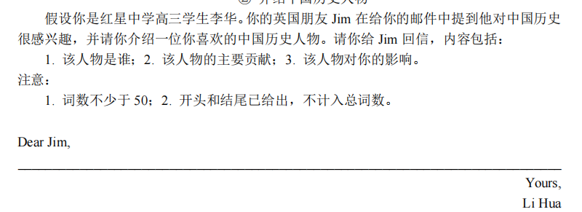

Slide 79
My Favorite Figure in Chinese History
As for my favorite figure in Chinese history, it must be Confucius.（简介人物）
As is known, he is one of the greatest thinkers andeducators in China. He established an educational system,which greatly influenced the development of traditional Chinese culture. Furthermore, he made many wise sayings that helped many people learn about nature, the world, and the human behavior. To develop friendships with other countries and popularize the Chinese culture, we have founded Confucius Institutes throughout the world in recent years.
Actually, his thoughts always inspire me to pursue knowledge and I’d like to be a teacher like him one day.
1简介人物
2.介绍人物事迹
3.对我的影响
参考范文1

Slide 80
My Favorite Figure in Chinese History
Among the Chinese historical figures,Fan Zhongyan is my favourite figure. Here are the reasons.
Fan Zhongyan, a distinguished Chinese writer and politician in the Song Dynasty, left a permanent mark due to his significant contribution to society. His dedication to a series of reforms aimed at national prosperity earned him admiration. Notably, he proposed establishing a national school system, which had a far-reaching influence on the Chinese educational system.
What impresses me most is his famous philosophy of life:“Be the first to worry about the troubles across the land, thelast to enjoy universal happiness." Fan Zhongyan is such arole model that he always encourages me to be a man of noble character.
1简介人物
2.介绍人物事迹
3.对我的影响
参考范文2

Slide 81
(表格摘选自维克多英语官网)
命题意图
在应用文写作中学生需要用英语介绍中国的优秀传统文化、美德和习俗，用英语讲好中国故事。这不仅要求学生具备丰富的文化背景知识，还需要他们能够将这些知识融入写作中，通过文字传递出对中国文化的热爱和认同。这样的考查旨在增强学生的国家认同感和家国情怀，促进中华文化的传承和弘扬。

Slide 82
(表格摘选自维克多英语官网)
命题规律
1.贴近生活实际，重视表达思想。
2.强调基础扎实，突出关键能力。
3.体裁灵活多变，强调开放创新。

Slide 83
(表格摘选自维克多英语官网)
备考策略与建议
1.立足教材，紧扣课程标准。
2.应用文写作话题选材尽量贴近学生生活真实情境，在实际 的中西方文化交际背景下要求学生完成写作。
3.强化应用文写作流程实战技能训练。
4.加强应用文写作策略指导。
5.针对考试中存在的问题进行针对性课堂教学。

Slide 84

（二）阅读理解题目
2024年 新课标I卷阅读理解B篇

Slide 85
“I am not crazy,” says Dr. William Farber, shortly after performing acupuncture (针灸) on a rabbit. “I am ahead of my time.” If he seems a little defensive, it might be because even some of his coworkers occasionally laugh at his unusual methods. But Farber is certain he’ll have the last laugh. He’s one of a small but growing number of American veterinarians (兽医) now practicing “holistic” medicine – combining traditional Western treatments with acupuncture, chiropractic (按摩疗法) and herbal medicine.
Farber, a graduate of Colorado State University, started out as a more conventional veterinarian. He became interested in alternative treatments 20 years ago when he suffered from terrible back pain. He tried muscle-relaxing drugs but found little relief. Then he tried acupuncture, an ancient Chinese practice, and was amazed that he improved after two or three treatments. What worked on a veterinarian seemed likely to work on his patients. So, after studying the techniques for a couple of years, he began offering them to pets.
Leigh Tindale’s dog Charlie had a serious heart condition. After Charlie had a heart attack, Tindale says, she was prepared to put him to sleep, but Farber’s treatments eased her dog’s suffering so much that she was able to keep him alive for an additional five months. And Priscilla Dewing reports that her horse, Nappy, “moves more easily and rides more comfortably” after a chiropractic adjustment.
Farber is certain that the holistic approach will grow more popular with time, and if the past is any indication, he may be right: Since 1982, membership in the American Holistic Veterinary Medical Association has grown from 30 to over 700. “Sometimes it surprises me that it works so well,” he says. “I will do anything to help an animal. That’s my job.”
1Introduction to “holistic” medicine&Dr. William Farber
2The reason why Dr. William Farber applied “holistic” medicine to pets
3Two successful examples
4Positive comments on the holistic approach

Slide 86
24. What do some of Farber’s coworkers think of him?
A. He’s odd. B. He’s strict.
C. He’s brave. D. He’s rude.
Para1
①“I am not crazy,” says Dr. William Farber, shortly after performing acupuncture (针灸) on a rabbit. “I am ahead of my time.” If he seems a little defensive, it might be because even some of his coworkers occasionally laugh at his unusual methods. But Farber is certain he’ll have the last laugh. He’s one of a small but growing number of American veterinarians (兽医) now practicing “holistic” medicine – combining traditional Western treatments with acupuncture, chiropractic (按摩疗法) and herbal medicine.

Slide 87
25. Why did Farber decide to try acupuncture on pets?
A. He was trained in it at university.
B. He was inspired by another veterinarian.
C. He benefited from it as a patient.
D. He wanted to save money for pet owners.
Para2
②Farber, a graduate of Colorado State University, started out as a more conventional veterinarian. He became interested in alternative treatments 20 years ago when he suffered from terrible back pain. He tried muscle-relaxing drugs but found little relief. Then he tried acupuncture, an ancient Chinese practice, and was amazed that he improved after two or three treatments. What worked on a veterinarian seemed likely to work on his patients. So, after studying the techniques for a couple of years, he began offering them to pets.

Slide 88
26. What does paragraph 3 mainly talk about?
A. Steps of a chiropractic treatment.
B. The complexity of veterinarians’ work.
C. Examples of rare animal diseases.
D. The effectiveness of holistic medicine.
Para3
③Leigh Tindale’s dog Charlie had a serious heart condition. After Charlie had a heart attack, Tindale says, she was prepared to put him to sleep, but Farber’s treatments eased her dog’s suffering so much that she was able to keep him alive for an additional five months. And Priscilla Dewing reports that her horse, Nappy, “moves more easily and rides more comfortably” after a chiropractic adjustment.

Slide 89
27. Why does the author mention the American Holistic Veterinary Medical Association?
A. To prove Farber’s point.
B. To emphasize its importance.
C. To praise veterinarians.
D. To advocate animal protection.
Para4
④Farber is certain that the holistic approach will grow more popular with time, and if the past is any indication, he may be right: Since 1982, membership in the American Holistic Veterinary Medical Association has grown from 30 to over 700. “Sometimes it surprises me that it works so well,” he says. “I will do anything to help an animal. That’s my job.”

Slide 90
24. What do some of Farber’s coworkers think of him?
A. He’s odd. B. He’s strict.
C. He’s brave. D. He’s rude.
Task 2 Review the important phrases/sentences and translate.
1. perform acupuncture | 实施针灸 | 22.have a serious heart condition | 有严重的心脏病
2.defensive adj. | 存有戒心的 | 23.ease her dog’s suffering | 减轻她的狗的痛苦
3. coworker n. | 同事；合作者 | 24.additional adj. | 额外的
4.occasionally adv. | 偶然，偶尔 | 25.comfortably adv. | 舒服地
6.have the last laugh | 笑到最后 | 26.adjustment n. | 调整
7.practice “holistic” medicine | 练习整体医学疗法 | 27. approach n. | 方法
8. combine …… with …… | 使……结合 | 28.indication n. | 暗示，迹象
9.traditional adj. | 传统的 | 29.membership n. | 会员资格
10.treatment n. | 治疗，医治 | 30.association n. | 协会，社团，联盟
11.herbal adj.& n. | 药草的；草药 | 31.odd adj. | 古怪的
12.graduate n. | 毕业生 | 32. train vt. | . 培训，训练
13.conventional adj. | 传统的 | 33. inspire vt. | 激励，鼓舞
14.alternative adj.& n. | n. 替代物 adj. 可替代的 | 34. benefit from | 从……中受益
15. suffer from terrible back pain | 遭受严重的背部疼痛 | 35. patient n. | 病人
16.muscle-relaxing drugs | 肌肉松弛剂 | 36. complexity n. | 复杂性，错综复杂
17.relief n. 宽慰，轻松 | relieve vt. | 37. effectiveness n. | 有效性
18.an ancient Chinese practice | 一种古老的中国做法 | 38. emphasize its importance | 强调它的重要性
19.practice n.(熟词生义) | 惯常做法 | 39. praise vt. | 表扬，赞美
20.technique n. | 技巧，工艺 | 40. advocate animal protection | 提倡动物保护
21.pet n. | 宠物 | 41. prove | 证实，证明

Slide 91
感谢观看
梁晓林

