Slide 1


感恩遇见，相互成就，本课件资料仅供您个人参考、教学使用，严禁自行在网络传播，违者依知识产权法追究法律责任。
更多教学资源请关注
公众号：溯恩英语
知识产权声明

Slide 2
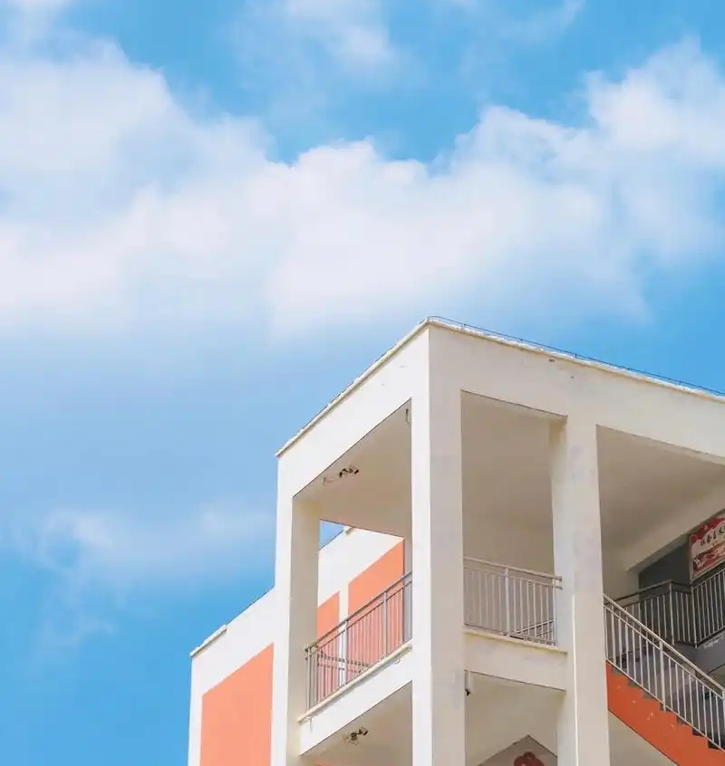

My Views
on Filming Short Videos on Campus
—2025浙江1月首考
应用文演讲稿分析

Slide 3

Lead in
What is most challenging for you in this writing assignment?
Possible difficulties:
1.construct the structure of the writing
2.show opinions about filming short videos on campus
3.offer relevant suggestions
...

Slide 4
Analyze
Audience: Classmates
（回忆版）假定你是李华，你要参加课前一分钟演讲，针对高中生在校园内拍摄短视频的现象写一篇演讲稿。
1.表达观点
2.提出建议
Views
Topic : the phenomenon of filming short videos on campus
A speech
Suggestions
What’s the genre of this writing?
What do the underlined parts tell us?
In this speech, what should be included in each part ?

Slide 5
Construct
Greet the audience
Opening
State the topic
advantages
Opinions
speech
disadvantages
Body
Suggestions
comprehensive and logical?
Closing
Summarize/anticipate/appeal/appreciate

Slide 6

Brainstorm
Topic : filming short videos on campus
Advantages
For individuals
For school
enrich our campus life
relieve academic stress
cultivate innovative thinking
enhance practical capacities
foster aesthetic abilities
capture moments of campus life
leave precious memories
strengthen the cultural construction
enhance the school's reputation and image
create a vibrant campus culture
showcase unique courses, and school culture

Slide 7

Brainstorm
Topic : filming short videos on campus
Disadvantages
For individuals
For others
cause distraction from studies
affect academic performance
disturb others
invade others’ privacy
Suggestions
prioritize academic commitments
strike a balance between academics and hobbies
ensure positive content
respect other’s privacy
follow school relevant policies
film short videos in designated areas during appropriate time

Slide 8


Practice
Version 1
Good morning, everyone! Today, I’d like to share with you my opinions about an increasingly rising phenomenon: filming short videos on campus.
Version 2
Hello, everyone! Here and now, I’d like to talk about a common phenomenon on our campus:students using their mobile phones to shoot videos.

Slide 9

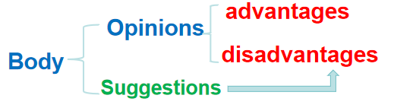
Practice
It is no denying that there is a rich blend of benefits of shooting short videos on campus, ranging from enriching our campus life,cultivate our innovative thinking and practical abilities to capture moments of our precious campus life.However, it also poses challenges because it may lead to our distraction from studies and invade other’s privacy. To address these issues, it would be wise and beneficial for us to strike a balance between studies and shooting videos and show more respect to other’s privacy when filming videos.

Slide 10
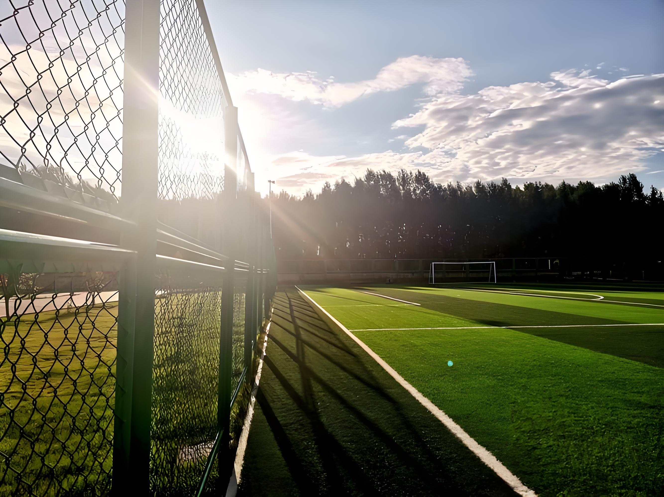

Practice
Version 1
I do believe that, with the balance and respect, not only can we promote our personal growth through filming videos, but we can also create a vibrant campus culture.Thank you for your attention!
Version 2
Let’s embrace this as an opportunity to inspire creativity while maintaining responsibility. Together, we can make our campus a vibrant space for expression and growth.Thank you!

Slide 11

Sample writing one
Good morning, everyone! Here and now, I’d like to share with you my opinions about an increasingly rising phenomenon: filming short videos on campus.
It is no denying that there is a rich blend of benefits of shooting short videos on campus, ranging from enriching our campus life,cultivate our innovative thinking and practical abilities to capture moments of our precious campus life.However, it also poses challenges because it may lead to our distraction from studies and invade other’s privacy. To address these issues, it would be wise and beneficial for us to strike a balance between studies and shooting videos and show more respect to other’s privacy when filming videos.
I do believe that, with the balance and respect, not only can we promote our personal growth through filming videos, but we can also create a vibrant campus culture.Thank you for your attention!

Slide 12
Sample writing two
——collected from Sunedu
Ladies and gentlemen,Good morning!Today,I'd like to talk about a common phenomenon on our campus:students using their mobile phones to shoot videos.Almost everywhere we go,we can see students filming,whether it's in the classroom,library,or even during lectures.While it's great to capture memories and share them with others,this behavior can be quite distracting and disruptive.It can affect the learning environment and disturb both teachers and fellow students.
To address this issue,I have a few suggestions.Firstly,we should set specific times and places where video recording is allowed.For example,it could be limited to designated areas during breaks.Secondly,teachers could incorporate video-making into assignments,so students have a structured way to express themselves without disrupting classes.Lastly,we should raise awareness about the importance of focusing on our studies and respecting others'learning experiences.
Thank you for your attention!

Slide 13
Sample writing three
——collected from Teacher AIAI
Good morning, everyone! High school students filming short videos on campus is a creative and meaningful activity. It allows students to express their ideas, showcase their talents, and capture memorable moments of school life. Through this process, they develop skills in storytelling, teamwork, and technical proficiency, which are essential in today’s digital age.
However, we must be mindful of boundaries-respecting privacy, following school policies, and ensuring the content promotes positivity and respect.
Let’s embrace this as an opportunity to inspire creativity while maintaing responsibility. Together, we can make our campus a vibrant space for expression and growth.
Thank you!

Slide 14
Accumulate
enrich our campus life
relieve academic stress
cultivate innovative thinking
enhance practical capacities
foster aesthetic abilities
capture moments of campus life
leave precious memories
strengthen the cultural construction
enhance the school's reputation and image
create a vibrant campus culture
showcase unique courses, and school culture
cause distraction from studies
affect academic performance
invade others’ privacy
prioritize academic commitments
strike a balance between academics and hobbies
ensure positive content
respect other’s privacy
follow school relevant policies
film short videos in designated areas during appropriate time
丰富我们的校园生活
缓解学业压力
培养创新思维
提高实践能力
培养审美能力
捕捉校园生活的瞬间
留下珍贵的回忆
加强校园文化建设
提升学校的声誉和形象
创造充满活力的校园文化
展示独特的课程和学校文化
导致学习分心
影响学习成绩
侵犯他人隐私
优先考虑学术承诺
在学业和爱好之间取得平衡
确保正面内容
尊重他人隐私
遵守学校相关政策
在适当的时间，在指定的区域拍摄短视频

Slide 15

Thank you!

