Slide 1


感恩遇见，相互成就，本课件资料仅供您个人参考、教学使用，严禁自行在网络传播，违者依知识产权法追究法律责任。
更多教学资源请关注
公众号：溯恩英语
知识产权声明

Slide 2

The World
December 16th-31st, 2024

Slide 3
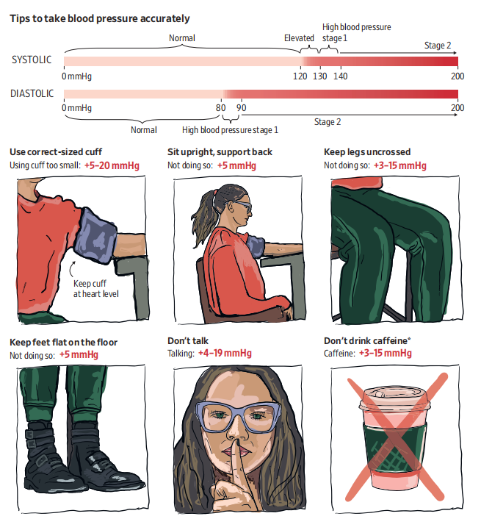
1. Blood-Pressure Inaccuracies Mask Heart Health Risks
血压值不准确掩盖心脏健康风险

Slide 4
Text Completion
The Wall Street Journal (December 18 2024 A6)
Your blood-pressure reading probably isn’t as accurate as you think. More often than not, patients and even nurses and doctors are skipping steps that help paint ___ accurate portrait of someone’s blood pressure.
_____ someone sits and positions their arm, whether they just had a cup of joe or chitchat with their practitioner during the measurement, and other factors can produce ________ (read) that are higher or lower than normal blood pressure.
Getting the right reading is important for _________ (prevent) heart attacks, strokes and other potentially fatal conditions. What does it take to get your reading right? You should sit with both feet on the ground, legs uncrossed, back straight and your arm _________ (support) on a table or other surface, according to guidelines from the American Heart Association and other organizations. A cuff should be positioned over your bare arm at the level of your heart. You shouldn’t talk or scroll on your phone while it _______________ (measure), and your bladder should be empty. And you should take your blood pressure at least a couple of _____ (time) in a sitting.
Anxiety can also be a factor. Some people have elevated blood pressure in a doctor’s office, though it ________ (typical) reads normal at home.
High blood pressure, or hypertension, is the _______ (lead) risk factor for premature death and disability worldwide. Nearly half of U.S. adults have high blood pressure, and only 20% have it ______ control, according to the Centers for Disease Control and Prevention.
an
How
readings
preventing
supported
is being measured
times
typically
leading
under

Slide 5
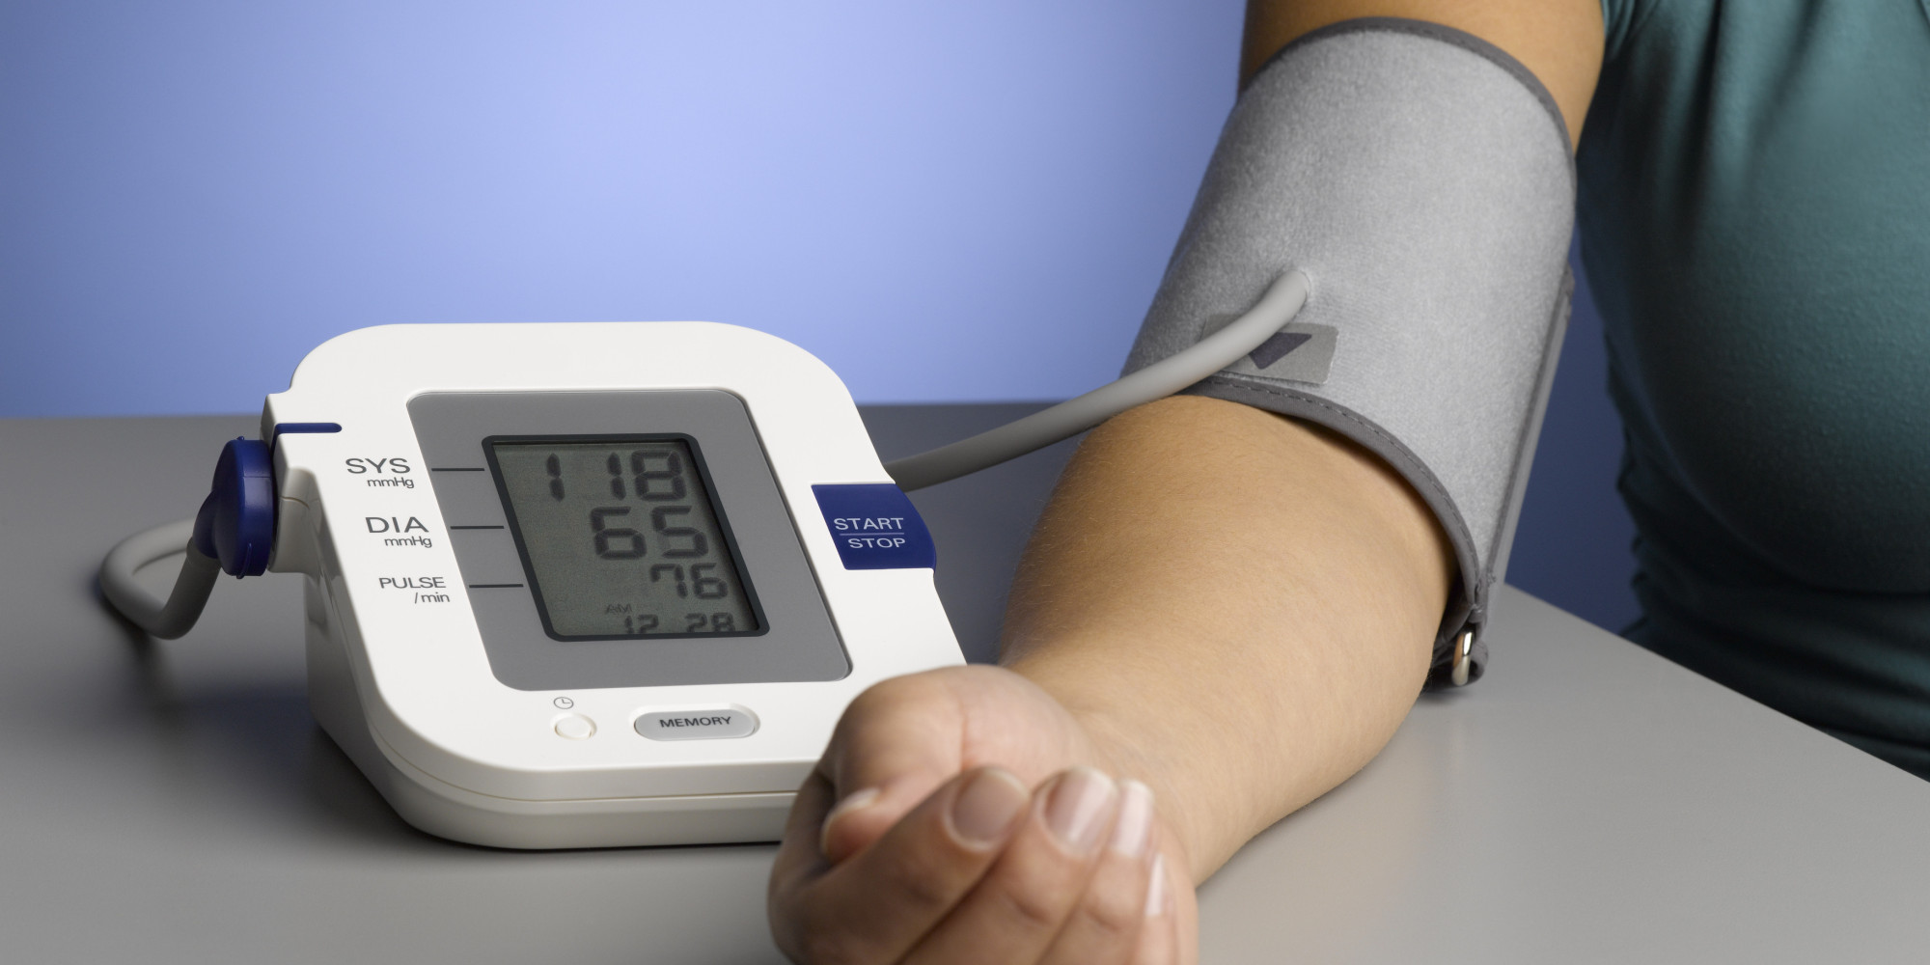
Reading Comprehension
Which of the following statements about blood pressure measurement is correct according to the text?
A. Measurements taken by professional medical workers are often accurate.
B. One should drink plenty of water right before the measurement.
C. Some people get inaccurate measurements at the hospital because they are nervous.
D. Almost 20% of American adults suffer from hypertension.

Slide 6
Vocabulary
1. chitchat: conversation about things that are not important
闲聊；聊天；闲谈
Not being a mother, I found the chitchat exceedingly dull.
我没当母亲，所以觉得那样的闲谈无聊透顶。
2. premature: happening before the normal or expected time
未成熟的；过早的；提前的
His career was brought to a premature end by a succession of knee injuries.
因为膝盖接二连三地受伤，他的职业生涯提前结束了。
Translation
我们就天气闲聊了几句。
We exchanged some chitchat about the weather.
Translation
交通事故仍然是造成美国人过早死亡的头号因素。
Accidents are still the number one cause of premature death for Americans.

Slide 7
Translation
How someone sits and positions their arm, whether they just had a cup of joe or chitchat with their practitioner during the measurement, and other factors can produce readings that are higher or lower than normal blood pressure. Getting the right reading is important for preventing heart attacks, strokes and other potentially fatal conditions.
一个人的坐姿和手臂的位置，在测量过程中是否刚刚喝了一杯咖啡或与医生聊天，以及其他因素都会产生高于或低于正常血压的读数。获得正确的读数对于预防心脏病、中风和其他潜在的致命疾病非常重要。
You should sit with both feet on the ground, legs uncrossed, back straight and your arm supported on a table or other surface, according to guidelines from the American Heart Association and other organizations. A cuff should be positioned over your bare arm at the level of your heart. You shouldn’t talk or scroll on your phone while it is being measured, and your bladder should be empty. And you should take your blood pressure at least a couple of times in a sitting.
根据美国心脏协会和其他组织的指导方针，你应该双脚着地，双腿不交叉，背部挺直，手臂支撑在桌子或其他表面上。袖带应该裹在裸露的手臂上，与心脏齐平。在测血压时，你不应该打电话或玩手机，而且你的膀胱应该是空的。你应该一次至少测量几次血压。

Slide 8
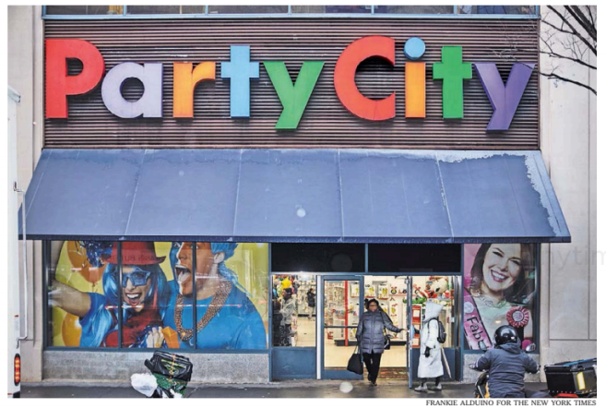
2. Party City Chain Closing Its 748 Stores by February
Party City连锁店将于2月关闭其748家门店
A Party City store in Brooklyn. The company told its 16,000 employees that all storeswould be closed by February.

Slide 9
Text Completion
The New York Times（December 23, 2024 B5)
Party City, the party supply store that has provided the glittering backdrops for generations of birthday ___________ (celebrate), New Year’s Eve bashes and Super Bowl gatherings, announced just days before Christmas that it was closing ___ (it) doors for good.
Party City store managers _________ (tell) that stores would begin a “wind-down process” that started on Friday ____ would last until about Feb.28, 2025. Store managers could keep their pay and benefits until then if they wanted to keep working, according to ___ internal letter reviewed by The New York Times.The company said in a quarterly report filed with the Securities and Exchange Commission that it had 748 retail stores in North America. ________ (found) in 1986 and employing more than 16,000 people, the chain party-supply store sold balloons, costumes, accessories and other party goods.
It was not ___________ (immediate) clear how many stores would close in February. The total number of employees who were laid off on Friday and how many would remain until the end of February were also not clear. Company representatives did not respond ___ requests for comment on Friday.
Early on Friday afternoon, there was still some foot traffic at the Party City on Atlantic Avenue in Brooklyn, ______ employees were blowing up balloons and helping customers. The _______ (shelf) were somewhat sparse, and holiday items were being sold at a discount: Christmas items, 50 percent off; New Year’s items, 20 percent off.
celebrations
its
were told
and
an
Founded
immediately
to
where
shelves

Slide 10
Vocabulary
1. wind-down: a gradual reduction in activity as sth comes to an end逐渐减少至终止；逐步结束
The wind-down of the company was handled very efficiently. 处理公司逐步缩减直至关闭的事宜效率很高。
2. sparse: only present in small amounts or numbers and often spread over a large area稀少的；稀疏的；零落的
Vegetation becomes sparse higher up the mountains. 山上越高的地方植物越稀少。
Translation
资金的缺乏导致了太空探索的逐渐减少。
Lack of funds led to the wind-down of space exploration.
Translation
关于这个主题的信息很少。
The information available on the subject is sparse.

Slide 11
Translation
Party City, the party supply store that has provided the glittering backdrops for generations of birthday celebrations, New Year’s Eve bashes and Super Bowl gatherings, announced just days before Christmas that it was closing its doors for good.
派对用品商店Party City曾为几代人的生日庆祝活动、跨年派对和超级碗聚会提供闪闪发光的背景，但就在圣诞节前几天，它宣布将永远关门。
Early on Friday afternoon, there was still some foot traffic at the Party City on Atlantic Avenue in Brooklyn, where employees were blowing up balloons and helping customers. The shelves were somewhat sparse, and holiday items were being sold at a discount: Christmas items, 50 percent off; New Year’s items, 20 percent off.
周五下午早些时候，布鲁克林大西洋大道上的Party City仍有一些人流量，员工们正在吹气球，帮助顾客。货架上有些稀疏，节日用品在打折出售：圣诞节用品打五折；新年单品打八折。

Slide 12
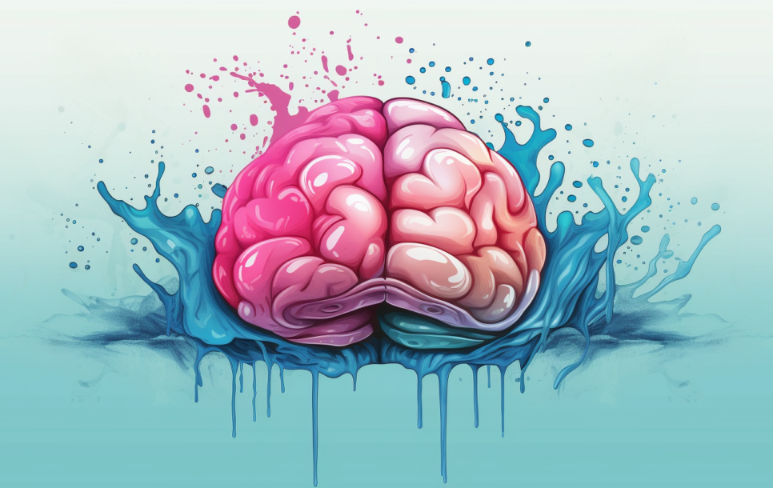
3. The Brain Is Mostly Water and Fat
大脑主要由水和脂肪组成

Slide 13
Text Completion
Psychology Now（December 19, 2024 P10)
Many organs of the human body are mostly water, and the brain is no different. The other compounds - including fats, proteins, carbohydrates and others - only make up about a
quarter of our brain material. ________, a brain’s dry weight shows that fat is the dominant structural element of the brain. These aren’t just the sorts of saturated fats you’d find in your
favourite takeaway or snack, but types of lipids, including cholesterol and fatty acids, that ________ (use) to form myelin.
Myelin is a structure made up of approximately 80% lipids and 20% protein and is found ________ (wrap) around parts of our brain cells, known as neurons. Neurons are composed of three main structural elements, including dendrites, ______ receive electrical signals from neighbouring cells.The cell body, also known as a soma, contains genetic information ____ provides the cell with energy. Axons carry electrical impulses away from the cell towards neighbouring neurons. Like electrical wiring in our homes, axons require ___ insulating sheath to protect the cell and ensure that the signal remains strong and moving in the desired direction. Myelin sheaths are used for this task, meaning neurons with long axons harbour a lot of fatty material.
The brain _________ an abundance of axons-so many that myelin-dense areas change the colour of the brain on scans, _______ (turn) it white rather than grey. Grey matter, which is found around the periphery of the brain, is mostly composed of soma. Matter, however, consists mostly of axons and their fatty coatings of myelin. _____________________ the brain might be surprisingly fatty, without lipids it _______ (simple) wouldn’t be able to function.
However
are used
wrapped
which
and
an
possesses
turning
While /Though / Although
simply

Slide 14
Vocabulary
1. dominant: more important, powerful or noticeable than other things 首要的；占支配地位的；占优势的；显著的
The firm has achieved a dominant position in the world market. 这家公司在国际市场上占有举足轻重的地位。
2. insulating: preventing heat, sound, electricity, etc. from passing through 起隔热（或隔音、绝缘）作用的
We’ve already mentioned the insulating effect of snow. 我们已经提到了雪的隔热效果。。
Translation
西班牙中部在经济上已失去了其主导地位。
Economically, the centre of Spain has lost its dominant role.
Translation
橡胶被发现是一种良好的绝缘材料。
Rubber is found a good insulating material.

Slide 15
Translation
Many organs of the human body are mostly water, and the brain is no different. The other compounds - including fats, proteins, carbohydrates and others - only make up about a
quarter of our brain material.
人体的许多器官大多是水，大脑也不例外。其他化合物——包括脂肪、蛋白质、碳水化合物等——只占我们大脑物质的四分之一左右。
Myelin is a structure made up of approximately 80% lipids and 20% protein and is found wrapped around parts of our brain cells, known as neurons. Neurons are composed of three main structural elements, including dendrites, which receive electrical signals from neighbouring cells.
髓磷脂是一种由大约80%的脂质和20%的蛋白质组成的结构，被发现包裹在我们脑细胞的一部分，即神经元。神经元由三种主要结构元素组成，包括树突，树突接收来自邻近细胞的电信号。

Slide 16

4. DIY spending down in favour of experiences
DIY消费减少，更倾向于体验

Slide 17
Text Completion
The Times（December 31, 2024 P11)
what
Britons are redefining _____ they spend their money on as they focused more on entertainment and travel this year while _______ (cut) back on groceries and home improvements.
Consumer spending on entertainment _____ (rise) by 5.8 percent during the year, with demand for ticket sales at big music concerts driving the increase, according to data from Barclays. A rush to buy Oasis reunion tickets helped _______ (fuel) a rise in spending on live entertainment, with more money being spent on concerts, live shows and events. Blockbuster film _______ (release) such as Wicked, Paddington in Peru and Gladiator II added to the spending spree in the sector as more people headed to the cinema.
Nights in front of the television were also popular. Demand for streaming led to a 13.2 percent increase in spending on digital content and ____________ (subscribe), making it the fastest-growing sector ________ (survey). The rising cost of on-demand film and TV services such as Netflix and Disney+ also fuelled the trend. Experience-led spending remained important for consumers this year. Strong demand for holidays caused spending on travel to grow by 6.9 percent over the year. The data also showed that households in the UK ranked holidays ___ their top priority for discretionary purchases.
Households cut back ___ home improvement projects as the amount spent on DIY fell by 7.3 percent year on year. Britons also bought ____ (little) indoor and outdoor decor, with spending in furniture retailers decreasing by 2.2 percent, while garden centres slipped by 2.4 percent.
cutting
rose
to fuel
releases
subscriptions
surveyed
as
on
less

Slide 18
Vocabulary
1. spree: a short period of time that you spend doing one particular activity that you enjoy, but often too much of it（常指过分）玩乐，作乐；纵乐
Some people went on a spending spree in December to beat the new tax. 一些人在12月份抢在新税收政策实施前疯狂消费。
2. discretionary: decided according to the judgement of a person in authority about what is necessary in each particular situation; not decided by rules自由决定的；酌情行事的；便宜行事的
Magistrates were given wider discretionary powers. 地方法官们被赋予了更广泛的酌情决定权。
Translation
他们大吃大喝， 花了一大笔钱。
They went on the spree and spent a lot of money.
Translation
法官有很大的酌情决定权。
Judges have great discretionary powers.

Slide 19
Translation
Britons are redefining what they spend their money on as they focused more on entertainment and travel this year while cutting back on groceries and home improvements.
英国人正在重新定义他们的消费方式，今年他们更多地把注意力放在娱乐和旅游上，而减少了在食品杂货和家居装修上的开支。
Households cut back on home improvement projects as the amount spent on DIY fell by 7.3 percent year on year. Britons also bought less indoor and outdoor decor, with spending in furniture retailers decreasing by 2.2 percent year on year, while garden centres slipped by 2.4 percent.
随着DIY支出同比下降7.3%，家庭削减了家装项目。英国人对室内和室外装饰的购买也减少了，家具零售商的支出同比下降了2.2%，园艺中心的支出下降了2.4%。

Slide 20

5. BBC News 12/20/2024

Slide 21

Dictation
A senior United Nations official has _____________ the large-scale return of refugees to Syria. The head of the UN’s International Organization for Migration, Amy Pope said that without humanitarian assistance, sending people back would further destabilize the country.
Two of Japan’s largest carmakers are in talks to discuss a possible merger to equip them to compete against _____________ makers. Nissan and Honda said they were exploring various possibilities for future ____________.
A US military official has said that North Korean forces fighting for Russia against Ukraine have suffered several hundred _________ since going into battle in Russia’s Kursk region.
There are ____________ that a cyclone that hit the Indian Ocean Island of Mayotte could have killed many hundreds of people. The French overseas territory was battered by Cyclone Chido on Saturday.
Armed men have stormed and ________ a hospital in the Haitian capital, Porto Prince, the hospital director said patients and staff had been evacuated.
Australia is flying in _________ medical teams to Vanuatu following the powerful earthquake that struck the Pacific Island nation on Tuesday. At least fourteen people are known to have been killed.
Apple has told the Reuters news agency that it strongly disputes allegations that it uses so-called ______________ in its products. It was responding to a case filed by the Democratic Republic of Congo.
A former archbishop of Canterbury has ____ the Church of England following revelations he’d helped an alleged child abuser to return to the priesthood. George Carey said it had been an honor to serve the church.
Scientists working in the Canadian Arctic region say _____________ as a result of global warming is forcing polar bears to spend longer on shore.
warned against
electric vehicle
collaboration
casualties
growing fears
set fire to
emergency
conflict minerals
quit
melting sea ice

Slide 22
Vocabulary
1. allegation: a pulic statement that is made without giving proof, accusing sb of doing sth that is wrong or illegal （无证据的）说法，指控
Several people made allegations of corruption in the city’s police department.
有几个人声称该市警察部门腐败。
2. revelation: a fact that peope are made aware of, especially one that has been secret and is surprising 被暴露的真相；被曝光的秘闻
Shocking revelations about their private life appeared in the papers.
有关他们私生活的令人震惊的爆料出现在报纸上。
Translation
公司否认了这些指控。
The company has denied the allegations.
Translation
他的日记中没有任何秘密的爆料。
His diaries do not contain any secret revelations.

Slide 23
Translation
Two of Japan’s largest carmakers are in talks to discuss a possible merger to equip them to compete against electric vehicle makers. Nissan and Honda said they were exploring various possibilities for future collaboration.
日本最大的两家汽车制造商正就可能的合并进行谈判，以使它们有能力与电动汽车制造商竞争。日产和本田表示，他们正在探索未来合作的各种可能性。
Australia is flying in emergency medical teams to Vanuatu following the powerful earthquake that struck the Pacific Island nation on Tuesday. At least fourteen people are known to have been killed.
太平洋岛国瓦努阿图星期二发生强烈地震后，澳大利亚派遣紧急医疗队前往该国。目前已知至少有14人死亡。
Apple has told the Reuters news agency that it strongly disputes allegations that it uses so-called conflict minerals in its products. It was responding to a case filed by the Democratic Republic of Congo.
苹果公司对路透社表示，它强烈否认在其产品中使用所谓冲突矿产的指控。它是在回应刚果民主共和国提起的一起案件。

