Slide 1


感恩遇见，相互成就，本课件资料仅供您个人参考、教学使用，严禁自行在网络传播，违者依知识产权法追究法律责任。
更多教学资源请关注
公众号：溯恩英语
知识产权声明

Slide 2
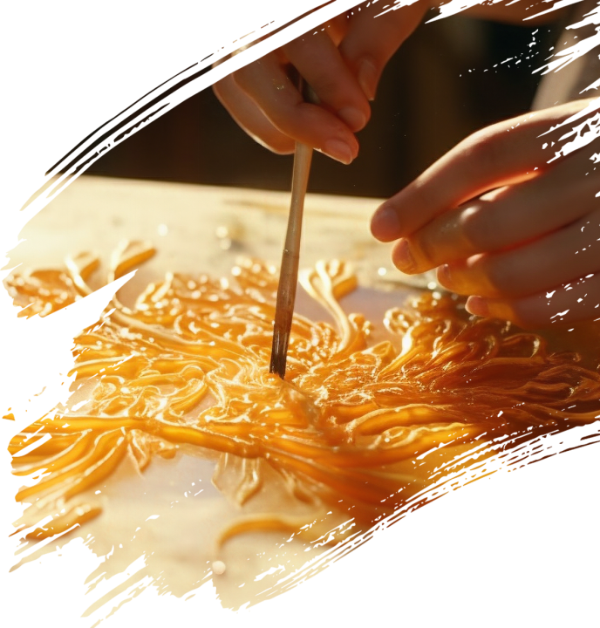
A News Report
非遗文化进校园

Slide 3
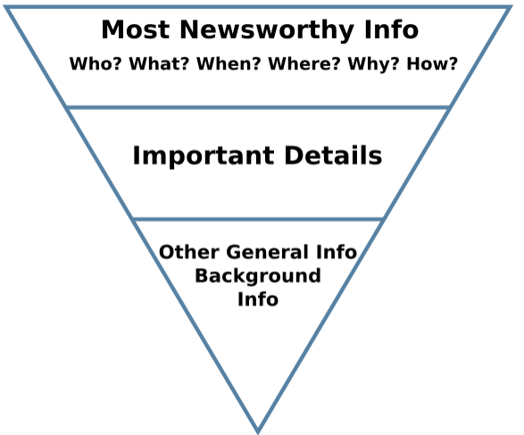
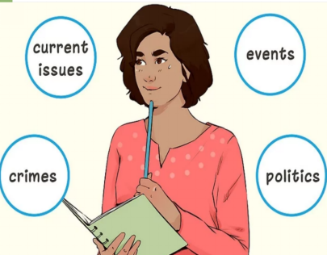
What is a news report?
An inverted pyramid
A news report is a fact-based story, on a particular event or incident happening /happened. News report gives all the information about incidents that already happened or currently taking place along with covering answers of 5Ws and 1H i.e. What, Where, When, Who, Why, and How.

Slide 4
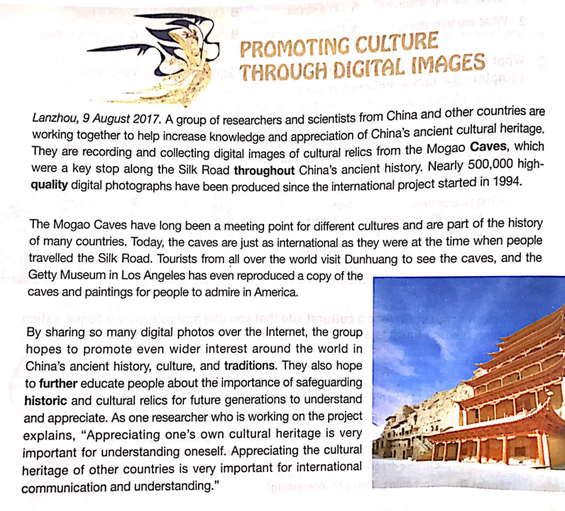
example1
Headline
the Lead
Body
ending

Slide 5
example 2
A Sponsored Walk(慈善步行)
Last Sunday some students participated in a 5 kilometers’ sponsored walk organized by the School Volunteers Association.
In the process we raised about￥1000, with which we bought some books. After that, we went to a nearby welfare house. On arriving (一...就) there, we began to distribute(分发) the books among the kids. They each got a copy. Everyone couldn’t wait to read, a big smile spreading across their faces（独立主格结构）.
Though humble, we were very glad that our activity made a difference to the unfortunate kids there.
Headline: 标题简洁\概括
Para.1 点题：活动简要概括（时间，地点，人物，事件） +活动目的（如果有）
Para.2 要点：活动主要内容展开
Para.3 活动意义：对活动的评价
语言特点：
简洁、精准、客观，常用一般过去时报道事件，用一般过去时或现在时总结评价

Slide 6
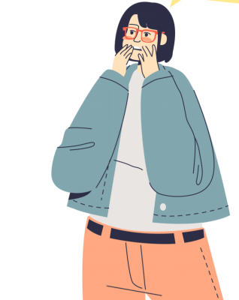
（2025.1.16高一上绍兴期末应用文）
上周末你参加了学校学生会组织的“非遗文化进校园”活动。请你给校英文报写一篇报道,内容包括：
1. 活动的过程；
2. 收获与感想。
What is an intangible Cultural Heritage?

Slide 7
上周末你参加了学校学生会组织的“非遗文化进校园”活动。请你给校英文报写一篇报道,内容包括： 1. 活动的过程； 2. 收获与感想。
Tangible Cultural Heritage(物质文化遗产) ：
consists of physical artifacts and structures like historical buildings and archaeological finds.物质文化遗产由实物手工艺品和建筑物（如历史建筑和考古发现）构成。
Intangible Cultural Heritage(非物质文化遗产):
involves non - physical elements such as traditional skills, performing arts, and oral traditions. 非物质文化遗产涉及非实物元素，像传统技艺、表演艺术和口头传统。
the Great Wall, the Beijing Central Axis（北京中轴线）, The Forbidden City, Mogao Caves (莫高窟), Terra-Cotta Army (兵马俑) , Temple of Confucius(孔庙), Cemetery of Confucius and the Kong Family Mansion (孔林孔府), Ancient City of Ping Yao, Summer Palace(颐和园), Classical Gardens of Suzhou、Mount Taishan, etc.
Paper cutting, Chinese calligraphy,Beijing opera, sugar painting, acupuncture (针灸)，Hunan embroidery(湘绣) Shadow puppetry(皮影), Kun Qu opera, Engraved block printing(雕版印刷术), etc.

Slide 8
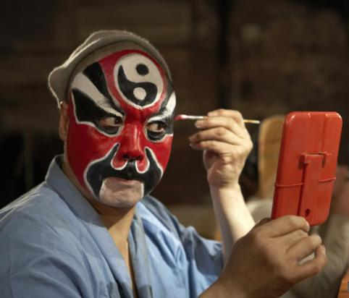
Beijing Opera, an important part of Chinese intangible cultural heritage, enjoys great popularity in China.Dating back to the 18th century, Peking Opera has over two hundred years of history. lt's a performance that combines music, singing, drama, poetry and costume design with explosive effect, The actors wear traditional costumes and masks, incorporating exaggerated movements,martial art and mime into their performances.
Beijing Opera
08

Slide 9
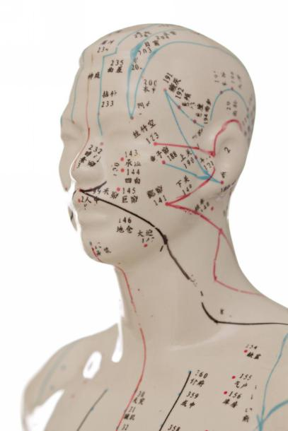
acupuncture /ˈækjupʌŋktʃə(r)/ n. 针灸

Slide 10
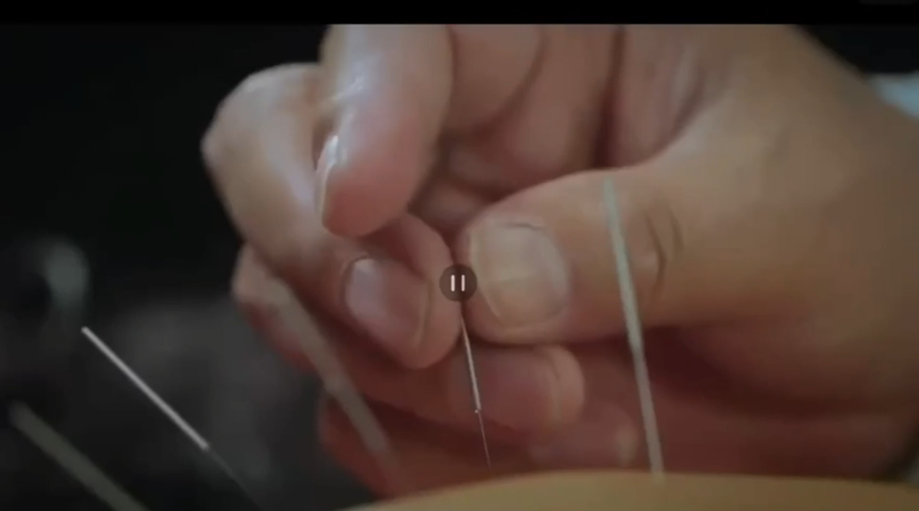
Acupuncture, an ancient Chinese medical practice, has been a remedy (治疗) for countless patients for thousands of years. ...It is a treatment that aims to promote the body's self -regulating functions自我调节功能. Its therapeutic /ˌθerəˈpjuːtɪk/治疗的principles are in line with the philosophical concepts of traditional Chinese medicine, which emphasizes holistic /həˈlɪstɪk/整体的, balance of bodily functions and overall 全面的physiological 生理的wellbeing. Practices can vary in forms, including needle insertion插入, cupping拔罐 and scraping刮痧. Needle insertion, the most common method, is carried out by inserting hair- thin needles into meridians 经络or specific points on the body that
channel vital energy...It is used in 113 of its 120
member countries, illustrating its widespread
recognition and application. As an ancient
Chinese medical practice, with a rich history
and deep cultural significance, it is an
embodiment 体现of profound cultural
heritage and holistic path to healing.
视频1

Slide 11
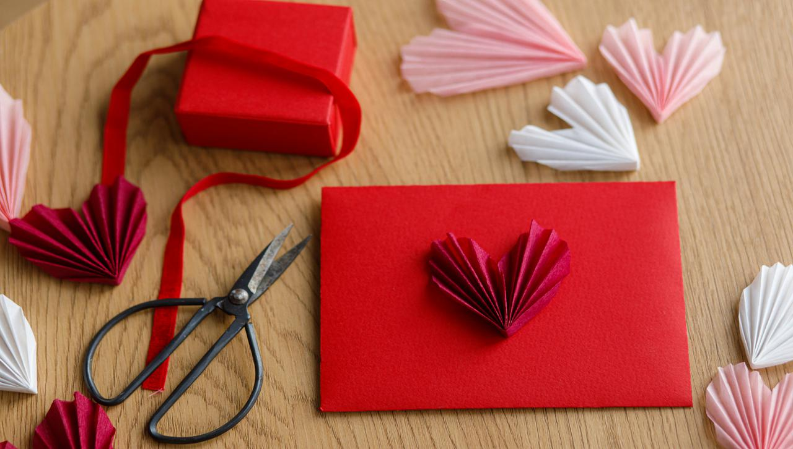
paper cutting

Slide 12
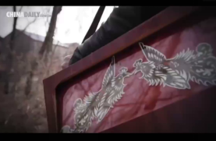
A pair of scissors, a piece of paper and a pair of dexterous /ˈdekst(ə)rəs/灵巧的 hands, that's all that's needed to create delicate works of paper cuttings. Originating in the southern and Northern Dynasties, this Asian form of art has decorated windows across China to celebrate the Spring Festival for generations. Patterns of whichever of the 12 Chinese zodiac /ˈzəʊdiæk/ animals, ... as well as festive /ˈfestɪv/ 节日的 scenes of family reunions and temple fairs are still lighting up Chinese homes today. Often created without any reference to a drawn draft, various patterns and images such as animals and flowers and mythological
/ˌmɪθəˈlɒdʒɪkl/ 神话的 and historical figures, each with their own connotations
/ˌkɒnəˈteɪʃ(ə)n/ 含义are cut and carved with s~ and burins/ˈbjʊərɪn/雕刻刀. This is the unrivaled /ʌnˈraɪvəld/无敌的 scale of paper cutting, an art form closely related to the nation's original culture and religious beliefs,
such as for productive worship繁衍生息, praying for
blessings祝福 and warding off disasters避灾免难.
视频2

Slide 13
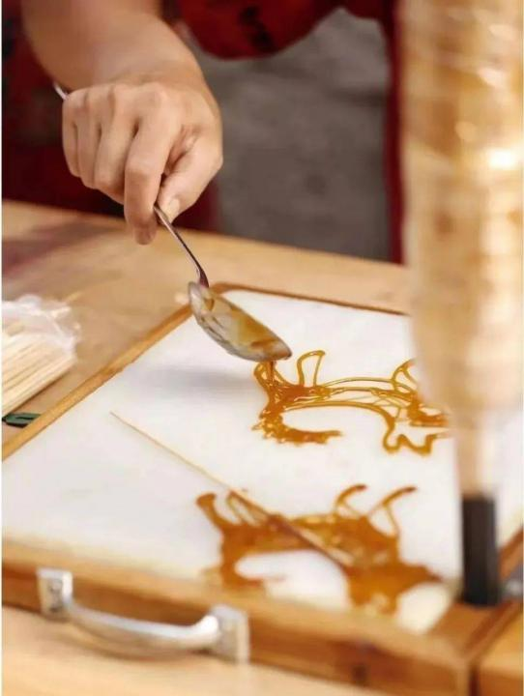
sugar painting

Slide 14
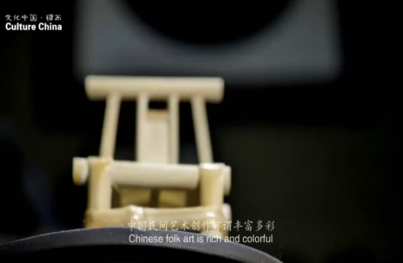
Chinese folk art is rich and colorful. Sugar painting is one of them. To make the paint, you put refined(精致的) sugar into the pot. Cook with low heat and make it into crystal clear syrup/ˈsɪrəp/糖浆. Tools for sugar painting are spoons and shovels /ˈʃʌv(ə)l/铲子. With their outstanding craftsmanship, a variety of beautiful figures, flowers, birds and animals are shown in front of you. This sugar-made handicraft is loved by children very much. It seems very easy when making it but it takes years to perfect. The completed works are highly artistic. This kind of ~ can often be seen in Chinese traditional temple fairs.
视频3

Slide 15
上周末你参加了学校学生会组织的“非遗文化进校园”活动。请你给校英文报写一篇报道,内容包括： 1. 活动的过程； 2. 收获与感想。
para.1 导语--活动概括（如加目的要尽量简洁）
Aiming to do/ Aimed at/ with the purpose of doing/ In a bid to do
旨在(短语)____________________________
参加 (短语) ___________________________
举办 vt. ___________________________
目的：____________________________
engage in/get actively involved in/take an active part in...
学校+ host/launch/mount/stage或活动+kick off
2. 非谓语
Aiming to deepen students’ insight into intangible cultural heritage around us, an exhibition was staged in our school library last Friday, which won widespread applause (by both students and teachers).
提高意识to raise students’ cultural heritage preservation
增长知识 to deepen students’ insight into intangible cultural heritage
...
1. 无灵主语
Last Friday witnessed a resounding activity of Intangible Cultural Heritage into Campusstaged by our school, which was hailed(赞扬) by both students and teachers.或which turned out to be a hit/success.

Slide 16
上周末你参加了学校学生会组织的“非遗文化进校园”活动。请你给校英文报写一篇报道,内容包括： 1. 活动的过程； 2. 收获与感想。
para.2 活动过程（注意内容）
有很多boast a variety of...
著名的考古学家a distinguished archaeologist
工匠n(男) craftsman
展出v showcase/display/exhibit
展示v demonstrate
融合v blend /coupled with
收藏很多house a large collection of
亲身体验experience sth first hand
动手体验hands-on activities

Slide 17
para.2 活动过程(注意逻辑：按时间/空间/...展开)
² The activity mainly consisted of three parts. First of all,...
Then followed,...Finally,...
² The activity began with a video showcasing the profound history of painting facial masks in Peking Opera. Following that, Professor Liu, a renowned actor, delivered a lecture focusing on the process of making facial masks and the significance of preserving this intangible cultural heritage.活动以一段视频开始，视频展示了京剧脸谱画的深厚历史。随后，著名表演家刘教授主讲了制作脸谱的过程以及保护这一非物质文化遗产的意义。
² One of the highlights of the event was ...

Slide 18
上周末你参加了学校学生会组织的“非遗文化进校园”活动。请你给校英文报写一篇报道,内容包括： 1. 活动的过程； 2. 收获与感想。
2.这次活动的特色是各种各样的活动。
The event featured a variety of activities.
3.活动以一位著名文化专家的演讲开始，他解释了非物质文化遗产的重要性及其在保护中国传统中的作用。
It began with a lecture by a renowned cultural expert who detailed the significance of intangible cultural heritage and its role in preserving Chinese traditions.

Slide 19
上周末你参加了学校学生会组织的“非遗文化进校园”活动。请你给校英文报写一篇报道,内容包括： 1. 活动的过程； 2. 收获与感想。
4.之后，还有几个沉浸式的工作坊，学生们在那里学习了剪纸、书法、中国结等传统技能。
Following that, there were several immersive workshops where students learned traditional skills such as paper-cutting, calligraphy, Chinese knotting, to name but a few.
5.这些亲身体验让参加者直接接触美学艺术形式，并对其文化内涵有更深的了解。
These hands-on experiences allowed participants to engage directly with the aesthetic art forms and gain a deeper understanding of their cultural connotations.

Slide 20
上周末你参加了学校学生会组织的“非遗文化进校园”活动。请你给校英文报写一篇报道,内容包括： 1. 活动的过程； 2. 收获与感想。
para.3 收获与感想
6-7. 这次活动确实是一场视觉和听觉盛宴。
它不仅增强了我们的文化自信和认同，而且还激励我们珍惜和保护这些宝贵的遗产。
This event trulyfeasted oureyes and ears. /... was a feast for our...
Not only did it enhance our cultural confidence and identity, but it also inspired us to cherish and preserve these invaluable treasures of our heritage.

Slide 21
用于para.3拓展：
表示总结：
be well-received a. 受欢迎的 it won high applause from Sb 获得高度赞扬
resounding 轰动的 engaging吸引人的 informative增长见闻的
speak highly of高度赞扬 bring color to our high school life.
认知方面：
deepen one’s insight into...加深对...的了解 raise one’s awareness of...提高意识
catch a glimpse of一睹...的风采 broaden one’s horizons拓宽视野
cast light on sth使人明白
情感方面：
arouse/ boost one’s enthusiasm激发热情 fuel/ignite one’s passion 点燃激情
promote a sense of cultural pride促进文化自豪感
immerse sb in the charm of...沉浸在...魅力中
strengthen/enhance our cultural confidence增强文化自信

Slide 22
范文：
Getting to Know the Intangible Cultural Heritage Around Us
Last weekend, our school's Student Union organized an activity with the theme of "getting to know the intangible cultural heritage around us", which exposed all the students and teachers to the amazing cultural diversity of our country
The event kicked off with an expert's speech about the importance of intangible cultural heritage preservation, followed by a series of traditional art exhibitions and live folk music performances. The highlight of the experience was the interactive workshops where craftsmen not only demonstrated their excellent skills but also engaged students in making crafts.
The event turned out to be enjoyable and enlightening, through which we gained deep insights into the cultural treasures and meanwhile. It strengthened our awareness of the intangible cultural heritage protection.

Slide 23
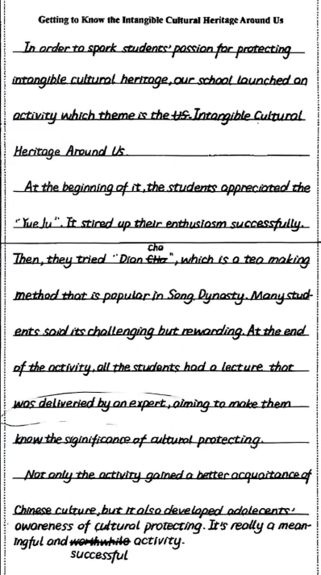
美文：
该习作书写出色，虽有语法及拼写等错误（如whose theme, stirred up,delivered by等）, 但at the beginning of...Then...At the end of the activity...连接词的使用使句子之间过渡自然、逻辑清楚；且高级表达spark, enthusiasm, challenging but rewarding, gain a better acquaintance of等的应用为文章增加了亮点。

Slide 24
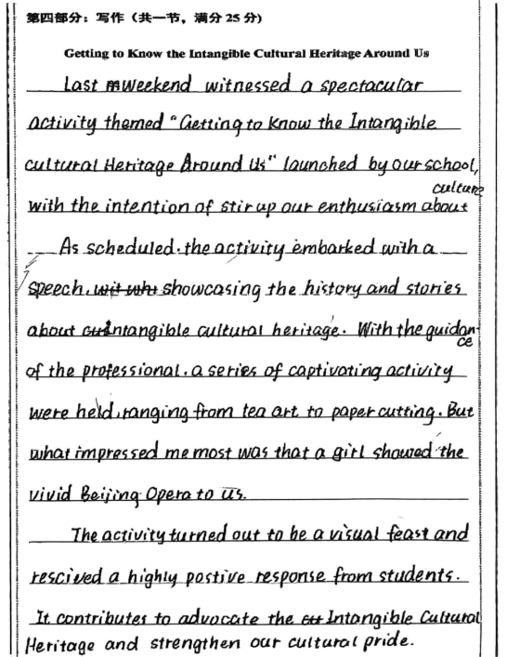
美文：
该习作虽有不少语言错误，如para.1 stir (stirring) up; para.2a series of activity (activities);para.3 rescived(received)、postive (positive)拼错,contribute to advocate(advocating)用错，strengthen (strengthens)主谓不一致以及表意不完整，如para.2 a speech (addressed by whom?未写)，且professional 一词也比较笼统，不如a renowned archaeologist/ expect on ...；整体语言还算丰富（如spectacular, launched, what impressed me most was等）、表达流畅、书写加分。

Slide 25
文化遗产类练习1
假定你是校英文报记者，你校上周举办了一场“文化遗产展览”活动。请你为此写一篇报道，内容包括：
1. 活动概况
2. 具体内容
3. 活动意义。
注意:
1.词数80左右;
2.可适当增加细节,以使行文连贯。

Slide 26
A Cultural Heritage Exhibition
Last Friday witnessed a resounding/rɪˈzaʊndɪŋ/轰动的 cultural heritage exhibition mounted in our school library, which was hailed by both students and teachers.
The exhibition kicked off with an engaging speech delivered by a renowned archaeologist, who shed light on the current situation of cultural relics and emphasized the crucial need to safeguard these treasures. Following this, participants embarked on a guided tour through the exhibits, featuring a wide collection of historical artifacts and art pieces. Informative descriptions attached unveiled rich connotations of each item. The highlight of the event was hands-on sessions where students were fully immersed in experiencing traditional calligraphy and paper-cutting.
The exhibition offered fun and more than fun. Not only did it promote a strong sense of cultural pride, but it also cultivated a greater awareness of the responsibility we share in preserving these priceless cultural assets
/ˈæset/ 资产 for future generations.

Slide 27
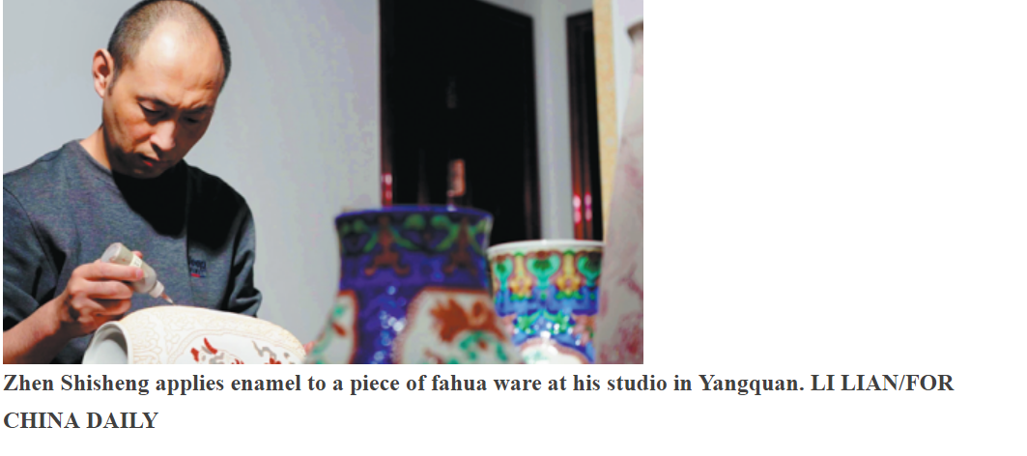

文化遗产类练习2
视频4
所谓珐华，又称法花、粉花，是一种低温釉陶的陶瓷装饰技术。相传，其烧于元代，盛于明代，清代过后就极为少见。

Slide 28
Zhen Shisheng is a man with hearing loss and speech difficulties. 56 his physical difficulties, Zhen has lived a meaningful life, thanks to his interest and talent in and enthusiasm for the traditional Shanxi art of fahua ware.
Fahua ware, which is mostly made in the south and east of Shanxi, is the porcelain version of cloisonne(景泰蓝), 57 the design elements are separated by copper wires. Porcelain featuring these techniques 58 (fire) at lower temperatures with the different colored glazes and enamels applied to individual areas created by the slip lines. When 59 (recall) his experience to learn the techniques to make this Shanxi handicraft with a history of hundreds of years, he said, "When you lose some abilities, you would cherish all the others 60 (leave) to you," Zhen said in sign language. "Only when you apply all your senses and abilities to your subject of work can you 61 (possible) succeed.” Zhen learned the craft from his father who is 62 master fahua ware craftsman in a porcelain factory. Zhen’s creativity and innovation are demonstrated in the 63 of using lines and glaze colors, as well as the selection of patterns and images for decoration.
The hardest part of learning to make fahua ware is that the fahua techniques 64 (lose) for about 300 years, and today's revival of the art has been made through artists' painstaking research into ancient documents and 65 (exist) museum exhibits, as well as their own imagination. And he believes this cultural heritage can be passed down to future generations.

Slide 29
keys:
56. Despite 57.where 58. is fired 59.recalling
60.left 61.possibly 62.a 63.freedom
64. have been lost 65.existing/existent

Slide 30
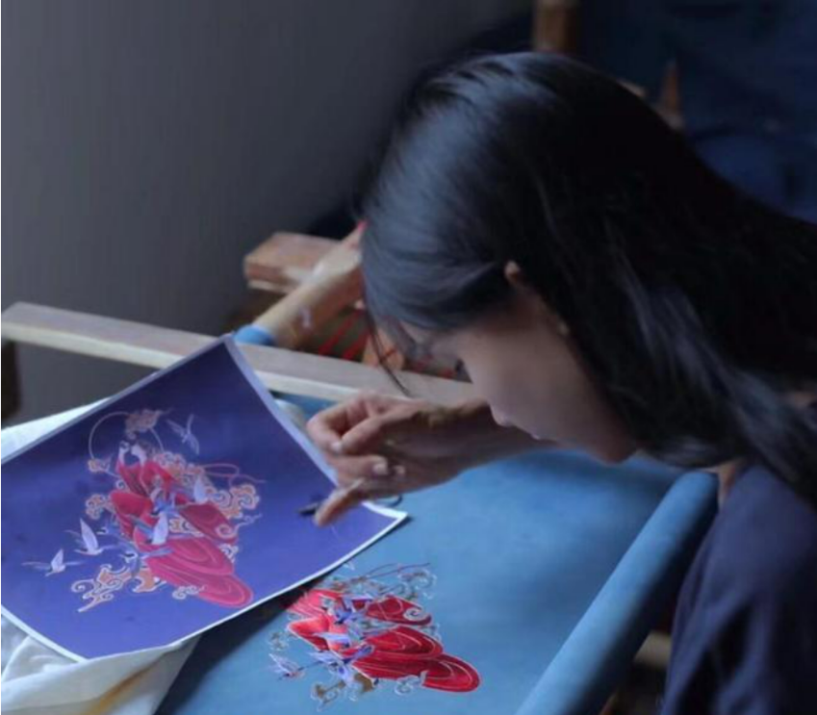
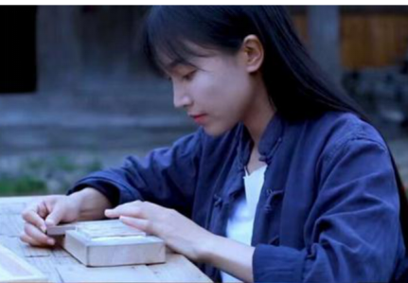
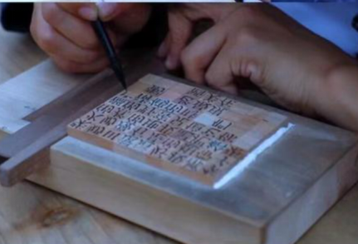
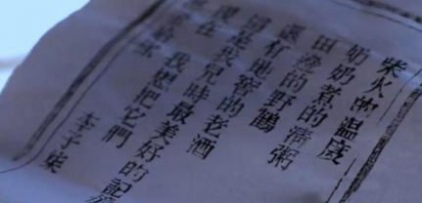
Thank you!

