Slide 1


感恩遇见，相互成就，本课件资料仅供您个人参考、教学使用，严禁自行在网络传播，违者依知识产权法追究法律责任。
更多教学资源请关注
公众号：溯恩英语
知识产权声明

Slide 2




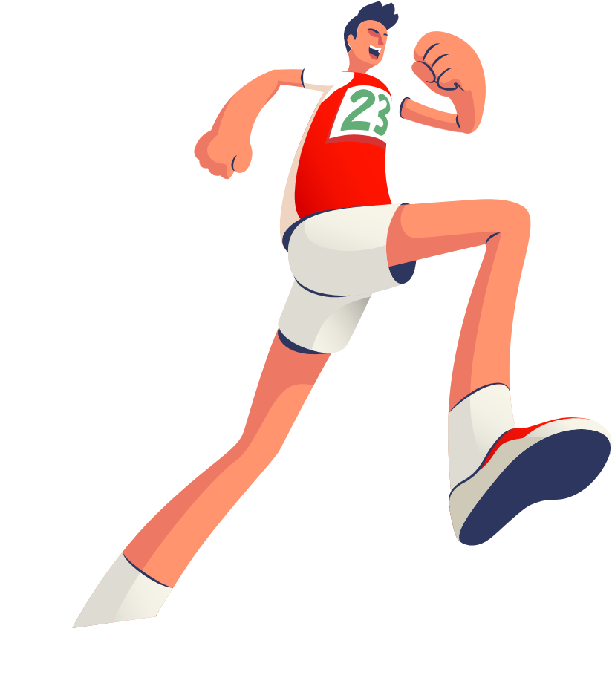


The Ultimate Trainers
Good English
Notes:
VCG41N1226331540 VCG211253393377

Slide 3

Teaching Objectives:
1. familiarize yourself with the main idea of these chapters
2. grasp the key words and expressions related to running/competitions.

Slide 4

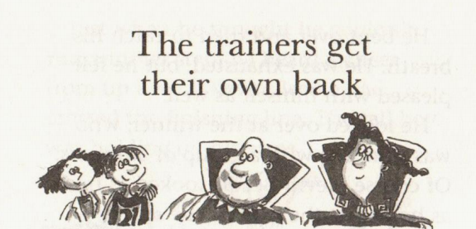
Chapter 9
What does the title mean?
Why do the trainers do that? How?

Slide 5
What does the title mean?
take revenge 报复/回敬某人

Slide 6

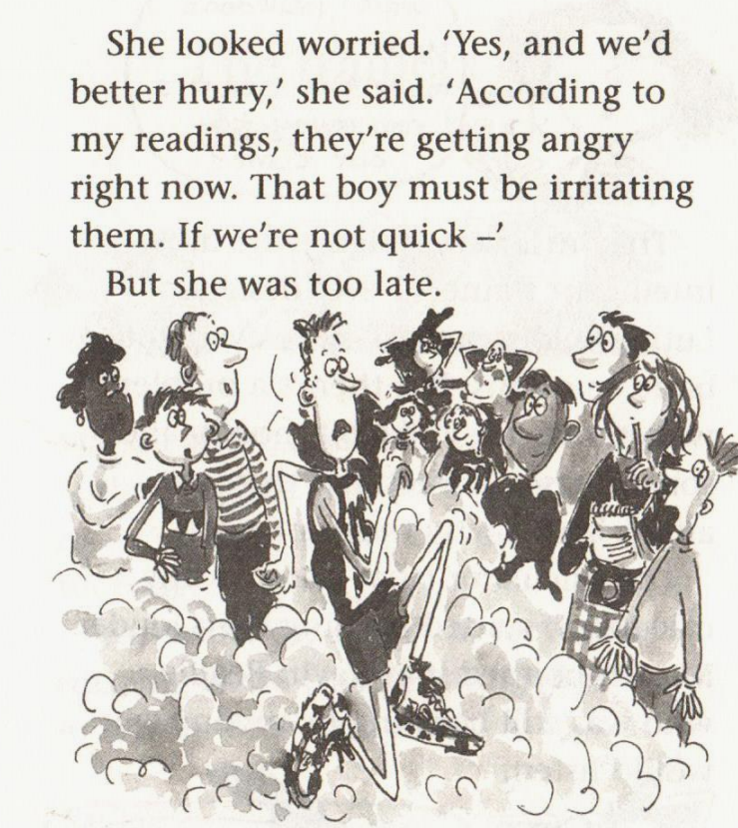
Why do the trainers do that? How?
irritate v. /ˈɪrɪteɪt/
make sb angry/impatient使不悦；使恼火
•The way she puts on that accent really irritates me.她故意操那种口音的样子实在令我恼火。
What goes around comes around.
善有善报，恶有恶报。
You reap what you sow.
种瓜得瓜，种豆得豆
Kevin’s arrogance irritates the trainers.
charge/race/zip/sprint/ ...
through the car wash/down the street nonstop

Slide 7
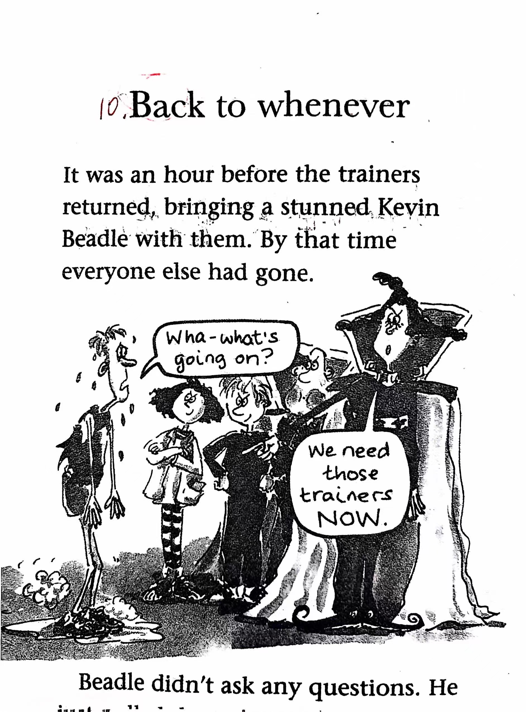
Chapter 10 Back to whenever
Who go back to whenever?
Can it be replaced by Back to wherever?

Slide 8
chapter 9
race
charge

zip
-pp-
jog慢跑
-gg-
sprint
zoom
pelt
whiz
at top speed以全速
pick up speed加速
run

Slide 9

He slapped Jake on the back.
slap /slæp/ ( -pp- )
1.to hit sb/sth with the flat part of your hand（用手掌）打，拍，掴
•She slapped his face hard.她狠狠给了他一个耳光。

Slide 10




Underline sentences indicating Kevin’s arrogance.
He was still boasting to anyone who would listen
One moment, Beadle was bragging about how easy the race had been.
boast /bəʊst/ i too much pride about sth that you have or can do自夸；自吹自擂
•She is always boasting about how wonderful her children are.她总是夸耀她的孩子们多么出色。
to have sth that is impressive and that you can be proud of
有（值得自豪的东西）
2. __________
Chunhui High school boasts many amazing sites.

Slide 11
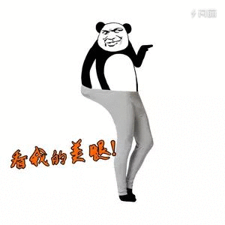
brag /bræɡ/
( -gg- )
~ to sb (about/of sth)
to talk too proudly about sth you own or sth you have done
吹嘘；自吹自擂
•He bragged to his friends about the crime.他向朋友炫耀他的罪行。

Slide 12
v with a dazed look on his face, he staggered away in his socks
一脸茫然地
摇摇晃晃地走
stagger v. /ˈstæɡə(r)/
1. to walk with weak unsteady steps, as if you are about to fall
摇摇晃晃地走；蹒跚；踉跄
[ + adv./prep.]
•The injured woman staggered to her feet.受伤的女人摇摇晃晃地站起身来。
•He staggered home, drunk.他喝醉酒，踉跄着回了家

Slide 13
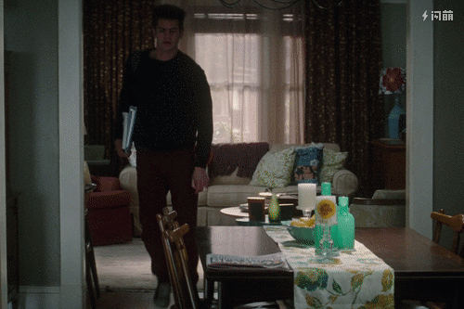
v The trainers hopped up into his arms.
跳到他怀里
hop /hɒp/ ( -pp- )
1.[ + adv./prep.] ( of a person/animal ) to move by jumping on one foot/both feet单脚跳行
He hurt one leg and had to hop everywhere.
A robin was hopping around on the path.
一只知更鸟在小路上跳来跳去。

Slide 14

v Jake pulled a face and Anna grinned.
做鬼脸=make a face

Slide 15
