Slide 1


感恩遇见，相互成就，本课件资料仅供您个人参考、教学使用，严禁自行在网络传播，违者依知识产权法追究法律责任。
更多教学资源请关注
公众号：溯恩英语
知识产权声明

Slide 2




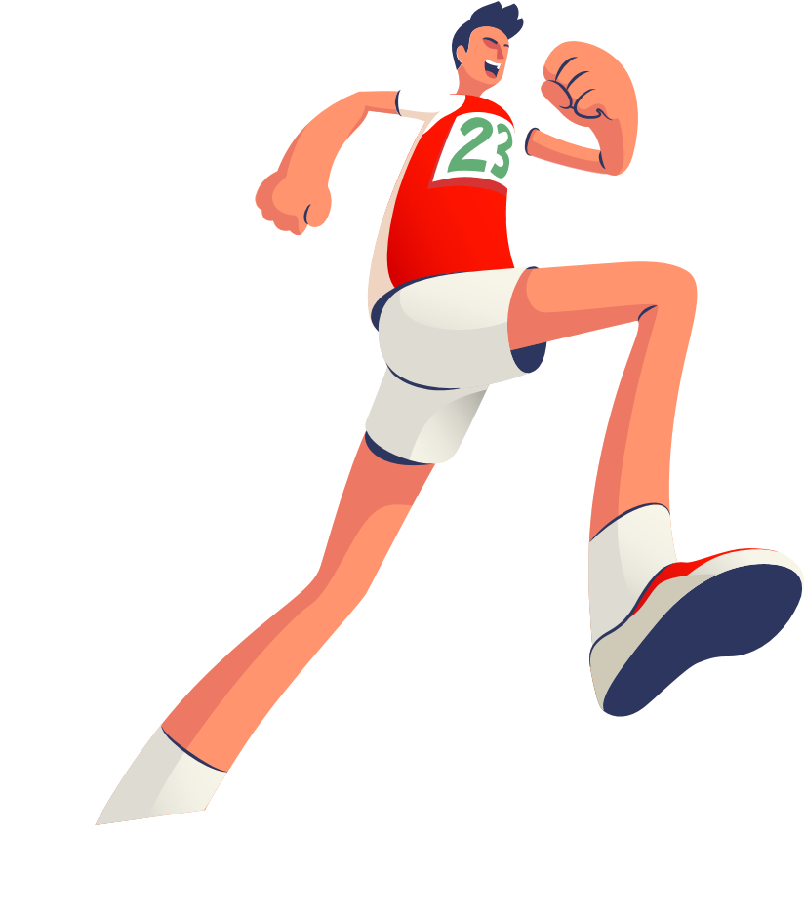


The Ultimate Trainers
Good English
Notes:
VCG41N1226331540 VCG211253393377

Slide 3
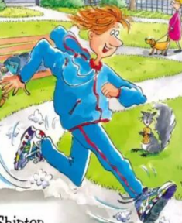
Teaching Objectives:
1. familiarize yourself with the main idea of these chapters
2. grasp the key words and expressions related to running/competitions.

Slide 4
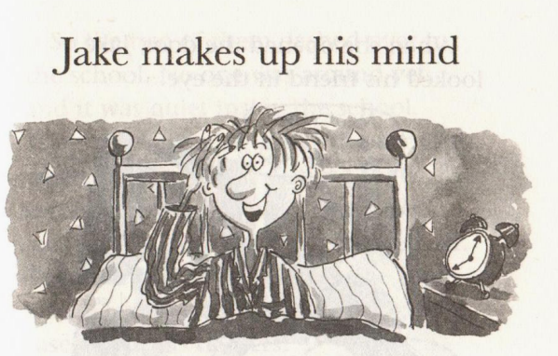
What does Jake make up his mind to do?
How does he feel after making the decision?
How do they deal with the trainers? What happened later?
Chapter 6

Slide 5
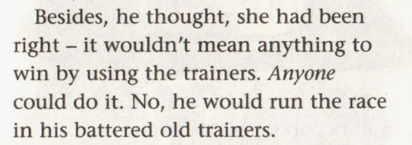
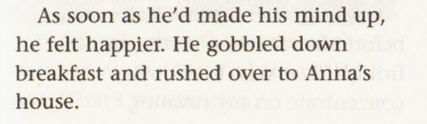
Read for content
What does Jake make up his mind to do?
How does he feel after making the decision?

Slide 6
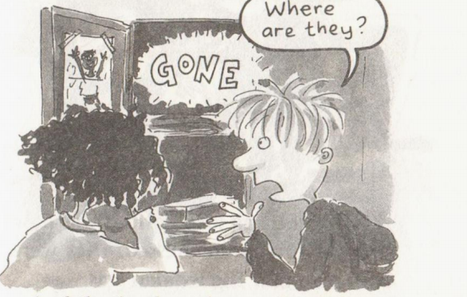
How do they deal with the trainers? What happened later?

Slide 7
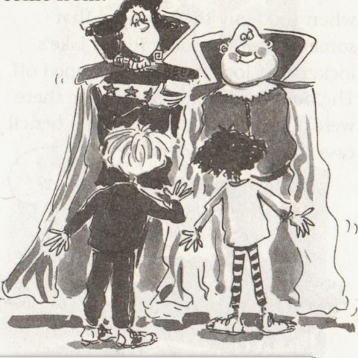
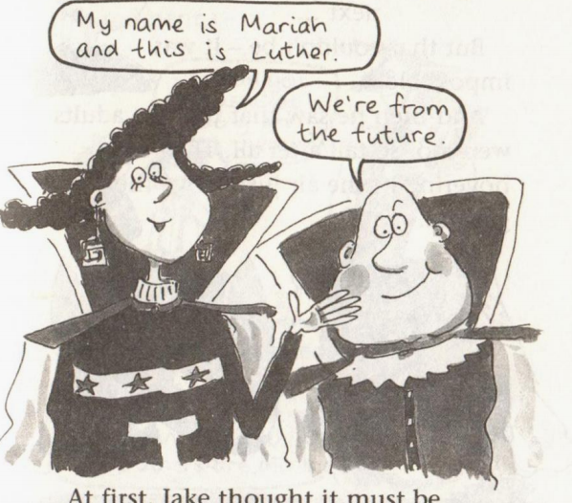
appearance?
action? (say, do)
Who are they? What do they look like?

Slide 8
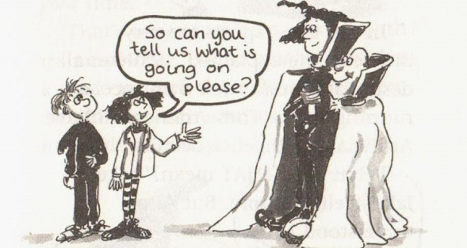
Chapter 7 Where are the trainers?

Slide 9
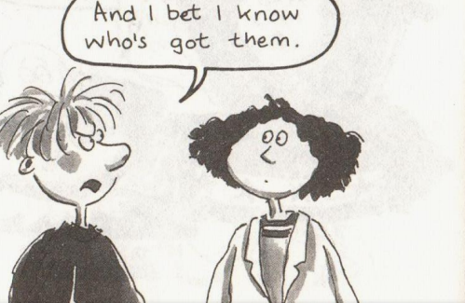

Slide 10
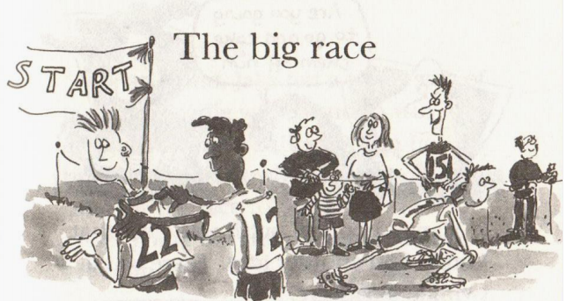
Chapter 8
Who joins in it?
Who wins? How?
Chapter 7 Where are the trainers?

Slide 11
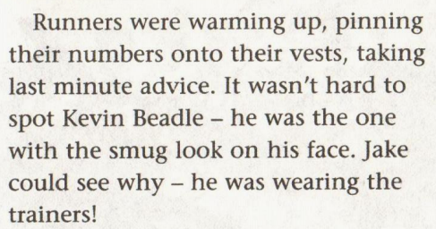
Chapter 7 Where are the trainers?

Slide 12
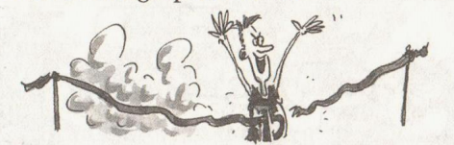
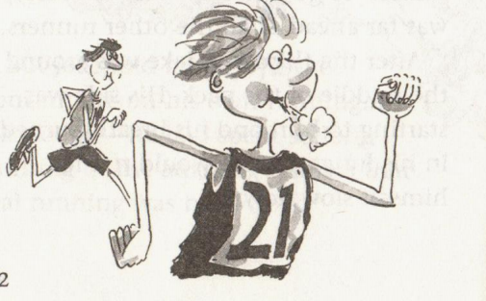
Who joins in it?
Who wins? How does Jake feel during and after the race?
Kevin Beadle had crossed the finishing line.
efforts
He was exhausted, but he felt pleased with himself as well
Jake told himself just to concentrate on his own running
He forced himself to go faster
He wouldn't let himself slow down
He gritted his teeth and pushed on
He overtook a few runners he didn't even look up to see how far ahead Cavin Beadle was
But on he ran
He dug deep into himself and ran on for the finishing line
looked as fresh as ...
contrast
after the 1st lap, his legs ached.
after the 3rd lap, his side was starting to hurt, and his breath burned in his lungs.
the last lap was a blur. His whole body ached...
challenges
value

Slide 13
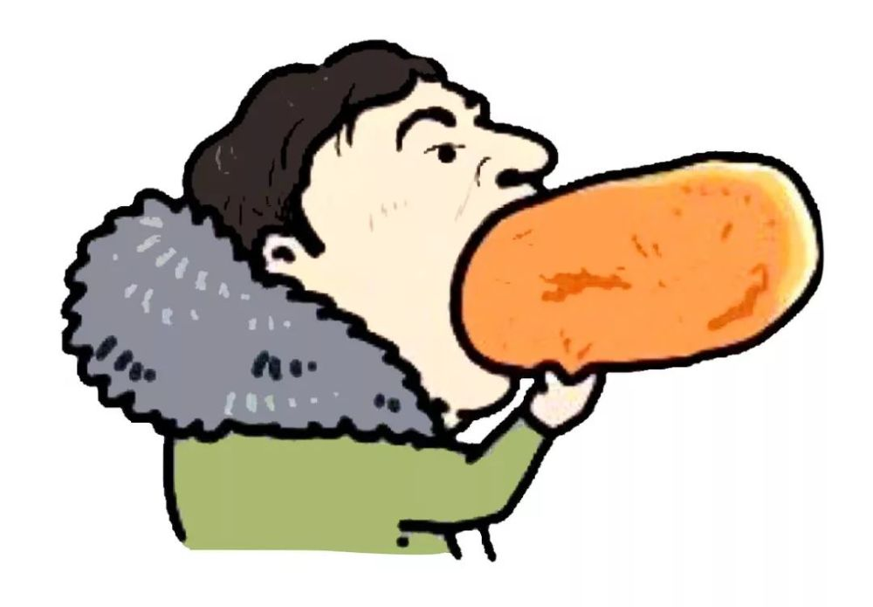
Read for language
He gobbled breakfast.
=wolf eg. He wolfed down his breakfast.
gobble v. /ˈɡɒbl/
~ sth (up/down)to eat sth very fast, in a way that people consider rude or greedy狼吞虎咽；贪婪地吃
They gobbled down all the sandwiches.

Slide 14
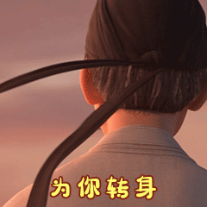
Jake and Anna whirled around.
whirl /wɜːl/ =spin (-nn-)
[ usually+ adv./prep.] to move, or make sb/sth move, around quickly in a circle or in a particular direction（使）旋转，回旋，打转
•Leaves whirled in the wind.落叶在风中旋转。
•She whirled around to face him.她猛地转过身子面对着他。

Slide 15
Jake nodded grimly.
严肃地说

Slide 16
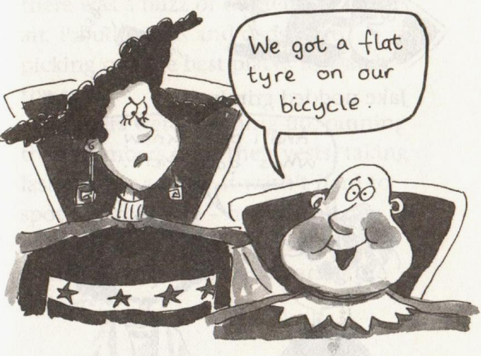
轮胎没气了

Slide 17
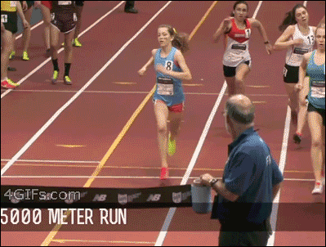
Kevin Beadle sprinted to the front of the pack.
sprint /sprɪnt/ to run or swim a short distance very fast冲刺
[ Vusually+ adv./prep.]
•He sprinted for the line.他向终点线冲去。

Slide 18

Jake overtook a few runners.
overtake v. ( overtook overtaken)
1.to go past a moving vehicle or person ahead of you because you are going faster than they are超过；赶上
[ VN]
•He pulled out to overtake a truck.他驶出车流，以超过一辆卡车。

Slide 19
chapter 6-7
v心理描写 With a jolt he realized...心里咯噔一下
v动作描写 He could jog down the road, puffing and panting.
气喘吁吁
v动作描写 It took us a while to track them down. 追踪到他们
v动作描写 They hovered in the air above the ground.
他们在地面上空盘旋。
They floated gently to the ground.
他们轻轻地飘向地面。
v动作描写 fall out with sb与某人闹翻

Slide 20
环境描写： chapter 8
² There was a buzz of excitement in the air. 空气中有兴奋的嚷嚷声
² The whistle blew and the race began. 哨声响了比赛开始了。
² the starting line 起跑线 the finishing line 终点线
² That gave Jake an extra burst of energy. 迸发出额外的能量
神态描写：
² He spotted (spot -tt-认出/发现) Kevin--he was the one with the smug look on his face. 沾沾自喜的表情
² There was a twinkle in his eyes. 眼睛一闪
² a smirk played on the tall boy’s face高个男孩脸上浮现自鸣得意的笑
心理描写：
² For a second, Jake felt a sharp stab of jealousy.妒忌得心里一阵刺痛
² His side was starting to hurt and his breath burned in his lungs呼吸在肺部燃烧

Slide 21
动作描写:
v Jake gritted his teeth and pushed on.咬紧牙关
v Luther was jumping up and down and yelling at the top of his voice. 用尽全力呐喊

