Slide 1


感恩遇见，相互成就，本课件资料仅供您个人参考、教学使用，严禁自行在网络传播，违者依知识产权法追究法律责任。
更多教学资源请关注
公众号：溯恩英语
知识产权声明

Slide 2

The World
January 1st-15th, 2025

Slide 3

1. GLAD TO HEAR IT 2 Stories to Make Your Day
暖心故事两则

Slide 4
Text Completion
Reader’s Digest (December 2024/January 2025 P11)
A History Lesson
A few years ago, in a Maryland thrift store, Anna Lee Dozier found a small ceramic vase that looked _______ (vague) Mayan, like “some kind of tourist reproduction thing,” she told WUSA in Washington, D.C. She paid $3.99 and took __ home. During a visit to a museum in Mexico City, she saw vases similar ___ the one she had bought. Intrigued, she sent photos of her vase to the Mexican Embassy and received ___________ (confirm) that it was a priceless Mayan artifact perhaps 1,800 years old. When the embassy asked for the valuable relic, Dozier agreed, telling NPR, “It’s important to recognize things with such cultural value to ___ entire counry.” She had another reason _____ (be) rid of it, she said: “I have three little boys. I was petrified that after 2,000 years I would be the one to wreck it!”
The Kids vs. the Kidnapper
The jolly jingle of the ice cream truck caught the ears of three 11-year-old girls in Kent, Washington. But as they headed toward it, their attention ___________ (divert) by the sight of a 6-year-old neighbor struggling against the grasp of a stranger. As the girls approached, the man picked up the child and walked away. _______ (cut) him off, the preteens asked, “Do you know this girl?” according to NBC News in Seattle. The little girl emphatically shook her head no. Spooked, the man put her down and fled. A neighbor who’d seen it all called the police, ____ the would-be kidnapper was caught. Awed by their actions, the Kent police said in a statement, “We are impressed beyond words at the maturity and protectiveness _________ (display) by these preteen girls.”
vaguely
it
to
confirmation
an
to be
was diverted
Cutting
and
displayed

Slide 5
Reading Comprehension
Which of the following statements is correct according to the text?
A. Anna bought the vase because she knew for sure it was a Mayan artifact.
B. Anna was forced to return the priceless ceramic vase to its rightful owner.
C. The preteens’ attention was diverted from the truck to the kid’s strange behavior.
D. The man failed to kidnap the 6-year-old girl because a neighbor called the police.

Slide 6
Vocabulary
1. petrify: to make sb feel extremely frightened 使吓呆；使惊呆
Prison petrifies me and I don’t want to go there.
监狱太可怕了，我不想去那里。
2. spook: to frighten a person or an animal; to become frightened
吓；惊吓；受惊
Investors were spooked by slowing economies.
经济增长速度的放慢让投资者神经紧张。
Translation
你把可怜的汤姆吓呆了。
You petrified poor Tom.
Translation
那奇怪的声音和亮光把我们吓坏了。
We were spooked by the strange noises and lights.

Slide 7
Translation
During a visit to a museum in Mexico City, she saw vases similar to the one she had bought. Intrigued, she sent photos of her vase to the Mexican Embassy and received confirmation that it was a priceless Mayan artifact perhaps 1,800 years old.
在参观墨西哥城的一家博物馆时，她看到了与她买的花瓶相似的花瓶。出于好奇，她把花瓶的照片寄给了墨西哥大使馆，并得到了证实，这是一件无价的玛雅文物，可能有1800年的历史。
Spooked, the man put her down and fled. A neighbor who’d seen it all called the police, and the would-be kidnapper was caught. Awed by their actions, the Kent police said in a statement, “We are impressed beyond words at the maturity and protectiveness displayed by these preteen girls.”
那人吓坏了，放下她逃走了。一个目睹了这一切的邻居报了警，那个想要绑架小女孩的人被抓住了。肯特警方惊叹于她们的行为，并在一份声明中说：“这些少女表现出的成熟和保护欲给我们留下了深刻的印象。”

Slide 8
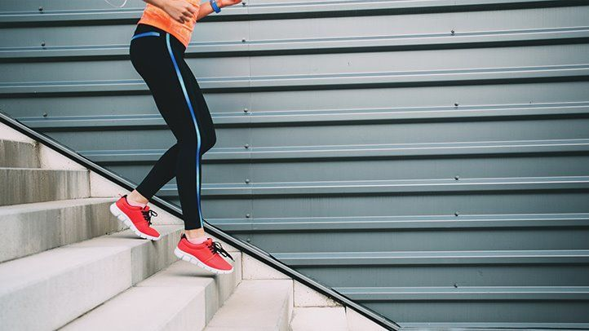
2. Take the stairs - they keep you alive
走楼梯——它们能让你活下去

Slide 9
Text Completion
Science Illustrated Australia（Issue 112, 2025 P11)
moving
When _______ (move) up and down between floors, a lift or escalator will conserve your energy and likely speed your journey. ____ choosing the stairs could provide major health benefits, the effects of which will last for years. So conclude UK researchers who report that stairs ___________ (dramatic) reduce the risk of dying from any cause. The results are based on nine studies involving a total of 480,000 people _____ (age) 35 to 84.
According to the researchers at the University of East Anglia, people climbing and descending stairs on a daily basis suffered a 24% lower risk of dying during the study period compared to those who did not. Climbing and descending stairs was also associated _____ a 39% lower risk of dying from heart disease, including heart attack, heart failure, and stroke.
Stairs and staircases combine strength and cardio training in one: you exercise both muscles and your heart and lungs at ____ same time.The researchers suggest that this dual benefit is one of the reasons _____ the activity is associated with a longer lifespan, and they urge everyone who is capable to go up and down more stairs.
“If you have the choice between stairs and the lift, choose the stairs; it ___________ (benefit) your heart,” says lead author Sophie Paddock, an interventional cardiologist at the University of East Anglia. “Even short periods of physical activity have a __________ (benefit) effect and should fit easily into your daily _______ (routine) .”
But
dramatically
aged
with
the
why
will benefit
beneficial
routines

Slide 10
Vocabulary
1. descend: to come or go down from a higher to a lower level下来；下去；下降
The wind-down of the company was handled very efficiently. 处理公司逐步缩减直至关闭的事宜效率很高。
2. dual: having two parts or aspects两部分的；双重的；双的
The piece of furniture serves a dual purpose as a cupboard and as a table. 这件家具有两个用途，既作橱柜也作饭桌。
Translation
她缓慢地走下楼梯。
She descended the stairs slowly.
Translation
她有英美双重国籍。
She has dual British and American nationality.

Slide 11
Translation
So conclude UK researchers who report that stairs dramatically reduce the risk of dying from any cause. The results are based on nine studies involving a total of 480,000 people aged 35 to 84.
这是英国研究人员得出的结论，他们报告说，爬楼梯能显著降低因任何原因死亡的风险。这一结果是基于对48万名年龄在35岁至84岁之间的人进行的9项研究得出的。
The researchers suggest that this dual benefit is one of the reasons why the activity is associated with a longer lifespan, and they urge everyone who is capable to go up and down more stairs.
研究人员表示，这种双重好处是这项活动与长寿有关的原因之一，他们督促每个有能力上下楼梯的人多走楼梯。

Slide 12
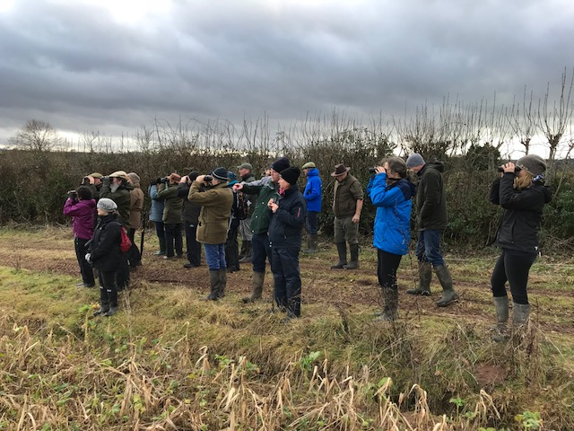
3. Watch the birdie
数小鸟

Slide 13
Text Completion
Country Life UK（January 1, 2025 P21)
The GWCT’s annual Big Farmland Bird Count kicks off on February 7 this year and runs for two weeks. Last year, of the total 140 species recorded, 27 were red listed, _________ (include) the linnet, snow bunting and lapwing and the most commonly _______ (spot) were starling, wood pigeon and field fare.
The UK ________ (lose) more than 70 million wild birds over the past 50 years, with more than 60% of farmland birds affected. Farmers have the opportunity to be at the forefront of any efforts _________ (restore) those populations, explains television presenter and farmer Adam Henson. Nature-friendly farming is the way forward and, to make sure we’re getting it right, providing the best habitats and support for our farmland birds, __ is important to keep records.
The GWCT’s Dr Roger Draycott adds: “Since the count started in 2014, it has helped us understand _____ wildlife is doing on our land.….By spending just half ___ hour in one spot on your farm or shoot, counting the birds you see and submitting your results to the GWCT, the results help us build a ________ (nation) picture of which species are benefiting from ___________ (conserve) efforts, and which are most ___ need of help.” Visit www.bfbc.org.uk for information on how to take part.
including
spotted
has lost
to restore
it
how
an
national
conservation
in

Slide 14
Vocabulary
1. kick off: to begin 开始
The carnival kicked off with a wonderful firework display. 狂欢节以一场精彩的烟花表演拉开了序幕。
2. at the forefront of (sth.): in or into an important or leading position in a particular group or activity处于最前列；进入重要地位（或主要地位）
Women have always been at the forefront of the Green movement. 妇女总是在环境保护运动的最前列。
Translation
展览从10月24日开始。
The shows kick off on October 24th.
Translation
他们一直处于政治变革运动的前沿。
They have been at the forefront of the campaign for political change.

Slide 15
Translation
The GWCT’s annual Big Farmland Bird Count kicks off on February 7 this year and runs for two weeks. Last year, of the total 140 species recorded, 27 were red listed, including the linnet, snow bunting and lapwing and the most commonly spotted were starling, wood pigeon and field fare.
一年一度的GWCT“农田鸟类统计”活动将于今年2月7日开始，为期两周。去年，在记录的140种鸟类中，有27种被列为红色名单，包括红雀、雪猎鸟和田凫，最常被发现的是欧椋鸟、林鸽和田鸡。
By spending just half an hour in one spot on your farm or shoot, counting the birds you see and submitting your results to the GWCT, the results help us build a national picture of which species are benefiting from conservation efforts, and which are most in need of help.
在你的农场或拍摄地点花半个小时，数一数你看到的鸟类，并把你的结果提交给GWCT，结果可以帮助我们建立一个国家的图片，哪些物种从保护工作中受益，哪些物种最需要帮助。

Slide 16
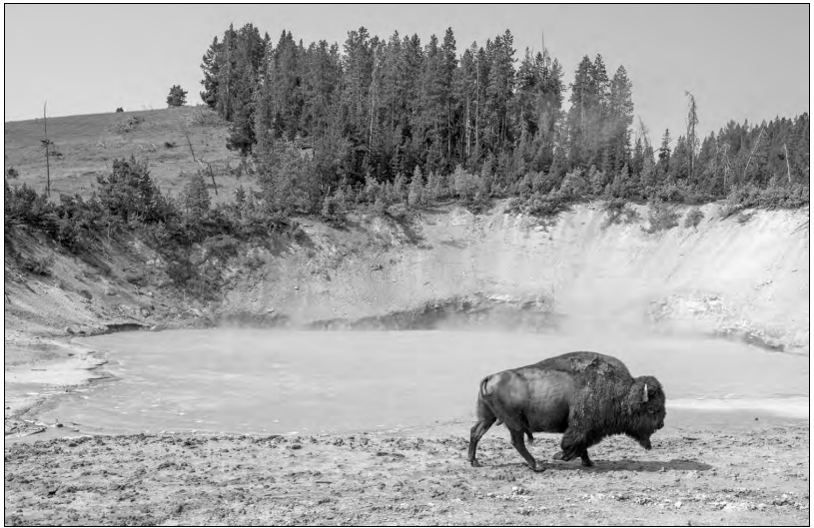
4. Will Yellowstone have an eruption? Scientists read the magma to find out.
黄石公园会喷发吗？岩浆可以给你答案。

Slide 17
Text Completion
The Washington Post (January 3, 2025 A3)
With its famous hot springs and gushing geysers, Yellowstone is one the most iconic national parks in the country and _________ (astonish) millions of visitors every year.
Those awe-inspiring sights are thanks to the magma ______ (bury) miles beneath the surface, part of one of the world’s largest active volcanic systems. _____ exactly the magma is stored there — and therefore, how it would erupt — has been a mystery.
Now, scientists have used advanced techniques ______ (find) the answers to some of these questions. ____ volcanic eruption is unlikely to occur at Yellowstone National Park because of the magma formations underneath, according to research published in the journal Nature on Wednesday, and the ____________ (concentrate) of volcanic activity will be shifting northeast.
Two types of magma exist under the park. One is basaltic magma, ______ triggers most volcanic activity on Earth. It erupts more easily because it has a lower resistance to flow, but underneath Yellowstone, it’s dense and buried deep in the Earth’s crust. So it’s unlikely to erupt.
Rhyolitic magma, on the other hand, is much thicker and _____________ (resistant) to flow. Underneath Yellowstone, basaltic magma heats the surrounding rock to help create this kind of magma in the Earth’s upper crust.
The study’s finding that volcanic activity is shifting is _____ scientists would expect, Klemetti Gonzalez said, as the North American plate continues _______ (inch) to the west-southwest over the volcanic hot spot underneath. However, Bennington said, it’s unlikely to affect visitors’ experience in our lifetimes.
astonishes
buried
How
to find
A
concentration
which
more resistant
what
inching

Slide 18
Vocabulary
1. trigger: ~ sth (off)to make sth happen suddenly 发动；引起；触发
Stress may act as a trigger for these illnesses.
压力也许是引发这些疾病的一个原因。有人呼吁工会保持克制。
2. dense: difficult to see through 浓密的；浓重的
Lobell drove on and on through the dense and blowing snow.
洛贝尔迎着浓密、纷飞的雪花不停地开车。
Translation
坚果可以引起严重的过敏反应。
Nuts can trigger off a violent allergic reaction.
Translation
森林的一些地方仍然茂密不可进入。
Parts of the forest are still dense and inaccessible.

Slide 19
Translation
A volcanic eruption is unlikely to occur at Yellowstone National Park because of the magma formations underneath, according to research published in the journal Nature on Wednesday, and the concentration of volcanic activity will be shifting northeast.
根据周三发表在《自然》杂志上的一项研究，由于地下的岩浆形成，黄石国家公园不太可能发生火山喷发，火山活动的集中将向东北转移。
The study’s finding that volcanic activity is shifting is what scientists would expect, Klemetti Gonzalez said, as the North American plate continues inching to the west-southwest over the volcanic hot spot underneath.
克莱梅蒂·冈萨雷斯说，研究发现，火山活动正在发生变化，这是科学家们所预料到的，因为北美板块继续向西-西南缓慢移动，越过下面的火山热点。

Slide 20

5. BBC News 01/03/2025

Slide 21

Dictation
Israel’s former Minister of Defense Yoav Gallant, had _______ from parliament. He said the most urgent goal of the ongoing war was to bring back the Israeli hostages still held by Hamas. He also ________ the government’s failure to enlist ultra Orthodox Jews into the military. Mr. Gallant is wanted by the International Criminal Court for alleged war crimes.
The Palestinian Authority has _________ broadcast by the Qatari news network Al Jazeera in the occupied West Bank, accusing it of stirring strife. The authority has been angered by the network’s ________ of clashes between Palestinian security forces and other armed groups in Jenin. Israel banned Al Jazeera last May.
The Israeli military has issued an _________ order for the remaining residents in Jabalia in northern Gaza ahead of an imminent strike. It said it was ____________ continued rocket fire from the area. The New Year began with intense Israeli airstrikes across Gaza, which the Civil Defense Agency says killed more than 20 people.
A Tesla cyber truck has exploded outside the ________ of the Trump Tower in the U.S. gambling resort of Las Vegas, killing one person inside the vehicle and injuring 7 others. More details from Peter Bowes.
“The police say smoke started coming from the electric vehicle after it ________ outside the Trump Hotel. It exploded shortly afterwards, killing the driver. In a post on X, Tesla’s boss Elon Musk said the blast was caused by very large fireworks and/or a bomb being carried in the truck and was unrelated to the vehicle itself. The police are yet to _______ the cause, but investigators say given that it involved a cybertruck and the Trump Hotel, many questions remain to be answered. Elon Musk is a close ____ of Donald Trump, the president-elect who is a part owner of the hotel.”
resigned
criticized
suspended
coverage
evacuation
in response to
entrance
pulled up
confirm
ally

Slide 22
Vocabulary
1. strife: angry or violent disagreement between two people or groups of people 冲突；争斗；倾轧
The boardroom strife at the company is far from over.
公司董事会的明争暗斗还远没有结束。
2. imminent: (especially of sth unpleasant) likely to happen very soon
（尤指不愉快的事）即将发生的；临近的
They warned that an attack is imminent.
他们警告袭击即将发生。
Translation
金钱是造成很多婚姻不和的一个主要原因。
Money is a major cause of strife in many marriages.
Translation
眼前似乎没有危险。
There appeared no imminent danger.

Slide 23
Translation
The Israeli military has issued an evacuation order for the remaining residents in Jabalia in northern Gaza ahead of an imminent strike. It said it was in response to continued rocket fire from the area. The New Year began with intense Israeli airstrikes across Gaza, which the Civil Defense Agency says killed more than 20 people.
在即将到来的空袭之前，以色列军方对加沙北部贾巴利亚的剩余居民发布了撤离令。以色列称这是对该地区持续发射火箭弹的回应。新年伊始，以色列对加沙进行了猛烈的空袭。民防局称这次空袭造成20多人死亡。
The police say smoke started coming from the electric vehicle after it pulled up outside the Trump Hotel. It exploded shortly afterwards, killing the driver. In a post on X, Tesla’s boss Elon Musk said the blast was caused by very large fireworks and/or a bomb being carried in the truck and was unrelated to the vehicle itself.
警方表示，这辆电动汽车在特朗普酒店外停车后就开始冒烟。汽车不久后爆炸，导致司机死亡。特斯拉老板埃隆·马斯克在X上发帖称，爆炸是由卡车上携带的大量烟花和/或炸弹引起的，与车辆本身无关。

