Slide 1


感恩遇见，相互成就，本课件资料仅供您个人参考、教学使用，严禁自行在网络传播，违者依知识产权法追究法律责任。
更多教学资源请关注
公众号：溯恩英语
知识产权声明

Slide 2
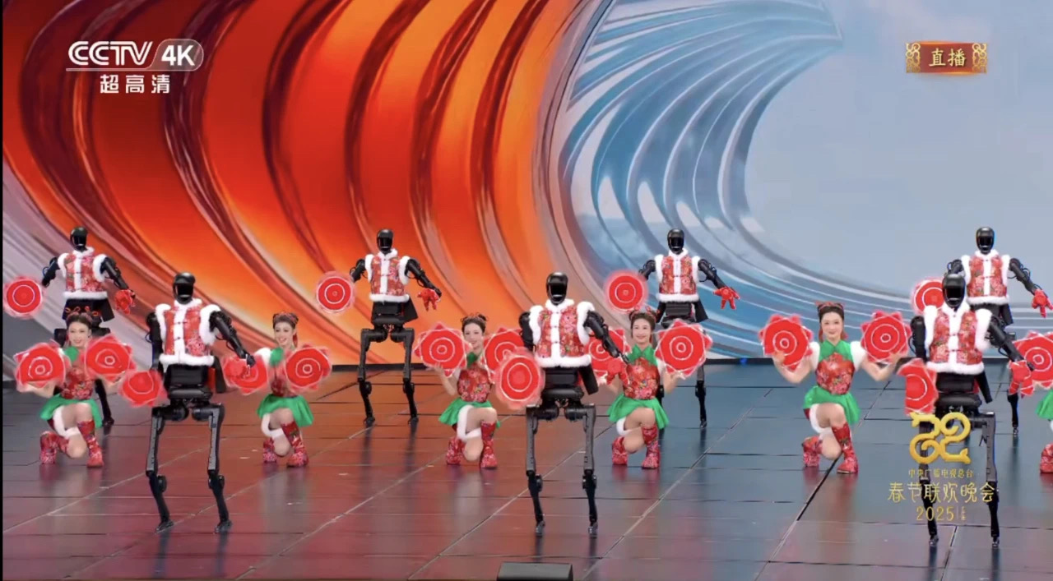
The First Lesson in 2025
When
Traditional Culture meets Modern Technology

Slide 3
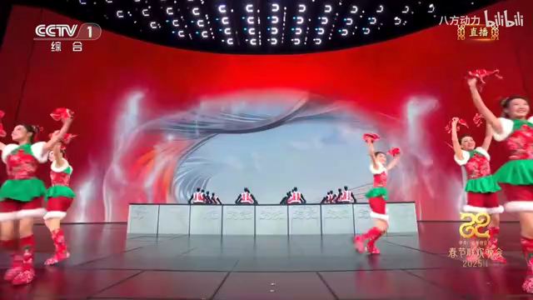
1.What did you see in the video?
Robots were dancing Yangko
2.How do you feel about the performance?
Traditional dance combines with modern technology

Slide 4

3.Can you think of other examples where tradition meets technology ?
Vocabulary Building：
Tradition,innovation, technology, artificial intelligence (AI), robotics, intangible cultural heritage (非遗), fusion(融合）, creativity, restore(修复）,revive（复兴）
Sentence：
eg. The fusion of tradition and technology creates something unique.
AI brings paper cutting to life

Slide 5
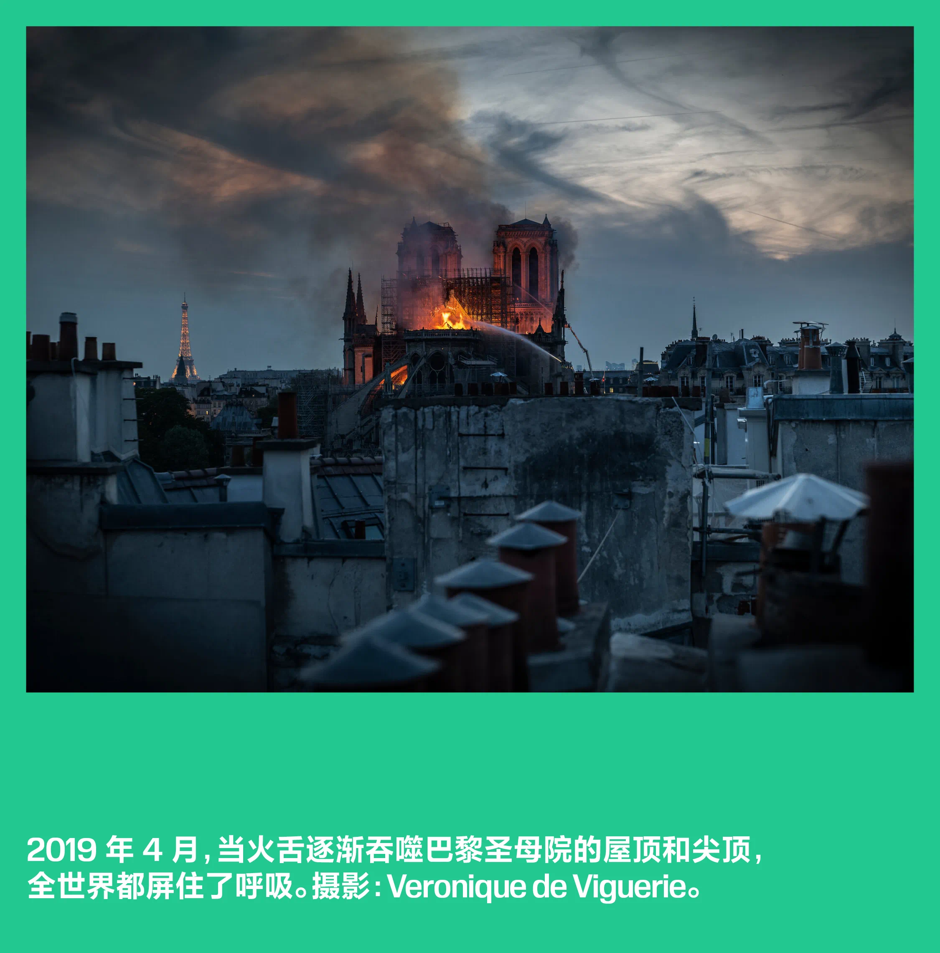
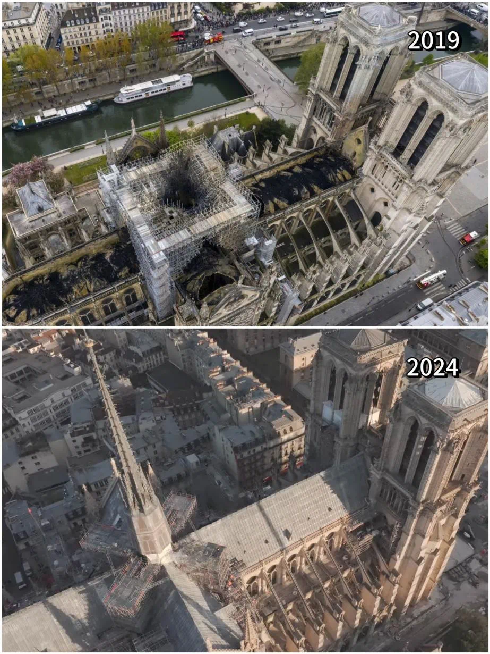
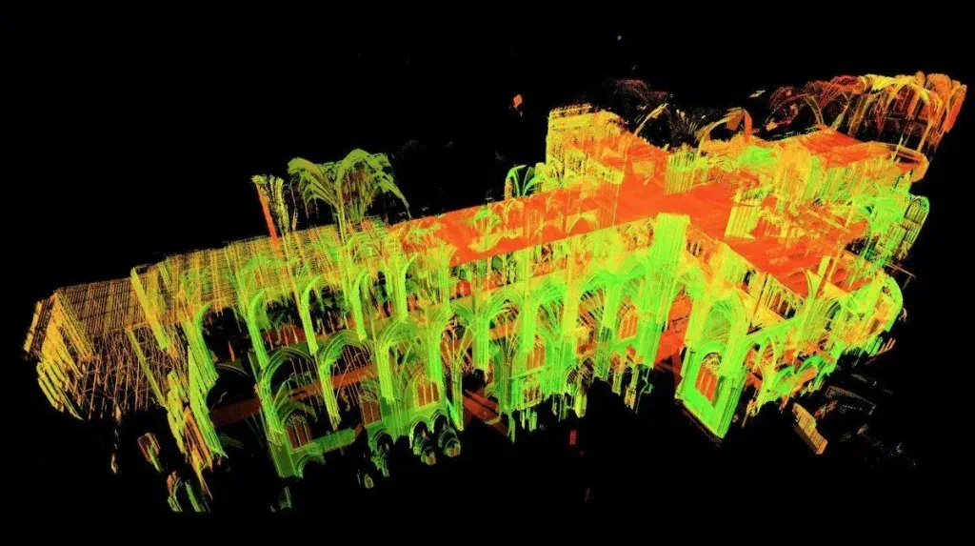
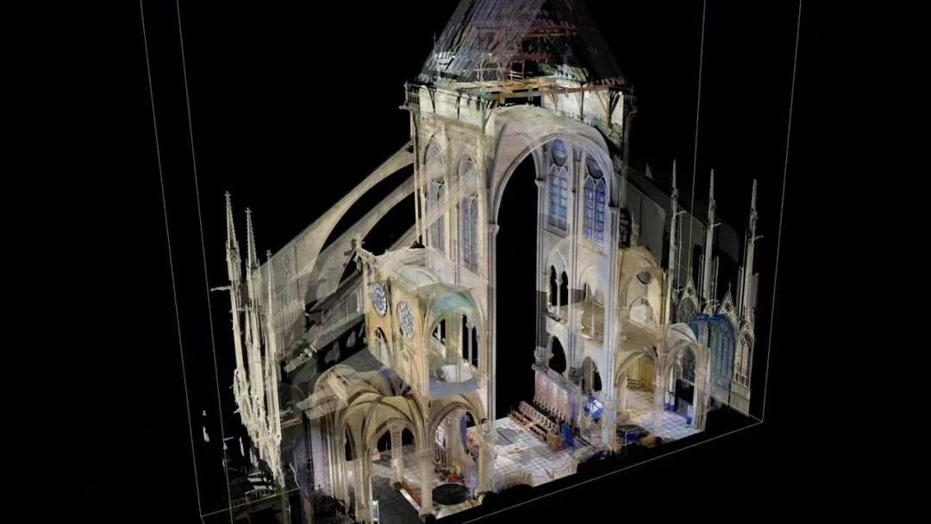
4.What can we depend on largely to make it possible?
3D Scanning &Modeling Technology

Slide 6
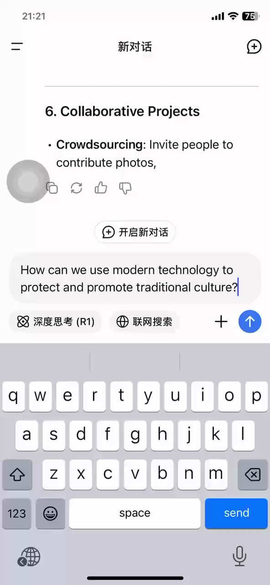
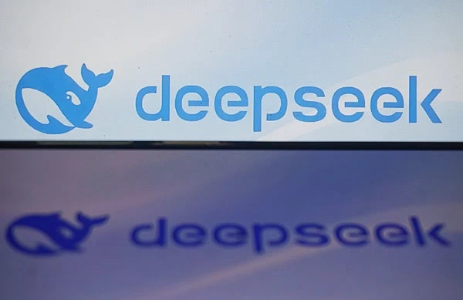
5. How can we use modern technology to protect and promote traditional culture?
Can we use modern technology to help us answer the question?

Slide 7
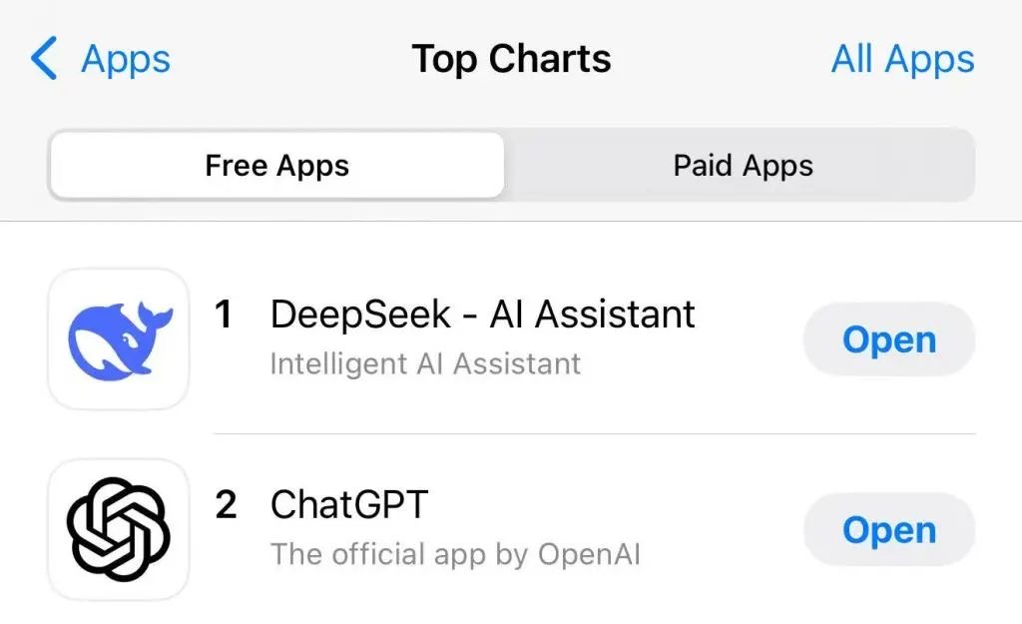
Know more about Deepseek
DeepSeek, ____1___(found) in July 2023, is a Chinese AI startup that develops open-source large language models (LLMs). DeepSeek ____2_______(increase) to the top of the free app download charts in the United States region of the Apple App Store so far, surpassing the once-dominant ChatGPT.
Unlike traditional methods____3_____ rely heavily on supervised fine-tuning, DeepSeek's models learn by interacting with their environment and ____4____(receive) feedback on their actions, similar to_____5___ humans learn through experience. This allows them___6______ (develop ) more sophisticated reasoning abilities and adapt __7___ new situations more_____8____ (effective).
Venture capitalist Marc Andreessen posted on X: “Deepseek R1 is one of the most amazing and impressive ____9_______(breakthrough） I’ve ever seen — and as open source, __10___ profound gift to the world.”
founded
has increased
that/which
receiving
how
to develop
to
effectively
breakthroughs
a

Slide 8
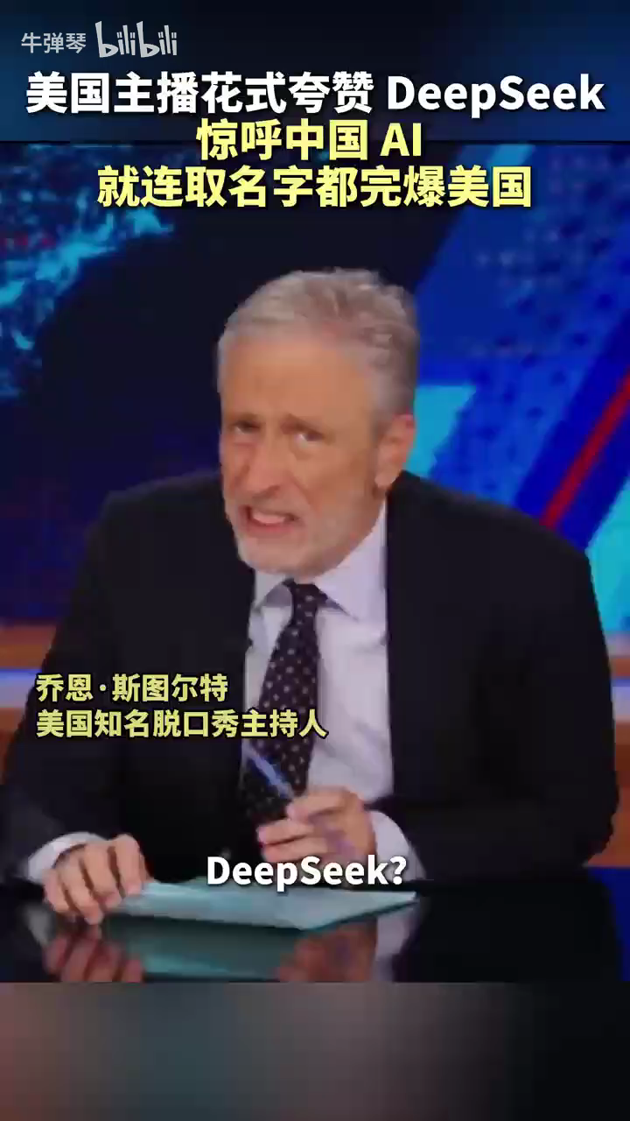
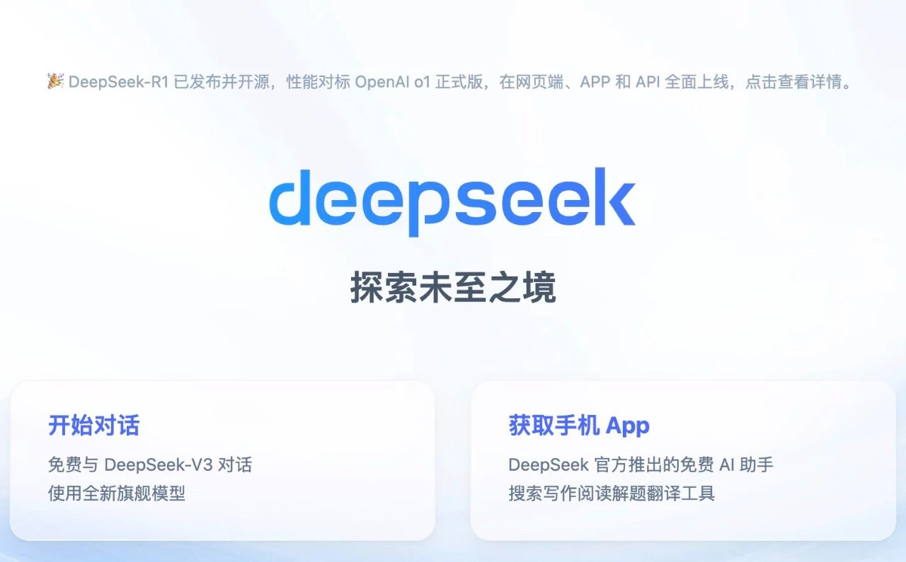
How can we translate Deepseek more accurately to attract more users ?
VS

Slide 9
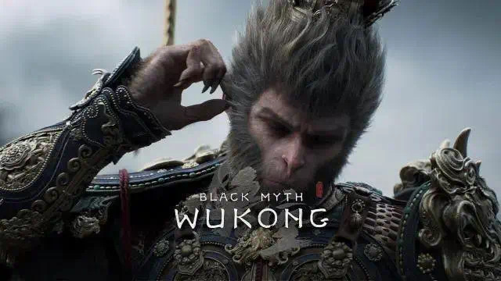
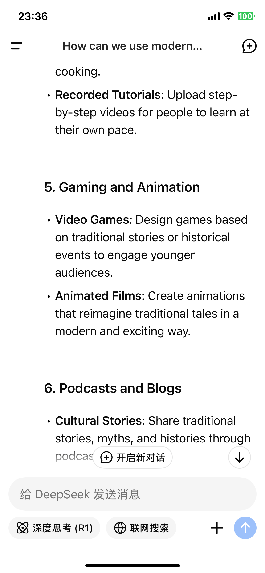
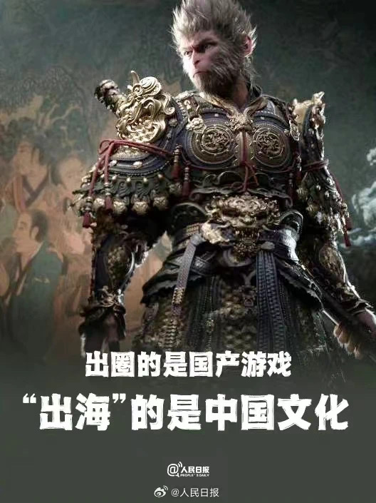
Recall：How can we use modern technology to protect and promote traditional culture?
The success of the game owes a lot to the selection of Wukong – the monkey king hero from the classic Chinese novel Journey to the West – _____ the game’s hero.The appeal of traditional culture and the ________ (apply) of modern video techniques are working ______(wonder).
as
application
wonders
What comes to your mind in terms of animated film?

Slide 10

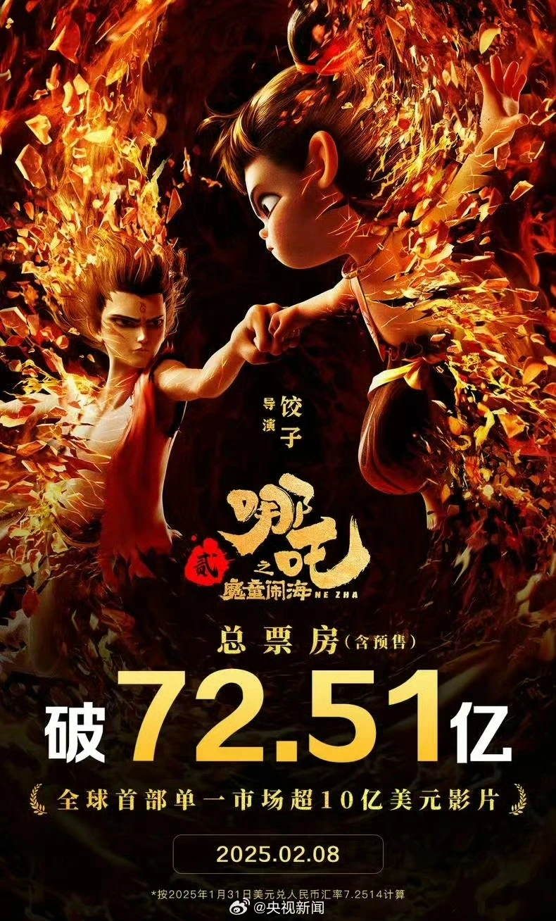
Listen & Think
Why does Nezha 2 become so successful ?
Five years ago, "Nezha: The Demon Child's Descent" achieved a _________ miracle of _________yuan and sparked a wave of Chinese animated films with its high praise from __________. Five years later, "Ne Zha: The Demon Child Stirs Sea" returns with a more vivid story and stunning scenes, sparking nationwide discussion.
The success of “Ne Zha 2” is a ________ of the rise of Chinese animated films. In recent years, Chinese animated films have maintained _____________ and entered a period of rapid development.
In terms of _______________, from large-scale fight scenes to architecture with________ aesthetic(美学） styles, and character portrayals, “Ne Zha 2” surpasses its predecessor, showcasing the high level of Chinese animation production and providing audiences with an immersive _________________. From 21世纪英文报
box office
5 billion
audiences
reflection
high popularity
visual production
Eastern
viewing technology

Slide 11
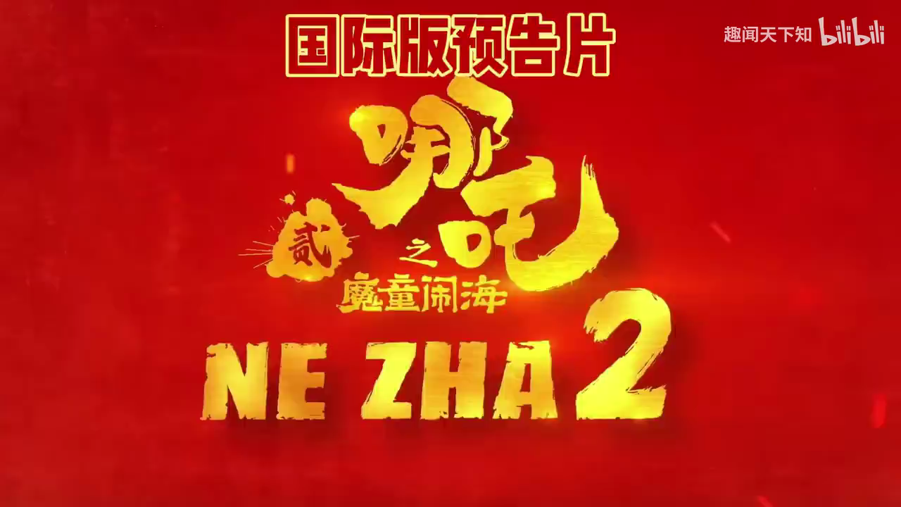
Watch &Think
How does the movie blend traditional Chinese mythology with modern animation technology?
Because it combines traditional Chinese mythology with modern animation technology by using advanced CGI (computer-generated imagery) and visual effects to bring ancient stories to life. Additionally, the movie includes traditional Chinese art styles, such as ink painting and calligraphy, into the background and special effects, creating a unique visual experience that honors the past while embracing the future.

Slide 12
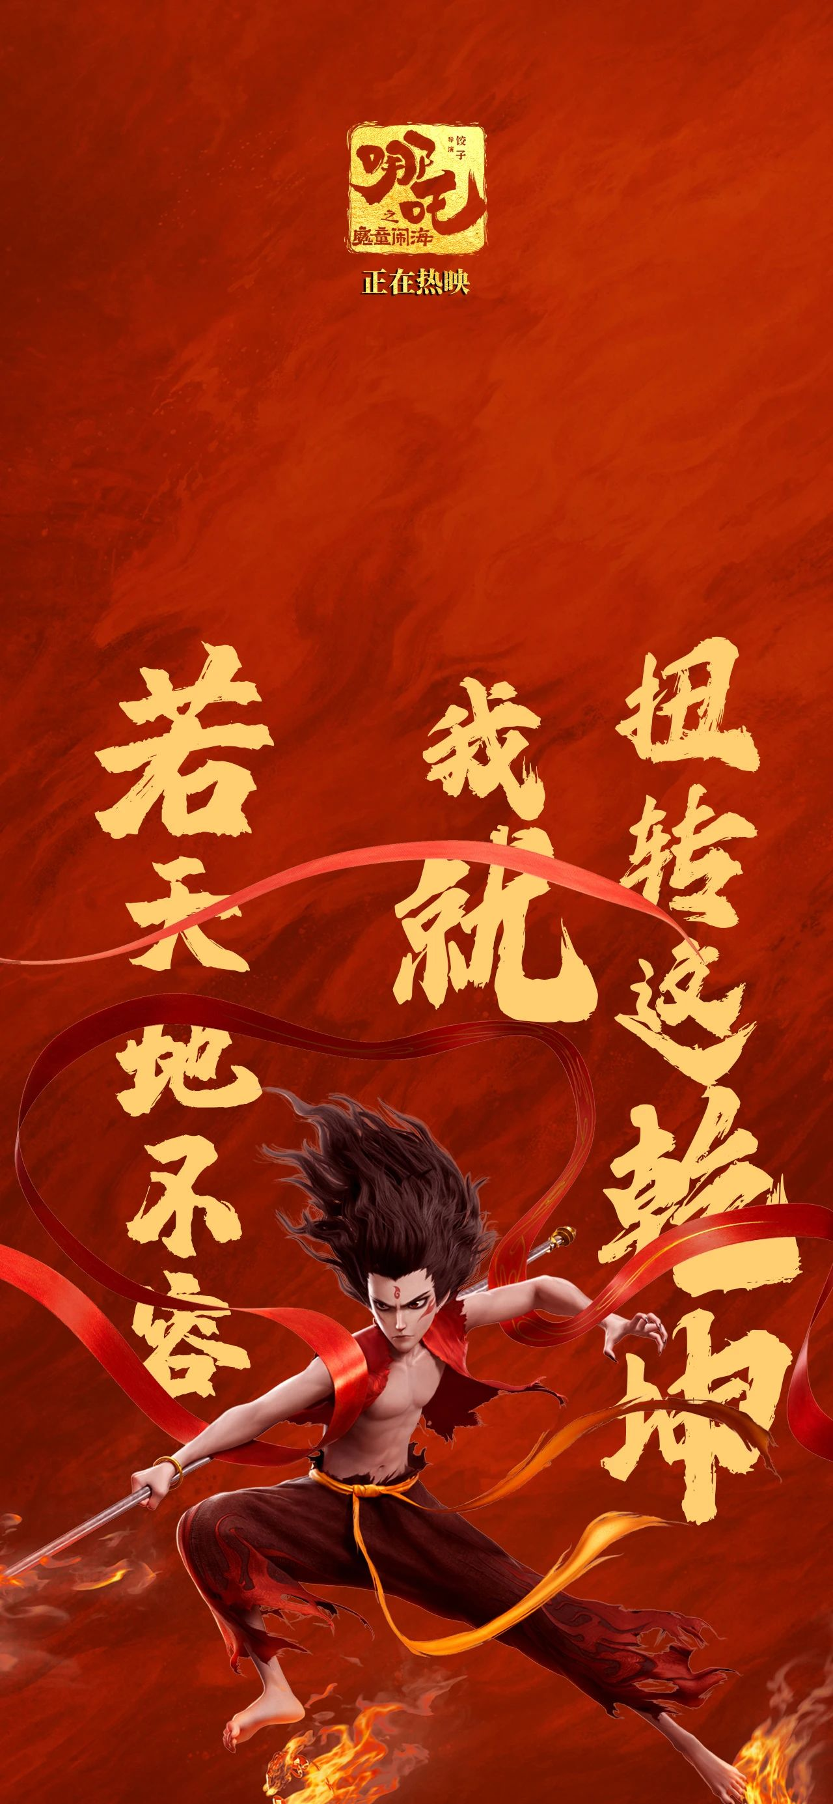
Share&Translation
Which line from the movie impresses you most ?
若前方无路，我便踏出一条路。若天理不容，我便逆转这乾坤。
If there is no way ahead, I will carve out a path. If the world won't tolerate me, I will reverse the order of the universe.
我若成佛，天下无魔；我若成魔，佛奈我何。
If I become a Buddha, there will be no demons in the world. If I become a demon, what can Buddha do to me?

Slide 13
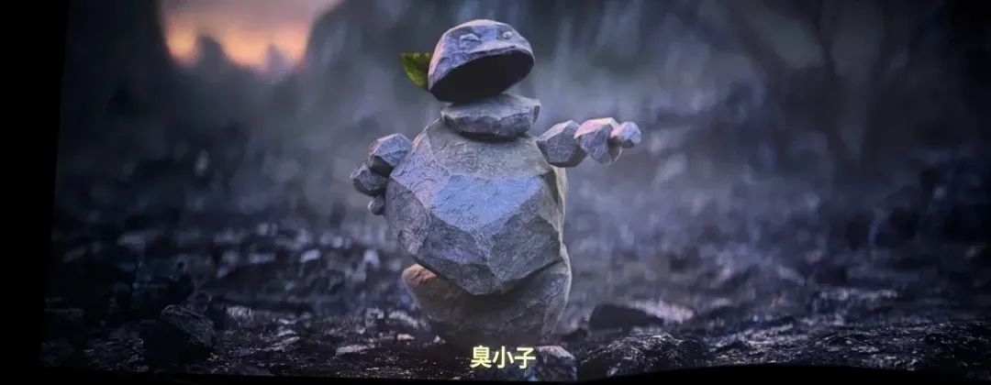
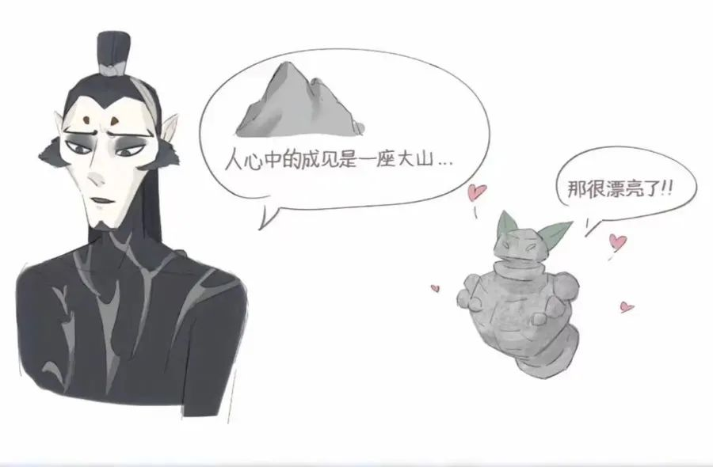
留得青山在， 不怕没柴烧
As long as the green hills are there, one need not worry about firewood.
Where there is a life, there is a hope.
The prejudice in people's hearts is like a huge mountain, no matter how hard you try, you can't move it.

Slide 14
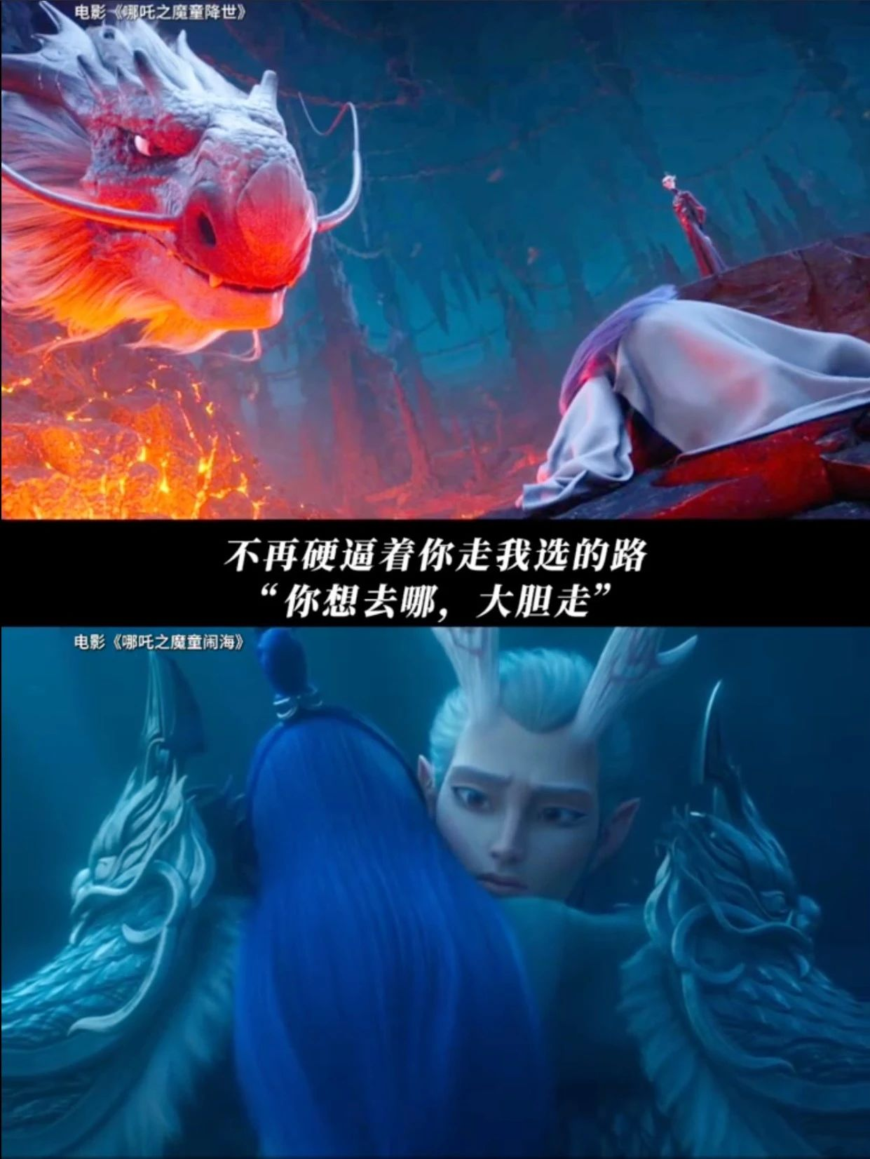
父辈的经验毕竟是过往，未必全对，你的路还需你去闯。
The experiences of our parents’ generation are, after all, a thing of the past and may not necessarily be entirely right.
Your path has to be forged by yourself. From now on, stay true to yourself.

Slide 15
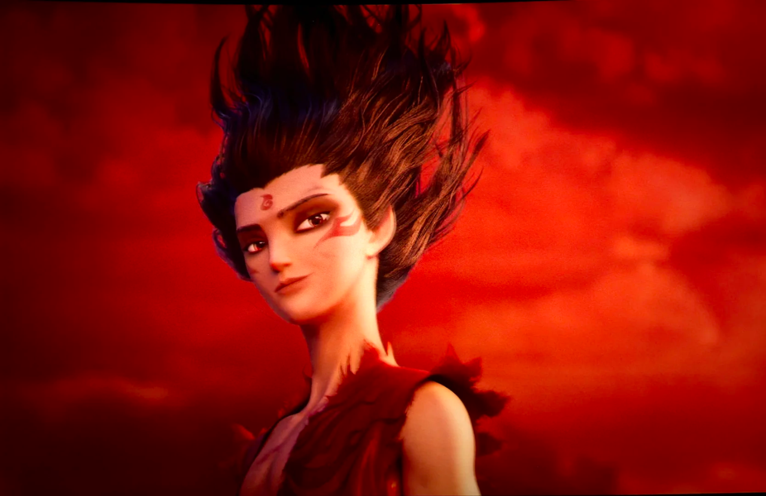
Do you actually want to change the world?
You just want to try.
Because you are still young and don't know your limits.

Slide 16
Homework
假设你是李华，你校英文报正在举办以“科技与传统文化的融合”为主题的征文活动。请你写一篇短文投稿，内容包括：
1. 科技在保护与推广传统文化中的作用；
2. 结合具体例子（如春晚机器人扭秧歌、DeepSeek技术或电影《哪吒2》）；
3. 你对科技与传统文化融合的看法。
注意：
1. 词数80左右；
2. 可以适当增加细节，以使行文连贯。

Slide 17
One possibleSample
When Traditional Culture meets modernTechnology
In today’s fast-paced world, technology plays a crucial role in preserving and promoting traditional culture.
For instance, during the Spring Festival Gala, robots performed the traditional Yangko dance, blending ancient art with modern robotics. This not only attracts younger generations but also showcases cultural heritage in an innovative way. Additionally, AI technologies like DeepSeek help digitize and analyze historical artifacts, making them accessible to a global audience. Movies such as "Nezha 2" also demonstrate how animation and CGI can bring ancient myths to life, making them more engaging for people worldwide.
In my opinion, the fusion of technology and tradition is essential for cultural preservation. It not only protects our heritage but also inspires creativity and innovation. By embracing technology, we can ensure that traditional culture remains vibrant and relevant for future generations.

