Slide 1


感恩遇见，相互成就，本课件资料仅供您个人参考、教学使用，严禁自行在网络传播，违者依知识产权法追究法律责任。
更多教学资源请关注
公众号：溯恩英语
知识产权声明

Slide 2




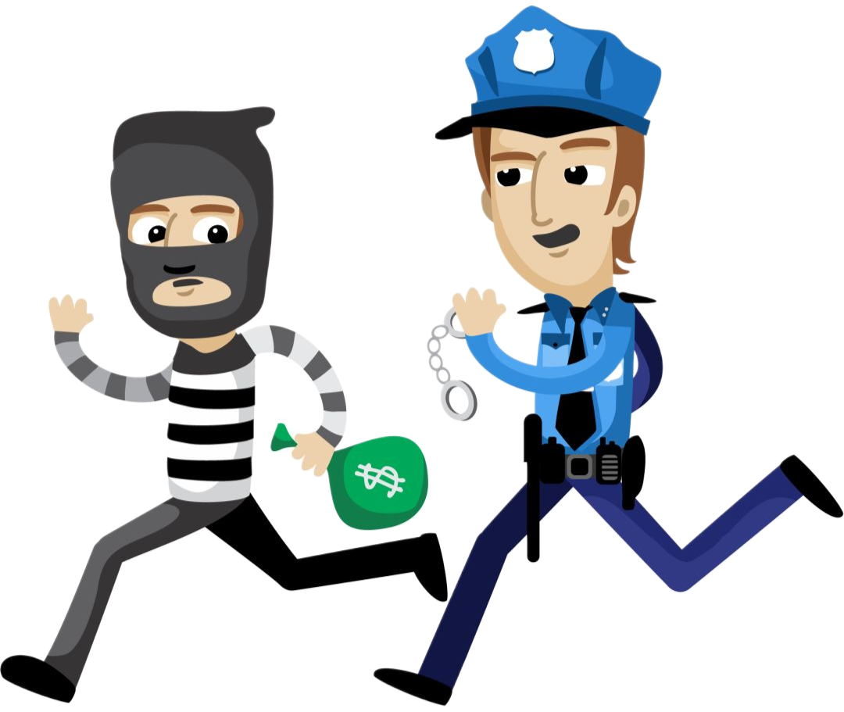

山重水复“续”有路，读析“写”评又一村
a thief …
杭州二中树兰高级中学 郭合英

Slide 3

文本解读(读)
搭建支架(析)
Learning objectives
建构语言(写)
作品点评(评)

Slide 4
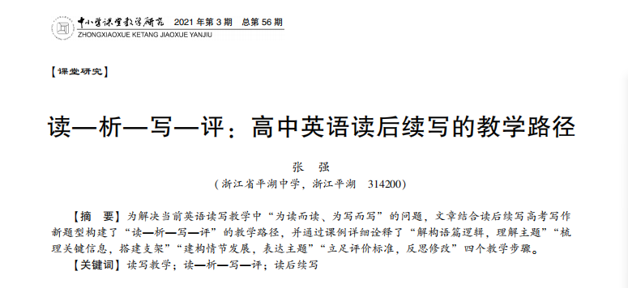
该篇续写的理论依据：读—析—写—评
为解决当前英语读写教学中 “为读而读、 为写而写” 的问题，文章结合读后续写高考写作新题型构建了 “读—析—写—评” 的教学路径， 并通过课例详细诠释了 “解构语篇逻辑， 理解主题” “梳理关键信息，搭建支架” “建构情节发展，表达主题” “立足评价标准， 反思修改” 四个教学步骤。

Slide 5
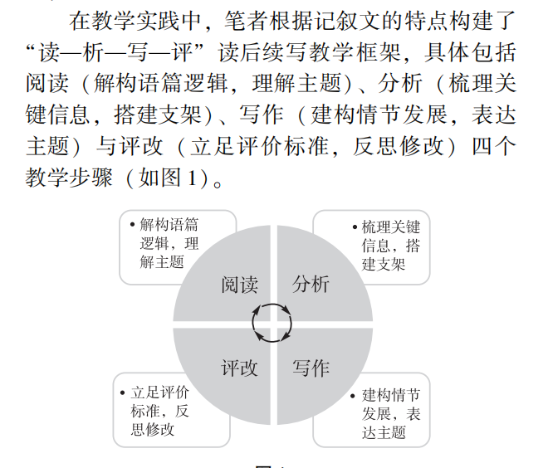
阅读
分析
评改
写作

Slide 6

1
文本解读(读)
阅读：解构语篇逻辑，
理解主题

Slide 7
文本解读
第二节（满分25分）
阅读下面材料，根据其内容和所给段落开头语续写两段，使之构成一篇完整的短文。
Kevin was pretty bored. His mother was at work, and his father had been away on business. Therefore, he was left in the care of Mrs. Hill, an old lady who lived next door. His parents had raised the 12-year-old to be a good boy. He never got into trouble, though sometimes he wanted to do risky things. Mrs. Hill was asleep. Kevin sighed (叹息) and hoped something exciting would happen. Suddenly, a movement outside caught his eye.
Mrs. Hill’s front window faced Mr. and Mrs. Green’s house across the street. The couple had both gone to work, so it was strange that someone was over there. Kevin stared at the man at their front door. Suddenly, the man jumped through an open window into the house. With his heart in his mouth, Kevin grabbed Mrs. Hill’s home phone and called the police.
Thinking that the man might get away with whatever he wanted before the police arrived, Kevin decided to do something. He rushed out of Mrs. Hill’s house and crossed the street quickly. Grabbing a branch from a cut-down tree, he jumped in through the window. “Stop right there! You must leave right now!” he called out, holding the branch with both hands.

Slide 8
The man froze for a second, but when he saw the skinny boy he breathed a sigh of relief. “Hey, kid, put that down. It was my home. My parents used to live here and my father’s watch was here,” he explained, trying to lift a floorboard.
At that moment, the sounds of a police car echoed (回响) in the air. The man stood up in a panic, then ran through the house toward the window and jumped out. Kevin followed out and told the arriving police officers what had happened. They pursued and arrested the man.
Kevin went back to Mrs. Hill’s house. Somehow he wasn’t sure he had done the right thing. “What if he has told the truth?” he thought to himself. The man’s words sounded pretty convincing.
注意：
1．续写词数应为150左右；
2．请按如下格式在答题卡的相应位置作答。
Paragraph 1: When Mr. and Mrs. Green got home, Kevin went to talk to them.
Paragraph 2: Kevin and Mr. Green took the watch they had found to the police station.

Slide 9
Step1: Skimming (5W1H)
Kevin and his parents, Mrs. hill, Mr. and Mrs. Green,
the man
Is the man a thief ?
how
who
Kevin thought that the man might get away with whatever he wanted before the police arrived.
in Mr. and Mrs, Green’s house
why
Elements of
the story
where
Mrs. Hill was asleep. Kevin hoped something exciting would happen.
Kevin found the man jumped through an open window into Mr. and Mrs Green’s house.
when
what

Slide 10
Step 2: Summarizing the main idea
Kevin’s parents were wrapped up in their own business, therefore, he was left
1 (take) after by his neighbour, Mrs. Hill. Kevin was always feeling
2 (bore), hoping something exciting would happen.
Mrs. Hill’s front window faced Mr. and Mrs. Green’s house across the street. The couple 3 (go) to work. Suddenly, Kevin found a man jumping through an open window into the house. 4 his heart in his mouth, Kevin grabbed Mrs. Hill’s phone and called the police. Thinking that the man might escape 5 the police arrived, Kevin decided to do something. 6 (grab) a branch, he jumped in through the window, ordering the man to stop and leave right now. However, the man said his parents 7 (use) to live here and his father’s watch was here.
At that moment, the sounds of a police car echoed in the air. The man ran through the window in 8 panic. Kevin told the police 9 (officer) what had happened. They pursued and arrested the man. Somehow Kevin wasn’t sure he had done the right thing because the 10 (man) words sounded pretty convincing.
to be taken
bored
had gone
With
before
Grabbing
used
a
officers
man’s

Slide 11
2
搭建支架(析)
分析：梳理关键信息，
搭建支架

Slide 12

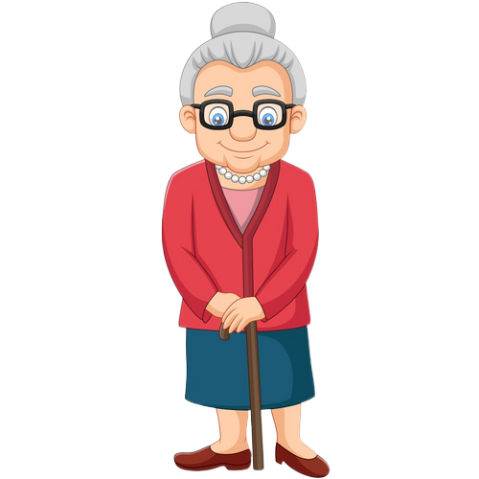


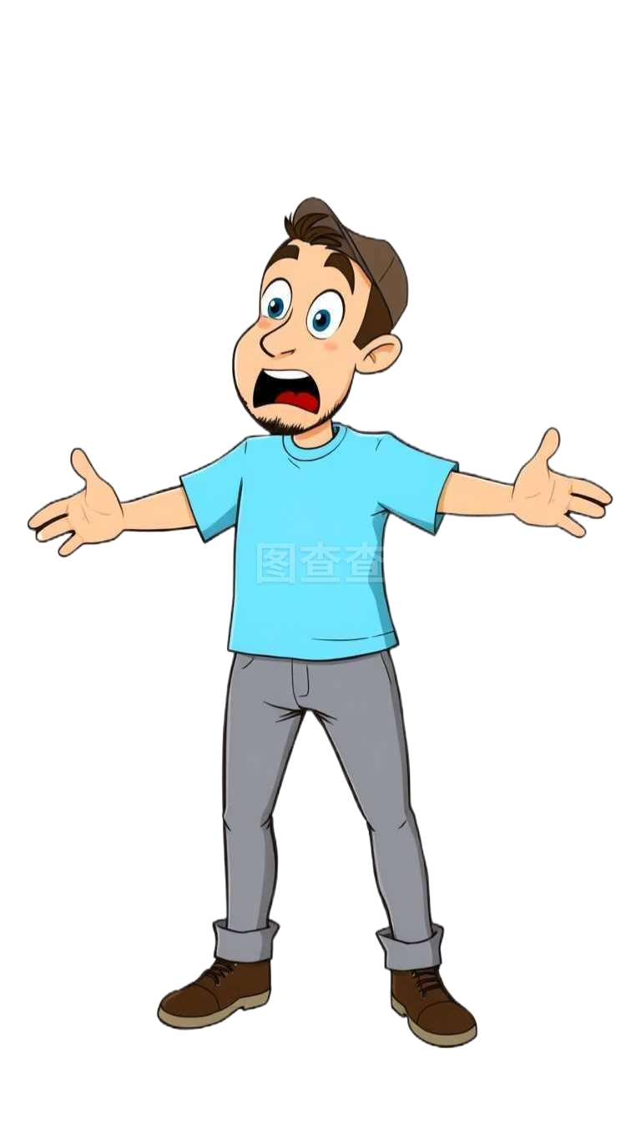
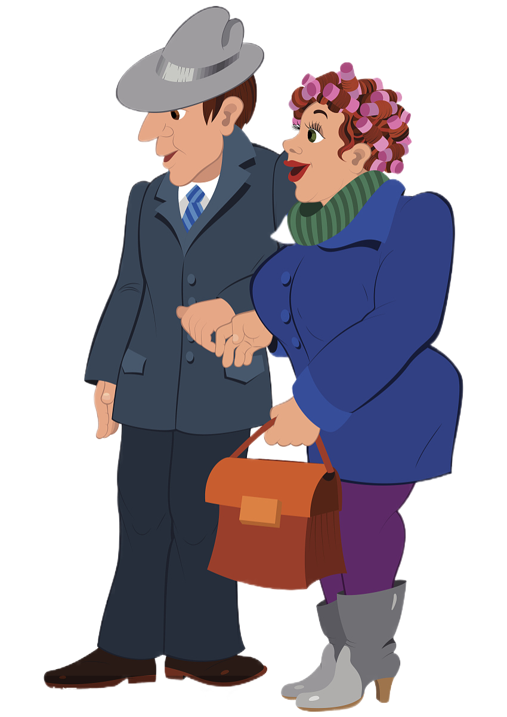
Step 3: 构建人物关系图
parents-son
neighbour
Parents were busy with their own things.
主要人物：Kevin
Mrs. Hill
Kevin was looked after by Mrs. Hill
Mrs. Hill’s front window faced Mr. and Mrs. Green’s house across the street.
Kevin’s parents
police-public
由此可知：
此人为原房主的儿子
原文线索：It was my home. My parents used to live here and my father’s watch was here,” he explained…
neighbour
Kevin
neighbour
In Kevin’s opinion, the man was a thief, so he called the police.
The man jumped into Mr. and Mrs. Green’s house through the open window.
stranger
Mr. and
Mrs. Green
policeman
a man

Slide 13
Step 4: 根据契诃夫发则，挖掘矛盾
Kevin was pretty bored. … Kevin sighed (叹息) and hoped something exciting would happen. Suddenly, a movement outside caught his eye.
故事的伏笔：希望激动人心的事发生。
Mrs. Hill’s front window … so it was strange that someone was over there. Kevin stared at the man at their front door. Suddenly, the man jumped through an open window into the house. … Kevin grabbed Mrs. Hill’s home phone and called the police.
故事的起因：看到一个陌生人从窗户跳
入格林家并报警。
… Kevin decided to do something. … Grabbing a branch from a cut-down tree, he jumped in through the window. …
故事的发展：在警察没来之前，Kevin采取了措施。

Slide 14
It was my home. My parents used to live here and my father’s watch was here,” he explained, trying to lift a floorboard.
这个人所说的话如果是真的，那么这个人就是原房主的儿子，他回来拿父亲遗落的手表也无可厚非，只是他这种的“破窗而入”的方式让Kevin 认为他是“小偷”。
故事的高潮：警车响起，“小偷”逃跑，
警察追赶逮住小偷。
警察逮住小偷，故事看似圆满。但如果忽略细节就会失去与原文的协同。让我们继续出发寻求线索。
… the sounds of a police car echoed. The man … ran through … the arriving police officers pursued and arrested the man.
为故事转折设下伏笔：
Kevin开始动摇之前的想法，认为那个人也许不是个小偷。
…Somehow he wasn’t sure he had done the right thing. “What if he has told the truth?” The man’s words sounded pretty convincing.
注意：
1．续写词数应为150左右；
2．请按如下格式在答题卡的相应位置作答。
Paragraph 1: When Mr. and Mrs. Green got home, Kevin went to talk to them.
Paragraph 2: Kevin and Mr. Green took the watch they had found to the police station.
推断故事的结局：
1.那个人是小偷吗？
2.那块手表是谁的？

Slide 15

思考：Is that man a thief？
原文线索 1
原文线索 2
原文线索 3
这篇续写可谓 “险象环生”、“环环有套”，稍不注意就会落入命题人设置的圈套，让你误以为那个人是小偷。但只要我们睁大眼睛，遵循协同原则，认真分析，就会找到一条解决问题的方法，正所谓：
…but when he saw the skinny boy he breathed a sigh of relief. “Hey, kid, put that down.
Somehow he wasn’t sure he had done the right thing. “What if he has told the truth?” The man’s words sounded pretty convincing.
Kevin and Mr. Green took the watch they had found to the police station.
山重水复“续”有路，读析“写”评又一村
这也是唯一验证这个男人是不是小偷的证据了。
如果这个男人是小偷，看到瘦骨嶙峋的Kevin一定会伤害，但他没有，说明他不是小偷。
此段的作用就是让故事来个欧亨利式的反转。可谓：山重水复疑无路，柳暗花明又一村。
Mr. Green带上这块从地板下面找到的手表去警察局（根据协同可知），他要将它还给原房主的儿子。

Slide 16

思考：What is the function of this sentence?
文章没有交代原因，也许是这个男人急于给父母一个惊喜，等不及the Greens夫妇回来，刚好窗户开着，就迫不及待破窗而入了。
可是，这个男人为什么要 “破窗而入”去Mr Green家拿手表呢？
这句话是故事发展的催化剂。正是这个男人“破窗而入”的方式，让Kevin认为这个男人是小偷，才会打电话报警，才有了后面故事的发展。
Suddenly, the man jumped through an open window into the house.

Slide 17
Step 5 : 利用原文线索，搭建“性格”支架
Kevin sighed and hoped something exciting would happen.
challenging
With his heart in his mouth, Kevin grabbed Mrs. Hill’s home phone and called the police.
sharp
Kevin decided to do something. He rushed out of Mrs. Hill’s house and crossed the street quickly. Grabbing a branch from a cut-down tree, he jumped in through the window.
brave
Somehow he wasn’t sure he had done the right thing. “What if he has told the truth?” he thought to himself. The man’s words sounded pretty convincing.
considerate

Slide 18
Step 6: 利用逆推法，搭建故事支架
Paragraph 1: When Mr. and Mrs. Green got home, Kevin went to talk to them.
Kevin told them what had happened.
What did Mr. and Mrs. Green say and do after hearing the story?
Mr Green found the watch from a floorboard.
此句既协同Kevin所说的又呼应下文。
呈上
Paragraph 2: Kevin and Mr. Green took the watch they had found to the police station.
启下
主旨升华：Kevin的善良、勇敢和心思缜密。
Why did Mr Green take the watch to the police station ?
What did Mr Green say to the police?
Was the man set free?

Slide 19
Step 7 : 利用故事走向，推测Kevin的心理活动
The Greens found the watch from the floorboard.
惊讶与自责
Kevin and Mr. Green took the watch they had found to the police station.
着急与担心
After the truth was clarified, the man was released.
欣慰与释怀
Although there was a misunderstanding, he received praise and thanks from the police, the man, and the Green couple.
自豪与开心

Slide 20
3
建构语言(写)
写作：学生基于讨论后的续写思路，列出续写的细节要点。

Slide 21
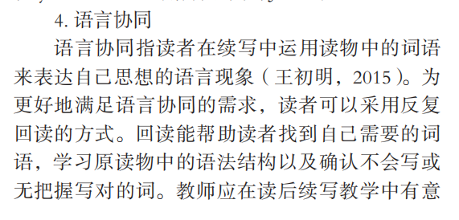
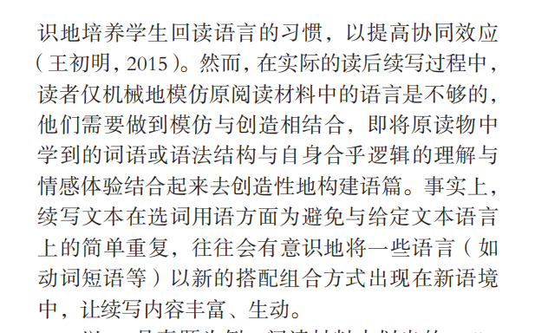
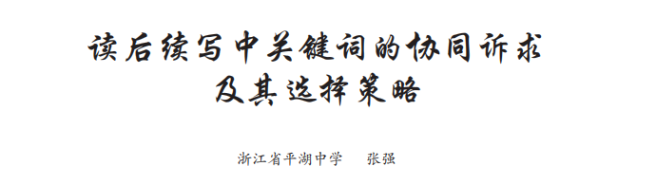
Step 8: 根据原文语言特色，建构语言
模仿语言
创造语言
模仿语言
创造语言

Slide 22
Step 7: 根据原文语言特色，建构语言
第二节（满分25分）
阅读下面材料，根据其内容和所给段落开头语续写两段，使之构成一篇完整的短文。
Kevin was pretty bored. His mother was at work, and his father had been away on business. Therefore, he was left in the care of Mrs. Hill, an old lady who lived next door. His parents had raised the 12-year-old to be a good boy. He never got into trouble, though sometimes he wanted to do risky things. Mrs. Hill was asleep. Kevin sighed (叹息) and hoped something exciting would happen. Suddenly, a movement outside caught his eye.
Mrs. Hill’s front window faced Mr. and Mrs. Green’s house across the street. The couple had both gone to work, so it was strange that someone was over there. Kevin stared at the man at their front door. Suddenly, the man jumped through an open window into the house. With his heart in his mouth, Kevin grabbed Mrs. Hill’s home phone and called the police.
Thinking that the man might get away with whatever he wanted before the police arrived, Kevin decided to do something. He rushed out of Mrs. Hill’s house and crossed the street quickly. Grabbing a branch from a cut-down tree, he jumped in through the window. “Stop right there! You must leave right now!” he called out, holding the branch with both hands.
同位语+定语
无灵表达
it作形式主语
with的复合结构
非谓语

Slide 23
非谓语
The man froze for a second, but when he saw the skinny boy he breathed a sigh of relief. “Hey, kid, put that down. It was my home. My parents used to live here and my father’s watch was here,” he explained, trying to lift a floorboard.
At that moment, the sounds of a police car echoed (回响) in the air. The man stood up in a panic, then ran through the house toward the window and jumped out. Kevin followed out and told the arriving police officers what had happened. They pursued and arrested the man.
Kevin went back to Mrs. Hill’s house. Somehow he wasn’t sure he had done the right thing. “What if he has told the truth?” he thought to himself. The man’s words sounded pretty convincing.
注意：
1．续写词数应为150左右；
2．请按如下格式在答题卡的相应位置作答。
Paragraph 1: When Mr. and Mrs. Green got home, Kevin went to talk to them.
Paragraph 2: Kevin and Mr. Green took the watch they had found to the police station.
宾语从句
定语从句

Slide 24

Step 7: 根据原文语言特色，建构语言
Paragraph 1: When Mr. and Mrs. Green got home, Kevin went to talk to them.
(与给出句的衔接)他把事情的经过绘声绘色地向Mr. and Mrs. Green描述了一番。
He described the whole process to Mr. and Mrs. Green in a vivid and lifelike manner.
语言特色：绘声绘色地

Slide 25
Step 7: 根据原文语言特色，建构语言
Paragraph 1: When Mr. and Mrs. Green got home, Kevin went to talk to them.
在听了Kevin的描述之后，格林夫妇很是惊讶并向Kevin表示感谢。
With Kevin’s description over, the Greens’ jaws dropped and thanked him a thousand and one times.
语言特色：with的复合结构+习语表达+夸张

Slide 26
Step 7: 根据原文语言特色，建构语言
Paragraph 1: When Mr. and Mrs. Green got home, Kevin went to talk to them.
kevin自豪地说不用谢，但同时也表达了自己的怀疑-他不确定这个男人说的是否属实。
Kevin said no thanks with pride, but at the same time he expressed his doubts as well - he wasn’t sure whether the man was telling the truth.
语言特色：原文语言产出

Slide 27
Step 7: 根据原文语言特色，建构语言
Paragraph 1: When Mr. and Mrs. Green got home, Kevin went to talk to them.
当Mr Green夫妇把Kevin所说的细节拼在一起的时候，他们环顾四周，确定家里未丢任何东西。
When the Greens pieced together the details Kevin had mentioned, they looked around, confirming that nothing had been stolen from the house.
语言特色：定语从句 + 非谓语

Slide 28
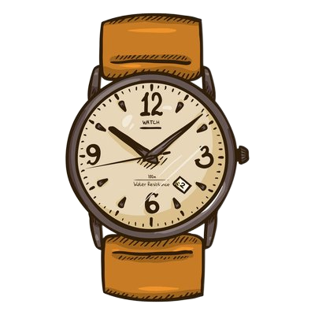
Step 7: 根据原文语言特色，建构语言
Paragraph 1: When Mr. and Mrs. Green got home, Kevin went to talk to them.
于是，他们决定按照Kevin所说的去验证一下地板下面是否真的有手表（与原文协同）。
So, they decided to check if there was really a watch as Kevin had said.
语言特色：宾语从句

Slide 29
Step 7: 根据原文语言特色，建构语言
Paragraph 1: When Mr. and Mrs. Green got home, Kevin went to talk to them.
令在场所有人惊讶的是，他们在地板下面真的找到了一块手表。
Surprise came over everyone who was on the spot. They really found a watch just lying under the floor.
语言特色：无灵表达 + 定语从句 + 现分作定

Slide 30
Step 7: 根据原文语言特色，建构语言
Paragraph 1: When Mr. and Mrs. Green got home, Kevin went to talk to them.
经过格林夫妇反复确认，这块手表真的不是他们的，这足以说明那个男人不是小偷。
Repeatedly confirmed by Mr. and Mrs. Green, the watch was really not theirs, which was enough to show that the man was not a thief.
语言特色：过分做状 + 定语从句 + 宾语从句

Slide 31
Step 7: 根据原文语言特色，建构语言
Paragraph 1: When Mr. and Mrs. Green got home, Kevin went to talk to them.
Kevin意识到自己冤枉了人，这让他感到自责。他急切地请求格林夫妇带上这块手表去警察局说明真相。（带上手表与下文给出句协同）
Self-accusation visited Kevin, who realized he had done wrong to the man. He eagerly asked the Greens to go to the police station with the watch to tell the truth.
语言特色：无灵表达 + 定语从句 + 原文语言
+ 呼应下文给出句（协同）

Slide 32
Step 7: 根据原文语言特色，建构语言
Paragraph 2: Kevin and Mr. Green took the watch they had found to the police station.
他们向警察说明了情况，并把手表交给了警察。警察联系了前房东并仔细核对了手表的细节特征。
They explained everything to the police and handed over the watch. The police contacted the former landlord, checking carefully the details concerning the watch.
语言特色：非谓语

Slide 33
Step 7: 根据原文语言特色，建构语言
Paragraph 2: Kevin and Mr. Green took the watch they had found to the police station.
所有的细节都和那个男人交代的一模一样。难怪他一直向警察说自己是无辜的。
All the details were exactly the same as what the man had stated. No wonder he had been telling the police that he was innocent.
语言特色：宾语从句

Slide 34
Step 7: 根据原文语言特色，建构语言
Paragraph 2: Kevin and Mr. Green took the watch they had found to the police station.
警察把手表还给了男人，释放了他，但也警告他拿回自己的东西一定要通过正当的方式切不可“破窗而入” 。
The police returned the watch to the man, released him, and warned him that he must get back his own property through proper means and that he shouldn’t “break into the house through the window”.
语言特色：动作链 + 宾语从句

Slide 35
Step 7: 根据原文语言特色，建构语言
Paragraph 2: Kevin and Mr. Green took the watch they had found to the police station.
看到男人被释放，kevin终于松了一口气。感到欣慰的同时他也不好意思地走上前去向这个男人道歉。
Seeing the man released, Kevin finally breathed a sigh of relief. At the same time, he also walked up to the man awkwardly to apologize to him.
语言特色：非谓语

Slide 36
Step 7: 根据原文语言特色，建构语言
Paragraph 2: Kevin and Mr. Green took the watch they had found to the police station.
令人感到意外的是，这个男人不仅没有责怪Kevin，反而夸他勇敢、善良。格林先生也拍着Kevin的肩膀，在他面前竖起了大拇指。
Surprisingly, the man didn’t blame Kevin, but praised him for his bravery and kindness. Mr. Green also patted Kevin on the shoulder, giving him a thumb up before him.
语言特色：非谓语

Slide 37
Step 7: 根据原文语言特色，建构语言
Paragraph 2: Kevin and Mr. Green took the watch they had found to the police station.
听到他们的表扬，kevin异常的开心，他觉得正是自己的勇敢和考虑周到让他做了正确的事情。
Hearing their praise, Kevin was over the moon, feeling that it was his bravery and consideration that led him to do the right thing.
语言特色：非谓语 + 强调句

Slide 38
4
作品点评(评)
点评： 教师在点评时要引导学生体验作品中涌现出来的亮点， 让生在自己作为读者的真实体验中培养写作的读者意识。

Slide 39
原创作品
给出句与续写句衔接自然
When Mr. and Mrs. Green got home, Kevin went to talk to them. He described the whole process to Mr. and Mrs. Green in a vivid and lifelike manner. With Kevin’s description over, the Greens stood jaw-dropped, thanking him a thousand and one times. Kevin said no thanks with pride, but at the same time he expressed his doubts as well - he wasn’t sure whether the man had told the truth. When the Greens pieced together the details Kevin had mentioned, they looked around, confirming that nothing had been stolen from the house. So, they decided to check if there was really a watch as Kevin had said. Surprise came over everyone who was on the spot. They really found a watch just lying under the floor. Repeatedly confirmed by Mr. and Mrs. Green, the watch was really not theirs, which was enough to show that the man was not a thief. Surprise and self-accusation visited Kevin, who realized he had done wrong to the man. He eagerly asked the Greens to go to the police station with the watch to tell the truth.
格林夫妇听到真相后的反应
这些都为男人不是
小偷做了铺垫
带上手表去警局，这呼应下文的给出句

Slide 40
原创作品
给出句与续写句衔接自然（They呼应Kevin和格林先生）
进一步证实了这个男人
不是小偷
Kevin and Mr. Green took the watch they had found to the police station. They explained everything to the police and handed over the watch. The police contacted the former landlord, checking carefully the details concerning the watch. All the details were exactly the same as what the man had stated. No wonder he had been telling the police all the time that he was innocent.The police returned the watch to the man, released him, and warned him that he must get back his own property through proper means and that he shouldn’t “break into the house through the window”. Seeing the man released, Kevin finally breathed a sigh of relief. At the same time, he also walked up to the man awkwardly to apologize to him. Surprisingly, the man didn’t blame Kevin, but praised him for his bravry and kindness. Mr. Green also patted Kevin on the shoulder, giving him a thumb up before him. Hearing their praise, Kevin was over the moon, feeling that it was his bravery and consideration that led him to do the right thing.
首尾呼应：
开头：Kevin总想让一件激动人心的事情发生。
结尾：激动人心的事情发生了。Kevin庆幸是自己的勇敢和考虑周到让自己做了件正确的事情。
警察对这个男人不正当的“破窗而入”行为进行了批评。
Kevin因自己的“误会”
向男人道歉。
呼应主题：表扬Kevin的勇敢和善良。

Slide 41
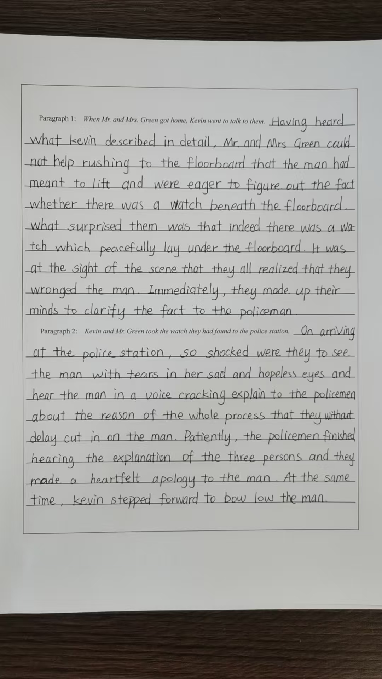
原创作品
给出句与续写句衔接自然
呼应原文：he explained, trying to lift a floorboard.
为男人不是小偷做了铺垫。
与下文的衔接有些不妥, 建议改成：they determined to clarify the fact to the policeman with the watch.

Slide 42
原创作品
her 改为his
in a cracking voice explaining
呼应原文；这个男人不是小偷。
结尾处倘若能加一两句升华，
内容会更丰满。

Slide 43
改为proud更符合当时的心情
与给出句衔接自然
学生作品（李秉骋）
呼应男人说的话，暗示男人不是小偷
When Mr. and Mrs. Green got home, Kevin went to talk to them. With a trembling voice, Kevin began to describe everything that had just happened. Hearing the man’s claim about the watch， Mr. Green’s brows knitted tightly in deep thought, murmuring, “We did buy this house from an old couple. Perhaps the man had been telling the truth all along.” Down sank Kevin’s heart, as if it had been plunged into an icy river. “Let’s open the mystery under the floorboard .” Mr. Green suggested. Then they lifted the loose floorboard. There, tucked away in a dusty corner like a forgotten secret, was an old box. Inside it was a silver watch, its hands frozen in time. Kevin, staring at it, felt his guilt welling up like a surging wave. Gently patting his shoulder, Mrs. Green said, “Thank you for protecting our home, Kevin. How brave you are!” But her words did little to assuage his guilt. Determined, they prepared to return the watch.
Kevin的心情由“骄傲”到“下沉”，暗示着他可能冤枉那个男人。
呼应下文的给出句

Slide 44
续写句与给出句衔接自然
呼应男人说的话(这房子之前属于他父母的)
Kevin and Mr. Green took the watch they had found to the police station. Only after they had made their fingers to the bones to explain the situation to the officers did the truth come to light. It turned out that the man was none other than the son of the previous owners. Desperate as he was to retrieve his father’s watch, he had to take such a rash act. Out came the police, warning him before setting him free. Before leaving, the man gave Kevin a thumbs up and praised him for his bravery. A strange mixture of relief and embarrassment washed over Kevin like a wave. It was Mr. Green who smiled at him, saying “It is your good intentions that matter, kid.” Nodding his head, Kevin realized that even mistakes could serve as a stepping stone to learning, and that bravery can take countless forms. On the surface, Kevin had misunderstood the man, but in fact, his actions made the light of justice shine.
写出了男人“破窗而入”的原因
警察对于男人的“破窗而入”给予警告
主旨升华：对Kevin正义的肯定。

Slide 45


