Slide 1


感恩遇见，相互成就，本课件资料仅供您个人参考、教学使用，严禁自行在网络传播，违者依知识产权法追究法律责任。
更多教学资源请关注
公众号：溯恩英语
知识产权声明

Slide 2

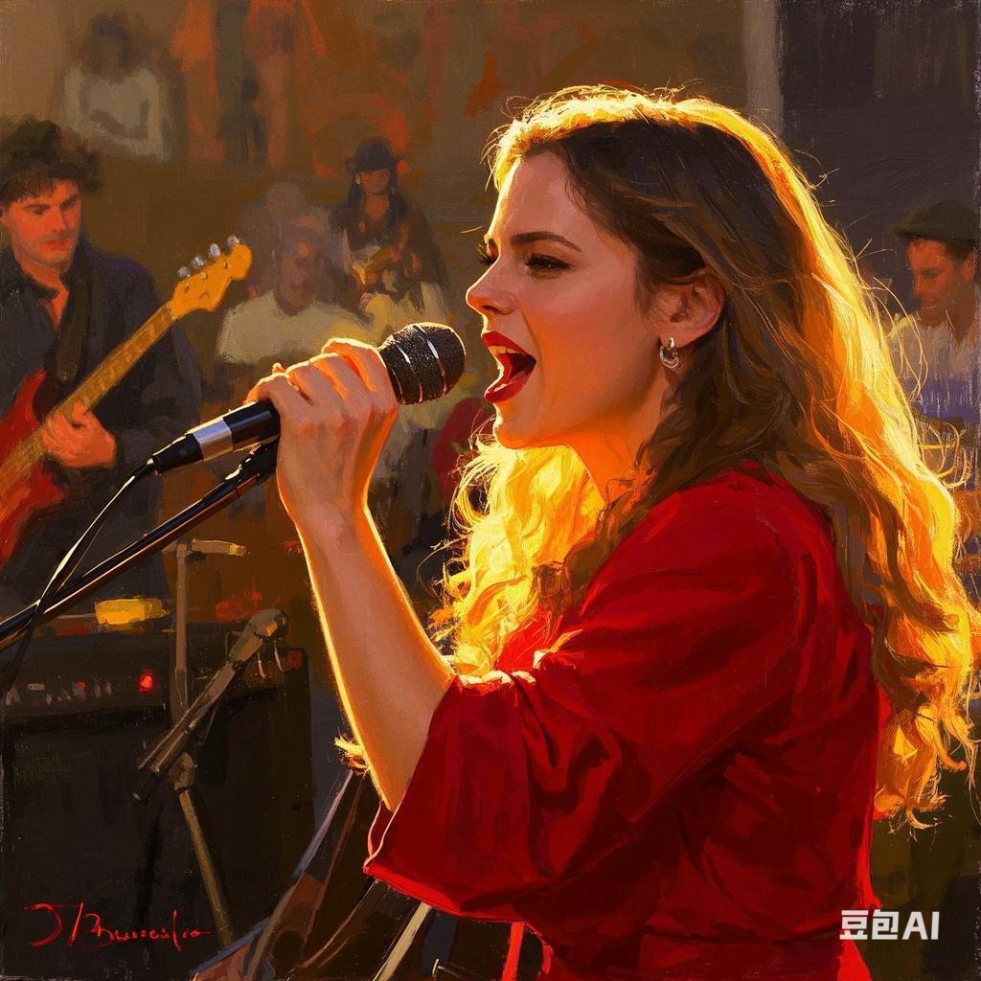
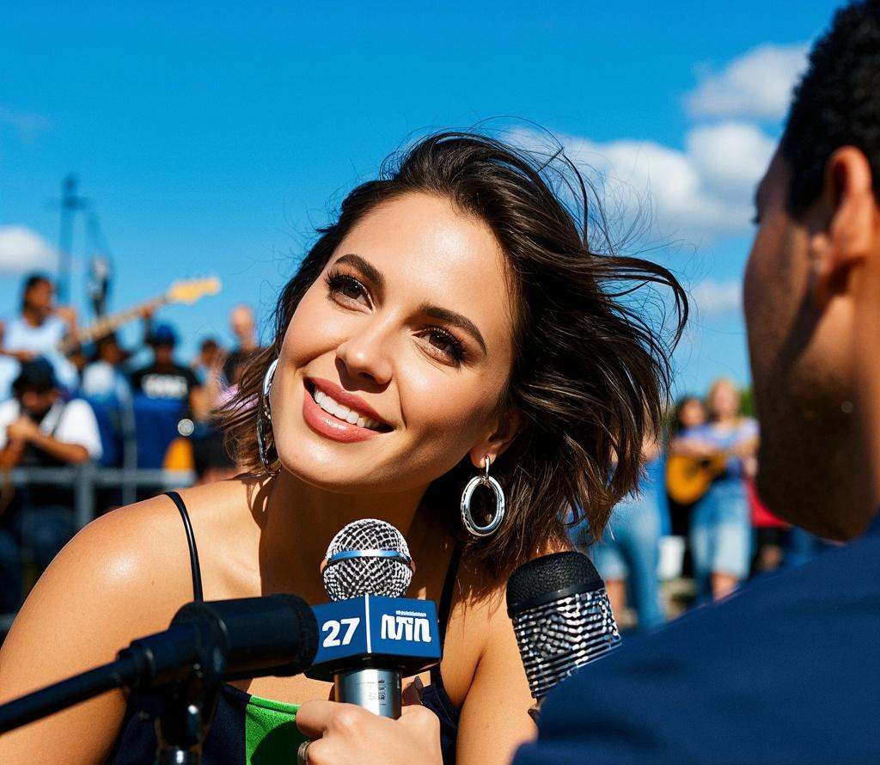
宁波九校高二期末读后续写
Dream Goes On
采用侧面描写：
次要人物和环境烘托手法
Judyliu

Slide 3
I spent 15 years trying to make it in the music industry. When I was a teenager, I did any odd job to afford time in a recording studio. I knocked at managers’ doors and sent out demo (录音样带) after demo. but I got nowhere. In 2010, aged 27, I was doing a job in a restaurant when I wrote a song called Dream Goes On. It was a song about never giving up. I just let out all of my frustrations at the keyboard.
Over the next five years, the music career was never realized but I persisted. Then, in 2019, I uploaded Dream Goes On to a music-sharing website. I just wanted someone to notice my music.
Later that year, I received an email out of the blue(突然地) from Music World from South Korea requesting a license for the song. They had chosen my song from the millions on the music-sharing website for a theme tune for one of their shows. I was amazed and negotiated a contract for $5,000 for the use of the song and signed up straight away. I was pretty excited, but didn't think anything more would come of it so I focused on my job in the restaurant
This February, Music World organized a musical festival in Seoul and my song Dream Goes On was also chosen as the theme tune for the festival. I watched on YouTube as my song was being played to a huge crowd of people. It was amazing.
After three days of the festival, I was contacted by Music World and they asked if I'd like to go to Seoul to sing Dream Goes On in a concert, They flew me out there the next day. I was welcomed like a celebrity.-everyone I met thought I was a big name in England. I had to tell them that I wasn't a pop star.
P1 :I had never performed the song live, and hadn't been on stage for years.
P 2:After the concert, I had photographers and journalists battling to interview me.

Slide 4
记叙文要素
Time | This February: Music World organized a musical festival in Seoul; the author was invited to sing in a concert
Place | P1:South Korea (Seoul for the musical festival and concert) P2: not specified
Characters | The author (a musician trying to make it in the music industry)，reporters, audience
Main plots | The author spent 15 years struggling in the music industry without success, but then suddenly got opportunities from a foreign company after uploading a song online.
Emotional Line: | Frustration: Spent 15 years trying to make it in the music industry but got nowhere. Amazed and excited: When receiving the email from Music World and negotiating the contract. Surprised: When being invited to Seoul to perform and being welcomed like a celebrity. Nervous (implied in P1 as never performing the song live and not being on stage for years): Before the concert. Overwhelmed: After the concert with photographers and journalists battling to interview.
theme | Perseverance in the face of long - term failure, as demonstrated by the author in the music industry, can lead to unexpected success,

Slide 5
读原文 找出找出前文伏笔
找出前文伏笔
1动词短语
2名词短语
3 形容词
I spent 15 years trying to make it in the music industry. When I was a teenager, I did any odd job to afford time in a recording studio. I knocked at managers’ doors and sent out demo (录音样带) after demo. but I got nowhere. In 2010, aged 27, I was doing a job in a restaurant when I wrote a song called Dream Goes On. It was a song about never giving up. I just let out all of my frustrations at the keyboard.
Over the next five years, the music career was never realized but I persisted. Then, in 2019, I uploaded Dream Goes On to a music-sharing website. I just wanted someone to notice my music.
Later that year, I received an email out of the blue(突然地) from Music World from South Korea requesting a license for the song. They had chosen my song from the millions on the music-sharing website for a theme tune for one of their shows. I was amazed and negotiated a contract for $5,000 for the use of the song and signed up straight away. I was pretty excited, but didn't think anything more would come of it so I focused on my job in the restaurant
This February, Music World organized a musical festival in Seoul and my song Dream Goes On was also chosen as the theme tune for the festival. I watched on YouTube as my song was being played to a huge crowd of people. It was amazing.
After three days of the festival, I was contacted by Music World and they asked if I'd like to go to Seoul to sing Dream Goes On in a concert, They flew me out there the next day. I was welcomed like a celebrity.-everyone I met thought I was a big name in England. I had to tell them that I wasn't a pop star.
P1 :I had never performed the song live, and hadn't been on stage for years.
P 2:After the concert, I had photographers and journalists battling to interview me.

Slide 6
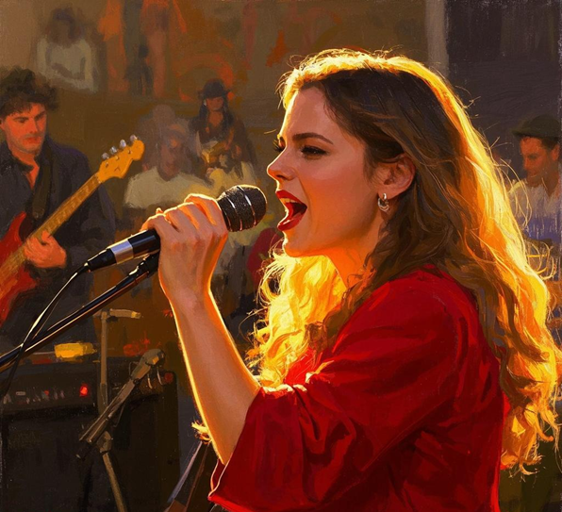
情节搭建
P1 :I had never performed the song live, and hadn't been on stage for years.
1 What kind of movements and emotional expressions did I have before I was on stage?
2 When I was on stage, did my singing go smoothly? What kind of emotions did I convey in my singing?
3 What were my movements, emotions and psychological activities when I sang?
4 And how did the audience react?
采用侧面描写：
次要人物和环境烘托手法

Slide 7
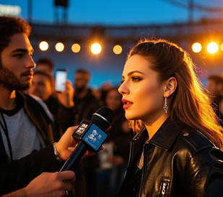
情节搭建
P 2:After the concert, I had photographers and journalists battling to interview me.
1 What questions did the journalists and photographers ask and act ?
2 How did I react when I heard these questions? How did I answer them?
3 How did the ending of the article echo the previous text and reflect the theme?
采用侧面描写：
次要人物和环境烘托手法

Slide 8

P1：I had never performed the song live, and hadn't been on stage for years.
.
情绪衔接
时间过渡+动作+情绪（紧张）
当上台的时刻越来越近，我的心在胸腔里疯狂跳动。站在后台，我能感觉到自己的双手在不受控制地颤抖。我不停地在衣服上擦着满是汗水的手掌，试图平复紧张的神经。我的双腿微微颤抖，我深吸了几口气，努力让自己镇定下来。
As the moment to step onto the stage approached, my heart was pounding wildly in my chest. Standing backstage, I could feel my hands shaking uncontrollably. I kept wiping my sweaty palms on my clothes, trying to calm my nerves. My legs trembled slightly, and I took several deep breaths, attempting to steady myself.

Slide 9
P1：I had never performed the song live, and hadn't been on stage for years.
.
时间过渡+场景描写（情境感）+心理活动（呼应前文）
当我终于走上舞台，聚光灯打在身上，一瞬间，我呆住了。但接着，音乐响起，我找到节奏，开始歌唱。随着旋律流淌，我仿佛一下子回到了 27 岁。
When I finally walked onto the stage, the spotlight hit me, and for a split second, I froze. But then, as the music started, I found my rhythm and began to sing. As the melody flowed, I was suddenly transported back in time to when I was 27.
此刻，在这个舞台上歌唱，我能感受到与那时相同的热情和决心。每唱出一个音符，我的信心便更增一分。
Now, as I sang on this stage, I could feel the same passion and determination I had back then. With each note, my confidence grew.

Slide 10
P1：I had never performed the song live, and hadn't been on stage for years.
环境烘托手法衬托表演成功（适当利用比喻夸张）
掌声如雷鸣般在音乐厅里回荡，撞击着墙壁，充盈着每一个角落。人们猛地站起身，双手用力鼓掌，仿佛永远不会停下。有些人把手指放进嘴里，大声吹着口哨，尖锐的声音划破空气。
The applause thundered through the concert hall, echoing off the walls and filling every corner. People leaped to their feet, their hands clapping so vigorously that it seemed as if they might never stop. Some were whistling loudly, their fingers in their mouths, creating sharp sounds that cut through the air.
旗帜和荧光棒在空中疯狂挥舞，形成一片五彩斑斓、起伏涌动的庆祝海洋。又仿佛空气中充满了电流，每一个分子都因兴奋和认可而振动。
Flags and glow sticks were waved wildly in the air, creating a colorful, undulating sea of celebration. It was as if the very air was charged with electricity, every molecule vibrating with excitement and approval.

Slide 11
Paragraph 2 : After the concert, I had photographers and journalists battling to interview me.
（次要人物衬托）
我站在那里，沐浴在聚光灯和成功的喜悦中，很快就被一群摄影师和记者团团围住。相机闪光灯不停闪烁，强光几乎让我睁不开眼。记者们相互推挤，把麦克风伸到我面前，急切地想要得到我的回应 。
As I stood there, bathed in the spotlight and the warm glow of success, I was quickly surrounded by a throng of photographers and journalists. Cameras flashed non-stop, the bright lights nearly blinding me. Reporters pushed and jostled each other, shoving their microphones in my face, eager to get a quote.

Slide 12
Paragraph 2 : After the concert, I had photographers and journalists battling to interview me.
采用侧面描写：次要人物和环境烘托手法
“能跟我们讲讲你创作这首歌的灵感来源吗？” 一名记者大声问道。“能给我讲讲这首歌背后的故事吗？” 另一名记者问道。
"Could you tell us about the inspiration behind your song?" one journalist shouted."Can you tell me the story behind this song?" another journalist asked.

Slide 13
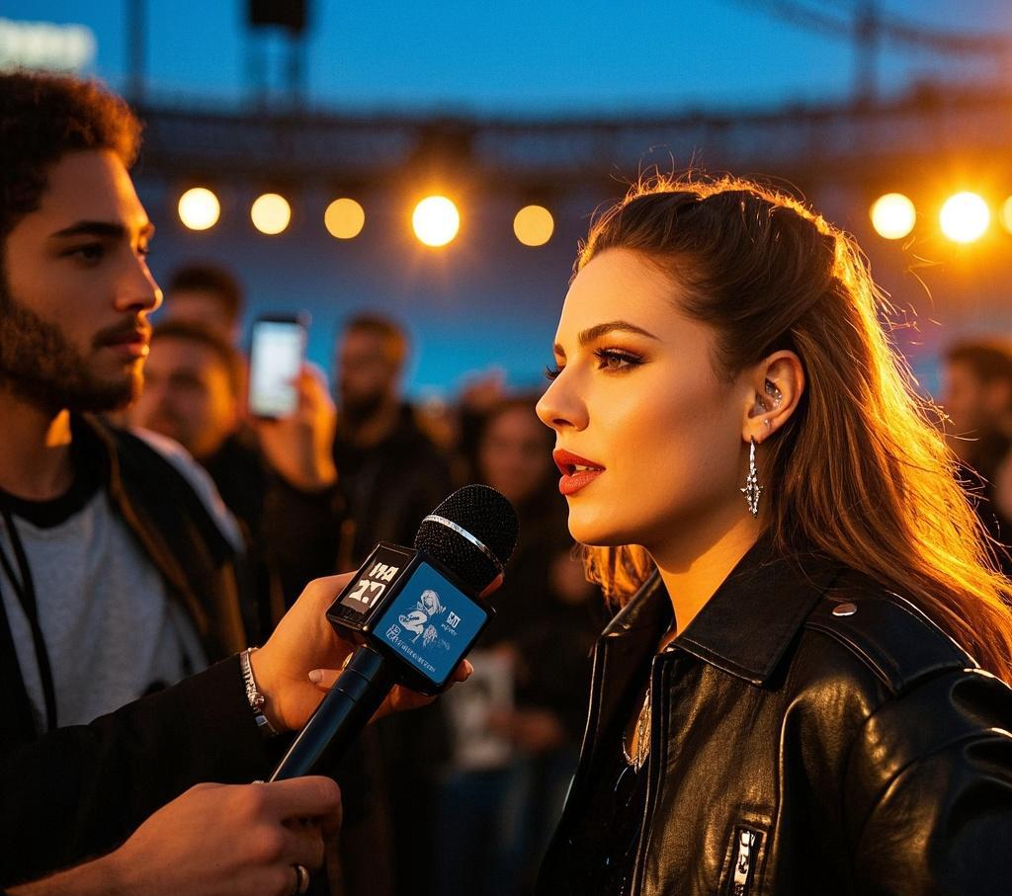
Paragraph 2 : After the concert, I had photographers and journalists battling to interview me.
呼应前文
我告诉他们，这首歌蕴含着一段长达 15 年的故事。在这个故事背后，有无数次我敲响经纪人的门，寄出样带，却一次又一次遭到拒绝。然而，我从未放弃。我始终相信，总有一天，我的音乐能被懂它的人听到
I told them that this song was woven with a 15 - year - long story. Behind this story, there were countless times when I knocked on managers' doors, sent out demo tapes, only to be rejected again and again. However, I never gave up.

Slide 14
Paragraph 2 : After the concert, I had photographers and journalists battling to interview me.
呼应前文
这首歌不仅是写给我自己的，也是写给所有追逐梦想的人。只要有坚定不移的毅力和对所做之事深深的热爱，成功最终会降临。这是一个充满希望的信息，提醒着我们，无论面临多少挫折，只要坚守对梦想的热爱，我们就能克服一切障碍，实现目标 。
This song was not only dedicated to myself but also to everyone out there chasing their dreams. I aimed to convey that with unwavering perseverance and deep - rooted love for what you do, success will eventually find its way to you. It's a message of hope, a reminder that no matter how many setbacks we face, as long as we stay true to our passion, we can overcome all obstacles and achieve our goals.
主题提升

Slide 15
Judy 下水作文
采用侧面描写：次要人物和环境烘托手法
As the moment to step onto the stage approached, my heart was pounding wildly in my chest. I kept wiping my sweaty palms on my clothes, trying to calm my nerves. When I finally walked onto the stage, the spotlight hit me, and for a split second, I froze. But then, as the music started, I found my rhythm and began to sing. With each note, my confidence grew. When I finished Dream Goes On, people leaped to their feet, their hands clapping so vigorously that it seemed as if they might never stop. Some were whistling loudly, their fingers in their mouths, creating sharp sounds that cut through the air. Flags and glow sticks were waved wildly in the air, creating a colorful, undulating sea of celebration. It was as if the very air was charged with electricity, every molecule vibrating with excitement and approval.
After the concert, I had photographers and journalists battling to interview me. Cameras flashed non-stop, the bright lights nearly blinding me. Reporters pushed and jostled each other, shoving their microphones in my face, eager to get a quote. "Could you tell us about the inspiration behind your song?" one journalist shouted.“ Can you tell me the story behind this song?" another journalist asked. I told them that this song was woven with a 15 - year - long story. Behind this story, there were countless times when I knocked on managers' doors, sent out demo tapes, only to be rejected again and again. However, I never gave up. This song was not only dedicated to myself but also to everyone out there chasing their dreams.
比喻
主题提升

Slide 16
官方范文
环境衬托
I had never performed the song live, and hadn't been on stage for years. Seized by a strong sense of tension, I stood on the stage, seeing the huge cheers and a sea of lights below the stage. I was lost at the moment, holding the microphone tightly. I tried my best to collect myself and began to sing my own song which I had practiced hundreds of times. Looking back the years, I had experienced as I sang on the stage, l realized that it is the opportunity that I had been waiting for the whole life. I kept myself full of enthusiasms I was singing on the stage, showing the best to the audience.
After the concert, I had photographers and journalists battling to interview me. With them around me , a long queue of fans were waiting to have their photograph taken with me. I was like a superstar and that night was like a real dream for me. I had knocked on doors for years, yet my moment came when the opportunity called me. Life can surprise you. It has reinspired my passion for music. This has made all the odd jobs and weekends spent in recording studios all worthwhile.
夸张+比喻
主题提升

Slide 17
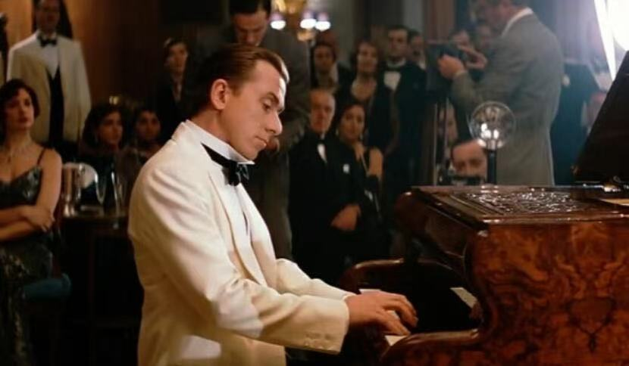
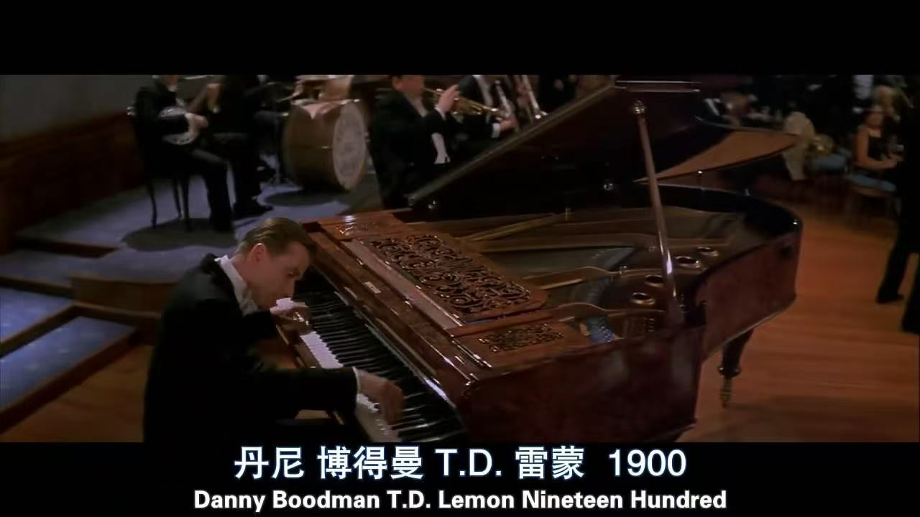
语料积累：《海上钢琴师》斗琴观众的反映
People held their breath, greedily devouring the notes, dumbfounded, like a bunch of super idiots. Everyone remained silent. After that final super chord that seemed to be played by a hundred hands, the piano seemed on the verge of bursting at any moment, yet there was still not a sound. In this maddening silence, 1900 stood up, picked up the cigarette butt, leaned forward over the keyboard, and pressed it against the strings. There was a hissing sound. When the cigarette butt was pulled out, it was already on fire. It was burning beautifully. 1900 held it in his hand as if it were a candle. He didn't smoke and didn't know how to hold a cigarette butt with his fingers. He walked a few steps to Jerry Roll Morton and handed him the cigarette, saying, "You smoke. I don't know how." Only then did people wake up from the magic and burst into screams and applause, going crazy. I don't know. I've never seen such a scene. In the shouts, everyone wanted to touch 1900, like in a brothel, in chaos. And I saw him, Jerry Roll Morton, in the middle of it, nervously smoking that unlucky cigarette, trying to find a suitable expression but couldn't.
采用侧面描写：次要人物和环境烘托手法

Slide 18
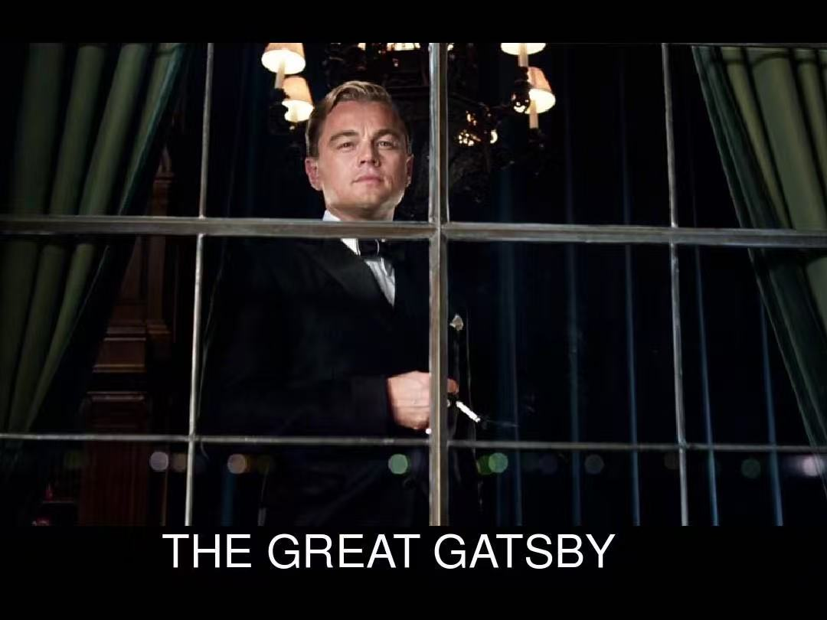
语料积累：《了不起的盖茨比》记者蜂拥而至采访盖茨比的场景
One day in the morning, an ambitious young journalist came all the way from New York to interview Gatsby. As Gatsby appeared in his luxurious mansion, the journalists swarmed around him like bees. They held up their notebooks and pencils, eager to get the first-hand news. "Mr. Gatsby, how did you achieve such great success?" one journalist asked. "What's your next plan?" another one shouted. "What's your opinion on the current political situation?" the third one inquired. Gatsby smiled, answering the journalists' questions calmly and confidently. His voice was steady and every word seemed to be a well-considered golden saying. The flashlights kept flashing, illuminating his handsome face and confident smile. He became the focus of the whole scene and everyone's eyes were fixed on him.
采用侧面描写：次要人物和环境烘托手法

Slide 19
观众热烈反应
The audience erupted into thunderous applause and cheers, their excitement filling every corner of the venue.
观众爆发出雷鸣般的掌声和欢呼声，他们的兴奋之情充斥着场地的每一个角落。
People in the audience were on their feet, whistling, shouting, and clapping vigorously, showing their enthusiastic support.
观众们站起身来，吹着口哨、大声呼喊并用力鼓掌，展现出他们热烈的支持。
The performance was met with a rapturous reception as the audience couldn't contain their joy, cheering loudly and waving their hands in the air.
这场表演受到了狂热的欢迎，观众们抑制不住喜悦，大声欢呼并在空中挥舞着手。
The auditorium resounded with the audience's exuberant roars of approval, creating an electrifying atmosphere.
礼堂里回荡着观众们兴高采烈的赞许声，营造出激动人心的氛围。
The audience showered the stage with a storm of applause, expressing their whole - hearted appreciation for the show.
观众向舞台报以暴风雨般的掌声，表达他们对这场演出全心全意的赞赏 。

Slide 20
观众不喜欢
The audience showed their dissatisfaction by booing loudly and shaking their heads in disappointment.
观众们大声发出嘘声，失望地摇头，以此表达他们的不满。
There were scattered boos and disgruntled murmurs from the audience as they clearly did not enjoy the performance.
观众中传来零星的嘘声和不满的低语，显然他们不喜欢这场表演。
The audience's lack of enthusiasm was palpable, with many sitting in silence, unresponsive to the show on stage.
观众明显缺乏热情，许多人静静地坐着，对舞台上的表演毫无反应。
People in the audience wore expressions of boredom and started leaving their seats one by one, indicating their disinterest.
观众们面露厌烦之色，开始一个接一个地离开座位，表明他们毫无兴趣。
The performance failed to resonate with the audience, who expressed their discontent through frowns and restless shifting in their seats.
这场表演未能引起观众的共鸣，他们通过皱眉和在座位上不安地挪动来表达不满 。

Slide 21

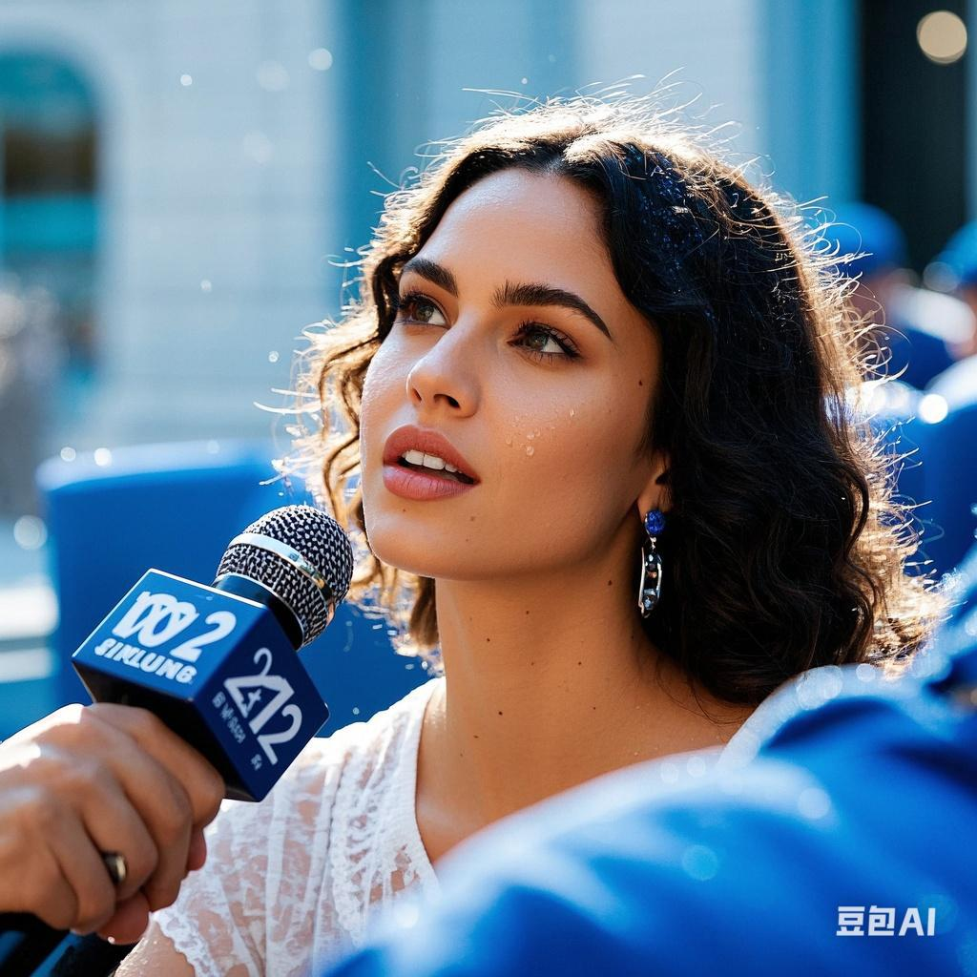
感谢聆听

