Slide 1



感恩遇见，相互成就，本课件资料仅供您个人参考、教学使用，严禁自行在网络传播，违者依知识产权法追究法律责任。
更多教学资源请关注
公众号：溯恩英语
知识产权声明

Slide 2





2025
新
阵
Love your life
Pursue your dream
地
教育联盟
Fay
英语试题解析

Slide 3


阅读理解
详 解

Slide 4




语篇 | 体裁 | 话题 | 主要内容
A | 应用文 | Unique Museums | 介绍了几家独特的博物馆，包括Museum of Bad Art、 “黑手党博物馆”The Mob Museum和International Tennis Hall of Fame。文章通过这些博物馆的特色展品和历史背景，展示了博物馆的多样性和趣味性。
B | 说明文 | Conservation of Endangered snails | 讲述了夏威夷本土树蜗牛（Hawaiian native tree snails）的保护工作，特别是科学家大卫·西斯科（David Sischo）和他的团队如何努力拯救这些濒临灭绝的物种。
C | 说明文 | Gaslighting in the Workplace | 讨论了“Gaslighting”（心理操纵）这种行为的起源、定义及其在工作场所中的表现和影响。文章通过分析其在工作场所的常见原因和应对方法，帮助读者识别和应对这种心理操控行为。
D | 说明文 | Gender Gap in ChatGPT Usage | 探讨了ChatGPT在不同职业中性别使用差距的原因，包括女性对新技术的不自信以及“好学生”心态对女性使用ChatGPT的限制。文章通过研究数据和案例分析，揭示了性别差异背后的潜在因素。
七选五 | 说明文 | Mind Mapping as an Effective Tool | 本文介绍了思维导图是一种高效组织和记忆信息的方法，能够帮助人们更好地组织信息、增强记忆和激发创造力，是值得在学习和工作中广泛应用的策略。

Slide 5

A
Interesting museums

Slide 6

A
Museums have changed. We’ll always have the Met in New York and the Louvre in Paris, but nowadays you’ll find a museum for absolutely everything and everyone. Here are some interesting museums.
Museum of Bad Art (Boston, Massachusetts)
The mission of MOBA is to collect, exhibit and celebrate art that will be shown in no other venue. Highlights include Lucy in the Field with Flowers, a painting found in 1993 leaning against a trash barrel, waiting for garbage collection. This painting was the first of the MOBA collection. A low point—and a must-see—is the painting Our Lady of Perpetual Housework.
The Mob Museum (Las Vegas, Nevada)
This 1933 former U.S. post office and federal courtroom was bought by the city of Las Vegas in 2002 for $1, with the condition it be used for something cultural...like a museum. Officially the National Museum of Organized Crime and Law Enforcement, this museum tells a visual story of the war between the mob and the police. The museum ends its tour by inviting you into a fully operational—and legal—speakeasy.
International Tennis Hall of Fame (Newport, Rhode island)
This museum was built on the site of the first United States National Lawn Tennis Championships in 1881 (which grew into the U.S. Open in New York). A highlight is a Kings Court for “court tennis,” first played by monks and kings dating back to 1538. In this ancient game, the ball can bounce off the walls and windows and still be in play. There are only 10 such courts in North America, as they cost approximately $3 million to make.
21.What do we know about the Museum of Bad Art?
A. Its collections are all masterpieces.
B. It is the most popular museum in Boston.
C. It aims to show art not displayed elsewhere.
D. It only exhibits paintings found near trash barrels.
22.Why was the former U.S. post office and federal courtroom sold for just $1?
A. Because the building was in bad condition.
B. Because the building was linked with illegal activities.
C. Because the owner wanted to give it away for charity.
D. Because the city agreed to use it for cultural purposes.
23.Where might this passage be taken from?
A. A travel magazine.
B. A sports brochure.
C. A history textbook.
D. A research paper.

Slide 7
With the condition
On the site of
Bounce off
Be in play
在…的条件下
在…的地点
弹跳离开
在进行中
A
Interesting museums

Slide 8
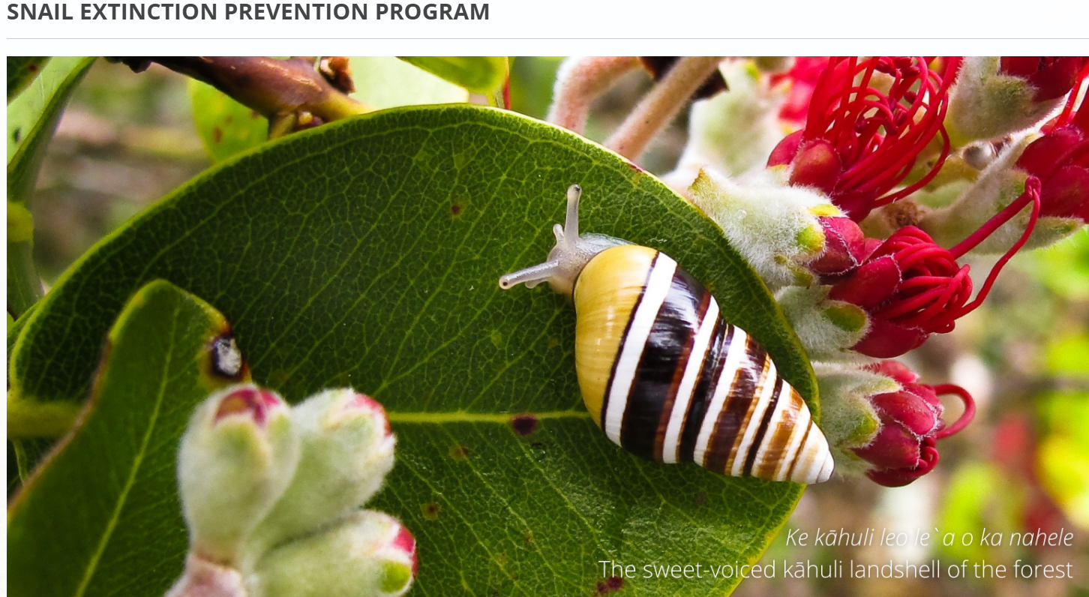
B
Conservation of Hawaii’s native tree snails.

Slide 9
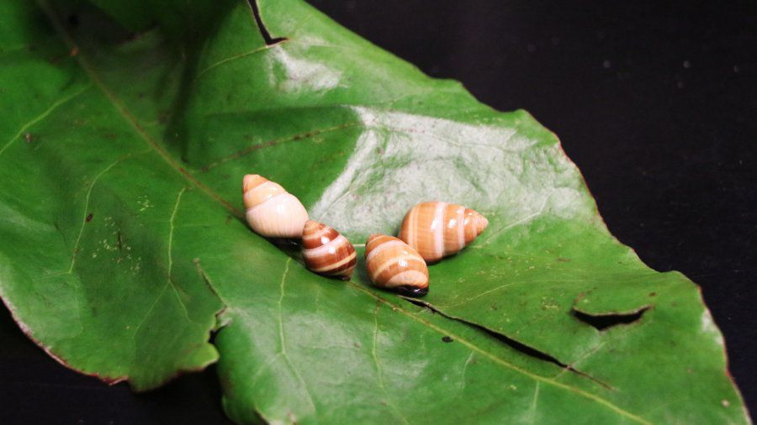
B
1When Hurricane Douglas came barreling toward Oahu in 2020, David Sischo quickly packed up and drove to higher ground. But he wasn’t shifting his family. He was shifting snails.
2Sischo works with some of the rarest endangered species on the planet, kahuli—Hawaii’s native tree snails. The colorful, jewel-like snails were once so abundant. It’s said they were like Christmas ornaments covering the trees. Almost all of the 750 different species were found only in Hawaii. Today, more than half of those species are gone, the extinctions happening in the span of a human lifetime. Sischo and his team with Hawaii’s Department of Land and Natural Resources have the heavy task of saving what’s left.
3To stave off extinction, 40 species of snails, each about the size of a dime, live in human care inside an unremarkable trailer near Honolulu. For some, it’s the only place where they’re found, their wild populations having completely disappeared. “Most people, when they think endangered species going extinct, they think of pandas and tigers and elephants, but imagine having 40 different species that are all as rare as pandas are,” Sischo says.
4This winter, one species of snail will inch toward an auspicious milestone. It will be released in a special enclosure in the mountains of Oahu, one that has been painstakingly prepared to give the snails the best chance of survival in their natural environment.
5Still, the outlook for Hawaii’s snails is uncertain, symbolizing a new era in the conservation of endangered species. Around the world, plants and animals are being brought into enclosure as a last-ditch effort against extinction. But as the climate heats up and invasive species continue to spread, many have no clear path to return to nature in the near term. That could mean they stay in human care. In the face of the biodiversity crisis, many wildlife biologists say there’s no other choice. “These are biological treasures that are irreplaceable,” Sischo says. “It is now or never. What we manage to keep on Earth will be what the next
B
1When Hurricane Douglas came barreling toward Oahu in 2020, David Sischo quickly packed up and drove to higher ground. But he wasn’t shifting his family. He was shifting snails.
2Sischo works with some of the rarest endangered species on the planet, kahuli—Hawaii’s native tree snails. The colorful, jewel-like snails were once so abundant. It’s said they were like Christmas ornaments covering the trees. Almost all of the 750 different species were found only in Hawaii. Today, more than half of those species are gone, the extinctions happening in the span of a human lifetime. Sischo and his team with Hawaii’s Department of Land and Natural Resources have the heavy task of saving what’s left.
3To stave off extinction, 40 species of snails, each about the size of a dime, live in human care inside an unremarkable trailer near Honolulu. For some, it’s the only place where they’re found, their wild populations having completely disappeared. “Most people, when they think endangered species going extinct, they think of pandas and tigers and elephants, but imagine having 40 different species that are all as rare as pandas are,” Sischo says.
4This winter, one species of snail will inch toward an auspicious milestone. It will be released in a special enclosure in the mountains of Oahu, one that has been painstakingly prepared to give the snails the best chance of survival in their natural environment.
5Still, the outlook for Hawaii’s snails is uncertain, symbolizing a new era in the conservation of endangered species. Around the world, plants and animals are being brought into enclosure as a last-ditch effort against extinction. But as the climate heats up and invasive species continue to spread, many have no clear path to return to nature in the near term. That could mean they stay in human care. In the face of the biodiversity crisis, many wildlife biologists say there’s no other choice. “These are biological treasures that are irreplaceable,” Sischo says. “It is now or never. What we manage to keep on Earth will be what the next generation is able to put back.”
Lead-in
Background information
Conservation Efforts
Importance & Urgency
Main idea: the conservation of endangered tree snail, highlighting the efforts to protect them from extinction and the broader challenges in preserving biodiversity.

Slide 10
B
1When Hurricane Douglas came barreling toward Oahu in 2020, David Sischo quickly packed up and drove to higher ground. But he wasn’t shifting his family. He was shifting snails.
2Sischo works with some of the rarest endangered species on the planet, kahuli—Hawaii’s native tree snails. The colorful, jewel-like snails were once so abundant. It’s said they were like Christmas ornaments covering the trees. Almost all of the 750 different species were found only in Hawaii. Today, more than half of those species are gone, the extinctions happening in the span of a human lifetime. Sischo and his team with Hawaii’s Department of Land and Natural Resources have the heavy task of saving what’s left.
24.What was David’s primary concern when Hurricane Douglas approached?
A. The safety of his family.
B. The protection of rare tree snails.
C. The withdrawal of local residents.
D. The observation of the hurricane.
25.What’s the present state of kahuli?
A. They are now more abundant than ever.
B. All 750 species are still thriving in Hawaii.
C. They are in a critical situation of extinction.
D. They can be found in various parts of the world.

Slide 11
B
3To stave off extinction, 40 species of snails, each about the size of a dime, live in human care inside an unremarkable trailer near Honolulu. For some, it’s the only place where they’re found, their wild populations having completely disappeared. “Most people, when they think endangered species going extinct, they think of pandas and tigers and elephants, but imagine having 40 different species that are all as rare as pandas are,” Sischo says.
4This winter, one species of snail will inch toward an auspicious milestone. It will be released in a special enclosure in the mountains of Oahu, one that has been painstakingly prepared to give the snails the best chance of survival in their natural environment.
5Still, the outlook for Hawaii’s snails is uncertain, symbolizing a new era in the conservation of endangered species. Around the world, plants and animals are being brought into enclosure as a last-ditch effort against extinction. But as the climate heats up and invasive species continue to spread, many have no clear path to return to nature in the near term. That could mean they stay in human care. In the face of the biodiversity crisis, many wildlife biologists say there’s no other choice. “These are biological treasures that are irreplaceable,” Sischo says. “It is now or never. What we manage to keep on Earth will be what the next generation is able to put back.”
26.What does the phrase “stave off” in Paragraph 3 most probably mean?
A. Clarify. B. Accelerate. C. Witness. D. Prevent.
27.What can be inferred from the last paragraph?
A. The future of Hawaii’s snails is promising.
B. The biodiversity crisis is easy to deal with.
C. The ways to protect endangered species are numerous.
D. The conservation of endangered species is challenging.

Slide 12
Barreling toward
Pack up
Shift his family
In the span of
An unremarkable trailer
Go extinct
A special enclosure
Symbolize a new era
A last-ditch effort
Heat up
Invasive species
In the face of
The biodiversity crisis
向…疾驰而去
打包
转移家庭
在…期间
一个不起眼的拖车
灭绝
一个特殊的围栏
象征一个新时代
孤注一掷的努力
加热
入侵物种
面对
生物多样性
It is now or never. What we manage to keep on Earth will be what the next generation is able to put back.
机不可失时不再来。我们在地球上保留的东西是下一代能够恢复的东西。
B
Conservation of Hawaii’s native tree snails.

Slide 13
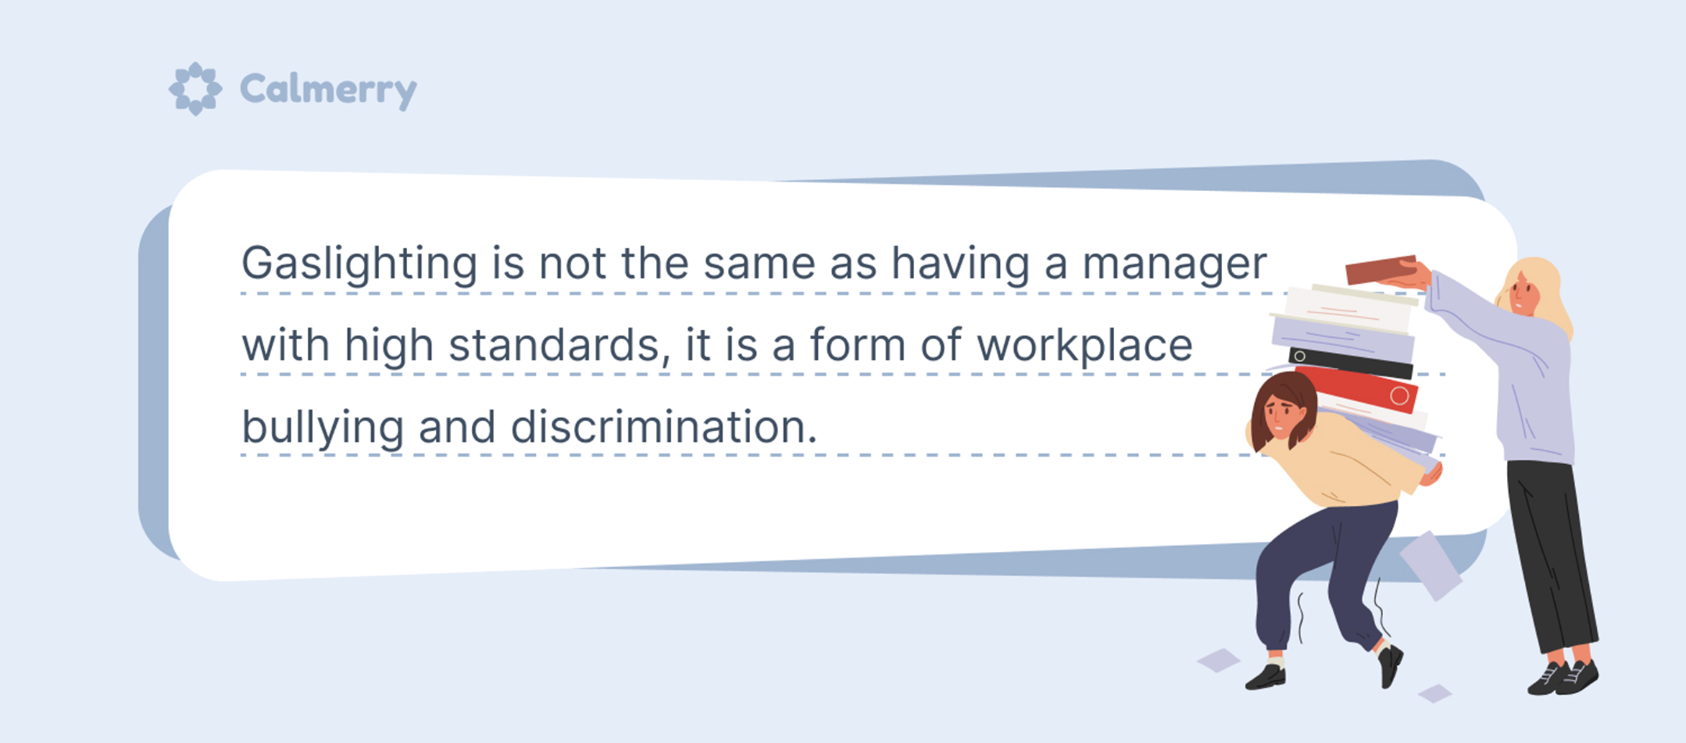
C
Gaslighting in the Workplace

Slide 14
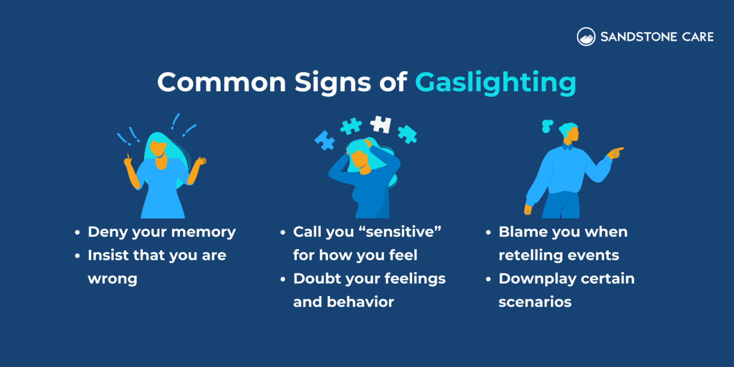
C
1Has someone ever told you something that made you doubt your own memory or judgment? If so, you may be a victim of gaslighting. “Gaslighting” is a kind of psychological abuse to gain power over others by purposely making other people think they’re wrong even when they’re right. The term comes from Patrick Hamilton’s play in 1938. Lead character Jack Manningham seeks to convince his wife Bella that she is going crazy, by saying she is imagining the dimming of the gas light in their home, when it was actually he who lowered the brightness of the light.
2Gaslighting is initially used to talk about what happens in romantic relationships. However, many individuals also experience gaslighting at work. In fact, a recent survey has found that 58% of the respondents said they have experienced gaslighting at work. It’s unsurprising since gaslighting usually involves a power relationship and a need to control others. In the workplace, the dynamics between a boss and his employee can be the perfect breeding ground for this type of behavior. Your boss may tell you to handle an assignment in a certain way, but when you do, he gets annoyed and says it isn’t what he wants. It makes you feel like your memory is faulty.
3In order to find out whether your boss’s behavior really constitutes gaslighting or he is just a poor communicator, you could write down your experiences and ask yourself what really has happened, what his motives might be, and how your emotion is affected. But always be careful because gaslighters know how to fly under the radar. They are skilled at weakening an employee’s confidence and sense of reality in a clever and hard-to-prove way.
4To protect yourself, at the end of the conversation with your boss, repeat back what you have heard and follow up with an e-mail restating the main points, documenting the interactions between you two. But don’t get your hopes high that this will automatically solve the problem, Robin Stern, author of The Gaslight Effect, warns, because it’s hard to get a gaslighter to change his behavior pattern. If things don’t improve, you may want to consider getting out of the gaslighting situation by looking for a new position.
C
1Has someone ever told you something that made you doubt your own memory or judgment? If so, you may be a victim of gaslighting. “Gaslighting” is a kind of psychological abuse to gain power over others by purposely making other people think they’re wrong even when they’re right. The term comes from Patrick Hamilton’s play in 1938. Lead character Jack Manningham seeks to convince his wife Bella that she is going crazy, by saying she is imagining the dimming of the gas light in their home, when it was actually he who lowered the brightness of the light.
2Gaslighting is initially used to talk about what happens in romantic relationships. However, many individuals also experience gaslighting at work. In fact, a recent survey has found that 58% of the respondents said they have experienced gaslighting at work. It’s unsurprising since gaslighting usually involves a power relationship and a need to control others. In the workplace, the dynamics between a boss and his employee can be the perfect breeding ground for this type of behavior. Your boss may tell you to handle an assignment in a certain way, but when you do, he gets annoyed and says it isn’t what he wants. It makes you feel like your memory is faulty.
3In order to find out whether your boss’s behavior really constitutes gaslighting or he is just a poor communicator, you could write down your experiences and ask yourself what really has happened, what his motives might be, and how your emotion is affected. But always be careful because gaslighters know how to fly under the radar. They are skilled at weakening an employee’s confidence and sense of reality in a clever and hard-to-prove way.
4To protect yourself, at the end of the conversation with your boss, repeat back what you have heard and follow up with an e-mail restating the main points, documenting the interactions between you two. But don’t get your hopes high that this will automatically solve the problem, Robin Stern, author of The Gaslight Effect, warns, because it’s hard to get a gaslighter to change his behavior pattern. If things don’t improve, you may want to consider getting out of the gaslighting situation by looking for a new position.
Definition/origin of Gaslighting
Gaslighting at work
Identification of the gaslighting behavior
Response/suggestions of the gaslighting behavior
Main idea: The article explains gaslighting’s definition and highlights how this occurs in workplaces and offers advice on recognizing and dealing with it.

Slide 15
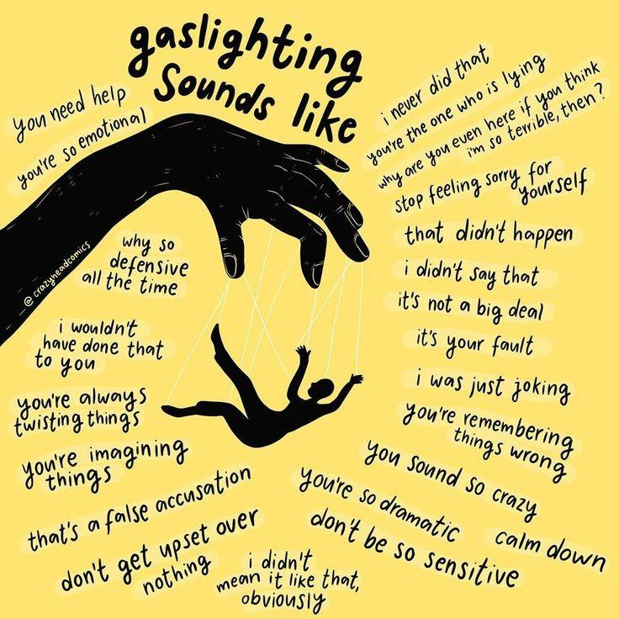
C
1Has someone ever told you something that made you doubt your own memory or judgment? If so, you may be a victim of gaslighting. “Gaslighting” is a kind of psychological abuse to gain power over others by purposely making other people think they’re wrong even when they’re right. The term comes from Patrick Hamilton’s play in 1938. Lead character Jack Manningham seeks to convince his wife Bella that she is going crazy, by saying she is imagining the dimming of the gas light in their home, when it was actually he who lowered the brightness of the light.
2Gaslighting is initially used to talk about what happens in romantic relationships. However, many individuals also experience gaslighting at work. In fact, a recent survey has found that 58% of the respondents said they have experienced gaslighting at work. It’s unsurprising since gaslighting usually involves a power relationship and a need to control others. In the workplace, the dynamics between a boss and his employee can be the perfect breeding ground for this type of behavior. Your boss may tell you to handle an assignment in a certain way, but when you do, he gets annoyed and says it isn’t what he wants. It makes you feel like your memory is faulty.
28.Why does the author mention Patrick Hamilton’s play in paragraph 1?
A. To introduce a famous play in history.
B. To show the origin of the term “gaslighting”.
C. To describe how people go crazy in daily life.
D. To explain the relationship between couples.
29.Why is gaslighting common in the workplace according to the text?
A. Because employees are too sensitive.
B. Because bosses are poor communicators.
C. Because employers want to dominate.
D. Because work assignments are too difficult.

Slide 16

3In order to find out whether your boss’s behavior really constitutes gaslighting or he is just a poor communicator, you could write down your experiences and ask yourself what really has happened, what his motives might be, and how your emotion is affected. But always be careful because gaslighters know how to fly under the radar. They are skilled at weakening an employee’s confidence and sense of reality in a clever and hard-to-prove way.
4To protect yourself, at the end of the conversation with your boss, repeat back what you have heard and follow up with an e-mail restating the main points, documenting the interactions between you two. But don’t get your hopes high that this will automatically solve the problem, Robin Stern, author of The Gaslight Effect, warns, because it’s hard to get a gaslighter to change his behavior pattern. If things don’t improve, you may want to consider getting out of the gaslighting situation by looking for a new position.
30. What is suggested for employees to determine if their boss is gaslighting them?
A. E-mailing their boss to ask for documents.
B. Having an argument with the boss.
C. Recording and analyzing their experiences.
D. Making a complaint to the superiors.
31.What is the author’s purpose in writing this passage?
A. To introduce gaslighting’s origin and its solutions.
B. To highlight gaslighting’s harm and its reasons.
C. To discuss a survey on gaslighting and its effects.
D. To explain gaslighting’s definition and its types.
Recording and analyzing their experiences.
To introduce gaslighting’s origin and its solutions.

Slide 17

Psychological abuse
Gain power over
The perfect breeding ground
Fly under the radar
Be skilled at
Weaken one’s confidence
Sense of reality
Restate the main points
Document the interactions
Hope high
心理虐待
获得对…的控制权
完美滋生地
低调行事
擅长于
削弱某人的自信
现实感
重申要点
记录互动
抱有高希望
Gaslighting in the Workplace: 10 Signs and How to Deal with It
C
Gaslighting in the Workplace

Slide 18
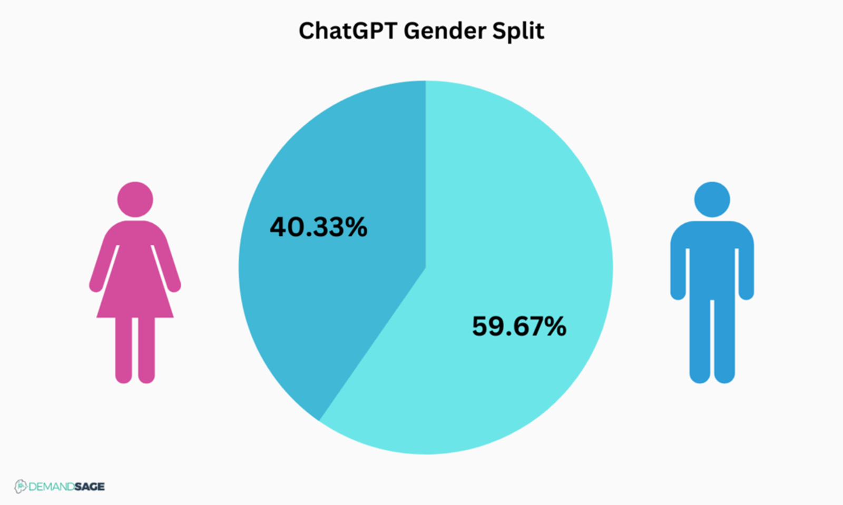
D
Gender Gap in ChatGPT Usage

Slide 19
D
1Be more productive. That is how ChatGPT, a generative-artificial-intelligence tool from OpenAI, sells itself to workers. But despite industry hopes that the technology will boost productivity across the workforce, not everyone is on board. According to two recent studies, women use ChatGPT between 16 and 20 percentage points less than their male peers, even when they are employed in the same jobs or read the same subject.
2The first study, published as a working paper in June, explored ChatGPT at work. Anders Humlum of the University of Chicago and Emilie Vestergaard of the University of Copenhagen surveyed 100,000 Danes across 11 professions in which the technology could save workers time, including journalism, software-developing and teaching. The researchers asked respondents how often they turned to ChatGPT and what might keep them from adopting it.
3Across all professions, women were less likely to use ChatGPT than men who worked in the same industry. For example, only a third of female teachers used it for work, compared with half of male teachers. Among software developers, almost two-thirds of men used it for work, compared with less than half of women did. The gap shrank only slightly, to 16 percentage points, when people in the same firms working on similar tasks were compared. As such, the study concludes that a lack of female confidence may be in part to blame: women who did not use AI were more likely than men to highlight that they needed training to use the technology.
4Another potential explanation for the gender imbalance comes from a survey of 486 students at the Norwegian School of Economics (NHH). It also found a gender gap: female students enrolled in the NHH’s only undergraduate programme were 18 percentage points less likely to use ChatGPT often. When the researchers separated students by admission grades, it became clear that the gap reflected the behaviour of mid- and high-performing women. Low performers were almost as likely as men to use the technology.
5Why might this be? The researchers probed what was going on with some clever follow-up questions. They asked students whether they would use ChatGPT if their professor forbade it, and received a similar distribution of answers. However, with clear approval, everyone, including the better-performing women, reported that they would make use of the technology. In other words, the high-achieving women appeared to put a ban on themselves. “It’s the ‘good girl’ thing,” reckons Ms Isaksson. “It’s this idea that ‘I have to go through this pain, I have to do it on my own and I shouldn’t cheat and take short-cuts.’”
D
1Be more productive. That is how ChatGPT, a generative-artificial-intelligence tool from OpenAI, sells itself to workers. But despite industry hopes that the technology will boost productivity across the workforce, not everyone is on board. According to two recent studies, women use ChatGPT between 16 and 20 percentage points less than their male peers, even when they are employed in the same jobs or read the same subject.
2The first study, published as a working paper in June, explored ChatGPT at work. Anders Humlum of the University of Chicago and Emilie Vestergaard of the University of Copenhagen surveyed 100,000 Danes across 11 professions in which the technology could save workers time, including journalism, software-developing and teaching. The researchers asked respondents how often they turned to ChatGPT and what might keep them from adopting it.
3Across all professions, women were less likely to use ChatGPT than men who worked in the same industry. For example, only a third of female teachers used it for work, compared with half of male teachers. Among software developers, almost two-thirds of men used it for work, compared with less than half of women did. The gap shrank only slightly, to 16 percentage points, when people in the same firms working on similar tasks were compared. As such, the study concludes that a lack of female confidence may be in part to blame: women who did not use AI were more likely than men to highlight that they needed training to use the technology.
4Another potential explanation for the gender imbalance comes from a survey of 486 students at the Norwegian School of Economics (NHH). It also found a gender gap: female students enrolled in the NHH’s only undergraduate programme were 18 percentage points less likely to use ChatGPT often. When the researchers separated students by admission grades, it became clear that the gap reflected the behaviour of mid- and high-performing women. Low performers were almost as likely as men to use the technology.
5Why might this be? The researchers probed what was going on with some clever follow-up questions. They asked students whether they would use ChatGPT if their professor forbade it, and received a similar distribution of answers. However, with clear approval, everyone, including the better-performing women, reported that they would make use of the technology. In other words, the high-achieving women appeared to put a ban on themselves. “It’s the ‘good girl’ thing,” reckons Ms Isaksson. “It’s this idea that ‘I have to go through this pain, I have to do it on my own and I shouldn’t cheat and take short-cuts.’”
Introduction/theme
Background of the first study
Findings/analysis
Further study
Conclusion/Behavior Explanation

Slide 20
2The first study, published as a working paper in June, explored ChatGPT at work. Anders Humlum of the University of Chicago and Emilie Vestergaard of the University of Copenhagen surveyed 100,000 Danes across 11 professions in which the technology could save workers time, including journalism, software-developing and teaching. The researchers asked respondents how often they turned to ChatGPT and what might keep them from adopting it.
3Across all professions, women were less likely to use ChatGPT than men who worked in the same industry. For example, only a third of female teachers used it for work, compared with half of male teachers. Among software developers, almost two-thirds of men used it for work, compared with less than half of women did. The gap shrank only slightly, to 16 percentage points, when people in the same firms working on similar tasks were compared. As such, the study concludes that a lack of female confidence may be in part to blame: women who did not use AI were more likely than men to highlight that they needed training to use the technology.
32.What do we know about ChatGPT gender usage gap according to the first study?
A. It is only found in a few specific professions.
B. It is caused by women’s less access to high-tech.
C. It is partly due to women’s lack of confidence.
D. It disappears on similar tasks in the same firm.

Slide 21
4Another potential explanation for the gender imbalance comes from a survey of 486 students at the Norwegian School of Economics (NHH). It also found a gender gap: female students enrolled in the NHH’s only undergraduate programme were 18 percentage points less likely to use ChatGPT often. When the researchers separated students by admission grades, it became clear that the gap reflected the behaviour of mid- and high-performing women. Low performers were almost as likely as men to use the technology.
5Why might this be? The researchers probed what was going on with some clever follow-up questions. They asked students whether they would use ChatGPT if their professor forbade it, and received a similar distribution of answers. However, with clear approval, everyone, including the better-performing women, reported that they would make use of the technology. In other words, the high-achieving women appeared to put a ban on themselves. “It’s the ‘good girl’ thing,” reckons Ms Isaksson. “It’s this idea that ‘I have to go through this pain, I have to do it on my own and I shouldn’t cheat and take short-cuts.’”
33. What does Paragraph 4 mainly talk about?
A. NHH students’ ChatGPT use in different cases.
B. Comparison of ChatGPT use among NHH students.
C. Professors’ impact on NHH students’ ChatGPT use.
D. Reasons for top NHH female students’ self-restriction.
34. What is the reason for high-achieving women’s behavior according to Ms Isaksson?
A. They think using ChatGPT is cheating.
B. They believe using ChatGPT is painful.
C. They fear punishment for using ChatGPT.
D. They are not interested in new technology.
Comparison .

Slide 22
D
1Be more productive. That is how ChatGPT, a generative-artificial-intelligence tool from OpenAI, sells itself to workers. But despite industry hopes that the technology will boost productivity across the workforce, not everyone is on board. According to two recent studies, women use ChatGPT between 16 and 20 percentage points less than their male peers, even when they are employed in the same jobs or read the same subject.
2The first study, published as a working paper in June, explored ChatGPT at work. Anders Humlum of the University of Chicago and Emilie Vestergaard of the University of Copenhagen surveyed 100,000 Danes across 11 professions in which the technology could save workers time, including journalism, software-developing and teaching. The researchers asked respondents how often they turned to ChatGPT and what might keep them from adopting it.
3Across all professions, women were less likely to use ChatGPT than men who worked in the same industry. For example, only a third of female teachers used it for work, compared with half of male teachers. Among software developers, almost two-thirds of men used it for work, compared with less than half of women did. The gap shrank only slightly, to 16 percentage points, when people in the same firms working on similar tasks were compared. As such, the study concludes that a lack of female confidence may be in part to blame: women who did not use AI were more likely than men to highlight that they needed training to use the technology.
4Another potential explanation for the gender imbalance comes from a survey of 486 students at the Norwegian School of Economics (NHH). It also found a gender gap: female students enrolled in the NHH’s only undergraduate programme were 18 percentage points less likely to use ChatGPT often. When the researchers separated students by admission grades, it became clear that the gap reflected the behaviour of mid- and high-performing women. Low performers were almost as likely as men to use the technology.
5Why might this be? The researchers probed what was going on with some clever follow-up questions. They asked students whether they would use ChatGPT if their professor forbade it, and received a similar distribution of answers. However, with clear approval, everyone, including the better-performing women, reported that they would make use of the technology. In other words, the high-achieving women appeared to put a ban on themselves. “It’s the ‘good girl’ thing,” reckons Ms Isaksson. “It’s this idea that ‘I have to go through this pain, I have to do it on my own and I shouldn’t cheat and take short-cuts.’”
35. Which of the following would be the best title for the text?
A. ChatGPT: A New Productivity Booster
B. ChatGPT: A Game-Changer in Education
C. The Gender Difference in ChatGPT Usage
D. The Impact of ChatGPT on Different Professions
The Gender Difference

Slide 23
A generative-artificial-intelligence tool
Boost productivity
Be on board
Respondents
Shrink slightly
Be in part to blame
The gender imbalance
Enroll in
Admission grades
Probe
Put a ban on
Take short cuts
生成式人工智能工具
D
提高生产力
同意或支持
受访者
略微缩小
有部分责任
性别不平等
注册或参加
录取成绩
探索、调查
禁止
走捷径
Gender Gap in ChatGPT Usage

Slide 24
A generative-artificial-intelligence tool
Boost productivity
Be on board
Respondents
Shrink slightly
Be in part to blame
The gender imbalance
Enroll in
Admission grades
Probe
Put a ban on
Take short cuts
生成式人工智能工具
D
提高生产力
同意或支持
受访者
略微缩小
有部分责任
性别不平等
注册或参加
录取成绩
探索、调查
禁止
走捷径
Gender Gap in ChatGPT Usage

Slide 25
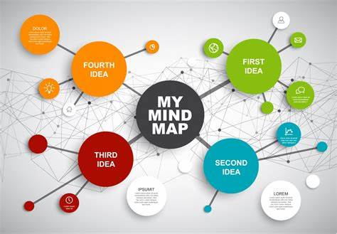
七选五
Mind Mapping as an Effective Tool

Slide 26
You have to make a speech. You have done your research and now have plenty of ideas bouncing around in your head that you want to get across. The big question you face at this point is how to organize those thoughts. 36 You need to brainstorm some supporting ideas and then figure out how those ideas fit together.
These are just two cases that many people deal with frequently. Some use outlining to flesh out and organize their ideas, but is that the best strategy? ____37____
38 This two-dimensional structure is designed to help you remember information because its format is easy for your mind to remember. More than 250 million people worldwide use them, so why don’t you have a try and see what they are all about?
What is a mind map? Simply put, it is one’s ideas put into the form of a visual diagram that starts with a central idea. Put this idea in a bubble in the middle of a page with lines radiating out to other bubbles that contain related themes or concepts. 39 Use words, short phrases or images to express your ideas. And use color-coded bubbles for a visual representation of each branch’s connection.
Studies have shown that this technique of using pictures, colors and visual arrangement has improved people’s recall and memory of information by 10 to 15 percent. 40 Creativity is aroused because of the spatial arrangement, enabling people to make more links and associations on topics of any kind. Additionally, it increases one’s productivity because mind mapping makes it easier to learn faster.
So whether you’re in charge of a project or writing a research paper, make this technique a core part of your planning process!

Slide 27
1You have to make a speech. You have done your research and now have plenty of ideas bouncing around in your head that you want to get across. The big question you face at this point is how to organize those thoughts. 36 You need to brainstorm some supporting ideas and then figure out how those ideas fit together.
2These are just two cases that many people deal with frequently. Some use outlining to flesh out and organize their ideas, but is that the best strategy? ____37____
3 38 This two-dimensional structure is designed to help you remember information because its format is easy for your mind to remember. More than 250 million people worldwide use them, so why don’t you have a try and see what they are all about?
4What is a mind map? Simply put, it is one’s ideas put into the form of a visual diagram that starts with a central idea. Put this idea in a bubble in the middle of a page with lines radiating out to other bubbles that contain related themes or concepts. 39 Use words, short phrases or images to express your ideas. And use color-coded bubbles for a visual representation of each branch’s connection.
5Studies have shown that this technique of using pictures, colors and visual arrangement has improved people’s recall and memory of information by 10 to 15 percent. 40 Creativity is aroused because of the spatial arrangement, enabling people to make more links and associations on topics of any kind. Additionally, it increases one’s productivity because mind mapping makes it easier to learn faster.
6So whether you’re in charge of a project or writing a research paper, make this technique a core part of your planning process!
Problem----Solution
36.指称、语义: E 指称主题一致、承上启下
37.逻辑、语义: F a linear manner vs a mind map、承上启下
38.指代、语义: G mind mapping---This two-dimensional structure 、语义复现
39.段落主旨: B many-legged= lines radiating out/ each branch
40.段落结构: 已知好处-----过渡-----额外好处
A. But it doesn’t stop there.
B. It should look like a many-legged spider.
C. This is a common problem that many people face.
D. It has proven to increase not only productivity and creativity but also memory.
E. Or perhaps you are planning to write a paper, and all you have is the main topic.
F. If everyone thought in a linear manner, then the answer would be yes, but most people don’t.
G. Enter mind mapping, a technique that shows how different ideas and facts relate to one another.

Slide 28


完形填空
详 解

Slide 29
1The side door of the aircraft was opened, and a brisk wind rushed in. Packed tightly like sardines were fourteen silent people. Two of them were my adult children, 41 out at the endless sky.
2When we reached an altitude of 14,000 feet, my son’s face turned pale as he 42 inched to the opening and fell out of the 43 . Something went cold in my heart. But, only seconds later, instructions were being 44 , and it was my daughter’s turn. Her face, however, was 45 , and she laughed and whooped, falling away into the wild blue. For a quick moment, a desperate fear 46 me, and I wondered if that was the last time I would see them. But the thought soon 47 as I felt a strong pull on my pack and was moved into position.
3With a big birthday approaching, my children had chosen to surprise me with an unforgettable way to dive into the decade. I’d wanted to 48 , but when a woman celebrating her fiftieth wedding anniversary spontaneously decided to 49 , I knew I had to do it, too.
4Now I was in the 50. I forgot all the instructions as the sheer terror and joy 51 . Although it felt like forever, the minute before the parachute (降落伞) opened was memorable. With the earth quickly approaching, I spied my son and daughter running to 52 me. We had an excited three-way 53 .
5It was a(n) 54 moment. I could have refused to leave the plane, missing both the extreme thrill of the dive and the unique beauty of the view from the sky. 55 to the appearance of safety no longer felt like the only option.
1The side door of the aircraft was opened, and a brisk wind rushed in. Packed tightly like sardines were fourteen silent people. Two of them were my adult children, 41 out at the endless sky.
2When we reached an altitude of 14,000 feet, my son’s face turned pale as he 42 inched to the opening and fell out of the 43 . Something went cold in my heart. But, only seconds later, instructions were being 44 , and it was my daughter’s turn. Her face, however, was 45 , and she laughed and whooped, falling away into the wild blue. For a quick moment, a desperate fear 46 me, and I wondered if that was the last time I would see them. But the thought soon 47 as I felt a strong pull on my pack and was moved into position.
3With a big birthday approaching, my children had chosen to surprise me with an unforgettable way to dive into the decade. I’d wanted to 48 , but when a woman celebrating her fiftieth wedding anniversary spontaneously decided to 49 , I knew I had to do it, too.
4Now I was in the 50. I forgot all the instructions as the sheer terror and joy 51 . Although it felt like forever, the minute before the parachute (降落伞) opened was memorable. With the earth quickly approaching, I spied my son and daughter running to 52 me. We had an excited three-way 53 .
5It was a(n) 54 moment. I could have refused to leave the plane, missing both the extreme thrill of the dive and the unique beauty of the view from the sky. 55 to the appearance of safety no longer felt like the only option.
Initial Tension
Before skydiving
Fear and Desperation
during skydiving
Inspiration and Decision
Terror and Joy
after skydiving
reflection
Fear to thrive

Slide 30
1The side door of the aircraft was opened, and a brisk wind rushed in. Packed tightly like sardines were fourteen silent people. Two of them were my adult children, 41 out at the endless sky.
2When we reached an altitude of 14,000 feet, my son’s face turned pale as he 42 inched to the opening and fell out of the 43 . Something went cold in my heart. But, only seconds later, instructions were being 44 , and it was my daughter’s turn. Her face, however, was 45 , and she laughed and whooped, falling away into the wild blue. For a quick moment, a desperate fear 46 me, and I wondered if that was the last time I would see them. But the thought soon 47 as I felt a strong pull on my pack and was moved into position.
41. A. leaving B. standing C. staring D. putting
42. A. cautiously B. swiftly C. closely D. proudly
43. A. wing B. hole C. window D. plane
44. A. overlooked B. barked C. interrupted D. posted
45. A. regretful B. grateful C. joyful D. sorrowful
46. A. overcame B. refreshed C. discouraged D. confused
47. A. crept B. surged C. returned D. passed
41. A. leaving B. standing C. staring D. putting
42. A. cautiously B. swiftly C. closely D. proudly
43. A. wing B. hole C. window D. plane
44. A. overlooked B. barked C. interrupted D. posted
45. A. regretful B. grateful C. joyful D. sorrowful
46. A. overcame B. refreshed C. discouraged D. confused
47. A. crept B. surged C. returned D. passed
bark: to give orders or instructions in a loud, rough voice
Eg: She barked out an order.
Overcome:表达情感、困难或挑战被征服或被克服的情况
The side door of the aircraft - 飞机的侧门
A brisk wind rushed in - 一阵疾风涌入
packed tightly like sardines - 挤得像沙丁鱼一样
reach an altitude of 14,000 feet - 到达了14,000英尺的高度
Turn pale - 脸色苍白
inch to the opening - 挪向开口处
laugh and whoop - 笑着尖叫
falling away into the wild blue - 向那狂野的蓝色坠落
The thought soon passed/faded away - 这个念头很快（消散）
A strong pull 强烈拉力

Slide 31
3With a big birthday approaching, my children had chosen to surprise me with an unforgettable way to dive into the decade. I’d wanted to 48 , but when a woman celebrating her fiftieth wedding anniversary spontaneously decided to 49 , I knew I had to do it, too.
4Now I was in the 50. I forgot all the instructions as the sheer terror and joy 51 . Although it felt like forever, the minute before the parachute (降落伞) opened was memorable. With the earth quickly approaching, I spied my son and daughter running to 52 me. We had an excited three-way 53 .
5It was a(n) 54 moment. I could have refused to leave the plane, missing both the extreme thrill of the dive and the unique beauty of the view from the sky. 55 to the appearance of safety no longer felt like the only option.
48. A. give out B. set out C. chicken out D. work out
49. A. dive B. divorce C. withdraw D. abandon
50. A. jungle B. air C. dilemma D. darkness
51. A. came back B. faded away C. died down D. rolled in
52. A. rescue B. greet C. address D. search
53. A. hug B. exchange C. match D. comment
54. A. temporary B. awkward C. desperate D. symbolic
55. A. Climbing B. Sticking C. Responding D. Dropping
48. A. give out B. set out C. chicken out D. work out
49. A. dive B. divorce C. withdraw D. abandon
50. A. jungle B. air C. dilemma D. darkness
51. A. came back B. faded away C. died down D. rolled in
52. A. rescue B. greet C. address D. search
53. A. hug B. exchange C. match D. comment
54. A. temporary B. awkward C. desperate D. symbolic
55. A. Climbing B. Sticking C. Responding D. Dropping
give out - 分发 set out - 出发/开始
chicken out 临阵退缩work out 解决/锻炼
came back回来/恢复
faded away - 逐渐消失
died down - 平息/减弱
rolled in - 到达/涌入
Symbolic : it represents an important change, although it has little practical effect.
dive into the decade - 难忘的方式进入新的十年
sheer terror and joy - 纯粹的恐惧和喜悦
spied my son and daughter看到我的儿子和女儿
excited three-way hug - 激动的三人互相拥抱
extreme thrill of the dive - 跳伞的极度刺激
Stick to the appearance of safety no longer felt like the only option : to embrace new experiences or take risks that could lead to growth or excitement.

Slide 32



Emei Kung Fu Girls
语法填空

Slide 33
The Emei Kung Fu Girls, a female Kung Fu group consisting of nine Gen-Z members who are passionate about traditional Chinese martial arts, has gone viral on China’s social media.
Ling Yun, the core member of the group, 56 is also an inheritor of Emei martial arts, and other members are skilled in Emei Kung Fu techniques. Short 57 (video) of them performing Emei martial arts have effectively promoted the intangible cultural heritage. In their first promotional video, they wear green uniforms and perform various Emei Kung Fu techniques against the backdrop of Mount Emei in southwest China’s Sichuan Province, 58 (demonstrate) the unique charm of Emei martial arts, which 59 (date) back to the Spring and Autumn Period.
Ling, who began to learn martial arts at the age of 4, realized that preserving and spreading Emei martial arts culture couldn’t rely 60 (mere) on practitioners’ training, and Emei Kung Fu should be promoted in a way that appeals to modern aesthetics 61 (reach) both domestic and international audiences. Therefore, forming a group of versatile talents who could make Emei martial arts culture thrive in modern society became 62 priority.
As a result, the Emei Kung Fu Girls group was officially launched at the 63 (four) Emei Martial Arts Inheritance Conference on April 29, 2024. The group has cracked the code of social media success by carving out its distinctive style. Their costumes strike a perfect balance between practicality and grace and combine traditional elements 64 modern aesthetics, featuring ink-green and red color schemes, cloud patterns, and 65 (innovate) cutting techniques.
56.who定语从句：从句缺失主语，先行词为人.
57.videos: 考查名词单复数
58.demonstrating:非谓语
59.dates：谓语动词时态
The Emei Kung Fu Girls, a female Kung Fu group consisting of nine Gen-Z members who are passionate about traditional Chinese martial arts, has gone viral on China’s social media.
Ling Yun, the core member of the group, 56 is also an inheritor of Emei martial arts, and other members are skilled in Emei Kung Fu techniques. Short 57 (video) of them performing Emei martial arts have effectively promoted the intangible cultural heritage. In their first promotional video, they wear green uniforms and perform various Emei Kung Fu techniques against the backdrop of Mount Emei in southwest China’s Sichuan Province, 58 (demonstrate) the unique charm of Emei martial arts, which 59 (date) back to the Spring and Autumn Period.
Ling, who began to learn martial arts at the age of 4, realized that preserving and spreading Emei martial arts culture couldn’t rely 60 (mere) on practitioners’ training, and Emei Kung Fu should be promoted in a way that appeals to modern aesthetics 61 (reach) both domestic and international audiences. Therefore, forming a group of versatile talents who could make Emei martial arts culture thrive in modern society became 62 priority.
As a result, the Emei Kung Fu Girls group was officially launched at the 63 (four) Emei Martial Arts Inheritance Conference on April 29, 2024. The group has cracked the code of social media success by carving out its distinctive style. Their costumes strike a perfect balance between practicality and grace and combine traditional elements 64 modern aesthetics, featuring ink-green and red color schemes, cloud patterns, and 65 (innovate) cutting techniques.
The Emei Kung Fu Girls, a female Kung Fu group consisting of nine Gen-Z members who are passionate about traditional Chinese martial arts, has gone viral on China’s social media.
Ling Yun, the core member of the group, 56 is also an inheritor of Emei martial arts, and other members are skilled in Emei Kung Fu techniques. Short 57 (video) of them performing Emei martial arts have effectively promoted the intangible cultural heritage. In their first promotional video, they wear green uniforms and perform various Emei Kung Fu techniques against the backdrop of Mount Emei in southwest China’s Sichuan Province, 58 (demonstrate) the unique charm of Emei martial arts, which 59 (date) back to the Spring and Autumn Period.
Be passionate about对…充满热情
Go viral走红
Be skilled熟练
Martial arts武术
Intangible cultural heritage非遗
Date back to追溯
Ling, who began to learn martial arts at the age of 4, realized that preserving and spreading Emei martial arts culture couldn’t rely 60 (mere) on practitioners’ training, and Emei Kung Fu should be promoted in a way that appeals to modern aesthetics 61 (reach) both domestic and international audiences. Therefore, forming a group of versatile talents who could make Emei martial arts culture thrive in modern society became 62 priority.
60.merely:副词修饰动词
61.to reach:way用法
62. a：冠词 a priority首要问题
Preserve and spread 保护与传播
Rely on依赖，依靠
Appeal to吸引
Modern aesthetic现代审美
63.fourth/Fourth
64.and/with:动词搭配
65.innovative:词形转换
Crack the code 破解密码
Strike a balance平衡

