Slide 1


感恩遇见，相互成就，本课件资料仅供您个人参考、教学使用，严禁自行在网络传播，违者依知识产权法追究法律责任。
更多教学资源请关注
公众号：溯恩英语
知识产权声明

Slide 2
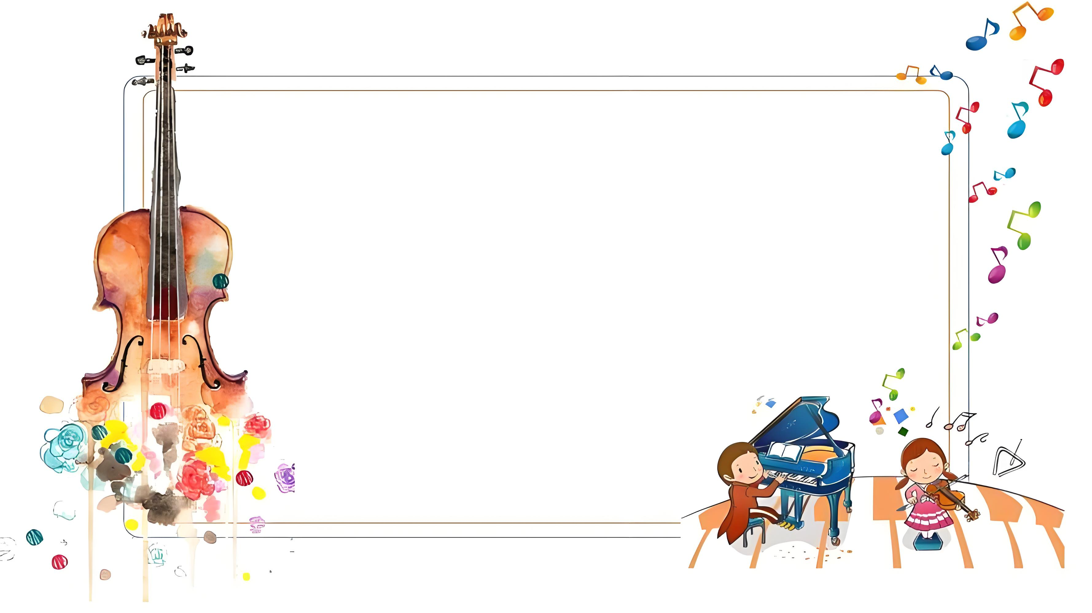
Music and Me
—2025.2月名校协作体
高三应用文演讲稿分析

Slide 3

What makes a good speech?
Lead in
Clear Structure结构清晰
Strong Logic逻辑性强
Personalization个人化
Vivid Language语言生动
Interactivity互动性
Emotional Resonance情感共鸣
Accurate Grammar语法准确
Relevant Content内容相关
Time Management时间控制
Strong Conclusion结尾有力

Slide 4
Analyze
theme :
Music and Me
Audience: judges/teachers/schoolmates
假定你是李华，你将参加你校举办的“Music and Me”主题演讲比赛，请撰写一份演讲稿，内容包括：（1）分享你和音乐的故事；（2）音乐对你的影响
story
influence/impact
What do the underlined parts tell us?
What’s the structure of this speech?
What’s the main content should be included in each part ?

Slide 5
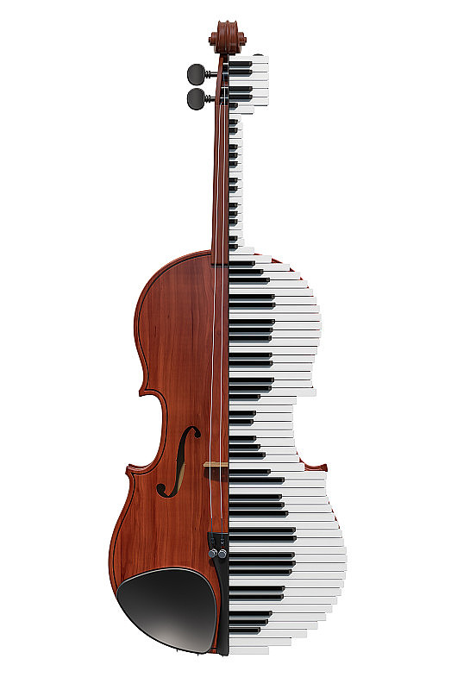
Free Talk
What is most challenging for you in this writing assignment?
Possible difficulties:
1.Construct the structure of the speech clearly
2.Arrange all parts logically
3.Choose proper music story to share
4.Make a good conclusion for this speech
...

Slide 6
Construct
Greet the audience
Opening
State the theme
Story
correspondingrelated
speech
Body
logic?
Influence
Closing
Summarize/anticipate/appeal/appreciate

Slide 7
How to Choose a Good Story About Music and Me?
Brainstorm
Dimensions for Story Selection:
01
Musical Beginnings音乐启蒙
02
Learning Journey学习经历
Memorable Moments难忘时刻
03
04
05
Emotional Connection情感连接
Personal Growth个人成长
06
Social Connections社交互动

Slide 8

Practice
Story +Influence
1.Musical Beginnings
Tips:How did you first encounter music? Was it through family influence, school programs, or a chance opportunity?
音乐启蒙: 你是如何开始接触音乐的？是家庭影响，还是学校课程，或是偶然的机会？
Example :
Story ： 我六岁时，父母送我一架钢琴作为生日礼物。从那天起，我每天练习简单的旋律，逐渐爱上了黑白键间流淌的美妙音符。
At the age of six, my parents gifted me a piano for my birthday. From that day on, I practiced simple melodies daily, gradually falling in love with the beautiful notes flowing between the black and white keys.
Influence： 音乐启蒙点燃了我对艺术的热情，培养了我对美的感知能力。
Musical beginnings ignited my passion for art and nurtured my ability to perceive beauty.

Slide 9
Practice
Story +Influence
2.Learning Journey
Tips:What was your experience learning music? What challenges did you face, and what did you gain?
学习经历: 你学习音乐的过程是怎样的？遇到过哪些挑战和收获？
Example :
Story ： 学习钢琴的过程中，我曾因复杂的乐谱感到挫败，但在老师的鼓励下，我坚持每天练习，最终成功演奏了肖邦的《夜曲》。
While learning the piano, I once felt defeated by complex sheet music, but with my teacher’s encouragement, I practiced daily and eventually mastered Chopin’s Nocturne.
Influence： 这段经历教会了我毅力和专注，也让我明白了努力的价值。
This experience taught me perseverance and focus, and made me understand the value of hard work.

Slide 10
Practice
Story +Influence
3.Memorable Moments
Tips: Were there any special moments tied to music? For example, your first performance, a competition, or meeting a musician.
难忘时刻: 有没有因为音乐而经历过的特别时刻？例如第一次登台表演、参加比赛、与音乐人相遇等。
Example :
Story 1 ： 在我十五岁时，我第一次在学校音乐会上独奏。尽管紧张得手心出汗，但当掌声响起时，我感到前所未有的成就感。
At fifteen, I performed my first solo at a school concert. Though my palms were sweaty with nerves, the applause filled me with an unparalleled sense of achievement.
Influence： 这次经历让我克服了舞台恐惧，增强了自信心，也让我爱上了与观众分享音乐的感觉。
This experience helped me overcome stage fright, boosted my confidence, and made me fall in love with sharing music with an audience.

Slide 11
Practice
Story +Influence
3.Memorable Moments
Example :
Story2： 在一次国际音乐节上，我演奏了中国传统曲目《茉莉花》，外国观众的热烈反响让我深感文化自豪。
At an international music festival, I performed the traditional Chinese piece Jasmine Flower, and the enthusiastic response from foreign audiences filled me with cultural pride.
Influence：这次经历让我更加珍惜自己的文化根源，也让我意识到音乐是跨越文化界限的桥梁。
This experience deepened my appreciation for my cultural roots and made me realize music is a bridge across cultural boundaries.

Slide 12
Practice
Story +Influence
4.Emotional Connection
Tips:How does music affect your emotions? Do you use it to express feelings, relieve stress, or find inspiration?
情感连接: 音乐如何影响你的情绪？你是否会用音乐来表达情感、缓解压力、寻找灵感？
Example :
Story ： 高中时，我经历了一段低谷期。每当感到孤独，我就会弹奏贝多芬的《月光奏鸣曲》，音乐成了我情感的避风港。
In high school, I went through a low period. Whenever I felt lonely, I would play Beethoven’s Moonlight Sonata, and music became my emotional sanctuary.
Influence：音乐让我学会了用艺术表达情感，也帮助我在困境中找到内心的平静。
Music taught me to express emotions through art and helped me find inner peace during tough times.

Slide 13
Practice
Story +Influence
5.Personal Growth
Tips:How has music shaped your personality, values, or outlook on life?
个人成长: 音乐对你的性格、价值观、生活态度等方面产生了哪些积极的影响？
Example :
Story ： 通过多年的音乐学习，我不仅掌握了演奏技巧，还学会了如何规划时间、设定目标并一步步实现它们。
Through years of music study, I not only mastered skills in performing but also learned to manage time, set goals, and achieve them step by step.
Influence： 音乐塑造了我的自律性和目标导向思维，这些品质在其他领域也让我受益匪浅。
Music shaped my discipline and goal-oriented mindset, qualities that have benefited me in other areas as well.

Slide 14
Practice
Story +Influence
6.Social Connections
Tips:How has music helped you connect with others? Have you made friends or joined groups through music?
社交互动: 音乐如何帮助你与他人建立联系？你是否通过音乐结识了朋友、参与了团体活动？
Example :
Story ： 高中时，我加入了学校的交响乐团。与来自不同背景的乐手合作，我们共同创造了令人难忘的音乐瞬间。
In senior high school, I joined the school orchestra. Collaborating with musicians from diverse backgrounds, we created unforgettable musical moments together.
Influence： 这段经历让我学会了团队合作，也让我通过音乐结识了志同道合的朋友。
This experience taught me teamwork and helped me make like-minded friends through music.

Slide 15






How to write a strong conclusion for this Speech?
Think
02
总结核心观点 (Summarize the Core Message)
01
呼吁共鸣
(Call for Resonance)
03
以情感收尾
(End with Emotion)
结合故事
(Tie Back to Your Story)
05
04
展望未来
(Look to the Future)

Slide 16
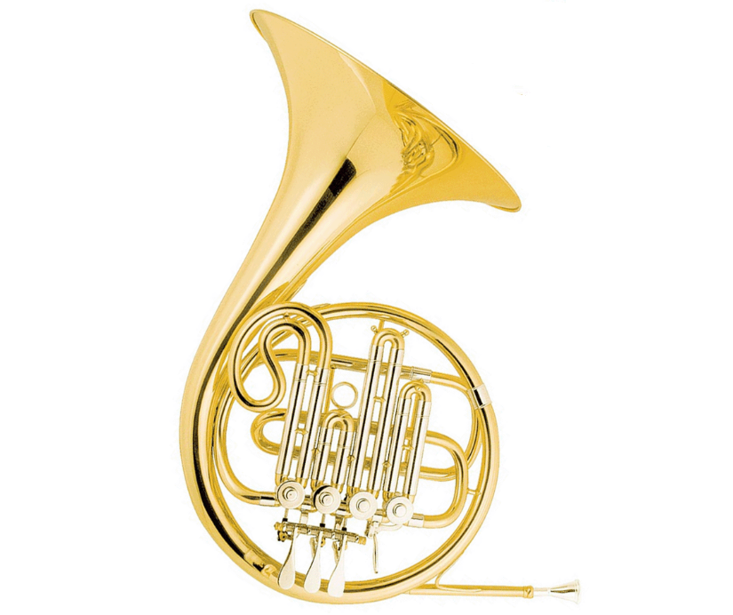
Practice
1. 总结核心观点 (Summarize the Core Message)
Summarize the importance of music in your life in concise language, echoing the theme of the speech.用简洁的语言重申音乐对你的重要性，呼应演讲的主题。
Example:
总之，音乐不仅丰富了我的生活，还让我在情感上得到了极大的满足。
In conclusion, music has not only enriched my life but also provided me with immense emotional fulfillment.

Slide 17
Practice
2. 呼吁共鸣 (Call for Resonance)
通过提问或号召，鼓励听众思考音乐在他们生活中的意义。
Encourage the audience to reflect on the role of music in their lives through a question or call to action.
Example:
我希望大家都能找到属于自己的音乐，让它成为你们生活中的一部分。
I hope everyone can find their own music and let it become a part of their lives.

Slide 18
Practice
3. 以情感收尾 (End with Emotion)
用一句富有感染力的话结束，给听众留下深刻印象。
End with a powerful, emotional statement that leaves a lasting impression.
Example:
Music is not just sound; it is the heartbeat of our souls. Let it guide you, heal you, and remind you of the beauty in life.
音乐不仅仅是声音，它是我们灵魂的心跳。让它指引你、治愈你，并提醒你生活中的美好。
记住，音乐不仅是声音，它是生活的旋律。
Remember, music is not just sound; it is the melody of life.

Slide 19
Practice
4. 展望未来 (Look to the Future)
表达对未来的期待，强调音乐将继续影响你的生活。
Express hope for the future, emphasizing how music will continue to influence your life.
Example:
As I move forward, I know music will remain a constant source of strength and joy. I can’t wait to see where this journey takes me next.
在未来的路上，我知道音乐将始终是我力量和快乐的源泉。我迫不及待地想看看这段旅程将带我去向何方。

Slide 20
Practice
5. 结合故事 (Tie Back to Your Story)
回到演讲开头提到的故事，形成一个完整的叙事闭环。
Return to the story you shared at the beginning, creating a full narrative circle.
Example:
Just like that little girl who first touched the piano keys, I still believe in the magic of music. It has been my guide then, and it will be my guide forever."
就像那个第一次触碰钢琴键的小女孩一样，我依然相信音乐的神奇。它曾经是我的指引，也将永远是我的指引

Slide 21


Sample writing one
Hello, everyone!
My name is Li Hua, and I’m thrilled to share with you my journey of “Music and Me”.
From a tender age, music has been my soul companion, whispering stories joy and sorrow through melodies. It was the piano’s gentle notes that first captivated my heart, leading me to explore a world of harmonies and rhythms.
Music has shaped me in more ways than one. It’s been my sanctuary, healing my wounds and igniting my passions. Through its magic, I’ve learned empathy, resilience, and the art of expressing the inexpressible.
Thank you for letting me share this harmonious bond between music and me.
That's all. Thank you!

Slide 22
Sample writing two
Hello, everyone!
I’m Li Hua and today I’m honored to share with you my journey of “Music and Me”.
Music, like an invisible thread, has woven my past, present, and future together. Since childhood, I’ve been captivated by the melodies my mother played on the piano—my first glimpse into the world of music. At ten, I picked up the violin and began my musical journey. Though practice was challenging, the moment I performed on stage for the first time, all my efforts transformed into priceless fulfillment.
Not only does music taught me perseverance and focus, but it also provides a sanctuary of peace in a chaotic world. It is both a comfort to my soul and a witness to my growth.
That's all. Thank you!

Slide 23
Sample writing three
Hello, everyone!
My name is Li Hua, and I’m thrilled to share with you my journey of “Music and Me”.
To me, music is not just a combination of melodies but witnesses my growth. At fifteen, I performed my first solo at a school concert. Though my palms were sweaty with nerves, the applause filled me with an unparalleled sense of achievement.
It is music that helps me overcome stage fright, boost my confidence, and find inner peace during tough times.
Remember, music is not just sound; it is the melody of life.I hope all of you can find your own music and let it guide you, heal you, and remind you of the beauty in life.
Thank you!

Slide 24





Homework
1.Polish your writing.
2.Memorize the 25 advanced expressions about Music from the following aspects.
Music significance
音乐意义
Music function
音乐功能
Performing experience
难忘时刻
Musical Beginnings
音乐启蒙
Learning Journey
学习经历

Slide 25

Thank you!

