Slide 1


感恩遇见，相互成就，本课件资料仅供您个人参考、教学使用，严禁自行在网络传播，违者依知识产权法追究法律责任。
更多教学资源请关注
公众号：溯恩英语
知识产权声明

Slide 2


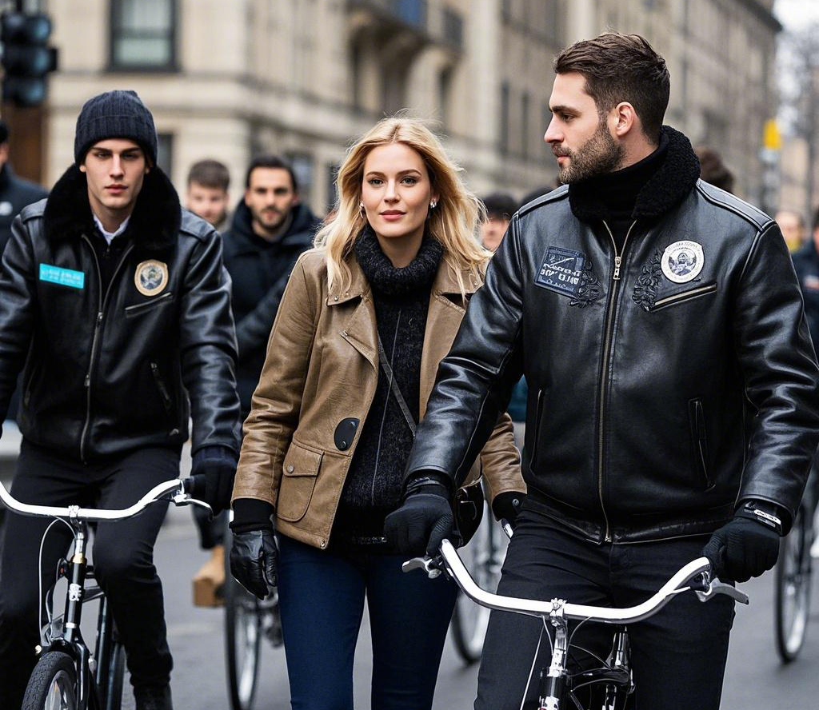

2025年01八省联考续写
摩托车手与流浪狗：
特别的纪录片之夜
关注续写微技能：前文取材和情节创新点
Judyliu

Slide 3
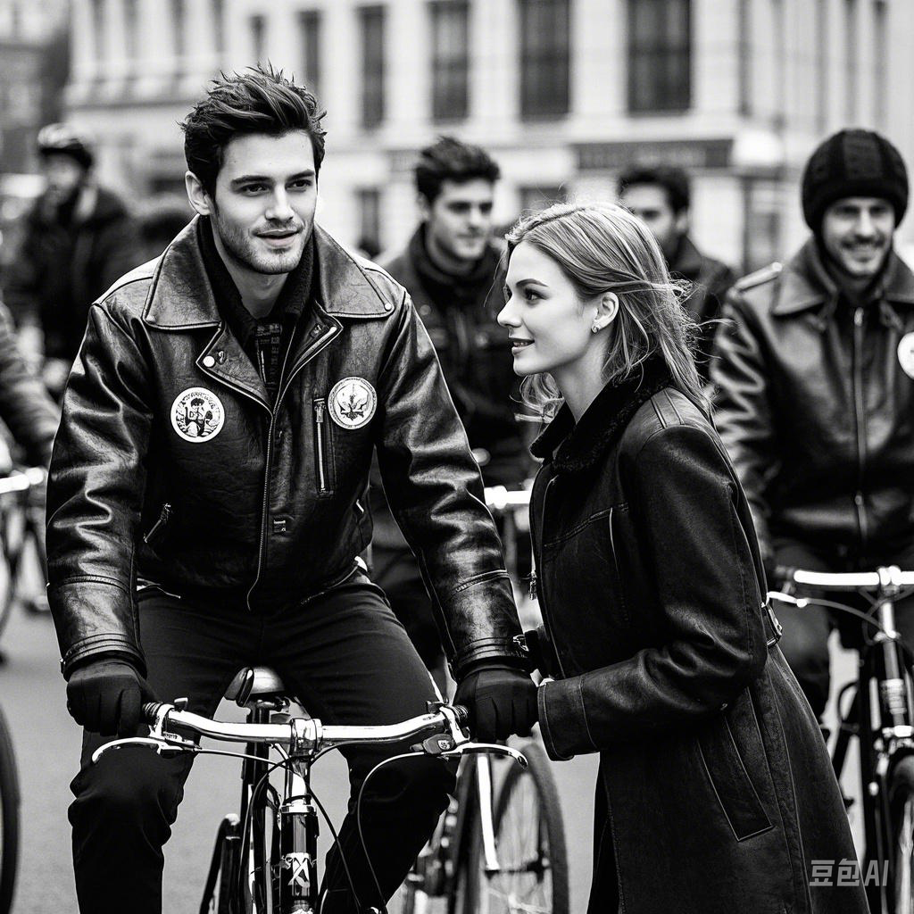
读原文 找出记叙文要素
2025年01八省联考续写
I was in Philadelphia for a conference when I saw an ad in the hotel. A nearby theater was showing a documentary (纪录片) about several local animal shelters that were helping to save abandoned dogs across the country. I love animals, and I felt an urge to go to this fundraising event. However, none of my co-workers would go with me, and I was worried about walking on the street alone at night.
I resigned myself to spending the evening in my hotel room, but as soon as I got back to my room I felt restless and bored. The theater where the event was taking place was only about five blocks from the hotel, and the area around the hotel didn’t seem particularly dangerous. So, I decided to brave it. I gathered up my wallet and room key and set off.
It was already getting dark and the streets were nearly deserted. I managed to find the street the theater was on, but when I turned the corner, I stopped in shock. In front of the theater were a group of bikers — very big, tough-looking bikers.
I’ve known lots of motorcycle enthusiasts and most are nice people. However, in this case, I was a woman all alone, in a strange neighborhood, at night, and there were twenty or so very large men — all wearing insignia (徽章) that indicated they were in some sort of club — standing before me. Warning bells began to sound in my head, and my heart was pounding. Was I at the right theater? Had I misread the date of the event?
A sign outside the theater told me that I was in the right place on the right evening. Nevertheless, I wondered if I should rush back to my hotel instead of walking through that crowd of bikers. I finally decided that I would be safer inside the theater. Hopefully, the bikers would have gone away by the time the film was over.
P1:I hurried into the theater, only to find there were even more bikers inside.
P2:When the film began, I realized that the bikers were an animal rescue group.

Slide 4
记叙文要素
Time | When the author was in Philadelphia for a conference (implied as an ongoing period)I n the evening, when it was getting dark
Place | Philadelphia (the city where the story takes place) The street leading to the theater near the hotel The theater where the documentary was being shown
Characters | The author (a woman attending a conference who loves animals) A group of bikers
Contradiction | The author wanted to attend a fundraising event at a nearby theater to watch a documentary about animal shelters. She was worried about walking alone at night. When she arrived at the theater, she was intimidated by a group of tough - looking bikers outside and inside the theater, which made her question her safety and whether she should leave.
Emotional Line: | Initial interest: The author felt an urge to go to the fundraising event when she saw the ad about the animal - related documentary. Resignation: Since no co - workers would go with her and she was worried about walking alone at night, she resigned herself to staying in the hotel room. Restlessness and boredom: After getting back to the room, she felt restless and bored, which led her to change her mind and decide to go to the event. Shock and fear: When she saw the group of bikers in front of the theater, she was shocked and afraid, with warning bells in her head and her heart pounding. Hesitation: She hesitated between rushing back to the hotel and entering the theater, worried about her safety among the bikers.
Theme: 1True character is not defined by outward appearances but by actions and intentions. It encourages readers to avoid making snap judgments based on looks alone.
2This theme highlights how love for animals can serve as a universal language, bringing people together and fostering connections that might not otherwise exist.
3 The story highlights how appearances can be misleading and encourages readers to look beyond stereotypes. It shows that courage and an open mind can lead to unexpected positive experiences.

Slide 5
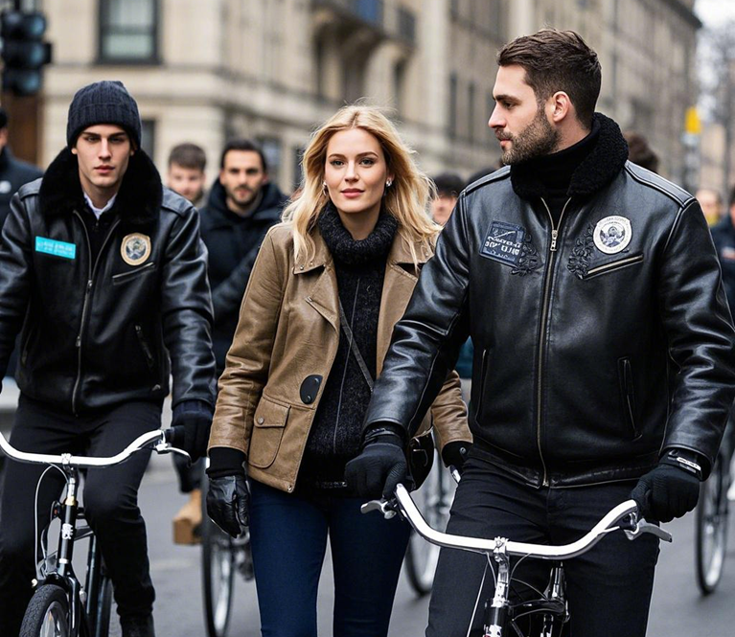
读原文 ，寻找可以“前文取材” 伏笔
I was in Philadelphia for a conference when I saw an ad in the hotel. A nearby theater was showing a documentary (纪录片) about several local animal shelters that were helping to save abandoned dogs across the country. I love animals, and I felt an urge to go to this fundraising event. However, none of my co-workers would go with me, and I was worried about walking on the street alone at night.
I resigned myself to spending the evening in my hotel room, but as soon as I got back to my room I felt restless and bored. The theater where the event was taking place was only about five blocks from the hotel, and the area around the hotel didn’t seem particularly dangerous. So, I decided to brave it. I gathered up my wallet and room key and set off.
It was already getting dark and the streets were nearly deserted. I managed to find the street the theater was on, but when I turned the corner, I stopped in shock. In front of the theater were a group of bikers — very big, tough-looking bikers.
I’ve known lots of motorcycle enthusiasts and most are nice people. However, in this case, I was a woman all alone, in a strange neighborhood, at night, and there were twenty or so very large men — all wearing insignia (徽章) that indicated they were in some sort of club — standing before me. Warning bells began to sound in my head, and my heart was pounding. Was I at the right theater? Had I misread the date of the event?
A sign outside the theater told me that I was in the right place on the right evening. Nevertheless, I wondered if I should rush back to my hotel instead of walking through that crowd of bikers. I finally decided that I would be safer inside the theater. Hopefully, the bikers would have gone away by the time the film was over.
P1:I hurried into the theater, only to find there were even more bikers inside.
P2:When the film began, I realized that the bikers were an animal rescue group.
可前文取材的伏笔种类
1人物动作表情可以变化或重复
2人物的心理活动可以变化或困惑有了结果
3人物对话可以重复或呼应
4 前文的环境和工具再利用

Slide 6
情节搭建
P1:I hurried into the theater, only to find there were even more bikers inside.
1 What did the she feel when she saw more bikers inside the theater?
2 How did the bikers react when she entered the theater? Did they notice her ?
3 Did she try to talk to anyone, or did she keep to herself?
4 What thoughts were running through my mind as she waited for the film to start?
P2:When the film began, I realized that the bikers were an animal rescue group.
1 What was the scenes of the documentary, and how did it capture her attention?
2 How did the bikers react to the film? Did they show any emotions or gestures?
3 Did she overhear any conversations among the bikers that confirmed their involvement in animal rescue?
4 What kind of gains and reflections did the author have through this incident?
心理活动表达微技能：高级句型+语法
创新点：电影院里的小插曲
创新点：纪录片里的车手们做的事情
创新点：结尾设计+立意提升

Slide 7
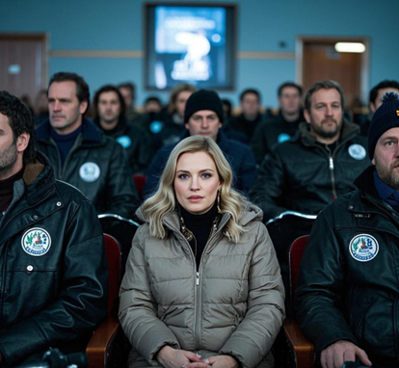
P1:I hurried into the theater, only to find there were even more bikers inside.
1 What did the she feel when she saw more bikers inside the theater?
前文取材+ 五感写环境
警报声再次在我脑海中响起，我的心跳得更厉害了。（前文取材）
The warning bells sounded in my head again, and my heart was pounding even harder.
剧院里灯光昏暗，空气中弥漫着一股淡淡的皮革和机油的味道，显然是摩托车手们的夹克和装备散发出的气息。耳边传来低沉的交谈声和偶尔爆发的笑声，声音在空旷的剧院里回荡，仿佛一层层声浪将我包围。我环顾四周，摩托车手们到处都是——成群地坐着，有的靠在椅背上，有的俯身向前，手里拿着饮料或零食。他们的靴子在地板上发出沉重的脚步声，偶尔还能听到金属链条碰撞的清脆声响。（ 五感写环境）
The theater was dimly lit, and the air carried a faint smell of leather and motor oil, clearly coming from the bikers' jackets and gear. Low voices and occasional bursts of laughter filled my ears, echoing through the empty theater like waves of sound surrounding me. I looked around and saw bikers everywhere—sitting in groups, some leaning back in their seats, others leaning forward, holding drinks or snacks. Their boots made heavy footsteps on the floor, and now and then, I could hear the crisp clinking of metal chains.

Slide 8
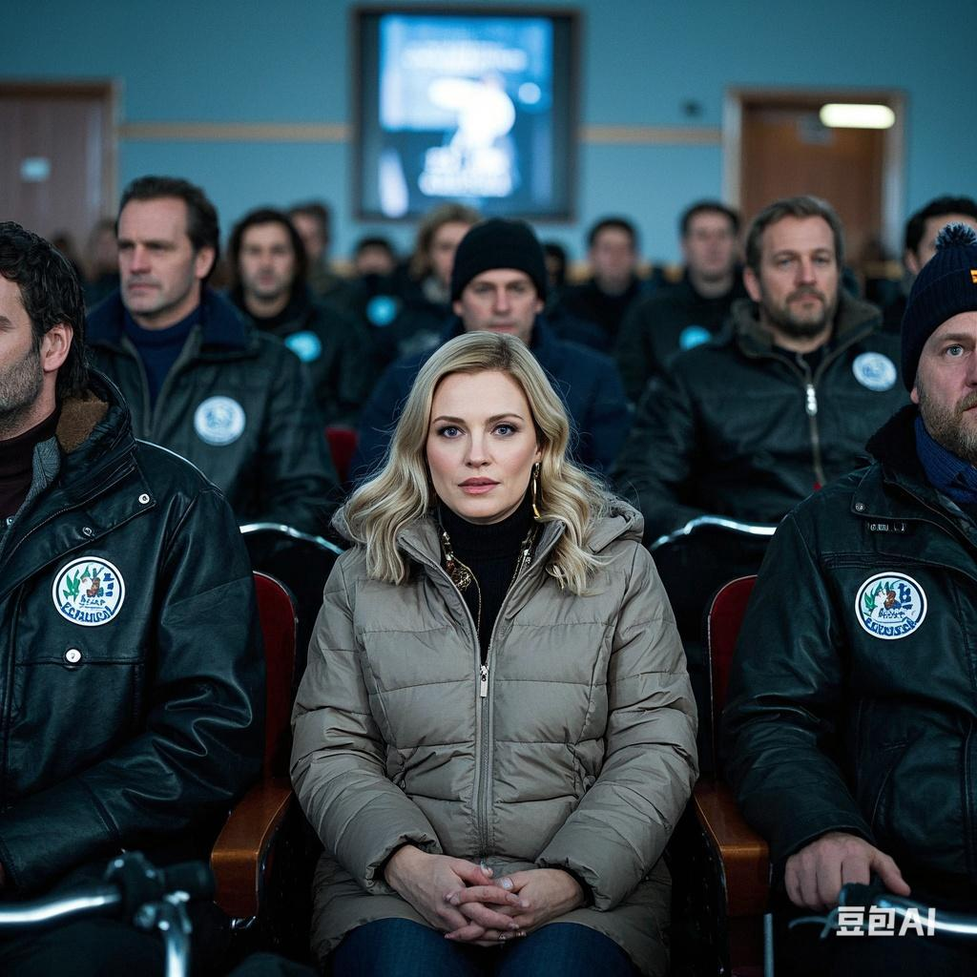
P1:I hurried into the theater, only to find there were even more bikers inside.
1 How did the bikers react when she entered the theater?
前文取材+心理活动+虚拟+排比
要是我没有那么愚蠢，独自一人走过那五个街区来到这家剧院就好了。要是我没有那么鲁莽，以为自己可以鼓起勇气独自来到这里就好了。
If only I hadn’t been so foolish as to walk those five blocks alone and come to this theater. If only I hadn’t been so reckless as to think I could brave coming here all by myself.

Slide 9
P1:I hurried into the theater, only to find there were even more bikers inside.
创新点：电影院里的小插曲A:幽默的车手
2 How did the bikers react when she entered the theater
3 Did she try to talk to anyone, or did she keep to herself?
4 What thoughts were running through my mind as she waited for the film to start?
对话+ 人物刻画
就在我正要离开的时候，一个骑车人转过身来对我咧嘴一笑。他那粗犷的面容因洋溢的暖意而变得柔和，这暖意驱散了我的紧张。“第一次来这儿？” 他问道，声音沙哑却透着友好。我点点头，他往后靠了靠，轻笑起来。“放松点，我们可不是怪物 —— 除非你是只流浪狗！” 他眨了眨眼，“那样的话，我们可能会追你…… 只为给你一个家。”
Just as I was about to leave, a biker turned to me and grinned. His rough face softened with a warmth that melted my nerves. "First time here?" he asked, his voice like gravel but friendly. I nodded. He leaned back, chuckling. "Relax, we’re not monsters—unless you’re an abandoned dog!" He winked. "Then we might chase you… to give you a home." His playful tone startled me into a laugh.

Slide 10
P1:I hurried into the theater, only to find there were even more bikers inside.
创新点：电影院里的小插曲B：送徽章的车手
2 How did the bikers react when she entered the theater
3 Did she try to talk to anyone, or did she keep to herself?
4 What thoughts were running through my mind as she waited for the film to start?
对话+ 人物刻画
就在我准备离开的时候，一个摩托车手转过脸来对我微笑。他那看起来粗犷的面容因和善的神情而变得柔和。他非常有礼貌地和我攀谈起来。“这是你第一次来这儿吗？” 他问道。接着，他把手伸进口袋，掏出一枚勋章，递给我。“这是给你的。” 他温柔地说。我有点困惑，但他礼貌又热忱的态度渐渐驱散了我的恐惧.
Just as I was about to leave, a biker turned his face towards me and smiled. His rough - looking face softened with a kind expression. He started a conversation with me very politely. "Is this your first time here?" he asked. Then, he reached into his pocket, pulled out a insignia, and handed it to me. "This is for you," he said gently. I was a bit confused but his polite and warm - hearted attitude gradually dispelled my fear.

Slide 11
P1:I hurried into the theater, only to find there were even more bikers inside.
过渡衔接二段首句
我们聊着聊着，不知不觉中，电影开始了。
As we chatted, time flew by unnoticed, and before we knew it, the movie started.
P2:When the film began, I realized that the bikers were an animal rescue group.

Slide 12
P2:When the film began, I realized that the bikers were an animal rescue group.
纪录片里的车手们做的事情
1 What was the scenes of the documentary, and how did it capture her attention?
2 How did the bikers react to the film? Did they show any emotions or gestures?
举例+ 动作描写
随着纪录片的播放，我逐渐被流浪狗和拯救它们的摩托车手的故事吸引。屏幕上，摩托车手们穿过雨夜的街道，车头灯划破黑暗。一个镜头中，车手用粗糙却温柔的手将颤抖的小狗裹进毯子；另一个画面里，一群车手合力从瓦砾中救出一只被困的狗，他们的脸上沾满泥土，但目光坚定而专注。”
As the documentary played, I found myself drawn into the stories of the rescued dogs and the bikers who saved them. The screen showed bikers riding through rain-soaked streets, their headlights cutting through the darkness. One scene captured a biker cradling a shivering puppy in his arms, his rough hands surprisingly gentle as he wrapped it in a blanket. Another moment showed a group of bikers working together to free a dog trapped under rubble, their faces streaked with dirt but eyes focused and determined.

Slide 13
P2:When the film began, I realized that the bikers were an animal rescue group.
2 How did the bikers react to the film? Did they show any emotions or gestures?
举例+排比
剧院里的摩托车手们与屏幕上的情感共鸣——当伤痕累累的灵缇犬蹦跳着奔向新家时，他们爆发出欢呼；当救援濒临失败时，连空气都凝固成紧绷的弦。每个故事都让我心底泛起涟漪。
The bikers in the theater mirrored the emotions on screen. When a scarred dog pranced into its new home, they erupted into cheers; when a rescue teetered on the edge of failure, the air seemed to freeze into a taut string. Each story sent ripples through my heart.

Slide 14
P2:When the film began, I realized that the bikers were an animal rescue group.
3 What kind of gains and reflections did the author have through this incident?
反差法：
那一夜让我明白，皮夹克和轰鸣的引擎下可能藏着最柔软的心。有时候，最坚硬的外壳守护着世间最深的善意。
That night taught me that leather jackets and roaring engines can hide the gentlest hearts. Sometimes, the world’s toughest exteriors guard its deepest kindness.
创新点：结尾设计+立意提升A反差法

Slide 15
P2:When the film began, I realized that the bikers were an animal rescue group.
3 What kind of gains and reflections did the author have through this incident?
前文伏笔：
were a group of bikers — very big, tough-looking bikers.
A sign outside the theater told me that I was in the right place on the right evening.
排比+前文取材：
这些高大、强悍的摩托车手和纪录片一起告诉我，我来对了地方，也来对了时间。
It was these big, tough-looking bikers along with the documentary that told me I was in the right place on the right night.
创新点：结尾设计+立意提升B 前文取材

Slide 16
P2:When the film began, I realized that the bikers were an animal rescue group.
3 What kind of gains and reflections did the author have through this incident?
修辞提升：拟人
看着手中的徽章，我感觉它仿佛在对我微笑，说着：“你属于这里，在这些心怀热忱、能有所作为的人中间。”
Looking at the insignia in my hand, I felt as if it were smiling at me, saying, "You belong here, among these people who care enough to make a difference."
创新点：结尾设计+立意提升C 修辞提升

Slide 17
P2:When the film began, I realized that the bikers were an animal rescue group.
创新点：结尾设计+立意提升D 名言警句
3 What kind of gains and reflections did the author have through this incident?
名言警句
当我走回酒店时，城市似乎变得更安静、更柔和，仿佛世界暂停了下来，让我有时间反思。这让我想起了海伦·凯勒的一句话：“人生要么是一场大胆的冒险，要么就什么都不是。” 那一夜，我勇敢地踏入了未知，而在这样做时，我找到了自己的同伴！
As I walked back to the hotel, the city seemed to become quieter and gentler, as if the world had paused, giving me time to reflect. This reminded me of a quote from Helen Keller: "Life is either a daring adventure or nothing at all." That night, I bravely stepped into the unknown, and in doing so, I found my kindred spirits!

Slide 18
P2:When the film began, I realized that the bikers were an animal rescue group.
创新点：结尾设计+立意提升D 故事闭环
3 What kind of gains and reflections did the author have through this incident?
故事闭环
我迫不及待地想回到酒店，与同事们分享当晚奇妙的旅程，诉说如坐过山车般起伏不定的情绪，以及我所收获的感悟 。
I couldn't wait to get back to the hotel and share with my colleagues the magical journey of that night, as well as a roller - coaster of emotions and the gains I had experienced.

Slide 19
下水作文
P1:I hurried into the theater, only to find there were even more bikers inside. The warning bells sounded in my head again, and my heart was pounding even harder. The theater was dimly lit, and the air carried a faint smell of leather and motor oil, clearly coming from the bikers‘ jackets and gear. “If only I hadn’t been so foolish as to walk those five blocks alone and come to this theater. If only I hadn’t been so reckless as to think I could brave coming here all by myself. Just as I was about to leave, a biker turned to me and grinned. His rough face softened with a warmth that melted my nerves. "First time here?" he asked, his voice like gravel but friendly. I nodded. "Relax, we’re not monsters—unless you’re an abandoned dog!" He winked. His playful tone startled me into a laugh. As we chatted, time flew by unnoticed, and before we knew it, the movie started.”
P2:When the film began, I realized that the bikers were an animal rescue group. As the documentary played, I found myself drawn into the stories of the rescued dogs and the bikers who saved them. One scene captured a biker cradling a shivering puppy in his arms, his rough hands surprisingly gentle as he wrapped it in a blanket. Another moment showed a group of bikers working together to free a dog trapped under rubble, their faces streaked with dirt but eyes focused and determined. The bikers in the theater mirrored the emotions on screen. When a scarred dog pranced into its new home, they erupted into cheers; when a rescue teetered on the edge of failure, the air seemed to freeze into a taut string. Each story sent ripples through my heart. It was these big, tough-looking bikers along with the documentary that told me I was in the right place on the right night.

Slide 20
下水作文默写：
P1: I ____________________（1）怀着紧张又期待的心情，匆匆走进了剧院，only to find there were even more bikers inside. The warning bells _________________（2）瞬间在我脑海中尖锐地响起 again, and my heart was （3）剧烈跳动，仿佛要冲破胸膛 even harder. The theater was dimly lit, and the air carried a faint smell of leather and motor oil, clearly coming from the bikers‘ jackets and gear. “_________________（4）要是我没这么蠢，独自走过那五个街区来到这家剧院就好了。要是我没这么鲁莽，以为自己能独自勇敢来到这里就好了。 Just as I was about to leave, a biker turned to me and ____________________（5）脸上绽放出友好的笑容。His rough face softened with a warmth that melted my nerves. "First time here?" he asked, his voice like ____________________（6）粗糙的砂砾摩擦，但透着友善 but friendly. I nodded. "Relax, we’re not monsters—unless you’re an abandoned dog!" He winked. His playful tone startled me into a laugh. As we chatted, time flew by unnoticed, and before we knew it, the movie started.”
P2:When the film began, I realized that the bikers were an animal rescue group. As the documentary played, I found myself ____________________（7）不知不觉被深深吸引到那些获救狗狗和救助它们的骑行者的故事中。One scene captured a biker ____________________（8）小心翼翼地把一只瑟瑟发抖的小狗抱在怀里，his rough hands surprisingly gentle as he wrapped it in a blanket. Another moment showed a group of bikers working together to free a dog trapped under rubble, their faces ____________________（9）满是尘土，但眼神专注而坚定 but eyes focused and determined. The bikers in the theater ____________________（10）随着屏幕上的情节，真切地反映出各种情绪。When a scarred dog pranced into its new home, they ____________________（11）爆发出热烈的欢呼声；when a rescue teetered on the edge of failure, the air seemed to freeze into a taut string. Each story sent ripples through my heart. It was these big, tough-looking bikers along with the documentary that told me I was in the right place on the right night.

Slide 21
(1) Hurried into the theater with a mix of nervousness and anticipation
(2) Instantly rang sharply in my head
(3) Pounding violently as if it would burst out of my chest
(4) If only I hadn’t been so foolish as to walk those five blocks alone and come to this theater. If only I hadn’t been so reckless as to think I could brave coming here all by myself
(5) Broke into a friendly smile
(6) Rough gravel rubbing, yet full of friendliness
(7) Unconsciously deeply drawn into the stories of the rescued dogs and the bikers who saved them
(8) Cradling a shivering puppy carefully in his arms
(9) Streaked with dust
(10) Truly mirrored various emotions along with the plot on the screen
(11) Erupted into warm cheers

Slide 22

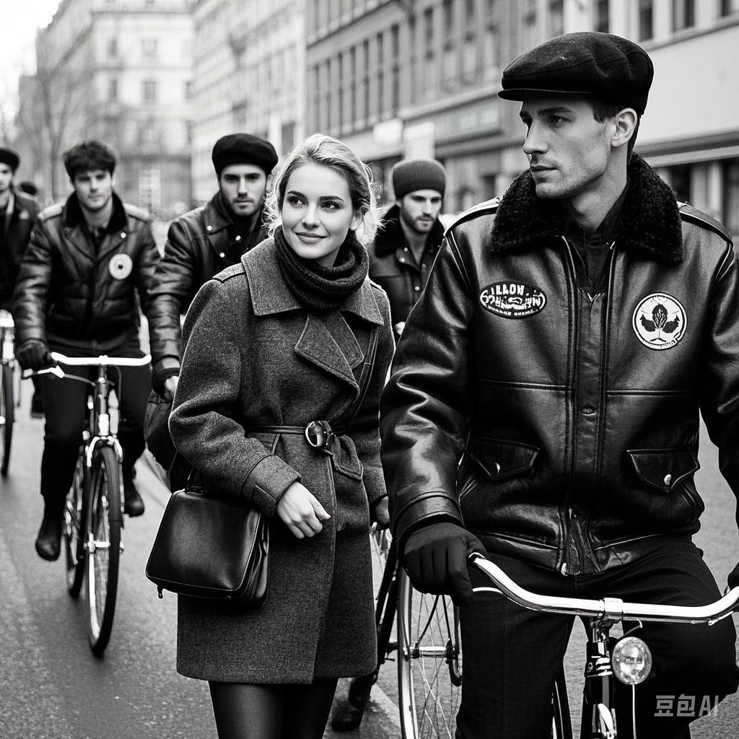
六月高考
加油！

