Slide 1



感恩遇见，相互成就，本课件资料仅供您个人参考、教学使用，严禁自行在网络传播，违者依知识产权法追究法律责任。
更多教学资源请关注
公众号：溯恩英语
知识产权声明

Slide 2

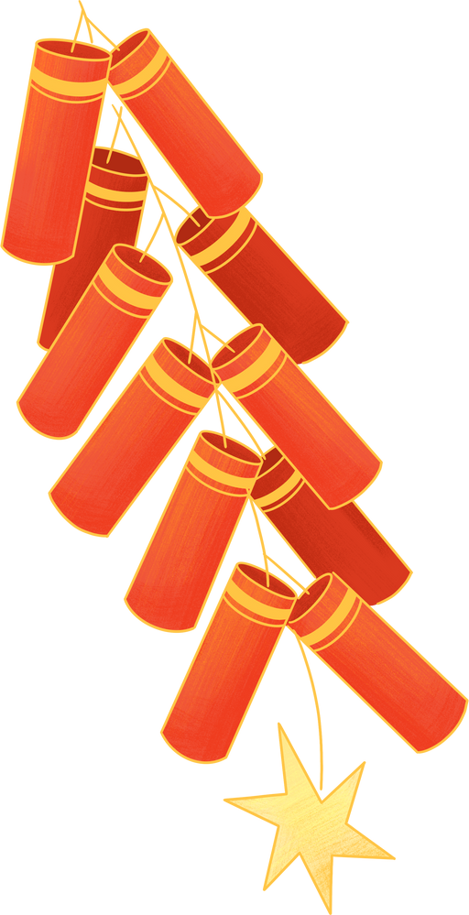



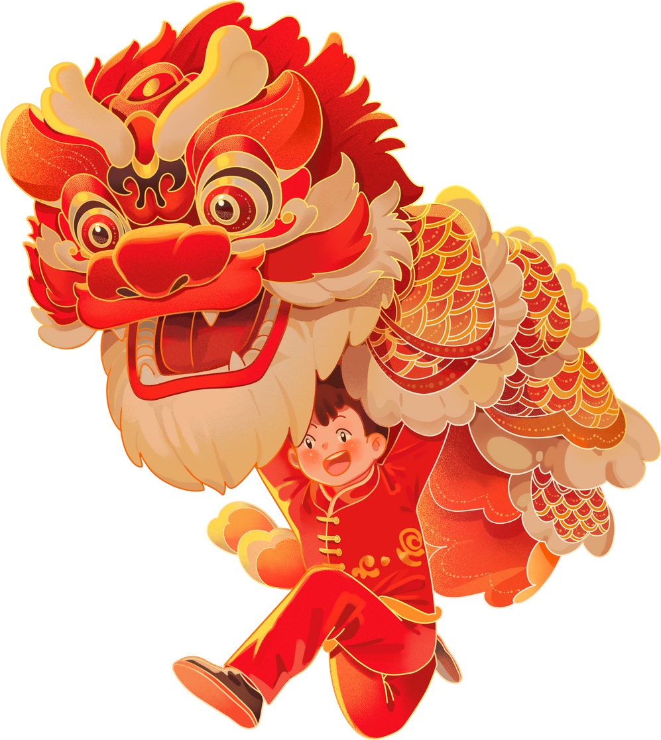
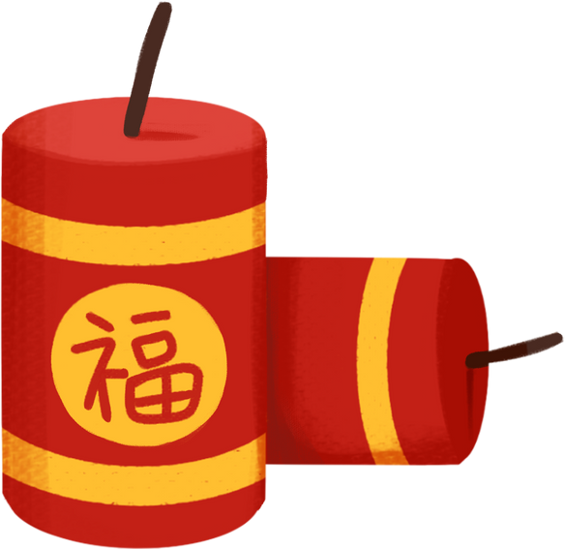


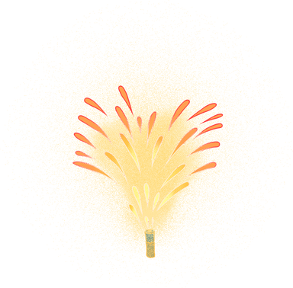

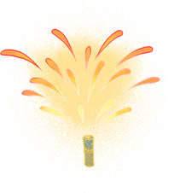
春节民俗体验
CHINESE NEW YEAR'S ACTIVITY EXPERIENCE
Fay 2025

Slide 3


Output-Driven Hypothesis
输出驱动
由文秋芳教授提出，强调“以输出为驱动，以输入为支撑，注重学习过程”
Define Output Goals
提供输入支持
设计输出任务
Provide Input Support
Design Authentic Output Tasks
持续循环与提升
提供反馈与改进
Continuous Cycling and Improvement
Provide Feedback and Facilitate Improvement

Slide 4
题目
假定你是李华，你的英国笔友 Tom 对近期申遗成功的中国春节很感兴趣，请你写一封邮件向他 介绍春节期间你所经历的一次民俗体验。内容包括：
1. 民俗体验过程。
2. 体会或感受。
参考词汇：folk-custom 民俗

Slide 5

Define Output Goals
Language aspect: To express ideas accurately and fluently, demonstrating English writing skills.
Cultural aspect: To introduce Chinese Spring Festival folk-customs, promote cultural exchange, and enhance cross-cultural awareness.
Structural aspect: To organize content according to the letter format, ensuring clarity and logical coherence.
Emotional aspect: To share personal experiences, express love for folk culture, and reflect on cultural inheritance.
Interactive aspect: To stimulate the pen pal’s interest and promote cultural exchange and interaction.

Slide 6
Provide Input Support
Structural aspect
假定你是李华，你的英国笔友 Tom 对近期申遗成功的中国春节很感兴趣，请你写一封邮件向他 介绍春节期间你所经历的一次民俗体验。内容包括：
1. 民俗体验过程。
2. 体会或感受。
参考词汇：folk-custom 民俗
文体类型 | 邮件/告知
交际对象 | 英国笔友 Tom
语言风格 | 友好轻松
篇章结构 | 开头+主体+结尾
内容要点 | 写信目的/背景+民俗/民俗体验过程+感受/交际

Slide 7
Provide Input Support
Cultural aspect
假定你是李华，你的英国笔友 Tom 对近期申遗成功的中国春节很感兴趣，请你写一封邮件向他介绍春节期间你所经历的一次民俗体验。内容包括：
1. 民俗体验过程。
2. 体会或感受。
参考词汇：folk-custom 民俗
民俗定义
春节民俗范畴
民俗体验过程

Slide 8
Provide Input Support
folk-customs
Folklore, also known as folk-customs, refers to the traditional customs, beliefs, stories, and practices that are passed down through generations within a particular culture or community. It encompasses a wide range of cultural expressions, including traditional arts, rituals, festivals, myths, legends, and social norms.
春节民俗
Spring Festival Folklore

Slide 9

贴“福”字（Pasting the Character "Fu"）
祭祖（Ancestor Worship）
春节民俗
逛庙会（Visiting Temple Fairs）
发红包（Giving Red Envelopes）
贴窗花（Pasting Paper-Cuttings）
舞龙舞狮（Dragon and Lion Dances）
Pasting Spring Couplets
Setting Off Firecrackers
Paying New Year's Visits
贴春联
守岁
放鞭炮
大扫除
拜年
吃年夜饭
Staying Up Late on New Year's Eve
Spring Cleaning
Reunion Dinner
包饺子（making dumplings）
……

Slide 10
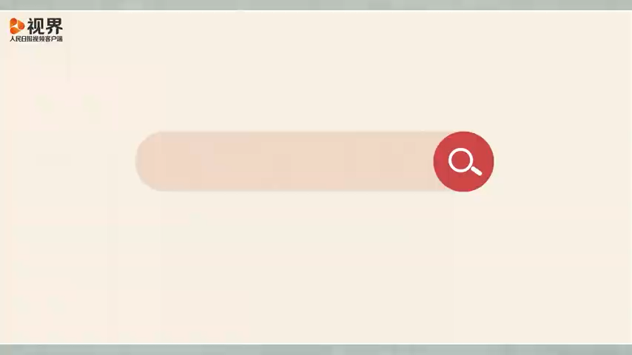
Provide Input Support
Folk customs of the Spring Festival

Slide 11

Provide Input Support
Significance of the Spring Festival

Slide 12
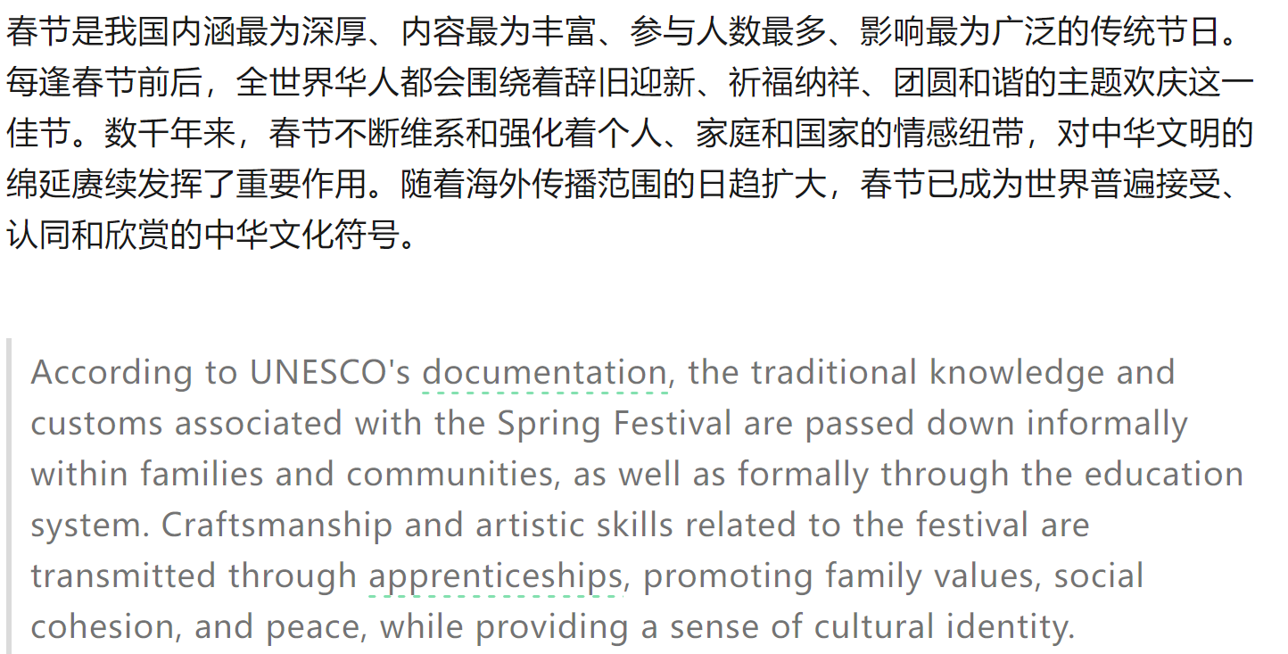
Provide Input Support
Significance of the Spring Festival

Slide 13
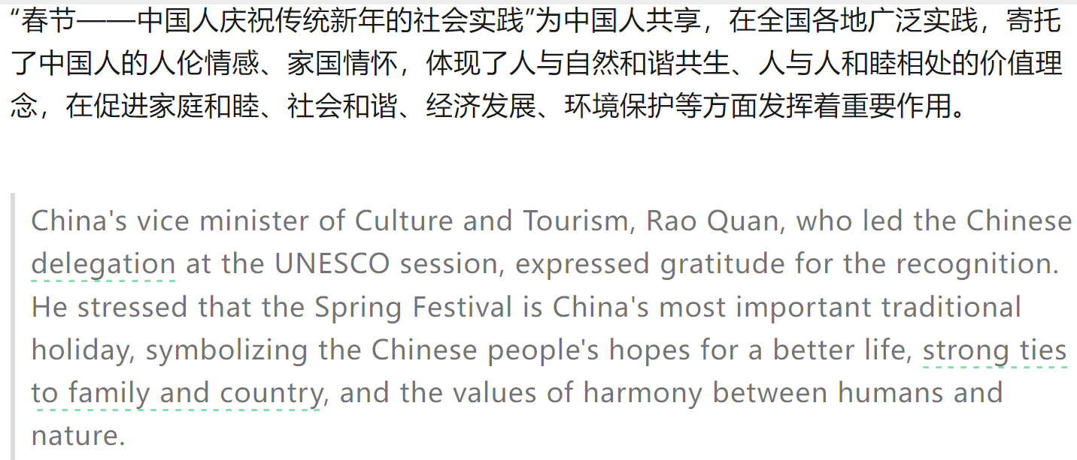
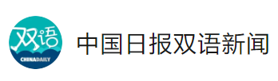
Provide Input Support
Significance of the Spring Festival
During the Spring Festival, a time for family reunions, the warmth and laughter around the dinner table only serve to deepen the bonds of affection.

Slide 14
Provide Input Support
Language aspect-- BEGINNING
简洁版：
Hearing that you've always been curious about the Spring Festival, I'm writing to tell you about a folk-custom experience I had during the Spring Festival.
亲切版：
Guess what? I just experienced the most amazing thing during the Spring Festival! Since you've shown such great interest in it, I thought I'd write and tell you all about it. This festival is super special to us Chinese, and there are so many cool traditions that make it really stand out. I'm sure you'll find it as fascinating as I do.
正式版：
Hope this email finds you well. I am writing to share with you an unforgettable folk-custom experience I had during the Spring Festival, which has recently been inscribed on the UNESCO list of Intangible Cultural Heritage. As you know, the Spring Festival is the most significant traditional festival in China, and it is rich with unique customs and cultural significance.

Slide 15
Provide Input Support
Language aspect--BODY
体验过程模式化：
To begin with/ To be specific, 活动安排①（完整句子）.This was followed by 活动安排②（动名词词块）. What mattered the most during the event was that...活动亮点内容（完整句子）, which 定语从句（活动意义/收获/感悟）
体验过程情绪化：
XXX was filled with joy and excitement. As we gathered 地点, the atmosphere was electric with anticipation. The process of doing 1. was a collaborative effort, with everyone doing2 and doing3 . …… More importantly, it was a moment of connection and shared tradition.
体验过程场景化：
Everyone was assigned a task. Some were busy doing 1, while others were doing2 and doing 3. The air was filled with laughter and chatter, creating a warm and festive atmosphere. As we worked together, we shared stories and traditions, making the experience not just about XXX but about bonding and preserving our cultural heritage.

Slide 16
Provide Input Support
Language aspect--ENDING
体会与感悟（个人感悟 文化价值 社会价值 ）
This experience not only brought us closer but also gave me a deeper appreciation for the traditions that have been passed down through generations.
This experience was a wonderful reminder of the importance of family and tradition, and it truly strengthened our sense of community and cultural identity.
The Spring Festival has shown me that our traditions have the power to unite us, to remind us of our shared humanity, and to inspire us to build a better world.
The Spring Festival is more than just a holiday; it's a celebration of our enduring cultural legacy.
……
交际互动：
I look forward to hearing about your own cultural celebrations and how they shape your community.
I felt a deep sense of pride and joy in being part of something so timeless and meaningful. I hope you get the chance to experience some of our traditions one day.
……

Slide 17
Output Tasks
简版
Hearing that you've always been curious about the Spring Festival, I'm writing to tell you about a folk-custom experience I had during the Spring Festival.
To begin with, we prepared the dough and filling for the dumplings. This was followed by rolling out the dough and wrapping the dumplings. When we finished the preparation, we all gathered around the table to enjoy the dumplings we had made together.
It made me realize how these traditions bring us closer and create memories that last a lifetime. I hope one day you can join us and feel the same warmth and happiness I felt during this special time.
假定你是李华，你的英国笔友 Tom 对近期申遗成功的中国春节很感兴趣，请你写一封邮件向他 介绍春节期间你所经历的一次民俗体验。内容包括：
1. 民俗体验过程。
2. 体会或感受。
参考词汇：folk-custom 民俗
包饺子（making dumplings）

Slide 18
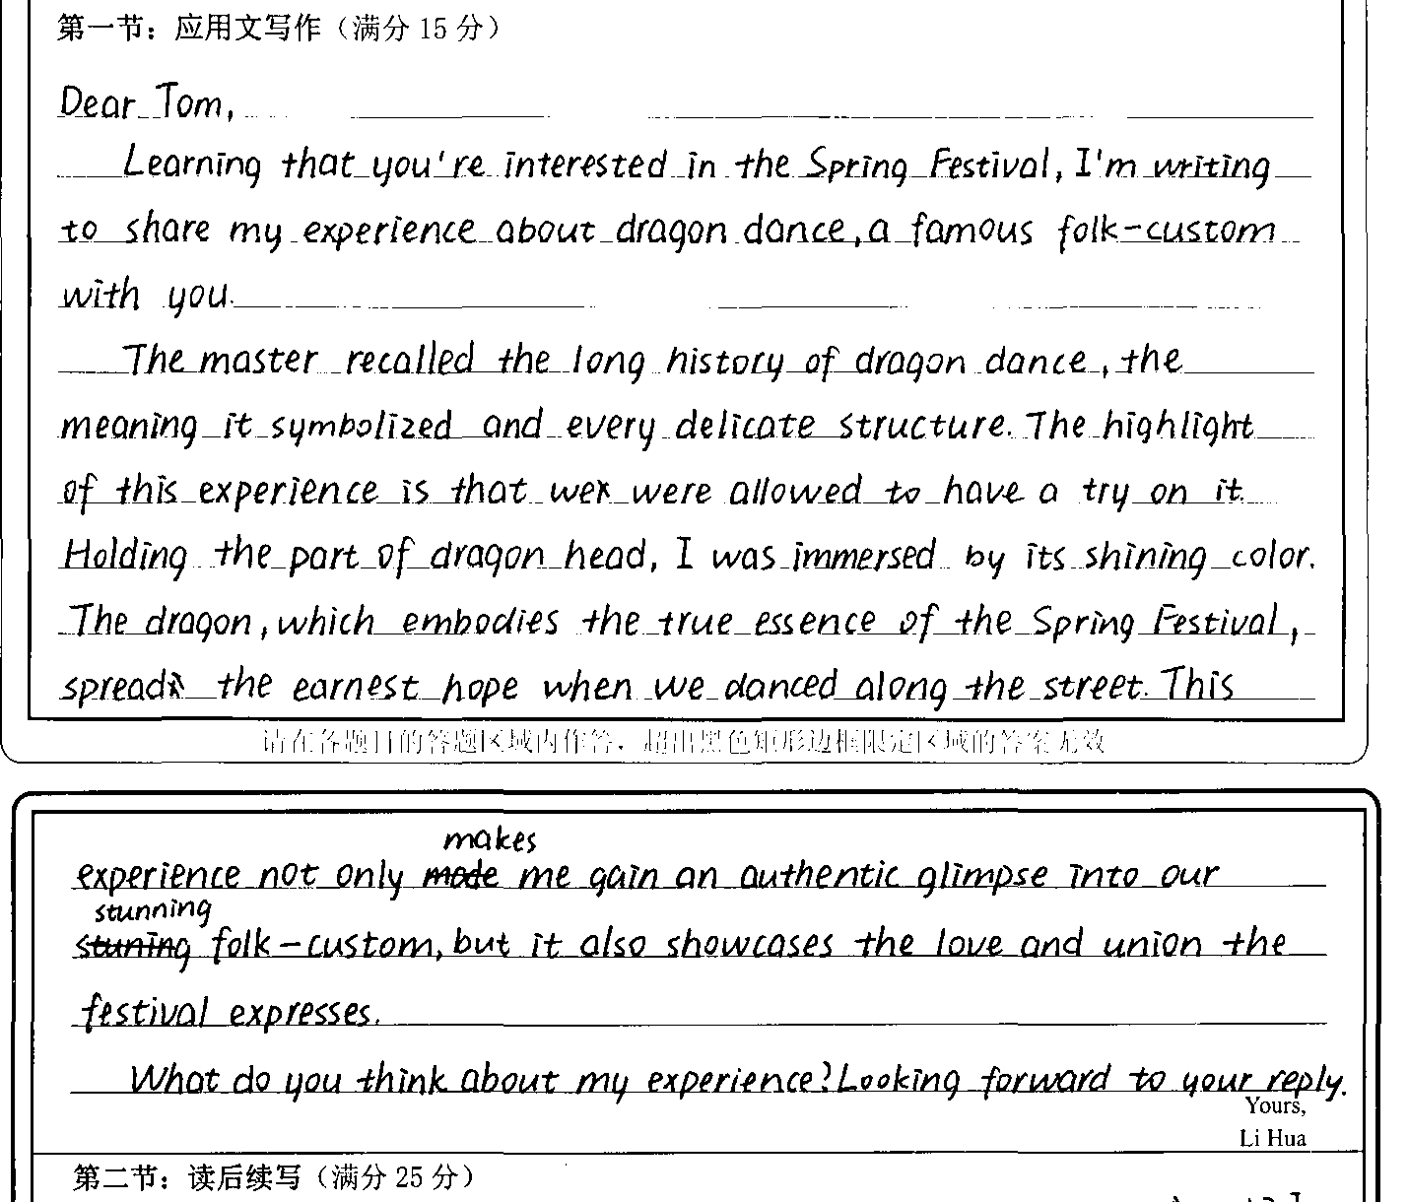
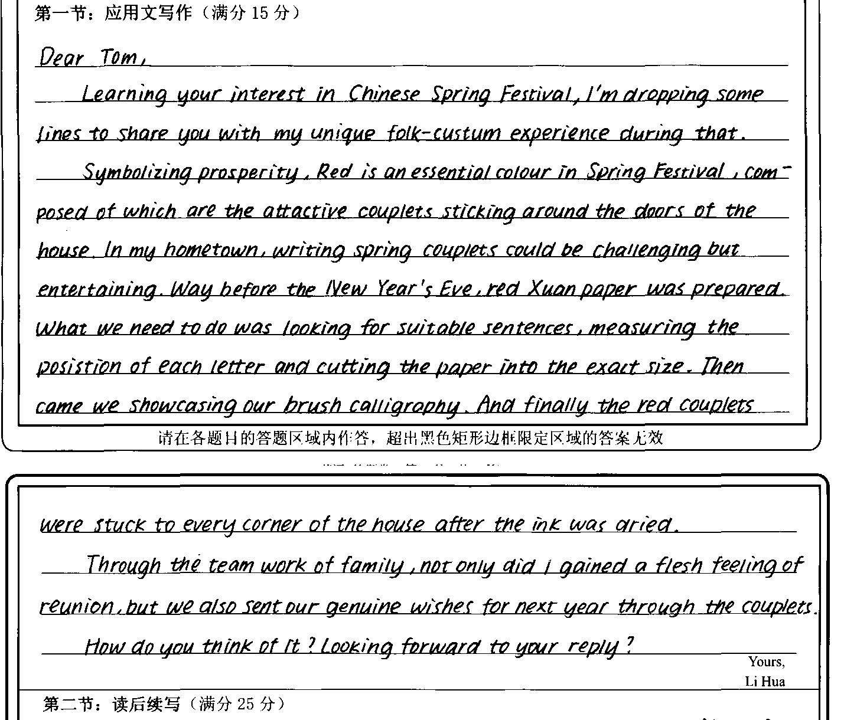
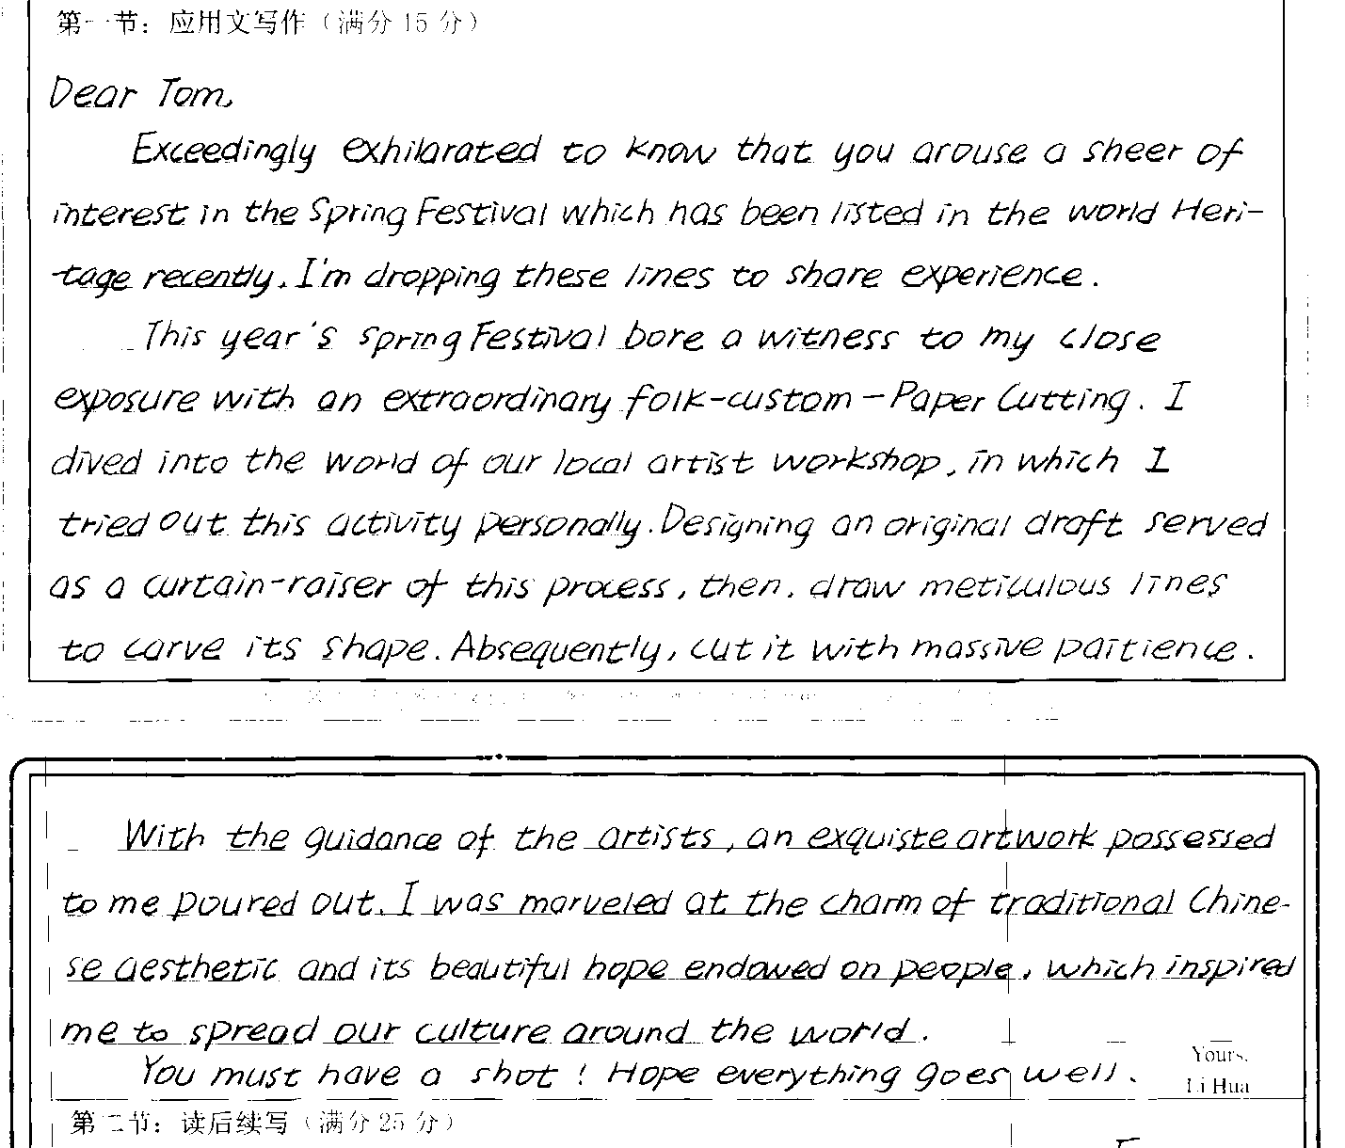
Feedback &improvement
Dragon dance
Writing couplets

Slide 19
Output Tasks
简版
Hearing that you've always been curious about the Spring Festival, I'm writing to tell you about a folk-custom experience I had during the Spring Festival.
To begin with, we prepared the dough and filling for the dumplings. This was followed by rolling out the dough and wrapping the dumplings. When we finished the preparation, we all gathered around the table to enjoy the dumplings we had made together.
It made me realize how these traditions bring us closer and create memories that last a lifetime. I hope one day you can join us and feel the same warmth and happiness I felt during this special time.
改版
Exceedingly exhilarated to know that you arouse a sheer of interest in the Spring Festival which has been listed in the world Heritage recently, I'm dropping these lines to share my experience.
In China, one of the most representative customs is making dumplings. On New Year's Eve afternoon, My family and I firstly prepared the dough and filling for the dumplings. This was followed by rolling out the dough and wrapping the dumplings. Upon completion of our endeavors, we all gathered around the table to enjoy the dumplings we had made together. Laughter and joy filled the room.
It made me realize how these traditions bring us closer and create memories that last a lifetime. I hope one day you can join us and feel the same warmth and happiness I felt during this special time.
General-introduction/significance
Specific-detailed experience
Conclusion-reflection
Interactive Communication
包饺子（making dumplings）

Slide 20
范文
making Chinese paper-cuttings
Dear Tom,
I’m extremely delighted to learn that you’re fascinated by the Spring Festival, which has recently been inscribed on the intangible cultural heritage list. Now, I’m eager to share a unique folk-custom experience with you.
During the Spring Festival, I participated in making Chinese paper-cuttings. First, I selected a vivid pattern from a collection of samples. Then, armed with a pair of scissors and a piece of red paper, I started to cut carefully along the lines. It was a painstaking process, but with patience and perseverance, a beautiful paper-cutting emerged in my hands.
This experience not only immersed me in the rich festive ambiance but also enabled me to appreciate the profoundness and elegance of traditional Chinese culture. I sincerely hope you can come and experience the Chinese Spring Festival in person.
Yours,
Li Hua

Slide 21
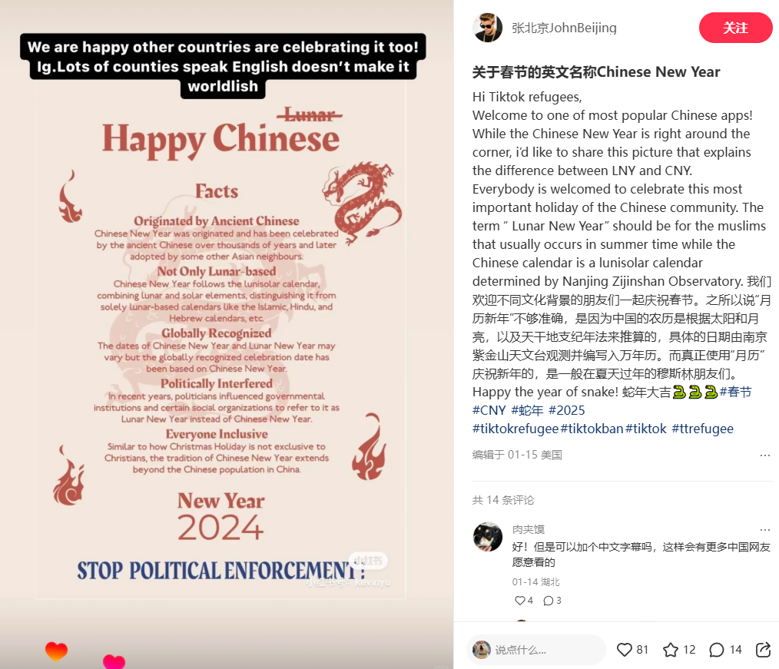
No matter where you are, whether online or offline, the warmth of the Spring Festival connects "global villagers", bringing their hearts closer together. Through sharing joy and culture, people unknowingly bridge the distance between each other.

Slide 22

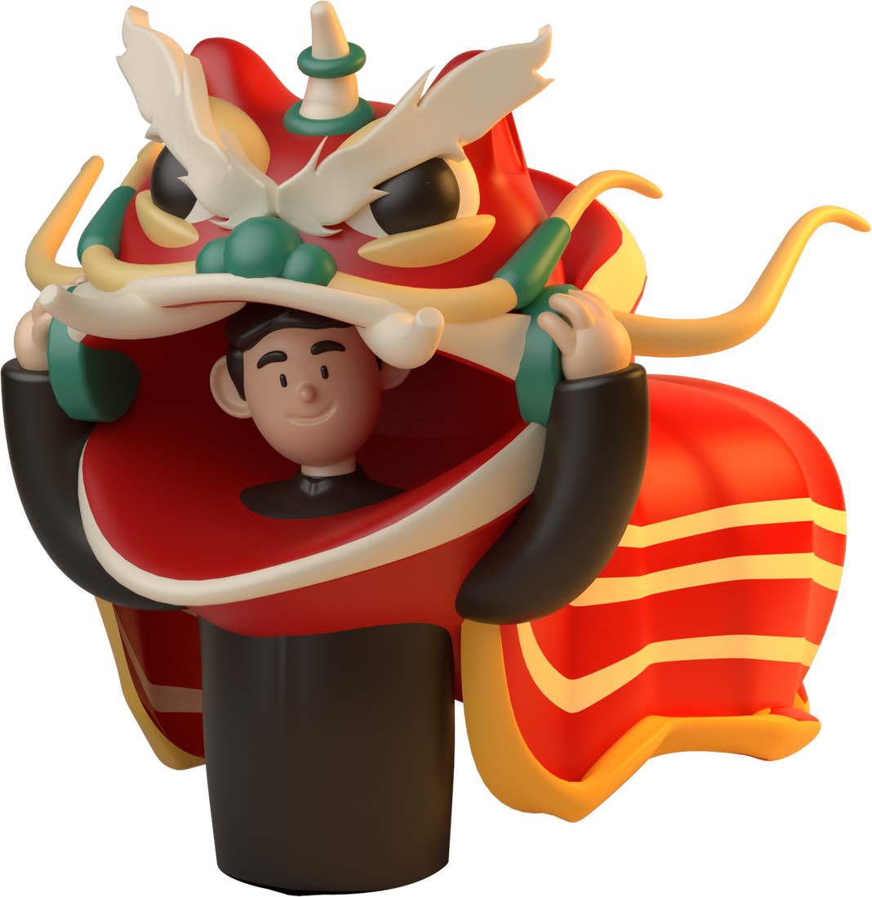

20
25
HAPPY
NEW YEAR
欣欣向荣
万象更新

