Slide 1



感恩遇见，相互成就，本课件资料仅供您个人参考、教学使用，严禁自行在网络传播，违者依知识产权法追究法律责任。
更多教学资源请关注
公众号：溯恩英语
知识产权声明

Slide 2
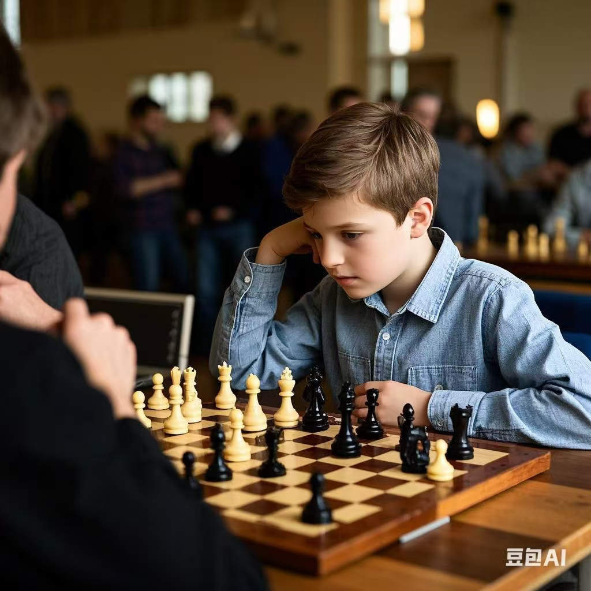
Winners Never Quit！
---2025届-2-25 七彩联盟
人与自我之成长篇
郑素红

Slide 3

There was a young boy named Jackson who had a burning desire to become a great chess player. He lived in a small town where chess was unpopular. The lack of proper coaches or training facilities nearby didn't dampen his spirits at all, for his fascination with the game knew no bounds.
Every day after school, he would dash home eagerly and set up his old chessboard. For hours on end, he would study books borrowed from the library, his eyes scanning the pages attentively in an attempt to absorb new strategies. He practiced against himself religiously, moving the pieces back and forth, his mind deeply engaged in analyzing each move with care.
When he took part in local chess matches, he was frequently underestimated. The tournament hall was filled with noisy people. The other players, armed with better resources and professional training, laughed at his simple techniques.

Slide 4
In one particular tournament, as he sat at the table for his first game, he could feel the eyes on him. His opponent made quick and decisive opening moves. Jackson, though nervous, focused hard. But soon, he found himself in a difficult position as his opponent's pieces advanced aggressively. He lost the game and was very disappointed.
In the next game, the situation was no better. His opponent's fingers moved swiftly over the pieces, while Jackson's hands were a bit sweaty as he tried to keep up, with his strategies easily countered (对抗)：The taunts (嘲弄）of his opponents rang in his ears, but he refused to be disheartened.
During the break, he sat alone in the corner, replaying the games in his mind to identify his mistakes. Realizing the need to be more creative and bold in his move, he immersed himself deeper into analyzing the games of the chess masters for inspiration. With every page he read and every move he analyzed, his determination grew like a burning fire.
Para1: With a new - found determination, Jackson told himself that winners never quit.
Para 2: In the final moments of the game, the pressure was intense.

Slide 5

Read for elements
characters： Main roles: Jackson
Minor role: opponents audience
2. narrative perspective: third -person
3. time： unknown
place： a chess tournament hall
Event : Jackson participated in a tournament and lost his first game but he never gave up and continued the following section of the game after reflection on his failure.

Slide 6


5.
story
line
Climax
Realizing the need to be more creative and bold in his move, he immersed himself deeper into analyzing the games of the chess masters for inspiration. With every page he read and every move he analyzed, his determination grew like a burning fire.
Para1: With a new - found determination,Jackson told himself that winners never quit.
In one particular tournament, he lost the game and was very disappointed, but he refused to be disheartened.
Para2: In the final moments of the game, the pressure was intense.
Jackson had a burning desire to become a great chess player. …The lack of proper coaches or training facilities nearby didn't dampen his spirits at all, for his fascination with the game knew no bounds.
background
Ending
Beginning

Slide 7

Read for clues and echoes
hidden clues | echoes
During the break, he sat alone in the corner, replaying the games in his mind to identify his mistakes. Realizing the need to be more creative and bold in his move, he immersed himself deeper into analyzing the games of the chess masters for inspiration. With every page he read and every move he analyzed, his determination grew like a burning fire. | With the strategies of the chess masters crossing his mind, Jackson’s pieces advanced aggressively. Focusing on the chessboard and analyzing every possible move, he moved his fingers over the pieces swiftly and boldly, which literally gave his opponent a hard blow. In panic, his rival made a few deadly mistakes, putting himself in a tough situation.

Slide 8
Read for clues and echoes
hidden clues | echoes
In the next game, the situation was no better. His opponent's fingers moved swiftly over the pieces, while Jackson's hands were a bit sweaty as he tried to keep up, with his strategies easily countered (对抗)：The taunts (嘲弄）of his opponents rang in his ears, but he refused to be disheartened. | 4. Beads of sweat popping up on the forehead, the opponent refused to be disheartened, attempting to counter Jackson.

Slide 9
Read for clues and echoes
hidden clues | echoes
When he took part in local chess matches, he was frequently underestimated. The tournament hall was filled with noisy people. The other players, armed with better resources and professional training, laughed at his simple techniques. | 5. With his creative chess strategies, Jackson turned champion of the tournament after numerous rounds of games, a dark horse without good resources and professional training.

Slide 10
心理描写
神态描写
动作描写
外貌描写
环境描写
对话描写
语言
无灵主语
动作链
分词作状语
With 复合结构
独立主格
从句
倒装句
虚拟语气
强调句
长短句结合
考生构思情节的同时，要考虑合适的语言句式以及修辞

Slide 11
Plot the continuation story
Para1: With a new-found determination, Jackson told himself that winners never quit.
Para2: In the final moments of the game, the pressure was intense.
Link1: How did Jackson feel now?
Body: What did Jackson do in the game?
Link2: How did his opponent feel? What did he do then and what was the situation ?
Link1: How did the rival feel? What did he do
Body: How did Jackson feel and what did he do? What was the result of the tournament?
Ending: What lesson did Jackson learn from the experience?

Slide 12
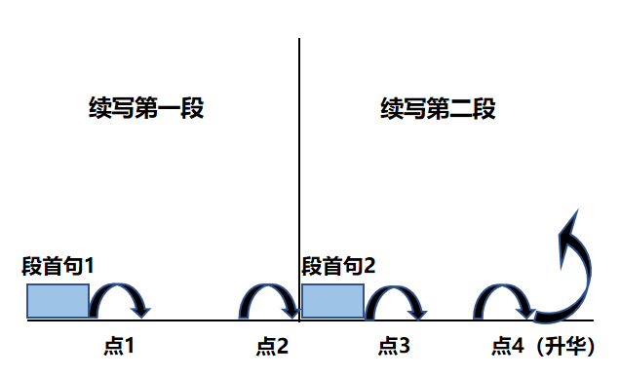
Plot Continuation
点1：位于续写第一段段首，流畅衔接前面的故事（常与原文最后一段呼应）和第一段段首语；
点2：位于续写第一段段尾，流畅衔接第二段段首句；
点3：位于续写第二段段首，续写衔接第二段段首语；
点4：文章结尾升华，给予读者正能量，揭示和强调主题。

Slide 13
Design link1
Para1: With a new-found determination, Jackson told himself that winners never quit.
Link1 A : (回扣原文 最后一段Jackson 自己错误的反思以及所给首句，以自信昂扬的姿态出场继续比赛的下半场) Overwhelmed by an enormous sense of confidence, Jackson strode up to the chess table, holding his head high.
Link1 B: ( 回扣determination) Wearing a determined look on his face, Jackson went back to the tournament area.

Slide 14
Design link2
Para1: With a new-found determination, Jackson told himself that winners never quit.
Para2: In the final moments of the game, the pressure was intense.
Link2 A: (呼应第二段所给首句；比赛进行到快结尾了） Time ticking by, Jackson got the upper hand with a tiny advantage, turning the tables on his arrogant opponent.
Link2B: ( 比赛要到尾声了，如果设置第二段才绝地反击，可以加上围观者的窃窃私语以及嘲弄声）As the game progressed, he stayed focused, ignoring the whispers and taunts around him.

Slide 15
Design link3
Para2: In the final moments of the game, the pressure was intense.
Link3A: ( 体现一下比赛对手的紧张表现） Beads of sweat popping up on the forehead, the opponent refused to be disheartened, attempting to counter Jackson.
Link3B: (回扣下棋的步骤) Each of Jackson’s well-planned and carefully-analyzed moves over the chessboard carried hope for success.

Slide 16
Design ending
Para2: In the final moments of the game, the pressure was intense.
Ending A: (主题式结尾) When delivering his acceptance speech, Jackson shared with them his favorite motto ---Winners never quit, quitters never win.
Ending B: ( 感悟式结尾) It dawned on Jackson that no matter how tough a situation is, he can overcome any obstacle with burning determination and proper strategies.

Slide 17
Para1: With a new-found determination, Jackson told himself that winners never quit. Overwhelmed by an enormous sense of confidence, Jackson strode up to the chess table, holding his head high. No sooner had Jackson sat down than the fierce / intense game continued. With the strategies of the chess masters crossing his mind, Jackson’s pieces advanced aggressively. Focusing on the chessboard and analyzing every possible move, he moved his fingers over the pieces swiftly and boldly, which literally gave his opponent a hard blow. In panic, his rival made a few deadly mistakes, putting himself in a tough situation. His initial depression replaced with excitement, a slight smile appeared on Jackson’s lips. Time ticking by, Jackson got the upper hand with a tiny advantage, turning the table on his arrogant opponent. (117)

Slide 18
Para2: In the final moments of the game, the pressure was intense. Beads of sweat popping up on the forehead, the opponent refused to be disheartened, attempting to counter Jackson. Mind racing fast, Jackson stayed sharp, calm and focused. With the last decisive and bold move, the game came to an end. Never had the audience expected that Jackson would become the winner. With his creative chess strategies, Jackson turned champion of the tournament after numerous rounds of games, a dark horse without good resources and professional training. Thrilled cheers and deafening applause exploded in the air. Jackson held the trophy tightly in his hands, tears of joy mingled with pride welling up in his eyes. When delivering his acceptance speech, Jackson shared with them his favorite motto ---Winners never quit, quitters never win. (123)

Slide 19
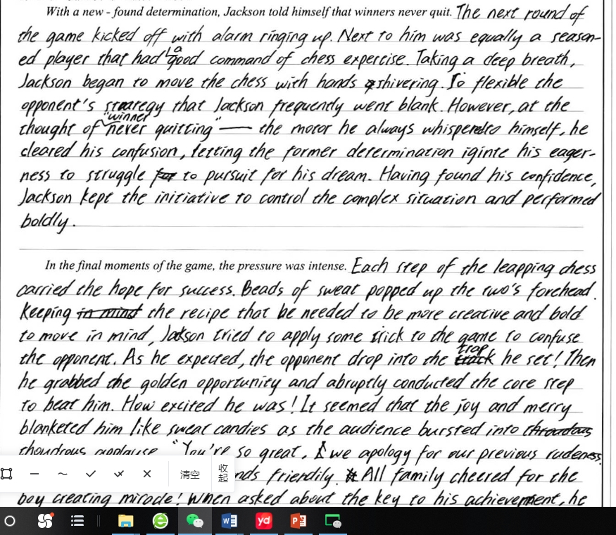
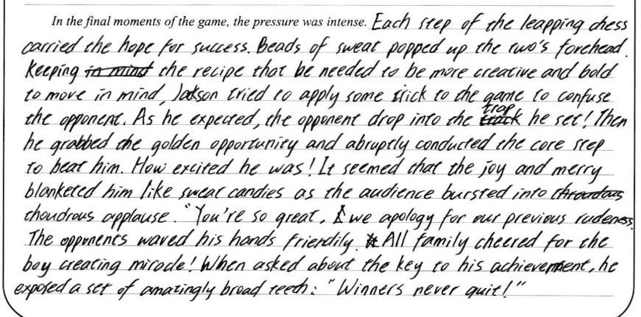
考生习作点评：
考生对于故事的构思贴合原文，能紧扣原文进行创作。
心理活动，表情，动作描写都比较生动形象。
书写有少许涂改,拼写也有几处错误，但是鉴于原文本下棋比赛内容创作虽然难度大，但考生思路清晰并完成紧扣主题的创作，故本文不失为佳作一篇）

Slide 20
