Slide 1


感恩遇见，相互成就，本课件资料仅供您个人参考、教学使用，严禁自行在网络传播，违者依知识产权法追究法律责任。
更多教学资源请关注
公众号：溯恩英语
知识产权声明

Slide 2
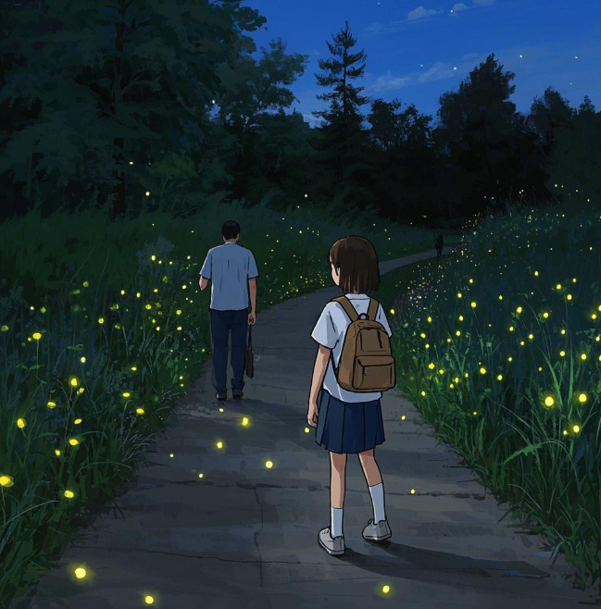
萤火虫之光
2025年2月强基联考读后续写讲解
---“阅读五要素+十句五定法”
妙解考场作文情节之滞
海亮实验中学 陈虹

Slide 3
阅读下面材料，根据其内容和所给段落开头语续写两段,使之构成一篇完整的短文。
It was the late 1980s, I was 15. It had been nine years since I last saw my dad. To mark our reunion in the country of my birth, my dad, who adored adventures, wanted me to “visit all your people and see every corner of your beautiful home," so he took us on a road trip.
However , admiring Jamaica's landscape was the last thing on my mind as I sat in the back of the Beetle, angry at my dad because he had dropped in and out of our childhood, My aim was to get to know him better. Not Jamaica.
Once, when he was unwell, I had to take the bus back to Kingston later than usual instead of him driving me, The sun was sinking, and the sky was darkening.
“You sure you're OK to walk up the shortcut to the bus stop?" he asked, sensing my citygirl nerves at the prospect of navigating a lightless country path.
“I'm fine,” I lied.
He rolled his eyes, coughed, put on his jacket and shoes, and led me up the path, As we walked, with leaves rustling(沙沙作啊), he found the energy to give me a mini biology lecture on the luminescent(发冷光的) powers of the fireflies and instructed me to “spot their guiding lights,, Before I knew it, we were safe at our destination.
“Love you, be safe," he waved to me, before heading back down the dark track, fireflies flashing around him.
“Bye, take care."I replied, Loving him too, but not always able to say it.
注意:1.续写词数应为 150 左右;
2.请按如下格式在答题纸的相应位置作答,
However, as he started to walk back down the dark track, I felt a sudden urge to follow.
A couple of days later, my dad took a drive around Jamaica with me.

Slide 4
第五档： 21-25
记叙文阅读理解能力
与所给短文融洽度高，与所提供各段落开头语衔接合理。
所使用语法结构和词汇丰富，准确，可能有些许错误，但完全不影响意义表达。
有效地使用了语句间的连接成分，使所续写短文结构紧凑。
记叙文书面表达能力

Slide 5
第四档： 16-20
与所给短文融洽度较高，与所提供各段落开头语衔接较为合理。
所使用的语法结构和词汇较为丰富、准确，可能有些许错误，但不影响意义表达。
比较有效地使用了语句间的连接成分，使所续写短文结构紧凑。

Slide 6
该篇读后续写过程中存在的问题：
续写内容与所给短文在叙述意图上不一致
续写内容与所给短文在相关细节上相矛盾
续写内容与所给短文在语篇结构上不连贯

Slide 7
Five elements
一

Slide 8





一 Identify the Five Elements
Place
Events
Place
Emotions
Time
Characters
Emotions
Characters
Time

Slide 9
Analysis:
- The story is set in the late 1980s. I, 15 years old, was in my adolescence(青春期).
- The nine-year separation from her father adds emotional weight to the narrative, highlighting the significance of their reunion.
Time
Text clue:It was the late 1980s, I was 15. It had been nine years since I last saw my dad.
Analysis:
- Jamaica, my birthplace, symbolizes “home” and a sense of belonging.
- The dark country path and the fireflies create a vivid setting that mirrors the emotional tension in the story.
Text clue: “Jamaica” is the primary setting.
“the back of the Beetle” and “a lightless country path.”
Place
Analysis:
- My” emotional conflict drives the narrative.
- The father’s character is revealed through small details (e.g., his cough, his explanation of fireflies), showing his vulnerability(脆弱）and affection.
Text clue: I:a 15-year-old girl who harbors complex feelings of anger and love toward her father.
Father: An adventurous man who loves his daughter but has been absent for much of her childhood. He is physically frail (coughing, tired) but caring.
Characters

Slide 10
Analysis:
- The road trip serves as a catalyst（催化剂） for repairing the father-daughter relationship.
- The scene on the dark path is an important moment, using the fireflies as a metaphor(隐喻) for guidance and hope.
Events
Text clue:
- Father takes me on a road trip to reconnect with my roots.
- In one scene, father, despite being unwell, accompanies me on a dark path to the bus stop, explaining the luminescence(冷光) of fireflies.
Emotions
Text clue:
- “My”anger: “angry at my dad because he had dropped in and out of our childhood.”
- Father’s care: “Love you, be safe.”
- “My” internal conflict: “Loving him too, but not always able to say it.”
Analysis:
- The emotion moves from estrangement（疏远） to tentative（试探性的） understanding.
- The fireflies’ cold light symbolizes the father’s subtle（微妙） but enduring love, while the dark path represents unresolved emotional barriers.

Slide 11
二 Analyze Relationships Between Elements
The nine-year separation fuels the daughter’s anger and sense of abandonment.
Time
Emotions
The dark path symbolizes emotional barriers, while the fireflies represent hope and guidance.
Place
Emotions
Characters
Events
The father’s absence and return are central to the emotional conflict.

Slide 12
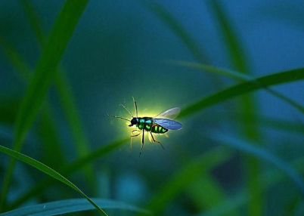
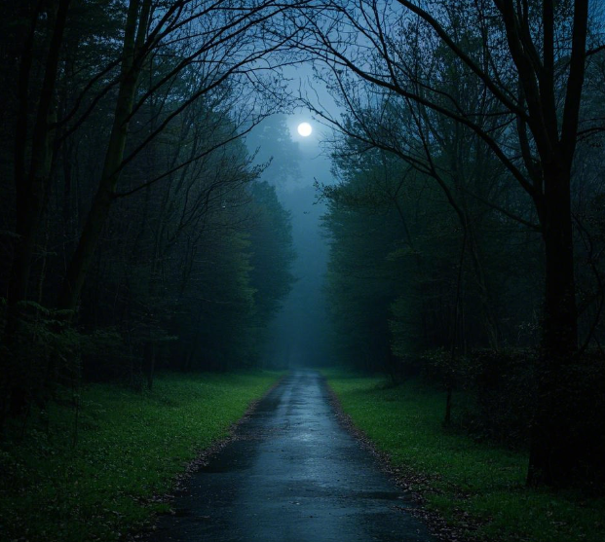
三 Explore Symbols and Metaphors（隐喻）
They are not just part of the setting but also symbolize the father’s love and guidance.
It is both a physical space and a metaphor for the daughter’s emotional struggles.

Slide 13
四 Predict Plot Development
Para 1:However, as he started to walk back down the dark track, I felt a sudden urge to follow._______
Para 2:A couple of days later, my dad took a drive around Jamaica with me._________
The direction for continuation writing:
Time: Para 1 --- “that night”
Para 2--- “ A couple of days later”
Place: Para 1 --- “on the dark path”
Para 2--- “a drive around Jamaica”
Characters: Develop the father-daughter relationship through dialogue and actions.
Events: Design key events (e.g., followed/not followed,unexpected situations, shared memories) to drive the plot.
Emotions: Transition from “estrangement(疏远)” to “reconciliation（和解）,” using detailed descriptions to deepen the theme.
Based on the five elements, anticipate possible continuations:
- Will the daughter follow her father?
- How will the road trip help mend their relationship?
- How will the symbolism of fireflies evolve?
父女关系：疏远→ 试探 → 理解 → 和解
象征链：萤火虫（引导）→ 黑暗（隔阂）→ 阳光（接纳）

Slide 14
Plot development
二

Slide 15
.何为十句五定法
读后续写续写的内容有两段，即paragraph 1&paragaph 2。每段写五句(或五个情节)，一共十句（或十个情节）。其中有五句（或五个情节）已经定下，如下图所示
Para 1 |  | Para 2
1 | 衔接para1 首句 心理描写、动作链 | 6 | 衔接para2 首句 心理描写、动作链
2 |  | 7
3 |  | 8
4 |  | 9 | 结局（正能量）
5 | 衔接para2 首句 | 10 | 升华主题

Slide 16
情节构建(十句五定法)（思路1：followed my father）
第一段思路(五句)
我决定跟随 | 我违背原本计划，因情感驱动选择跟随父亲。
我观察细节 | 黑暗中火光照亮父亲的背影，我注意到他身体的虚弱（与前文“unwell”和“coughed”相呼应）。
对话互动 | 我主动开口，父亲意外却温柔回应，展现父女间的试探性沟通。
共同行走 | 两人沉默前行，萤火虫的微光成为环境纽带。
情感升华 | 沉默中我第一次感受到无需语言的情感连接，愧疚与爱交织。
第二段思路(五句)
旅程启程 | 父女开车探索牙买加乡村，背景设定为白天。
环境渲染 | 热带风光与车里的音乐营造轻松氛围，暗示情感缓和。
父女互动 | 父亲主动讲述年轻时的故事，展现他鲜为人知的过往。
结局 | 我从被动到主动参与，因父亲的幽默而发笑，体现隔阂消融。
主题升华 | 我内心愤怒消散，转变为对父亲的理解与接纳，主题收束
观 察
行 动
情感转变

Slide 17
情节构建(十句五定法)（思路2：didn’t follow my father）
第一段思路(五句)
我决定不跟随 | 我站在原地，听着父亲的脚步声渐行渐远，萤火虫的光芒逐渐消失。
意外突发 | 黑暗中突然传来父亲的剧烈咳嗽声，随后是树枝断裂的响动，父亲可能摔倒
冲动追赶 | 我不顾一切冲进黑暗，沿途被荆棘划伤，最终在萤火虫微光下找到蜷缩在地的父亲。
归途沉默 | 两人缓慢返回，我紧握父亲手臂，萤火虫围绕成圈，仿佛守护者。
次日清晨的发现 | 隔天父亲高烧卧床，我默默端水送药，发现他钱包里褪色的全家福照片。
第二段思路(五句)
旅程启程 | 父女开车探索牙买加乡村，背景设定为白天。
环境渲染 | 热带风光与车里的音乐营造轻松氛围，暗示情感缓和。
父女互动 | 父亲主动讲述年轻时的故事，展现他鲜为人知的过往。
结局 | 我从被动到主动参与，因父亲的幽默而发笑，体现隔阂消融。
主题升华 | 我内心愤怒消散，转变为对父亲的理解与接纳，主题收束
Tips:情节不能停滞“不跟随”，情节很容易停滞，可以采取“用意外打破僵局”的模式

Slide 18
Language bank
三

Slide 19
动作描写
走：She shuffled（拖） her feet, unsure of whether to follow.
He lingered（徘徊） at the doorway, hesitating before stepping inside.
面部表情与肢体语言：Her hands trembled as she reached for the door handle.
A soft smile spread across her face as she finally understood.
He let out a deep breath, his shoulders relaxing.
互动与接触：He wrapped his arm around her, shielding her from the cold wind.
She turned away, avoiding his gaze.
He stepped back, creating distance between them.*

Slide 20
情感描写
愤怒与疏离： A wave of anger surged through her, making it hard to speak.
She felt a cold emptiness, as if a wall had been built between them.
He seemed distant, his eyes avoiding hers.
内疚与自责：Guilt gnawed（咬） at her, making it hard to meet his eyes.
He sighed, regret heavy in his voice.
She blamed herself for not trying harder to understand him.
He muttered under his breath, cursing his own mistakes.
理解与和解：A sense of clarity washed over her, and she finally saw things from his perspective.
He nodded slowly, his expression softening.
Tears welled up in her eyes as she reached out to hug him.
He smiled faintly, the tension between them melting away.

Slide 21
情感描写
愤怒与疏离： A wave of anger surged through her, making it hard to speak.
She felt a cold emptiness, as if a wall had been built between them.
He seemed distant, his eyes avoiding hers.
内疚与自责：Guilt gnawed（咬） at her, making it hard to meet his eyes.
He sighed, regret heavy in his voice.
She blamed herself for not trying harder to understand him.
He muttered under his breath, cursing his own mistakes.
理解与和解：A sense of clarity washed over her, and she finally saw things from his perspective.
He nodded slowly, his expression softening
Tears welled up in her eyes as she reached out to hug him.
He smiled faintly, the tension between them melting away.

Slide 22
环境描写
自然景观： The fireflies danced in the darkness, their tiny lights flickering like stars.
The vibrant（活力的） colors of the Jamaican countryside stretched out before them, a breathtaking sight.
天气与氛围：The air was thick with tension, the sky heavy with dark clouds.
The warm breeze carried the scent of blooming flowers, lifting her spirits.
象征性环境：The path ahead was shrouded（笼罩） in darkness, but the fireflies offered a glimmer of hope.
The dense forest gave way to a wide clearing, symbolizing a new beginning.

Slide 23
Versions
四

Slide 24
原卷范文
However, as he started to walk back down the dark track, I felt a sudden urge to follow. I couldn't let him go alone, not in his condition, l called out to him, "Dad, wait!" He turned around, a bit surprised but also relieved to see me, “ You okay, love?" he asked, concern etching his face, I nodded, my heart pounding in my chest, “I just... I want to make sure you're okay," I stammered, trying to hide my worry. He smiled gently, patting my hand. “I'm glad you're here," he said, his voice softening. We walked together, the fireflies tiny lights a comforting presence in the dark. It was in these moments, walking side by side, that I began to see him not just as my distant father but as a man with his own stories and struggles and the distance that had once felt so vast was now beginning to close, one step at a time.
A couple of days later, my dad took a drive around jamaica with me. Sitting beside him in the car, listened as he spoke—not just about the landscapes, but about his life. He pointed out the places he had explored as a young man, the rivers he used to swim in, and the small villages where he had made friends. Every wave he exchanged with passersby, showed me a side of him I had never seen before. Slowly, my frustration began to fade, replaced by curiosity, and then admiration. For the first time, I saw Jamaica not just as a place but as a part of him—his past, his home, his identity. And in embracing his world, I found myself understanding him in a way I never had before. Maybe love didn't always have to be spoken; sometimes, it was simply about being present, about choosing to see someone for who they truly were.

Slide 25
下水文：（跟随版）
However, as he started to walk back down the dark track, I felt a sudden urge to follow. The fireflies' gentle glow illuminated（照亮，阐明） his path, and I couldn't help but notice how frail（脆弱） he looked under the dim light. My heart ached with a mix of guilt and affection. I quickened my pace, catching up to him. "Dad," I called out softly. He turned, surprised, and smiled. "I thought you'd be on the bus by now," he said. I shrugged, "I just wanted to make sure you got back safely." We walked together in silence, the fireflies guiding us like tiny lanterns. For the first time in years, I felt a connection that words couldn't express.
A couple of days later, my dad took a drive around Jamaica with me. The vibrant landscapes and the soft music playing on the radio created a soothing atmosphere. As we drove through the lush countryside, he pointed out various landmarks and shared stories from his youth. I found myself laughing at his anecdotes, realizing how much I had missed by not knowing him better. The journey became more than just a tour of Jamaica; it was a journey into understanding and forgiveness. By the end of the day, the anger I had held onto for so long began to dissolve, replaced by a newfound appreciation for the man who was my father.

Slide 26
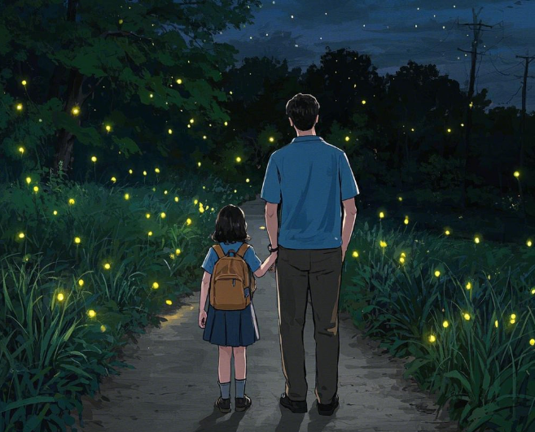
单击此处添加标题
THANKS
单击此处添加文本

