Slide 1



感恩遇见，相互成就，本课件资料仅供您个人参考、教学使用，严禁自行在网络传播，违者依知识产权法追究法律责任。
更多教学资源请关注
公众号：溯恩英语
知识产权声明

Slide 2
2024学年第二学期浙江省七彩阳光新高考研究联盟返校联考
（阅读部分）
北师大嘉兴附中 吴晨华

Slide 3
题型 | 话题 | 体裁 | 词数
阅读A | 人与社会：Three of the best marathons in the US | 应用文 | 262
阅读B | 人与社会：An encounter with an old bookstore and the effort to help it survive | 记叙文 | 358
阅读C | 人与社会：A research project on synthetic blood made from the stem cells of embryos | 社会新闻类文本 | 331
阅读D | 人与社会：Reevaluating economic assumptions through a mathematical model | 科普类说明文 | 351
七选五 | 人与自我：Tips on creating and delivering a presentation | 议论文 | 240
完形填空 | 人与社会：The power of Armus’s compassion in a tense bank robbery | 记叙文 | 295
语法填空 | 人与社会：China’s South-to-North Water Diversion Project | 说明文 | 247

Slide 4
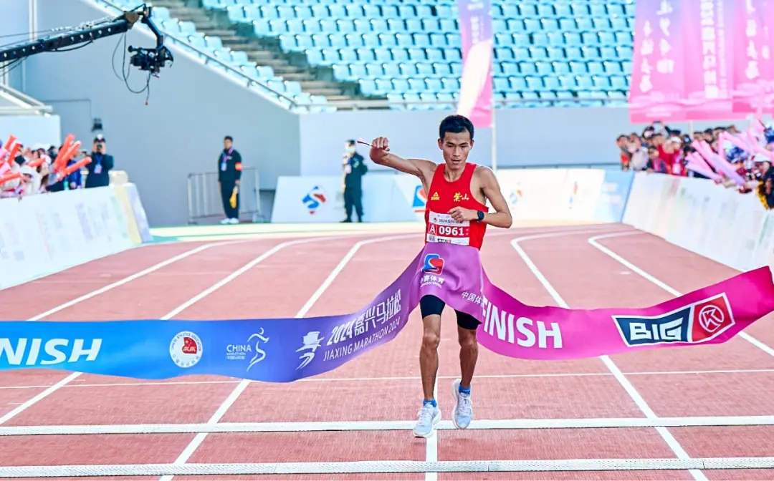

A篇
人与社会：Three of the best marathons in the US

Slide 5
If you’re already into running marathons, or just thinking about running one, then you’re
in for a real treat. The U.S. has an abundance of marathons for all different levels in every
state. Here’s a look at some of the best marathons in the US.
⚫ The Maui Paradise Marathon
Date: April 27, 2025
Location: Maui, HI
Website Info: MAUIMARATHON.com–The Maui Paradise Marathon
This marathon is unique, as it enables runners to schedule their own date and course. Runners love this beautiful course in popular Maui. Runners must also fund their own meals and drinks, as this isn’t your typical marathon.
⚫ Bank of America Chicago Marathon
Date: October 12, 2025
Location: Chicago
Website Info: CHICAGOMARATHON.com–Bank of America Chicago Marathon
This marathon has often been referred to as one of the most respected marathons in the world. While this course is flat and fast, making it easy for beginners, many of the best runners sign up for this marathon due to its high status. Every runner wants the opportunity to participate in this marathon at least once.
⚫ Las Vegas Rock ’N Roll Marathon
Date: February 22-23, 2025
Location: Las Vegas, NV
Website Info: RUNROCKNROLL.com–Las Vegas Rock ‘N Roll Marathon
This marathon is very unique, and not only is there plenty of rock-n-roll music to jam to while running, but the marathon allows runners to run to wedding churches with their significant others and either get married or renew their wedding vows. Of course, it’s not required to visit any of the wedding churches, but it’s certainly very popular.
21. What distinguishes Maui Paradise Marathon from the other marathons?
A. The pleasant weather.
B. Its beautiful scenery.
C. Free meals and drinks.
D. Its flexible date and course.
22. Why do many marathon runners consider Chicago Marathon a must-do event?
A. Because it is easy to sign up for.
B. Because it has a flat and fast course.
C. Because it enjoys a high reputation among the runners.
D. Because it’s suitable for beginners as well as professionals.
23. Which website may lovers visit if they want a special wedding?
A. MAUIMARATHON.com
B. HONOLULUMARATHON.org
C. CHICAGOMARATHON.com
D. RUNROCKNROLL.com

Slide 6
A篇词汇拓展
1. 词义猜测
1) If you’re already into running marathons, or just thinking about running one, then you’re
in for a real treat. The U.S. has an abundance of marathons for all different levels in every
state.
He's into surfing in a big way.
I'm into electronics myself.
2) Not only is there plenty of rock-n-roll music to jam to while running, but the marathon allows runners to run to wedding churches with their significant others and either get married or renew their wedding vows.
He jammed his fingers in his ears.
We were stuck in a traffic jam.
The fruit can be made into jam.
3) This marathon has often been referred to as one of the most respected marathons in the world. While this course is flat and fast, _________ (make) it easy for beginners, many of the best runners _____________ 报名参加 this marathon due to its high status.
Marcia had referred to him as a dear friend.
喜欢，对……有兴趣；被迷住，被……深深吸引
喜之不尽
大量的；丰富的
→adj. abundant
喜欢
对……有兴趣
播放
重温他们的结婚誓言
塞住
堵塞
果酱
被称作为…
making
sign up for

Slide 7
A篇词汇拓展
2. 熟词生义
This marathon is unique, as it enables runners to schedule their own date and course. Runners love this beautiful course in popular Maui.
* The contest will take place in the school hall at 3 p.m. on March 5, 2025.(应用文)
Runners must also fund their own meals and drinks, as this isn’t your typical marathon.
* The museum is privately funded.
* Thanks to the collective efforts, we managed to raise enough funds to cover the rent for a while.(阅读B)
* We also set up an online crowdfunding page to collect donations .(阅读B)
is scheduled
资助
筹集资金
众筹
3. 重点词
What distinguishes Maui Paradise Marathon from the other marathons?
→ adj.
distinguished
celebrated → celebrity
noted
renowned

Slide 8
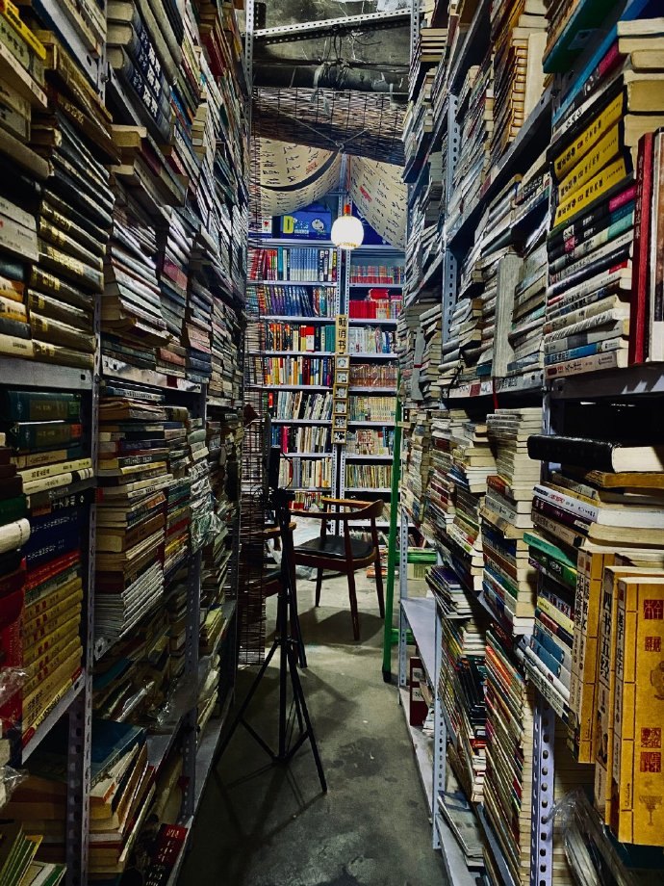
B篇
人与社会：An encounter with an old bookstore and the effort to help it survive

Slide 9
There was an old bookstore on the corner of my street. I discovered it one sunny afternoon when I was exploring the neighborhood. The moment I pushed open the door, a unique aroma (芳香) embraced me. The shelves were stuffed with books of every genre and age. I could see the spines of well-loved classics, rare first editions, and forgotten treasures. The owner, a middle-aged man with glasses and a warm smile, was busy tidying up. He greeted me and told me to feel free to look around. I started browsing and was immediately fascinated by a collection of old travelogues that seemed to hold the secrets of far-off lands.
Over the following weeks, I became a regular. I would spend hours there, losing myself in the pages of different books. Sometimes, the owner would recommend a particular book based on our conversations. His knowledge and passion for literature were truly inspiring.
However, change was on the horizon. The city was developing rapidly, and new, modern shops were replacing the old ones. One day, I noticed a sense of gloom in the bookstore. The owner informed me that due to the skyrocketing rent and the competition from online bookstores, he was struggling to keep the doors open. It seemed that this little shelter of literature might soon disappear.
I was determined not to let that happen. I reached out to my schoolmates and local community groups. We organized a book fair in front of the bookstore, inviting local authors and artists to participate. We also set up an online crowdfunding page to collect donations. People from all over the neighborhood came to show their support. They bought books, donated money, and shared their own memories of the bookstore.
Thanks to the collective efforts, we managed to raise enough funds to cover the rent for a while. The bookstore survived this crisis. A community’s love and support can preserve something truly valuable. The old bookstore was not just a place to buy books; it was a cornerstone of our community’s cultural and emotional heritage, and it was worth every bit of the fight to save it.
24.What caught the writer’s attention the most during his first visit to the bookstore?
A. The packed book shelves.
B. The ancient travel accounts.
C. The friendly and devoted shop owner.
D. The rich collection of literature classics.
25. Why did the bookstore face the risk of shutting down?
A. Poor management of the store.
B. Rising rent and e-commerce pressure.
C. A decrease in people’s interest in literature.
D. The run-down condition and out-of-style decorations.
26.Which of the following best describes the writer?
A. Warm-hearted and influential.
B. Inspiring and economical.
C. Reserved and passionate.
D. Ambitious and knowledgeable.
27. What of the following does the writer mainly emphasize in the passage?
A. The crucial role of joint efforts in conserving cultural treasure.
B. The negative impact of urban expansion on personal hobbies.
C. The marked advantage of small local businesses over large ones.
D. The unavoidable replacement of old traditions by modern trends.

Slide 10
B篇词汇巩固
v./n. 拥抱；欣然接受
___ unique aroma embraced me
be stuffed with
the spines of well-loved ___________(classic)
___________ (forget) treasures
feel free to look around
be fascinated by
lose myself in the pages =
on the horizon
a sense of gloom → head drooping and eyes________
reach out to
organize a book fair
thanks to the collective efforts = ______ efforts
cover the rent
survive this crisis
on the corner → cornerstone
catch one’s attention
the rich collection of → an ___________ of
conserve cultural treasure = ________ something truly valuable
独特的香味围绕着我
塞满了
深受喜爱的经典的书脊
被遗忘的宝藏
随意四处看看
被……迷住
沉迷于书页中
即将来临的
忧郁的感觉
向（某人）提供帮助或支持
举办书展
多亏了共同的努力
挺过这次危机
在角落→基石/柱/基础/墙角石
吸引某人注意
丰富的收藏
保护文化瑰宝
a
classics
forgotten
be buried / absorbed in
gloomy
joint
abundance
preserve

Slide 11
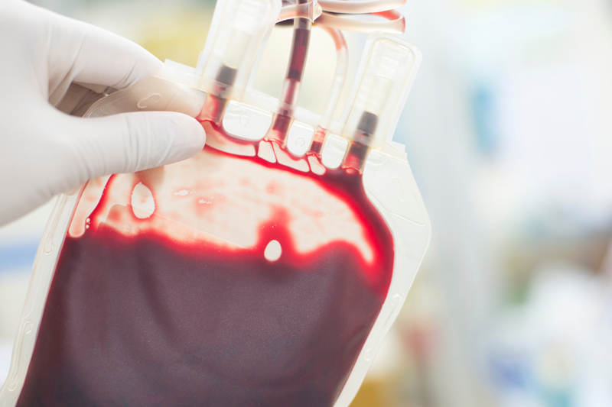
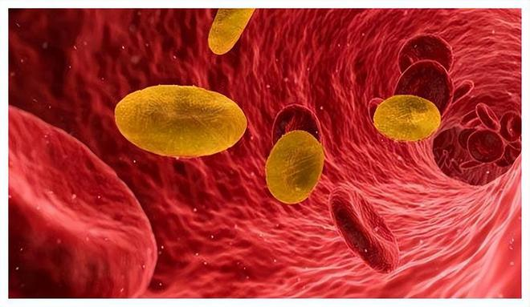
C篇
人与社会：A research project on synthetic blood made from the stem cells of embryos

Slide 12
What if there is no blood left in the bank when patients need an immediate transfusion (输血)? Scientists in Britain plan to become the first in the world to produce unlimited amounts of human blood from embryonic stem cells (胚胎干细胞) for emergency transfusions.
A major research project is to be announced this week, which will end in three years with the first transfusions into human volunteers of synthetic (人造的) blood made from the stem cells of embryos. It could help to save the lives of anyone from victims of traffic accidents to soldiers on a battlefield by completely changing the present blood transfusion services, which have to rely on human donors to provide a constant supply of fresh blood.
Britain will play a vital role in the global race to develop synthetic blood. The Wellcome Trust, the world’s biggiest medical research charity, has promised £3m towards the cost of the project. A spokesman for the Wellcome Trust said that an announcement is likely to be made in the coming week.
The project will be led by Professor Marc Turner of Edinburgh University, who has been involved in studies investigating how to ensure donated blood is infection-free. Researchers will test human embryos to find those that can develop into the “O-negative” blood group, which is the universal donor group whose blood can be transfused into anyone. This blood group is relatively rare, accounting for about 7% of the population, but it could be produced in unlimited quantities from embryonic stem cells in the laboratory. Such synthetic blood would have the benefit of not being at risk of being infected with viruses such as HIV and the human form of “mad cow” disease.
The project was held up because of the difficulty of finding funding for “translational” research that attempts to take scientific studies in the laboratory into the earliest stages of commercial development. This problem has now been overcome.
28. What is the primary objective of the project?
A. To save the lives of accident victims.
B. To inspire more voluntary blood donors.
C. To produce sufficient blood for emergencies.
D. To transform the present blood transfusion services.
29. Why does the author mention Professor Marc Turner’s studies?
A. To praise his effort to the research.
B. To show the project leader’s expertise.
C. To emphasize the importance of his research.
D. To illustrate the rareness of the “O-negative” blood group.
30. In what way will synthetic blood be superior to normal blood?
A. It will help patients to recover sooner.
B. It will avoid the risk of various infections.
C. It will cure the patients of their diseases.
D. It will be offered to transfusion patients for free.
31. How does the writer sound in the text?
A. Excited. B. Critical.
C. Pessimistic. D. Informative.
topic
benefits
The background of a research project
The research process of the project
benefits
The current situation

Slide 13
What if there is no blood left in the bank when patients need an immediate transfusion (输血)? Scientists in Britain plan to become the first in the world to produce unlimited amounts of human blood from embryonic stem cells (胚胎干细胞) for emergency transfusions.
A major research project is to be announced this week, which will end in three years with the first transfusions into human volunteers of synthetic (人造的) blood made from the stem cells of embryos. It could help to save the lives of anyone from victims of traffic accidents to soldiers on a battlefield by completely changing the present blood transfusion services, which have to rely on human donors to provide a constant supply of fresh blood.
Britain will play a vital role in the global race to develop synthetic blood. The Wellcome Trust, the world’s biggiest medical research charity, has promised £3m towards the cost of the project. A spokesman for the Wellcome Trust said that an announcement is likely to be made in the coming week.
The project will be led by Professor Marc Turner of Edinburgh University, who has been involved in studies investigating how to ensure donated blood is infection-free. Researchers will test human embryos to find those that can develop into the “O-negative” blood group, which is the universal donor group whose blood can be transfused into anyone. This blood group is relatively rare, accounting for about 7% of the population, but it could be produced in unlimited quantities from embryonic stem cells in the laboratory. Such synthetic blood would have the benefit of not being at risk of being infected with viruses such as HIV and the human form of “mad cow” disease.
The project was held up because of the difficulty of finding funding for “translational” research that attempts to take scientific studies in the laboratory into the earliest stages of commercial development. This problem has now been overcome.
28. What is the primary objective of the project?
A. To save the lives of accident victims.
B. To inspire more voluntary blood donors.
C. To produce sufficient blood for emergencies.
D. To transform the present blood transfusion services.
29. Why does the author mention Professor Marc Turner’s studies?
A. To praise his effort to the research.
B. To show the project leader’s expertise.
C. To emphasize the importance of his research.
D. To illustrate the rareness of the “O-negative” blood group.
30. In what way will synthetic blood be superior to normal blood?
A. It will help patients to recover sooner.
B. It will avoid the risk of various infections.
C. It will cure the patients of their diseases.
D. It will be offered to transfusion patients for free.
31. How does the writer sound in the text?
A. Excited. B. Critical.
C. Pessimistic. D. Informative.
批判的
提供有用信息的
增长见闻的

Slide 14
C篇长难句分析
which
A major research project is to be announced this week, _________ will end in three years with the first ____________(transfuse) into human volunteers of synthetic (人造的) blood ______(make) from the stem cells of embryos.
It could help to save the lives of anyone from victims of traffic accidents ____ soldiers on a battlefield by ___________(complete) changing the present blood transfusion services, _______ have to rely on human donors to provide a constant supply of fresh blood.
A spokesman for the Wellcome Trust said that an announcement is likely ___________ (make) in the coming week.
The project will be led by Professor Marc Turner of Edinburgh University, _______ has been involved in studies ___________(investigate) how to ensure _________(donate) blood is infection-free.
Researchers will test human embryos to find those ______ can develop into the “O-negative” blood group, ________ is the universal donor group __________ blood can be transfused into anyone.
This blood group is relatively rare, _____________(account) for about 7% of the population, but it could be produced in ___________(not limit) quantities from embryonic stem cells in the laboratory.
Such synthetic blood would have the benefit of not being at risk of ____________(infect) with viruses such as HIV and the human form of “mad cow” disease.
transfusions
made
to
completely
which
to be made
who
investigating
donated
that
which
whose
accounting
unlimited
being infected

Slide 15

D篇
人与社会：Reevaluating economic assumptions through a mathematical model

Slide 16
However much we learn from things going wrong, we will never become the best decision-makers. This finding comes from a mathematical game that simulates (模拟) a large economy, and suggests we may need to rethink assumptions built into economic theories. In such theories, people are typically represented as reasonable agents who learn from past experiences to enhance their performance, eventually reaching a stable state in which they know how to maximize their earnings.
To test whether economists are correct to assume that learning from the past can help people avoid chaos rather than stability, Garnier-Brun and his colleagues invented a mathematical model for a game featuring hundreds of simulated players. Each player can choose between two actions, like buying or selling a stock. They also interact with each other, and the players’ decision-making is influenced by what they have done before — meaning they are able to learn from experience.
In different game scenarios (设想), the researchers expected that the game would always result in chaos, with players unable to learn how to optimize their performance. Economic theory would also suggest that, given the right set of parameters (参数), the players would settle into a stable state where they had mastered the game — but the researchers found this wasn’t really the case. The most likely outcome was a state that never settled.
Team member Jean-Philippe Bouchaud says that, in the absence of one centralized, god-like player who could coordinate everyone, regular players could only learn how to reach “satisficing” states. That is a level that satisfied minimum expectations but not much more. Players gained more than they would have done by playing at random, so learning wasn’t useless, but they still gained less than they would have if past experience had allowed them to truly optimize their performance.
Bouchaud says the game model is too simple to be immediately adopted for making real-world predictions, but he sees the study as a challenge to economists to drop many assumptions that currently go into theorizing processes, like merchants choosing suppliers or banks setting interest rates.
32. What effect of past experiences do economists suppose?
A. Better decisions and higher income.
B. A state of confusion and disorder.
C. Ignorance of future opportunities.
D. Decreased interactions between people.
33. Why did Garnier-Brun and his colleagues create a mathematical model?
A. To simulate a large economy.
B. To predict future economic trends.
C. To analyze interactions between players.
D. To assess the assumption of economists.
34. The underlined word “satisficing” in Paragraph 4 most probably means _______.
A. highly satisfying B. constantly improving
C. minimally acceptable D. completely unpredictable
35. Which of the following is the best title for the text?
A. Reevaluating Economic Assumptions through a Game Model
B. A Mathematical Game Model for Simulating Large Economies
C. Challenges in Predicting Economic Stability through Games
D. The Importance of Learning from Experience in Economics
A new finding
A mathematical model to test
追求最低要求的满意结果
Scenarios and results
Analysis of the results
Future influence

Slide 17
D篇主题词汇归纳
mathematical model
数学模型
模拟 → __________(simulate) players
假设,假定 v. → n. ______________
经济理论 → to assess the assumptions of ___________(economy)
go into theorizing process
_________ performance = _________ performance →__________ earnings 优化，强化，最大化
达到稳定状态
→ avoid chaos rather than _________(stable)
决策者/做决策
one centralized, god-like player who could coordinate everyone = ______________________
simulate
simulated
assume
assumption
economic theories
economists
进入理论化过程
enhance
optimize
maximize
reach a stable state = ____________ a stable state
settle into
stability
decision-makers / decision-making
centralized coordination
***注意词的变形
in the __________(absent) of
a state of _________(confuse) and disorder
__________(ignore) of future opportunities
___________(decrease) interactions between people
absence
confusion
ignorance
decreased

Slide 18

七选五
人与自我：Tips on creating and delivering a presentation

Slide 19
Step1 读文本大意、理篇章结构
Tips on presentation
Whether you’re in high school or college, presentations have become an essential part of academic life. Yet, many students find themselves nervous, unsure, or even unprepared when it comes to creating and delivering a presentation. 36.________________
Before diving into your presentation, take a moment to think about your audience. Are you presenting to your classmates, teachers, or even a broader school community? 37._____________ If you’re talking to classmates, you might be able to make the tone more casual. If it’s for teachers, consider focusing on depth, clarity, and structure.
A key to any great presentation is simplicity. 38._________________ Stick to one idea per slide and make your content clear and to the point. Bear in mind that your audience is there to hear you. They are not to read paragraphs on a screen.
Visuals are a powerful tool in presentations. 39._______________ Meanwhile, they also help to explain complex ideas more effectively. But, no matter how visually appealing your slides are, your delivery needs to be smooth. Practice your speech several times to make sure you’re comfortable with the flow and timing of your presentation. It’s also helpful to rehearse in front of a friend or family member who can give you feedback.
40.______________ Summarize the main points, emphasize the key takeaways, and provide a clear call to action, especially if you need your audience to do something after the presentation like turning in feedback forms or starting a class discussion

Slide 20
Step2 读选项，抓关键
A. They make your slides more engaging.
B. A good presentation always ends with a strong conclusion.
C. Good eye contact helps speakers connect with the audience.
D. Understanding who will be listening helps you tailor your content.
E. You don’t want to put off your audience by appearing unprofessional.
F. Don’t overcrowd your slides with too much text or overwhelming data.
G. Fortunately, with the right approaches, anyone can excel at presentations.
句间衔接
指代、代词
关键词

Slide 21
Step3 逐一分析、聚焦上下文
Whether you’re in high school or college, presentations have become an essential part of academic life. Yet, many students find themselves nervous, unsure, or even unprepared when it comes to creating and delivering a presentation. 36.________________
Before diving into your presentation, take a moment to think about your audience.
A key to any great presentation is simplicity.
Visuals are a powerful tool in presentations.
40.______________
转折 36 G 主旨 + 代词
A. They make your slides more engaging.
B. A good presentation always ends with a strong conclusion.
C. Good eye contact helps speakers connect with the audience.
D. Understanding who will be listening helps you tailor your content.
E. You don’t want to put off your audience by appearing unprofessional.
F. Don’t overcrowd your slides with too much text or overwhelming data.
G. Fortunately, with the right approaches, anyone can excel at presentations.

Slide 22
Step3 逐一分析、聚焦上下文
Before diving into your presentation, take a moment to think about your audience. Are you presenting to your classmates, teachers, or even a broader school community? 37._____________ If you’re talking to classmates, you might be able to make the tone more casual. If it’s for teachers, consider focusing on depth, clarity, and structure.
顺承 37 D 例证 + 上下义
A. They make your slides more engaging.
B. A good presentation always ends with a strong conclusion.
C. Good eye contact helps speakers connect with the audience.
D. Understanding who will be listening helps you tailor your content.
E. You don’t want to put off your audience by appearing unprofessional.
F. Don’t overcrowd your slides with too much text or overwhelming data.
G.

Slide 23
Step3 逐一分析、聚焦上下文
A key to any great presentation is simplicity. 38._________________ Stick to one idea per slide and make your content clear and to the point. Bear in mind that your audience is there to hear you. They are not to read paragraphs on a screen.
例证 38 D Don’t do … Do 并列修正
A. They make your slides more engaging.
B. A good presentation always ends with a strong conclusion.
C. Good eye contact helps speakers connect with the audience.
D.
E. You don’t want to put off your audience by appearing unprofessional.
F. Don’t overcrowd your slides with too much text or overwhelming data.
G.

Slide 24
Step3 逐一分析、聚焦上下文
Visuals are a powerful tool in presentations. 39._______________ Meanwhile, they also help to explain complex ideas more effectively. But, no matter how visually appealing your slides are, your delivery needs to be smooth. Practice your speech several times to make sure you’re comfortable with the flow and timing of your presentation. It’s also helpful to rehearse in front of a friend or family member who can give you feedback.
解释 39 A 代词 they+ 并列
A. They make your slides more engaging.
B. A good presentation always ends with a strong conclusion.
C. Good eye contact helps speakers connect with the audience.
D.
E. You don’t want to put off your audience by appearing unprofessional.
F.
G.

Slide 25
Step3 逐一分析、聚焦上下文
40.______________ Summarize the main points, emphasize the key takeaways, and provide a clear call to action, especially if you need your audience to do something after the presentation like turning in feedback forms or starting a class discussion
并列 40 B 例证 + 上下义
A.
B. A good presentation always ends with a strong conclusion.
C. Good eye contact helps speakers connect with the audience.
D.
E. You don’t want to put off your audience by appearing unprofessional.
F.
G.

Slide 26
文本词汇整理
present
1. presentation → v. __________
2. essential → n. _________________
3. nervous → n. _________________
4. casual
5. clarity → v. ___________
6. structure
7. simplicity → adj._________ v.___________
8. visuals → adj.______________ n. _________
9. complex
10.delivery → v.__________
11. rehearse
12. feedback
13. summarize → n.__________ v/n.________
14. emphasize → n.__________
15. call to action
1. (n.) 展示，演示，呈现或介绍
2. (adj.) 必要的，重要的，本质的或基本的
3. (adj.) 紧张的，神经的，易激动的
4. (adj.) 随意的，非正式或临时的
5. (n.) 清晰，明确，透明度或清澈
6. (n.) 结构，框架，建筑物或组织
7. (n.) 简单，简洁，朴素或天真
8. (n.) 视觉材料，图像，视觉效果或视觉艺术
9. (adj.) 复杂的，复合的或综合的
10. (n.) 表达，传递，交付或分娩
11. (v.) 排练，练习，详述或复述
12. (n.) 反馈，意见，回授或回声
13. (v.) 总结，概括，概述或摘要
14. (v.) 强调，着重，使突出或加强
15. (n.) 行动号召，呼吁或激励
essential/ essence
nerve/ nervousness
clarify
simple
simplify
visual/visible
vision
deliver
summary
sum
emphasis

Slide 27
文本词汇拓展
academic life
Presentations have become an essential part of _____________(学业生活)
Before ___________(深入探究) your presentation, take a moment to think about your audience.
If it’s for teachers, consider focusing on _________(deep), clarity and structure.
__________(坚持) one idea per slide and make your content clear and _________ (切题).
____________(牢记)that your audience is there to hear you.
No matter how visually ____________________(有吸引力的) your slides are, your _________(deliver) needs to be smooth.
Understanding who will be listening helps you ______ (适合) your content.
Don’t overcrowd your slides with too much text or ____________(overwhelm)data.
Fortunately, with the right__________(approach), anyone can excel at presentations.
diving into
depth
Stick to
to the point
Bear in mind
appealing/ engaging
delivery
tailor
overwhelming
approaches

Slide 28
文本词汇巩固
1. 演讲的结构非常清晰，观众很容易理解。(structure, presentation , make )
The structure of the presentation was very clear, making it easy for the audience to understand.
2. 在演讲结束时，演讲者强调了关键点并呼吁大家采取行动。(emphasize, call to action)
At the end of the presentation, the speaker emphasized the key points and gave a call to action.
3. 使用视觉材料可以使幻灯片更加吸引人。(visuals, engaging)
Using visuals can make the slides more engaging.
4. 多次排练有助于确保演讲的流畅性。(rehearse, delivery)
Rehearsing several times helps ensure a smooth delivery.
5. 反馈对于改进演讲非常重要。(feedback, essential)
Feedback is essential for improving the presentation.

Slide 29

完形填空
人与社会：The power of Armus’s compassion in a tense bank robbery

Slide 30
41. A. excitement B. tension C. loneliness D. depression
42. A. inquiring B. expecting C. ignoring D. warning
43. A. cash B. food C. drink D. shelter
44. A. considered B. described C. recognized D. interpreted
45. A. affection B. curiosity C. indifference D. sympathy
46. A. hospital B. prison C. university D. church
47. A. tough B. boring C. glorious D. pleasant
48. A. scolded B. encouraged C. greeted D. wrapped
49. A. knocked B. ordered C. tripped D. dragged
50. A. comfort B. inform C. reward D. release
51. A. attempted B. armed C. organized D. staged
52. A. open-minded B. far-sighted C. calm-acting D. deep-thinking
53. A. simply B. automatically C. gradually D. normally
54. A. arrange B. feed C. educate D. drive
55. A. conveys B. expands C. enriches D. overcome
=nervousness
调查、询问
compassion 同情+共情（理解+帮助 ）
pity （同情，怜悯，未必行动）
sympathy（同情，理解，未必感同身受）
喜爱，关爱
不感兴趣，漠不关心
同情（心）
光荣的，值得称道的
责骂，训斥
用(手臂、指头或腿)围紧
绊，绊倒
拖动
企图的；未遂的
武装的
精心策划的
有远见的，眼光远大的
冷静勇敢的
深度思考
自动地

Slide 31
Step1 透内涵：首尾初读，了解文脉走向与内涵
The power of Armus’s compassion in
tense/unusual
a ______________bank robbery
Michael Armus, a 69 - year - old retired auto body painter, entered the Bank of the West in Woodland, California, on a sunny May morning in 2023 and felt the 41 . “Something's not right.” Normally greeted warmly by the tellers, he found them 42 him and looking worried. He overheard a teller whispering to another that a robber had passed a note demanding 43 and claiming to have a gun. Unexpectedly, Armus 44 the man, Eduardo Plasencia, as a street musician he had seen before.
Instead of fear, Armus felt 45 for Plasencia and approached him, asking if he had a job. Plasencia, tears streaming down his face, said that he didn't want to hurt anyone and that he just wanted to go to 46 , as there was nothing for him in town. Armus, who had been through 47 times himself, approached Plasencia and suggested they talk outside. Plasencia agreed, and the two walked out of the bank.
Once outside, Armus 48 the man in a bear hug, and Plasencia began to cry in his embrace. Police soon arrived with rifles (步枪) and 49 both men to the ground. It took 45 minutes for police to realize Armus was not involved in the robbery and 50 him. Plasencia, who never had a gun, was charged with 51 robbery.
Armus, described by police as a(a) “ 52 and brave customer,” was more modest, saying he 53 felt Plasencia's pain and panic. Armus, who volunteers to 54 homeless people and keeps pillows and blankets in his car for those living on the streets, believes in the power of compassion. “Love 55 all things, and the world needs more compassion,” he says. “Try to be kind to somebody; it makes a difference.”

Slide 32
Step2 明线索：全文细读，明晰文本内在线索
The power of Armus’s compassion in
tense/unusual
a ______________bank robbery
Michael Armus, a 69 - year - old retired auto body painter, entered the Bank of the West in Woodland, California, on a sunny May morning in 2023 and felt the 41 . “Something's not right.” Normally greeted warmly by the tellers, he found them 42 him and looking worried. He overheard a teller whispering to another that a robber had passed a note demanding 43 and claiming to have a gun. Unexpectedly, Armus 44 the man, Eduardo Plasencia, as a street musician he had seen before.
Instead of fear, Armus felt 45 for Plasencia and approached him, asking if he had a job. Plasencia, tears streaming down his face, said that he didn't want to hurt anyone and that he just wanted to go to 46 , as there was nothing for him in town. Armus, who had been through 47 times himself, approached Plasencia and suggested they talk outside. Plasencia agreed, and the two walked out of the bank.
Once outside, Armus 48 the man in a bear hug, and Plasencia began to cry in his embrace. Police soon arrived with rifles (步枪) and 49 both men to the ground. It took 45 minutes for police to realize Armus was not involved in the robbery and 50 him. Plasencia, who never had a gun, was charged with 51 robbery.
Armus, described by police as a(a) “ 52 and brave customer,” was more modest, saying he 53 felt Plasencia's pain and panic. Armus, who volunteers to 54 homeless people and keeps pillows and blankets in his car for those living on the streets, believes in the power of compassion. “Love 55 all things, and the world needs more compassion,” he says. “Try to be kind to somebody; it makes a difference.”
tension
ignored
cash
recognized
sympathy
prison
tough
wrapped
ordered
release
attempted
calm –acting
simply
feed
overcomes

Slide 33
写作词汇拓展
感受到紧张
无意中听到某人耳语
一张要求……并声称……的纸条
意外地
表示同情
走近
眼泪从他脸上流下来
给他一个熊抱
在他的怀抱中哭泣
感受他的痛苦
相信同情心的力量
爱能战胜一切，世界需要更多的同情
试着善待你周围的人，这会产生很大的影响。
feel the tension
overhear sb. whispering to
a note demanding… and claiming …
unexpectedly
feel sympathy
approach
tears streaming down his face
wrap the man in a bear hug
cry in his embrace
feel his pain
believe in the power of compassion
Love overcomes all things and the world needs more compassion
Try to be kind to people around you and it makes a difference.

Slide 34
写作词汇拓展
续写情景训练1
当我走过昏暗的走廊时，我感受到空气中的紧张气氛。“有点不对劲”我想。 正常情况下挤满了人，今天却空空的，人们三三两两散布着。无意中听到一个人不停地叹气，我注意到他衣衫褴褛，手里攥着一张皱巴巴的纸条，泪汪汪的眼睛里满是绝望。一股同情涌上心头。一句话也没说，我走近他，给了他一个紧紧的拥抱。他在我的怀抱中默默地抽泣，而我深深感受到了他的痛苦。在那一刻，我坚信同情的力量。爱能战胜一切，而这个世界需要更多的爱。试着对身边的人友善一些——这真的会带来改变。
felt the tension in the air
As I walked through the dimly lit hallway, I_______________________. “____________”I thought . __________________________ , it was empty now with several people dotting around . _____________________________________________, I noticed a man in rags with a crumpled note in his hand, ____________________________________. ___________. ________________________________.Without a word, I _____________ him and ______________________. He__________________________, and I__________________. In that moment, I________________________________.
___________________________, and the world needs more of it. _______________________________________________
Sth is not right
Normally crowded with people
Overhearing a man heavily sighing constantly
watery eyes storming clouds of despair /brimming
with despair
A wave of sympathy washed over me
approached
wrapped him in a bear hug
sobbed quietly in my embrace
felt his pain deeply
believed in the power of compassion
Love overcomes all things
Try to be kind to those around you—it truly makes a difference.

Slide 35
写作词汇拓展
续写情景训练2
Michael Armus离开银行后，决定继续帮助Eduardo Plasencia。他联系了当地的社会服务机构，为Plasencia安排了心理辅导和职业培训。几个月后，Plasencia找到了一份稳定的工作，并重新开始了他的生活。Armus的善举不仅改变了Plasencia的命运，也激励了更多人关注无家可归者的困境。
After the incident at the bank, Michael Armus couldn‘t stop thinking about Eduardo Plasencia. ________________(下定决心去帮助), Armus _______________(向…寻求帮助) a local social service organization, explained Plasencia’s situation and arranged for him psychological counseling and job training. Over the next few months, Armus visited Plasencia regularly, ________________________________ (给予鼓励和支持). Slowly but surely, Plasencia began to ___________________(重拾信心) and eventually ___________________(找到一份稳定的工作) at a local community center. One day, Plasencia ___________ (走近，靠近)Armus ___________________(眼中含泪). “Thank you for not giving up on me,” he said. “You showed me that there‘s still hope in this world.” Armus replied, ____________________(脸上带着笑容), “Sometimes, all it takes is a little compassion to change someone’s life” ___________________________ (爱可以克服一切). Not just did Armus’s actions impact Plasencia, but they inspires more notice taken of the struggles faced by the homeless.
Determined to help
reached out to
offering encouragement and support
regain his confidence
found a stable job
approached
with tears in his eyes
wearing a bright smile
Love overcomes all things

Slide 36
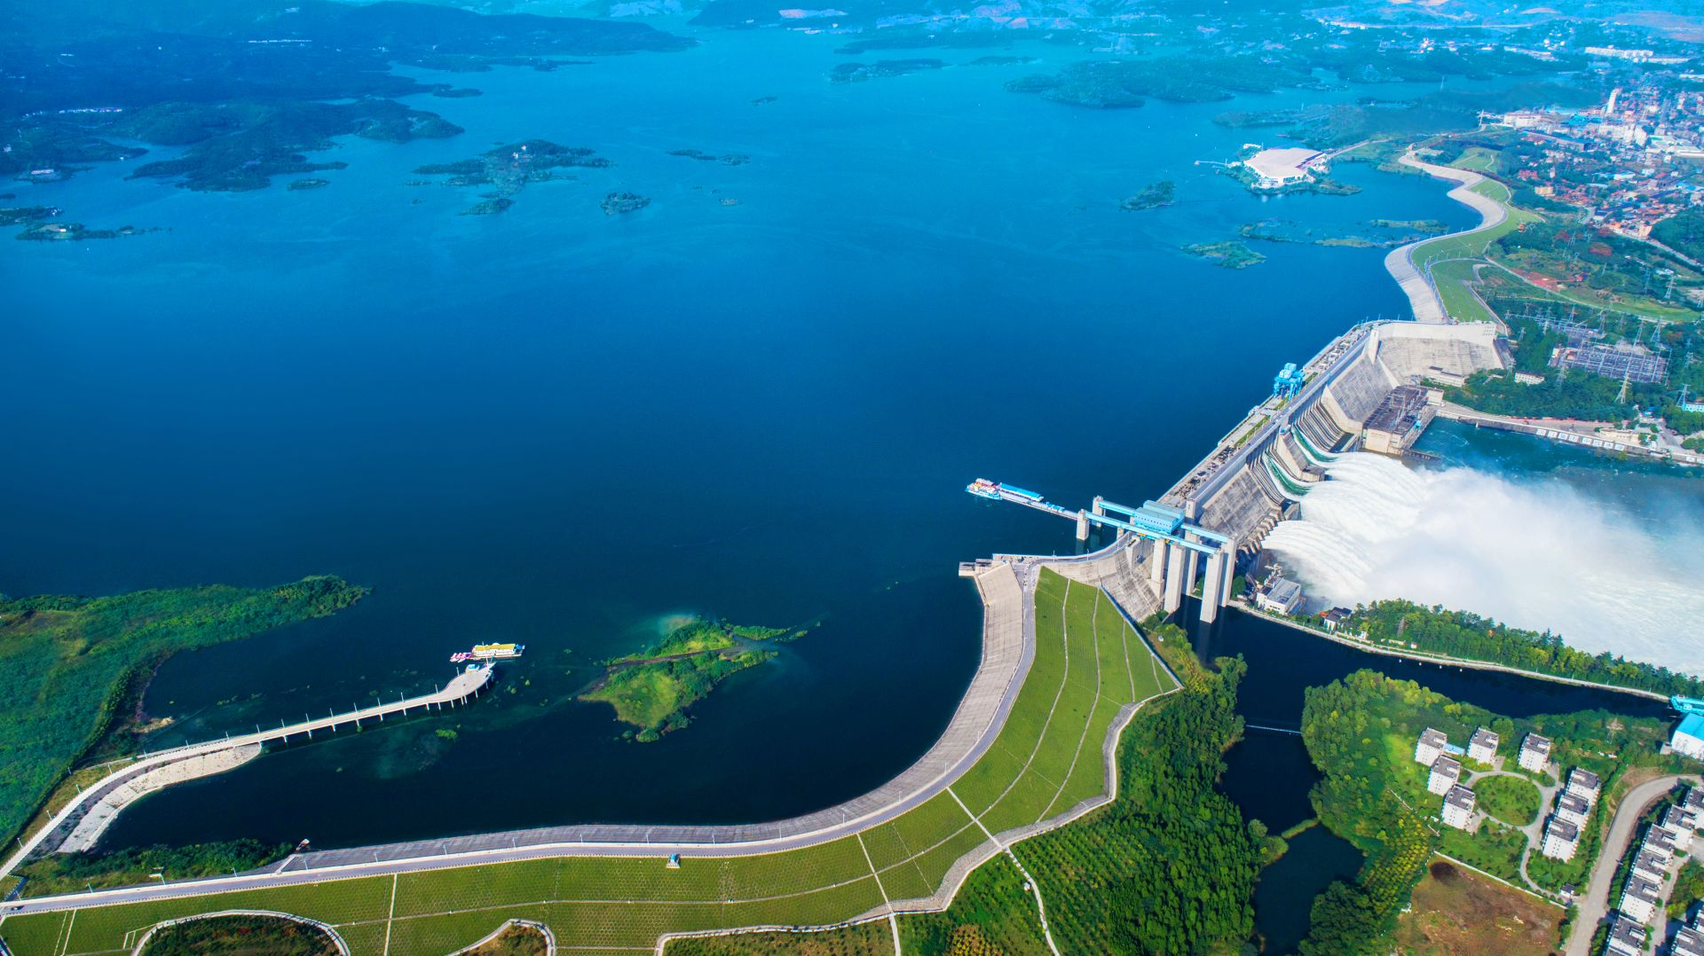
语法填空
人与社会：China’s South-to-North Water Diversion Project

Slide 37
China’s South-to-North Water Diversion Project has benefited more than 185 million people over the past 10 years, official data showed. This mega water diversion project transports water over long 56.____________ (distance) from the country’s water-rich south to its northern regions, 57.____________ hundreds of millions of people once faced “absolute water scarcity” as 58.____________ (define) by United Nations standards. The conceptual development of this project began in the 1950s, with the first phases of its middle and eastern routes becoming 59 .____________ (operation) in late 2014.
During the past decade, it has conveyed more than 76.7 billion cubic meters of water to the country’s northern regions, providing 60.____________ stable water supply to 45 major cities and more than 185 million people, according to data from the Ministry of Water Resources.
Designed with three routes, the project 61.____________ (stretch) across four of China’s major river basins, namely, the Yangtze, Huaihe, Yellow and Haihe. The middle route, the 62.____________ (important) of the three as it supplies water to the Chinese capital Beijing, begins at the Danjiangkou Reservoir in central Hubei Province. The water flows north via canals and pipelines, crossing beneath the Yellow River before reaching the city’s water 63.____________ (treat) plants. Today, nearly 80 percent 64.____________ the water consumed in Beijing’s urban areas has made this 15-day journey from Danjiangkou. The eastern route conveys water from East China’s Jiangsu province to areas including Tianjin and Shandong. The western route is at the planning stage and is yet 65.____________ (build).
China’s South-to-North Water Diversion Project has benefited more than 185 million people over the past 10 years, official data showed. This mega water diversion project transports water over long 56.____________ (distance) from the country’s water-rich south to its northern regions, 57.____________ hundreds of millions of people once faced “absolute water scarcity” as 58.____________ (define) by United Nations standards. The conceptual development of this project began in the 1950s, with the first phases of its middle and eastern routes becoming 59 .____________ (operation) in late 2014.
During the past decade, it has conveyed more than 76.7 billion cubic meters of water to the country’s northern regions, providing 60.____________ stable water supply to 45 major cities and more than 185 million people, according to data from the Ministry of Water Resources.
Designed with three routes, the project 61.____________ (stretch) across four of China’s major river basins, namely, the Yangtze, Huaihe, Yellow and Haihe. The middle route, the 62.____________ (important) of the three as it supplies water to the Chinese capital Beijing, begins at the Danjiangkou Reservoir in central Hubei Province. The water flows north via canals and pipelines, crossing beneath the Yellow River before reaching the city’s water 63.____________ (treat) plants. Today, nearly 80 percent 64.____________ the water consumed in Beijing’s urban areas has made this 15-day journey from Danjiangkou. The eastern route conveys water from East China’s Jiangsu province to areas including Tianjin and Shandong. The western route is at the planning stage and is yet 65.____________ (build).
distances
where
缺名词，给名词，即为名词复数
缺定语从句连接词，先行词为地方
defined
完整表述: as it is defined by
operational
缺形容词
a
supply为可数名词，缺冠词
stretches
缺谓语动词，思考时态语态主谓一致
most important
3条线的比较，涉及最高级而非名词
treatment
“城市用水处理厂”，缺名词修饰名词plant
of
“百分之八十的水”
固定搭配be yet to do, build与主语为被动关系
to be built

Slide 38
语法填空词汇学习
拉开距离
物理距离 /心理距离
distance n.__________________________ V. ___________
Eg a. She always distances herself from controversy.
b. The ________________ (distance) between the cities are quite different.
c. The distance between us seemed to grow wider.
d. long-distance relationship / remote(distant) control /a distant look / bridge physical/emotional distance
e. Life is about finding the right distance ,not too close to burn, not too far to warm (译）
operational adj “可操作的”或“运行的”
The new airport is expected to be ______________ (operation) by the end of this year.
3. treatment n “处理”或“治疗” N+N a stone bridge water ________________ facilities
The water treatment plant is very efficient../The new ______________ (treat) for the disease is very effective.
4. be to do /be to be done
The bridge is _____________(build) next year
5. yet
a. -Have you finished your work? -Not yet.
b. a simple yet effective method
c. Their products are expensive, yet customers just keep coming back for more.
d. The best has yet to come.
distances
人生真谛在于距离的尺度，近不至灼，远不失温。
operational
treatment
treatment
将要被做
to be built
否定句/疑问句 尚未/已经
然而，尽管
然而，尽管
尚未做

Slide 39
易错点比较
1. This mega water diversion project transports water over long distances from the country’s water – rich south to its northern regions, 57 hundreds of millions of people once faced “absolute water scarcity” as 58 (define) by United Nations standards.
相比较: …… , _____________ hundreds of millions of people there once faced “absolute water scarcity” as defined by United Nations standards.
2. This is the park _____________ we often play basketball.
This is the park _____________ we often visit.
3. The conceptual development of this project began in the 1950s, with the first phases of its middle and eastern routes _____________ (become) operational in late 2014.
4. The new water __________ plant will become __________ next year.
新的水处理厂将在明年投入使用。
5. This is a complex problem __________ by the experts.这是专家们定义的一个复杂问题。
where
defined
because
where
which/that/-
becoming
treatment
operational
defined

Slide 40
文本再填空
China’s South - to - North Water Diversion Project_______________ (benefit) more than 185 million people over the past 10 years, official data showed. This mega water diversion project transports water over long distances from the country's water - rich south to _____ northern regions, where hundreds of millions of people once faced “absolute water scarcity” _____defined by United Nations standards. The____________( concept) development of this project began in the 1950s, __________ the first phases of its middle and eastern routes becoming operational in late 2014.
During the past decade, it has conveyed more than 76.7 billion cubic meters of water to the country‘s northern regions, providing a stable water supply to 45 major cities and more than 185 million people, according to data from the Ministry of Water Resources.
___________(design) with three routes, the project stretches across four of China's major river basins, namely, the Yangtze, Huaihe, Yellow and Haihe. The middle route, the most important of the three ______ it supplies water to the Chinese capital Beijing, begins at the Danjiangkou Reservoir in central Hubei Province. The water flows north via canals and pipelines, crossing beneath the Yellow River before reaching the city's water treatment ________(plant). Today, nearly 80 percent of the water__________ (consume) in Beijing's urban areas has made this 15 - day journey from Danjiangkou. The eastern route conveys water from East China's Jiangsu province to areas including Tianjin and Shandong. The western route is at the planning stage and is _______ to be built.
has benefited
its
as
conceptual
with
Designed
as/since
plants
consumed
yet

Slide 41
Thanks for your attention

