Slide 1


感恩遇见，相互成就，本课件资料仅供您个人参考、教学使用，严禁自行在网络传播，违者依知识产权法追究法律责任。
更多教学资源请关注
公众号：溯恩英语
知识产权声明

Slide 2

拉波夫叙事理论指导下的
高中英语读后续写
—2025年2月浙江省名校协作体读后续写
高小聪 陕西省礼泉县教育局教研室

Slide 3
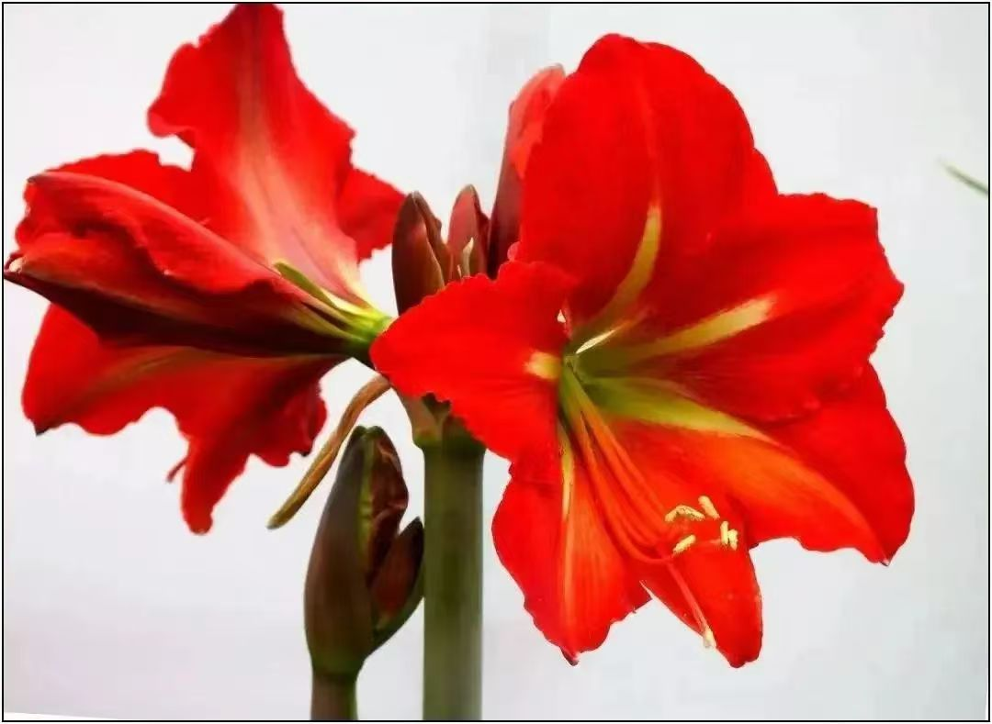
Contents：
Ⅰ. 呈现拉波夫叙事模式
Ⅱ. 解析读后续写任务
Ⅲ. 巧妙构思多元结局
Ⅴ. 积累善行类语块

Slide 4
点题（Abstract）
what
即叙事者对故事的简要概述，一般位于故事开头，可指向故事的主题。
纲要
outline
指向（Orientation）
when, where, who,
surroudings
是叙事者对时间、地点、人物、环境的描述，为事件的展开作铺垫，但并非所有的叙事都有这四个指向。
拉波夫
叙事模式
进展和冲突（Complication
and conflicts）
how
是对故事发展变化的描述，按照一定的顺序推进，通过人物语言、动作、心理活动的描写来呈现故事的曲折发展。
发展
development
拉波夫叙事模式由美国语言学家拉波夫和瓦莱茨基提出，在叙事学等领域影响广泛。
体现叙事者或故事中的人物对于事件的观点、态度，评议可以出现在故事的各个地方，在进展与结局之间常常会有评议。通过观点、态度、评议体现人性、凸显主题。
评议 Evaluation
人性与主题
(humanity and theme)
why
结局（Resolution）
what
是对故事人物和事件最终结果的交代。
结尾
Ending
是故事与现实的链接，是故事对现实的影响或故事赋予现实生活的意义，通常表达作者的感悟和价值取向，升华故事主题。
回应（Coda）
why

Slide 5
解析读后续写任务
纲要 outline
第二节(满分 25分)
阅读下面材料，根据其内容和所给段落开头语续写两段，使之构成一篇完整的短文。
P1.Right after I had my first son, I found myself with a surplus of baby formula (奶粉) I couldn't use due to his stomach issues. Not wanting it to go to waste,I tuned to a website for giving away items for free. Shortly afterward a young woman from my small town reached out, expressing her desperate need for the formula. She explained that her husband had just passed away in an accident, leaving her in a dificult situation, Feeling a tug at my heart. I immediately promised to save all the formula for her.
P1.点题（Abstract）
P1&P2指向
（Orientation）
I had a surplus of ________ due to my baby’s stomach issues. I volunteered _______ all the formula for a young woman who got into _______ with her husband _____________ by Internet.
Sympathy and Kindness
formula
to save
trouble
passing away

Slide 6
P2. However, three days passed, and I heard nothing, I tried to connect her but failed, My husband suggested it might be a cruel joke or maybe some sort of sick tricks. Unwilling to believe it, I decided to give it one last try.
Right after I _____ my first son
Time
had
My house in the small _____;
The young woman’s cottage situated in the middle of the _______, in a _________part of town
town
P1.点题
（Abstract）
Places
desert
desolate
纲要
outline
Leading roles: I, a _______ full of love and compassion; a young ________ in trouble whose husband had passed away;
Supporting role: My ________(become suspicious of the young woman’s situation);
mother
woman
P1&P2指向（Orientation）
Characters
husband
giveaway
The _________ of surplus formula brings to light the difficult situation of a young mother, laying the __________for subsequent conflicts and actions.
Settings
foundation

Slide 7
(P1-P5）发展 development
P3. This time I got through. In the telephone. I could hear the tiredness and strain in her voice as she mentioned she'd just managed to pay her phone bill and had to wait until she could find a way to get closer to town. It was clear she was struggling. Trying to keep my tone neutral，I offered to send the formula to her house. After an awkward silence，she agreed and provided her address.
进展
（Complicating Action）
冲突
Conflicts
I _______ information online about ___________ formula , and a young mother ____________ to us for help. Losing touch with her, my husband __________ it was a sick trick, but I____________ contacting her. Eventually, the phone was connected and we ________to deliver the formula, food and essentials to the young mother's home, ________I witnessed her extremely poor living conditions.
post
My losing contact with the young mother's led to a _____________, highlighting the _________between her desperate living situation and the my goodwill.
giving away
reached out
trust crisis
suspected
insisted on
contrast
offered
where

Slide 8
P1-P5评议（Evaluation）
P4.Once I hung up,I felt compelled to do more than just provide the formula. We checked her address and discovered she lived in a desolate part of town. Her cottage was situated in the middle of the desert, far removed from any public transportation. Realizing how tough her situation must be, I went through my pantry (食品储藏室), fridge and freezer, gathering anything we could spare. In total, we filled three bags and a laundry hamper with food and essentials.
人性（Humanity）
主题（Theme）
Emotional descriptions:
I heard the young woman’s miserable situation, feeling a _____ at my heart.
Hearing her tiredness and strain in her voice, I tried to keep my tone ________.
...I felt ____________ to do more than just provide the formula...
...she welcomed us inside, her face devoid(没有) of _________.
...she still seemed almost ________, as if life had drained all the ______ from her.
tug
neutral
compelled
emotion
numb
color

Slide 9
P1-P5评议（Evaluation）
P5.When we arrived at her home the next day, she welcomed us inside, her face devoid(没有) of emotion. The sight that greeted me was heartbreaking: her living space was almost empty, with only a single couch and a bare kitchen. Even when we unloaded the items, she still seemed almost numb, as if life had drained all the color from her. Without a word, she simply nodded, turned away, and mechanically began making a bottle for her son, her movements slow and detached.
人性（Humanity）
主题（Theme）
Environmental descriptions:
The emptiness and _____________ of the desert cottage symbolized the young mother's ________.
Depictions of actions:
The young mother's behaviors implied her ____________________with the pressure of life.
desolateness
The power of love, kindness and sympathy:
... ...
despair
psychological trauma
注意:
(1)续写词数应为150左右;
(2)请按如下格式在答题卡的相应位置作答。
Paragraph 1: On the way back home, I couldn't shake her from my mind._________________
Paragraph 2: Several weeks later; the woman came to me.__________________________________
结尾Ending
结局
（Result or Resolution）
... ...
回应
（Coda）
... ...

Slide 10
巧妙构思多元结局
一、 首尾呼应, 主题升华
前文（P5)：
...arrived at her home the next day
her face —devoid(没有) of emotion.
... tiredness and strain in her voice
进展（Complicating Action）
Possible version：
续写P1. On the way back home, I couldn' shake her from my mind. My heart ached for the young woman and her son, their plight echoing in my thoughts. Determined to offer more support, I started researching local resources and support networks that could assist her. I even reached out to a nearby charity organization, explaining her situation and pleading for their help. The response was overwhelming - clothes, toys, and even monetary donations poured in, Each contribution filled me with a sense of warmth and hope, as if we were all part of a larger, compassionate tapestry. （Faced with the heartwarming contributions, I prayed that our small gestures would bring them a semblance of comfort and hope.
续写P2 Several weeks later, the woman came to me. She was visibly different, her face brightened with a smile I hadn't seen before and her eyes, once tired and strained, now sparkled with gratitude. She thanked me profusely, holding her son in her arms, looking much more at ease. “Thank you for restoring our faith in humanity. Your kindness has given us strength to keep going." she said, her voice filled with gratitude. Her joy and relief were so genuine that it moved me deeply. (Observing the positive transformation in her bestowed upon me a sense of gratification and strengthed my belief in the power of kindness and community backing.)
前文（P5）：
The sight — heartbreaking
living space — empty, with only a single couch and a bare kitchen
过渡句— 承上启下
前文（P5）：
she —almost numb
life — had drained all the color from her.
结局（Resolution）
前文（P5）：
she — simply nodded, turned away, and mechanically began making ...
movements— slow and detached
前文（P5）Feeling a tug at my heart...
回应（Coda）

Slide 11
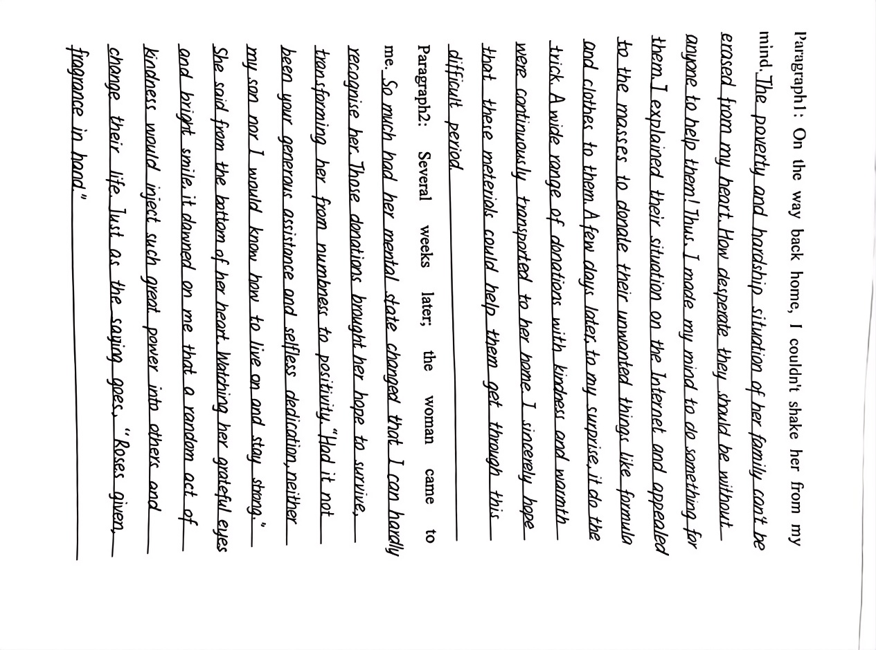
巧妙构思多元结局
The young woman’s desperate situation ________ in my mind.
lingered
Having learned about her tragic experience by Internet, varieties of __________came to her home.
donations
二、深刻感悟,
立德树人
Love, kindness and help not only made her out of trouble but also brought her __________ and confidence in life.
happiness
Bring out the theme that love and kindness lies in _________ functions.
two-way

Slide 12
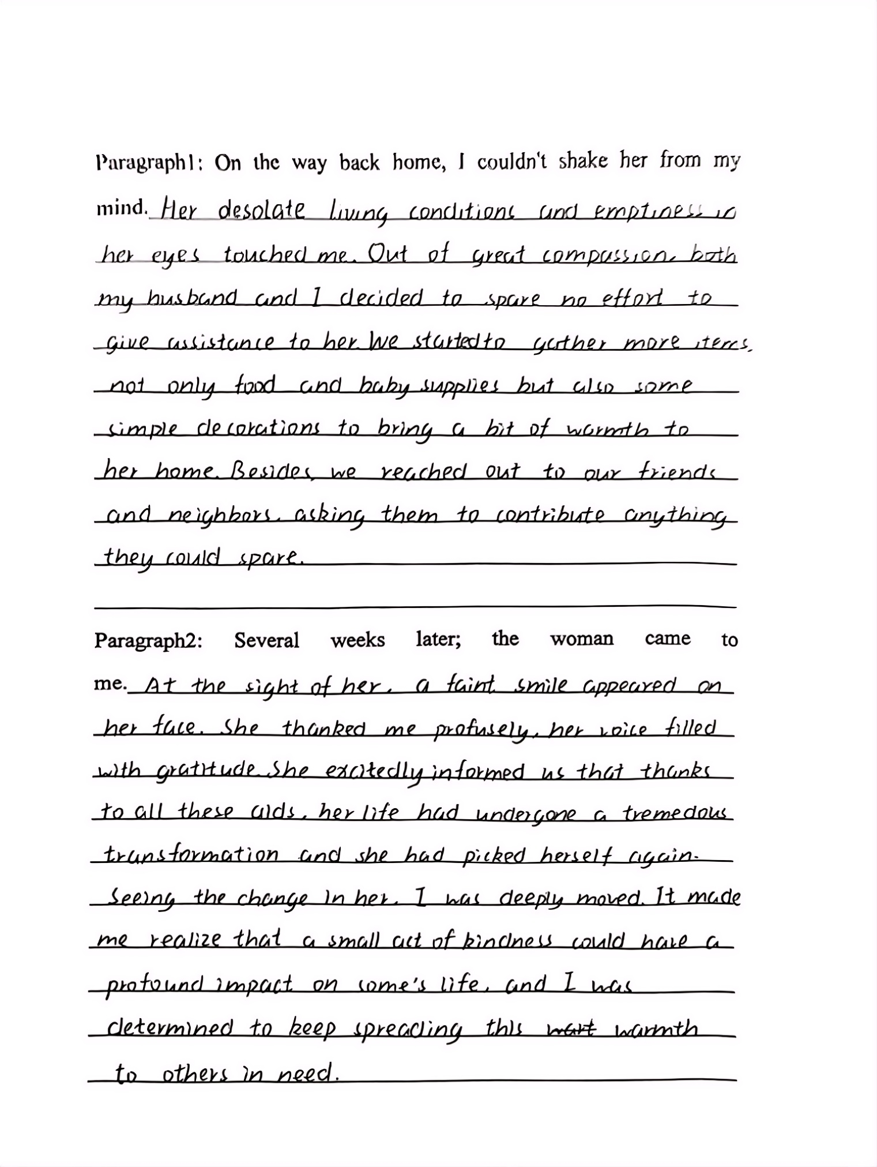
The miserable experience and the _________ of her life made her physically and _________ exhausted，which had drained all the happiness from her. Compassion and kindness propmted us to do our __________ to help her out.
poverty
mentally
endeavour
三、自然结尾,
以景结情
Kind acts making a gentle smile _________ on her face, she picked _______ up again. gratitude was _______ words.
danced
herself
beyond
Small acts of kindness makes a great __________ to her— I will keep spreading ________ to others in need
difference
warmth

Slide 13
善行类语块整理
the tiredness and strain in her voice 声音疲倦、紧张
her face devoid(没有) of emotion 脸上没有意思表情
seemed almost numb 几乎麻木了
life had drained all the color from her 生活滤干了她所有的色彩
her movements slow and detached
be sunk into hopelessness 陷入绝望
in despair 在绝望中
dash one’s hopes 使某人的希望破灭
be overwhelmed by a feeling of despair 深感绝望
with one’s head and shoulders hanging down 耸拉着头和肩
绝望无助：

Slide 14
善行类语块整理
after an awkward silence 一阵尴尬的沉默
flush with embarrassment 尴尬得脸发红
lower one’s head 低下头
feel one’s face burning 脸上滚烫
feel the blood rush to one’s face 感到血液涌上脸颊
One’s face blushed. 某人脸红了
尴尬窘迫：
in low spirits 情绪低落
with a heavy heart 怀着沉重的心情
be down in spirits/be blue 情绪低落
with a long face 哭丧着脸
a burst of sadness 一阵悲伤
悲伤难过：

Slide 15
善行类语块整理
do sb a favor 帮某人一个忙
It’s much better to teach how to fish than to give fish.
授人以鱼不如授人以渔。
give/lend sb a hand 帮助某人
spare no efforts to help 不遗余力地帮助
without any reward/without concern for return 不求回报
put one’s heart into... 全心全意
offered to do sth. 自愿做某事
feel compelled to do sth. 觉得要做某事
plead for their help 请求帮助
提供帮助：
express/offer one’s heartfelt gratitude 表达衷心的感谢
give sb a hug 拥抱某人
hold sb tightly in the arms 把某人紧紧抱在怀里
hold one’s hands tightly 紧紧握住某人的双手
thank sb with a lump in one’s throat 哽咽着向某人道谢
be grateful for 对.....表示感激
appreciate sb’s doing sth. 感谢某人做了某事
表达感激：

Slide 16
善行类语块整理
be moved to tears 感动得流泪
moist/misty eyes 眼睛湿润了
a warm current rises in one’s heart 一股暖流涌上心头
feel warm 感到温暖
be touched/moved deeply/profoundly 深受感动
choke with sobs 哽咽
tears spring to one’s eyes 热泪盈眶
melt the ice in her heart 融化了她内心的冰川
温暖感动：
One’s eyes danced with joy and sweetness. 眼里荡漾着开心与甜蜜
flash a bright smile 闪过灿烂的微笑
One’s eyes twinkled with pleasure. 眼里闪耀着快乐
be lighthearted 满心欢喜
wear a shining smile 挂着灿烂的微笑
a wild joy took control of sb 内心狂喜
One’s face lit up 满脸喜色
开心喜悦：

Slide 17
善行类语块整理
be aware of 意识到
be overcome with emotion 心中百感交集
in/hold the belief that... 相信......
learn from the experience that 从这段经历中学到......
deeply understand 深刻地领悟
make sb. realize... 使某人意识到......
意识领悟：
By showing kindness to others, I learn that sympathy and help can make a positive impact on the world around him.
By putting herself in others shoes, I have learned to be more empathetic and understanding towards those around her.
kindness comes full circle (爱出者爱返，福往者福来).
.
善良与同理心：

Slide 18

爱出者爱返，福往者福来.
kindness comes full circle.
— 汉.贾谊《新书》

