Slide 1


感恩遇见，相互成就，本课件资料仅供您个人参考、教学使用，严禁自行在网络传播，违者依知识产权法追究法律责任。
更多教学资源请关注
公众号：溯恩英语
知识产权声明

Slide 2
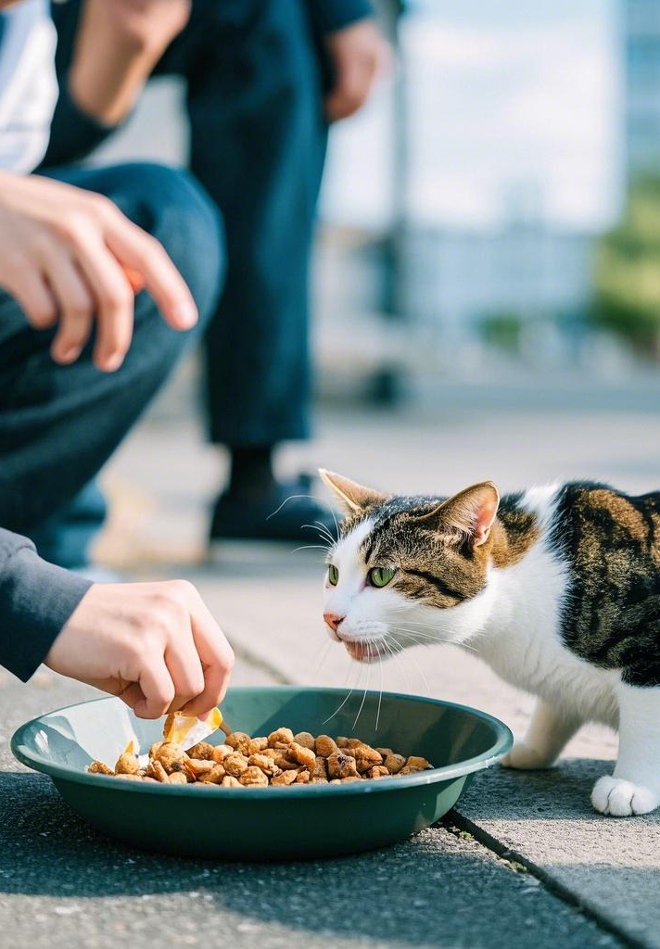
My Views
on Stray Cats at School
—2025.2高三强基联考应用文投稿议论文分析

Slide 3
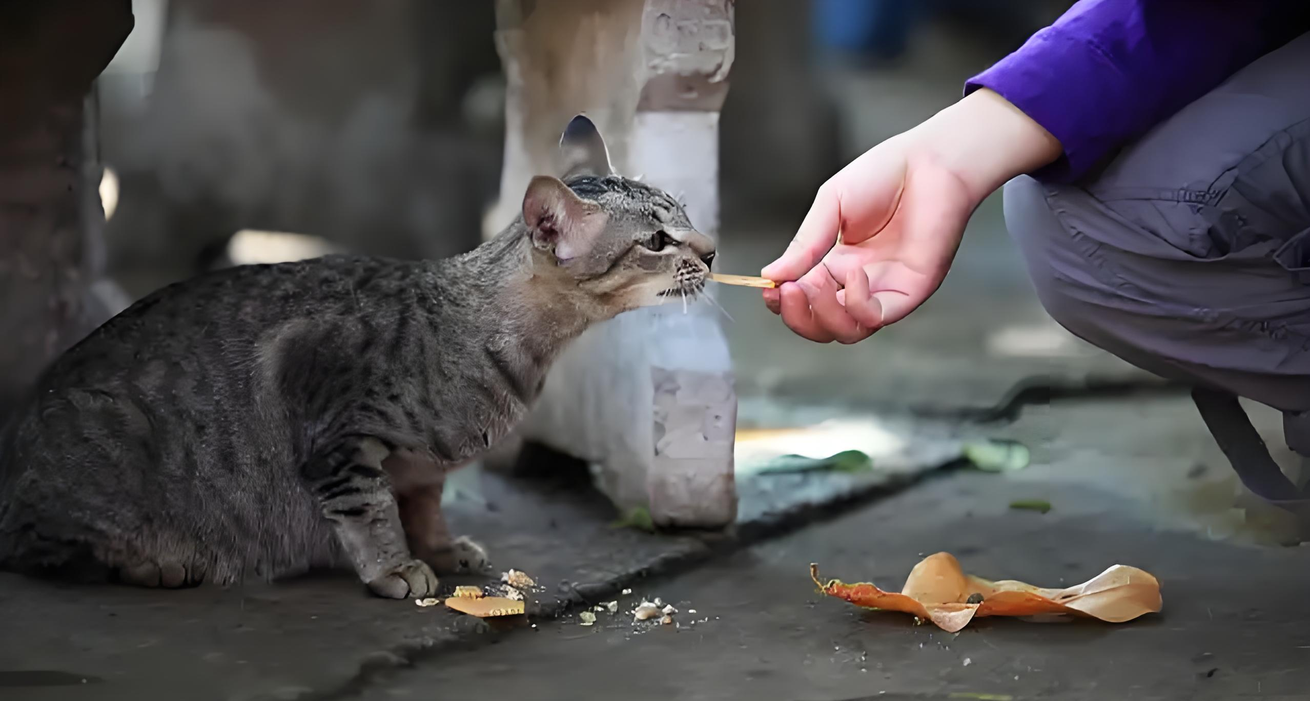
Lead in
What is most challenging for you in this writing assignment?
Possible difficulties:
1.describe the phenomenon
2.show opinions about feeding stray cats at school
3.offer relevant suggestions
...

Slide 4
Analyze
Topic : the phenomenon of feeding stray cats at school
Receiver: editor of school English newspaper
假定你是李华，近期你校出现了多只流浪猫（stray cats）许多同学在课间对其进行投喂。为此，校英文报就此现象进行征稿，请你写一则短文投稿。内容包括：
1.陈述看法
2.提出建议
Contribution
Argumentation
Short Essay
Views
My Views on Stray Cats at School
Suggestions
What’s the genre of this writing?
What do the underlined parts tell us?
In this article, what should be included in each part ?

Slide 5
Construct
comprehensive
Introduction
Briefly introduce the phenomenon of students feeding stray cats during breaks.
Opinions
State your view on whether this is a positive or negative behavior, and explain why.
Short
Essay
Suggestions
Offer practical advice on how the school or students should address the situation,, and explain why.
Summarize your thoughts and encourage responsible actions.
Conclusion

Slide 6

Brainstorm
Topic : feeding stray cats at school
opinons
positive
act/cats/students/humans & animals
negative
a kind and compassionate act
reflect students' care for animals
foster a sense of responsibility and empathy among students
help the cats survive
create a harmonious atmosphere on campus, where humans and animals coexist peacefully
lead to potential problems
overfeeding might cause the cats to rely too much on humans
reduce cats’ ability to survive independently
attract more stray animals to the campus
increase the risk of hygiene issues or even conflicts between cats and students

Slide 7
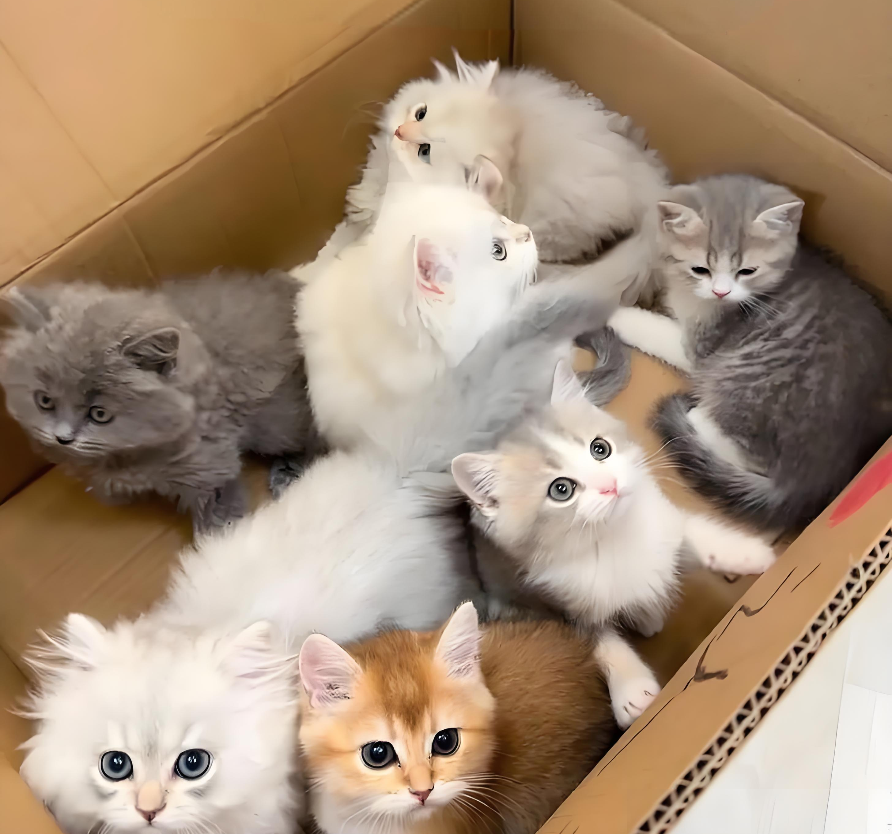
Brainstorm
Suggestions
Organize a Stray Cat Care Program (组织流浪猫关爱计划):
Set Up Designated Feeding Areas (设立指定投喂区域)
Educate Students on Responsible Feeding (教育学生负责任地投喂):
Encourage Adoption (鼓励领养)

Slide 8

Practice and Accumulate
Organize a Stray Cat Care Program
(组织流浪猫关爱计划):
The school can work with animal protection organizations to establish a systematic care program for stray cats. This includes regular feeding, vaccination, and sterilization to ensure the cats' health and control their population.
学校可以与动物保护组织合作，建立一个系统的流浪猫关爱计划。包括定期投喂、接种疫苗和绝育，以确保猫咪的健康并控制它们的数量。

Slide 9
Practice and Accumulate
Set Up Designated Feeding Areas (设立指定投喂区域):
Designate specific areas on campus for feeding stray cats to avoid littering and maintain cleanliness. This also helps monitor the cats' activities and ensures they do not disturb classrooms or other facilities.
在校园内设立专门的投喂区域，以避免乱扔垃圾并保持环境整洁。这也有助于监控猫咪的活动，确保它们不会干扰教室或其他设施。

Slide 10
Practice and Accumulate
Educate Students on Responsible Feeding (教育学生负责任地投喂):
The school can hold workshops or seminars to teach students how to care for stray cats responsibly. For example, students should avoid feeding cats unhealthy food and learn to respect the cats' natural behavior.
学校可以举办讲座或研讨会，教育学生如何负责任地照顾流浪猫。例如，学生应避免投喂不健康的食物，并学会尊重猫咪的自然习性。

Slide 11
Practice and Accumulate
Encourage Adoption (鼓励领养):
Promote adoption campaigns to find permanent homes for friendly and healthy stray cats. This reduces the number of stray cats on campus and gives them a better life.
推广领养活动，为温顺且健康的流浪猫寻找永久家庭。这可以减少校园内流浪猫的数量，并改善它们的生活。

Slide 12
Conclusion
Summary + Encouragement
In conclusion, while feeding stray cats is a kind gesture, it is important to approach the situation responsibly. Let’s work together to ensure the well-being of both the cats and the school community.
总之，虽然投喂流浪猫是一种善意的行为，但我们需要以负责任的态度来处理这一问题。让我们共同努力，确保猫咪和校园社区的共同福祉。
Call to Action
Take action today! Whether it’s volunteering for a stray cat care program, spreading awareness, or adopting a cat, every small effort counts. Together, we can make a difference!
今天就行动起来吧！无论是参与流浪猫关爱计划、传播相关知识，还是领养一只猫咪，每一份小小的努力都很重要。携手共进，我们就能带来改变！
Anticipate
I do believe that/ Undoubtly/Surely, with the rules and efforts, not only can we ensure the well-being of stray cats, but we can also create a vibrant and harmonious campus.我确实相信/毫无疑问/当然，通过规定和努力，我们不仅可以确保流浪猫的幸福，而且我们也可以创造一个充满活力和和谐的校园。

Slide 13

Sample writing one
My Views on Stray Cats at School
Recently, several stray cats have been spotted on our campus, with many students feeding them during break times. While this behavior shows the kindness and compassion of our students, I believe it could lead to potential issues, such as health risks and the possibility of attracting even more stray cats.
To address this concern, I would like to offer a few suggestions. First, we could set up specific areas for feeding the cats, ensuring these locations are clean and easily accessible. Additionally, we could organize a volunteer team of students who are passionate about animal welfare to monitor and care for the cats.
By taking these measures, we can create a harmonious environment for both the stray cats and our school community.

Slide 14
Sample writing two
My Views on Stray Cats at School
Recently, a craze for feeding stray cats during breaks has hit our school.It is no denying that there is a rich blend of benefits of it, ranging from helping the cats survive,reflecting students' care for animals and fostering a sense of responsibility and empathy among students. However, it may also poses threats, such as health risks and the possibility of attracting even more stray cats.
To maximize the pros while minimizing the cons, it’s feasible for the school to set up designated feeding areas, so as to guarantee/ensuring these locations are clean and easily accessible. As for we students, it’s strongly suggested that we organize a volunteer team to monitor and care for the cats regularly.
Let’s work together to ensure the well-being of both the cats and the school community.Take action today! Every small effort counts.

Slide 15
Thank you!

