Slide 1


感恩遇见，相互成就，本课件资料仅供您个人参考、教学使用，严禁自行在网络传播，违者依知识产权法追究法律责任。
更多教学资源请关注
公众号：溯恩英语
知识产权声明

Slide 2
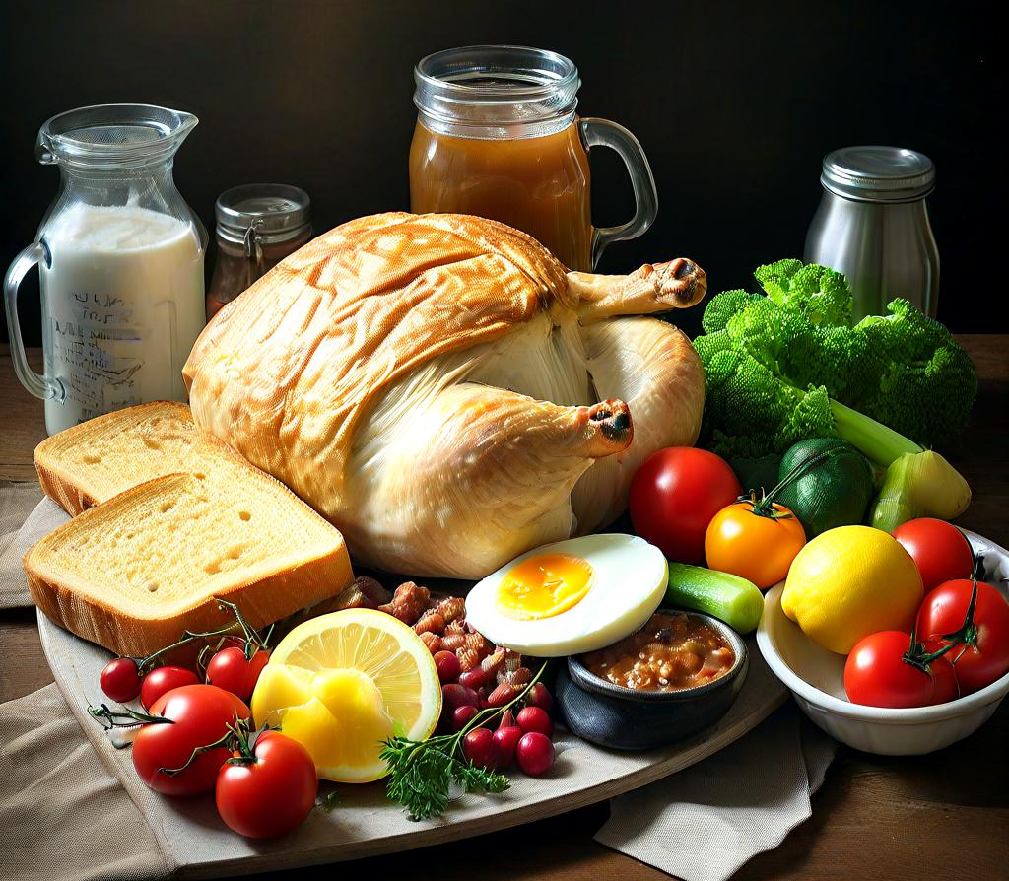
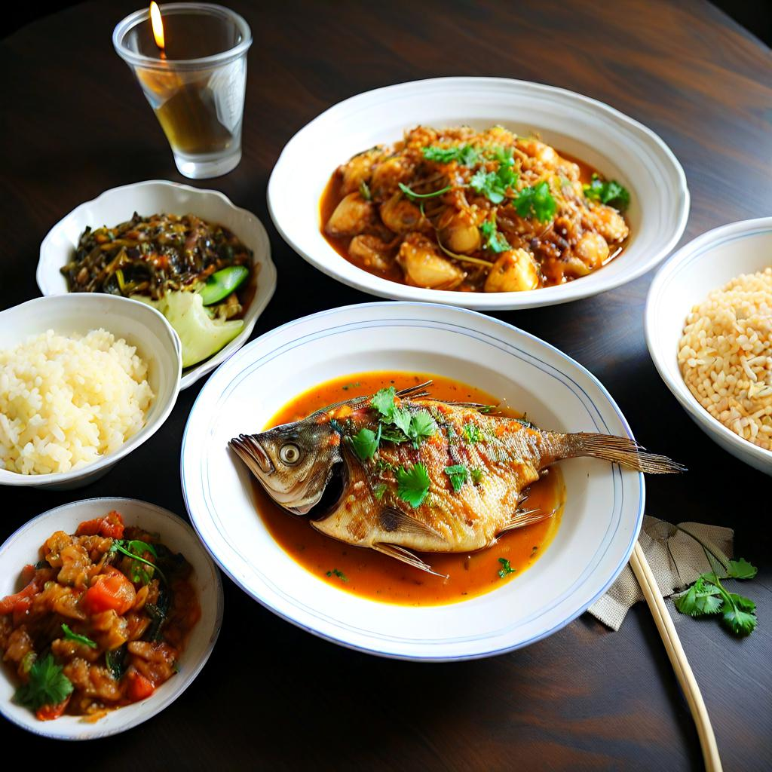
Convenience Food or Fresh Food
—The Dietary Choices Trend Among Chinese Youth
新人教版选B2U3Workbook
Reading and Writing

Slide 3

Learning Objectives
Understand the main idea: Analyze the attitudes of Chinese youth towards fresh food and convenience food.
Master key vocabulary: Learn words and expressions related to healthy eating.
Enhance reading skills: Deepen comprehension through techniques such as detail understanding and inference.
Discuss and reflect: Discuss the importance of healthy eating based on personal dietary habits.

Slide 4
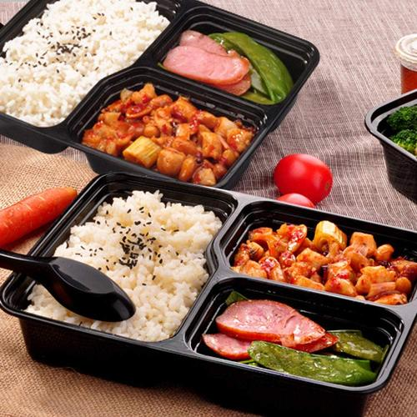
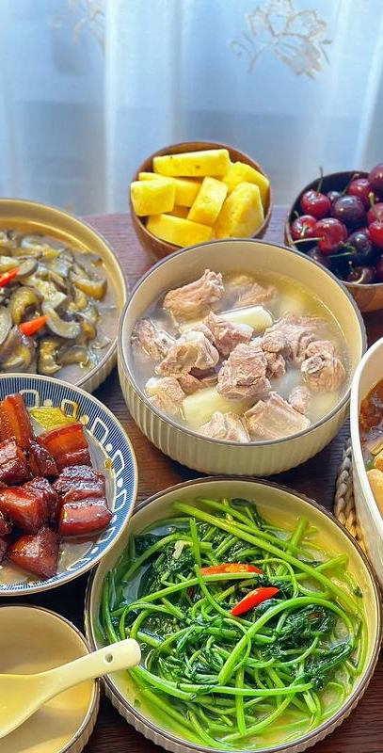
Lead-in
01
What do you prefer to eat in your daily life? Convenience food that‘s quick and easy, or fresh food that you prepare yourself?
02
What do you think are the advantages and disadvantages of convenience food and fresh food?

Slide 5
Perspective | Convenience Food | Fresh Food
Time Efficiency | Advantages: Saves time; quick to prepare or consume. | Advantages: Encourages mindful eating and better time management.
 | Disadvantages: May lead to unhealthy eating habits due to over-reliance. | Disadvantages: Requires more time for shopping, preparation, and cooking.
Health & Nutrition | Advantages: Some options are fortified加强 with nutrients. | Advantages: Generally healthier, with more natural nutrients and fewer additives添加剂.
 | Disadvantages: Often high in preservatives防腐剂, salt, sugar, and unhealthy fats. | Disadvantages: Requires knowledge to prepare balanced meals.

Slide 6
Perspective | Convenience Food | Fresh Food
Cost | Advantages: Often cheaper in the short term. | Advantages: Can be cost-effective if planned well (e.g., buying in bulk).
 | Disadvantages: Long-term health costs may outweigh initial savings. | Disadvantages: Can be expensive if buying organic or high-quality ingredients.
Health & Nutrition | Advantages: Minimal preparation reduces energy use at home. | Advantages: Lower carbon footprint if sourced locally and sustainably.
 | Disadvantages: High packaging waste and carbon footprint from processing. | Disadvantages: Requires more effort to reduce food waste and spoilage.

Slide 7
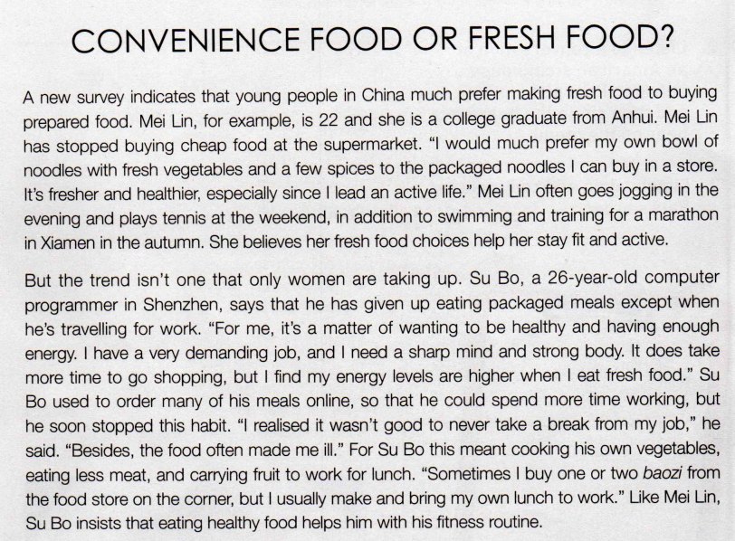
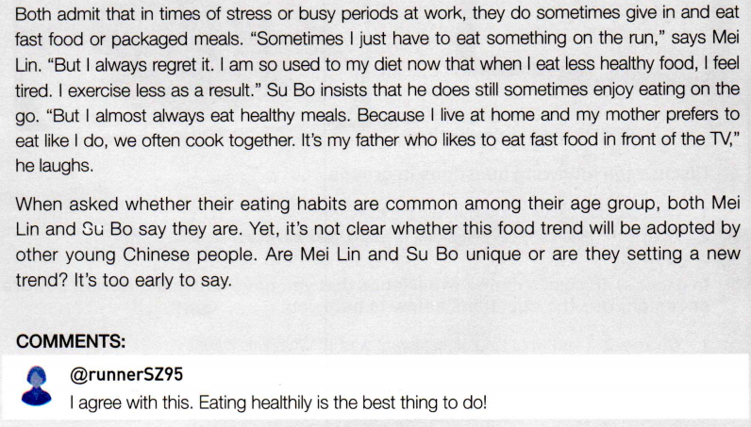
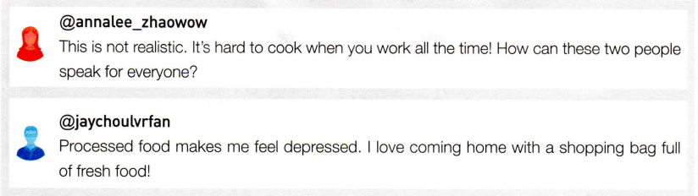
Comprehending
What is the genre and possible source of the article?
The article is a news feature or lifestyle report. It combines survey data, personal anecdotes, and expert opinions to explore a trend among young Chinese people regarding their dietary preferences.
The article could be from a health and lifestyle magazine, a news website, or a blog focused on food trends and wellness.

Slide 8
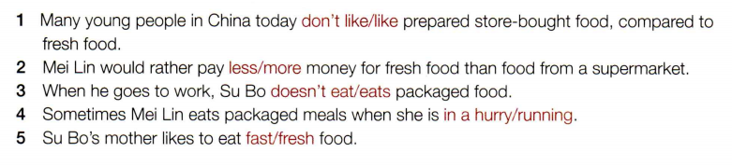
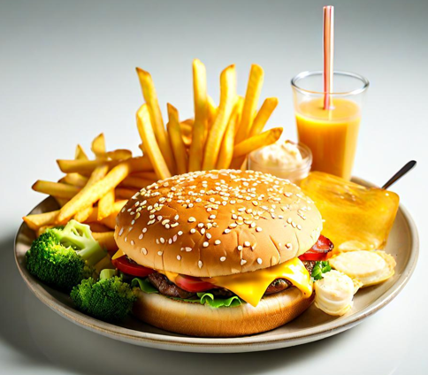
Comprehending
Activity 1 Read the text and complete the statements by circling the correct words or phrases.

Slide 9
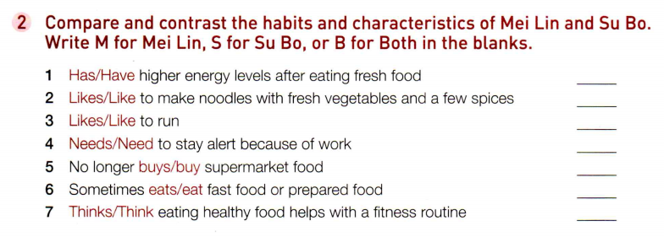
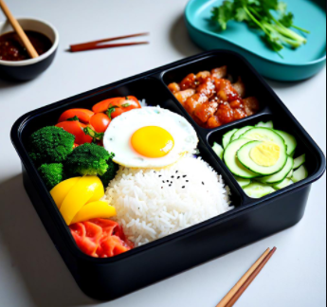
Comprehending
S
M
M
S
M
B
B

Slide 10
Comprehending
Central Theme: Mei Lin’s Food Choices and Lifestyle
Background Information
  Age， Identity， Dietary Habit: Stopped buying cheap supermarket food
Food Choices
  Preference: Homemade noodles vs. packaged noodles
  Reasons: Fresher, healthier
  Ingredients: Fresh vegetables, a few spices
Lifestyle ️
  Daily Activities: Jogging, tennis
  Other Activities: Swimming, marathon training
  Connection Between Diet and Health:
  Staying fit and active
Summary
  Core Idea: Fresh food supports an active lifestyle
CONVENIENCE FOOD OR FRESH FOOD?
A new survey indicates that young people in China much prefer making fresh food to buying prepared food. Mei Lin, for example, is 22 and she is a college graduate from Anhui. Mei Lin has stopped buying cheap food at the supermarket. “I would much prefer my own bowl of noodles with fresh vegetables and a few spices to the packaged noodles I can buy in a store. It’s fresher and healthier, especially since I lead an active life.” Mei Lin often goes jogging in the evening and plays tennis at the weekend, in addition to swimming and training for a marathon in Xiamen in the autumn. She believes her fresh food choices help her stay fit and active.

Slide 11
Comprehending
Central Theme: Su Bo’s Food Choices and Lifestyle
Background Information
Age，Identity，Dietary Habit
Reasons for Choosing Fresh Food
Health: Wants to be healthy and have enough energy
Job Demands: Needs a sharp mind and strong body
Energy Levels: Higher energy with fresh food
Past Habits and Changes
Past Habit: Ordered meals online to save time
Reasons for Change: Unhealthy to never take a break, packaged meals made him ill
Current Habits: Cooks vegetables, eats less meat, brings fruit, occasionally buys baozi
Connection to Fitness
Belief: Healthy food helps with fitness routine
Similarity to Mei Lin: Emphasizes fresh food for staying fit
But the trend isn’t one that only women are taking up. Su Bo, a 26-year-old computer programmer in Shenzhen, says that he has given up eating packaged meals except when he’s travelling for work. “For me, it’s a matter of wanting to be healthy and having enough energy. I have a very demanding job, and I need a sharp mind and strong body. It does take more time to go shopping, but I find my energy levels are higher when I eat fresh food.” Su Bo used to order many of his meals online, so that he could spend more time working, but he soon stopped this habit. “I realised it wasn’t good to never take a break from my job,” he said. “Besides, the food often made me ill.” For Su Bo this meant cooking his own vegetables, eating less meat, and carrying fruit to work for lunch. “Sometimes I buy one or two baozi from the food store on the corner, but I usually make and bring my own lunch to work.” Like Mei Lin, Su Bo insists that eating healthy food helps him with his fitness routine.

Slide 12
Comprehending
Both admit that in times of stress or busy periods at work, they do sometimes give in and eat fast food or packaged meals. “Sometimes I just have to eat something on the run,” says Mei Lin. “But I always regret it. I am so used to my diet now that when I eat less healthy food, I feel tired. I exercise less as a result.” Su Bo insists that he does still sometimes enjoy eating on the go. “But I almost always eat healthy meals. Because I live at home and my mother prefers to eat like I do, we often cook together. It’s my father who likes to eat fast food in front of the TV,” he laughs.
What’s the main idea of this part?
It mentions the challenges and family influence.
What writing techniques are employed in this part? Why the author use them?
The author uses Contrast ,Quote to emphasize the importance of healthy eating and bring the characters to life while showing their dietary choices in busy lives and allows readers to think about their eating habits in a relaxed atmosphere and may inspire them to make healthier lifestyle choices.

Slide 13
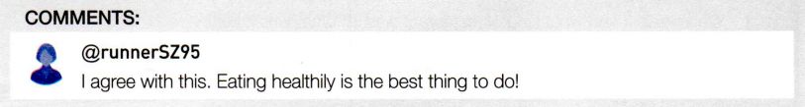
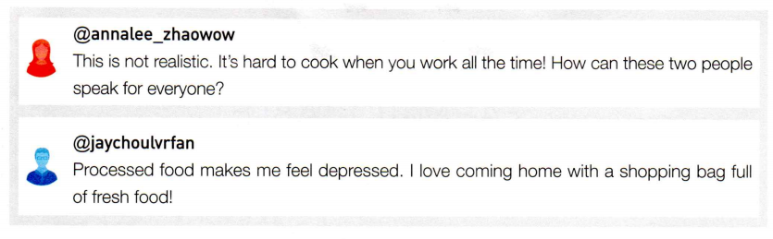
Comprehending
Comments and Reactions
When asked whether their eating habits are common among their age group, both Mei Lin and Su Bo say they are. Yet, it’s not clear whether this food trend will be adopted by other young Chinese people. Are Mei Lin and Su Bo unique or are they setting a new trend? It’s too early to say.

Slide 14
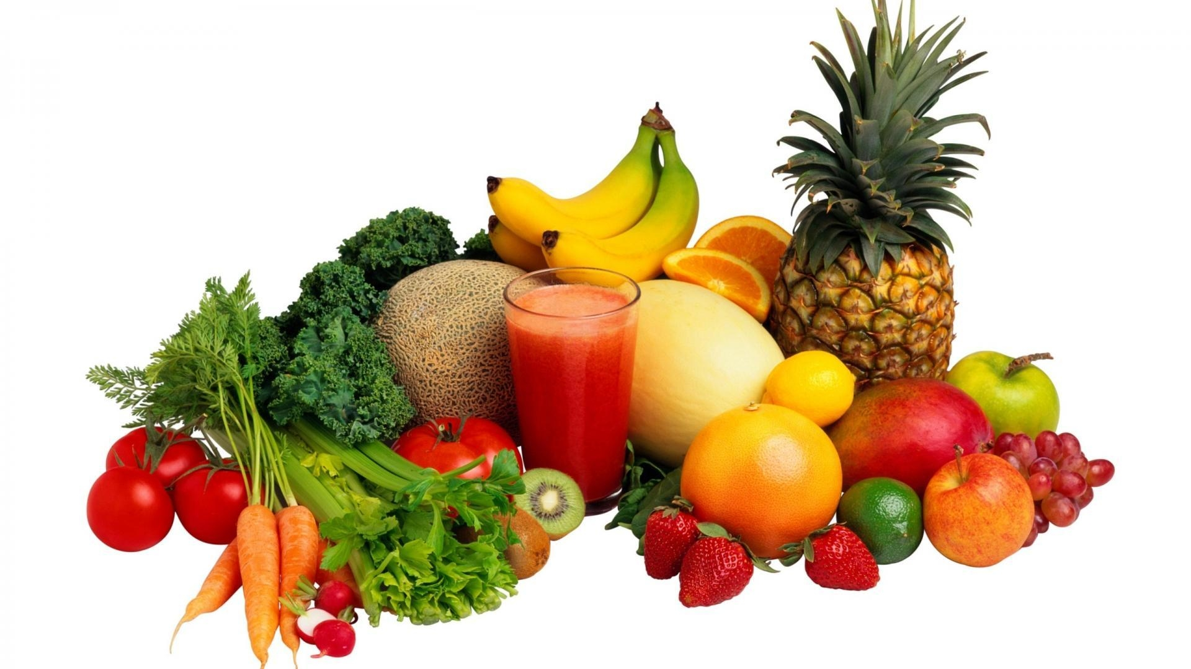
Discussion
Discuss in pairs the comments you would write in response to this article and give our reasons?
Suggested answer:
Of course fresh food is more nutritious. They are full of vitamins and fibre. Convenient food often contains more sugar, salt, fat, and other unhealthy things. My mother always cooks for us with fresh ingredients although she is busy. In my family, it's very important to eat healthily..

Slide 15
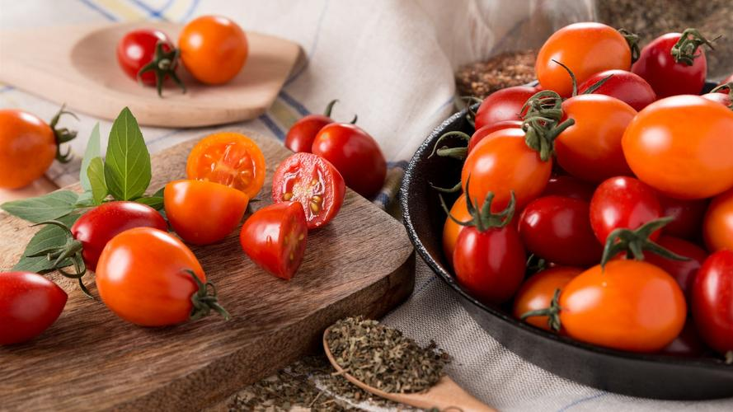
Writing
Write a short essay on whether you prefer fresh food or prepared food.
1.List two or three reasons why you prefer one choice over the other.
Reason 1 _______________________________________________________________
Reason 2 _______________________________________________________________
Reason 3 _______________________________________________________________
2.For each reason, give at least one supporting detail.
Detail 1 _______________________________________________________________
Detail 2 _______________________________________________________________
Detail 3 _______________________________________________________________
Prepared food is quicker.
Some prepared food is just as healthy.
Prepared food often tastes better.
It usually takes less than five minutes to get a prepared meal, while cooking with fresh ingredients requires several hours when you include the time for shopping, for preparing the meal, and for cleaning up afterwards.
Not all prepared food is bad for you—you just have to make healthy choices—salad instead of a hamburger, for example. And, in fact, some convenience stores and supermarkets even sell special lines of healthy prepared meals now.
Not everyone is a good cook, so it makes sense to buy prepared food that tastes better. For example, there is a brand of prepared dumplings which is quite healthy, and tastes wonderful.

Slide 16
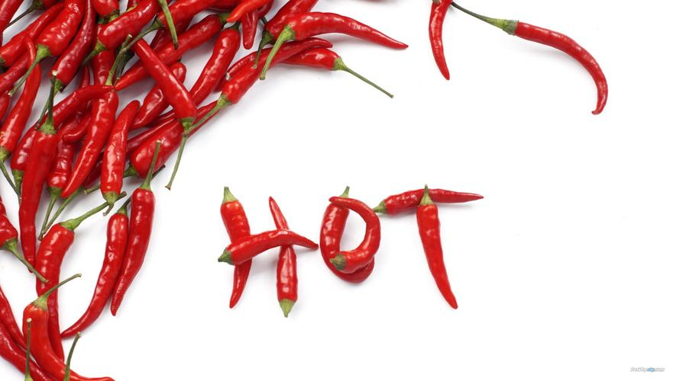
3.Now use your notes to write your essay. Remember to include an introduction and a conclusion. Use the following structures to help you.
  For me, simple fresh food is the best kind of food ….
  The first reason is that …. For example, ….
  In conclusion, ….
Sample writing
Everyone is different and has a different kind of lifestyle, and for me, prepared food is the best kind of food. There are three reasons for this. Firstly, prepared food is quicker. My parents and I are all very busy, so we simply do not have much time. It usually takes less than five minutes to get a prepared meal, while cooking with fresh ingredients requires several hours when you include the time for shopping, for preparing the meal, and for cleaning up afterwards. Secondly, not all prepared food is bad for you—you just have to make healthy choices—salad instead of a hamburger, for example. And, in fact, some convenience stores and supermarkets even sell special lines of healthy prepared meals now. Lastly, not everyone is a good cook, so it makes sense to buy prepared food that tastes better. For example, there is a brand of prepared dumplings which is quite healthy, and tastes wonderful.

Slide 17
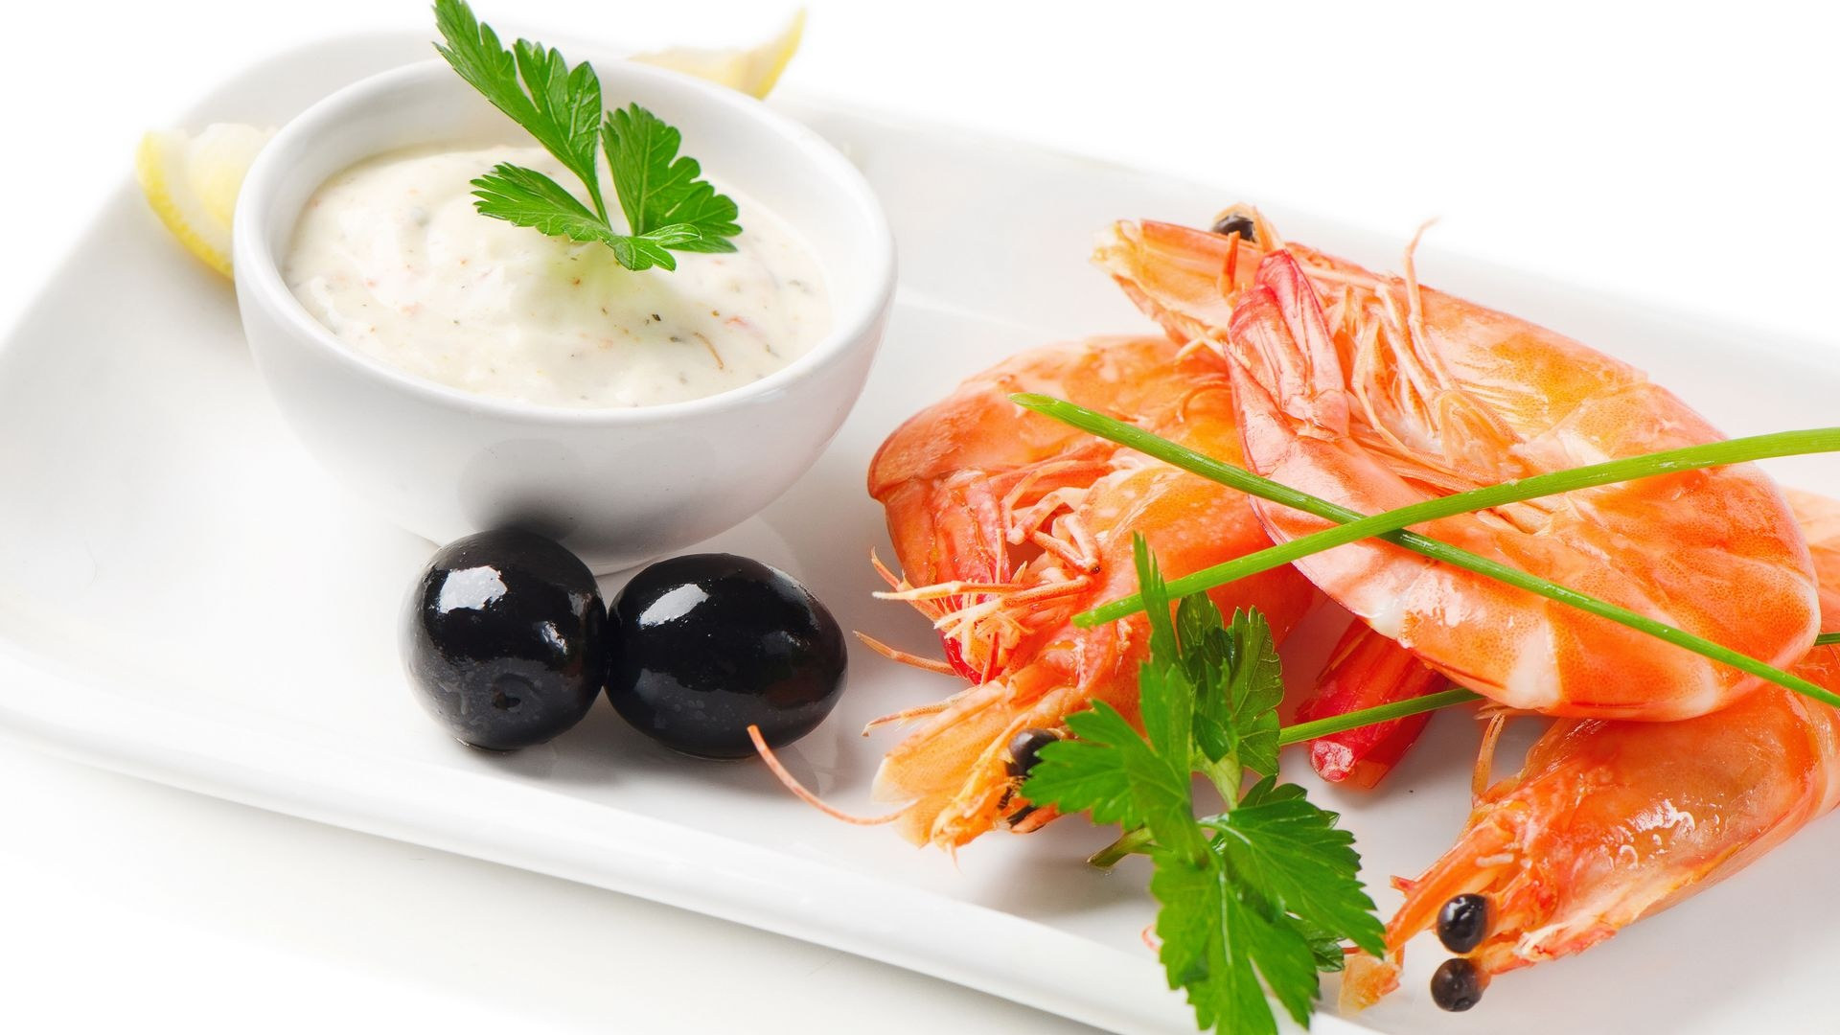
Deep Thinking
In today's fast-paced life, which do you think can better meet the dietary needs of Chinese youth between convenience food and fresh food? Why?
Suggested answer:
In today's fast-paced life, convenience food meets the dietary needs of Chinese youth better than fresh food. The reasons are as follows: Firstly, convenience food saves time, which is suitable for a busy lifestyle. Many young people do not have enough time to shop and prepare fresh ingredients. Secondly, many convenience foods are now focusing on health and offer nutritious options. Finally, the taste of convenience food is usually better, which can satisfy the taste buds of young people.

Slide 18
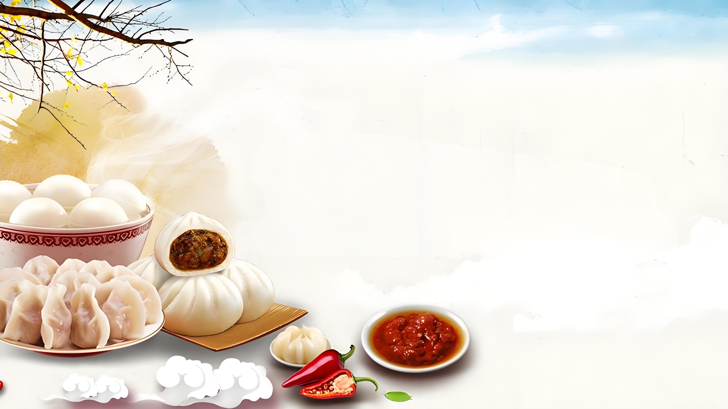
Thank you!

