Slide 1


感恩遇见，相互成就，本课件资料仅供您个人参考、教学使用，严禁自行在网络传播，违者依知识产权法追究法律责任。
更多教学资源请关注
公众号：溯恩英语
知识产权声明

Slide 2



2025年深圳市高三年级第一次调研考试
英语 阅读部分分析
北师大嘉兴附中 吴晨华

Slide 3
题型 | 话题 | 体裁 | 词数
阅读A | 人与社会：One of the camp of BGSU for high school students to explore life at sea | 说明文 | 246
阅读B | 人与自我：Jules Verne, one of the fathers of science fiction | 记叙文 | 321
阅读C | 人与社会：An introduction to intellectual humility | 说明文 | 366
阅读D | 人与自然：An artificial sensor system modelled on Mormyrids, a family of African fish | 说明文 | 350
七选五 | 人与社会：The key factors in the design of a green roof | 说明文 | 260
完形填空 | 人与自我：A lesson learned by working in the paddy fields | 记叙文 | 257
语法填空 | 人与社会：A beautiful display of Olympic spirit | 记叙文 | 218

Slide 4
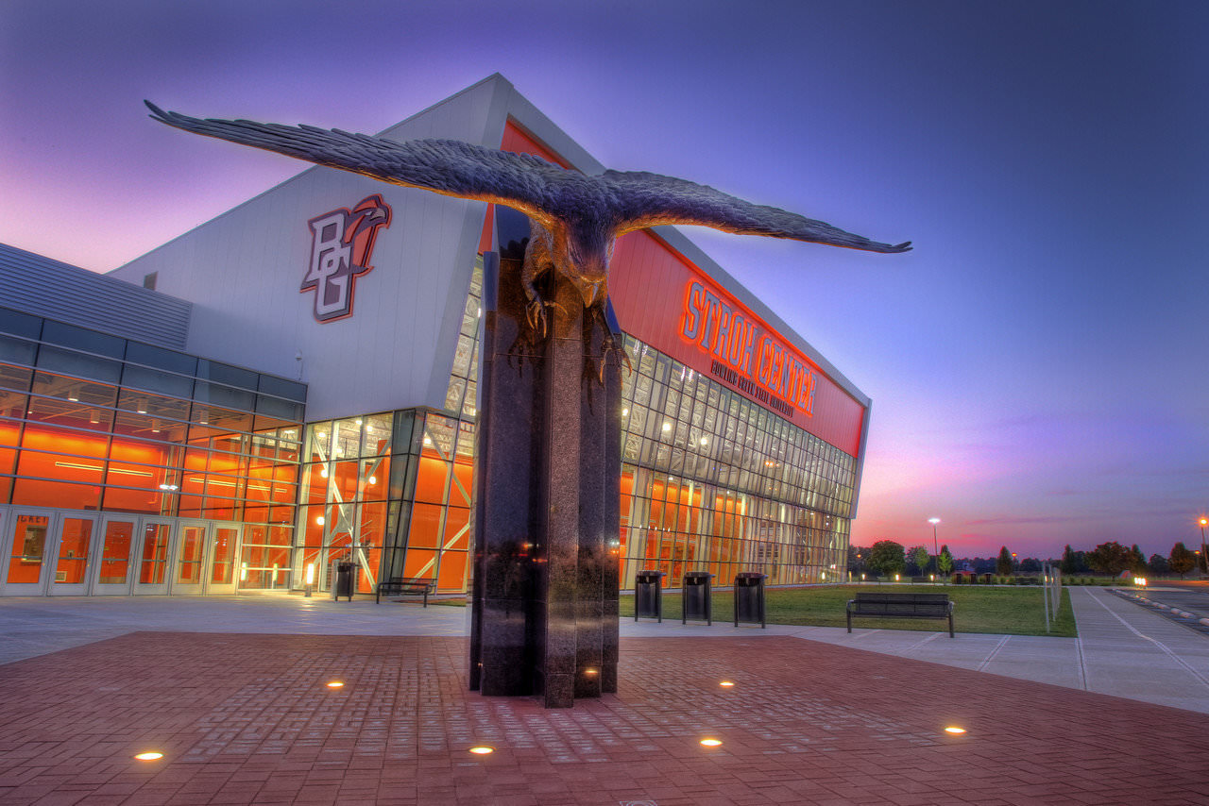
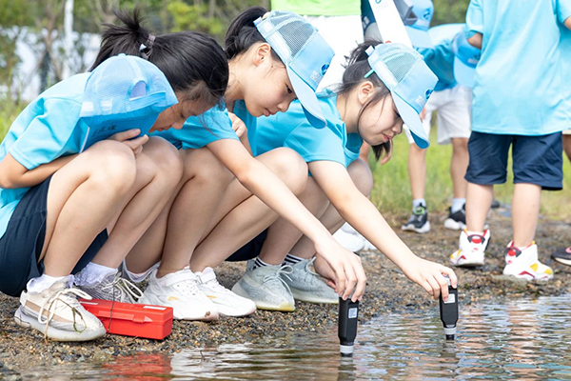
A篇
人与社会：One of the camp of BGSU for high school students to explore life at sea

Slide 5
A
Are you interested in how marine (海洋的) ecosystems work? Do you want to know more about marine animals? Bowling Green State University (BGSU) has one of the few camps in the Midwest where high school students can explore life at sea!
Camp Dates: June 8-13,2025
What kinds of activities do campers get to do?
· Field trips to locations around Northwest Ohio to examine marine life and environments
· Hands-on activities to practice specimen(标本) collection procedures
· Design and run an experiment in our research lab
· Behind-the-scene trip to the Toledo Zoo to learn about marine animals
· Meet professionals to learn what it means to be a marine scientist
What does the cost cover?
The BGSU Marine Biology camp will offer both residential and non-residential options. The cost of the non-residential program is $850, with an additional $400 fee for the residential option. The total program cost covers room and board, all materials for labs and activities as well as transportation for field trips. A 10% discount is available for early admission.
Application Requirements
· Letter of recommendation
· Complete the online form
· Complete responses to short-answer questions
Note: Answers to questions provided by anyone other than that applicant will disqualify the application.
Application Deadlines
· March 2,2025 — To be considered for early admission. Applicants will be informed by March 14.
· April 25,2025— General Application Deadline.
Note: All spaces may fill after selection from the early admission deadline.
21. What does the camp offer?
A. Sample gathering practice.
B. Field trips to nature museums.
C. Research lab membership.
D. Lectures on marine knowledge.
22. What is the early admission cost for the residential option?
A.$400. B. S765.
C.$1,125. D.$1,250.
23. Which of the following will result in an applicant's disqualification?
A. Forgetting to confirm admission
B. Providing responses given by others.
C. Missing the early application deadline.
D. Failing to recommend other applicants.

Slide 6
A篇文本知识重难点
海洋生态系统
实地考察
实际操作活动
标本收集程序
幕后的参观
录取；进人
取消...的资格
推荐信/动机信、意向书
截止日期
提前录取
项目费用
申请要求
选拔后满员
住宿和非住宿选择
1. marine ecosystems
2. field trips
3. hands-on activities
4. specimen collection procedures
5. behind-the-scene trip
6. admit → n. _____________
7.disqualify → n.____________
8.recommendation letter /motivation letter
9. due date =______________
10. early admission
11.program cost
12. application requirements
13. fill after selection
14.residential and non-residential options
15. Answers to questions provided by anyone other than that applicant will disqualify the application.
16.The cost of the non-residential program is $850, with an additional $400 fee for the residential option.
admission
disqualification
deadline
→ rather than
→ accommodation / boarding

Slide 7
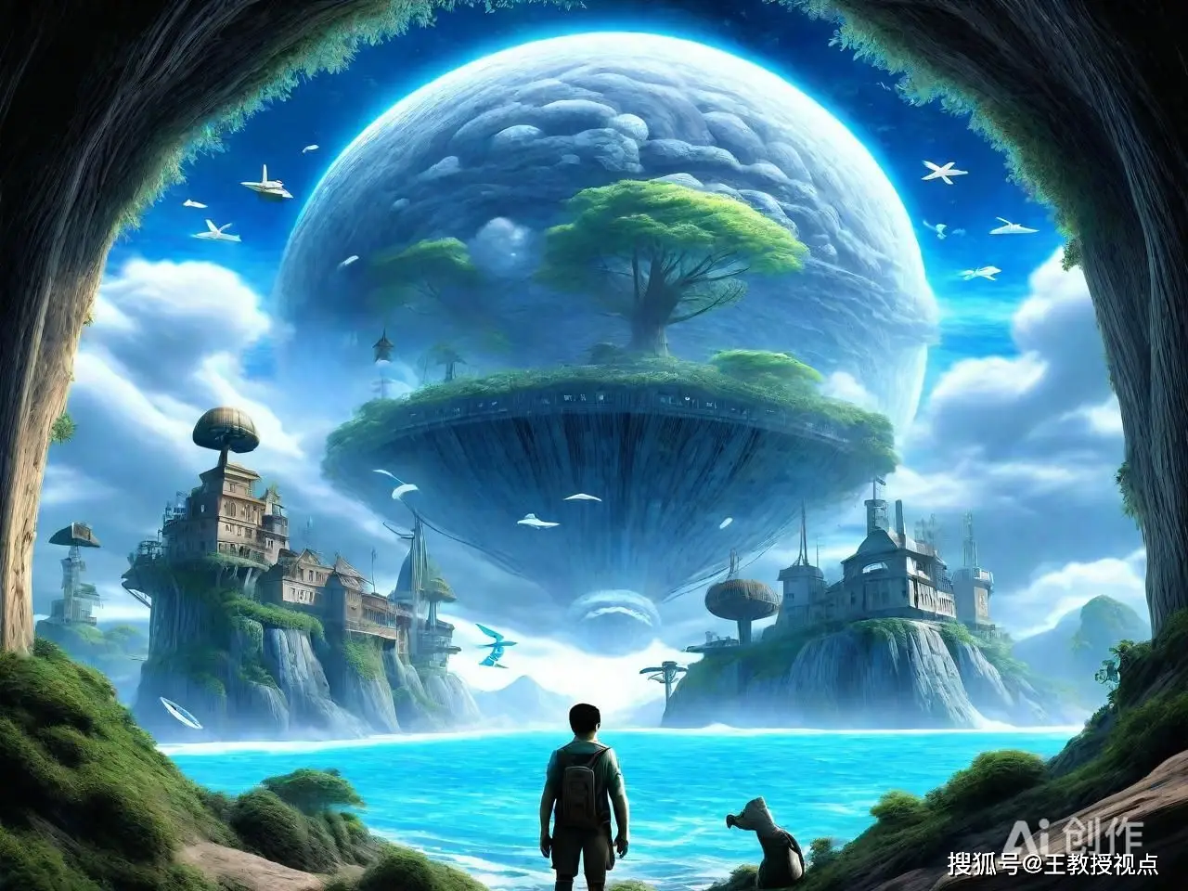
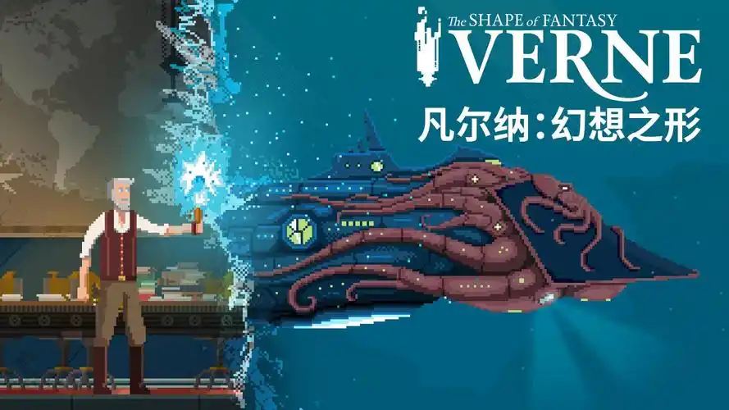
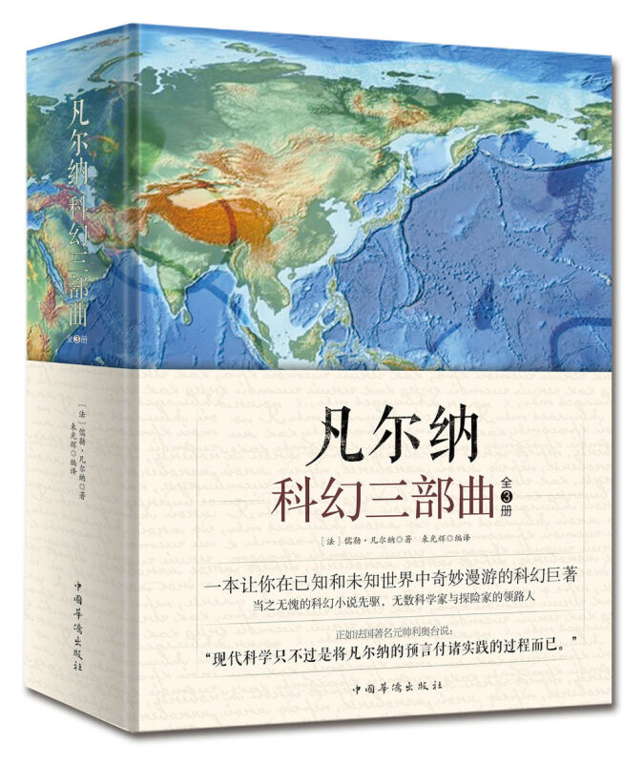
B篇
人与自我：Jules Verne, one of the fathers of science fiction

Slide 8
B
Jules Verne is widely regarded as one of the fathers of science fiction. His “Extraordinary Voyages(航海)” series transport readers on grand adventures to the far reaches of Earth and beyond. But Verne did more than just tell entertaining stories —— he also predicted over 100modern-day inventions and technologies in his writings.
For example, in the 1889 short story In the Year 2889, Verne painted a picture of a highly networked world with global multimedia communications. He described the“phonotelephote,”which sent sound and images over great distances. The main character, Fritz Napoleon Smith, is able to easily communicate via this technology with his wife on another continent:
“Mr. Smith was able distinctly to see his wife despite the distance that separated him from her... Mrs. Smith immediately appeared on the telephonic screen, with her features smiling and her eyes moist(潮湿的) with tears.”
Verne's technically-grounded adventure tales represented a new approach to imagining the future through fiction. Unlike other writers of his day who penned more fanciful or supermatural stories, Verne aimed for realism in his futuristic visions, always basing them on cutting-edge science and his own extensive research. This laid the foundation for the “hard science fiction” of the 20th century and beyond.
Verne is often thought of as a technological optimist, a champion of scientific progress and innovation. But his writings also reveal another perspective. Many of his stories feature a brilliant but mad scientist whose inventions ultimately bring more harm than good. Captain Nemo in 20.000 Leagues Under the Sea uses his submarine (潜艇) to violently attack ships. For Verne, human nature determined whether technology would be a force for good or a source of destruction.
The spirit of adventure in Verne's timeless stories will live on, continuing to inspire generations to push the boundaries of the possible and create the world of tomorrow. That is perhaps the greatest achievement of the extraordinary voyages of Jules Verne.
24. How does Mr. Smith contact his wife in In the Year 2889?
A. By holding an in-person talk.
B. By making a long-distance call.
C. By sending a letter back home.
D. By having an instant video chat.
25. What is the “hard science fiction” based on?
A. The unrealistic fantasies.
B. The fictional technologies.
C. The latest research findings.
D. The imagined future worlds.
26. What can we infer about Verne from Captain Nemo's story?
A. He is disappointed with human nature
B. He is aware of the danger of technology.
C. He is in favour of scientific development.
D. He is different from the writers of his time.
27. Which of the following best describes Jules Verne according to the text?
A. Strong-willed. B. Fantasy-seeking.
C. Positive-minded. D. Forward-thinking.

Slide 9
B篇文本知识重难点
1. 被认为是
2.科幻小说
3. 将读者传送到地球远端或更远的地区
4.一个高度网络化的世界
5. global multimedia communications
6. 为…奠定基础
7.技术乐观主义者
8.reveal another perspective
9.人性
10.向善的力量
11. 毁灭的根源
12. 永恒的故事
13. fantasy-seeking
14. positive-minded
15. forward-thinking
16. instant video chat
be regarded as/be thought of as
science fiction
transport readers to the far reaches of Earth and beyond
a highly networked world
全球多媒体通信
lay the foundation for
a technological optimist
揭示另一个视角
human nature
a force for good
a source of destruction
timeless stories
追求幻想的
心态积极的
有前瞻性的
即时视频聊天

Slide 10
B篇文本长难句分析
清楚地，明白地
despite
Mr. Smith was able distinctly to see his wife _________ the distance that separated him from her.
Verne's technically-grounded adventure tales represented a new approach _______imagining the future through fiction.
Unlike other writers of his day who penned more fanciful or supernatural stories, Verne aimed for ________(real)in his futuristic visions, always___________( base) them on cutting-edge science and his own extensive research.
Many of his stories feature __ brilliant but mad scientist _______inventions ultimately bring more harm than good.
The spirit of adventure in Verne's timeless stories will live on, _________ (continue) to inspire generations to push the boundaries of the possible and create the world of tomorrow.
以技术为基础的冒险故事
to
撰写幻想的或超自然的
realism
basing
未来愿景
a
whose
continuing
突破可能的界限，创造明天的世界

Slide 11
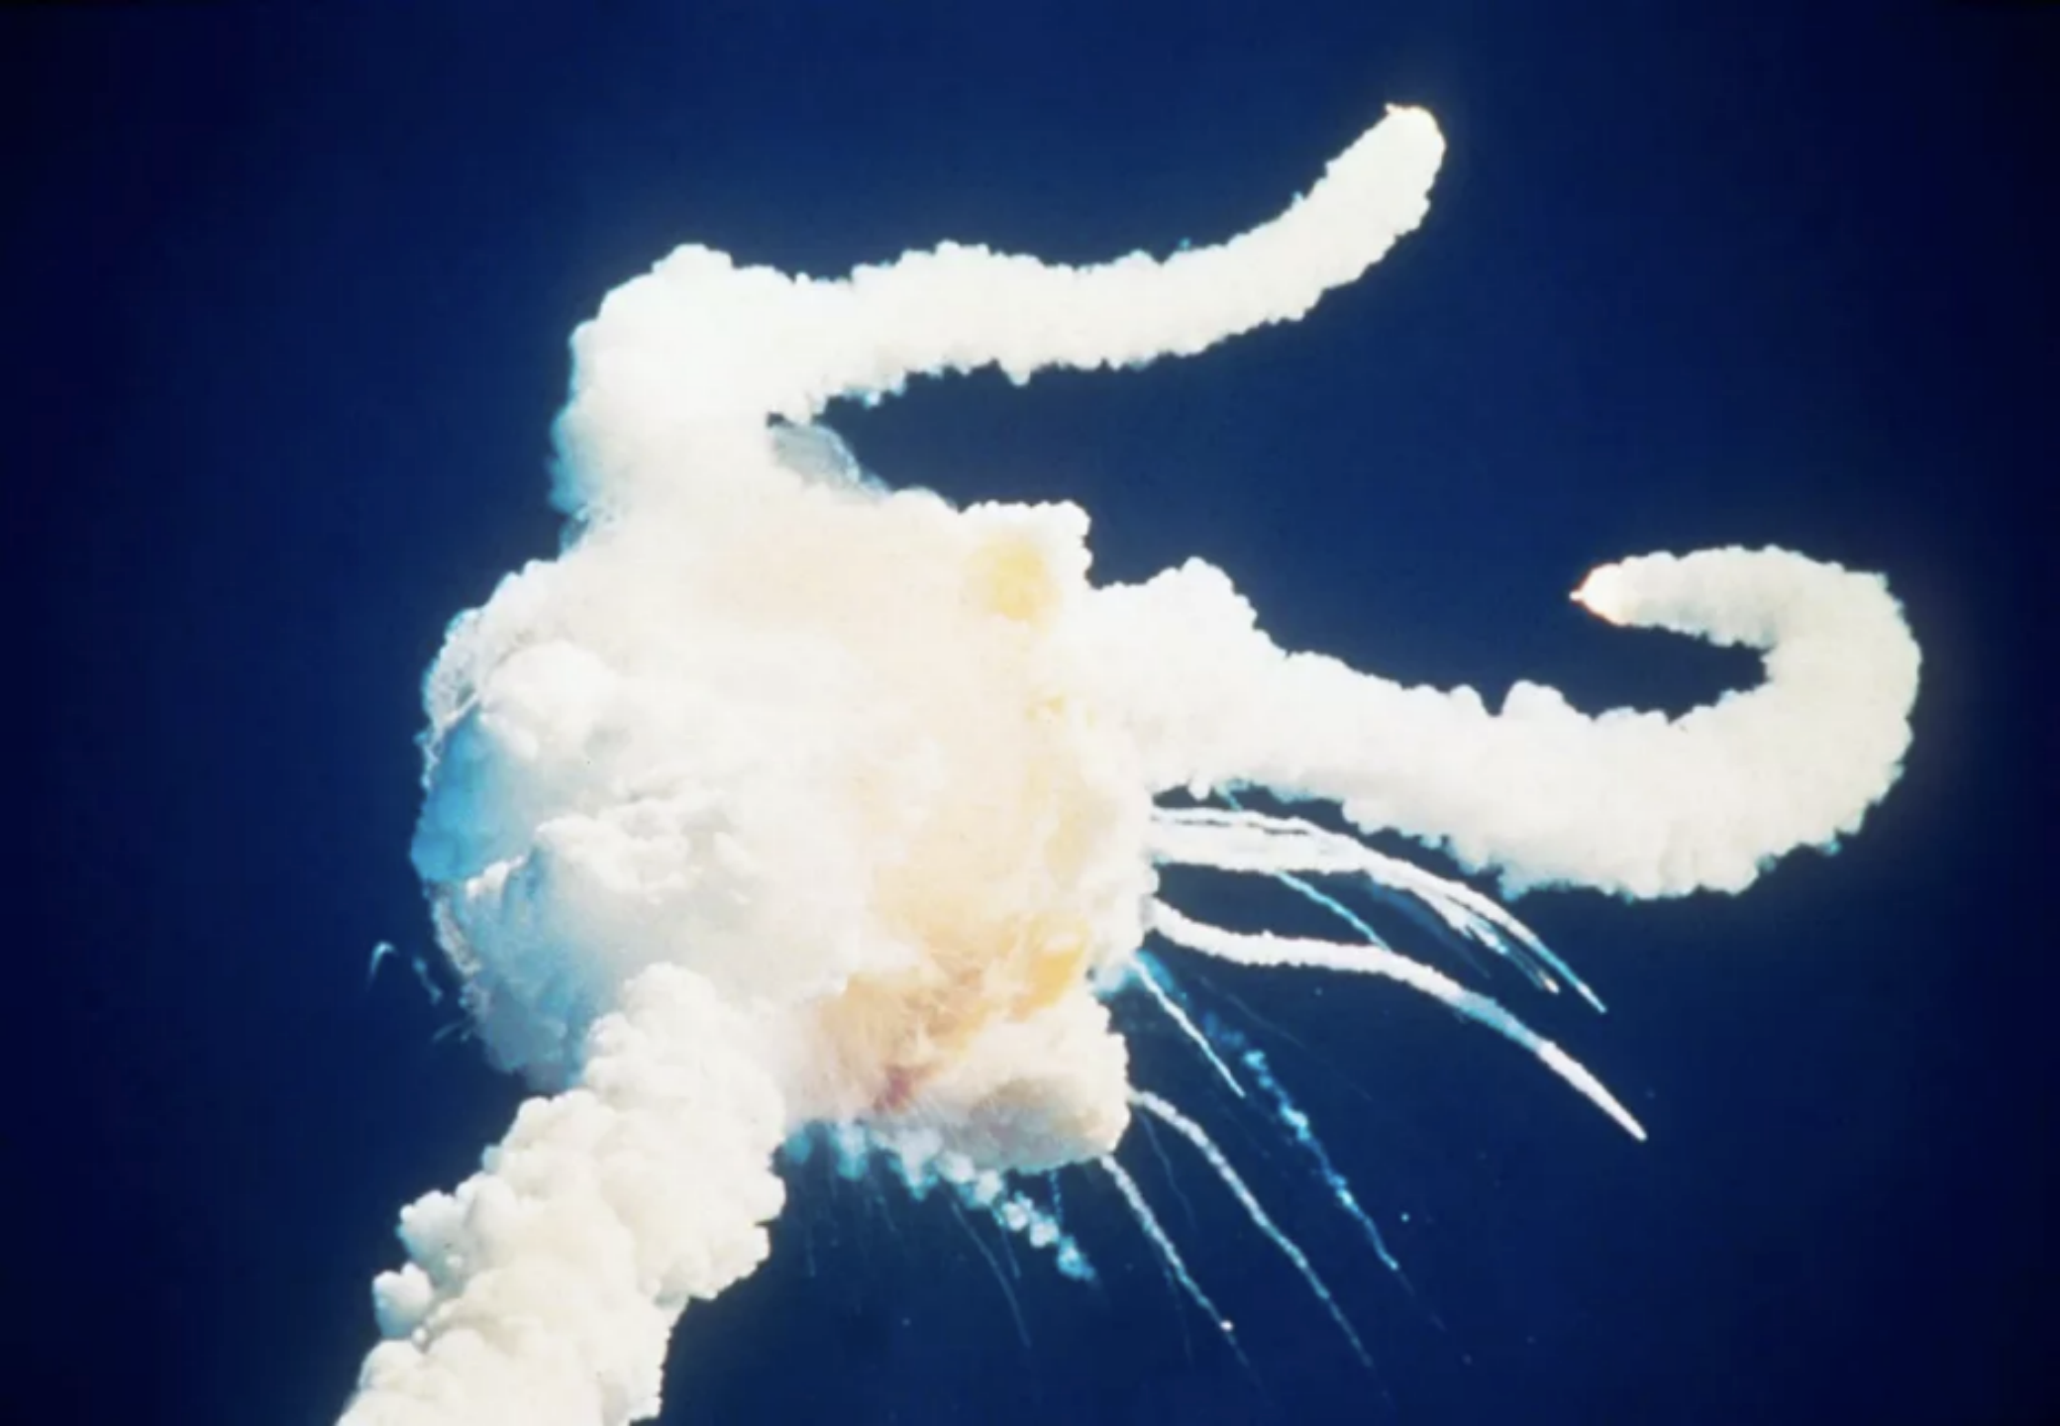
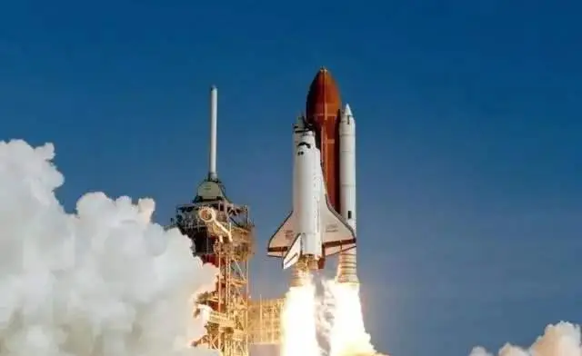
C篇
人与社会：An introduction to intellectual humility

Slide 12
C
Self-confidence is trusting in our abilities or qualities. It's usually seen as a good thing. But is it possible that we might benefit from a little less confidence in our beliefs?
For many years, Dr. Mark Leary, a neuroscientist at Duke University in Durham, N. C., has studied the role of people's beliefs in their behavior. He found overconfidence is very common, especially when it comes to what people believe to be true, and can lead us to disastrous decisions. In 1986, NASA believed that the risk of loss for any space flight was roughly1 in 100,000. It was an overconfident belief and might have led to the explosion of the Challenger. The good news is that there’s a “vaccine (疫苗)” for overconfidence, and that's what scientists call “intellectual humility”—— recognizing that your beliefs could be wrong.
A survey of 144 college students to measure their intellectual humility found that students who saw their thinking could be wrong tended to be more curious and more likely to seek out new knowledge. They ended up knowing more at the end of the day. But does it actually help you beyond that?
To find out more, Dr. Tenelle Porter at Ball State University conducted a series of studies with high school students. She found that students with intellectual humility were much more likely to test themselves to see whether they really understood the material and seek out potential holes in their understanding. When they got test scores, they'd change their study strategies to improve their performance and master the material for the next test.
Students who didn't see their knowledge could be wrong might instead just sail through their studying and wouldn't stop to ask themselves if they truly understood what they read, heard, or did. Such students thought they got a subject down pat, but when asked to explain it on a test, they found they didn't actually understand as much as they had thought.
Although it might be good for you, researchers recognize that questioning your beliefs can be truly hard. Still, it's important to remember that questioning beliefs isn't always about replacing old ones with new ones. If you find it hard to question a belief, try taking “baby steps.”
28. Why does the author mention the explosion of the Challenger?
A. To express his sorrow for the loss.
B. To stress the high risk of space flights.
C. To show the result of wrong operation.
D. To give an example of overconfidence.
29. What do we know about intellectual humility according to Porter's research?
A. It urged students to gain recognition
B. It encouraged students to take exams.
C. It helped students to adjust learning methods
D. It motivated students to memorize knowledge.
30. What do the underlined words “got a subject down pat” mean in paragraph 5?
A. Fully mastered a subject.
B. Put great effort into a subject.
C. Really enjoyed a subject.
D. Benefited a lot from a subject.
31. What will probably be discussed in the following paragraphs?
A. Why questioning our belief is hard.
B. Why intellectual humility is helpful.
C. How to become a confident person.
D. How to practice intellectual humility.
what
why
how

Slide 13
C篇文本知识重难点
self-confidence
overconfidence
roughly/ approximately/ or so/ more or less/ around/ about
merely/ barely
study strategies
test scores
learning methods
potential
intellectual humility
question beliefs
自信
过分自信
大致大约
几乎
研究策略
考试成绩
学习方法
潜在的
知识谦逊
质疑信念

Slide 14
C篇长难句分析及词汇学习
what
He found overconfidence is very common, especially when it comes to ____ people believe to be true, and can lead us to _____________(disaster) decisions.
The good news is that there’s a “vaccine (疫苗)” for overconfidence, and that's ______scientists call “intellectual humility”——__________( recognize) that your beliefs could be wrong.
A survey of 144 college students ____________(measure) their intellectual humility found that students ___ saw their thinking could be wrong tended to be more curious and ___________( likely )to seek out new knowledge. They ended up __________(know) more at the end of the day.
Students _____ didn't see their knowledge could be wrong might instead just sail through their studying and wouldn't stop ________(ask )themselves if they truly understood what they read, heard, or did.
Such students thought they got a subject down pat, but when ______(ask) to explain it on a test, they found they
If you find it hard to question a belief, try taking “baby steps”.
disastrous
what
recognizing
to measure
who
more likely
knowing
找出；搜寻出
轻松完成
who
to ask
asked
完全掌握某物
循序渐进；一小步一小步来

Slide 15
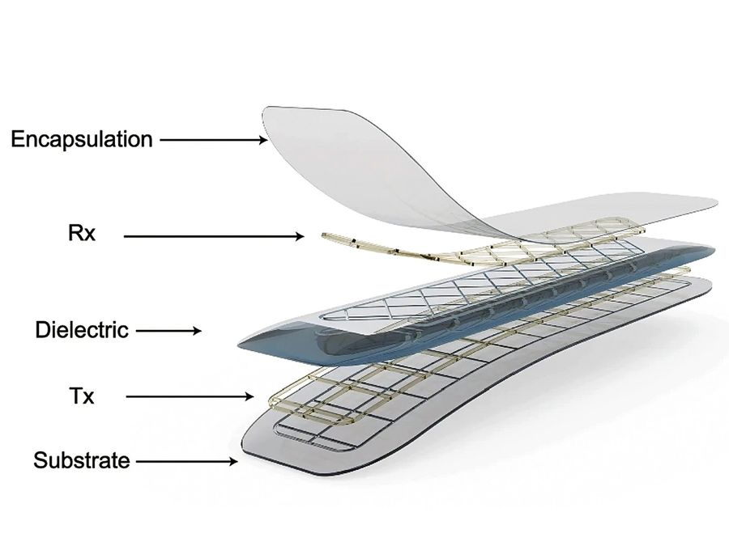
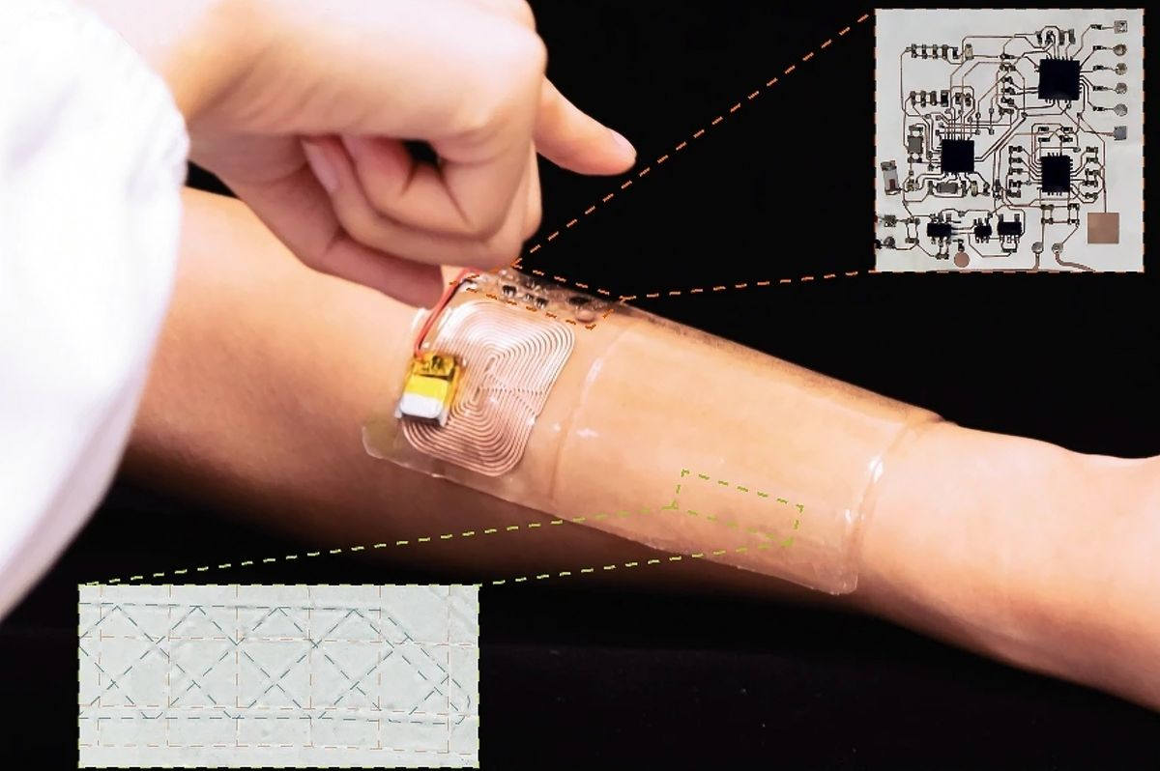
D篇
人与自然：An artificial sensor system modelled on Mormyrids, a family of African fish

Slide 16
D
The ability to detect a nearby presence without seeing or touching it may sound fantastical— but it's a real ability that some creatures have. A family of African fish known as Mormyrids are weakly eclectic, and have special organs that can locate a nearby target, even when it's hiding in the mud. Scientists have now developed an artificial sensor system modelled on the ability of these fish.
“We developed a new strategy for 3D motion positioning by electronic skin, bio-inspired by' electric fish,'” says Dr. Xinge Yu, an associate professor in the Department of Biomedical Engineering at the City University of Hong Kong. The team described their e-skin sensor in a paper published on November 14 in Nature.
The artificial sensor is multi-layered. One layer acts as a transmitter(发射器), which will generate an electric field once activated, and another layer acts as a receiver to detect both the direction and the distance to an object. A separate controller creates the driving signal to activate the transmitter. When an object comes within range, the electric field around the sensor is disrupted(扰乱), which in turn can be detected by the receiver. This data is then processed by a microcontroller unit, which computes the position of the target object and sends that information to a smartphone or other devices.
A special biogel (生物凝胶) is used in the sensor, which has the ability to transmit and receive electric signals from a pattern of microchannels on the surface. The end result is a sensor that is thin, soft and flexible, making it easy to adapt to irregular surfaces, such as the human body. In contrast to the traditional sensor system that needs a large number of sensors to achieve spatial positioning, the new system can locate an object precisely in 3D space using just a few sensors. This significantly reduces the power consumption of data collection, transmission, and processing.
The researchers hope that this sensor could one day open up a new range of wearable technologies, including sensors for human-machine interaction and thin, flexible e-skin.
what
32. The first paragraph aims to show _________.
A. the special ability of African fish
B. the inspiration for a new invention
C. the big challenge of locating objects
D. the reason for developing a sensor
33. What is the correct order of the system's working procedures?
a. The transmitter creates an electric field
b. A unit computes the position of the target.
c. The controller sends the activating signal.
d. The receiver detects the change of electric signals.
e. The electric field is disrupted by an approaching object.
A. c-a-e-d-b. B. c-a-d-e-b.
C. a-c-e-d-b. D. a-e-c-d-b.
34. What is an advantage of the new sensor system?
A. Its sensitivity to different stimulations. B. Its adaptation to environmental changes.
C. Its efficiency in achieving 3D positioning.
D. Its speed in data collection and processing.
35. What is the best title for the text?
A. Machine Detective “Wears” Flexible E-skin
B. Bio-inspired Sensor “Feels” Without Touching
C. E-Skin Sensor: The Future of Machine Learning
D. Electric Fields: The Frontier of Object Detection
background
working procedures
benefits
future

Slide 17
D篇文本主题词汇
artificial sensor system
electric field
bio-inspired
microcontroller unit
wearable technologies
human-machine interaction
3D motion positioning
power consumption
data collection and processing
flexible e-skin
人工传感器系统
电场
仿生的
微控制器单元
可穿戴技术
人机交互
三维运动定位
功耗
数据收集与处理
有弹性的电子皮肤

Slide 18
D篇文本长难句分析
fantasy幻想空想 fantastic 太棒了 fantastical 幻想的，不切实际的
fantastical
The ability __________(detect) a nearby presence without seeing or touching it may sound ___________ (fantasy)— but it's a real ability that some creatures have.
“We developed a new strategy for 3D motion positioning by electronic skin, bio-inspired by' electric fish,'” says Dr. Xinge Yu, ____ associate professor in the Department of Biomedical Engineering at the City University of Hong Kong.
The artificial sensor is multi-layered. One layer acts as a transmitter(发射器), which will generate an electric field once activated, and another layer acts as a receiver to detect both the direction and the distance to an object. A separate controller creates the driving signal to activate the transmitter. When an object comes within range, the electric field around the sensor is disrupted(扰乱), which in turn can be detected by the receiver. This data is then processed by a microcontroller unit, which computes the position of the target object and sends that information to a smartphone or other devices.
In contrast to the traditional sensor system that needs a large number of sensors to achieve ________ (space) positioning, the new system can locate an object ________(precise) in 3D space using just a few sensors. This significantly reduces the power ____________(consume) of data collection, transmission, and processing.
The researchers hope that this sensor could one day open up a new range of wearable technologies, including sensors for human-machine interaction and thin, flexible e-skin.
an artificial sensor system ___________(model) on the ability of these fish.
to detect
an
spatial
precisely
consumption
开辟一个新范围/领域
modelled

Slide 19
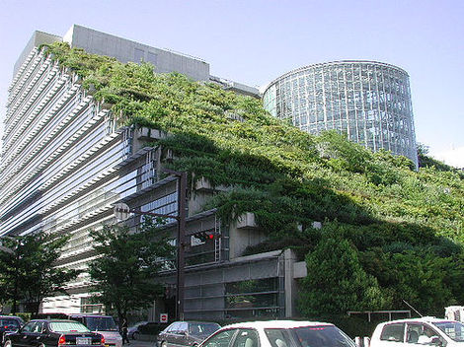
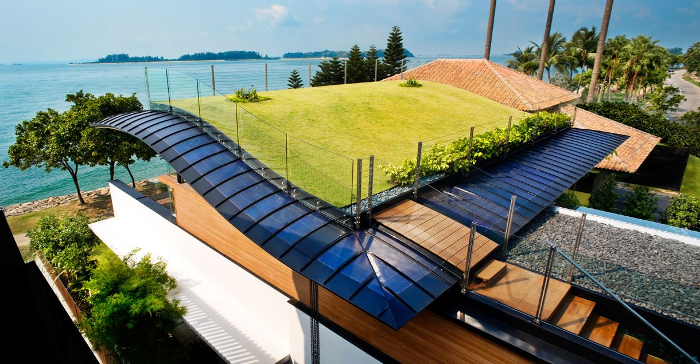
七选五
人与社会：The key factors in the design of a green roof

Slide 20
Green roofs have been around for thousands of years, long before modern housing was developed. From the simple grass-covered roofs above caves to the famous Hanging Gardens of Babylon, they remained an important part of architecture. 36 They bring enormous environmental benefits and offer solutions to some pressing ecological challenges of our time.
In the design of a green roof, there are key factors that count. The first step is to install(安装) a protective layer over the roof to prevent water damage. 37 It's essential to choose high-quality materials, as once the green roof is completed and the building is in use, replacing the protective layer becomes difficult and expensive.
Next, a drainage(排水) layer, which is often made of pebbles or a special mat, is placed on top. It helps water flow off the roof instead of pooling on it. Then, a growing medium, like soil or other similar materials, is spread over the drainage layer. 38
Now it's time to choose plants for the roof. Some plants have shallow root systems and don't need much water. 39 Sedum and chives are good examples of such plants. They are not only water-efficient but tough and long-lasting.
40 It's important to think about your budget. On average, it costs S25 to $30 per square foot to install a green roof. This doesn't include the cost of installing or repairing the normal roof underneath. And there is labour cost to cover. If a traditional roof costs $30 per square foot, installing a green roof could easily double that expense.

Slide 21
A. This is where the plants will grow.
B. However, green roofs come at a high cost.
C. Today, green roofs are gaining more attention.
D. These features make them ideal for green roofs.
E. As a result, they led to the popularity of green roofs.
F. Green roof materials can range from grass to solar panels.
G. The layer also stops plant roots growing into the roof structure.

Slide 22
Green roofs have been around for thousands of years, long before modern housing was developed. From the simple grass-covered roofs above caves to the famous Hanging Gardens of Babylon, they remained an important part of architecture. 36 They bring enormous environmental benefits and offer solutions to some pressing ecological challenges of our time.
转折 36 C 例证
A. This is where the plants will grow.
B. However, green roofs come at a high cost.
C. Today, green roofs are gaining more attention.
D. These features make them ideal for green roofs.
E. As a result, they led to the popularity of green roofs.
F. Green roof materials can range from grass to solar panels.
G. The layer also stops plant roots growing into the roof structure.

Slide 23
In the design of a green roof, there are key factors that count. The first step is to install(安装) a protective layer over the roof to prevent water damage. 37 It's essential to choose high-quality materials, as once the green roof is completed and the building is in use, replacing the protective layer becomes difficult and expensive.
并列 37 G
A. This is where the plants will grow.
B. However, green roofs come at a high cost.
C.
D. These features make them ideal for green roofs.
E. As a result, they led to the popularity of green roofs.
F. Green roof materials can range from grass to solar panels.
G. The layer also stops plant roots growing into the roof structure.

Slide 24
Next, a drainage(排水) layer, which is often made of pebbles or a special mat, is placed on top. It helps water flow off the roof instead of pooling on it. Then, a growing medium, like soil or other similar materials, is spread over the drainage layer. 38
解释 38 A
A. This is where the plants will grow.
B. However, green roofs come at a high cost.
C.
D. These features make them ideal for green roofs.
E. As a result, they led to the popularity of green roofs.
F. Green roof materials can range from grass to solar panels.
G.

Slide 25
Now it's time to choose plants for the roof. Some plants have shallow root systems and don't need much water. 39 Sedum and chives are good examples of such plants. They are not only water-efficient but tough and long-lasting.
解释 39 D 例证
A.
B. However, green roofs come at a high cost.
C.
D. These features make them ideal for green roofs.
E. As a result, they led to the popularity of green roofs.
F. Green roof materials can range from grass to solar panels.
G.

Slide 26
40 It's important to think about your budget. On average, it costs $25 to $30 per square foot to install a green roof. This doesn't include the cost of installing or repairing the normal roof underneath. And there is labour cost to cover. If a traditional roof costs $30 per square foot, installing a green roof could easily double that expense.
转折 40 B 总结、例证
A.
B. However, green roofs come at a high cost.
C.
D.
E. As a result, they led to the popularity of green roofs.
F. Green roof materials can range from grass to solar panels.
G.

Slide 27
七选五文本主题词汇
green roofs
architecture
bring enormous environmental benefits
offer solutions to pressing ecological challenges
key factors that count
install a protective layer
It's essential to choose high-quality materials.
growing medium
shallow root systems-
water-efficient plants-
There is labour cost to cover
think about your budget
绿色屋顶
建筑学：建筑结构
带来巨大的环境效益
给紧迫的生态挑战提供解决方案
很重要的关键因素
安装保护层
7.选择高质量的材料很重要
生长介质
浅根系
节水植物
有人工成本要支付
考虑预算
Next, a drainage layer, which is often made of pebbles or a special mat, __________ (place) on top.
is placed

Slide 28
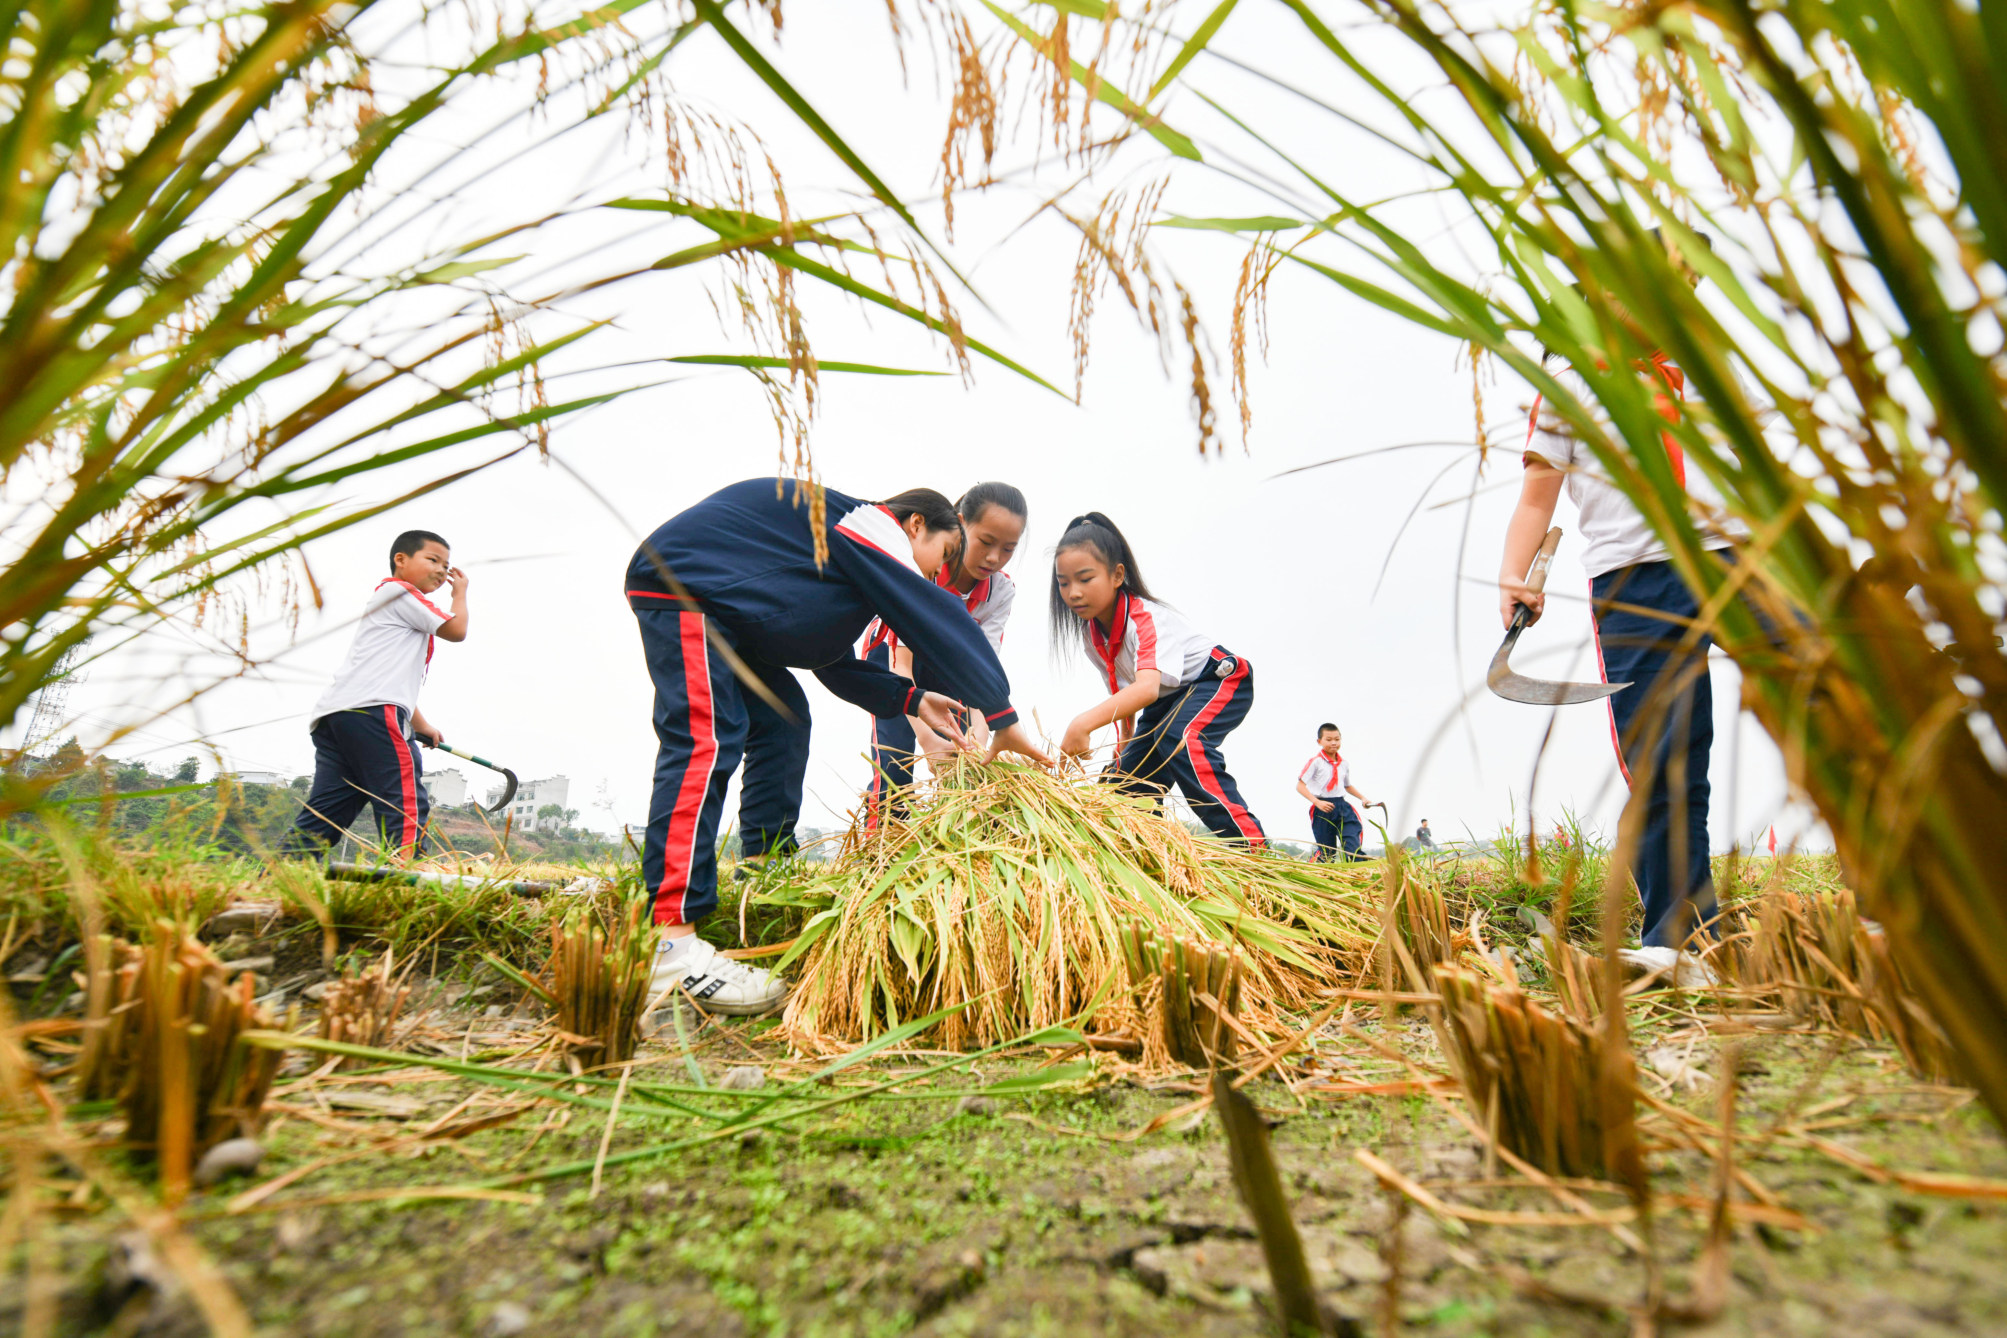
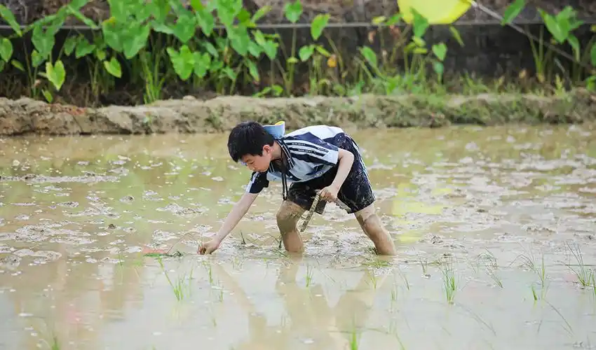
完形填空
人与自我：A lesson learned by working in the paddy fields

Slide 29
Step1: 选项全击破
41. A. remind B. warn C. attract D. train
42. A. wealth B. luck C. labour D. wisdom
43. A. gently B. hardly C. loudly D. usually
44. A. climbed B. bit C. cut D. fell
45. A. arched拱形的 B. broad C. strong D. straightened直起身的
46. A. hold B. produce C. drop D. replace
47. A. quick B. proud C. quiet D. patient
48. A. Slowly B. Slightly C. Safely D. Sadly
49. A. pick B. find C. sow播种 D. wish
50. A. fields B. books C. neighbours D. clothes
51. A. affordable B. acceptable C. dependable可靠的 D. livable适于居住的
52. A. boats B. weeds野草 C. fishes D. waves
53. A. welled up B. broke up结束,打碎 C. cooled off变凉;平静下来 D. held off阻止，拖延
54. A. drag B. kick踢，踢腿 C. plant把…牢牢插进,稳固地放置D. lift
55. A. promoted B. educated C. comforted D. rewarded

Slide 30
Step2: 首尾定主题, 整体定框架
A lesson learned by working in the paddy fields
I once worked in the remote but beautiful countryside. All farm work can, in my experience, 41 train a person to develop a Spartan(斯巴达的) spirit.
From the age of eight, I had to contribute my share of 42 labor along with my parents and two elder brothers. On the hottest summer days when the air 43 hardly flowed, I knelt in a paddy field(稻田) with my knees deep in mud. The bugs and worms in the water 44 bit into my skin, and the sun burned upon my 45 arched back. Sweat streamed down; if a drop ran into the eyes, it would 46 produce tears. So I always kept my face as low as possible.
I told myself, “Be 47 patient !” If my parents and brothers could go on taking it, so could I .48 Slowly I pulled myself together and dragged myself forward. I learned not to be afraid of difficulties and the meaning of “you reap(收获) what you 49 sow .”
“Judge a man not by his face, but by his 50 fields ,” my mother used to say. The land is 51 dependable, as long as you are willing to work on it. When the wind blew and the rice plants moved like 52 waves in the sea, breathtakingly beautiful, a deep sense of satisfaction 53 welled up in me.
Although later I went into academic research, I shall always remember what working in the paddy fields taught me: 54 plant your feet firmly on the ground, never give up and you will be 55 rewarded.
plant feet firmly on the ground
never give up
be rewarded

Slide 31
Step3: 主体找线索
A lesson learned by working in the paddy fields
I once worked in the remote but beautiful countryside. All farm work can, in my experience, 41 train a person to develop a Spartan(斯巴达的) spirit.
From the age of eight, I had to contribute my share of 42 labor along with my parents and two elder brothers. On the hottest summer days when the air 43 hardly flowed, I knelt in a paddy field(稻田) with my knees deep in mud. The bugs and worms in the water 44 bit into my skin, and the sun burned upon my 45 arched back. Sweat streamed down; if a drop ran into the eyes, it would 46 produce tears. So I always kept my face as low as possible.
I told myself, “Be 47 patient !” If my parents and brothers could go on taking it, so could I .48 Slowly I pulled myself together and dragged myself forward. I learned not to be afraid of difficulties and the meaning of “you reap(收获) what you 49 sow .”
“Judge a man not by his face, but by his 50 fields ,” my mother used to say. The land is 51 dependable, as long as you are willing to work on it. When the wind blew and the rice plants moved like 52 waves in the sea, breathtakingly beautiful, a deep sense of satisfaction 53 welled up in me.
Although later I went into academic research, I shall always remember what working in the paddy fields taught me: 54 plant your feet firmly on the ground, never give up and you will be 55 rewarded.
plant feet firmly on the ground
never give up
be rewarded

Slide 32
Step4: 句间找逻辑
A lesson learned by working in the paddy fields
I once worked in the remote but beautiful countryside. All farm work can, in my experience, 41 train a person to develop a Spartan(斯巴达的) spirit.
From the age of eight, I had to contribute my share of 42 labor along with my parents and two elder brothers. On the hottest summer days when the air 43 hardly flowed, I knelt in a paddy field(稻田) with my knees deep in mud. The bugs and worms in the water 44 bit into my skin, and the sun burned upon my 45 arched back. Sweat streamed down; if a drop ran into the eyes, it would 46 produce tears. So I always kept my face as low as possible.
I told myself, “Be 47 patient !” If my parents and brothers could go on taking it, so could I .48 Slowly I pulled myself together and dragged myself forward. I learned not to be afraid of difficulties and the meaning of “you reap(收获) what you 49 sow .”
“Judge a man not by his face, but by his 50 fields ,” my mother used to say. The land is 51 dependable, as long as you are willing to work on it. When the wind blew and the rice plants moved like 52 waves in the sea, breathtakingly beautiful, a deep sense of satisfaction 53 welled up in me.
Although later I went into academic research, I shall always remember what working in the paddy fields taught me: 54 plant your feet firmly on the ground, never give up and you will be 55 rewarded.
果因关系
因果关系
语义场
语义场

Slide 33
完形填空读写表达积累
Spartan spirit
paddy field
reap what you sow
academic research
breathtakingly beautiful
deep sense of satisfaction
Plant firmly on the ground-
never give up
arched back
Contribute my share of labor
斯巴达精神
稻田
种瓜得瓜，种豆得豆
学术研究
令人惊叹的美丽
深深的满足感
脚踏实地
永不放弃
弓起的背
贡献我的劳动份额

Slide 34
完形填空读写表达积累
田间农作
I _________ in a paddy field with my knees deep in mud.
The bugs and worms in the water _______ into my skin
The sun _______ upon my arched back.
2. pull myself together and drag myself forward
3.当风起稻浪，美丽异常，一种深深的满足感油然而生。
4.Although later I went into academic research, I shall always remember what working in the paddy fields taught me: 振作起来，脚踏实地，永不放弃，定有回报
knelt
bit
burned
振作起来，慢慢向前
When the wind blew and the rice plants moved like waves in the sea, breathtakingly beautiful, a deep sense of satisfaction welled up in me.
Pull yourself together, plant your feet firmly on the ground, never give up and you will be rewarded.

Slide 35
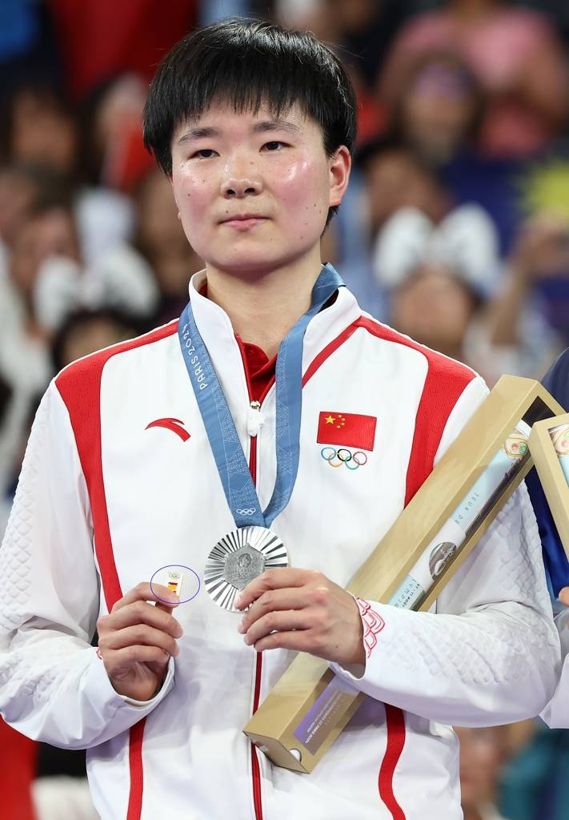
语法填空
人与社会：A beautiful display of Olympic spirit

Slide 36
On August 5, 2024, Chinese badminton player He Bingjiao won a silver medal at the Paris Olympics. However, 56 truly stood out was a touching moment on the podium(领奖台). As she received her medal, He Bingjiao held a badge(徽章) 57 (feature) the Spanish flag, which aroused widespread curiosity online.
This gesture was to express respect and care for her semifinal opponent, Spain's Carolina Marin, who 58 (retire) from the match due to injury. He Bingjiao explained, "I brought the Spanish badge because Marin's suffering broke my heart. I hope she sees this and wish her a speedy 59 (recover).”
During their semifinal match, Marin performed well but 60 (force) to stop after getting injured. He Bingjiao immediately reached out, offering support and checking on Marín, who was 61 (visible) upset.
The act rapidly made headlines around the world. The International Olympic Committee praised He Bingjiao 62 showing the Olympic values of respect and friendship. Spanish media also highlighted the 63 (emotion) moment, with many fans applauding her sportsmanship. Pau Gasol, the legendary Spanish basketball player, called it 64 beautiful display of Olympic spirit.
He Bingjiao's action not only demonstrated her respect for her opponent but also reflected the true spirit of the Olympics —— competition, 65 (pair) with unity and mutual (相互的)respect.
On August 5, 2024, Chinese badminton player He Bingjiao won a silver medal at the Paris Olympics. However, 56 truly stood out was a touching moment on the podium(领奖台).As she received her medal, He Bingjiao held a badge(徽章) 57 (feature) the Spanish flag, which aroused widespread curiosity online.
This gesture was to express respect and care for her semifinal opponent, Spain's Carolina Marin, who 58 (retire) from the match due to injury. He Bingjiao explained, "I brought the Spanish badge because Marin's suffering broke my heart. I hope she sees this and wish her a speedy 59 (recover).”
During their semifinal match, Marin performed well but 60 (force) to stop after getting injured. He Bingjiao immediately reached out, offering support and checking on Marín, who was 61 (visible) upset.
The act rapidly made headlines around the world. The International Olympic Committee praised He Bingjiao 62 showing the Olympic values of respect and friendship. Spanish media also highlighted the 63 (emotion) moment, with many fans applauding her sportsmanship. Pau Gasol, the legendary Spanish basketball player, called it 64 beautiful display of Olympic spirit.
He Bingjiao's action not only demonstrated her respect for her opponent but also reflected the true spirit of the Olympics —— competition, 65 (pair) with unity and mutual (相互的)respect.
what
主语从句缺主语（物）
非谓语：主动进行
featuring
(had) retired
谓语动词：时态语态主谓一致
recovery
缺名词
谓语动词：时态语态主谓一致/并列
was forced
visibly
缺副词
for
缺介词：praise sb. for
emotional
缺不定冠词
缺形容词
a
paired
非谓语：被动完成

Slide 37
语法填空文本主题词汇
About Olympic
silver medal hold a badge featuring the Spanish flag
sportsmanship Olympic values /spirit
semifinal match/ opponent The International Olympic Committee
突出的是
在线上引起广泛的好奇心
因伤退赛
快速康复
伸手/给支持/与…沟通
明显不安
成为全球头条 become a hit
突出感人的时刻
为体育精神鼓掌
奥运精神的展示
配对
团结和互相尊重
国际赞誉
银牌
印有西班牙国旗的徽章
体育精神
奥林匹克价值观（精神)
半决赛 /半决赛对手
国际奥委会
What stand out is…
arouse widespread curiosity online
retire from the match due to injury
a speedy recovery
reach out
visibly upset
make the headline around the world-
highlight emotional /touching moment
applaud her sportsmanship
display of Olympic spirit
pair with
unity and mutual respect
international praise

Slide 38
重点词拓展
判断feature含义
1.Mrs. Smith immediately appeared on the telephonic screen, with her features smiling and her eyes moist (潮湿的) with tears.
2.Many of his stories feature a brilliant but mad scientist whose inventions ultimately bring more harm than good.
3.Some plants have shallow root systems and don't need much water. These features make them ideal for green roofs.
4.He Bingjiao held a badge(徽章) featuring the Spanish flag, which aroused widespread curiosity online.

Slide 39
重点词拓展
feature
V 1. 以……为特色
The restaurant features a wide variety of local dishes.
2. （电影等）由……主演： (cast n 演员阵容）
This movie features a famous actor. ___________(Feature/Star)Streep, the film tells a heartwarming story.
3. 包含、出现：
The latest smartphone features a foldable screen and 5G connectivity.
N 1. 特征、特点
The key features of this product include its durability and ease of use. 耐用性
2. 面容、五官
She has delicate facial features.
3. （报纸、杂志的）特写、（广播、电视的）特别节目：
The newspaper's Sunday edition always includes a feature on local history.
4. （电影的）正片、故事片 （精选故事片）
The film festival will showcase a selection of new features from around the world.

Slide 40
Thanks for your attention

