Slide 1



感恩遇见，相互成就，本课件资料仅供您个人参考、教学使用，严禁自行在网络传播，违者依知识产权法追究法律责任。
更多教学资源请关注
公众号：溯恩英语
知识产权声明

Slide 2



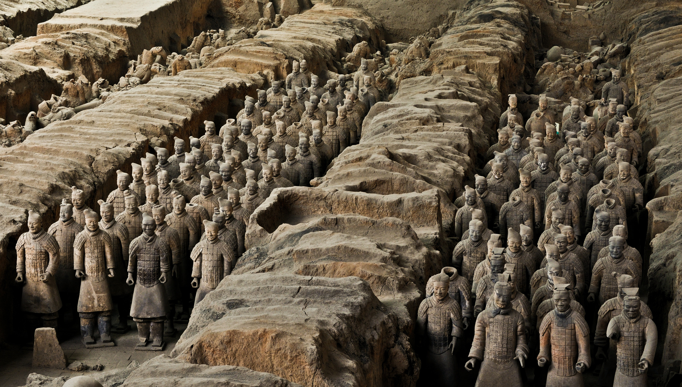
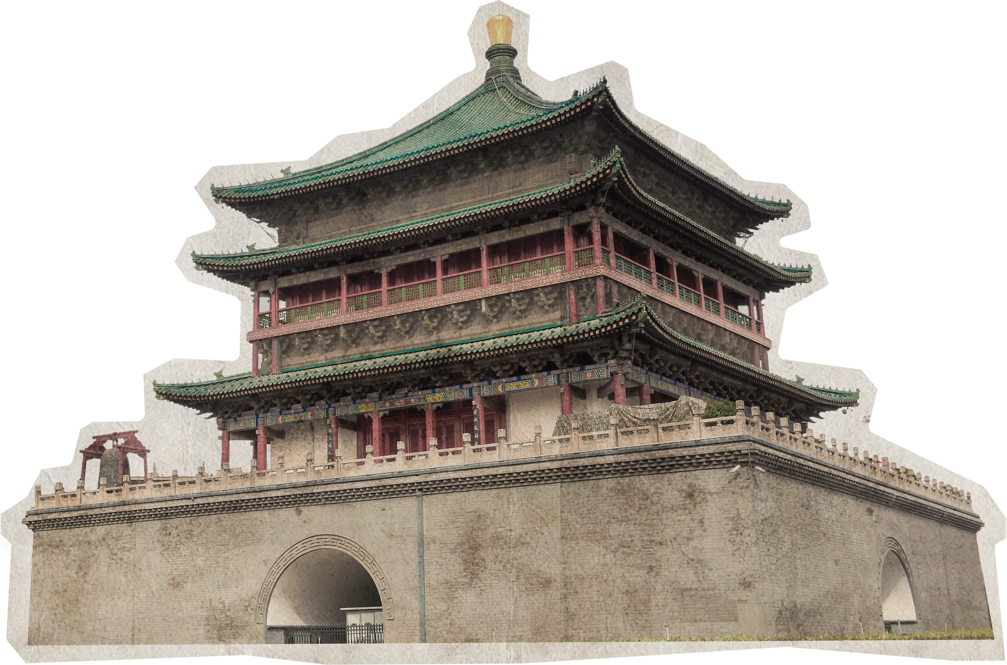


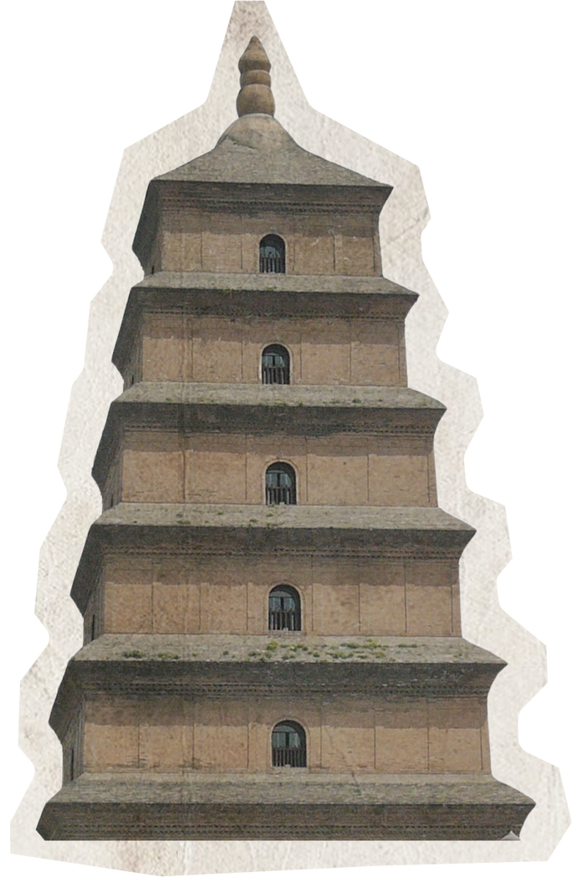



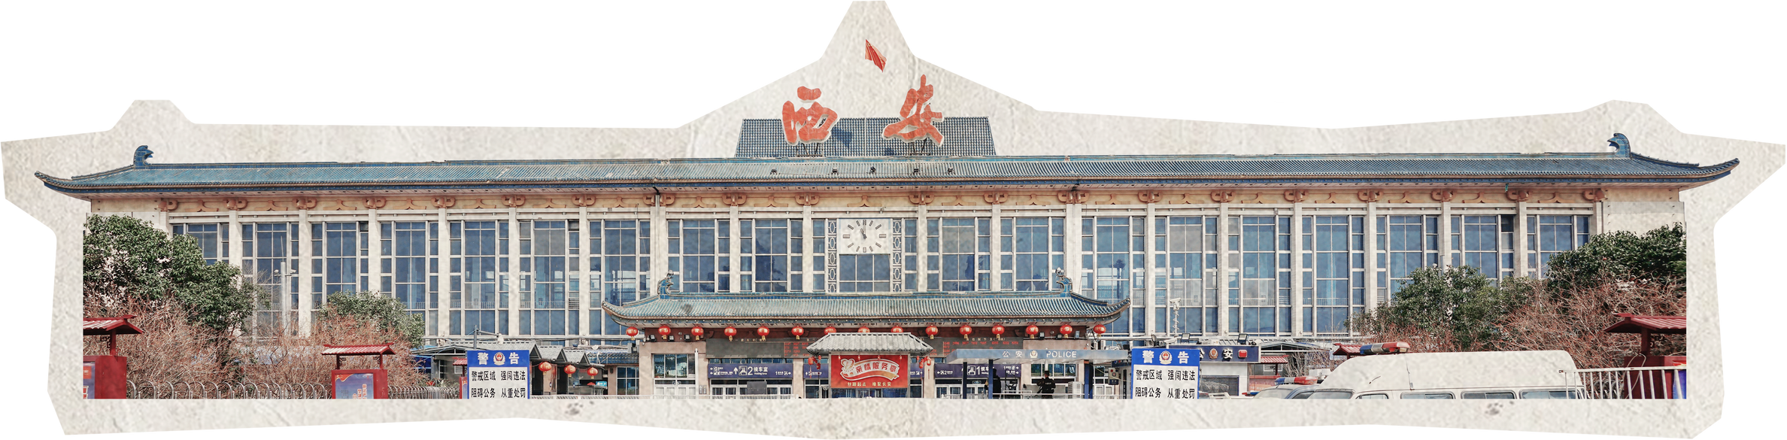
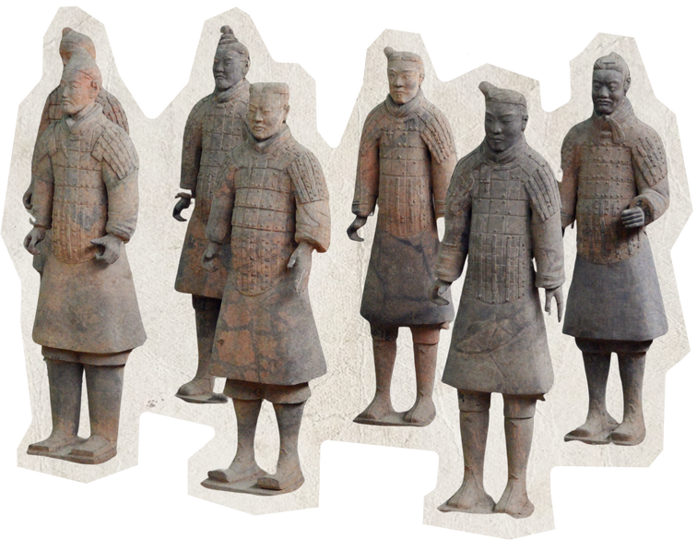
中
国
study tour
文化研究之旅
destinations

Slide 3





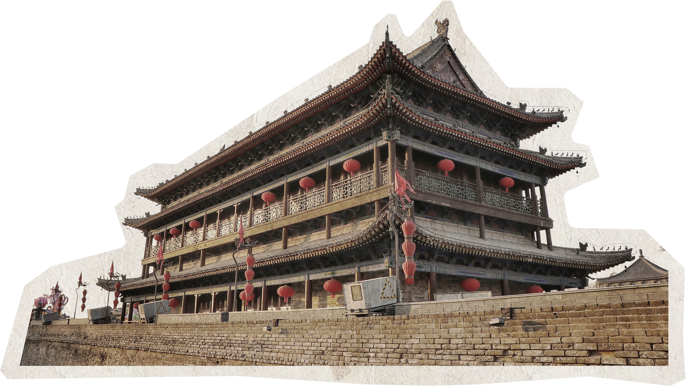


目录
01
阅读范文，构建图式
Xi An Traveling Guideline
02
仔细审题，分析要点
03
结合语境，拓展语料
04
综合运用，润色修缮

Slide 4
01建议信范文阅读
【2017北京卷】你的英国朋友Jim所在的学校要组织学生来中国旅行，有两条线路可以选择：“长江之行”或者“泰山之旅”。Jim来信希望你能给些建议。请你给他回信，内容包括：
1.你建议的线路；
2.你的理由；
3.你的祝愿。
注意：
1.词数 100 左右；
2.开头和结尾已给出，不计入总词数。
Dear Jim,
I’m happy to receive your letter and know you’re coming to China.
Of the two trips to the Yangtze River and Mount Tai, both are highly recommended. Personally, I prefer the tour along the Yangtze, the longest river and one of the mother rivers of Chinese civilization. You can learn a lot about the history of China and Chinese people. Moreover, the scenery along the river is amazing, with many well-known sightseeing spots. That’s why I think the trip along the Yangtze will be a better choice.
Hope you’ll have a good time in China.
Yours,
Li Hua

Slide 5
范文阅读
Dear Terry,
How are you doing? Learning that you are about to pay a visit to a Chinese friend and feel confused about the Chinese customs, I am writing to offer you some advice.
To begin with, I would like to suggest that you should arrive on time, because it is impolite to be late in Chinese traditional culture. In addition, it is a good idea to bring some appropriate gifts, such as a bunch of flowers or a box of Chocolates. Last but not least, you are supposed to pay attention to table manners when enjoying the meal. For example, you should avoid making noise while chewing the food or sticking your chopsticks into your food.
I sincerely hope that my suggestions would be helpful/beneficial/be of benefit to you. I am sure you will have a great time.
Yours,
Li Hua
【2018全国卷I】假如你是李华, 你的新西兰朋友Terry将去中国朋友家做客, 发邮件向你询问有关习俗, 请你回复邮件, 内容包括：
1.到达时间；
2.合适的礼物；
3.餐桌礼仪
注意：
1.词数不少于80；
2.开头和结尾已给出，不计入总词数。

Slide 6
范文阅读
Dear Jim,
I’m so glad to hear your future education plan in Beijing in your last letter. First I would like to express my warmest welcome to you and I am sure you will have the most unforgettable experience during your college in Beijing.
Learning your keen interest in Chinese culture, I suggest you apply for Peking University, one of the best universities in China. Its Chinese Literature major is perfect for you where you can be completely soaked in Chinese profound history and rich culture. As for preparation, some reading in advance in needed like The Story of the Stone while some online courses of spoken Chinese can be helpful for you to adapt into the Chinese language environment.
I sincerely hope your dream will come true and it’s my pleasure to show you around in Beijing when that day comes. If you have further questions, please feel free to let me know.
Yours,
Li Hua
【2018北京卷】假设你是红星中学高三学生李华，你的英国朋友Jim在给你的邮件中提到他对中国文化感兴趣，计划明年来北京上大学。他向你咨询相关信息。请给他回邮件，内容包括：
1.表示欢迎；
2. 推荐他上哪所大学；
3.建议他做哪些准备工作。
注意：
1.词数 100 左右；
2.开头和结尾已给出，不计入总词数。

Slide 7
范文阅读
【2019北京卷】假设你是红星中学高三学生李华。你的英国好友Jim打算暑假期间来北京、天津和上海旅游，发来邮件询问相关信息。请你给他回复邮件，内容包括:
1.交通出行；
2.必备衣物。
注意:
1.词数 100 左右；
2.开头和结尾已经给出，不计入总词数。
Dear Jim,
I’m pleased that you’re coming to tour in China.
I suggest that you begin from Beijing, and I’ll show you around. Tianjin will be your next stop. After that, you can go to Shanghai, where you can stay for a week. You can take high-speed trains to both cities. Summer in these cities is hot and rainy, so take summer wear plus an umbrella with you.
Looking forward to your arrival.
Yours,
Li Hua

Slide 8
范文阅读
【2023北京卷】假设你是红星中学高三学生李华。你的英国好友Jim正在策划一次以“绿色北京”为主题的社团活动，他发来邮件询问你的建议。请你用英文给他回复，内容包括：
1.活动形式；
.2.活动内容。
注意：
1.词数 100 左右；
2.开头和结尾已给出，不计入总词数。
Dear Jim,
Hearing that you are planning a club activity with the theme of “Green Beijing” and need my help, I am writing to offer you my suggestions.
I think you can carry out this activity in an interactive and experiential manner, which means students can participate and have a better understanding of “Green Beijing” through getting involved in different activities by themselves. You can showcase garbage classification on site, plant trees and publicize sharing economy, which will all fit into the theme of “Green Beijing”.
Hopefully, you will get some inspiration from my suggestions. Wish you success.
Yours,
Li Hua

Slide 9
范文阅读
Dear Ryan,
I’m Li Hua from Class 3. I think it’s not a good idea to randomly pair up students for the spoken English training after class. The reasons are as follows.
To begin with, randomly pairing up students may lead to unbalanced language abilities within the groups. This can hinder the progress of students as the more advanced one may dominate the conversation, leaving little room for the other students to improve. Besides, students may feel uncomfortable or less motivated if paired with someone who they don’t get along with or have difficulty communicating with.
My suggestion is to group students based on their language abilities or to let students choose their own partners. This way, everyone can feel more comfortable practicing and improving their spoken English together.
Thank you for considering my suggestion.
Yours,
Li Hua
【2023年新课标卷】假定你是李华，外教Ryan准备将学生随机分为两人一组，让大家课后练习口语，你认为这样分组存在问题。请你给外教写一封邮件，内容包括：
说明问题；
2. 提出建议。
注意：
1.词数不少于80；
2.开头和结尾已给出，不计入总词数。

Slide 10
范文阅读
Dear Jim,
I hope you are doing well. Delighted to hear that you are writing an article for Asia Today about the 75th anniversary of New China, I am writing to share my suggestions.
It is a good option to write about China’s fast economic growth. Over the past 75 years, China has changed from a farming country to the world’s second-largest economy, showing how quickly China has developed. Another helpful strategy is focusing on China’s amazing new technology, such as high-speed trains, space exploration, and renewable energy, all of which show that China is now a leader in technology and innovation. If I were you, I would discuss China’s efforts to reduce poverty, which have lifted millions of people out of poverty and improved the lives of many people.
These points not only highlight important achievements but also help readers understand how China has become such an important country. I hope these suggestions can be of some help! If you need more information, feel free to ask.
Yours,
Li Hua
【2024北京卷】假设你是红星中学高三学生李华。你的外国好友Jim准备给其校报的Asia Today栏目投稿。得知今年新中国成立75周年，他打算重点介绍中国的发展成就，发来邮件询问你的建议。请你用英文给他回复，内容包括:
1.建议投稿内容;
2.就以上建议简要说明理由。
注意：
1.词数不少于100；
2.开头和结尾已给出，不计入总词数。

Slide 11


建议信
图式
language
Learning that you are about to …and feel confused about …, I am writing to offer you some advice.
Hearing that…with the theme of “XXX” and need my help, I am writing to offer you my suggestions.
I sincerely hope that my suggestions would be helpful/beneficial/be of benefit to you
Learning your keen interest in …, I suggest you.
If you have further questions, please feel free to let me know.
Hopefully, you will get some inspiration from my suggestions. Wish you success.
It is a good option to …
Another helpful strategy is …
If I were you, I would …
My suggestion is …
…is perfect for you, which,….
….are highly recommended.
To begin with/ moreover/finally…
……
Self-introduction/greeting
Background information
Writing purpose ★
opening
Main body1
Suggestions/strategies/solutions
Reasons/significance
A letter of advice
Main body2
Problems/difficuties
Suggestions/strategies/solutions
Reasons/significance
closing
Expectations
ending

Slide 12
02 仔细审题，分析要点
假定你是李华。你的澳大利亚网友Jimmy将负责他们学校的中国文化研学之旅，发邮件咨询你的建议。请给他回封邮件，内容包括：
1．你推荐的研学地点；
2．你的理由。
Self-introduction/greeting
Background information
Writing purpose ★
opening
Main body1
Suggestions/strategies/solutions
Reasons/significance
A letter of advice
Main body2
Problems/difficuties
Suggestions/strategies/solutions
Reasons/significance
closing
Expectations
ending

Slide 13
假定你是李华。你的澳大利亚网友Jimmy将负责他们学校的中国文化研学之旅，发邮件咨询你的建议。请给他回封邮件，内容包括：
1．你推荐的研学地点；
2．你的理由。
Greeting
Background information
Writing purpose ★
Greeting: Hope this mail finds you well!
Background information: organize a study tour in China
Writing purpose ★recommend the place of the study tour
opening
Main body
Suggestions
Reasons/significance
A letter of advice
The place to recommend: cultural cities/ historical sites/ancient towns/traditional workshops/ unique museums…
Reasons:within and beyond the individual
Expectations
ending
closing
Expectation : I hope these suggestions can be of some help! If you need more information, feel free to ask.
I sincerely hope that my suggestions would be helpful to you. I am sure you will have a great time.
Looking forward to your arrival.

Slide 14
03 结合语境，拓展语料
中国文化研学地点
历史与文化遗产（Historical and Cultural Heritage）
西安（Xi'an）：作为中华文明和中华民族的重要发祥地，西安拥有丰富的历史遗迹，如兵马俑和古城墙，是探索古历史文化的热门研学旅游目的地。
名胜古迹（places of interest）如黄山、桂林山水等
民族与民俗文化（Ethnic and Folk Culture）
云南（Yunnan）：居住着多个少数民族，如白族和瑶族，可以体验当地民俗文化风情。
北京古北水镇(ancient towns)：体验春节传统习俗体验，包括包饺子、共享年夜饭，亲手制作非物质文化遗产灯笼、剪窗花.
现代都市与历史名城（Modern Urban & Historical City）
北京（Beijing）：中国的首都，北京拥有故宫博物院、中国国家博物馆等丰富的历史文化遗产，同时也是现代都市文化的代表。
广州（Gguang Zhou）：观赏中国特色园林景观，品味传统风味粤式茶点，逛庙会，听粤剧等。
互动与体验（Interaction and Experience）
敦煌莫高窟（Mogao Caves in Dunhuang）：在这里，游客可以体验壁画临摹等文化技艺，深入了解敦煌文化。
传统手工作坊(Traditional handicraft workshop)如：景德镇陶瓷（Jingdezhen porcelain）可以体验陶瓷工艺制作的全过程。陶瓷工艺历史悠久，体现了人与自然和谐共生。

Slide 15
陈述理由
Within the individual
知识技能（Knowledge & Skills）
offer a wealth of historical and cultural knowledge that can enhance your understanding of China.
It's a great opportunity to practice and improve Chinese language skills.
Cultural exchanges cultivate the ability to communicate and understand across cultures.
个人价值（Personal Values）
Engaging with diverse cultures promotes respect and global awareness.
Experiencing different cultural customs helps develop values that respect diversity.
思维品质（Thinking Quality）
Experiencing different cultures can foster open-mindedness and adaptability.
Exposure to different cultures fosters an open and tolerant mindset.
Understanding and respecting different cultures helps develop a global perspective.

Slide 16
陈述理由
Beyond the individual
社会影响（Social Impact）
Understanding and respecting different cultures contribute to a more inclusive and diverse society.
Sharing experiences can promote cultural exchange and understanding.
文化传承（Cultural Heritage）
Visiting these sites helps appreciate the depth of Chinese culture and its heritage.
Education and experiences can spark interest in cultural heritage among younger generations.
职业发展（Career Competitiveness）
Understanding Chinese culture can be an asset in a globalized job market.

Slide 17
陈述理由
General expression
弘扬中国传统文化 promote traditional Chinese culture
感受中国文化 catch a glimpse of traditional Chinese culture
更好地了解中国文化 have/gain a better understanding of Chinese culture
从新的视角去了解 learn... from a new perspective
深入了解古老文明的智慧gain some/deeper insight into the wisdom of this ancient civilization
培养兴趣爱好 develop/cultivate/boost hobbies and interests
拓展视野 broaden one’s horizons
丰富经验 enrich one‘s experience of…
丰富课余生活 enrich after-school life
提供/获得...实践/亲身经验 offer/gain hands-on experience of...
把课堂所学投入实践 put what we have learned in class into practice

Slide 18

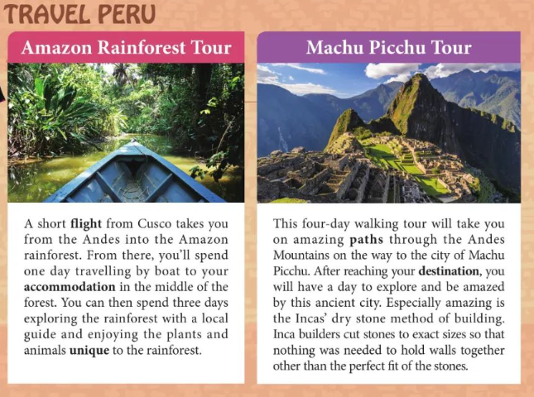
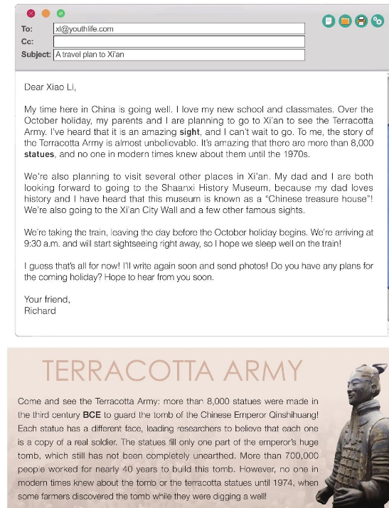
回顾教材

Slide 19
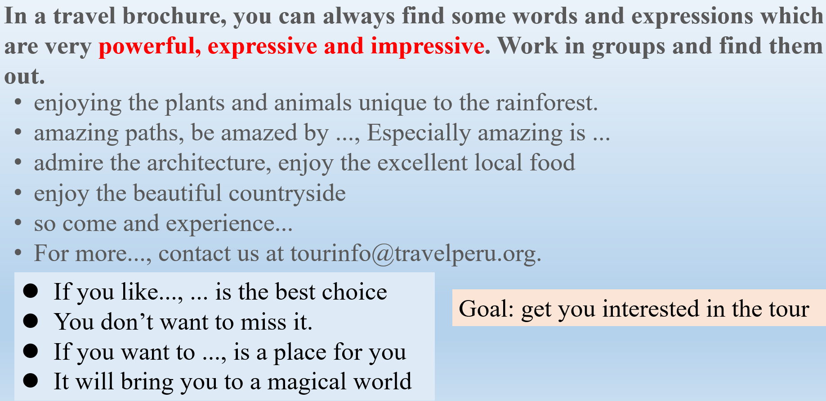
A travel plan
Main purpose for the tour
Other plans for the tour
transport
Final thoughts/wishes
Detailed introduction

Slide 20
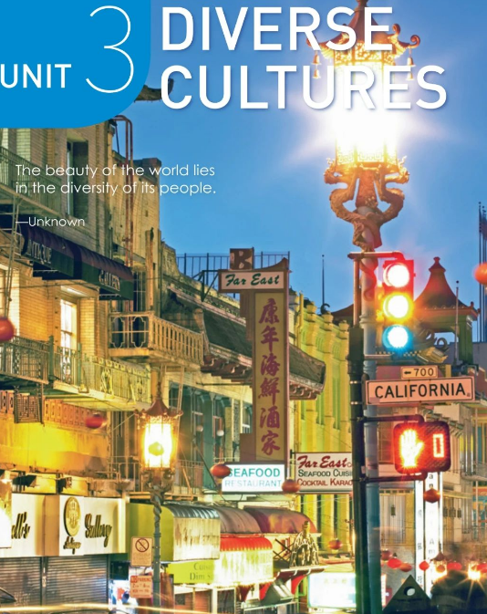
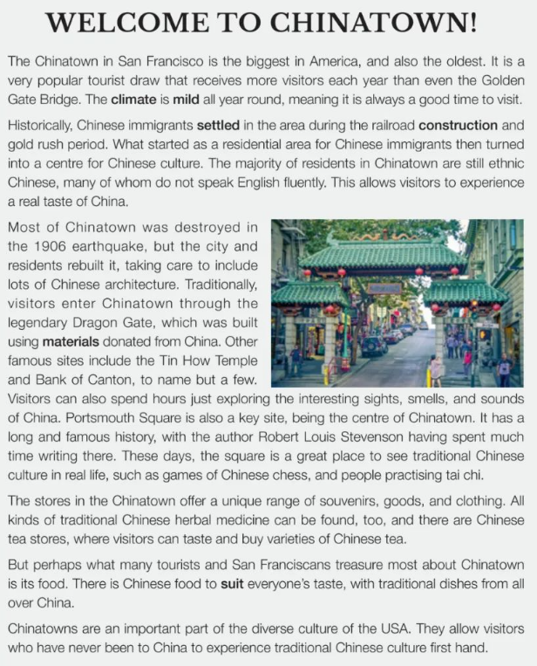

Slide 21
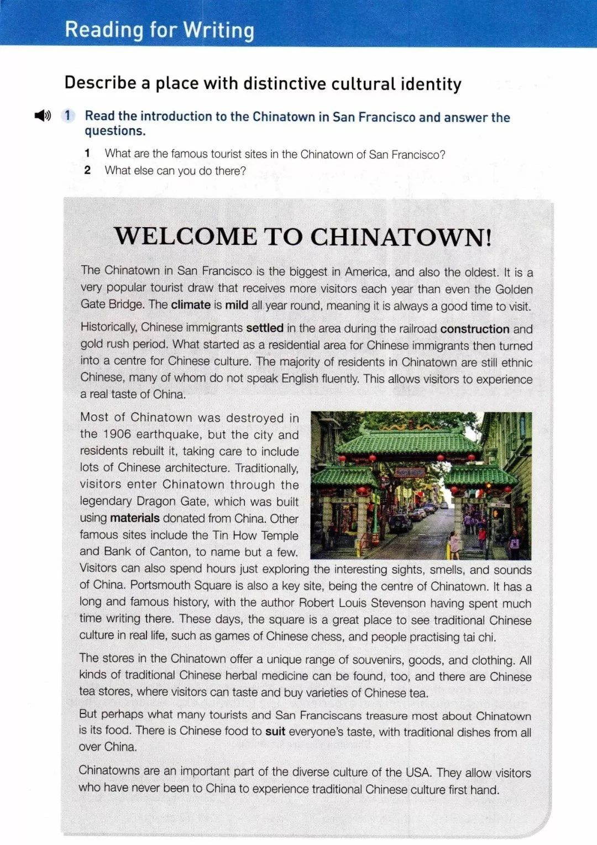

General
introduction
_________
_______________
to San Francisco Chinatown
location
Introduction
climate
history
P1
ethnic groups
languages
Detailed
information
________ _____________ of the Chinatown
Body
Tourist attractions
P2-5
Famous figures
Businesses and industries
Importance
Famous food/drink
______________ of Chinatown
Summary
P6

Slide 22
Para | P1 | P2 | P3 | P4 | P5 | P6
Items | Location Climate | History language residents | Famous figures Tourist attractions | Stores and goods | Famous food/drink | summary
EXP
W O R D S
S S P A T T E R N S
…biggest in America , and also the oldest ;
Historically, …
settled in..;
the majority of …;
allow visitors to experience a real taste of …
Traditionally, visitors enter …through the legendary…,
To name but a few; ..spend hours just exploring…;
…offer a unique range of/varieties of/ series of
… can be found;
suit everyone’s taste, with…
An important part of ;
first hand
..is mild all year;
a very popular tourist draw that…
what ..turned into a center for …;
many of whom… speak English fluently;
…,which was built using …
.. Also a key site,being ….
It has a …history, with…having spent much time…;
These days,… is a great place to see traditional…, such as…
There are…., where visitors can…
What many tourists treasure most is….
…it is a good time to visit

Slide 23
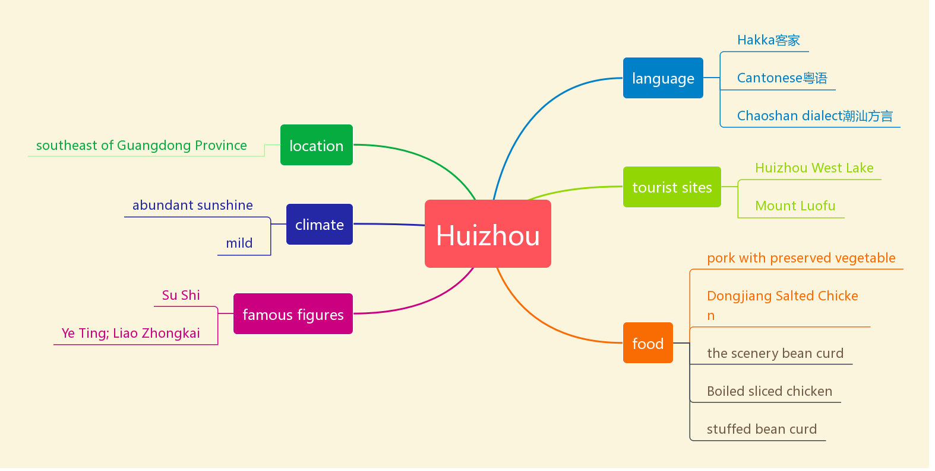
a sample mind map for recommending a place
The Wu dialect
the digital economy--Alibaba
business
Hangzhou dialect
Be located in/ lie in/stand
classic Hangzhou gardens
Qinghefang Ancient Street
distinctive seasons
West Lake
HANG ZHOU
pleasant weather
Wushan Square
Longjing shrimp
Su Dong Po
West Lake Fish in Vinegar Gravy
Bai Ju Yi; Shen Kuo…
stories
history
Lotus root powder
legend of the white snake
Be a capital of Wu &the Southern Song Dynasty
Beggar’s chicken
Dongpo Pork

Slide 24

A general introduction
Historically, Hangzhou was the capital of Wu and the Southern Song Dynasty. What started as a residential area then turned into a center of____________________________. ___________sites, ____________ scenery_____________landscape allows visitors to experience a real taste of this ___________________ city.
politic economy and culture
Historical
natural
cultural
ancient/unique
A travel plan/detailed information
To begin with, you can select _____________as a must-see site. It includes many famous places, such as_________________________________. Moreover, ______________ is also a key site, which________________________.
To start, don't miss out on ____________________, which is renowned for its ____________________. It covers a variety of _____________________,such as _____________________________________. Furthermore, ______________________is another highlight, offering a unique experience with its ________________________.
…
reference

Slide 25
04 综合运用，润色修缮
opening
Dear Jimmy,
Hope this mail finds you well! Hearing that you are going to organize a study tour in China , I’m writing to recommend Hang Zhou, a city rich in historical sites and cultural landscape.
To begin with, West Lake is a must-see site, serving as a great example of China's literary and artistic traditions. It includes many famous places such as Tiger-running Spring, the Lingyin Monastery, and the Moon Reflected in Three Pools,to name but a few. Moreover, Qinghefang Ancient Street is also a key site, which reflects the Chinese value of harmony between humanity and nature. By exploring these locations, you can immerse yourself in the historical and cultural aspects of Hangzhou, making them perfect spots for cultural and educational studies.
I sincerely hope that my suggestions would be helpful to you. If you have further questions, please feel free to let me know.
Yours,
Li Hua
Dear Jimmy,
Hope this mail finds you well! I'm thrilled to hear you are going to organize a study tour in China. I'm more than happy to recommend Hang Zhou, a city rich in historical sites and cultural landscape.
To begin with, West Lake is a a must-see site, It includes many famous places such as Tiger-running Spring, the Lingyin Monastery, and the Moon Reflected in Three Pools. Moreover, Qinghefang Ancient Street is also a key site, which is the only well-preserved part of the ancient city.
I sincerely hope that my suggestions would be helpful to you. If you have further questions, please feel free to let me know.
Yours,
Li Hua
Dear Jimmy,
Hope this mail finds you well! Hearing that you are going to organize a study tour in China , I’m writing to recommend Hang Zhou, a city rich in historical sites and cultural landscape.
To begin with, West Lake is a must-see site, which earns a great reputation for its peace and beauty. It includes many famous places such as Tiger-running Spring, the Lingyin Monastery, and the Moon Reflected in Three Pools, to name but a few. All of them bears a long history and rich Chines culture. Moreover, Qinghefang Ancient Street is also a key site, which is the only well-preserved part of the ancient city. As a miniature of the city's long history, it is the best place to embody the historical and cultural character of Hangzhou. I bet you’ll have a great time here!
I sincerely hope that my suggestions would be helpful to you. If you have further questions, please feel free to let me know.
Yours,
Li Hua
Body/advice
1Advice+1reason
closing
Suggestions +reasons

Slide 26
官方范文：
Dear Jimmy,
I’m delighted to learn that you are going to organize a study tour in China. For such an inspiring journey, I wholeheartedly recommend Xi’an.
Xi’an, an ancient capital of China, has a profound historical and cultural heritage. It was the starting point of the Silk Road, which once connected the East and the West, playing a crucial role in cultural exchanges.
There are numerous historical sites that can offer a vivid and immersive experience of Chinese culture. The Terracotta Army is a must-visit. Standing in front of the terracotta warriors, you can feel the charm of the ancient Qin Dynasty. The city wall of Xi’an is another iconic landmark, where you can enjoy the city view while cycling.
I hope this suggestion helps!
Yours,
Li Hua

