Slide 1


感恩遇见，相互成就，本课件资料仅供您个人参考、教学使用，严禁自行在网络传播，违者依知识产权法追究法律责任。
更多教学资源请关注
公众号：溯恩英语
知识产权声明

Slide 2
应用文
“理由阐释”类要点突破
2025高考二轮专题
——对比解析深圳一模和武汉二调应用文
郭烨辉

Slide 3
目录
01
导入分析与理论
02
解构+适配：深一模
03
动机+价值：*武二调
04
课后作业

Slide 4
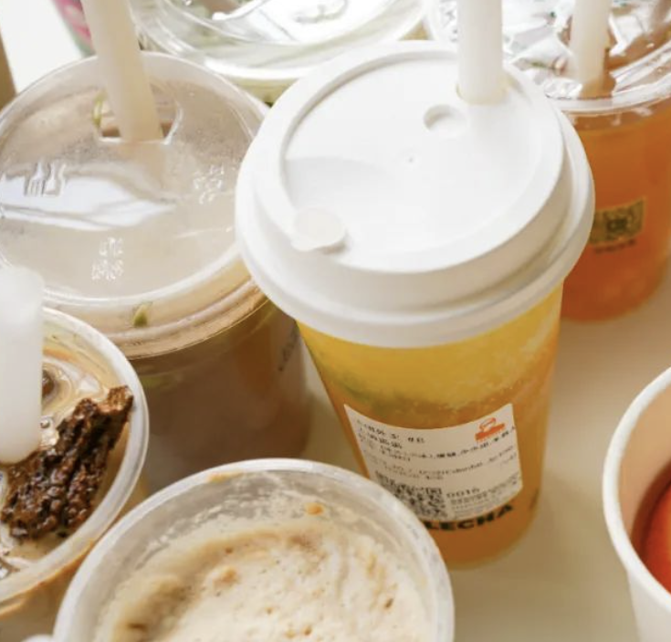





Ⅰ.Lead-in
Life is filled with countless choices, and each of your decisions often harbors profound reasons. Here are three sets of images. For each set, one student will be asked to make a selection and explain the rationale behind your choice.
VS
VS
人教版选必3 Healthy Lifestyle
人教版选必4 Launching Your Career
VS
外研版必修二
Unit4 Writing a movie review

Slide 5
Lead-in
Let’s review our responses and assess whether they have achieved the following:
Diverse Reasons (Emotional/Logical/Ethical)
Hierarchical Structure (Clear prioritization)
Transition Techniques (Use of transitional words and clauses)
Avioding Vagueness, repetition, going off-topic
Next, let’s evaluate these two excerpts to determine which one presents a more compelling argument?
Version A
I suggest improving the library because it's important. First, the environment is not good now. Students need better places for study. Second, we need more books. Some books are old. Third, activities can make the library more popular. I hope you will consider my ideas.
Version B
I suggest improving the library because it’s important in three key aspects. Academically, creating quiet study zones will directly support research projects. Culturally, introducing a monthly Book Explorer event—where students recommend books—could boost reading rates. Environmentally, replacing plastic chairs with with those made from recycled materials would align with our Eco-School motto.
Which one is more convincing?
具体化、结构化、情境化

Slide 6

深圳一模和武汉二调应用文
【2025.2深圳一模】 假定你是李华，你校正在为英语文学阅读室设计标识，现向学生征集意见。请你给负责此项工作的外教 Mr.Green写邮件，从以下标识中选择你最喜欢的一个，并说明理由。
注意：
1. 写作词数为80左右；
2. 可以增加适当细节，以使行文连贯；
【2025.2武汉二调】你班英语课开展“手工制作丰富生活(Handicrafting Enriches Life)”为主题的项目学习活动。请你写一篇发言稿，代表小组介绍你们的作品，内容包括：
1. 作品描述；
2. 创作缘由。
注意：
1. 写作词数应为80左右；
2. 请按如下格式在答题卡的相应位置作答。
《课标》明确将"思维品质"列为学科核心素养之一。说明理由的过程本质上是学生逻辑论证能力的展现，要求学生运用各种思维方法，体现命题者对批判性思维的重视。如深圳一模需比较标识设计的象征意义，武汉调考要求阐释手工创作的社会价值，均需要建立事物间的逻辑关联。

Slide 7
深圳一模VS武汉二调
维度 | 2025深圳一模 | 2025武汉调考
主题语境 | 校园生活 | 个人成长与社会实践
体裁 | 建议信 | 发言稿
人称时态 | 第一人称单数（I）为主，少量第二人称（you礼貌建议），一般现在时 | 第一人称复数（we）为主，兼顾听众互动（you）， + 一般现在时
说理层次 | 1. 标识选择 2. 分层理由 （设计元素/文化契合/实用功能） | 1. 作品描述 2. 创作动机 （兴趣驱动/教育意义/情感表达）
核心说服策略 | 通过比较标识差异突出所选优势 | 制作过程体现的生活与人文价值
关键难点 | 审美素养的实践运用 如何将视觉符号转化为文字描述 | 如何将制作流程升华为精神价值 如耐心培养/文化传承/环保意识
易错点 | 主次不分，过度描写非选标识 忽略与阅读室功能的直接关联 | 细节堆砌缺乏重点 创作理由未体现enrich life的主题

Slide 8

Ⅱ.破解意象象征义——深一模
【2025.2深圳一模】 假定你是李华，你校正在为英语文学阅读室设计标识，现向学生征集意见。请你给负责此项工作的外教 Mr.Green写邮件，从以下标识中选择你最喜欢的一个，并说明理由。
注意：
1. 写作词数为80左右；
2. 可以增加适当细节，以使行文连贯；
Books can connect us to the wider world, allowing us to explore different perspectives, places, and experiences.
The act of opening a book symbolizes the beginning of a journey into new knowledge, ideas, and cultures.
紧扣解构符号象征意义
I choose this slogan because it perfectly captures the essence of what an English literature reading room should represent: a gateway to endless learning and discovery. It encourages students to see books not just as sources of information, but as windows to explore the world and enrich our lives by expanding our horizons.
考虑功能适配性

Slide 9
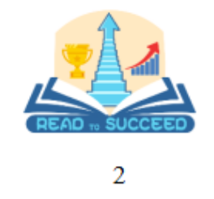
Ⅱ.破解意象象征义——深一模
紧扣解构符号象征意义
考虑功能适配性
progress, achievement, and personal growth
I would choose this logo because it offers a direct and motivating connection between reading and success. It is likely to resonate with students who are looking for practical outcomes from their studies. The imagery of trophies and a road to success makes the idea of reading tangible and goal-oriented.
How reading can help individuals explore their own identity, thoughts, and emotions.
I would choose this logo because it helps me gain insights about who we are and what we value. It emphasizes the introspective and self-discovery aspect of reading.

Slide 10
Ⅱ.对于选择A 不选B/C类型的理由阐述，除了正面，还需要？
说明其他的缺点
Brainstorm: Come up with at least one idea about each logo’s shortcomings.
Logo | Shortcomings
It may feel too generic or abstract.
The image of the globe may not immediately evoke the particular richness of literature or the specific educational goals.
It might be too focused on the idea of success and achievement, which could limit the broader, more intrinsic value of reading—such as enjoyment, personal enrichment, or the love of learning..
It might be too introspective for an academic setting.
This could make the logo feel a bit too narrow or individualistic for a reading room that aims to foster a collective academic experience.
考虑功能适配性
注意场景是英语文学阅读室

Slide 11

Ⅱ.Accumulation of Common Imagery Symbolism
意象 | 象征义 | 适合语境
Tree | Growth & Resilience | 个人发展/环境保护
Lighthouse | Guidance & Hope | 教育/人生导师
Seed | Potential & Possibility | 创新/青年成长
Key | Opportunity & Access | 国际交流
Mirror | Self-reflection/Truth | 个人发展/心理健康
Bridge | Bond & Understanding | 文化融合/国际关系
(Quill) Pen | Literary Heritage | 传统文化/数字时代
DNA | Life Code & Diversity | 生物科技/社会包容
Dragon | Power & Cultural Identity | 中国故事/全球化影响
Practice: Write a sentence to describe/figure out the underlying meanings of the logo
The logo symbolizes knowledge in the book guiding like a lighthouse, illuminating paths and steering away from ignorance.
This logo underscores the importance of continuous learning and the transformative power of knowledge in guiding one's journey.

Slide 12
Ⅱ.思维升华总结——如何写好这类比较+说理型要点？
在深圳一模应用文"选择文学阅读室标识并说明理由"的情境中，"说明理由"需紧扣解构符号象征意义与考虑功能适配性。需运用自身素养（审美、符号解读）解析视觉元素（书本、地球……），并关联英语文学的核心价值（探索、智慧、见识）。
此过程尤其考察符号解读能力——将图像符号转译为文化隐喻，以及语境化论证能力——结合阅读室的实际功能（鼓励创造性阅读）证明标识的适用性。例如选择"书中地球"标识，需阐明为什么书本中蕴含着“地球”，进而思考地球隐喻什么（如全球视野、国际眼光）。此外，向外教阐述需采用较为正式的阐释话语，区别于对普通师生的口语化说明，检验读者意识与语体选择能力。
1.使用 元素拆解法：描述标识—形状象征义解读 图文互动（延伸成路=通向成功）
2.深联结：绑定主题语境+注意场合（文学阅读室）
3.避免平行列举，用逻辑链连接理由（如：视觉吸引→文化共鸣→功能延伸）
最后牢记：选择理由=视觉描述×文化诠释+功能论证
备考
建议

Slide 13
Ⅲ.动机阐释——武汉二调
视角转换：we表集体智慧，慎用I
【2025.2武汉二调】你班英语课开展“手工制作丰富生活(Handicrafting Enriches Life)”为主题的项目学习活动。请你写一篇发言稿，代表小组介绍你们的作品，内容包括：
1. 作品描述；
2. 创作缘由。
注意：
1. 写作词数应为80左右；
2. 请按如下格式在答题卡的相应位置作答。
格式双核验：发言稿称呼+结语，避免书信格式
内容双驱动：实物描述+意义阐释
勿写制作步骤（属流程说明，非创作缘由）
忌空喊口号（需具体说明如何：“丰富”生活）

Slide 14
Ⅲ.三维度“脚手架”：说理的层次递进
The core argument of this piece lies in grasping the intrinsic connection between the description of the work and its creative rationale, meaning that the two are closely bound. Whatever specific work exists, there corresponds a fitting reason for its creation.
Reuse waste materials
→ Reduce campus plastic pollution
物质层面
环保
再生类
e.g.
Plastic Bottle
Herb Garden
Visual reminder of sustainable living → Inspire classmates’ eco-habits
意识层面
社会文化层面
Embodies Sustainable Development
→ youth’s role in green China

Slide 15
Ⅲ.三维度“脚手架”：说理的层次递进
The core argument of this piece lies in grasping the intrinsic connection between the description of the work and its creative rationale, meaning that the two are closely bound. Whatever specific work exists, there corresponds a fitting reason for its creation.
Learn paper-cutting techniques
→ Relieve daily stress and add color
器物层面
传统
文化类
e.g.
Intangible Heritage Shadow Puppet Bookmark
文化层面
Provide an insight into traditions
→ Spark interest in classic literature
国际交流层面
As cultural gifts for exchange students
→ Soft power transmission

Slide 16
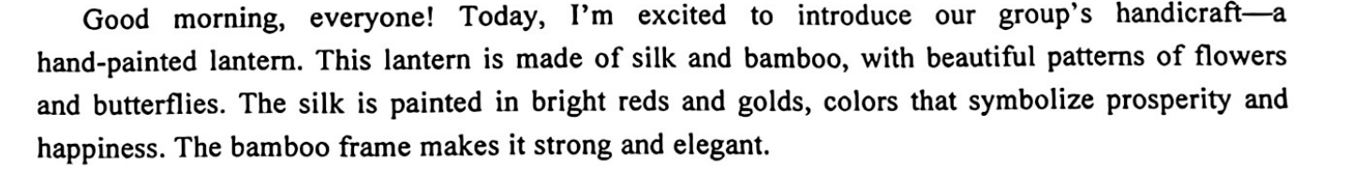
Ⅲ.描述→缘由
练习：Brainstorm your reasons for choosing this handicraft
We chose to create this lantern because it _________________ of Chinese festivals and brings warmth to our lives. In a __________ world, we wanted to____________________________ and share this festive spirit with everyone.
我们选择制作这个灯笼，因为它象征着中国节日的精神，为我们的生活带来温暖。在这个快节奏的世界里，我们希望重新连接我们的文化根源，并与大家分享这份节日的喜悦。
represents the spirit
fast-paced
reconnect with our cultural roots

Slide 17
Ⅲ.思维升华总结——如何写好这类对应动机型要点？
武汉二调应用文"阐释手工作品创作缘由"聚焦现实问题解决与价值升华，其更倾向于动机阐述。如学生以制作再生纸笔记本为例，理由说明可能需要完成双重跨越：1）具象到抽象——从"利用废纸"的操作行为，上升到"培养环保意识"；2）实用到育人——既说明"记录学习心得"的功能性，更需揭示"手工实践促进抗挫力"的成长意义。
此类写作考察多维度价值提炼能力，要求在生活经验与宏观主题（如劳动教育、可持续发展）间建立逻辑桥梁。
备考
建议
1.价值避免单一，有递进性：实际功能→教育→社会影响
2.痛点反推法：先预设生活问题，倒推作品针对性
3.避免泛泛而谈或强行拔高主题，必须注意到两个要点的相互对应、深度联系
微观细节→中观价值→宏观启示 的隐形逻辑链

Slide 18
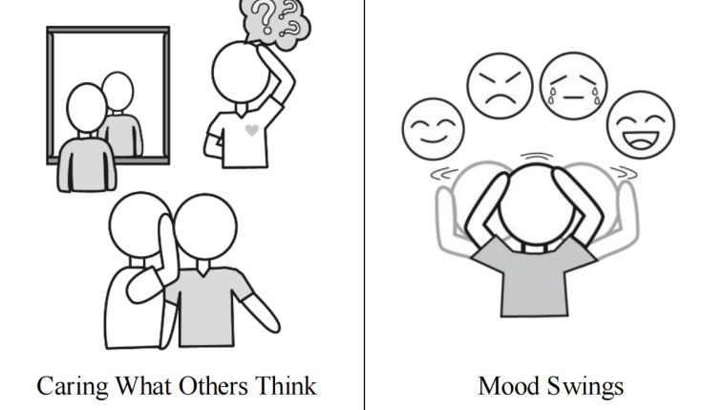
Ⅳ. Assignment
【笔者原创】
假定你是李华，你校英文报“Psychology of Teenagers”栏目正在征稿，请你选取图中反映的一个青少年心理问题，写一篇短文投稿，内容包括：
1.问题产生的原因；
2.你的建议。
注意：
1.写作词数应为 80 个左右；
2.请按如下格式在答题纸的相应位置作答。

Slide 19
笔者命题的思维倾向于传统的“发现问题—分析问题—解决问题”，写作是问题（任务）驱动的，其特征通俗来讲是“指出不好的，分析为什么，提出更好的做法”，而像深圳一模则是“选出最好的，分析为什么”。
Sample
Caring Too Much About Others’ Opinions
Many students grapple with the issue of caring deeply about what others think of them.
This concern can stem from a strong desire for social acceptance and fear of rejection. Another reason for this sensitivity is the formative stage of identity development during adolescence. Peer influence is also a significant factor, as teenagers often seek validation from their social circle to fit in.
To overcome this challenge, my suggestion is to cultivate self-awareness and self-acceptance. Engaging in activities that build confidence, such as hobbies and sports, can also be beneficial. It's essential to remember that everyone has unique qualities, and embracing individuality is crucial for personal growth and happiness.
Let's encourage our peers to be true to themselves and not let the opinions of others define their self-worth.

