Slide 1



感恩遇见，相互成就，本课件资料仅供您个人参考、教学使用，严禁自行在网络传播，违者依知识产权法追究法律责任。
更多教学资源请关注
公众号：溯恩英语
知识产权声明

Slide 2





2025
四
省
Love your life
Pursue your dream
英语联考
Fay
英语试题解析

Slide 3




语篇 | 体裁 | 话题 | 主要内容
 | 应用文 | Advanced YourStride watch | 一款名为YourStride的智能手表广告。该手表具备紧急情况下的即时联系功能以及自动跌倒检测系统。
 | 人物介绍 | a profile of Jon Batiste | 主要介绍音乐界重要人物乔恩·巴蒂斯特（Jon Batiste），讲述他在新专辑《蓝调贝多芬》中重新诠释贝多芬作品，介绍其音乐履历，展现他通过艺术连接过去与现在、引发人类情感共鸣的追求。
 | 说明文 | Evolutionary Shift in Dinosaur Feathers | 探讨了恐龙羽毛进化的研究，揭示了恐龙皮肤从爬行动物鳞片向羽毛转变的过程。文章强调了这一发现对理解脊椎动物进化的重要性,并介绍了研究中使用的先进技术。
 | 说明文 | The Growth Mindset in Education | 讨论了成长型思维（growth mindset）的概念及其在教育中的应用。文章强调了通过学习和努力提升智力的可能性，以及成长型思维对学生面对挑战、从失败中学习和接受批评的积极影响。
七选五 | 说明文 | Time Management and Task Prioritization | 介绍了 “3-3-3方法”，帮助人们更高效地安排任务。

Slide 4


阅读理解
详 解

Slide 5
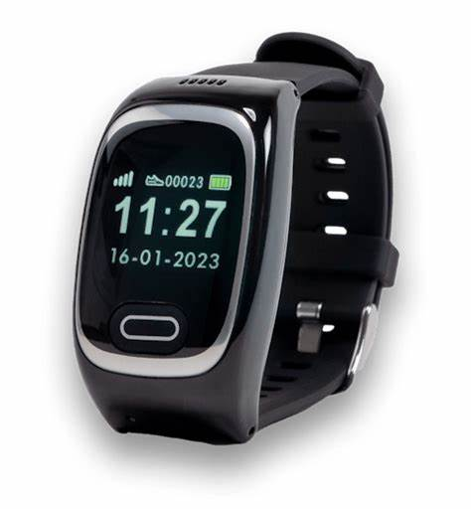
A
YourStride watch

Slide 6

A
In times of emergency, you are just a single button press away from being instantly linked to our professional emergency support crew.
Fall Detection
Our advanced YourStride watch is equipped with an intelligent automatic fall detection system. Sensing a fall, it will immediately get in touch with our highly trained and experienced 24/7 monitoring team. Additionally, you have the option to manually initiate a call for help by simply pressing the SOS button on the front face of the watch, ensuring you are always covered.
As 48% of falls occur outside, YourStride’s fall alarm watch has been designed to work both indoors and outdoors.
How the Alarm Service Works
The alarm service of the YourStride watch functions in a straightforward yet effective manner:
●When you press the SOS button or when the watch detects a fall, it gets an immediate response.
●Our team will then communicate with you through the watch, gathering all the necessary details.
●Appropriate help will be sent to your location.
Multifunctional Health Companion
Your Stride is a comfortable, lightweight wristwatch with a clear time and date display. Alongside the SOS button and automatic fall detection, it monitors your heart rate, blood pressure, and has a built-in step counter.
Another important feature is its complete independence from external connections. It operates autonomously, without the need for Wi-Fi or a landline. This means that no matter where you are in the UK, whether you’re in a remote countryside location or a bustling city center, you can confidently access the help you need.
Pricing
The YourStride watch is available at an affordable price of just £60. For those who require 24/7 emergency help, there is a monthly subscription fee of £15. An extra £2 per month for the additional fall detection feature.
Don’t wait until it’s too late. Invest in the YourStride watch today and take a proactive step towards your safety and well-being.
21．What will the watch do when detecting a fall?
A．It will contact the monitoring team. B．It will activate a loud alarm.
C．It will call the local hospital immediately.
D．It will initiate the SOS button automatically.
22．Which is a function of the watch besides detecting falls?
A．To adjust heart rate.
B．To monitor sleep quality.
C．To measure blood pressure.
D．To connect to the Internet.
23．How much should one pay for the watch with a year’s full service?
A．£60.
B．£204.
C．£240.
D．£264.
60+15x12+2x12=？
An advertisement

Slide 7

Be equipped with
Sense a fall
Get in touch with
Initiate a call
Be designed to
An immediate response
A built-in step counter
At an affordable price of
Invest in
配备有
感知跌倒
联系
发起通话
设计用于
立即响应
内置计步器
以可负担的价格
投资于
A
An advanced watch

Slide 8

B
a profile of Jon Batiste

Slide 9
B
1Jon Batiste, a big figure in the music world, views revisiting classic works as a golden opportunity, as seen in his latest album （专辑） “Beethoven Blues,” where he gives new life to Beethoven’s compositions. He perceives a universal and powerful essence in Beethoven’s music, similar to that in the blues.
2Batiste served as a bandleader for “The Late Show with Stephen Colbert” until 2022 and is now on the board at The Juilliard School. And he has received numerous Grammy nominations （提名） and wins across diverse musical categories. His documentary “American Symphony,” which details the composition and premiere of his symphony at Carnegie Hall in 2022, as well as the story of his wife Suleika Jaouad’s battle with leukemia (a type of blood illness), has earned him further recognition.
3Batiste maintains the idea that classical music, Beethoven’s works included, is suitable for reformation. There is a need to break away from the traditional perception of classical music. For instance, in his album, he starts with “Für Elise”, a piece familiar to many, and adds his own creative touches.
4However, Batiste’s journey at Juilliard was not without challenges. As an ambitious teenager from Louisiana, his unconventional pursuits outside the classroom sometimes conflicted with the school’s expectations. However, he later returned to Juilliard to honor his family’s musical legacy and is now working to make the institution more inclusive.
5During his wife’s illness, Batiste found that creativity served as a source of strength. His music, often associated with joy, also has roots in struggle, as exemplified by “American Symphony,” which addresses the nation’s deep-seated pain and cultural tensions. Through his art, Batiste aims to bridge the past and present, creating works that resonate （共鸣） with the human experience.
Introduction
Achievements
Innovation
Challenges
Impact

Slide 10
B
1Jon Batiste, a big figure in the music world, views revisiting classic works as a golden opportunity, as seen in his latest album （专辑） “Beethoven Blues,” where he gives new life to Beethoven’s compositions. He perceives a universal and powerful essence in Beethoven’s music, similar to that in the blues.
2Batiste served as a bandleader for “The Late Show with Stephen Colbert” until 2022 and is now on the board at The Juilliard School. And he has received numerous Grammy nominations （提名） and wins across diverse musical categories. His documentary “American Symphony,” which details the composition and premiere of his symphony at Carnegie Hall in 2022, as well as the story of his wife Suleika Jaouad’s battle with leukemia (a type of blood illness), has earned him further recognition.
24．What can we know about Batiste’s latest album?
A．It was released when he was a bandleader.
B．It is a collection of traditional blues music.
C．It includes Beethoven’s original compositions.
D．It gives new interpretations to Beethoven’s works.
25．What does paragraph 2 mainly focus on?
A．Batiste’s musical accomplishments. B．Batiste’s source of inspiration.
C．Batiste’s success in Grammy-related events. D．Batiste’s novel music comprehension.

Slide 11
B
3Batiste maintains the idea that classical music, Beethoven’s works included, is suitable for reformation. There is a need to break away from the traditional perception of classical music. For instance, in his album, he starts with “Für Elise”, a piece familiar to many, and adds his own creative touches.
4However, Batiste’s journey at Juilliard was not without challenges. As an ambitious teenager from Louisiana, his unconventional pursuits outside the classroom sometimes conflicted with the school’s expectations. However, he later returned to Juilliard to honor his family’s musical legacy and is now working to make the institution more inclusive.
5During his wife’s illness, Batiste found that creativity served as a source of strength. His music, often associated with joy, also has roots in struggle, as exemplified by “American Symphony,” which addresses the nation’s deep-seated pain and cultural tensions. Through his art, Batiste aims to bridge the past and present, creating works that resonate （共鸣） with the human experience.
26．Which words can best describe Batiste?
A．Well-educated and ambitious. B．Broad-minded and creative.
C．Warm-hearted and responsible. D．Strong-willed and considerate.
27．Which of the following might Batiste agree with?
A．The newer, the better. B．Classics should always be respected.
C．Something new can always be found in the old. D．There is nothing impossible for a willing heart.

Slide 12
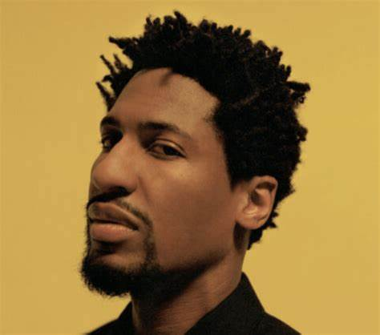
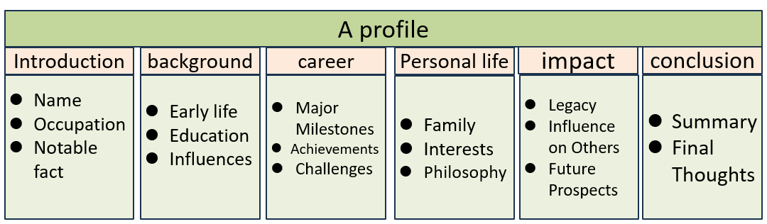
Perceive: vt.感知；理解；认为
She perceived a change in his attitude
He is often perceived as a strict teacher.
2018年高考英语全国卷Ⅰ阅读理解：People often perceive robots as a threat to jobs, but they can also create new opportunities. 认为
detail: vt.详细说明；详述
View…as
Give new life to
Serve as
Be on the board
Earn the recognition
Creative touches
Musical legacy
Be associated with
Be exemplified by
She detailed how the project would be implemented.
2019年高考英语全国卷Ⅱ完形填空：The instructions detailed every step of the process, making it easy to follow.详细说明
bridge: vt.架桥；连接；弥合
B
The new policy aims to bridge the gap between rich and poor.
Music can bridge across cultural differences.
2020年高考英语全国卷Ⅰ阅读理解：The program is designed to bridge the divide between urban and rural education.

Slide 13
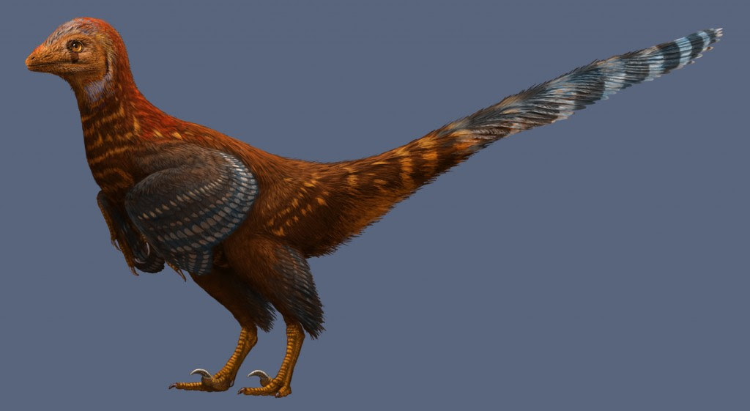
C
Evolutionary Shift in Dinosaur Feathers

Slide 14
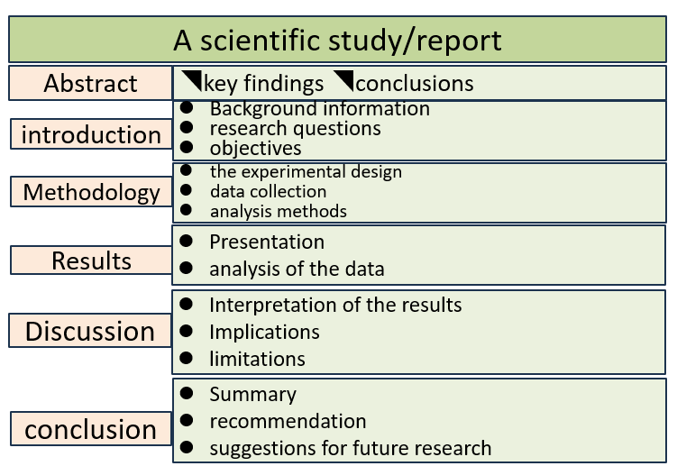
C
1Scientists have uncovered a crucial piece in the puzzle of dinosaur feather evolution （羽毛进化）. Some feathered dinosaurs, along with their characteristic sharp teeth and large bodies, also had skin similar to that of modern reptiles （爬行动物）. Feathers likely developed in specific areas of the dinosaur’s body, while other parts were covered in reptilian scales （鳞片）. A study published in the journal Nature Communications details these findings, providing new insights into the evolutionary shift from scales to feathers.
2Feathers serve a variety of functions beyond flight. For instance, peacocks use them to attract mates. Penguins benefit from reduced drag when they dive underwater, and herons can even use their feathers to create shade. Most feathered dinosaurs, such as theropods and sauropods, probably used feathers to keep warm.
3Maria McNamara, a scientist at University College Cork in Ireland and a co-author of the study, commented that the shift from reptilian scales to feathers is a crucial milestone in vertebrate （脊椎动物的） evolution. This phenomenon, despite being the focus of substantial research, still resists complete understanding. Although numerous feather fossils have been studied, fossilized skin is extremely rare.
4In this research, a team from University College Cork and Nanjing University in China examined a rare fossilized skin sample of the feathered dinosaur Psittacosaurus. This small, two-legged, horned dinosaur lived in what is now Mongolia and China during the early Cretaceous period, around 135—120 million years ago, when dinosaurs were starting to evolve into birds.
5The research team used a device which sent out ultraviolet light （紫外线） to identify areas of preserved Psittacosaurus skin, which are invisible under natural light. Further inspection with X-rays and infrared light revealed the preserved cellular structure. To their surprise, the fossilized skin was made of silica, the same compound （化合物） as glass. This type of preservation has never been found in vertebrate fossils before.
6The team believes that softer, more bird-like skin might have initially developed only in the feathered parts of the dinosaur’s body, while the rest of the skin resembled the scales of modern reptiles. This zoned development would have retained essential skin functions, like protection against abrasion, dehydration, and parasites. As a result, the first dinosaurs to develop feathers could survive and pass on the genes for feathers to their later generations.
Findings
Functions
the phenomenon/shift
The examination
Discovery
Conclusion/Hypothesis

Slide 15
C
1Scientists have uncovered a crucial piece in the puzzle of dinosaur feather evolution （羽毛进化）. Some feathered dinosaurs, along with their characteristic sharp teeth and large bodies, also had skin similar to that of modern reptiles （爬行动物）. Feathers likely developed in specific areas of the dinosaur’s body, while other parts were covered in reptilian scales （鳞片）. A study published in the journal Nature Communications details these findings, providing new insights into the evolutionary shift from scales to feathers.
2Feathers serve a variety of functions beyond flight. For instance, peacocks use them to attract mates. Penguins benefit from reduced drag when they dive underwater, and herons can even use their feathers to create shade. Most feathered dinosaurs, such as theropods and sauropods, probably used feathers to keep warm.
3Maria McNamara, a scientist at University College Cork in Ireland and a co-author of the study, commented that the shift from reptilian scales to feathers is a crucial milestone in vertebrate （脊椎动物的） evolution. This phenomenon, despite being the focus of substantial research, still resists complete understanding. Although numerous feather fossils have been studied, fossilized skin is extremely rare.
28．What’s the significance of the study?
A．It challenges our understanding of dinosaurs.
B．It helps better understand how scales formed.
C．It provides crucial evidence for vertebrate evolution.
D．It reveals how dinosaurs became extinct.
29．What message does Maria McNamara deliver?
A．Feathers evolved from scales very quickly.
B．The evolutionary process remains partly unknown.
C．There is an urgent demand for more feather fossils.
D．Feathers are necessary in dinosaurs’ defence mechanism.
resist: vt.抵抗、反抗或阻止某事发生
抵抗物理影响： resist heat、resist pressure。
抵抗影响或改变： resist change、resist temptation。
医学上抵抗疾病： resist infection
逻辑上抵抗结论：resist complete understanding

Slide 16
C
4In this research, a team from University College Cork and Nanjing University in China examined a rare fossilized skin sample of the feathered dinosaur Psittacosaurus. This small, two-legged, horned dinosaur lived in what is now Mongolia and China during the early Cretaceous period, around 135—120 million years ago, when dinosaurs were starting to evolve into birds.
5The research team used a device which sent out ultraviolet light （紫外线） to identify areas of preserved Psittacosaurus skin, which are invisible under natural light. Further inspection with X-rays and infrared light revealed the preserved cellular structure. To their surprise, the fossilized skin was made of silica, the same compound （化合物） as glass. This type of preservation has never been found in vertebrate fossils before.
6The team believes that softer, more bird-like skin might have initially developed only in the feathered parts of the dinosaur’s body, while the rest of the skin resembled the scales of modern reptiles. This zoned development would have retained essential skin functions, like protection against abrasion, dehydration, and parasites. As a result, the first dinosaurs to develop feathers could survive and pass on the genes for feathers to their later generations.
30．What can be learned about the research?
A．It lacked international cooperation.
B．It ignored the diversity of dinosaur species.
C．It employed multiple advanced technologies.
D．It mainly focused on the dinosaur’s appearance.
31．What does the underlined word “retained” in the last paragraph mean?
A．Preserved. B．Transformed. C．Stimulated. D．Removed.
Would have retained
Preserve
Conserve
Reserve
Maintain
…

Slide 17
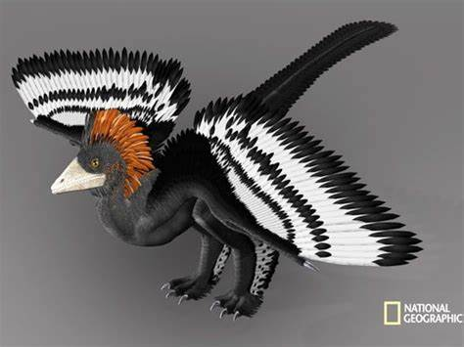
In the puzzle of
Provide new insights into…
Shift from… to…
Evolve into
Send out
Pass on
在……的谜题中
提供对……的新见解
从……转变到……
进化成
发出
传递下去
Uncover vt.揭露；发现；揭开
Uncover
Discover
Reveal
Unveil
Expose
Disclose
Bring to light
Shed light on
To discover something previously hidden or unknown; to remove a cover from something.
2018年高考英语全国卷Ⅰ阅读理解:The study uncovered a surprising link between sleep patterns and academic performance.
2020年高考英语全国卷Ⅱ完形填空:The archaeologists uncovered a hidden chamber beneath the pyramid.
C
Evolutionary Shift in Dinosaur Feathers

Slide 18
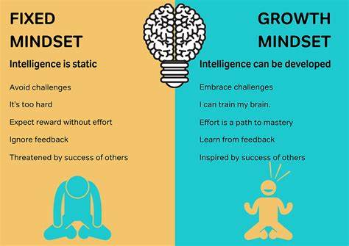
D
The Growth Mindset

Slide 19
D
1Ask students to describe their brain, and they’re likely to suggest a computer, a command center, or maybe a lightning-fast communications network. But they’d be better off thinking of the brain as a muscle that gets stronger with use. Researchers now understand that IQ isn’t fixed at birth. Just as we get more physically fit from exercising, we can build brainpower through the act of learning.
2Children who adopt what psychologist Carol Dweck calls a growth mindset （思维模式） understand that intelligence isn’t fixed but can be developed through effort. In Mindset, Dweck explains why students who have a growth mindset are more willing to tackle challenges, learn from failure, and see criticism as useful feedback （反馈） rather than an excuse to give up. This is the kind of thinking that keeps students motivated, even when learning is hard work.
3The good news is that even the mindset isn’t fixed. A growth mindset can be learned and enhanced by messages that praise persistence and set high expectations. For example, help students understand that challenging assignments will stretch their “thinking muscles.” At the same time, provide them with necessary support so they don’t get discouraged.
4It is widely believed that all brains are not equal and that context and ability influence learning. The brain connects new information to the old and can be changed by experience.
5Effective teaching strategies help students move toward higher-order thinking, or what neurologists call executive （执行） function. As professor Judy Willis, MD explains, “When educators offer students chances to put their learning into practice, particularly by engaging them in genuine, personally relevant activities accompanied by formative assessments and corrective feedback throughout a unit, the facts students learn are no longer rote （死记硬背） memory. Instead, these facts become solidly integrated into an interconnected memory framework, rather than being deserted due to lack of use.”
6Of course, all this brain activity is happening in a unique way for each student. By addressing learners’ individual needs, educators can help students strengthen the bonds that will lead to deeper understanding.
Lead in
Analysis
Proposed Solutions
Scientific Support
Conclusion and Implications

Slide 20
D
1Ask students to describe their brain, and they’re likely to suggest a computer, a command center, or maybe a lightning-fast communications network. But they’d be better off thinking of the brain as a muscle that gets stronger with use. Researchers now understand that IQ isn’t fixed at birth. Just as we get more physically fit from exercising, we can build brainpower through the act of learning.
2Children who adopt what psychologist Carol Dweck calls a growth mindset （思维模式） understand that intelligence isn’t fixed but can be developed through effort. In Mindset, Dweck explains why students who have a growth mindset are more willing to tackle challenges, learn from failure, and see criticism as useful feedback （反馈） rather than an excuse to give up. This is the kind of thinking that keeps students motivated, even when learning is hard work.
3The good news is that even the mindset isn’t fixed. A growth mindset can be learned and enhanced by messages that praise persistence and set high expectations. For example, help students understand that challenging assignments will stretch their “thinking muscles.” At the same time, provide them with necessary support so they don’t get discouraged.
32．Why does the author compare the brain to a muscle?
A．To prove they possess memory cells.
B．To show they can be strengthened through exercise.
C．To emphasize they transport information quickly.
D．To illustrate they are important organs of the body.
33．What are children with a growth mindset like according to Dweck?
A．They tend to shy away from trouble.
B．They prefer positive feedback from others.
C．They regard intelligence as an unchangeable quality.
D．They view barriers as opportunities for personal growth.
Strengthen: to get stronger
View…as
See…as
Regard…as
Consider…as
Perceive…as
Think of …as

Slide 21
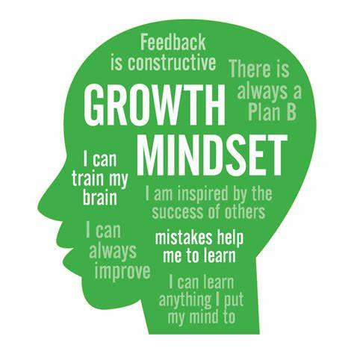
4It is widely believed that all brains are not equal and that context and ability influence learning. The brain connects new information to the old and can be changed by experience.
5Effective teaching strategies help students move toward higher-order thinking, or what neurologists call executive （执行） function. As professor Judy Willis, MD explains, “When educators offer students chances to put their learning into practice, particularly by engaging them in genuine, personally relevant activities accompanied by formative assessments and corrective feedback throughout a unit, the facts students learn are no longer rote （死记硬背） memory. Instead, these facts become solidly integrated into an interconnected memory framework, rather than being deserted due to lack of use.”
6Of course, all this brain activity is happening in a unique way for each student. By addressing learners’ individual needs, educators can help students strengthen the bonds that will lead to deeper understanding.
34．Which of the following enhances executive function?
A．Creative engagement. B．Organizing activities personally.
C．Engaging in direct interaction. D．Complete independence.
35．What can be the best title for the text?
A．IQ and Its Influence on Learning
B．The Growth Mindset: A Key to Difficulty-Solving
C．The Significance of Executive Function in Education
D．Brainpower Building: Encourage a Growth Mindset

Slide 22
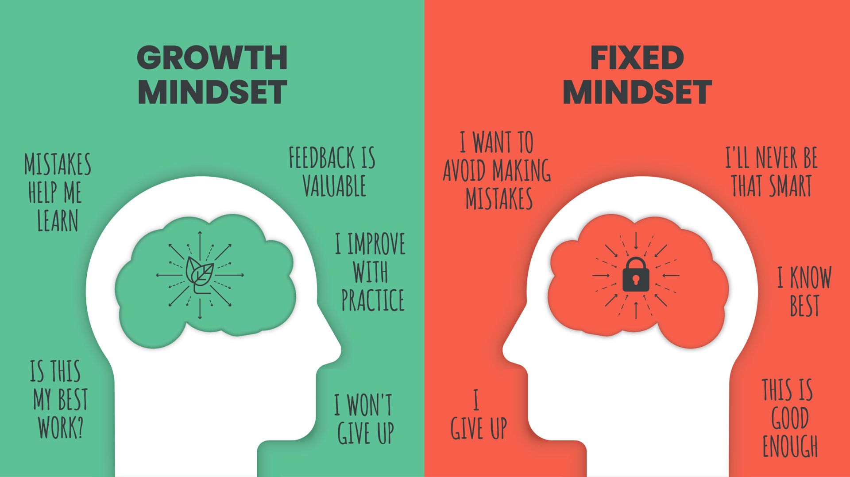
fix: vt.修复；固定；安排
be better off
Be willing to
Keep sb motivated
Set high expectations
Get discouraged
Move toward
Engage sb in
Integrate…into..
Due to
Lack of use
Strengthen the bonds
Put one’s learning into practice
Fix a car/ a date/ the price/a problem/a meal
IQ isn’t fixed at birth.智商并非在出生时就固定不变。
2018年高考英语全国卷Ⅱ阅读理解:She fixed her eyes on the screen, trying to catch every detail of the movie.
更好地
愿意
保持某人积极性
设定高期望
感到气馁
向……迈进
让某人参与
把……整合到……中
由于
缺乏使用
加强联系
把所学付诸实践
stretch: v.伸展；延续；竭尽全力
Stretch one’s arm/one’s imagination/the budget/the limits/the truth
The meeting stretched into the evening.
He stretched himself to finish the project on time.
2022年高考英语全国卷Ⅰ阅读理解:The project stretched over several months, requiring a lot of effort and resources.
Desert: vt.抛弃；遗弃；擅离职守
D
Desert one’s duty/a cause/one’s post/a sinking ship
The refugees deserted to a neighboring country.
2021年高考英语全国卷Ⅱ阅读理解:The team felt betrayed when their leader deserted them in the middle of the project.

Slide 23

七选五
The 3-3-3 method

Slide 24
Sometimes, determining which projects you should devote your time and energy to first takes energy you don’t have to spare. 36 , you still need to figure out how to prioritize them. Try the 3-3-3 method.
This technique comes from Oliver Burkeman, author of Four Thousand Weeks: Time Management for Mortals. 37 . First, devote three hours to deep work on your most important project. Next, complete three other urgent tasks that don’t require three hours of focus. Finally, do three “maintenance” tasks, like cleaning, answering emails, or scheduling other work.
38 . Jumping into it first means you’ll be fresh, focused, and more likely to be able to focus on a task without getting distracted. Keep those three hours free of emails, texts, chit-chat, or other smaller duties, to the best of your ability.
Deep work produces major productivity, so you’ll get a lot accomplished if you commit to it, but you can’t stay in that mindset forever. You’ll wear yourself out after about three hours. 39 .
Finally, your maintenance tasks give you a chance to get things done while giving your brain a rest. This technique is similar to “eating the frog”, or doing your hardest task first thing. 40 , or you can use it to put finishing touches on whatever you were working on during those three hours of intense focus.
You can use this technique to manage seven different tasks of varying urgency levels. Just be sure to stick with the process, starting with the big lift and finishing off with the little jobs that keep it all flowing.
problem
Solution proposal
Specific steps
Conclusion
A．So go to three other smaller tasks to stay productive
B．But even when you know what tasks need to be done
C．He advocates planning each workday around a 3-3-3 model
D．Even if you pay attention to how many resources you will need
E．He’ll feel the same sense of relief when moving onto lesser tasks
F．Use your maintenance time to prepare for the following day’s work
G．What distinguishes this method from others is the first three hours’ deep work
A．So go to three other smaller tasks to stay productive
B．But even when you know what tasks need to be done
C．He advocates planning each workday around a 3-3-3 model
D．Even if you pay attention to how many resources you will need
E．He’ll feel the same sense of relief when moving onto lesser tasks
F．Use your maintenance time to prepare for the following day’s work
G．What distinguishes this method from others is the first three hours’deep work

Slide 25
36.指称、逻辑、语义: B 指称主题一致、承上花费精力启下仍需找到方法
Sometimes, determining which projects you should devote your time and energy to first takes energy you don’t have to spare. 36 , you still need to figure out how to prioritize them. Try the 3-3-3 method.
This technique comes from Oliver Burkeman, author of Four Thousand Weeks: Time Management for Mortals. 37 . First, devote three hours to deep work on your most important project. Next, complete three other urgent tasks that don’t require three hours of focus. Finally, do three “maintenance” tasks, like cleaning, answering emails, or scheduling other work.
38 . Jumping into it first means you’ll be fresh, focused, and more likely to be able to focus on a task without getting distracted. Keep those three hours free of emails, texts, chit-chat, or other smaller duties, to the best of your ability.
Deep work produces major productivity, so you’ll get a lot accomplished if you commit to it, but you can’t stay in that mindset forever. You’ll wear yourself out after about three hours. 39 .
Finally, your maintenance tasks give you a chance to get things done while giving your brain a rest. This technique is similar to “eating the frog”, or doing your hardest task first thing. 40 , or you can use it to put finishing touches on whatever you were working on during those three hours of intense focus.
You can use this technique to manage seven different tasks of varying urgency levels. Just be sure to stick with the process, starting with the big lift and finishing off with the little jobs that keep it all flowing.
37.指称、段落结构: B OB指代、承接下文对3-3-3method进一步解释
38.语义、指代: G this method—it; the first 3hours—free of other duties
39.因果逻辑: A wear out----other tasks-----stay productive
40.指代、语义: F 上文maintenance tasks 下文it& finishing touches
A．So go to three other smaller tasks to stay productive
B．But even when you know what tasks need to be done
C．He advocates planning each workday around a 3-3-3 model
D．Even if you pay attention to how many resources you will need
E．He’ll feel the same sense of relief when moving onto lesser tasks
F．Use your maintenance time to prepare for the following day’s work
G．What distinguishes this method from others is the first three hours’ deep work
Prioritize:优先考虑
Jump onto 迅速跳上;加入
Maintenance维护；维修
Intense focus 高度集中
finishing touches 收尾工作

Slide 26
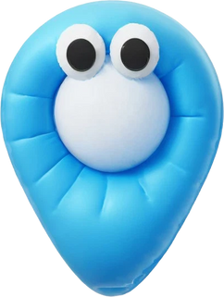

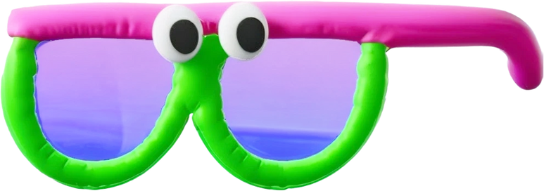
完形填空
详 解

Slide 27
1No one is willing to fall ill, especially in a foreign country alone. 41 , such was exactly what happened to me.
2A few months ago, while I was engaged in a volunteering project in Mwanza, Tanzania, something 42 happened—I fell ill. Despite my 43 to take medicines and avoid unboiled water, I was hit hard. I was 44 to a clinic with a high fever and severe body pain. Alone and terrified, I even thought, at a certain moment, that it was the 45 .
3 46 a battery of tests, I received a diagnosis （诊断） of serious malaria. The doctor gave me injections and tablets, 47 I wouldn’t have to be admitted to the hospital. I 48 taking the tablets, and desperately thinking “keep these down, keep these down!”, but nothing worked and I had to be 49 .
4Tears coursed down my cheeks. I was 50 with fear. Then, a kind nurse 51 . She remained by my side for a full eight hours even after her shift 52 , gently holding my hand. Her presence was really a great 53 . Had it not been for her, I can’t imagine how I could have 54 that night. The medicines gradually took effect and soon I was released.
5I never learned her name, yet the nurse has left a deep mark. It serves as a reminder that in the darkest times, a simple act of kindness can make a difference, crossing 55 and bringing warmth to strangers in need.

Slide 28
1No one is willing to fall ill, especially in a foreign country alone. 41 , such was exactly what happened to me.
2A few months ago, while I was engaged in a volunteering project in Mwanza, Tanzania, something 42 happened—I fell ill. Despite my 43 to take medicines and avoid unboiled water, I was hit hard. I was 44 to a clinic with a high fever and severe body pain. Alone and terrified, I even thought, at a certain moment, that it was the 45 .
3 46 a battery of tests, I received a diagnosis （诊断） of serious malaria. The doctor gave me injections and tablets, 47 I wouldn’t have to be admitted to the hospital. I 48 taking the tablets, and desperately thinking “keep these down, keep these down!”, but nothing worked and I had to be 49 .
41．A．Regrettably B．Constantly C．Originally D．Consequently
42．A．awkward B．strange C．unrecorded D．undesired
43．A．failure B．opportunity C．ambition D．effort
44．A．recommended B．rushed C．assigned D．returned
45．A．choice B．wisdom C．end D．truth
46．A．Patient with B．Subsequent to
C．Dependent on D．Concerned about
47．A．replying B．apologizing C．promising D．assuming
48．A．kept B．forgot C．delayed D．quit
49．A．investigated B．dismissed C．hospitalized D．distinguished
Patient with 对…有耐心
Subsequent to 在…之后
Dependent on 依赖于
Concerned about 关心，担忧
Hospitalize vt.住院治疗
41．A．Regrettably B．Constantly C．Originally D．Consequently
42．A．awkward B．strange C．unrecorded D．undesired
43．A．failure B．opportunity C．ambition D．effort
44．A．recommended B．rushed C．assigned D．returned
45．A．choice B．wisdom C．end D．truth
46．A．Patient with B．Subsequent to
C．Dependent on D．Concerned about
47．A．replying B．apologizing C．promising D．assuming
48．A．kept B．forgot C．delayed D．quit
49．A．investigated B．dismissed C．hospitalized D．distinguished
Be engaged in参与
Be hit hard受到重创
A battery of 一系列
Be admitted to 被录取；被送入

Slide 29
4Tears coursed down my cheeks. I was 50 with fear. Then, a kind nurse 51 . She remained by my side for a full eight hours even after her shift 52 , gently holding my hand. Her presence was really a great 53 . Had it not been for her, I can’t imagine how I could have 54 that night. The medicines gradually took effect and soon I was released.
5I never learned her name, yet the nurse has left a deep mark. It serves as a reminder that in the darkest times, a simple act of kindness can make a difference, crossing 55 and bringing warmth to strangers in need.
50．A．consumed B．equipped C．compared D．impressed
51．A．departed B．emerged C．passed D．called
52．A．increased B．continued C．occurred D．concluded
53．A．trick B．relief C．reminder D．success
54．A．weathered B．described C．witnessed D．enjoyed
55．A．ages B．races C．boundaries D．genders
50．A．consumed B．equipped C．compared D．impressed
51．A．departed B．emerged C．passed D．called
52．A．increased B．continued C．occurred D．concluded
53．A．trick B．relief C．reminder D．success
54．A．weathered B．described C．witnessed D．enjoyed
55．A．ages B．races C．boundaries D．genders
course down流下
Be consumed with fear 充满恐惧
Take effect 生效，起作用
Be released 被释放；出院
Serve as充当，作为
consume vt.消耗；吃喝；侵蚀
weather vt.经受得住，经历；风化，褪色
The disease consumed his body.
Be consumed by /with
2019年高考英语全国卷Ⅱ完形填空:The fire consumed the entire forest, leaving nothing but ashes.
Weather the storm: 渡过风暴；渡过难关
Weather through: 成功渡过（困难）
Be weathered by: 因……而风化或褪色。
2018：The small town weathered the economic downturn.

Slide 30
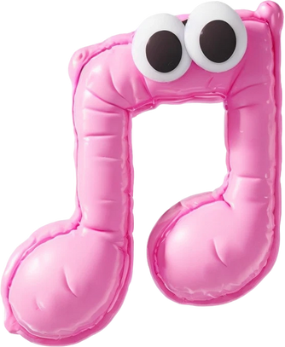


Music bond
语法填空

Slide 31
Though far apart in distance and culture, China and Ireland share surprising bonds, both famous for strong communities abroad and their shared enthusiasm 56 food, drink, and the arts. Among these, music stands out as a unique bond, with Irish music 57 (hold) a particular appeal in China.
Part of this cultural link is Li Yan, 58 65-year-old Beijing native who now lives in London. Playing the bodhran, a traditional Irish drum, in music gatherings that unite musicians, he has become a vital part of the Irish music scene. Originally a poet, Li, 59 (draw) to the storytelling and rhythms of Irish music, even astonishes audiences by singing Gaelic songs in Chinese.
The 60 (connect) between Irish and Chinese music is long-standing. In the 1980s, The Chieftains, a celebrated Irish group, 61 (perform) in China, introducing millions to Irish music. Their collaboration with Chinese musicians symbolized the harmony of both cultures. Equally 62 (remark) is Riverdance, a world-famous Irish dance show, which brought Irish culture to China.
It is Irish music’s shared traditions with China, such as drumming and poetry, 63 strongly appeal to people. “Music is borderless,” says Li, 64 journey illustrates that art has the power 65 (bond) people from different worlds together.
（be）drawn to被…吸引
Far apart相距甚远
Stand out as作为…脱颖而出
Long-standing
Appeal to
56.for：固定搭配 enthusiasm for
57.holding: with结构---非谓
58.a:冠词
59.drawn：非谓语动词
A particular appeal特别的吸引力
Long-standing长久的
Appeal to呼吁；吸引
60.connection:词性转换
61.performed:谓语动词时态
62.remarkable：词性转换 倒装
63.that：强调句式
64.whose:定语从句
65.to bond:非谓语动词

Slide 32
感
谢
观看

