Slide 1


感恩遇见，相互成就，本课件资料仅供您个人参考、教学使用，严禁自行在网络传播，违者依知识产权法追究法律责任。
更多教学资源请关注
公众号：溯恩英语
知识产权声明

Slide 2

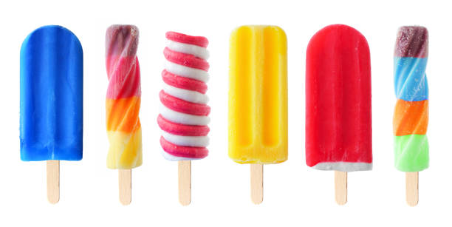
2025年3月高三天域联盟联考
读后续写讲评
基于主题语境的“以读促写”:
The Popsicle Kids

Slide 3
The Popsicle Kids
A nearly empty box of Popsicles (棒冰) in the freezer, left from a grandchild’s visit, caught my attention. Initially, I wanted to throw it away, but my wife suggested we give the remaining Popsicles to the neighborhood children. Her suggestion changed our life and led us to a future full of “Popsicle Kids.”
My wife and I, retired on Social Security, live in an apartment complex. After careers in sales and nursing, our daily concerns revolved around aches, pains, and dinner. We often wondered what good we were to the world.
That changed dramatically after we gave away the first Popsicle.
Minutes after watching a neighbor boy, a second grader, walk away with an icy treat, our doorbell rang. An adorable blond girl, about six, smiled sweetly, “Is it true you’re giving away Popsicles?”
With the box empty, we returned to our concerns.
Early the next morning, the doorbell rang repeatedly. Standing on our porch were the four children from the previous day. They vocalized their wants, chanting (有节奏地喊), “We want Popsicles! We want Popsicles!”
Looking into their eager young faces, I wondered, “What have I started?” Sensing a victory, they nodded eagerly when I explained the rules: ring the bell once, one Popsicle per day, and share something good about their day. But their thin shoulders bent downwards in disappointment when I mentioned they had to give something in return. I came to the rescue, suggesting they share something positive about their day, like what they learned at school or helping another student. Over time, new rules were added: “Ladies first,” “Don’t interrupt,” and “Properly get rid of the sticks.”
On holidays, they expressed their understanding of why the day was celebrated. Over the years, about fifty youngsters visited. Some became part of my life, like the four kids who joined me on the steps one spring to read “Where the Red Fern Grows.” We discussed catching crawfish, loving pets, and family relationships. This simple act of sharing Popsicles transformed our life, bringing joy and meaning to both the children and ourselves.
Read for the plot& theme
Who are “the Popsicle Kids”?
What did they do?
Why did my wife and I give away popsicles?
Why did my wife and I keep giving them away?
How did the writer describe the influence?
How about the thread(s) of the passage?
different rules
- the popsicles
- the development of the story
- the changes
Anything more? What do the changes indicate?
different routine
different living conditions
Para.1 One night, another boy appeared at the door, saying “I don’t want a Popsicle; I just need to talk.”
Para.2 I’ve sensed it’s more than Popsicles that bring these kids to our door.
People& Society
People& Growth
Theme-oriented:

Slide 4

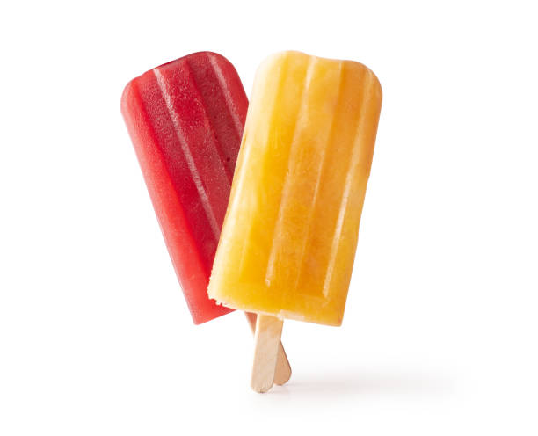
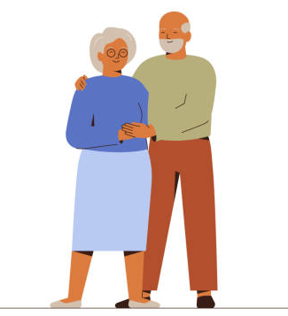


Cause
sociable, loving yet purposeless
- retired
- sales and nursing
- concerns: aches, pains, dinners
Any Significance?
Popsicles
Giving
Getting
- want an icy treat
the elderly couple
neighbourhood children
ring the bell once
one Popsicle per day
share something good
“Ladies first”
“Don’t interrupt”
“Properly get rid of the sticks”
expressed understandings
read “Where the Red Fern Grows”
discussed catching crawfish, loving pets, and family relationships.
“Popsicle Traditions”
small kindness
an icebreaker
an open door
a bond
trust...
manners, health/caring, sharing, interaction, learning, company, growth ...
Development
bringing joy and meaning
life-changing
- What did “I” sense?
- Would anything be the change this time?
another boy
Another encounter
sensed it’s more than Popsicles
want a talk

Slide 5
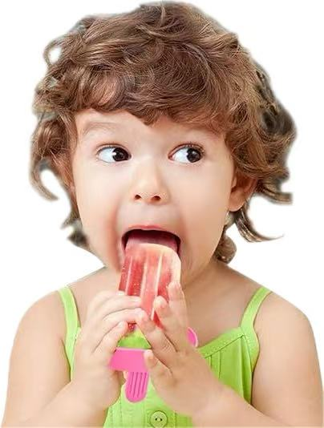
Para.1 One night, another boy appeared at the door, saying “I don’t want a Popsicle; I just need to talk.”
Para.2 I’ve sensed it’s more than Popsicles that bring these kids to our door.
What would the boy talk about?
How would I react to the boy’s request?
What made me sense something more ?
expressed understandings
read “Where the Red Fern Grows”
discussed catching crawfish, loving pets, and family relationships
- Would the boy share the positive as well?
I came to the rescue, suggesting they share something positive about their day, like....
What could I do for him?
What’s the boy’s real need?
How was our talk?
Why did he come if not for popsicles?
Action (chain)& Remarks.
How about the couple’s personality?
Physical? Mental!
Useless? Fruitful!
If you take the threads into account
What did I sense?
What’s the influence/change this time?
Any reflection? How would the future be like?
purposeless- joy& meaning- ?
What’s the difference?
...joy and meaning...
Over time, new rules were added...
Would anything be brought and added this time?
Keep track of the given text.
New rules...Another change...
Why did the write take down the story?
What’s the title? What’s the theme?

Slide 6
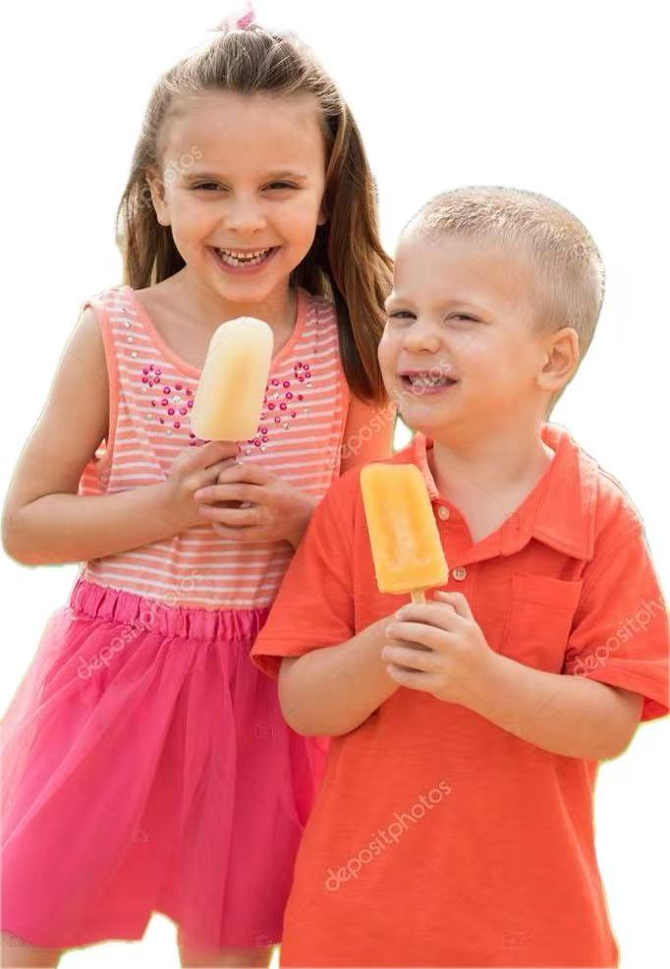
Imitate the language& Apply
Is there any other clue?
Her suggestion changed our life and led us to a future full of “Popsicle Kids.”
- ‌His visit further transformed our summer and introduced us to a new world of "Doorbell Stories".‌
Minutes after watching a neighbor boy, a second grader, walk away with an icy treat, our doorbell rang.
- Moments after gently covering my hands on his fists, those clenched tightly, his shoulders uncurled.
An adorable blond girl, about six, smiled sweetly, 'Is it true you’re giving away Popsicles?
- ‌A slim, hoodie-clad boy, around 13, asked with cracked voice, "Is it true the doorbell is always responded?
Looking into their eager young faces, I wondered, 'What have I started?'
- ‌Gazing at his trembling hands, I thought to myself, "Is a storm going to start?"
Over time, new rules were added: 'Ladies first,' 'Don’t interrupt,' and 'Properly get rid of the sticks.'
- ‌Gradually, new guidelines emerged: 'Tell your truth,' 'No judgment,' and 'Secrets stay here'.‌
呼应男孩"需要谈话"而非冰棒，暗示变化-新互动形式，从物质到精神
时间过渡；动作描写，突出男孩的脆弱与试探
外貌与语言描写，呼应男孩的诉求，暗示主题语境意义的升华
"storm"隐喻情绪爆发，暗示后续可能涉及孩子的心理困境
时间过渡；原文rules仿写，呼应孩子寻求倾诉的核心需求
Some became part of my life, like the four kids who joined me on the steps one spring to read “Where the Red Fern Grows.”
- More became closer to me, like the group of friends who spent afternoons in my garden, sharing stories, concerns and dreams.
比喻，从individual到community，呼应主题语境及意义升华

Slide 7

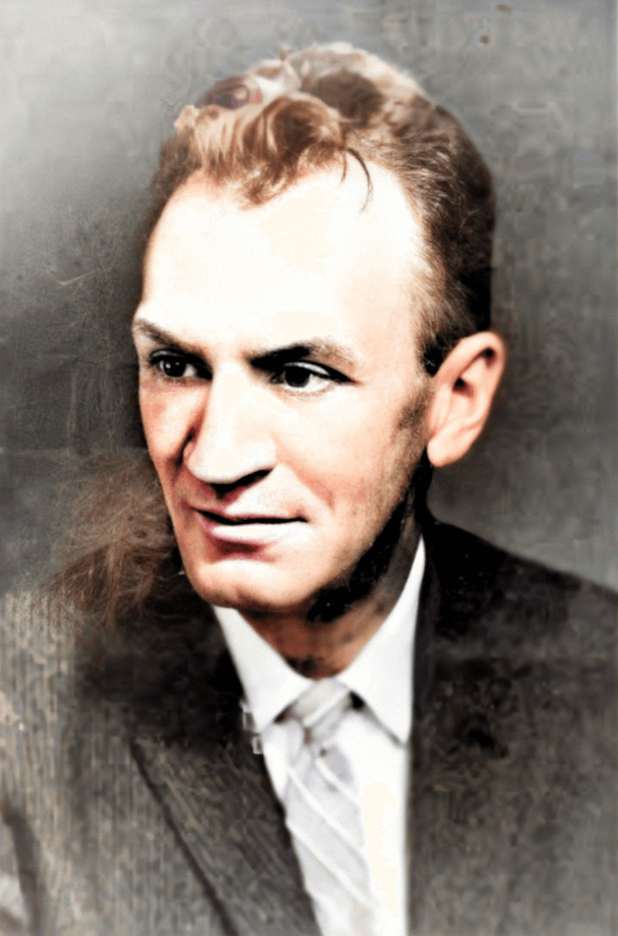
Why was “Where The Red Fern Grows” mentioned?
Does it enlighten you?
They seek the companionship and wisdom that my wife and I can offer, much like Billy sought the comfort of his loyal dogs in "Where the Red Fern Grows."
It reminded me of the resilience Billy showed in "Where the Red Fern Grows," facing adversity with determination and the support of his loyal companions.
We began to host afternoon gatherings where kids could share their worries and dreams, much like Billy's earnest conversations with Old Dan and Little Ann in "Where the Red Fern Grows."
Written by: Wilson Rawls (American)
Published in: 1961
About the story:
The story is set during the Great Depression and follows a young boy named Billy Colman, who dreams of owning two hunting dogs. Through firm determination and hard work, Billy saves enough money to buy two Redbone Coonhounds猎熊犬, which he names Old Dan and Little Ann.
Themes:
The novel explores themes such as the bond between humans and animals, loyalty, perseverance, and the bittersweet nature of life and death. The title's red fern symbolizes sacredness and eternal peace, as it is believed to grow where an angel plants it. This touching tale resonates deeply with readers, emphasizing the profound connections formed through love, trust, and shared experiences.

Slide 8
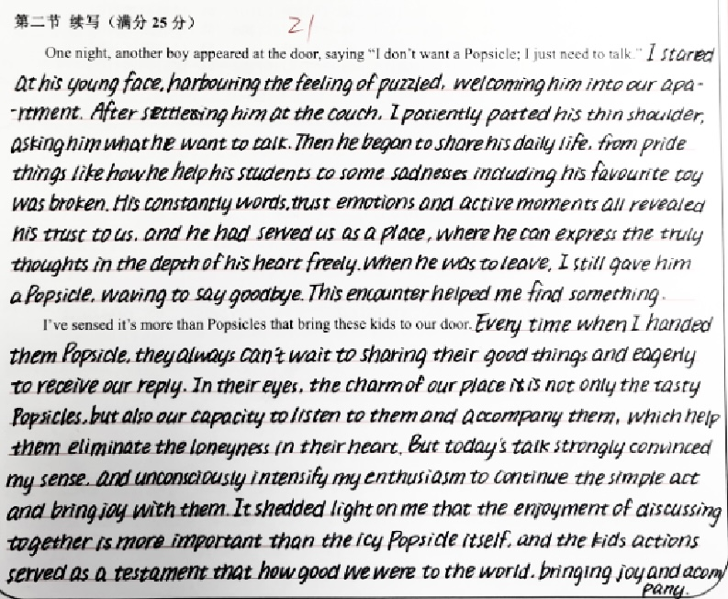
Students’ Versions
Advantages:
动作描写铺陈情节发展自然，时间状语推进发展，各个环节紧密相连，逻辑清晰
两段都有关于kids的描述契合主题，铺垫表达主题意义
紧扣标题和文本明线，上下文连贯
主题句more than重复段首结构进行强调，升华主题意义
句子结构合理，长短句结合;书写美观
Disadvantages:
单词拼写/时态错误，如settleing应为 settling，can’t应为couldn’t
段一首句harbouring...welcoming...两个非谓语的联用修饰不同对象，产生歧义，建议改为：Staring at the young face with a tinge of puzzle, I welcomed him into our apartment.

Slide 9
Teacher’s Version
Para.1 One night, another boy appeared at the door, saying “I don’t want a Popsicle; I just need to talk.” In his eyes was a depth of sadness I hadn’t seen before. After inviting him in, I seated him on the couch. He began to reveal how he was struggling at the new school. The unfamiliar environment and poor academic performance brought him choking loneliness and anxiety. My wife and I listened attentively, offering him the same warmth and understanding that had transformed our lives through the Popsicle Tradition. As he poured out his heart, I recalled the boy in "Where the Red Fern Grows," finding solace and strength amidst adversity. Before his departure, the boy thanked us for bringing him a sense of relief and safety, maybe just like those kids who came for Popsicles regularly.
Para.2 I’ve sensed it’s more than Popsicles that bring these kids to our door. Our icy dessert boosted the Popsicle Tradition unexpectedly, whose impact extended far beyond the sweet treats. It's the sense of sharing and connection they craved. It’s a place where they were always welcomed with responding bells and listening ears. There was an invisible yet interwoven bond built on trust and empathy created day by day between the young faces and us. Over time, new traditions kept evolving, like “Warrior Moments” when each child would share their own adventures, not just limited to the positive. We cooled the kids with Popsicles, while they warmed us with their laughter, trust and companionship.
侧面描写铺垫后文的发展
回扣原文细节，人物特征
引用原文文学意象“Where the Red Fern Grows”增强文本厚度
点题，表达主题语境意义
总结、概况、暗喻，拓展主题内涵
结尾以对比手法强化主题，突出“情感需求高于物质”的立意‌

Slide 10
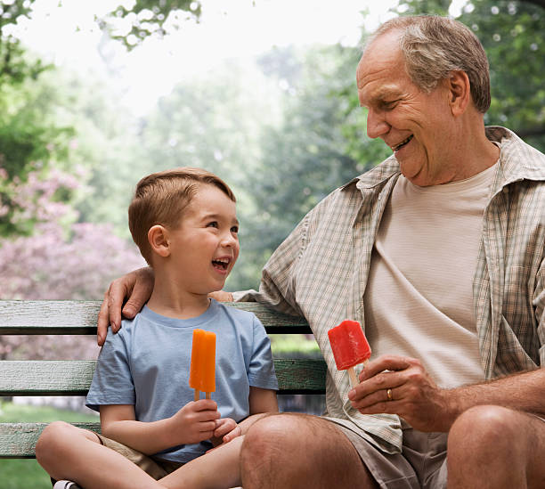
Peer Review Workshop‌
‌Exchange the writing with your deskmates and use a checklist to review:
Does the writing stick to the theme, mutual growth (adults& kids), of the given text?
Does the writing reflect the symbolic meaning of the popsicles?
Are sensory details used to replace simple or abstract expressions like adjectives?
Does the writing echo the clues in the given texts?
Does the second paragraph shift focus to community (not just one boy)?‌

