Slide 1

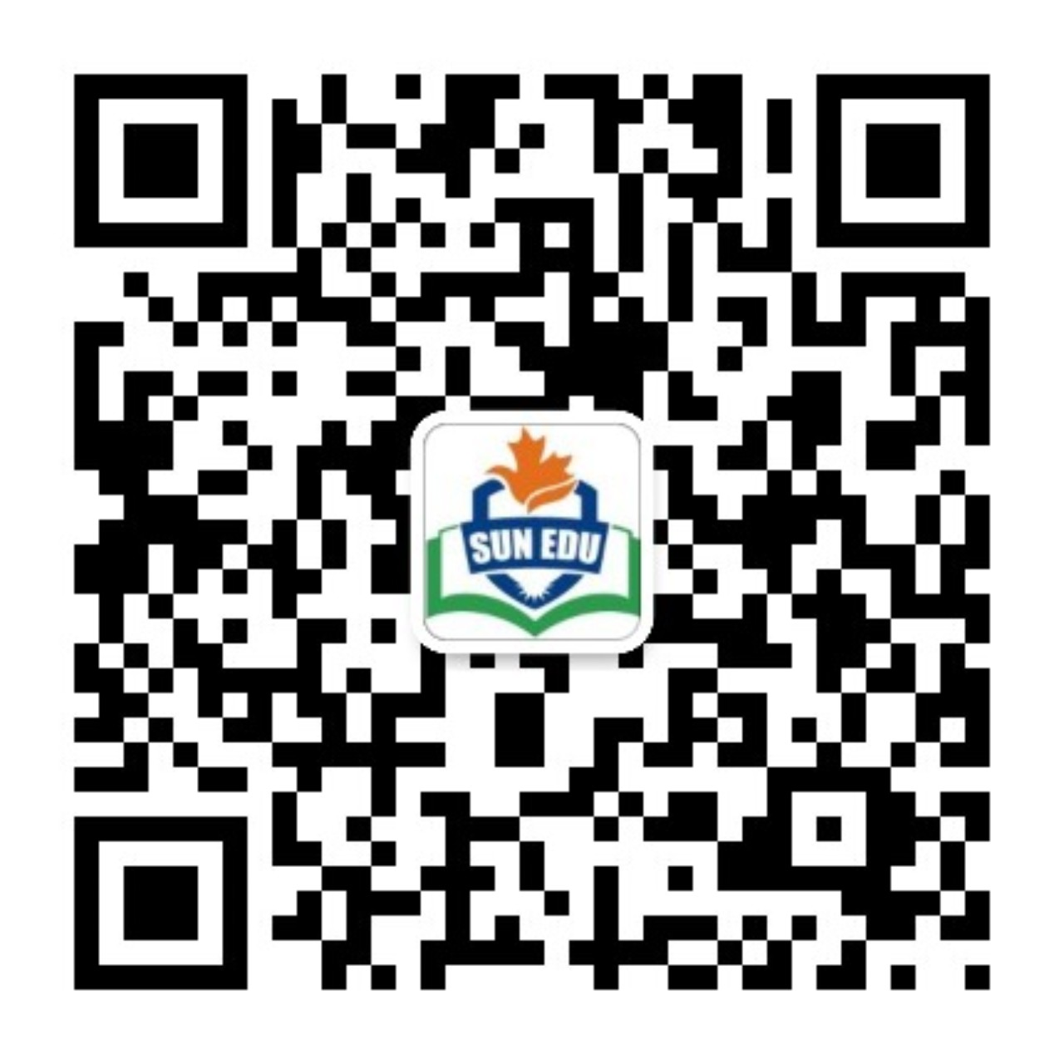
感恩遇见，相互成就，本课件资料仅供您个人参考、教学使用，严禁自行在网络传播，违者依知识产权法追究法律责任。
更多教学资源请关注
公众号：溯恩英语
知识产权声明

Slide 2
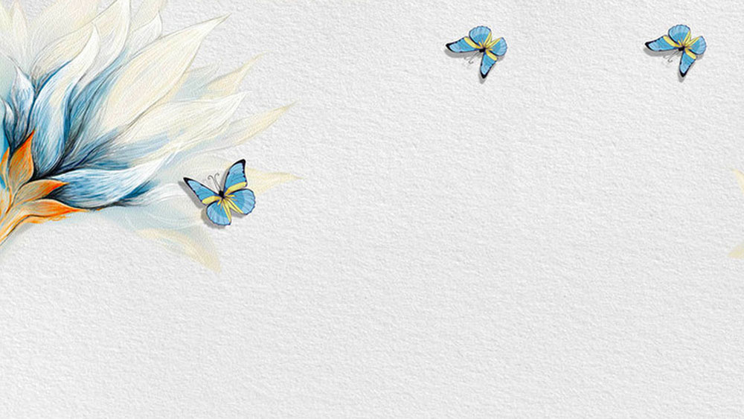

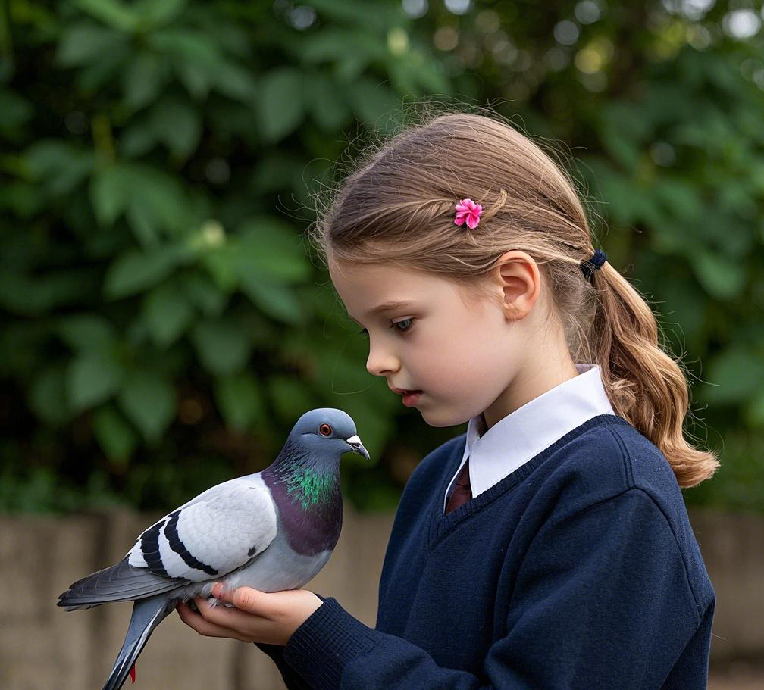
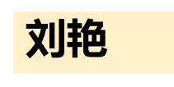
2025
高二名校协作体续写指导
受伤的鸽子
关注：如何设计人与动物互动

Slide 3
高二名校协作体续写
It wouldn't fly. It wouldn't eat. What was wrong with it? I thought to myself as I glanced at the pigeon.
The bird was trembling, leaning against a small tub I had placed it in. It rested on a sheet of newspaper with some grains scattered on it, but the poor thing didn't even seem to take note of it. Just as our eyes met—mine, dark brown; its fiery orange—the pigeon froze, and it puffed itself up in self-defense.
“I'm not going to hurt you,” I said softly, stroking the bird, but it kept its guard up. Its survival instincts (本能) were strong, no doubt, shaped by the world it had seen and the way people often treat animals.
“I have a lot of bird - friends,” I added and smiled at the bird, but it did nothing as well.
The pigeon was shaking. I found it earlier in the parking lot, seeking shelter under a motorcycle, trying to find comfort by the tire. It seemed healthy, had perfect wings, but didn't fly for some reason. Was it exhausted? Heartbroken? Abandoned? It had a look in its eye that felt like it had given up. I thought to give it an opportunity to change its mind.
I convinced my parents to let me keep the bird at our place as I thought that was its only chance to survive the night. The plan after that was to release it in the morning, though I hoped if we could become friends and end up adopting it.
I have a soft spot for animals in my heart. When I was younger and my parents didn't let me have a dog, I had all sorts of pets. I had a colony of ants once, and if you ask me, we had a unique bond. We had so much trust that I let them crawl over me. I was fine with spiders too and cared for jumping spiders, watching them hunt with fascination.
P1： So, giving up on this pigeon didn't feel right.
P2：The next morning, both my parents and I were woken up by the merry chirping of the pigeon.

Slide 4
记叙文要素
Time | from the evening when the pigeon is found to the next morning.
Place | Home, cinema
Characters | The main character is “I”. In the story, “I” am the one who discovers the pigeon, observes its conditions, and tries to help it. “I” show great concern and efforts in taking care of the pigeon. There are also “my parents” who agree to let “me” keep the pigeon at home for the night.
Main Conflict | The main conflict centers around the pigeon. The pigeon refuses to fly and eat, showing abnormal behavior. “I” am unsure about what has happened to it, whether it is exhausted, heart - broken, or abandoned. “I” want to help it, become its friend, and even adopt it, but the pigeon is on high alert against “me”, making it difficult for “me” to rescue and get close to it. Additionally, “I” am in a dilemma about whether to release the pigeon as originally planned the next morning, as “I” am not certain if the pigeon wants to stay and if it is truly beneficial for the pigeon.
The story implies the importance of compassion and care towards animals. It shows that every creature may face difficulties and have moments of giving up. By offering a helping hand and showing kindness, we can potentially change their situation and build a connection with them. Also, it reflects that our past experiences with animals can shape our empathy, and we should always respect and protect these vulnerable lives.

Slide 5
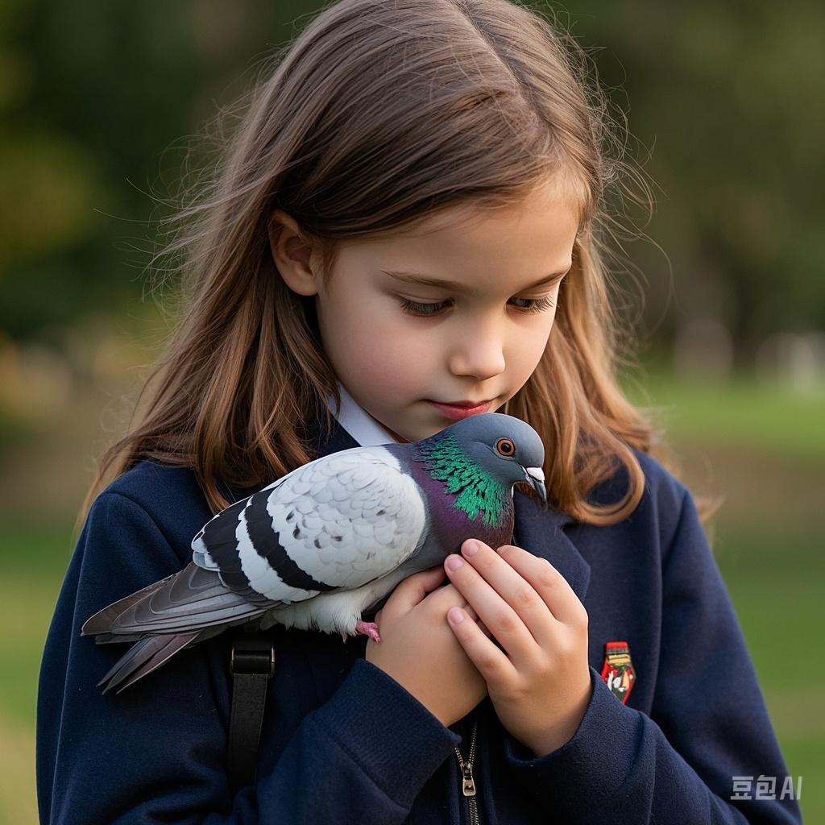
情节搭建
P1： So, giving up on this pigeon didn't feel right.
1 What actions might I take during the night to show I’m not giving up on the pigeon? For example, will I try different types of food or create a more comfortable environment?
2 How could I build trust with the pigeon, given its guarded behavior? Might I use gentle sounds or slow movements?
3 If the pigeon still refuses to eat or fly by morning, what will my next move be? Would I consider taking it to a vet?
（思维发散点1）
关注：如何设计人与动物互动
（思维发散点2）

Slide 6
思维指导：3步构建互动逻辑
用 “问题→行动→变化” 的简单链条展开，避免情节混乱：
问题（Problem）:
动物遇到什么困难？（受伤/害怕/饥饿）
The pigeon refused to eat and kept shaking.
行动（Action）:
主人公尝试哪些具体帮助？（分步骤写，每次只做1件事）
First, I put water near it. Then, I sang a soft song.
变化（Change）:
动物反应如何？情感如何变化？
Slowly, it stopped trembling and looked at me.
a crumb! My heart jumped. I smiled and gently touched its back. It didn’t move away. Maybe it was starting to trust me.
关注：如何设计人与动物互动

Slide 7
二、万能互动公式：感官细节替代复杂词汇
用“五感观察法”补足词汇量：
视觉（Sight）：羽毛颜色（gray feathers）、动作（nodded its head）
听觉（Hearing）：叫声（chirped softly）、环境音（rain tapping the window）
触觉（Touch）：温度（cold/warm）、质感（soft feathers）
嗅觉（Smell）：食物香（bread smell）、环境气味（fresh grass）
视觉+触觉：Its feathers felt rough, but when I touched its head gently, it closed its eyes.
听觉+情感：Hearing its weak chirp, I knew I couldn’t leave it alone.
关注：如何设计人与动物互动

Slide 8
三、情感递进法：设计“微小转折点”
用“三次尝试”制造波折，避免平铺直叙：
尝试次数 | 动作 | 动物反应 | 主人公情感
1 | 放食物在旁边 | 退缩/拒绝 | 失望但坚持
2 | 轻声说话/哼歌 | 停止颤抖/抬头 | 看到希望
3 | 轻抚背部/喂水成功 | 接受帮助/互动 | 感动/欣慰
First, I placed seeds near the pigeon. It turned away. （失望）
Next, I hummed a lullaby. It stopped shaking. （希望）
Finally, when I touched its wing, it didn’t move. My eyes filled with tears. （感动）

Slide 9
实战：将互动拆解为 “尝试帮助→遇到困难→突破点→情感变化” 四步
尝试帮助（基础动作）：
动作：Offer food/water（提供食物/水） → Touch gently（轻抚） → Speak softly（轻声说话）
I put some grains near its beak.（将谷物放在喙边）
I covered the tub with a towel to keep it warm.（用毛巾盖住箱子保暖）
遇到困难（鸽子反应）：
词汇：Shrink back（退缩）/ Flutter wings（扑腾翅膀）/ Refuse to eat（拒绝进食）
The pigeon turned its head away.（鸽子扭头避开）
It flapped its wings but couldn’t fly.（扑腾翅膀却飞不起来）
关注：如何设计人与动物互动

Slide 10
将互动拆解为 “尝试帮助→遇到困难→突破点→情感变化” 四步
3 突破点（微小进展）：
词汇：Take a small bite（咬一小口） → Stop trembling（停止颤抖） → Lean closer（靠近）
Finally, it pecked at a grain slowly.（终于，它慢慢啄了一粒谷物）
Its feathers became less puffy.（羽毛不再蓬松炸开）
4 情感变化（主人公感受）：
词汇：Feel hopeful（感到希望） → Smile with relief（欣慰微笑） → Worry again（再次担忧）
A tiny hope grew in my heart.（心中燃起一丝希望）
“Maybe it will survive,” I whispered.（“也许它能活下来，”我低语）
关注：如何设计人与动物互动

Slide 11
情节搭建
P2：The next morning, both my parents and I were woken up by the merry chirping of the pigeon.
1 Why is the pigeon chirping merrily? Has its condition improved, or has its attitude toward me changed?
2 What is my first reaction to the cheerful chirping? Am I surprised, happy, or confused?
3 Given my original plan to release the pigeon, might its cheerful behavior change my decision? If so, how?
（结尾设计：创新点）

Slide 12
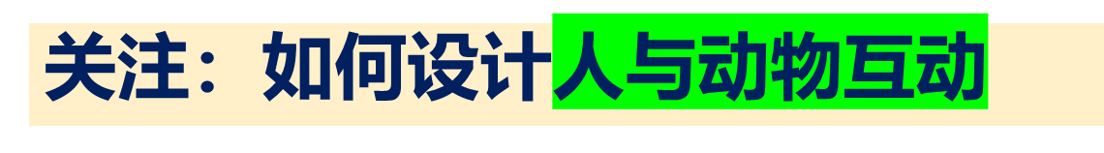
思维指导（象征思维）用动物行为暗示主题
将动物反应与主题（信任/希望/自由）挂钩，提升立意
动物行为 | 象征意义 | 适用主题
啄食一粒谷物 | 初步信任 | 善意与耐心
展翅尝试飞行 | 重获勇气 | 逆境成长
离开前回望 | 感恩与羁绊 | 尊重自然

Slide 13
语言提升：替换词表
动作
喂食：feed → offer food → give water
抚摸：stroke → touch gently → pat softly
观察：watch → look closely → check carefully
鸽子状态
害怕：scared → frightened → nervous
虚弱：weak → tired → fragile
恢复：recover → get better → become active
情感描写
担心：worry → feel anxious → be concerned
开心：happy → joyful → relieved
惊讶：surprised → shocked → amazed

Slide 14
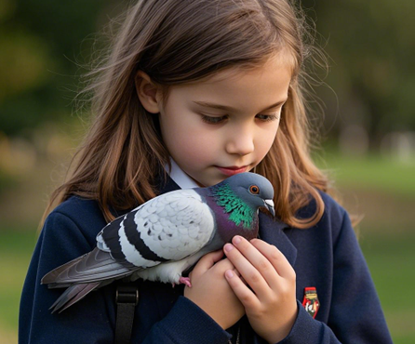
P1：低词汇量版
So, giving up on this pigeon didn’t feel right. I found a small box and put soft cloth inside. Carefully, I placed the pigeon in it. Then, I brought some bread crumbs and water. The pigeon looked at me with scared eyes and didn’t eat. “Don’t be afraid,” I said quietly. I sat beside the box and waited. Minutes later, it pecked a crumb! My heart jumped. I smiled and gently touched its back. It didn’t move away. Maybe it was starting to trust me.

Slide 15

P1：语言进阶版+前文取材
I found a soft cardboard box and lined it with a warm towel, just like the tiny glass home I once built for my ant colony. Carefully, I placed the trembling bird inside, noticing how its wings shivered. I brought some wet breadcrumbs and a small water dish, arranging them gently like I used to place sugar crystals for the ants. “Don’t be afraid,” I whispered, sitting cross-legged beside the box. The pigeon’s golden eyes locked onto mine, wide and pleading. Minutes ticked by. Then, like the ants finally trusting my hand, it tilted its head and pecked a crumb. My breath caught. When I reached to smooth its messy feathers, it stayed still—just like those ants once paused on my fingertip, testing the bond between us.

Slide 16
P2：低词汇量版
I jumped out of bed and ran to the box. The pigeon was flapping its wings happily, grains scattered around it. “It ate!” I shouted. My mom smiled and opened the window. The pigeon hopped onto my hand, its tiny feet tickling my skin. For a moment, we looked at each other—I didn’t want to let go, but I knew what to do. With a shaky breath, I lifted my hand. The pigeon paused, then flew out the window into the sunny sky. My heart felt heavy but warm. Maybe it wasn’t our pet, but it was free. And that was the best kind of ending.

Slide 17
P2：语言进阶版
Leaping from my bed, I rushed to the box. The pigeon, full of new life, flapped its shiny wings, scattering grains around. "It ate!" I cried, excited. Mom opened the window with a smile, and the morning sun shone in. The pigeon jumped onto my hand, its claws pricking me, reminding me it was wild. Our eyes met - mine sad to let go, its eyes showing something I couldn't read. With a shaky breath, I lifted my hand up. The pigeon paused, then flew into the bright sun. My heart ached a bit, but I also felt light. I knew it wasn't a pet, but a great memory. I understood that sometimes, the best way to keep a connection is to set something free, so it can live as it should.

Slide 18
参考范文：
So, giving up on this pigeon didn't feel right. After all, I’ve always had a special place in my heart for animals. I prepared a warm and cozy corner in my room for it. Soft rags were carefully lined there, creating a comfortable nest. I talked to it softly, sharing stories of my other pets and the adventures we had together. I even played some gentle music, thinking it might soothe the bird.Gradually, the pigeon began to relax a bit, starting to peck at the grains and take small bites. It was a small step, but it gave me hope that it was beginning to trust me. As night fell and deepened, I took one last peek at the pigeon before drifting off to sleep.
The next morning, both my parents and I were woken up by the merry chirping of the pigeon. The sound was a delightful surprise, a sign that the bird was feeling more at ease. As we gathered in my room, the pigeon slightly spread its wings as if testing the air. It seemed to have regained some of its energy overnight. I placed a few more grains on the floor, and this time, the pigeon approached the food directly, suggesting that it was slowly regaining its trust in the world around it. Seeing this, my parents and I exchanged smiles with each other. By the afternoon, the pigeon had made its way to the window. With a sudden burst of energy, the pigeon spread its wings and flew away, leaving us with a heartwarming memory.

Slide 19
  高考链接：2023年浙江1月续写
I was invited to a cookout on an old friend's farm in western Washington.I parked my car outside the farm and walked past a milking house which had apparently not been used in many years. A noise at a window caught my attention, so Ientered it. It was a hummingbird(蜂鸟), desperately trying to escape. She was covered in spider-webs(蛛网)and was barely able to move her wings. She ceased her struggle the instant I picked her up.
With the bird in my cupped hand, I looked around to see how she had gotten in. The broken window glass was the likely answer. I stuffed a piece of cloth into the hole and took her outside, closing the door securely behind me.
When Iopened my hand, the bird did not fly away; she sat looking at me with her bright eyes. I removed the sticky spider-webs that covered her head and wings. Still, she made no attempt to fly. Perhaps she had been struggling against the window too long and was too tired? Or too thirsty?
As I carried her up the blackberry-lined path toward my car where I kept a water bottle, she began to move. I stopped, and she soon took wing but did not immediately fly away.
Hovering(悬停),she approached within six inches of my face .For a very long moment, this tiny creature looked into my eyes, turning her head from side to side. Then she flew quickly out of sight.
During the cookout, I told my hosts about the hummingbird incident. They promised to fix the window.As I was departing, my friends walked me to my car. I was standing by the car when a hummingbird flew to the center of our group and began hovering. She turned from person to person until she came to me. She again looked directly into my eyes, then let out a squeaking call and was gone. For a moment, all were speechless. Then someone said,“She must have come to say good-bye.”
A few weeks later, I went to the farm again.
I was just about to leave when the hummingbird appeared.

Slide 20
一、互动情节拆解（问题→行动→变化）
阶段 | 原文内容 | 技巧分析
问题 | 蜂鸟被困蛛网，无法逃脱（“covered in spider-webs... barely able to move”） | 明确困境，制造紧张感。
行动 | 1. 清理蛛网；2. 堵住破窗；3. 提供水；4. 送行告别 | 分步骤行动，体现耐心与细致。
变化 | 蜂鸟从挣扎→信任→感恩（“looked into my eyes... flew to say goodbye”） | 通过动物行为传递情感升华。

Slide 21
二 感官细节运用（五感观察法）
感官 | 原文例句 | 作用
视觉 | “bright eyes”“hovering... within six inches of my face” | 突出蜂鸟的灵动与互动时的专注。
触觉 | “in my cupped hand”“soft wings”（需补充想象） | 增强真实感，拉近读者距离。
听觉 | “let out a squeaking call” | 用声音标记情感高潮（告别场景）。
隐喻 | “blackberry-lined path”“spider-webs” | 环境细节暗示危险与救助的艰难。

Slide 22
情感递进与转折点
阶段 | 原文线索 | 情感变化
初始 | 蜂鸟“desperately trying to escape”→绝望 | 紧张、担忧
转折1 | “ceased her struggle when picked up”→初步信任 | 希望萌芽
转折2 | “hovered before my face... looked into my eyes”→建立联系 | 感动、惊喜
高潮 | 蜂鸟归来“say goodbye”→感恩与羁绊 | 震撼、温暖

Slide 23
参考范文：
A few weeks later, I went to the farm again. On arrival, I approached the milking house and notice that the broken window had been completely fixed, with no sign of the danger that had once threatened the small bird. I was relieved and grateful that my friends had taken my warning to heart and taken action to protect the hummingbird. I spent the afternoon exploring the farm and chatting with my friends, hoping to catch a glimpse of the little bird. However, a ripple of sadness surged through me when not seeing the lovely creature the whole day. The night screen was to hang down.
I was just about to leave when the hummingbird appeared. She was flying around me and hovering just a few inches in front of my face. I was amazed and touched by this unexpected visit. The tiny bird seemed to be thanking me for rescuing her and making sure she was safe. I stood there, entranced by her beauty and grace as she flew circles around me. After a few moments, she let out a squeaking call as if bidding me farewell and flew off into the distance. As I said goodbye to the hummingbird and climbed into my car, I knew that I would always treasure the memory of that special encounter.

