Slide 1


感恩遇见，相互成就，本课件资料仅供您个人参考、教学使用，严禁自行在网络传播，违者依知识产权法追究法律责任。
更多教学资源请关注
公众号：溯恩英语
知识产权声明

Slide 2

“Angel” on the train
—2025.2高三新阵地联盟续写分析

Slide 3
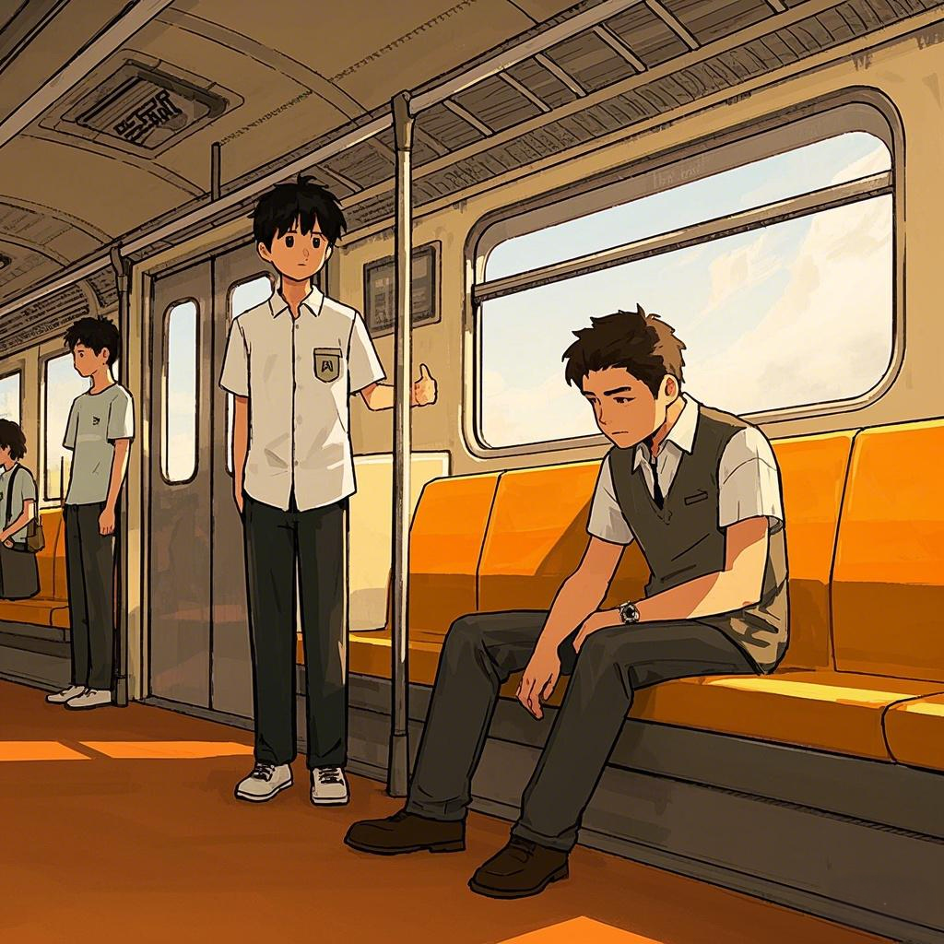
Free Talk
Imagine you are on the train near a man who seems to be in low spirits.
Explanation
What will you do？
Cause-effect：
Why will you do that?
Response:
If so, how will the man respond(action,emotion,speech)?
Process：
Then, what will you do next?

Slide 4

Reading Comprehension
Task 1.
Go through the whole passage and circle the main character,minor character, and the time.

Slide 5
My day started just like all the other days for the past 15 years where I get up, make some coffee, shower, get dressed, and leave for the train station at precisely 7:35 A.M. to arrive at work by 8:30. While on the train, I would always choose a seat away from the crowd so I could read the newspaper in peace and quiet.
At work, I am always burdened with questions from co-workers, suppliers, telephone calls, and then those dreaded meetings, so the last thing I need is some stranger to sit beside me and start small talk.
I don’t know why, but for some reason, when I got on the train today, it was unusually full. With hesitation, I sat down in the only seat available beside a middle-aged man who had his head down and seemed to be lost in his thoughts. I was glad that he didn’t notice when I sat next to him as he just continued to look down towards the floor.
Shortly after the train left for my 30-minute ride downtown, I found myself wondering what this man was thinking about. What could be so important that he didn’t even see me sitting next to him? I tried to forget about it and started to read my paper. However, for some strange reason, this “inner voice” kept prompting me to talk to this man. I tried to ignore the “voice” as there was no way I was starting a conversation with a complete stranger.
As you probably guessed, I eventually broke down and came up with an excuse to ask him a question. When he raised his head and turned his eyes toward me, I could see that he must have been really upset as he had red eyes and still had some tears rolling down the side of his face, despite his feeble attempt to wipe them away. I can’t describe the sadness I felt seeing someone in so much pain.
We talked for about 20 minutes, and in the end, he seemed to be doing better. As we were leaving the train, he thanked me heartily for being an “angel” by taking the time to talk. I never did find out what was making his heart so heavy with pain, but I was glad I listened to the “voice” that day.
Paragraph1 :Several weeks later, I found an envelope on my desk with the word “Angel” written on it.
Paragraph2:Deeply touched yet still shaken, I sat there holding the letter, feeling lucky that I followed my inner voice.

Slide 6



P3 Toady’s
train
P1 &2Daily
P4 30’ later
P5 eventually

Slide 7
P7 Several weeks later
P8 After reading the letter/before the desk
P6 After 20’ talking

Slide 8
Read Comprehension
Task 2.
Skim the whole passage to find the actions and emotions of the two characters.

Slide 9
Mark the actions in this part and analyze what emotions conveyed .
P1 My day started just like all the other days for the past 15 years where I get up, make some coffee, shower, get dressed, and leave for the train station at precisely 7:35 A.M. to arrive at work by 8:30. While on the train, I would always choose a seat away from the crowd so I could read the newspaper in peace and quiet.
P2At work, I am always burdened with questions from co-workers, suppliers, telephone calls, and then those dreaded meetings, so the last thing I need is some stranger to sit beside me and start small talk.

Slide 10
Mark the actions in this part and analyze what emotions conveyed .
P1 My day started just like all the other days for the past 15 years where I get up, make some coffee, shower, get dressed, and leave for the train station at precisely 7:35 A.M. to arrive at work by 8:30. While on the train, I would always choose a seat away from the crowd so I could read the newspaper in peace and quiet.
P2At work, I am always burdened with questions from co-workers, suppliers, telephone calls, and then those dreaded meetings, so the last thing I need is some stranger to sit beside me and start small talk.

Slide 11
Mark the actions in this part and analyze what emotions conveyed .
P1 My day started just like all the other days for the past 15 years where I get up, make some coffee, shower, get dressed, and leave for the train station at precisely 7:35 A.M. to arrive at work by 8:30. While on the train, I would always choose a seat away from the crowd so I could read the newspaper in peace and quiet.
P2At work, I am always burdened with questions from co-workers, suppliers, telephone calls, and then those dreaded meetings, so the last thing I need is some stranger to sit beside me and start small talk.
daily routines

Slide 12
Mark the actions in this part and analyze what emotions conveyed .
P1 My day started just like all the other days for the past 15 years where I get up, make some coffee, shower, get dressed, and leave for the train station at precisely 7:35 A.M. to arrive at work by 8:30. While on the train, I would always choose a seat away from the crowd so I could read the newspaper in peace and quiet.
P2At work, I am always burdened with questions from co-workers, suppliers, telephone calls, and then those dreaded meetings, so the last thing I need is some stranger to sit beside me and start small talk.
daily routines
reluctant to converse/pursue solitude/indifferent to others

Slide 13
Mark the actions in this part and analyze what emotions conveyed .
P1 My day started just like all the other days for the past 15 years where I get up, make some coffee, shower, get dressed, and leave for the train station at precisely 7:35 A.M. to arrive at work by 8:30. While on the train, I would always choose a seat away from the crowd so I could read the newspaper in peace and quiet.
P2At work, I am always burdened with questions from co-workers, suppliers, telephone calls, and then those dreaded meetings, so the last thing I need is some stranger to sit beside me and start small talk.
daily routines
reluctant to converse/pursue solitude/indifferent to others

Slide 14
Mark the actions in this part and analyze what emotions conveyed .
P1 My day started just like all the other days for the past 15 years where I get up, make some coffee, shower, get dressed, and leave for the train station at precisely 7:35 A.M. to arrive at work by 8:30. While on the train, I would always choose a seat away from the crowd so I could read the newspaper in peace and quiet.
P2At work, I am always burdened with questions from co-workers, suppliers, telephone calls, and then those dreaded meetings, so the last thing I need is some stranger to sit beside me and start small talk.
daily routines
reluctant to converse/pursue solitude/indifferent to others
burdened
explain
Tip1. Pay attention to the cause-effect when reading.

Slide 15
Emotion
in low spirit
Action
head down/lost in thought
P3 Toady’s
train
P1 &2Daily
P4 30’ later
P5 eventually
Action
Daily routines/thoughts
sat beside a man
Emotion
reluctant to converse
indifferent to others
glad
narrative skills
Detailed description of actions& emotions

Slide 16
What does the author want to convey by the marked words?
P3 I don’t know why, but for some reason, when I got on the train today, it was unusually full. With hesitation, I sat down in the only seat available beside a middle-aged man who had his head down and seemed to be lost in his thoughts. I was glad that he didn’t notice when I sat next to him as he just continued to look down towards the floor.

Slide 17
What does the author want to convey by the marked words?
I don’t know why, but for some reason, when I got on the train today, it was unusually full. With hesitation, I sat down in the only seat available beside a middle-aged man who had his head down and seemed to be lost in his thoughts. I was glad that he didn’t notice when I sat next to him as he just continued to look down towards the floor.
sustain curiosity and tension with creating a suspense

Slide 18
What does the author want to convey by the marked words?
I don’t know why, but for some reason, when I got on the train today, it was unusually full. With hesitation, I sat down in the only seat available beside a middle-aged man who had his head down and seemed to be lost in his thoughts. I was glad that he didn’t notice when I sat next to him as he just continued to look down towards the floor.
sustain curiosity and tension with creating a suspense
Strengthen the character’s personality with internal monologue
Tip2. Suspense and internal monologue are two crucial narrative skills.

Slide 19
Emotion
in low spirit
Action
head down/lost in thought
P3 Toady’s
train
P1 &2Daily
P4 30’ later
P5 eventually
Action
Daily routines/thoughts
sat beside a man
Emotion
reluctant to converse
indifferent to others
glad
narrative skills
Detailed description of actions& emotions
suspense
internal monologue

Slide 20
What emotions are conveyed here?
What the inner voice might be?
Shortly after the train left for my 30-minute ride downtown, I found myself wondering what this man was thinking about. What could be so important that he didn’t even see me sitting next to him? I tried to forget about it and started to read my paper. However, for some strange reason, this “inner voice” kept prompting me to talk to this man. I tried to ignore the “voice” as there was no way I was starting a conversation with a complete stranger.

Slide 21
What emotions are conveyed here?
What the inner voice might be?
Shortly after the train left for my 30-minute ride downtown, I found myself wondering what this man was thinking about. What could be so important that he didn’t even see me sitting next to him? I tried to forget about it and started to read my paper. However, for some strange reason, this “inner voice” kept prompting me to talk to this man. I tried to ignore the “voice” as there was no way I was starting a conversation with a complete stranger.

Slide 22
What emotions are conveyed here?
What the “inner voice” might be?
Shortly after the train left for my 30-minute ride downtown, I found myself wondering what this man was thinking about. What could be so important that he didn’t even see me sitting next to him? I tried to forget about it and started to read my paper. However, for some strange reason, this “inner voice” kept prompting me to talk to this man. I tried to ignore the “voice” as there was no way I was starting a conversation with a complete stranger.
conflicting/struggling
symbolize author’s empathy and kindness

Slide 23
really upset/painful
Emotion
in low spirit
raised his head;turn red eyes to me;tears rolling down;attempt to wipe away
Action
head down/lost in thought
P3 Toady’s
train
P1 &2Daily
P4 30’ later
P5 eventually
Action
Daily routines/thoughts
sat beside a man
kept wondering
start a conversion
Emotion
reluctant to converse
indifferent to others
curious
hesitant
self-controlled
feel the sadness beyond description
glad
narrative skills
Detailed description of actions& emotions
suspense
internal monologue
Detailed description of actions& facial expressions amd thoughts
internal monologue
symbolism

Slide 24
better mood
grateful
Emotion
Action
thanked me heartily
P7 Several weeks later
P8 After reading the letter/before the desk
P6 After 20’ talking
Action
leave the train
Emotion
glad/content/feel lucky
narrative skills
symbolism

Slide 25
What does “angel” symbolize?
small kindness/timely helper/temporary companion
What makes the author feel glad again?
We talked for about 20 minutes, and in the end, he seemed to be doing better. As we were leaving the train, he thanked me heartily for being an “angel” by taking the time to talk. I never did find out what was making his heart so heavy with pain, but I was glad I listened to the “voice” that day.

Slide 26
What does “angel” symbolize?
small kindness
What makes the author feel glad again?
For others
Alleviated the man's Pain Received heartfelt gratitude
We talked for about 20 minutes, and in the end, he seemed to be doing better. As we were leaving the train, he thanked me heartily for being an “angel” by taking the time to talk. I never did find out what was making his heart so heavy with pain, but I was glad I listened to the “voice” that day.
For himself
Followed inner voice, stepping out of the comfort zone, Experienced personal growth
Felt a sense of bond and self-worth
Theme
With following our inner voice, a random act of kindness not only brought comfort to the other person but also allowed me to experience a sense of meaning and warmth.
Tip3. The theme can be derived by analyzing symbolism, personal growth, and character’s emotions.

Slide 27
better mood
grateful
Emotion
Action
thanked me heartily
P7 Several weeks later
P8 After reading the letter/before the desk
P6 After 20’ talking
Action
leave the train
found an envelope with the word “Angel” written on it
I sat there holding the letter
Emotion
glad/content/feel lucky
Deeply touched yet still shaken
felt lucky that I followed my inner voice.
narrative skills
symbolism

Slide 28

Predict the plot
Task 3.
Come up with logical questions as many as possible, according to the following tips.

Slide 29

Five tips of predicting the plot
Focus on the main character, and use the minor character if we need.
To make the story logical and vivid, we’d better write the actions,emotions,thoughts and speech of the characters by emloying the ARE principle, especally the three linking sentences.
Consider the theme and narrative skills, especially the symbolism,and foreshadowing.
The plot of the story is often from negative to positive.
Repetition is an effective way to make the writing coherent.

Slide 30
Paragraph1 :Several weeks later, I found an envelope on my desk with the word “Angel” written on it.
第一段主角:the man’s letter
Linking1:What would I do next?
Open it.(action,emotion)
Linking2:What was written in the letter ?
elabortated on his pain
tell me what he terrible things would happen if he hadn’t met me
tell me the significant impact I had on him
expressd his heartfelt gratitude to me—call me “Angel”again
shocked
？
touched/impressed
Paragraph2:Deeply touched yet still shaken, I sat there holding the letter, feeling lucky that I followed my inner voice.
？
someting terrible might have happened to that man if I didn’t follow my inner voice to help him

Slide 31
Paragraph2:Deeply touched yet still shaken, I sat there holding the letter, feeling lucky that I followed my inner voice.
第二段主角: “I”
Link3:What did I think of the inner voice？
What would I do/say/think after reading this letter?
What’s my action in the long run?
its true meaing(★echo the symbolism of inner voice )
action;inner thoughts
reach out to others
Ending/theme
kindness(★echo the symbolism of Angel)

Slide 32

Appreciate the
sample writing

Slide 33
Appreciate the sample writing
Several weeks later, I found an envelope on my desk with only the word “Angel” written on it. ‌Curious and slightly puzzled, I opened it and found a heartfelt letter from the man I had met on the train that day. ‌In his letter, he thanked me for taking the time to talk to him when he was at his lowest. ‌He shared that he had been facing overwhelming personal struggles and had even considered ending his life that very day. ‌My simple act of reaching out, he wrote, had reminded him that there were still people who cared, and it gave him the strength to keep going. ‌The letter closed with words that touched me deeply: “You were the angel I needed. God heard my prayer and sent you at just the right time.”
细节描写‌（action;emotion）
‌信的内容关于（gratitude;pain）
我对他的影响（impact）
信的结尾文字（echo the theme）

Slide 34
Appreciate the sample writing
Deeply touched yet still shaken, I sat there holding the letter, feeling lucky that I followed my inner voice. I had almost ignored that “inner voice” urging me to speak to him, but now I understood why I hadn’t.It was a small act, but it was indeed a calling of my inner kindness, which had made a significant difference in his life. From that day on, I promised myself to always listen to that quiet voice within, especially when it nudged me to show kindness or reach out to someone in need even there was no apparent reason. Sometimes, a few minutes of our time can mean the world to someone else, and perhaps, in our own small way, we can all be someone’s “angel.”
回应伏笔‌（呼应前文“内在声音”的挣扎）
反思（微小善举改变人生）
结尾个人成长（呼应内在声音和主题）
象征与主题升华（echo the theme）

Slide 35

Thank you!

