Slide 1


感恩遇见，相互成就，本课件资料仅供您个人参考、教学使用，严禁自行在网络传播，违者依知识产权法追究法律责任。
更多教学资源请关注
公众号：溯恩英语
知识产权声明

Slide 2
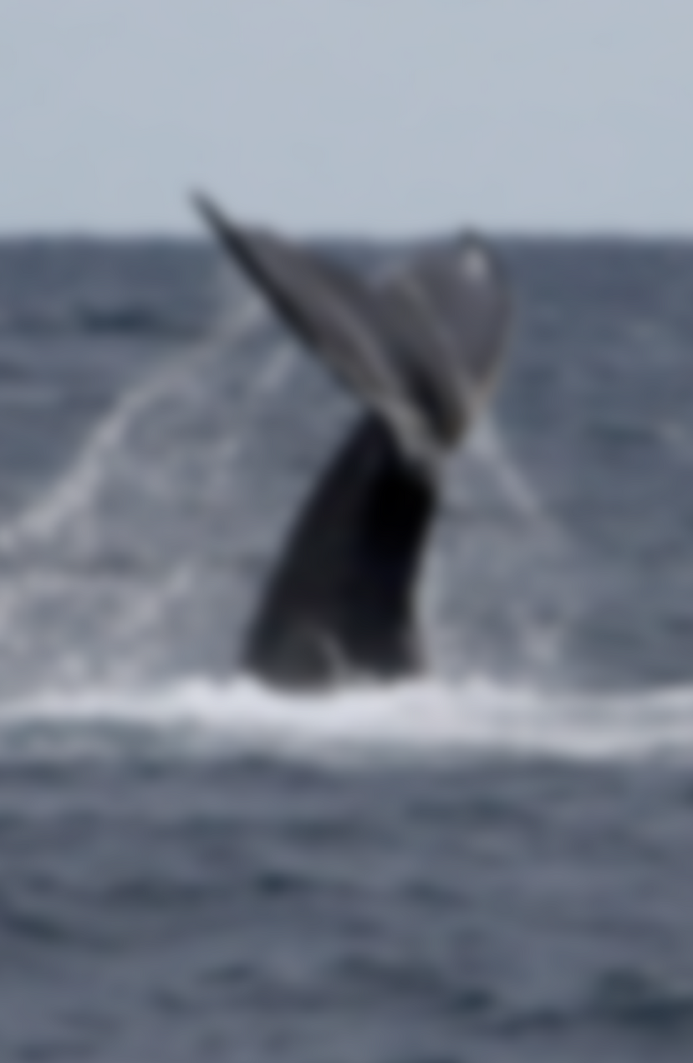
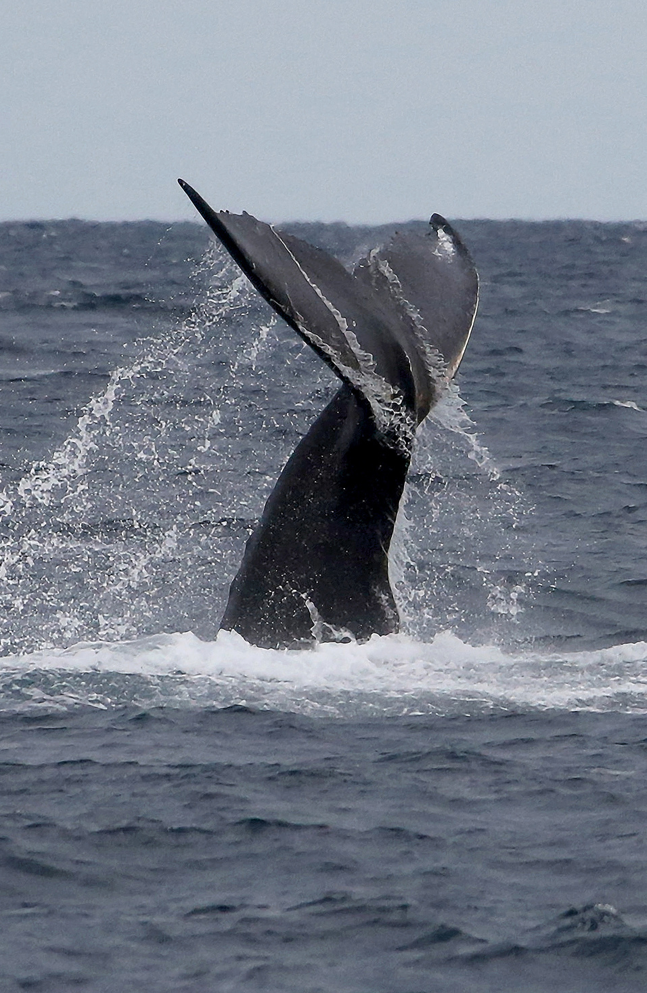
People need nature
宁波十校
保护海洋倡议书
From problems to solutions
2025.3.13 Fay

Slide 3
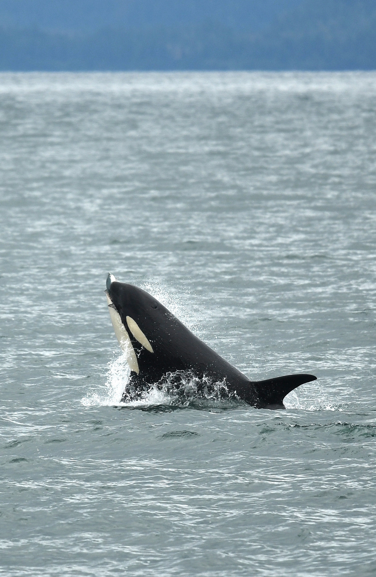
A letter of proposal
The main structure
opening
Purpose\
Background
Promote an initiative
Main body
Activities
Measures
Suggestions
Significance
Impact
closing
Reaffirm the call

Slide 4
文体类型
目标受众
语言风格
篇章结构
内容要点
倡议书
全体师生
正式得体
三段式
面临问题—具体做法---重要性+再次呼吁
时态
语气
人称
一般现在/将来
严肃正式
We、 it
审 题
OCEAN CONSERVATION
假设你是某中学学生会主席李华，你校即将举办一次以 “保护海洋”为主题的宣传活动。请你以学生会的名义，用英语写一封倡议书，号召全校师生积极参与保护海洋的行动。内容包括：
1.当前海洋面临的主要问题；
2.保护海洋的具体做法。
From problems
to solutions
problems
Main body
Measures/solutions/suggestions

Slide 5
Structure 1
Para1: problem statement and call to action
Para2: measures + significance（reasons）
Para3: conclusion + renew the appeal
Structure 1
Para1: background information and call to action
Para2: problem statements +measures + significance（reasons）
Para3: conclusion + renew the appeal
审 题
OCEAN CONSERVATION
假设你是某中学学生会主席李华，你校即将举办一次以 “保护海洋”为主题的宣传活动。请你以学生会的名义，用英语写一封倡议书，号召全校师生积极参与保护海洋的行动。内容包括：
1.当前海洋面临的主要问题；
2.保护海洋的具体做法。
From problems
to solutions
problems
Main body
Measures/solutions/suggestions

Slide 6
review
你校即将举办一次以 “保护海洋”为主题的宣传活动
Background information
活动公告开头
活动目的说明
活动主题介绍
We are excited/thrilled to announce an upcoming event at our school...
Join us for a special event focusing on…
Mark your calendars! Our school is hosting a special event focused on …
Get ready to dive into the world of ocean conservation! Our school is…
This event aims to inspire action towards..
The purpose/goal of this event is to…
This event is designed to…/seeks to highlight…
With the purpose/objective/aim/intension of…; in order to…; aiming to…; to raise…
With a focus on …
With the theme of …; themed with…
The theme/ focus of this event is…
"Protecting Our Oceans" is not just a theme—it’s a call to action.
...

Slide 7

opening
Get into the topic
Draw the attention
We are facing an alarming situation where...
It has come to our attention that...
Recent studies have revealed that...
Unfortunately, the issue of... is becoming increasingly urgent.
There is a growing concern over...
The problem of... cannot be ignored any longer.
Given that nowadays a serious issue about ……stand out, it’s high time that we should respond to ……
Call to action
It’s high time that …
…appeal to/call on/advocate…
We urge everyone to...
It's time for us to...
We must act now to...
We are launching an initiative to...
Together, we can make a difference in...
……

Slide 8
Main body
当前海洋面临的主要问题
From causes to effects
problem statement
Human activities
污染
pollution
过渡捕捞
Overfishing
栖息地破坏
Habitat Destruction
海洋垃圾---marine litter 塑料污染---Plastic Pollution 噪音污染---Noise Pollution
化学物质---Chemicals …
The effect
Impact on Marine Ecosystems
Impact on Marine Life
Impact on humans
Impact on the Planet's Future
Destroy balance of marine ecosystems, leading to a loss of biodiversity.
Nature cause
threat species’ survival and even be pushed to die out/extinct
气候变化
climate change
海洋酸化
Ocean Acidification
…
Affect food security, human’s health and the livelihood of fishers
lead to even greater environmental crises
Pose a threaten to the sustainable development.

Slide 9


Main body
★Measures/suggestions
保护海洋的具体做法
倡议对象：全校师生
Reducing Plastic Use----using reusable shopping bags and water bottles instead of single-use plastics ; Participate in Beach Cleanups; Minimize Chemical Use
Saving energy---choose eco-friendly transportation; reduce our carbon footprint;
use energy-efficient appliances; turn off the light timely;…
Raising Awareness---Learn about ocean conservation and share this knowledge with family and friends.
个人行为
Individual Action
集体行为
Collective Actions
Starting with Actions
Raising awareness
Community/school Initiatives: Engage in the ocean conservation events; Volunteer for ocean research or conservation projects.
Policy Advocacy: Support and advocate for policies and regulations that favor ocean conservation;
Public Awareness Campaigns: raise public consciousness about ocean conservation by social media, public speaking, and campaigns; spread knowledge about ocean conservation and inspire more people to take action.
Influencing others

Slide 10

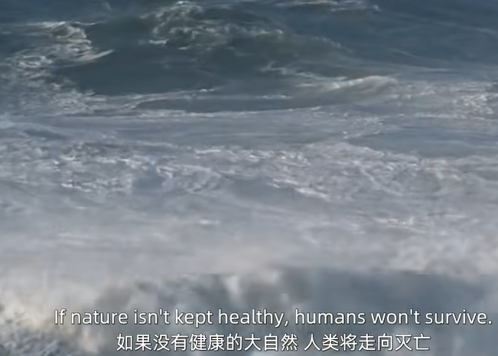

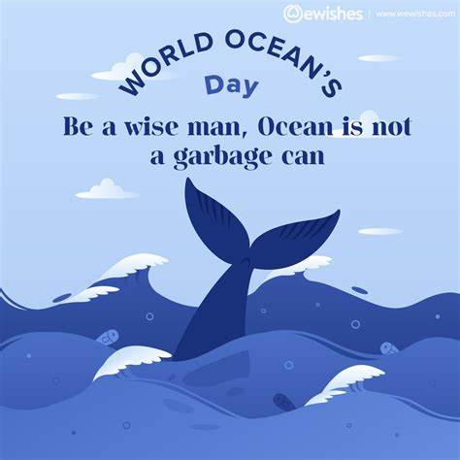
closing
Conclusion and highlight

Slide 11
Call for action
Expression review
Propose measures
Recently, the problem of...has aroused people’s concern. Thus , it is high time that we did sth.
Aiming to enhance awareness of …, I’m writing to call on everyone to…
Effective measures should be taken before things get worse.
Without doubt, it’s high time that immediate measures should be taken to change the present situation.
We should spare no effort to ...because only in this way can we...
Let’s join our hands and take immediate actions to ....
I’m here again to make an appeal to all of us to…. Only with joint effort can…
Actions speaker louder than words.
Small actions make a big difference!
To address this issue, we suggest...
A practical step would be to...
It would be beneficial/a great idea to...
…is highly recommended.
We should take immediate action by...
Only by … can …
…

Slide 12
Dear teachers and students,
As we all know, the ocean is the origin of life, but we are now facing an alarming situation where our oceans are under severe threat due to pollution, overfishing, and habitat destruction. Therefore, it is high time that we took immediate action to protect our oceans.
To protect the ocean, we can start with small actions. First, reduce plastic use by switching to reusable bags and bottles, which helps minimize waste and prevent plastic pollution in our oceans. In addition, saving energy is another crucial step—we can choose eco-friendly practices n like cycling or walking and make it a habit to turn off lights and appliances when not in use. Lastly , we should learn more about ocean conservation and share this knowledge with family and friends to raise the public awareness of environmental protection.
Remember, actions speak louder than words. Let’s join hands to create a sustainable and vibrant future for our oceans and our planet.
The Students' Union
Dear teachers and students,
In pursuit of cultivating students' awareness of environmental protection, our school will host an activity themed on Ocean Protection. I am excited to invite every student and teacher to join us in this important initiative to protect our oceans.
Currently, our oceans are facing serious challenges due to global warming and human activities. Rising sea levels threaten coastal areas, while pollution and habitat destruction harm marine ecosystems. To address these issues, we must take immediate action. First, we can participate in beach clean-ups to remove trash and prevent it from entering the ocean. Second, we should avoid dumping waste or chemicals into waterways, as these pollutants directly harm marine life. Finally, raising awareness about ocean protection is essential—by sharing knowledge and inspiring others, we can collectively take responsibility for safeguarding our oceans.
In conclusion, protecting the ocean requires everyone's effort. Let’s join hands and take action now to ensure a healthier and more sustainable future for our oceans and our planet.
The Students' Union
Structure 1
Para1: problem statement and call to action
Para2: measures + significance（reasons）
Para3: conclusion + renew the appeal
Structure 1
P1: background information and call to action
P2: problem statements +measures +（reasons）
Para3: conclusion + renew the appeal

Slide 13

Dear teachers and students,
As we all know, the ocean is vital to our planet, which provides us with food, regulates the climate, and supports a rich marine ecosystem. However, our oceans are facing serious threats, such as pollution, plastic waste, and overfishing, endangering marine life and our future.
To protect the ocean, it is highly recommended that immediate action be taken. First, reduce the use of disposable products and recycle waste accordingly. Second, allowing for the critical situation of marine lives, we are supposed to support sustainable fishing practices and avoid consuming endangered species. Lastly, spreading awareness about the importance of ocean conservation is on high agenda.
Let's work together to protect our oceans for a healthier and more sustainable future!
The Students' Union
官方范文

Slide 14
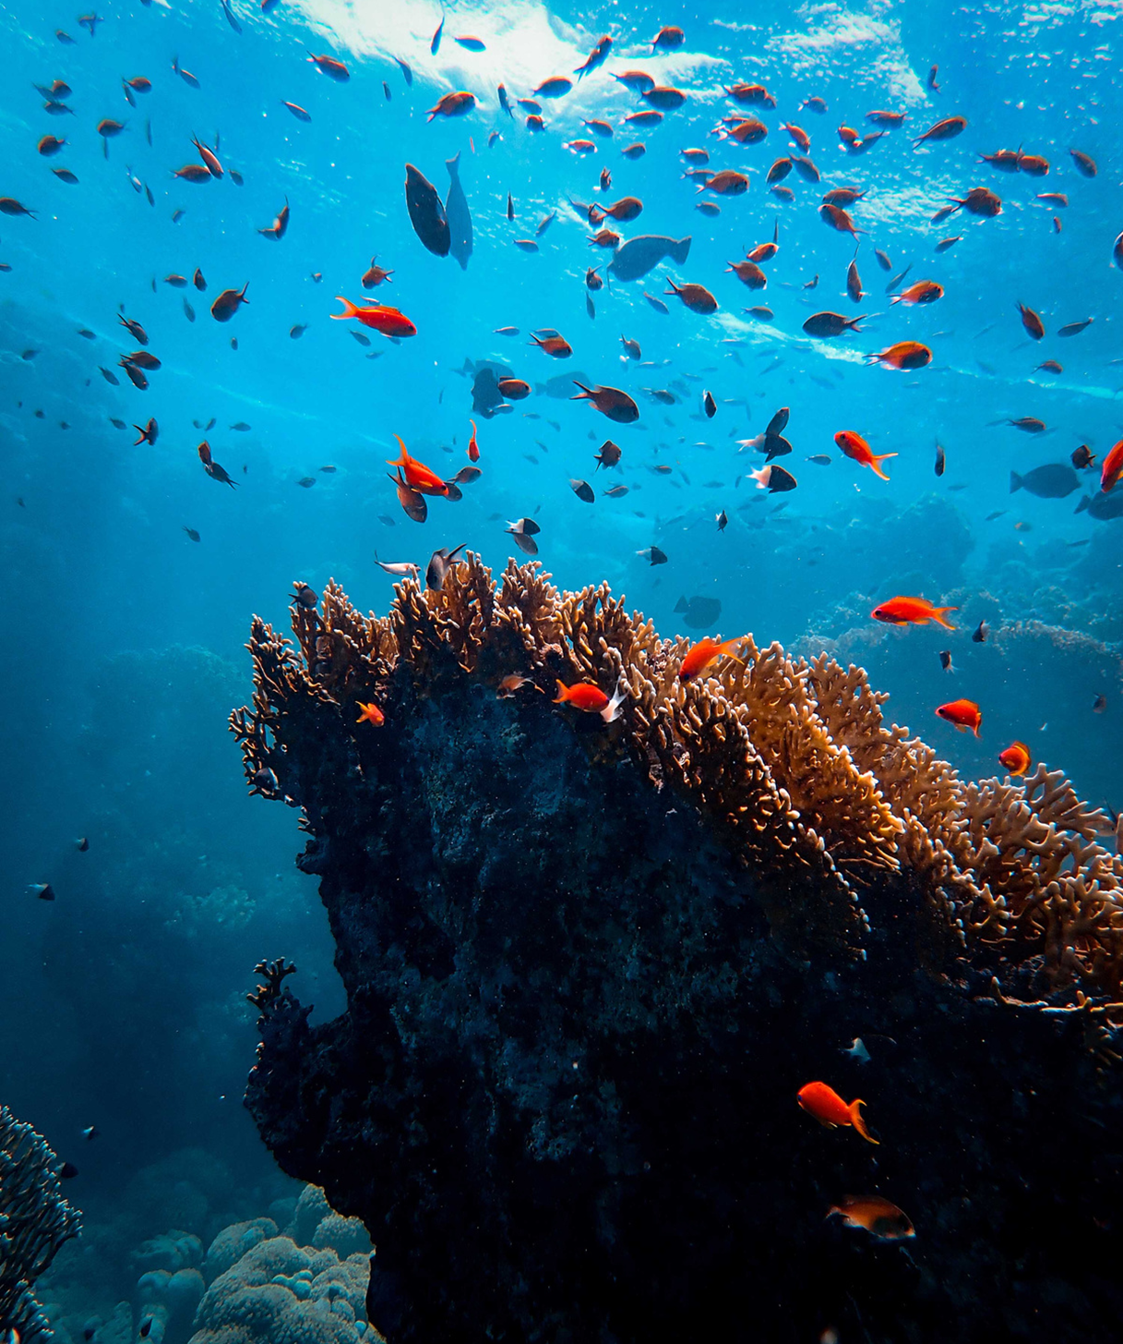
谢谢观看
THANK YOU

Slide 15
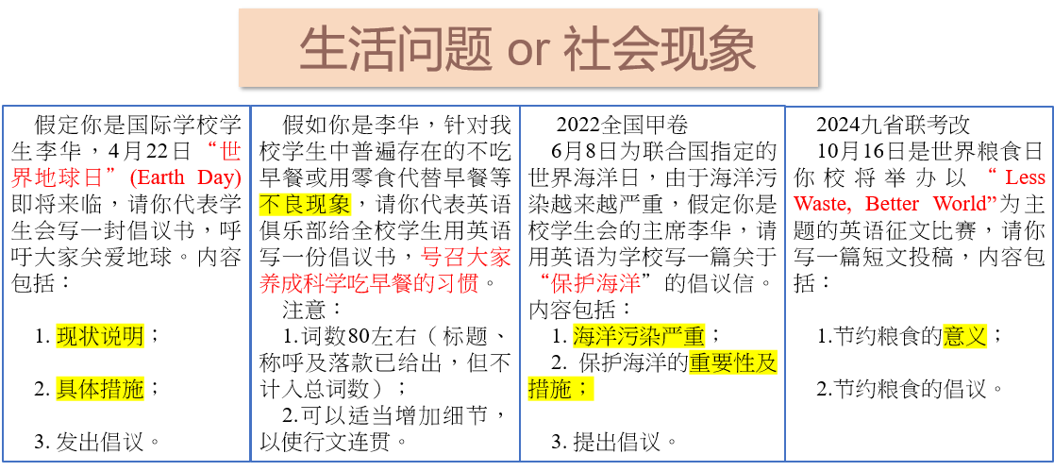
拓 展

Slide 16
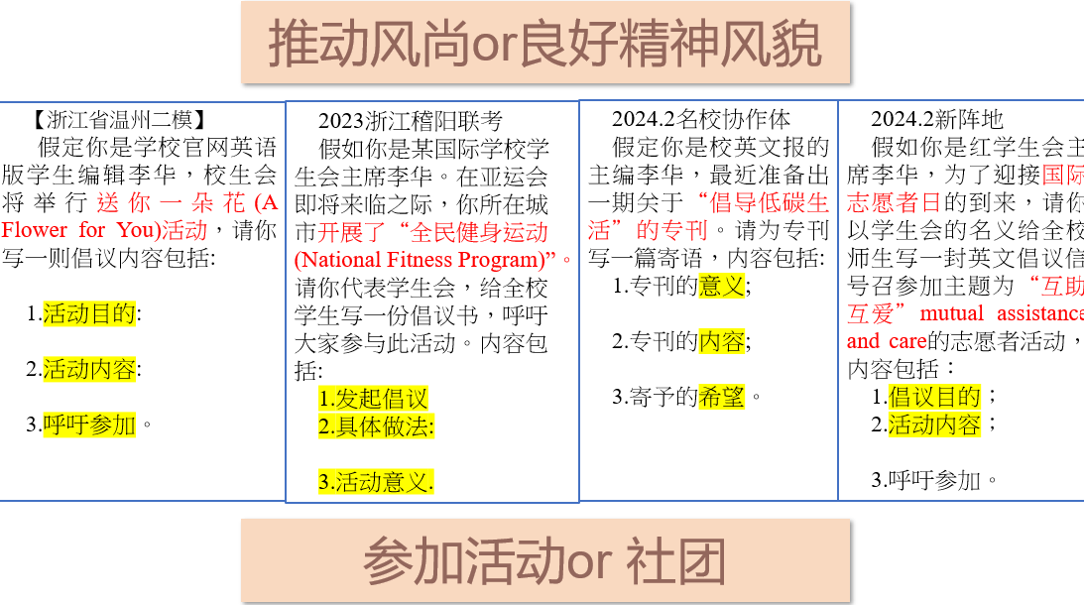
拓 展

Slide 17
Dear fellow students,
With Earth Day approaching, I firmly advocate everyone to care about the planet we live on.
Endless human demand for resources accounts for a dramatic rise in carbon emission, bringing the global temperature to an unprecedented level. It’s urgent for us to adopt a low-carbon lifestyle. Not only should we choose public transport instead of private vehicles, but we also need to apply energy-efficient equipment.
Our Mother Earth is severely “sick”. It’s high time we acted to “heal” the world. With joint efforts, she is bound to regain her vigor!
Students’ Union
2022.2名校协作体
假定你是国际学校学生李华，4月22日“世界地球日”(Earth Day)即将来临，请你代表学生会写一封倡议书，呼吁大家关爱地球。内容包括：
1. 现状说明；
2. 具体措施；
3. 发出倡议。
范文参考

Slide 18
【修改版高分考场作文】
Dear Readers,
Intended to appeal for more attention to the worsening climate change and promote various ways to ease the problem, we School English Weekly is scheduled to make a specific edition concerning “Advocating Low-Carbon Life”.
In this edition, the definition of green and low-carbon lives will be illustrated in a completely new perspective. Based on the climate crisis nowadays several students will share their solutions and give vivid practical experiences in their lives, showcasing how simple and how easy you can contribute to less carbon emission. In the following tech column, we’ll present you with some cutting-edge inventions that reduce carbon in the air, to boost our confidence in fighting climate change by living a low-carbon life.
Numerous options to live green are there for you to discover. Wish every reader could gain some inspiration on their way to carbon-free.
Dear Readers,
As the chief editor of our school’s English newspaper, I’m pleased to introduce our latest issue focused on advocating a low-carbon lifestyle. This edition’s significance lies in its aim to inspire a commitment to environmental conservation among us.
Featuring articles on the benefits of reducing carbon emissions, tips on sustainable living, and success stories of individuals and communities making a real difference, we provide a comprehensive guide to eco-friendly practices.
We aspire for this issue to serve as a catalyst for positive change, encouraging everyone to take actionable steps towards a greener future.
Warm regards,
Li Hua
Editor-in-chief
2024.2名校协作体
假定你是校英文报的主编李华，最近准备出一期关于“倡导低碳生活”的专刊。请为专刊写一篇寄语，内容包括:
1.专刊的意义;
2.专刊的内容;
3.寄予的希望

Slide 19
Dear fellow students,
With the approach of the Asian Games, The National Fitness Program is proceeding with full vigor(正在如火如荼地进行). Here, on behalf of the Student Union, I strongly advocate that every student should take an active part in it.
Initially, working out for one hour every day tops the list of my recommendation, during which time you can jog, walk or swim. Besides, it is also advisable to grasp/develop a sport skill, such as playing table tennis and basketball. You are also supposed to join a sport club in our school, where not only can you make more friends but also sharpen your excellent skills.
Let’s work out and keep moving. You can build up your body, strengthen your willpower and fully appreciate the unique charm of sports. After all, the greatest wealth is health.
The Student Union
2023浙江稽阳联考
假如你是某国际学校学生会主席李华。在亚运会即将来临之际，你所在城市开展了“全民健身运动 (National Fitess Program)”。请你代表学生会，给全校学生写一份倡议书，呼吁大家参与此活动。内容包括:
1.发起倡议
2.具体做法:
3.活动意义.

Slide 20
2024.2新阵地
假如你是红学生会主席李华，为了迎接国际志愿者日的到来，请你以学生会的名义给全校师生写一封英文倡议信，号召参加主题为“互助，互爱”mutual assistance and care的志愿者活动，内容包括：
1.倡议目的；
2.活动内容；
3.呼吁参加。
Dear teachers and schoolmates,
To celebrate the upcoming International Volunteer Day, we are appealing to all of you for the active participation of a volunteer campaign themed “mutual assistance and care”.
The campaign will fall on December 5th and various activities will be organized, ranging from visiting the local nursing home to bring the elderly residents fun and laughter to arranging a fundraising event for the local charity, where diverse handmade crafts and abundant second-hand items donated by the volunteers will be on sale. Through these activities, not only will the spirit of mutual assistance and care be promoted but also our sense of social responsibility will be nurtured.
We strongly advocate everybody making joint efforts to spread kindness and compassion for the betterment of our society.
the Students’ Union

