Slide 1



感恩遇见，相互成就，本课件资料仅供您个人参考、教学使用，严禁自行在网络传播，违者依知识产权法追究法律责任。
更多教学资源请关注
公众号：溯恩英语
知识产权声明

Slide 2
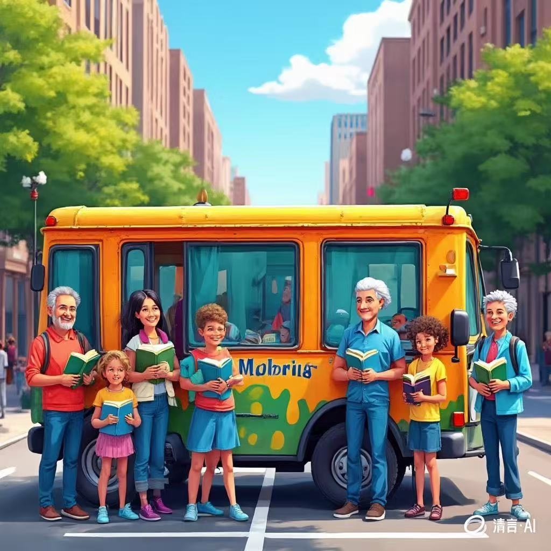
一封信，让图书馆“动”起来
---2025届-3 宁波十校联盟
人与社会+自我篇
郑素红

Slide 3

I never imagined that a single piece of paper could change my entire perspective on life. I was a librarian, a job that had defined my existence for over two decades. My days were spent among the quiet rows of books. I knew every corner of the library, every title on the shelves, and yet, I felt as if my own life was missing a chapter.
It was a typical Tuesday morning. I was sorting through a box of old donations, preparing to catalog some rare books, when I found a small, yellowed envelope between the pages of an ancient journal. It had no address, no stamp, and no indication of its origin. Curious, I carefully opened it.
The handwriting was elegant but faded, the ink barely visible against the paper. The letter read,
"Dear Stranger;
If you are reading this, know that you are not alone. Life has a way of making us feel isolated, as if our stories are insignificant. But every life matters. Every story is important. I hope the letter finds someone who needs to hear these words.
You are stronger than you think. You have the power to change your world, one small act at a time. Don't be afraid to take risks, to follow your dreams, and to embrace the unknown. The greatest journeys begin with a single step.
With hope,
A Friend"

Slide 4
I read the letter over and over, feeling a strange mix of emotions. The words resonated deeply within me, as if they were written specifically for me. I had always been content with my life, but lately, I felt a growing sense of restlessness. The library was my sanctuary(庇护所),but it had also become my prison. I had lost sight of my own dreams, my own story.
That evening, as I closed the library, I couldn't shake the feeling that the letter was a sign. I had always been cautious, preferring the safety of routine to the uncertainty of change. But the letter reminded me that life was meant to be lived, not just observed.
Paragraph 1:
The next morning, I walked into the library director's office, saying with resolution, "I have an idea."
Paragraph 2:
Weeks later, the moveable library program started, bringing libraries to different communities.

Slide 5
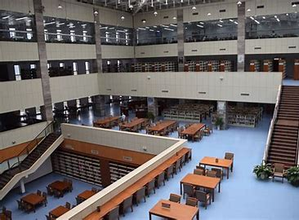
Read for elements
characters： I ( leading )
the library director; readers ( supporting)
2. narrative perspective: first -person
3. time： unknown
place： the library director’s office; moveable library; possible destinations of the moveable library
Event : A letter I came across when sorting through the books in the library redesigned my life and urged to pilot a moveable library programme.

Slide 6


5.
story
line
Climax
I was inspired by the letter and decided to change my routine , my life and even the world around me.
Para1: The next morning, I walked into the library director's office, saying with resolution, "I have an idea."
You are stronger than you think. You have the power to change your world, one small act at a time. Don't be afraid to take risks, to follow your dreams, and to embrace the unknown. The greatest journeys begin with a single step.
Para2:Weeks later, the moveable library program started, bringing libraries to different communities.
I was sorting through a box of old donations, preparing to catalog some rare books, when I found a small, yellowed envelope between the pages of an ancient journal.
background
Ending
Beginning

Slide 7

Read for clues and echoes
hidden clues | echoes
I never imagined that a single piece of paper could change my entire perspective on life. I was a librarian, a job that had defined my existence for over two decades. My days were spent among the quiet rows of books. I knew every corner of the library, every title on the shelves, and yet, I felt as if my own life was missing a chapter. | Only at that moment did I realize the meaning of being a librarian---bringing joy of reading and spreading knowledge.

Slide 8
Read for clues and echoes
hidden clues | echoes
You are stronger than you think. You have the power to change your world, one small act at a time. Don't be afraid to take risks, to follow your dreams, and to embrace the unknown. The greatest journeys begin with a single step. | 2. I was thrilled yet a little nervous with my first step out of my comfort zone, but the words from the letter echoed in my ears, giving me the courage and confidence to push forward. 3. The letter indeed guided me to rewrite my story, reinvent my life and change the world around me, one small act at a time.

Slide 9
Read for clues and echoes
hidden clues | echoes
I read the letter over and over, feeling a strange mix of emotions. The words resonated deeply within me, as if they were written specifically for me. I had always been content with my life, but lately, I felt a growing sense of restlessness. The library was my sanctuary(庇护所),but it had also become my prison. I had lost sight of my own dreams, my own story. | 4. I was no longer confined to the four walls of the old library, knowing that this was just the beginning of a much greater journey.

Slide 10
Read for clues and echoes
hidden clues | echoes
That evening, as I closed the library, I couldn't shake the feeling that the letter was a sign. I had always been cautious, preferring the safety of routine to the uncertainty of change. | 5. Watching these heart-touching interactions, I realized that I had taken that first step towards change, just like the letter had urged. 或者 I was thrilled yet a little nervous with my first step out of my comfort zone, but the words from the letter echoed in my ears, giving me the courage and confidence to push forward.

Slide 11
心理描写
神态描写
动作描写
外貌描写
环境描写
对话描写
语言
无灵主语
动作链
分词作状语
With 复合结构
独立主格
从句
倒装句
虚拟语气
强调句
长短句结合
考生构思情节的同时，要考虑合适的语言句式以及修辞

Slide 12
Plot the continuation story
Para1: The next morning, I walked into the library director's office, saying with resolution, "I have an idea."
Para2:Weeks later, the moveable library program started, bringing libraries to different communities.
Link1: What was the idea? What did the director think of it?
Body: How to build a moveable library?
Link2: What problem might emerge? How did I convince the director?
Link3: What did people in different communities do when seeing the moveable library? How did they feel?
Body: How did I feel about the moveable library program?
Ending: ① How did I reflect on this programme?
② What lesson did I learn from the experience?

Slide 13
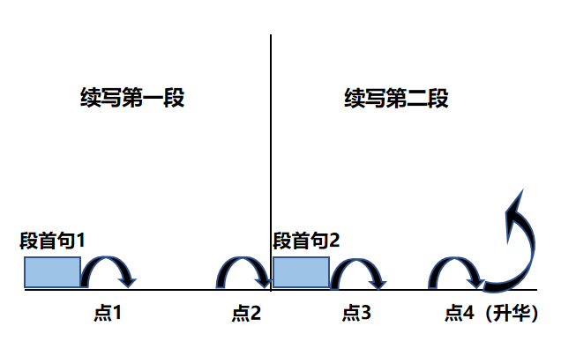
Plot Continuation
点1：位于续写第一段段首，流畅衔接前面的故事（常与原文最后一段呼应）和第一段段首语；
点2：位于续写第一段段尾，流畅衔接第二段段首句；
点3：位于续写第二段段首，续写衔接第二段段首语；
点4：文章结尾升华，给予读者正能量，揭示和强调主题。

Slide 14
Design link1
Para1: The next morning, I walked into the library director's office, saying with resolution, "I have an idea."
Link1A: (回扣首句 I have an idea+第二段首句moveable library阐述idea) Eagerly looking at him, I proposed starting a moveable library program. We could use an old van to transform into a traveling / mobile/ moveable library and bring books to communities that lacked easy access to reading resources.
Link1B: : (以首句director 为叙事对象） The director cast me a surprised look as if I were daydreaming of something ridiculous.

Slide 15
Design link2
Para1: The next morning, I walked into the library director's office, saying with resolution, "I have an idea.“
Para2:Weeks later, the moveable library program started, bringing libraries to different communities.
Link2 A: (最终馆长同意筹建移动图书馆) After a heated discussion, he finally nodded in agreement, giving me the green - light to start preparing.
Link2B: ( 馆长同意了，但是筹建工作也是困难重重的）I was thrilled yet a little nervous with my first step out of my comfort zone, but the words from the letter echoed in my ears, giving me the courage and confidence to push forward.

Slide 16
Design link3
Para2:Weeks later, the moveable library program started, bringing libraries to different communities.
Link3B: ( 移动图书馆进入社区的景象） As the van rolled into a small, rural neighborhood, children and adults alike rushed out with excitement.
Link3A: ( 读者的反响） Never had I expected that the response was overwhelming. Eyes sparkling with excitement, children explored the colorful picture books，flipping pages eagerly. Hands holding books tightly, elderly people reread stories that they had read a long time before.

Slide 17
Design ending
Para2:Weeks later, the moveable library program started, bringing libraries to different communities.
Ending A: (回扣信里面的具有哲理意义的语言结尾) The letter indeed guided me to rewrite my story, reinvent my life and change the world around me, one small act at a time.
Ending B: (感悟式结尾) I was no longer confined to the four walls of the old library, knowing that this was just the beginning of a much greater journey.

Slide 18
Para1: The next morning, I walked into the library director's office, saying with resolution, "I have an idea." Staring at the director with great passion, I proposed establishing a moveable library program. By doing so, we could take books to different communities, especially those lacking easy access to reading materials. Hearing my bold plan, the director was stunned, wearing a blank look on his face. Then I went on to explain how this could breathe new life into our library and reach people who might never set foot in our building. Time ticking away, he eventually agreed to let me pilot the project. I was thrilled yet a little nervous with my first step out of my comfort zone, but the words from the letter echoed in my ears, giving me the courage and confidence to push forward. (120)

Slide 19
Para2: That's when I noticed the Pumpkin Patch Closed sign.
Weeks later, the moveable library program started, bringing libraries to different communities. Never had I expected that the response was overwhelming. Eyes sparkling with excitement, children explored the colorful picture books and flipped pages eagerly. Hands holding books tightly, elderly people reread stories that they had read a long time before. People from the communities applauded us for our considerate programme. Scanning over our new readers, I saw how our simple act was changing lives, bringing joy and spreading knowledge. The library was no longer a static place; instead, it was a vibrant part of the community. Only at that moment did I realize the meaning of being a librarian. The letter indeed guided me to rewrite my story, reinvent my life and change the world around me, one small act at a time. (122)

Slide 20
Para1: The next morning, I walked into the library director's office, saying with resolution, "I have an idea." Eagerly looking at him, I proposed starting a moveable library program. We could use an old van to transform into a traveling / mobile/ moveable library and bring books to communities that lacked easy access to reading resources. At first, the director was hesitant and doubtful, citing concerns about cost and logistics. However, with a resolved attitude, I passionately shared with him how this could not only serve the community better but also breathe new life into our traditional library services. To convince him of my idea, I showed him detailed plans I'd drafted overnight, which was really beyond his expectation. After a heated discussion, he finally nodded in agreement, giving me the green - light to start preparing. (119)

Slide 21
Para2: Weeks later, the moveable library program started, bringing libraries to different communities. As the van rolled into a small, rural neighborhood, children and adults alike rushed out with excitement. I saw the joy in their eyes as they browsed through the shelves, selecting books they'd never had the chance to read before. One little girl, with a shy smile, picked up a fairy - tale book and couldn't put it down. Watching these heart-touching interactions, I realized that I had taken that first step towards change, just like the letter had urged. This new venture not only brought knowledge to others but also rekindled my own passion for life and work. I was no longer confined to the four walls of the old library, knowing that this was just the beginning of a much greater journey. (124)

Slide 22


