Slide 1



感恩遇见，相互成就，本课件资料仅供您个人参考、教学使用，严禁自行在网络传播，违者依知识产权法追究法律责任。
更多教学资源请关注
公众号：溯恩英语
知识产权声明

Slide 2





2025
金
Love your life
Pursue your dream
丽
衢
十二校联考
Fay
英语试题解析

Slide 3




语篇 | 体裁 | 话题 | 主要内容
 | 应用文 | Some best properties in Miami | 通过详细描述每处房产的特点、位置和价格，吸引潜在买家购买迈阿密的房产。
 | 记叙文 | the success of Frank Sterzer’s café | 主要介绍了Frank Sterzer从工程师转型为咖啡店老板，通过结合乡村的宁静与城市的便利，成功打造了一个受欢迎的咖啡品牌，并促进了当地经济的发展。。
 | 说明文 | The music album--Wild Concerto | Copeland通过将自然声音与音乐结合，创造出独特的音乐作品，旨在提高人们对濒危物种和噪音污染的意识。
 | 说明文 | Does AI have dementia? | 研究发现，AI模型在视觉和空间任务上表现较差，表现出类似早期痴呆的症状，尽管它们在记忆和注意力任务上优于人类。研究结果引发了关于AI与人类医生差异的讨论。
七选五 | 议论文 | Learn from Steve Jobs’ ---how to be creative | 通过分析史蒂夫·乔布斯的创造性思维，提出了如何培养创造力的建议。文章通过论点和论据（如好奇心、开放态度、正念等）来支持其观点.

Slide 4


阅读理解
详 解

Slide 5

A
Some best properties in Miami

Slide 6

A
Want to buy a house in Miami? Just click! Here are some best properties on the market this week: Homes in Miami.
Spring Garden
A 1920 Arts Crafts home, once belonged to a local hero: concert pianist and teacher Ruth Greenfield. The five-bedroom house has hardwood floors, a living room with central fireplace, an office with built-ins, and a kitchen-dining area with French doors to a roomy deck. The tropically landscaped double lot includes a big backyard and mature trees; parks, downtown, and Miami Beach are all nearby.
$2,750,000. Jackson Keddell, Douglas Elliman, (305)209-8066
South Miami
Ten minutes’ drive from the University of Miami and Fairchild Tropical Botanic Garden, this six-bedroom house is also walking distance to multiple local parks. The 2022 open- plan smart home comes with solar panels, EV chargers, an elevator, impact-resistant floor-to- ceiling sliders, a chef’s kitchen, a gym, and a sauna. Outside, enclosed by privacy foliage, are a lawn, patio, outdoor living space, and pool.
$6,950,000. Nathan Zeder, Coldwell Banker Realty, (786)252-4023
Coconut Grove
The Grove at Grand Bay is walking distance to parks, shops, and dining. This condo in the North Tower with four bedrooms plus staff quarters features floor-to-ceiling windows, steel art frames, wood and terrazzo floors, cement columns, and an open main space with a gourmet kitchen, wine refrigerator, and Biscayne Bay views through sliding doors to a balcony. Building amenities including parking, pools, and a playroom.
$7,985,000. Giorgio Vecchi and Dario Stoka, Douglas Elliman, (305)798-9300
Buena Vista
This organic-modern four-bedroom is a short walk from museums, Morningside Park, and the water. The 1960 open-plan house has beamed ceilings, polished concrete floors, bi-fold glass doors from the living room and primary bedroom to the wraparound deck, and a chef’s kitchen. Outside are a landscaped front and an expansive pea-gravel backyard surrounded by mature trees.
$1,695,000. IssamShalhoub, ONE Sotheby’s International Realty,(305)930-5805
21. Which is the best choice for eco-friendly tech buyers?
A. Spring Garden.
B. South Miami.
C. Buena Vista.
D. Coconut Grove.
22. What do the four properties have in common?
They are all once owned by celebrities.
B. They all feature smart facilities.
C. They are all designed in identical styles.
D. They all gain easy access to parks.
23. Where is the text probably from?
A travel journal.
B. A market analysis.
C. A commercial website.
D. A property assessment report.
gain easy access to parks
---nearby
---walking distance
---a short walk
A. 旅行日记。
B. 市场分析。
C. 商业网站。
D. 房产评估报告。

Slide 7
Just click!
Click here - 点击这里
Online exclusive - 网络专享
Web-only content - 仅限网络内容
Browse our site - 浏览我们的网站
Visit our website - 访问我们的网站
Sign up now - 现在注册
Download our app - 下载我们的应用程序
Check out our latest - 查看我们的最新内容
Follow us on social media - 在社交媒体上关注我们
Share this article - 分享这篇文章
Comment below - 在下方评论
Like and subscribe - 点赞并订阅
Stay updated - 获取最新信息
Register for free - 免费注册
A
An office with built-in
A kitchen-dining area
Landscaped double lot
Be enclosed by
Beam-ceilings
Bi-fold glass doors
Solar panels
EV chargers
Impact-resistant floor-to-ceiling sliders
内置办公室
厨房餐厅区域
双层园景地段
被……环绕
横梁天花板
折叠玻璃门
太阳能板
电动车充电器
防冲击的落地滑门
Some best properties in Miami
Property : n.
所有物，财产；地产，房地产；特性，性质

Slide 8
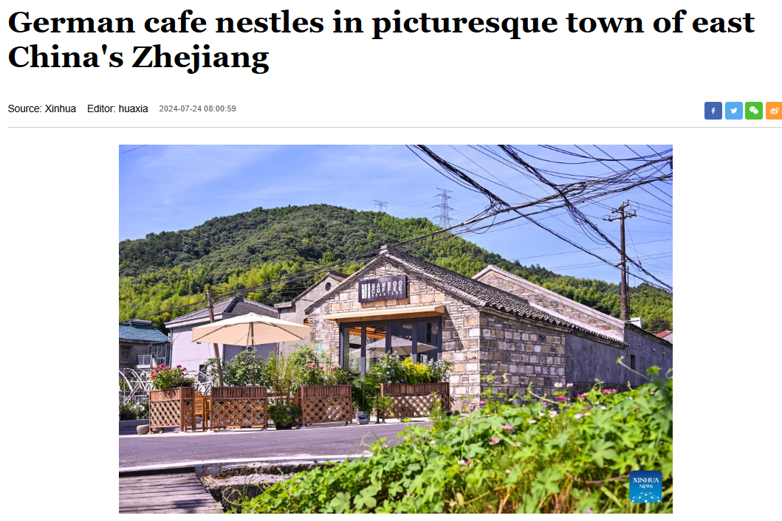
B
the success of Frank Sterzer’s café

Slide 9
B
1The rich aroma of freshly roasted coffee filled the air inside a quaint stone cabin in the eastern Chinese village that houses Frank Sterzer’s café: Bamboo Coffee Roasters.
2After more than 20 years as an engineer and executive with leading automobile companies in Germany and China, Frank has found a new calling and fulfillment in the village of Maoli near Ningbo in Zhejiang province. Inspired by his lifelong love of coffee, a passion for roasting beans prompted Frank to turn what had been a hobby into a thriving business. “Zhejiang’s countryside has excellent infrastructure and beautiful landscapes, and I find it the ideal place to start my business,” Frank says. Maoli is located less than a 30-minute drive from the Ningbo city center, striking a pleasing balance between urban convenience and rural tranquility.
3For Frank, the experience of sipping a cup of coffee while enjoying a slice of handmade cake and gazing at the countryside, captures the type of serene lifestyle he hopes to share with visitors. “Bamboo Coffee Roasters is a place to share the charm of this mountain village with visitors from all over the world,” he explains.
4The café is named after the abundance of bamboo around Maoli, while its logo was inspired by a photograph Frank took of a nearby bamboo forest. He has also created a small coffee factory behind the shop front, where excellent beans from around the world are neatly stacked next to gently humming roasting machines. He roasts 10 metric tons a year. All these have become key components of the café’s success.
5Since opening in June 2024, Bamboo Coffee Roasters has quickly become a popular destination, attracting visitors from near and far including international travelers taking advantage of China’s expanded visa-free policies. Frank’s own family took advantage of this policy, with his mother and siblings visiting last year.
6Before the Spring Festival, the café was welcoming guests from allover, including nearby cities like Hangzhou and Shanghai. “We came to Ningbo for local delicacies and business, purchasing local produce. Products such as honey oranges, bamboo shoots and tea have also found wider markets, thanks to the café’s popularity,” one tourist said.
Lead-in
The motivation
The Café's Philosophy
The Café’s details
The Café’s
Success
and Impact
Main idea: Frank Sterzer, a former automotive executive, transformed his passion for coffee into a thriving rural café, "Bamboo Coffee Roasters," blending serene countryside charm with global appeal and boosting local economic growth.

Slide 10
1The rich aroma of freshly roasted coffee filled the air inside a quaint stone cabin in the eastern Chinese village that houses Frank Sterzer’s café: Bamboo Coffee Roasters.
2After more than 20 years as an engineer and executive with leading automobile companies in Germany and China, Frank has found a new calling and fulfillment in the village of Maoli near Ningbo in Zhejiang province. Inspired by his lifelong love of coffee, a passion for roasting beans prompted Frank to turn what had been a hobby into a thriving business. “Zhejiang’s countryside has excellent infrastructure and beautiful landscapes, and I find it the ideal place to start my business,” Frank says. Maoli is located less than a 30-minute drive from the Ningbo city center, striking a pleasing balance between urban convenience and rural tranquility.
3For Frank, the experience of sipping a cup of coffee while enjoying a slice of handmade cake and gazing at the countryside, captures the type of serene lifestyle he hopes to share with visitors. “Bamboo Coffee Roasters is a place to share the charm of this mountain village with visitors from all over the world,” he explains.
4The café is named after the abundance of bamboo around Maoli, while its logo was inspired by a photograph Frank took of a nearby bamboo forest. He has also created a small coffee factory behind the shop front, where excellent beans from around the world are neatly stacked next to gently humming roasting machines. He roasts 10 metric tons a year. All these have become key components of the café’s success.
24. What made Frank set up the café in Maoli?
A. The village’s outstanding facilities and picturesque sceneries.
B. China’s expanded visa-free policies for international travelers.
C. Frank’s newly found enthusiasm for coffee and roasting beans.
D. The combination of urban convenience with rural booming industry.
25.What is Paragraph 4 mainly about?
A. The operation of Frank’s business. B. The hardships of running the business.
C. Origins of Bamboo Coffee Roasters. D. The vast profit earned from the business.
outstanding facilities
---excellent infrastructure
picturesque sceneries
---beautiful landscapes

Slide 11
5Since opening in June 2024, Bamboo Coffee Roasters has quickly become a popular destination, attracting visitors from near and far including international travelers taking advantage of China’s expanded visa-free policies. Frank’s own family took advantage of this policy, with his mother and siblings visiting last year.
6Before the Spring Festival, the café was welcoming guests from allover, including nearby cities like Hangzhou and Shanghai. “We came to Ningbo for local delicacies and business, purchasing local produce. Products such as honey oranges, bamboo shoots and tea have also found wider markets, thanks to the café’s popularity,” one tourist said.
26. Why is the tourist remark mentioned in the last paragraph?
A. To prove guests from allover promoted Frank’s business.
B. To tell us the popularity of Frank’s business enhanced local economy.
C. To share with readers the intense interest of tourists in exploring Ningbo.
D. To advertise for the local businesses to promote the sale of local produce.
27. Which of the following is the best title for the text?
A. An overnight celebrity: from engineer to business founder
B. Relaxing Coffee culture: a new trend of lifestyle in Zhejiang villages
C. A Perfect integration: the fragrance of coffee and the peace of rural life
D. Bamboo Coffee Roasters: a miracle of international investment in China
The text focuses on how Frank Sterzer’s café, Bamboo Coffee Roasters, combines the art of coffee roasting with the tranquility and beauty of rural life in Zhejiang.

Slide 12
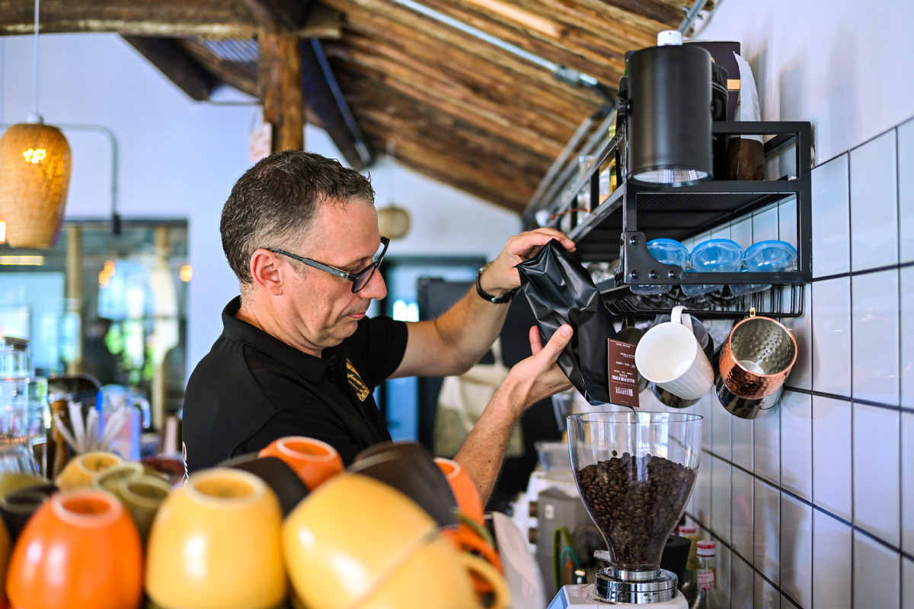
house: vt. 提供住所；容纳；存放
house + 人/物：“为……提供住所”或“容纳……”。
be housed in + 地点:“被安置在……”。
The collection is housed in the National Gallery.
produce: n.农产品，产物
fresh produce：新鲜农产品
local produce：本地农产品
organic produce：有机农产品
farm produce：农场产品
Be inspired by
A passion/enthusiasm for
A thriving business
Strike a balance between…
Be named after
Take advantage of
China’s expanded visa-free policy
Honey oranges
Bamboo shoots
Rural booming industry
An overnight celebrity
受到……的启发
对……的热情
蓬勃发展的生意
在……之间取得平衡
以……命名
利用
中国扩大的免签政策
蜜橘
竹笋
乡村蓬勃发展的产业
一夜成名的名人
produce农产品 U
product产品 C
production生产productivity生产力
Intergrate A with/into B
Combine A with/and B
Blend A with B
Mix A with B
Associate A with B
B

Slide 13

C
The music album--Wild Concerto

Slide 14
C
1Terns(燕鸥) chirping and wolves howling are among a pioneering composition that integrates sounds from nature with traditional instruments. Bird songs and animal calls will interact with orchestral music on an album by Stewart Copeland.
2Wild Concerto, released on 18 April, is a “cooperation between nature and music”. A croaking frog, a black-footed albatross(信天翁), and a red deer will “perform” with Copeland, alongside 30 musicians from the Kingdom Orchestra. Copeland said none of the natural recordings had been manipulated or retuned. “All the bird and animal sounds are exactly as they were, but I put them in positions so that they add up to a melody and rhythm,” he said. “ Their voices bring an super authenticity to the music. They all have their own individual melodies but when you put an instrument in, everything is more amazing.”
3Wild Concerto is inspired by the arctic tern’s migration from pole to pole, and creatures possibly encountered along the way. Copeland said there was a conservationist theme to the work. “Many of these species are endangered and their sounds could vanish in our lifetime. Through the Wild Concerto, their voices will be kept immortalized.”
4For six decades, he has captured sounds of the natural world, from rain-forests to deserts—recordings heard in natural history series such as Our Oceans and Blue Planet as well as about 150 films. With a document of almost 100,000 recordings he has been called “the David Attenborough of sound”. Copeland is a brilliant talent. He’s combined natural sounds and music seamlessly. This is another way for people to listen to nature.
5He hopes the album will raise awareness of creatures that are by noise pollution that their sounds cannot be captured cleanly: “Two-thirds of the species in my library are now basically extinct. Twenty-five or 30 years ago, when I wanted to record one hour of primitive sound, it took about three or four hours to do that with minimal editing, compared to 2,000 recording hours today, because there are so many man-made sounds in the environment...”
Introduction
—the album
From Artistic Innovation
From individual
specific details
about the album
The inspiration
&significance
Background on the Creator
to public
to Environmental Advocacy
Conclusion
---Call to action

Slide 15
1Terns(燕鸥) chirping and wolves howling are among a pioneering composition that integrates sounds from nature with traditional instruments. Bird songs and animal calls will interact with orchestral music on an album by Stewart Copeland.
2Wild Concerto, released on 18 April, is a “cooperation between nature and music”. A croaking frog, a black-footed albatross(信天翁), and a red deer will “perform” with Copeland, alongside 30 musicians from the Kingdom Orchestra. Copeland said none of the natural recordings had been manipulated or retuned. “All the bird and animal sounds are exactly as they were, but I put them in positions so that they add up to a melody and rhythm,” he said. “ Their voices bring an super authenticity to the music. They all have their own individual melodies but when you put an instrument in, everything is more amazing.”
Authenticity : the quality of being genuine or true.
28. What is the feature of the album Wild Concerto?
A. Integrating natural sounds with music perfectly.
B. Mixing bird songs with animal calls completely.
C. Producing super realistic bird songs and animal calls.
D. Making successful changes to bird songs and animal calls.
29. What does the underlined word “manipulated” in paragraph 2 mean?
A. Monitored. B. Analyzed. C. Matched. D. Edited.
Edit: to alter, adapt, or refine

Slide 16
3Wild Concerto is inspired by the arctic tern’s migration from pole to pole, and creatures possibly encountered along the way. Copeland said there was a conservationist theme to the work. “Many of these species are endangered and their sounds could vanish in our lifetime. Through the Wild Concerto, their voices will be kept immortalized.”
4For six decades, he has captured sounds of the natural world, from rain-forests to deserts—recordings heard in natural history series such as Our Oceans and Blue Planet as well as about 150 films. With a document of almost 100,000 recordings he has been called “the David Attenborough of sound”. Copeland is a brilliant talent. He’s combined natural sounds and music seamlessly. This is another way for people to listen to nature.
5He hopes the album will raise awareness of creatures that are by noise pollution that their sounds cannot be captured cleanly: “Two-thirds of the species in my library are now basically extinct. Twenty-five or 30 years ago, when I wanted to record one hour of primitive sound, it took about three or four hours to do that with minimal editing, compared to 2,000 recording hours today, because there are so many man-made sounds in the environment...”
30. What do we know about Copeland?
A. He was optimistic and hopeful about the wildlife situation.
B. He was indifferent and helpless about the noise pollution.
C. He expressed his great concern about the endangered species.
D. He demonstrated enormous passion about the success of the concert.
31.What does the author think of Copeland’s efforts?
A. Time-consuming and fruitless. B. Notable and remarkable.
C. Efficient and innovative. D. Meaningless and conventional.
Notable: deserving to be noticed or to receive attention ; important
Remarkable: worthy of being noticed; uncommon or extraordinary

Slide 17
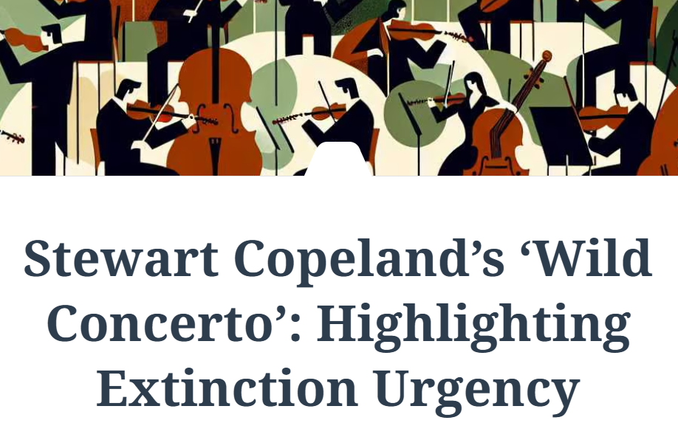
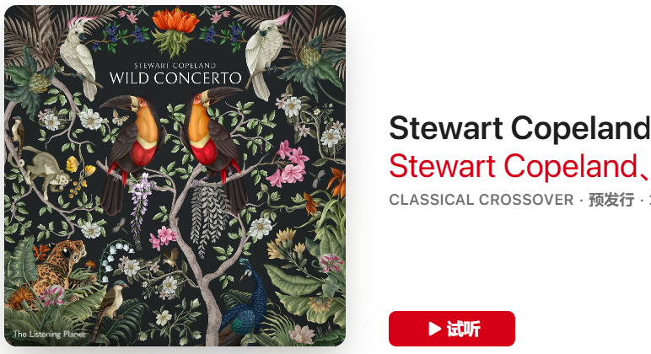
Integrate… with
Interact with
Add up to
A conservationist theme
Keep immortalized
Raise awareness of
将……与……融合
与……互动
加起来形成
保护主义主题
永垂不朽
提高……的意识
耗时的
徒劳的
显著的
显著的/非凡的
高效的
创新的
无意义的
传统的
Time-consuming
Fruitless
Notable
Remarkable
Efficient
Innovative
Meaningless
Conventional
vanish vi.消失；突然不见
vanish without a trace消失的无影无踪
The ancient civilization vanished without leaving any written records.
C
Wild Concerto

Slide 18
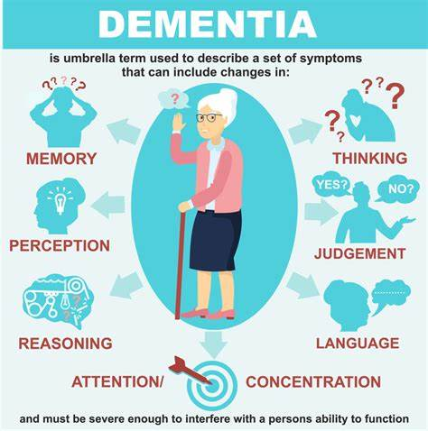
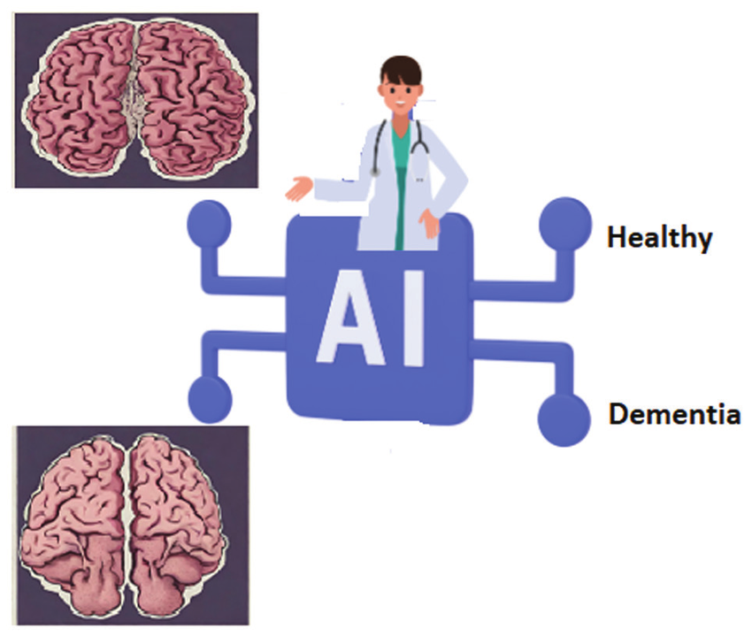
D
Does AI have dementia?

Slide 19
D
1Does AI have dementia, a serious mental disorder? Dayan, a cognitive specialist from Hadassah Medical Center and his colleague—Dr. Benjamin, a neurologist, and Gal, a data scientist at London-based Quantum Black Analytics, administered the Montreal Cognitive Assessment, or MoCA, to five leading LLMs (ChatGPT-4, ERGPT-40, Claude, Gemini 1 and Gemini1.5). This assesses cognitive impairment(认知缺陷) by giving “patients” a variety of simple tasks. For example, copy the drawing of a cube. Give as many words as you can that begin with the letter “F.” Subtract seven from 100 until you reach zero.
2To Dayan’s surprise, none of the models obtained the full score of 30 points. Most scored between 18 and 25, indicating mild cognitive impairment associated with early dementia. Every model outperformed the average person in attention and memory-related tasks but faltered on visual and spatial tasks, such as those that asked them to draw or orient themselves in the universe.
3Researchers also showed the chat-bots the Boston Diagnostic Aphasia Examination “cookie theft” picture, of a boy standing on a bench to steal cookies as his mother washes dishes. “Patients” describe it while analysts assess their speech and language function. All models correctly interpreted parts of the image, the study found, but none expressed concern that the boy was about to fall. This lack of empathy is commonly associated with front-to-temporal dementia, the study authors said. Notably, older models performed worse on the MoCA than newer versions. The authors drew a resemblance(相似点) between “dementia” risk in aging AI and in human brains.
4This December 2024 study was carried out for the Christmas edition of The BMJ—one of the world’s most medical journals, subjecting all articles to a thorough peer review process. In some way, the study was written more “tongue-in-cheek”. Methodologically, LLMs should not be examined by methods meant for people. However, the results may spark conversations about the differences between AI and human doctors—and the important roles both can play.
Lead in
Results / Findings
Further Analysis
Discussion /Significance

Slide 20
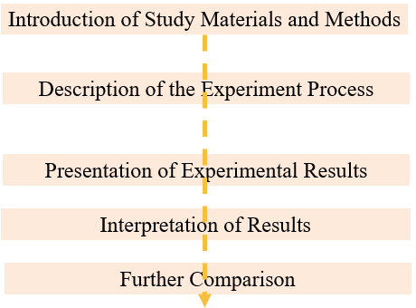
D
1Does AI have dementia, a serious mental disorder? a data scientist administered the Montreal Cognitive Assessment, or MoCA, to five leading LLMs (ChatGPT-4, ERGPT-40, Claude, Gemini 1 and Gemini1.5). This assesses cognitive impairment(认知缺陷) by giving “patients” a variety of simple tasks. For example, copy the drawing of a cube. Give as many words as you can that begin with the letter “F.” Subtract seven from 100 until you reach zero.
2To Dayan’s surprise, none of the models obtained the full score of 30 points. Most scored between 18 and 25, indicating mild cognitive impairment associated with early dementia. Every model outperformed the average person in attention and memory-related tasks but faltered on visual and spatial tasks, such as those that asked them to draw or orient themselves in the universe.
3Researchers also showed the chat-bots the Boston Diagnostic Aphasia Examination “cookie theft” picture, of a boy standing on a bench to steal cookies as his mother washes dishes. “Patients” describe it while analysts assess their speech and language function. All models correctly interpreted parts of the image, the study found, but none expressed concern that the boy was about to fall. This lack of empathy is commonly associated with front-to-temporal dementia, the study authors said. Notably, older models performed worse on the MoCA than newer versions. The authors drew a resemblance(相似点) between “dementia” risk in aging AI and in human brains.
Researchers also showed the chat-bots the Boston Diagnostic Aphasia Examination “cookie theft” picture, of a boy standing on a bench to steal cookies as his mother washes dishes.
“Patients” describe it while analysts assess their speech and language function. All models correctly interpreted parts of the image, the study found, but none expressed concern that the boy was about to fall.
This lack of empathy is commonly associated with front-to-temporal dementia, the study authors said.
Notably, older models performed worse on the MoCA than newer versions.
The authors drew a resemblance(相似点) between “dementia” risk in aging AI and in human brains.
Falter: losing power or strength
Outperform : Surpass; Outshine,
32. What can be inferred about the AI models’ performance on visual and spatial tasks?
A. They performed better than humans on these tasks.
B. They struggled more on these tasks compared to memory-related tasks.
C. They showed no difference in performance across all tasks.
D. They were unable to complete any visual or spatial tasks.
33. What did the researchers do to carry out the study in paragraph 3?
A. They assessed the computing ability of the AI models.
B. They tracked how the AI models processed the picture.
C. They measured the AI models’ scores of series of tests.
D. They analyzed the AI models’ ability of interpreting the picture.

Slide 21
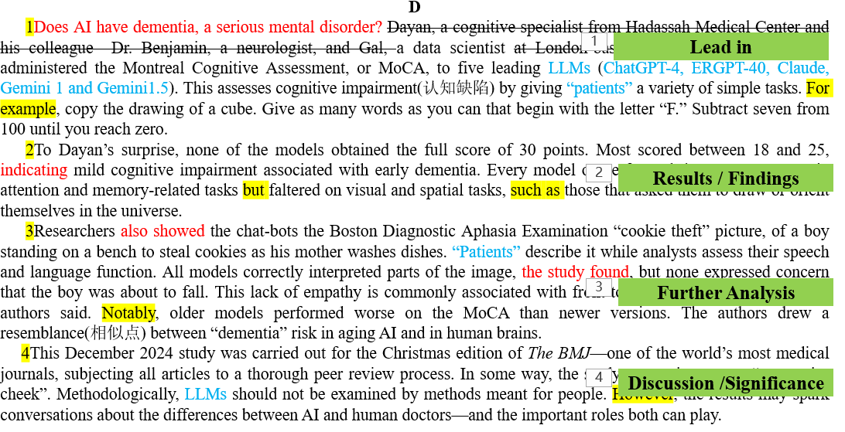
34. How does the passage develop?
A. It presents a problem, describes a study, and then discusses the results.
B. It compares different AI models and their development over time.
C. It develops by making comparisons between AI models and humans.
D. It lists the advantages and disadvantages of using AI in medical testing.
35. What is the author’s attitude toward the study’s findings?
A. Skeptical.
B. Enthusiastic.
C. Neutral.
D. Critical.
4This December 2024 study was carried out for the Christmas edition of The BMJ—one of the world’s most medical journals, subjecting all articles to a thorough peer review process. In some way, the study was written more “tongue-in-cheek”. Methodologically, LLMs should not be examined by methods meant for people. However, the results may spark conversations about the differences between AI and human doctors—and the important roles both can play.
Objective Statement of Facts
Objective Discussion of Methodology
Avoidance of Direct Evaluation
Neutral Description of Result

Slide 22
A serious mental disorder
Mild cognitive impairment
Be carried out
Be meant for
Spark conversation
Make comparisons
Administer vt.管理、执行、给予
Subtract vt.减去、扣除
Outperform vt.表现优于、超过
Interpret vt.解释、诠释、口译
Subject vt.使遭受、使经历；使服从
A. Skeptical（怀疑的）:
Doubtful Questioning
Cynical
Distrustful
Uncertain
B. Enthusiastic（热情的）:
Excited
Passionate
Zealous
Eager
Does AI have dementia?
一种严重的精神障碍
轻度认知障碍
实施，执行
旨在
引发讨论
进行比较
C. Neutral（中立的）:
Objective
Impartial
Unbiased
Detached
Supportive（支持的）:
Approving
Advocating
Supporting
Favorable
D

Slide 23

七选五
how to be creative

Slide 24
Steve Jobs was undoubtedly a creative person. His innovative ideas have given us many digital devices, without which we cannot seem to function very effectively anymore. There are indeed many things we can learn from Jobs on how to be creative. Here are several of them.
Curiosity
36 But somewhere along the way, we tend to lose or dismiss that nature of ours. Curiosity is the seed of creativity. It questions limiting beliefs and long-held assumptions. Meanwhile it also asks, why? Or why not?
Jony Ive, Apple’s Chief Design Officer, wrote about Jobs’ curiosity in the Wall Street Journal: His insatiable curiosity was not limited or distracted by his knowledge or expertise, nor was it casual or passive. 37 His curiosity was practiced with intention and rigor.
Openness to New Experiences
Only when we are open to new experience can we explore the world, and ourselves better.
38 Jobs was also the one who was certainly eager to explore new areas of study. He took a course in calligraphy while he was in the university, despite knowing that the class would not earn him any credit towards a degree. This later helped him a lot, bringing creativity into his world of technology.
Mindfulness & Meditation
Jobs used mindfulness and meditation to reduce his stress, gain more clarity, and enhance his creativity. Biographer Walter Isaacson quotes Jobs as saying: “ 39 Only when it calms, there’s room to see more. And that’s when your intuition starts to blossom. Also you start to see things more clearly. Your mind just slows down, and you see a tremendous expanses in the moment. You see so much more than you could see before.”
40 We only have to tweak our habits so that we can ignite the creativity within us.
C. We are blessed with the gift after we are well educated.
36 F. We are all born with the gift (just observe babies and toddlers).
37 A. It is not that tough to be creative.未承上
B. It was intense, energetic and restless.
G. It is a drive to explore novel ideas, or discover and learn unlearned skills.
38 G. It is a drive to explore novel ideas, or discover and learn unlearned skills.
39 D. Sit and hear, and you will find something enlightening.
E. Sit and observe, and you will see how restless your mind is.
tweak our habits 调整我们的习惯
ignite the creativity within us点燃我们内心的创造力
40 A. It is not that tough to be creative.

Slide 25



完形填空
详 解

Slide 26
Yuri Williams and Rodney Smith are friends. They spend the weeks before Christmas 41 the country. They visit all 50 states, making house calls to 42 who are sick or disabled. The pair arrive with plenty of 43 , and in costume. In past years, Williams has dressed up as various 44 , including Spider-Man, while Smith wears the attire(服装) of a Christmas elf.
Though Williams has been 45 joy this way for years, the drive to do it came from a joyless place. In 2009, he lost his 46 to cancer.
“I fell into a five-year 47 ,” he told Good Morning America. But he dug himself out by honoring his mother’s memory through 48 acts, including collecting gifts for children with special demands . Williams launched his 49 , A Future Super Hero and Friends, in 2018. His goal: to bring smiles to children with health challenges, including those fighting 50 conditions.
Williams and Smith start their gift-giving journey by 51 through the 48 states before flying to Alaska and Hawaii. Along the way, they 52 gifts, funded by the donations that come through the Future Super Hero website, which is also where people nominate families for the pair to visit.
The pair say they want to make sure families facing tough 53 never feel alone. “I don’t look to get 54 to do this,” Williams adds. “It’s just 55 for me for losing my mother, just keeping her name alive by doing this.”
41. A. wandering B. exploring
C. crossing D. fleeing
42. A. kids B. friends
C. people D. families
43. A. medicines B. money
C. clothes D. gifts
44. A. sales-men B. super-heroes
C. consultants D. architects
45. A. lasting B. searching
C. spreading D. receiving
46. A. mother B. father
C. wife D. son
47. A. unemployment B. disappointment
C. confusion D. depression
48. A. achievable B. charitable
C. reliable D. sustainable
49. A. nonprofit B. experiment
C. business D. campaign
50. A. dream-inspiring B. effort-rewarding
C. life-risking D. life-threatening
51. A. riding B. driving
C. sailing D. walking
52. A. stock up on B. cut down on
C. hold on to D. run out of
53. A. dreams B. schedules
C. projects D. battles
54. A. employed B. paid
C. honored D. awarded
55. A. healing B. relaxing
C. challenging D. inspiring
Introduction
Motivation and Backstory
Organization and Goals
The Process
52
A. 储备
B. 减少
C. 坚持
D. 用完
nominate提名；推荐；任命；
Impact and Significance

Slide 27
Yuri Williams and Rodney Smith are friends. They spend the weeks before Christmas 41 the country. They visit all 50 states, making house calls to 42 who are sick or disabled. The pair arrive with plenty of 43 , and in costume. In past years, Williams has dressed up as various 44 , including Spider-Man, while Smith wears the attire(服装) of a Christmas elf.
Though Williams has been 45 joy this way for years, the drive to do it came from a joyless place. In 2009, he lost his 46 to cancer.
“I fell into a five-year 47 ,” he told Good Morning America. But he dug himself out by honoring his mother’s memory through 48 acts, including collecting gifts for children with special demands . Williams launched his 49 , A Future Super Hero and Friends, in 2018. His goal: to bring smiles to children with health challenges, including those fighting 50 conditions.
Williams and Smith start their gift-giving journey by 51 through the 48 states before flying to Alaska and Hawaii. Along the way, they 52 gifts, funded by the donations that come through the Future Super Hero website, which is also where people nominate families for the pair to visit.
The pair say they want to make sure families facing tough 53 never feel alone. “I don’t look to get 54 to do this,” Williams adds. “It’s just 55 for me for losing my mother, just keeping her name alive by doing this.”
41. A. wandering B. exploring
C. crossing D. fleeing
42. A. kids B. friends
C. people D. families
43. A. medicines B. money
C. clothes D. gifts
44. A. sales-men B. super-heroes
C. consultants D. architects
45. A. lasting B. searching
C. spreading D. receiving
46. A. mother B. father
C. wife D. son
47. A. unemployment B. disappointment
C. confusion D. depression
48. A. achievable B. charitable
C. reliable D. sustainable
49. A. nonprofit B. experiment
C. business D. campaign
50. A. dream-inspiring B. effort-rewarding
C. life-risking D. life-threatening
51. A. riding B. driving
C. sailing D. walking
52. A. stock up on B. cut down on
C. hold on to D. run out of
53. A. dreams B. schedules
C. projects D. battles
54. A. employed B. paid
C. honored D. awarded
55. A. healing B. relaxing
C. challenging D. inspiring

Slide 28



语法填空

Slide 29
As we welcome the Year of the Snake in the Chinese lunar calendar, it is a time to reflect on the qualities that this ancient zodiac sign embodies. The Snake, the sixth animal in the 12-year cycle of the Chinese zodiac, 56 (associate) with wisdom, intuition, and transformation over history. Those 57 (bear) in the Year of the Snake are believed to possess a keen intellect, a calm demeanor, and an innate ability to navigate life’s challenges 58 grace and precision.
Unlike Chinese culture, the Snake is a symbol of mystery and 59 (deep) in Western culture, sometimes portrayed negatively. The Snake in Chinese tradition is seen as a creature of great insight and resourcefulness. It is said that people born under this sign are 60 (nature) problem-solvers, capable of seeing through complexities 61 finding elegant solutions.
The Year of the Snake is also a time for renewal and transformation. Just as a snake sheds its skin, this year encourages us to let go of old habits, 62 (embrace) new opportunities. The Snake’s energy reminds us that sometimes, the most profound transformations occur not through force, but through 63 is subtle shift and careful planning.
So, as the Year of the Snake 64 (unfold), let us shed our old skins, embrace new 65 (begin), and move forward with the wisdom and poise that this ancient symbol so beautifully represents.
the Chinese lunar calendar中国农历
reflect on反思 a calm demeanor沉着举止
A keen intellect 聪明才智an innate ability先天能力
56.has been associated：谓语动词
57.born: 非谓语
58.with:介词---以某种方式
59.depth：词性转换
60.natural：词性转换
61.and：并列结构
Be portrayed negatively被负面描绘
Be seen as 被视作
Be capable of 有能力
62.embracing：非谓语
63.what：宾语从句—what=the thing that
64.unfolds：谓语动词
65.beginnings：名词复数
a time for renewal and transformation
一个更新和转变的时期
shed old skin褪去旧皮
subtle shift 细微的转变
Move forward with wisdom带着智慧前行

Slide 30
感
谢
观看

