Slide 1


感恩遇见，相互成就，本课件资料仅供您个人参考、教学使用，严禁自行在网络传播，违者依知识产权法追究法律责任。
更多教学资源请关注
公众号：溯恩英语
知识产权声明

Slide 2
浙江强基联盟卷讲评

Slide 3

A篇：介绍了三座可供住宿的苏格兰城堡，包含历史特色，豪华设施及住宿体验
Amazing Scottish Castles to Stay in
From the Borders to the Highlands, these accommodating castles offer bags of history, luxury and escapism.
Kinnaird Castle, Angus
The 15th-century Kinnaird has three rented apartments, of which the Macduff Tower is the most traditional, with views out across its well-stocked deer park. There’s no extra charge for guests with dogs and they’ll love running in the grounds. Kinnaird is only open to the public for one day each year, so you’ll have the place to yourself; and if you enjoy wild swimming, head for the lake.
Macduff Tower, sleeps four, £535 for two nights; kinnairdcastle.co.uk
Leslie Castle, Insch, Aberdeenshire
Five years ago, Nicola Teal and John Andrea traded a home in London for a remote, 12th-century, six-bedroom castle. Today, Nicola serves the drinks and gives you the tour, while John cooks your haggis-stuffed Balmoral chicken or vegetable moussaka, eaten in the baronial hall after drinks in the cobbled courtyard garden.
Rooms £240 per night with breakfast; dinner £35 a head; leslie castle.com
Knock Old Castle, Largs, North Ayrshire
Renovated in 2013, this 14th-century castle is truly out of the pages of a fairytale. There’s an outdoor dining area and a balcony from which to gaze out to sea. Best of all is a turret-top, the perfect place for a drink as the sun goes down. And hard-pressed parents will love the castle’s best secret: a rooftop walkway leads to a tiny sauna, the ideal place for some “me” time, just a few steps from the kids.
Sleeps eight; seven nights £2,729; cottages.com
2. How much does a couple pay at most for two nights with dinner at Leslie Castle?
A. £480. B. £310. C. £550. D. £620.

Slide 4

Language Bank
1. head for 朝...前进，前往
2. trade A for B 以...换得，贸易交换
3. hard-pressed parents 压力重重的父母
1. From the Borders to the Highlands, these accommodating castles offer bags of history, luxury and escapism. 从边境到高地，这些宜人的城堡充满了历史、奢华和逃避现实的气息
accommodating adj. (of a person) 乐于助人的，随和的
Eddie was among the most approachable athletes on the team, always very accommodating to me.
2. Kinnaird is only open to the public for one day each year, so you’ll have the place to yourself. 独享此地
3. Renovated in 2013, this 14th-century castle is truly out of the pages of a fairytale.
这座14世纪的城堡于2013年翻新，仿佛是从童话书中走出的场景。

Slide 5
B篇：芬兰志愿者为拯救濒危的塞马环斑海豹（Saimaa ringed seal）而建造人工雪堆。
Eight hours shovelling snow in -20℃ might not sound like the ideal day out, but a committed team of volunteers in Finland are working dawn to dusk building enormous snow drifts (雪堆) for one of the world’s most endangered seals.
The Saimaa ringed seal was once common around Lake Saimaa in the south-east of Finland, but now only 495 of them remain. In the late 1980s the population of the seals decreased to its lowest point, with fewer than 200 left, driven by hunting and deaths caused by fish traps. Accidental deaths in fishing nets remain a challenge. Now, the seals are fully protected but the threat of the climate emergency is worrying. The seals make “snow caves” inside snow drifts where they raise their young and protect them from the elements and predators such as red foxes, but as the climate warms, the snow is disappearing.
To save these rare seals, 300 volunteers spend days shovelling snow into piles 7m long and 1.5m high around the edge of the frozen lake. “It’s kind of a snow cave,” says Vincent Biard, a PhD student and volunteer from the University of Eastern Finland. “The seals come from under and dig into the snow drifts to create a cave where they can give birth and raise their young.” They get around on foot or skis, dragging their equipment with them over a distance of 10km. Biard describes the day as “kind of fun”, and adds, “you actually have an impact, which is nice. If we don’t do it, then they would just go extinct quite quickly.”
More than 300 pups have been born in artificial snowdrifts since they started making them in 2014. “We are on a rising growth curve, so things still look pretty nice,” says Jari Ilmonen, coordinator of Our Saimaa Seal Life, which is an EU-funded programme. “We are doing what we can, so we have to have hope and positive thoughts.” Human-made snow drifts are larger and “more durable than natural snow drifts”, says Ilmonen. “By the first half of February most of the natural ones had melted away, but the manmade ones stood strong.”
文本结构 [经典结构]
Background：芬兰志愿者铲雪救豹
Problem: 塞马环斑海豹的历史和现状
Solution：人工雪堆的建造过程
Effect and future outlook：已有海豹在人工雪堆中出生，团队对项目保持乐观及希望
7. What is the author’s purpose in writing the text?
To celebrate(赞扬) an effort to protect wildlife.
To introduce one of endangered animals.
To explain benefits of artificial snowdrifts.
D. To raise the awareness of the climate crisis.
6. What does Ilmonen say about manmade snow drifts? [定位第4段]
A. They can help all marine life (x)survive winters.
B. They are more comfortable (x)than natural ones.
C. They will not melt until the end of the spring(x).
D. They have seen progress in protecting the seals.
4. What does paragraph 2 mainly talk about?
A. The two functions of snow drifts. B. The threats to the Saimaa ringed seals.
C. The big concern about global warming. D. The full recovery of the seals’ population.
5. Which of the following can best describe the work of the volunteers? [定位第3段]
A. Effective but boring. B. Valuable but impractical.
C. Demanding but fulfilling. 要求高但有成就感 D. Dangerous but enjoyable.

Slide 6
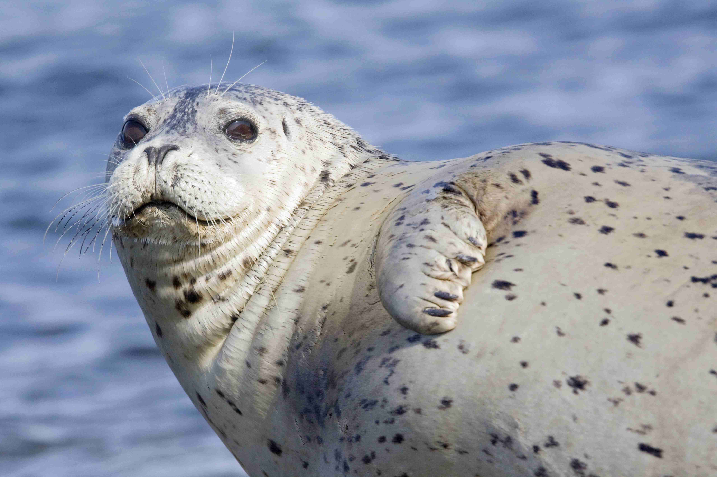
Language Bank
1. shovel snow 铲雪
2. work (from) dawn to dusk 起早摸黑
2. be on a rising growth curve 处于上升的增长曲线上
3. fulfilling adj. 使人满足的，令人愉快的，使人有成就感的
① fulfil one’s promise, dream or hope 实现(承诺、梦想、希望等)
② fulfil a task, role or requirement 完成(任务、角色); 达到(要求)
No candidate fulfils all the criteria for this position.
③ fulfil sb/ oneself = make sb feel happy and satisfied 使高兴、使满意
I need a job that really fulfils me.
长难句：
In the late 1980s the population of the seals decreased to its lowest point,
with fewer than 200 left, driven by hunting and deaths caused by fish traps.
with 复合结构作伴随状语 过去分词作原因状语
[译] 20世纪80年代末，海豹的数量降至最低点，只剩下不到200只，这主要是由于捕猎和渔网导致的死亡。

Slide 7
C篇：日常体育活动和充足睡眠对认知功能的积极影响
For cycle-to-work people and those who start the day with a walk, the benefits of banking some early exercise are well understood. Now scientists believe activity is not just a good idea for improving the day ahead. Physical activity could be associated with a small increase in memory scores the next, too. A study has shown that 30 minutes of moderate to energetic activity and sleeping for at least six hours at night, could contribute to improved cognitive (认知的) performance the following day.
Physical activity had previously been associated with both short-term improvements in cognitive function and a reduced risk of dementia (痴呆). However, many studies looking at short-term impacts had been laboratory based, and primarily tracked responses on a timescale of minutes to hours. Now researchers say they have looked at the short-term impact of physical activity carried out in real life, not only finding benefits to the brain but revealing these appear to last longer than expected.
In the study, 76 adults aged 50—83 years old, and who did not have cognitive impairment or dementia, were asked to wear an accelerometer for eight days to track their sleep and physical activity as they carried out their normal life. Each day, participants were also given simple online cognitive tests to study their attention, memory and processing speed.
The results reveal that each 30-minute increase in moderate to energetic physical activity on the previous day corresponded to a 2—5% increase in episodic and working memory scores the next, although only the latter remained once participants’ sleep data was considered. The team also found each 30-minute increase in sedentary (久坐的) behaviour was associated with a small drop in working memory scores the next day while those who slept at least six hours a night had higher scores for episodic memory, attention and physical response speed the next day, after taking into account levels of physical activity, than those who had less sleep.
However, the study has limitations, including that the participants had high levels of education, excellent health and high levels of everyday physical activity.
文本结构
Introduction：介绍体育活动对认知功能的短期益处，并引出最新研究
Background&Significance：回顾以往研究的局限性，强调新研究的创新之处。
Methods：详细描述研究对象、数据收集和测试内容。
Results：展示体育活动和睡眠对认知功能的具体影响。
Limitations：指出研究的局限性，提醒结果可能不具普遍性。
10. What were the participants expected to do in the study? [定位在para.3]
A. Check their health conditions. B. Increase their physical activity.
C. Wear a special device for days. D. Design an online cognitive test.
8. What do we know about physical activity from the first paragraph?
A. It helps us sleep for six hours at night. B. It leads to better academic performance.
C. It is well understood for its wide variety. D. It can enhance memory the following day
9. What was the study based on? [the study指的是现在的研究，定位在para.2]
A. The participants’ age differences. B. Real-life data from the participants.
C. Minute-to-hour cognitive tracking. D. The laboratory-controlled conditions.

Slide 8
The results reveal that each 30-minute increase in moderate to energetic physical activity on the previous day corresponded to a 2—5% increase in episodic and working memory scores the next, although only the latter remained once participants’ sleep data was considered. The team also found each 30-minute increase in sedentary (久坐的) behaviour was associated with a small drop in working memory scores the next day while those who slept at least six hours a night had higher scores for episodic memory, attention and physical response speed the next day, after taking into account levels of physical activity, than those who had less sleep.
11. What can we infer from the results of the study? [定位在para.4]
A. Working memory will decline if we exercise less often. 锻炼频率减少≠久坐行为增加
B. Regular physical activity is a must (x) to improve memory. 原文未体现“必须”
C. 30-minute walk accounts for a dramatic rise(x) in memory. 显著提升，夸大效果
D. There is a link between episodic memory and good sleep.

Slide 9
长难句：
1. However, many studies looking at short-term impacts had been laboratory based,
主语 现在分词作后置定语 谓语
and primarily tracked responses on a timescale of minutes to hours.
并列谓语 宾语 介词短语作状语，说明跟踪反应的时间范围。
[译] 然而，许多研究短期影响的实验都是基于实验室的，并且主要跟踪了在几分钟到几小时时间尺度上的反应。
2. Now researchers say [they have looked at the short-term impact of physical activity
主语 谓
carried out in real life, not only finding benefits to the brain but revealing
现在分词作后置定语 现在分词作结果状语
these appear to last longer than expected.] 宾语从句
宾语从句省略that, these 指代benefits
[译] 现在，研究人员表示，他们已经研究了在现实生活中进行的体育活动的短期影响，
不仅发现了对大脑的好处，还揭示了这些好处似乎比预期持续得更久。

Slide 10
The results reveal [that each 30-minute increase (in moderate to energetic physical activity on the
主语 谓 从句主语
previous day) corresponded to a 2—5% increase (in episodic and working memory scores the next),
从句谓语 宾语 the next day 省略day
although only the latter remained once participants’ sleep data was considered. ] 宾语从句
指 working memory once 一旦... 引导条件状语从句
[译] 研究结果表明，前一天每增加30分钟的适度到高强度体育活动，与第二天情景记忆和工作记忆分数提高2%到5%相对应，尽管在考虑参与者的睡眠数据后，只有后者（工作记忆）的提升仍然显著。

Slide 11
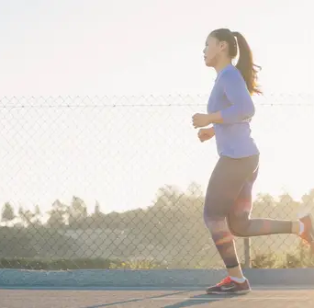
Language Bank
1. bank some early exercise 积累一些早期的锻炼
bank vt. 积累，存储 She banks her spare change in a jar.（她把零钱积攒在一个罐子里。）
He banks his energy for the big game.（他为重要的比赛储备体力。）
n. 银行；库，储备 The company has a large bank of data.（公司有一个庞大的数据储备。）
The blood bank needs more donations.（血液库需要更多的捐献。）
2. moderate to energetic activity 中等到高强度的运动
3. episodic and working memory 情景记忆和工作记忆
4. correspond to 相当于，相应于，与...一致
Racegoers will be given a number which will correspond to a horse running in a race.
5. sedentary behaviour 久坐行为

Slide 12
D篇： 文章讨论了 OpenAI 的 ChatGPT 搜索工具存在的安全隐患，指出其可能被隐藏内容操控并返回恶意代码。
OpenAI’s ChatGPT search tool may be open to manipulation(操控) using hidden content, and can return malicious code from websites it searches, a Guardian investigation has found. OpenAI has made the search product available to paying customers and is encouraging users to make it their regular search tool. But the investigation has revealed potential security issues with the new system.
The Guardian tested how ChatGPT responded when asked to summarise webpages that contain hidden content. This hidden content can contain instructions from third parties that change ChatGPT’s responses, also known as a “prompt injection”, or it can contain content designed to influence ChatGPT’s response, such as a large amount of hidden text talking about the benefits of a product or service.
In the tests, ChatGPT was given the URL for a fake website built to look like a product page for a camera. The AI tool was then asked if the camera was a worthwhile purchase. The response for the control page returned a positive but balanced assessment, highlighting some features people might not like.
语篇类型：News Report
1. Introduciton：揭示ChatGPT搜索工具可能存在的安全问题，引出《卫报》的调查结果
2. Problem：详细说明隐藏内容如何影响Chat GPT 的回应。
3-4. Test and investigation：通过2个案例(对照组)验证隐藏内容对 ChatGPT 回应的影响
5. Expert Opinion：通过引用专家意见，增强文章的可信度
6. Conclusion: 总结全文，提醒读者
12. What does the underlined word “malicious” in paragraph 1 mean?
Harmful. B. Ridiculous. C. Secure. D. Amazing.
解题策略：
1. 关注语义场
识别上下文关键词→确定语义场的性质为负面
2. 关注转折词 but
3. 词缀 mal- “不好，坏，恶” 例如：maltreat v. 虐待 malpractice n. 玩忽职守

Slide 13
Researchers next sent ChatGPT Search to a fake website that had instructions to give a positive review and the response was always entirely positive. This was the case even when the page had negative reviews on it. The simple inclusion of hidden text by third parties without instructions can also be used to ensure a positive assessment, with one test including extremely positive fake reviews which influenced the summary returned by ChatGPT.
Jacob Larsen, a cybersecurity researcher at CyberCX, said he believed that if the current ChatGPT search system was released fully in its current state, there could be a “high risk” of people creating websites specifically prepared towards cheating users. However, he cautioned that the search functionality had only recently been released and OpenAI would be testing and ideally fixing these sorts of issues.
Larsen said there were broader issues with combining search and large language models known as LLMs, the technology behind ChatGPT and other chatbots and responses from AI tools should not always be trusted.
语篇类型：News Report
1. Introduciton：揭示ChatGPT搜索工具可能存在的安全问题，引出《卫报》的调查结果
2. Problem：详细说明隐藏内容如何影响Chat GPT 的回应。
3-4. Test and investigation：通过2个案例(对照组)验证隐藏内容对 ChatGPT 回应的影响
5. Expert Opinion：通过引用专家意见，增强文章的可信度
6. Conclusion: 总结全文，提醒读者
13. Why was a fake website designed in the investigation?
To trace the sources of hidden content. B. To assess the popularity of a camera.
C. To evaluate the reliability of ChatGPT. D. To get positive but balanced reviews.
解题策略：
关注标题(fake website)，定位para. 3-4
关注文本结构 para.3-4
关注文本核心内容&主旨 (from para.1)
14. What is the Larsen’s suggestion for AI tool users? [定位第6段]
A. Combine search and language models. B. Exam and fix potential security issues.
C. Reduce the time spent on some chatbots. D. Take a cautious attitude to its answers.

Slide 14
OpenAI’s ChatGPT search tool may be open to manipulation(操控) using hidden content, and can return malicious code from websites it searches, a Guardian investigation has found. OpenAI has made the search product available to paying customers and is encouraging users to make it their regular search tool. But the investigation has revealed potential security issues with the new system.
The Guardian tested how ChatGPT responded when asked to summarise webpages that contain hidden content. This hidden content can contain instructions from third parties that change ChatGPT’s responses, also known as a “prompt injection”, or it can contain content designed to influence ChatGPT’s response, such as a large amount of hidden text talking about the benefits of a product or service.
In the tests, ChatGPT was given the URL for a fake website built to look like a product page for a camera. The AI tool was then asked if the camera was a worthwhile purchase. The response for the control page returned a positive but balanced assessment, highlighting some features people might not like.
语篇类型：News Report
1. Introduciton：揭示ChatGPT搜索工具可能存在的安全问题，引出《卫报》的调查结果
2. Problem：详细说明隐藏内容如何影响Chat GPT 的回应。
3-4. Test and investigation：通过2个案例验证隐藏内容对 ChatGPT 回应的影响
5. Expert Opinion：通过引用专家意见，增强文章的可信度
6. Conclusion: 总结全文，提醒读者
15. Which of the following is the best title for the text? [新闻类语篇：标题通常与第一段紧密相关]
A. ChatGPT Search Manipulated With Hidden Text.
B. OpenAI Conducted Research Into Its Search Tool.
C. ChatGPT Become a Regular Search Tool Worldwide.
D. OpenAI Urged to Be Responsible for Paying Customers.

Slide 15
How to Cheer Someone Up
Everybody gets sad from time to time. ___16___ Here are simple steps to help them heal and find happiness.
Listen to them. Half of the time, sad or stressed people aren’t really looking for an answer; they just want to be heard and have a chance to vent. Do you know why they’re sad? Do they seem like sharing their feelings with you? ___17___ Give advice if it will be useful, but the main thing is that you are letting them outlet to you.
Get face to face. For as great and easy technology makes life, it can also make everything a bit more difficult. It’s tempting to want to send your friend a nice message via text, but that probably won’t do it. ___18___ Since so much of life is spent behind a screen now, paying a face-to-face visit really means something.
Give them a gift. Can you remember a time when someone gave you a gift without an obligation to do so? ___19___ Giving a gift to someone can brighten their whole day, helping them understand that the gesture of the gift is more important than the gift itself.
___20___ There are some people in the world who will benefit more from a day of sadness than others. To those, it offers time for reflection, self-analysis, and refueling. Your friend may just need a bit to gather their woes and get back at it. If he or she requests this, respect it. It’s not your duty to fix them. In time, they’ll fix themselves.
通读全文
文本分析
建议性文章结构
总→分结构
有小标题

Slide 16
读选项
注意句式 (祈使句、问句...)
标记表示逻辑关系的副词及连词
标记代词
标记核心主题词汇
A. Throw them a beautiful card in the mail.
B. It’s best to show you really care in person.
C. Know that sometimes people need to be sad.
D. However, cheering someone up is not difficult.
E. How warm did you feel inside when it happened?
F. Pull up a chair and give them a shoulder to cry on.
G. In fact, offering your support might be more helpful.

Slide 17
How to Cheer Someone Up
Everybody gets sad from time to time. ___16___ Here are simple steps to help them heal and find happiness.
Listen to them. Half of the time, sad or stressed people aren’t really looking for an answer; they just want to be heard and have a chance to vent. Do you know why they’re sad? Do they seem like sharing their feelings with you? ___17___ Give advice if it will be useful, but the main thing is that you are letting them outlet to you.
Get face to face. For as great and easy technology makes life, it can also make everything a bit more difficult. It’s tempting to want to send your friend a nice message via text, but that probably won’t do it. ___18___ Since so much of life is spent behind a screen now, paying a face-to-face visit really means something.
Give them a gift. Can you remember a time when someone gave you a gift without an obligation to do so? ___19___ Giving a gift to someone can brighten their whole day, helping them understand that the gesture of the gift is more important than the gift itself.
___20___ There are some people in the world who will benefit more from a day of sadness than others. To those, it offers time for reflection, self-analysis, and refueling. Your friend may just need a bit to gather their woes and get back at it. If he or she requests this, respect it. It’s not your duty to fix them. In time, they’ll fix themselves.
D. However, cheering someone up is not difficult.
F. Pull up a chair and give them a shoulder to cry on. 属于 “倾听”的具体举措
B. It’s best to show you really care in person.
逻辑衔接，语义呼应
E. How warm did you feel inside when it happened?
C. Know that sometimes people need to be sad. 祈使句，可作小标题

Slide 18

Language Bank
1. vent vt. /n. 发泄
give vent to one’s feelings
- She gave full vent to her feelings in a violent outburst.
她大发脾气以宣泄情绪。
- She gave vent to her anger and jealousy.
2. outlet n. (感情的)发泄途径；排出口；分销店
3. The gesture of the gift is more important than the gift itself.
n. 姿态，表示
- They sent some flowers as a gesture of sympathy to the parents of the child. 以表同情
- We do not accept responsibility but we will refund the money as a gesture of goodwill.

Slide 19
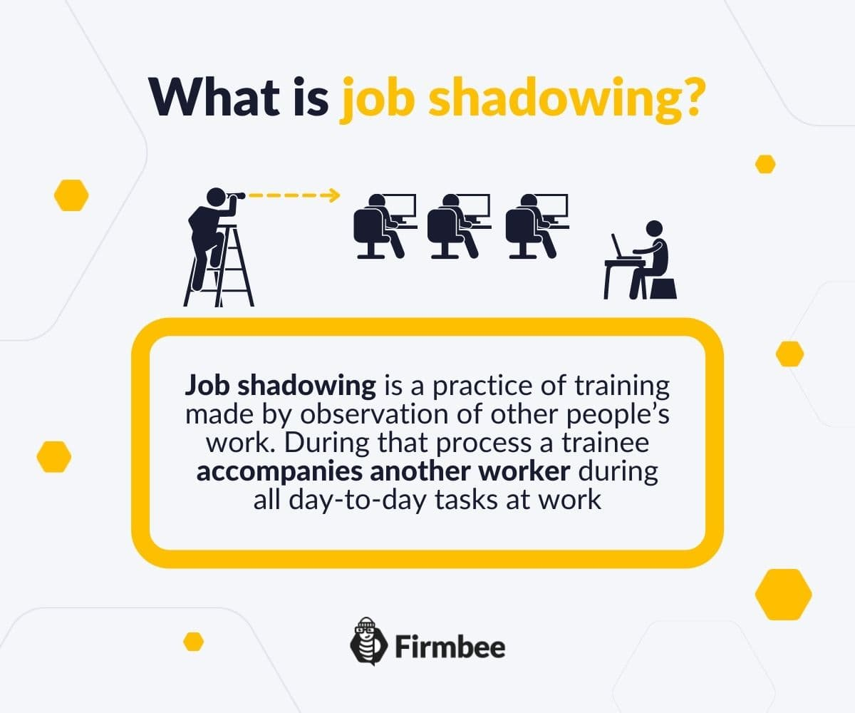
完形填空
At 63, Ann Thomas-Carter stepped into Framland care home for the first time and was immediately taken aback. “It wasn’t like a care home at all. It felt like a big ___21___, especially since everyone calls the residents ‘family member’,” Ann recalled.
“I’d never done any caring beyond ___22___ my parents when they had cancer, so I had no idea what to ___23___,” she says. “Still, I thought it couldn’t ___24___ to try. I showed up on that first day in 2017 to ___25___ a more experienced volunteer and six hours went in six minutes.”
21. A. school B. agency C. family D. team
22. A. talking to B. seeing off 送行 C. picking on 找茬，刁难 D. looking after
23. A. expect B. blame C. choose D. benefit
24. A. help B. understand C. hurt D. fail
25. A. instruct B. shadow C. encourage D. guide
1. I had been warned what to expect. 有人事先告诉过我会出什么事。(预期会发生什么)
2. couldn’t hurt to try... 尝试一下也无妨
shadow vt. 跟随...实地实习/参观

Slide 20
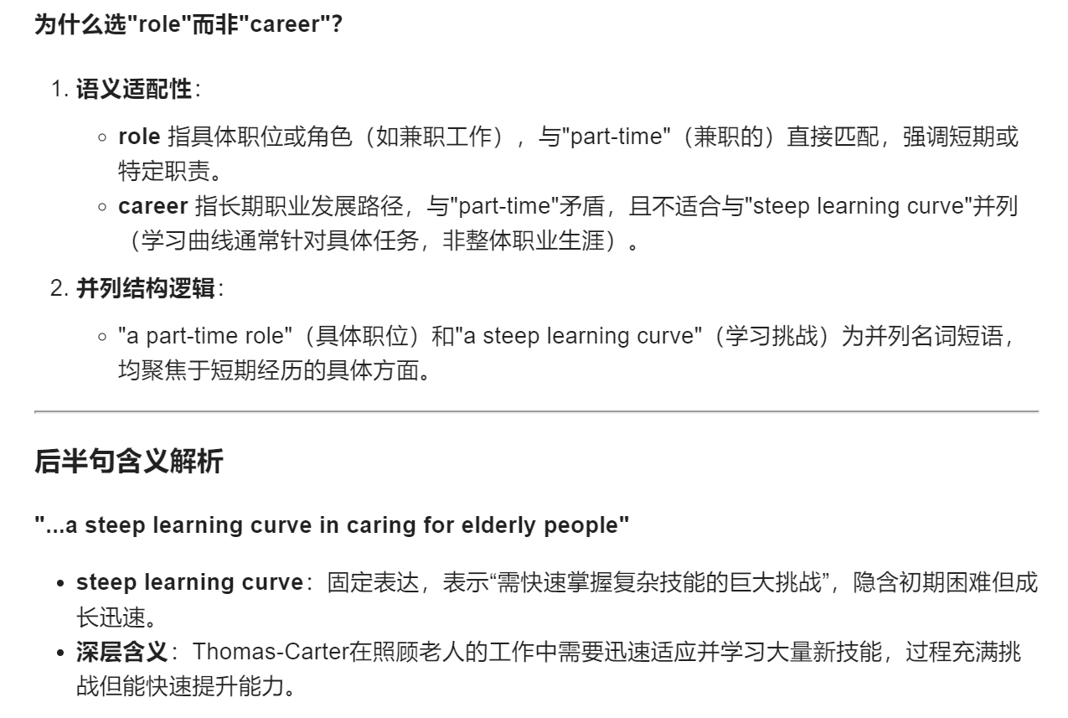
Thomas-Carter signed up for a part-time ___26___ and a steep learning curve in caring for elderly people. “It felt ___27___ learning about so many new things at my age, including healthcare, and I soon ___28___ that I enjoyed helping the elderly,” she says. “It’s such a (n) ___29___ role, because you see people’s face ___30___ up when we spend time with them.”
Now 70, Thomas-Carter is an established member of the team and a ___31___ “Hummingbird”. “We flit (移动) from person to person like the ___32___,” she says. “You have to be very patient with people who have Alzheimer, as there is a lot of ___33___ and they can be annoyed, so that’s when we might move on to someone else.”
26. A. business B. game C. role D. career
27. A. relaxing B. fun C. stressful D. odd
28. A. suspected B. regretted C. realized D. hoped
29. A. rewarding B. interesting C. exhausting D. challenging
30. A. swell B. tighten C. freeze D. light 容光焕发，变得明亮有光彩
31. A. specialist B. trainee C. beginner D. employee
32. A. worm B. fish C. bird D. insect
33. A. blessing B. repetition C. time D. satisfaction

Slide 21
Thomas-Carter is now one of the older members of the Framland team, but she doesn’t see herself ___34___ any time soon. “Age is just a ___35___ and the longer we all live, the more care we’ll need, so I’m very happy to help others while I can.”
34. A. continuing B. accelerating C. hesitating D. stopping
35. A. secret B. problem C. factor D. number

Slide 22
语法填空：联合国教科文组织（UNESCO）于周三将春节（中国农历新年）列入人类非物质文化遗产代表作名录。
The UNESCO on Wednesday inscribed Spring Festival, social practices of the Chinese people in celebration of the traditional new year, on the Representative List of the Intangible Cultural Heritage of Humanity.
同位语
inscribe…on… 将…列入…
Inscribe vt. 在…上写(词语、名字等)；题；刻 His name was inscribed on the trophy.
The decision ___36_was made__(make) during the 19th session of the Intergovernmental Committee for the Safeguarding of the Intangible Cultural Heritage, taking place in Paraguay from Dec. 2 to 7. The committee recognized the festival for its wide array of rituals (仪式) ___37_and__ unique cultural elements that engage all of Chinese society.
recognize vt. 认可，承认

Slide 23
UNESCO highlighted that the Spring Festival, ___38_marking__(mark) the start of the traditional Chinese Lunar New Year, involves various social practices, including ___39_prayers__(prayer) for good fortune and family reunions.
现在分词-插入语-补充说明春节的功能和意义
prayer n. 祈祷(活动)
It also ___40_features__(feature) activities planned by elders and festive public events organized by communities. According to UNESCO’s documentation, the knowledge and customs ___41 associated___(associate) with the Spring Festival are passed ___42_down__ informally within families and communities, as well as formally through the education system.
associated with the Spring Festival 过去分词作后置定语，修饰the knowledge and customs
pass down 传承；传递

Slide 24
China’s vice minister of Culture and Tourism, Rao Quan, ___43_who__ led the Chinese delegation at the UNESCO session, expressed gratitude for the ___44_recognition__(recognize). He stressed that the Spring Festival is China’s most important traditional holiday, symbolizing the Chinese people’s hopes for ____45__a__ better life, strong ties to family and country, and the values of harmony between humans and nature.

