Slide 1



感恩遇见，相互成就，本课件资料仅供您个人参考、教学使用，严禁自行在网络传播，违者依知识产权法追究法律责任。
更多教学资源请关注
公众号：溯恩英语
知识产权声明

Slide 2
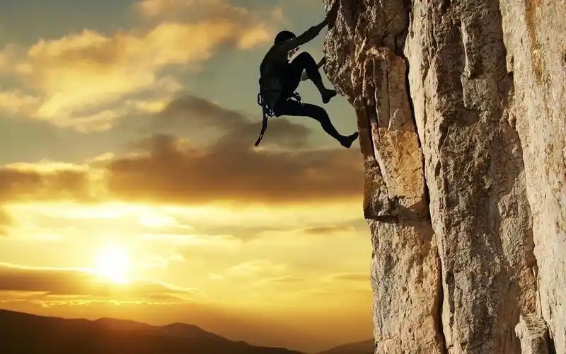
2025年浙江省温州二模英语
试卷讲评课件
郑素红

Slide 3
PART 1
阅读理解

Slide 4
语篇 | 体裁 | 话题 | 主要内容
 | 应用文 | Natural Reader | 介绍该程序的功能以及订阅方案，应用场景和拓展程序等。
 | 记叙文 | Yashaswi Bista‘s action against malaria | 斯坦福学生组织Stanford SupplyHer主席Yashaswi Bista在参与全球健康课程后，积极投身抗疟疾倡导行动的故事。
 | 说明文 | Impact of food waste and from visitors on ecosystem | 食物残渣或垃圾以及公共土地的游客的累积效应都会对生态造成长期的影响，呼吁公众提高环保意识，关注生态。
 | 说明文 | A robot performing inspections without saving sensitive information. | 介绍了普林斯顿学生Lepowsky研发的核武器检查机器人，旨在通过非侵入式、零数据存储的方式解决传统核军控检查中的信任危机。
七选五 | 议论文 | No –spend challenge | 介绍了“无消费挑战”的理财理念：通过暂停非必要开支来控制消费习惯，核心并非完全禁止消费，而是区分“必需品”和“消费欲望”，培养理性消费习惯而非压抑消费需求。
A
B
c
D

Slide 5


A 篇
Natural Reader ，是一款高性价比的AI文本转语音工具，主打声音克隆与多格式兼容，免费版满足基础需求，Plus版适合进阶用户与商业场景，助力打造个性化语音内容。向用户介绍如何使用。

Slide 6
Drag and drop your files, or type, paste, and edit text here.
Natural Reader is a professional text-to-speech program that changes any text, PDF, image, webpage and physical book into natural-sounding audio(音频) featuring the newest and highest AI voice technology.
We have both free and paid subscriptions to our applications to meet different users' needs on different budgets.
Free users can use any available Free Voices unlimitedly, sample Premium Voices for 20 minutes per day, and Plus Voices for 5 minutes per day.
Our Plus subscription includes exclusive(专有的) features such as access to Plus and LLM(Large Language Model)Voices, which are our newest and most advanced voices. Using LLM technology, you can even clone your own voice in minutes and make it speak in over 100 languages. You can also listen on the go with our mobile app. By using your phone's camera, you can scan physical books and notes and change them into speech. Offline listening is also supported, making it convenient for travel or other situations where internet access is limited.
If you are interested in using our voices for non-personal purposes, such as YouTube videos,e-learning, or other commercial or public projects, please check out our Natural Reader AI Voice Generator web application for more information and licensing options.
Our Chrome extension allows you to listen to webpages, Google Docs, online Kindle books, and emails directly from your browser. The extension supports both free and subscription voices, depending on your plan.
Natural Reader 程序概述
订阅方案
应用场景
推理判断题
23. What is the text?
A. A subscription plan. B. A program user guide.
C. A job advertisement. D. A mobile app review.
程序拓展
Natural Reader 程序概述

Slide 7

主题语境--人与社会
A 篇：应用文
Drag and drop your files, or type, paste, and edit text here.
Natural Reader is a professional text-to-speech program that changes any text, PDF, image, webpage and physical book into natural-sounding audio(音频) featuring the newest and highest AI voice technology.
点击添加标题
细节理解题
21. What is the major function of Natural Reader?
A. Create videos. B. Write a speech.
C. Generate images. D. Turn text into audio.

Slide 8
Our Plus subscription includes exclusive(专有的) features such as access to Plus and LLM (Large Language Model) Voices, which are our newest and most advanced voices. Using LLM technology, you can even clone your own voice in minutes and make it speak in over 100 languages. You can also listen on the go with our mobile app. By using your phone's camera, you can scan physical books and notes and change them into speech. Offline listening is also supported, making it convenient for travel or other situations where internet access is limited.
点击添加标题
细节理解题
22. What is only available for paid subscription?
A. Offline use of LLM. B. Automatic text translation.
C. Efficient voice cloning. D. Access to digitalized books.

Slide 9
A 篇：语料库
1. edit text 编辑文本
2. paid subscription 付费订阅
3. on different budgets 依据不同的预算
4. clone vt. 克隆
5. offline listening 离线收听
6. Voice Generator 语音生成器
7. browser 浏览器

Slide 10

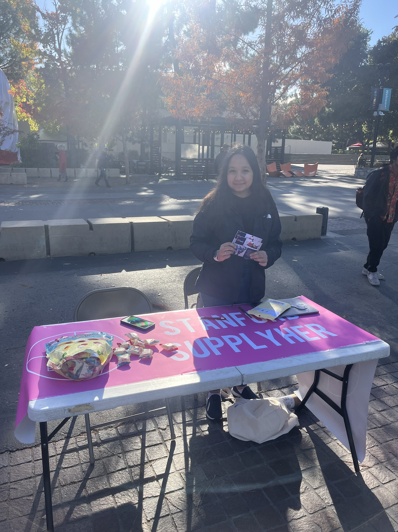
B 篇
Yashaswi Bista

Slide 11
After taking an introductory course in global health last winter, Yashaswi Bista, president of Stanford SupplyHer, was empowered to take action against malaria —— a disease that has been claiming hundreds of thousands of lives every year for centuries.
Stanford SupplyHer, a student group supporting women's health through art, hosted an event in partnership with United to Beat Malaria (UBM) to encourage funding for malaria prevention, treatment and research initiatives while tabling at White Plaza last Monday. “Knowing that malaria is especially dangerous to pregnant individuals and children makes advocacy for malaria funding and research essential for our mission,” said Bista.
“We in the U. S. need to be aware of the impact of global warming on malaria because less developed countries in other parts of the world are more heavily affected by our emissions,” Bist a said. Last year, the U. S. experienced its first local outbreaks of malaria since 2003. Infectious disease experts have warned that climate change will spread malaria and other diseases carried by mosquitoes to areas that were once free of malaria.
This summer, after discovering the work of UBM, a global grassroots campaign of the UN Foundation, Bista met with her congressional (国会的) representatives to advocate for malaria treatment and research. To support continued funding for global malaria programs, Bista wrote to officials in Congress. “It's easy for people to feel like they are powerless with issues as big as malaria. But any person can give input to their decision makers on issues as big as these,” wrote Maegan Cross, a senior advocate at UBM. “By sending messages to your elected officials in support of global health funding, you are making sure your voice is heard.”
Bista encouraged students to become involved in initiatives on campus to spread awareness of malaria and other global health issues. “Global health is important to me because there are so many health inequities(不平等) around the world and health itself is important to live a fulfilling life,” Bista said. “Because there are so many health inequities around the world, I want to raise awareness and help people live fulfilling lives.”
Motive & Action
background
Analysis of Malaria
action
Natural Reader 程序概述

Slide 12
主题语境--人与社会
B 篇：记叙文
(Para. 1) After taking an introductory course in global health last winter, Yashaswi Bista, president of Stanford SupplyHer, was empowered to take action against malaria —— a disease that has been claiming hundreds of thousands of lives every year for centuries.
点击添加标题
24. What inspired Bista to engage in actions against malaria?
A. A learning experience. B. A health crisis.
C. A grassroots campaign. D. A tabling event.
细节理解题

Slide 13
主题语境--人与自我
B 篇：记叙文
(Para. 2) Stanford SupplyHer, a student group supporting women's health through art, hosted an event in partnership with United to Beat Malaria (UBM) to encourage funding for malaria prevention, treatment and research initiatives while tabling at White Plaza last Monday. “Knowing that malaria is especially dangerous to pregnant individuals and children makes advocacy for malaria funding and research essential for our mission,” said Bista.
点击添加标题
细节理解题
25. What did Bista do to support malaria prevention?
A. She organized a charity sale. B. She launched a research project.
C. She campaigned for fundraising. D. She budgeted for malaria treatment.

Slide 14
(Para. 4) This summer, after discovering the work of UBM, a global grassroots campaign of the UN Foundation, Bista met with her congressional (国会的) representatives to advocate for malaria treatment and research. To support continued funding for global malaria programs, Bista wrote to officials in Congress. “It's easy for people to feel like they are powerless with issues as big as malaria. But any person can give input to their decision makers on issues as big as these,” wrote Maegan Cross, a senior advocate at UBM. “By sending messages to your elected officials in support of global health funding, you are making sure your voice is heard.”
点击添加标题
细节理解题
26. What is the message Maegan Cross intends to convey?
A. Community voices secure health funding.
B. Malaria outbreaks are difficult to prevent.
C. The public needs more knowledge about health.
D. Individual efforts matter in government decisions.

Slide 15
(Para. 1) After taking an introductory course in global health last winter, Yashaswi Bista, president of Stanford SupplyHer, was empowered to take action against malaria —— a disease that has been claiming hundreds of thousands of lives every year for centuries.
(Para. 5) Stanford SupplyHer, a student group supporting women's Bista encouraged students to become involved in initiatives on campus to spread awareness of malaria and other global health issues. “Global health is important to me because there are so many health inequities(不平等) around the world and health itself is important to live a fulfilling life,” Bista said. “Because there are so many health inequities around the world, I want to raise awareness and help people live fulfilling lives.”
点击添加标题
归纳概括题
27. Which of the following best describes Bista?
A. A health advocate. B. A club founder.
C. A woman pioneer. D. A disease specialist.

Slide 16
B 篇：语料库
1. be empowered to do sth 被授权去做…
2. take action against malaria 采取行动对抗疟疾
3. research initiative 研究计划
4.advocacy for …的宣传
5.advocate for …倡导….
6. be free of …没有…
7. become involved in initiatives on campus
积极参加校园活动
8. live a fulfilling life 充实地生活

Slide 17
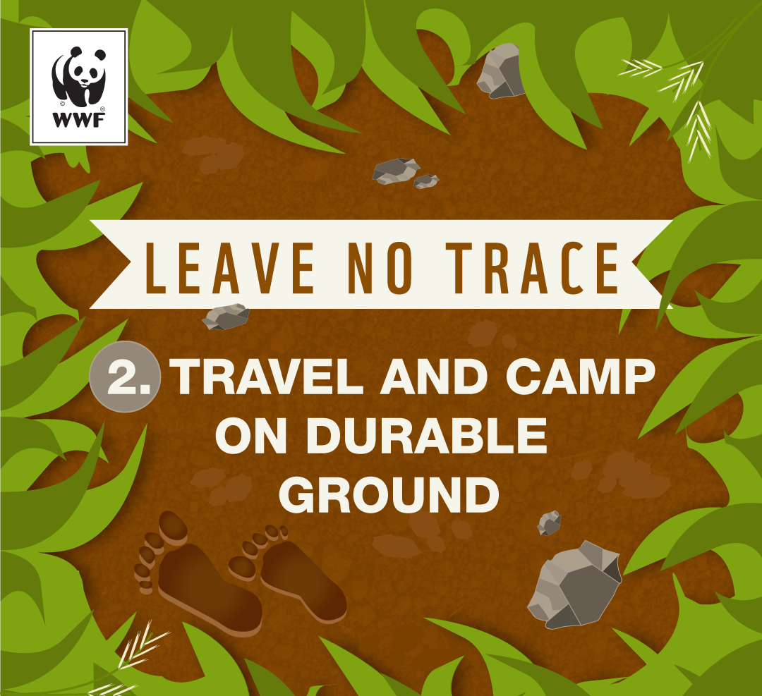

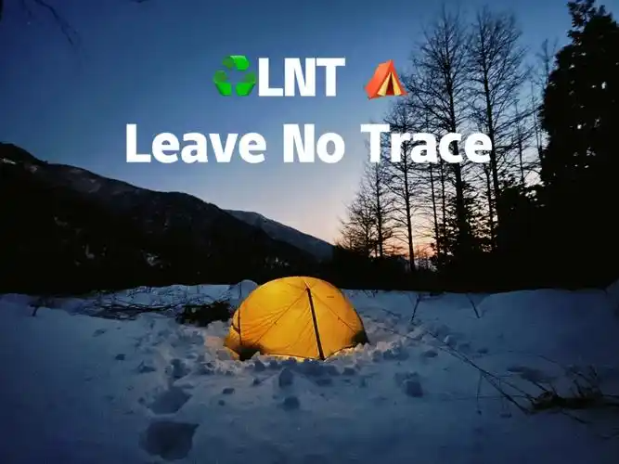
C 篇
旅游需谨慎！请勿留痕！

Slide 18
A dropped bag of chips disturbed a cave ecosystem in Carlsbad Caverns National Park,New Mexico. This cave is almost cut off from the outside world,so introducing anything foreign can be harmful."Things in the damp cave get wet quickly,"says park guide Ashley.The snack attracts tiny organisms,causing unwanted growth.Soon, small animals like crickets and spiders came to eat,spreading the pollution.Rangers found the bag within hours. "But that can be all it takes,"says Ashley."I'm sure some crickets got a bit of the snack."
Over 500 million people visit American public lands each year,creating many chances to harm wild places.“When you look at the numbers,it's incredible,”says Watts,head of the Leave No Trace Center in Colorado,an organization aimed at minimizing human impact on nature.
Food waste takes a long time to break down, especially in certain areas."It takes much longer for an apple core to rot in a desert than in a forest,"says Blye,a teacher at the University of Utah.Leaving waste introduces animals to an unnatural diet and changes their behavior with sometimes disastrous results.Bears who taste garbage and become a threat to humans may have to be put down."Bears can get used to unnatural food in three weeks," says Watts."Everyone loses in this case."
Biological waste is also problematic.Dog waste brings new bacteria into the ecosystem and scares away deer.Meanwhile,human waste and toilet paper introduces dangerous bacteria into water sources.
In national parks,trails(小路)are designed to avoid sensitive areas.Stepping off the trail,even for a quick photo,can scare wildlife away.Impacts from many visitors result in long-term damage to nature and wildlife. But people don't think of that when they see the perfect photo opportunity."It's just such a hard thing to resist,"says Blye.The risk to sensitive ecosystems isn't obvious."It's easy to think,oh,there's wildflowers over there.I shouldn't step on that,"says Blye,but these tiny ecosystems full of microscopic organisms essential to desert life provide many benefits,including reducing the risk of erosion(侵蚀)and helping absorb rainfall,and can take hundreds of years to return to its original state.
Leading in
Common phenomenon
Impact on animals
Impact on ecosystem
People’s unawareness

Slide 19
主题语境--人与自然
C 篇：夹叙夹议文
(Para. 1) A dropped bag of chips disturbed a cave ecosystem in Carisbad Caverns National Park, New Mexico. This cave is almost cut off from the outside world, so introducing anything foreign can be harmful. “Things in the damp cave get wet quickly,” says park guide Ashley. The snack attracts tiny organisms, causing unwanted growth. Soon, small animals like crickets and spiders came to eat, spreading the pollution. Rangers found the bag within hours. “But that can be all it takes,” says Ashley.“I'm sure some crickets got a bit of the snack.”
点击添加标题
28. What does Ashley mean by “But that can be all it takes.”?
A. The rangers' work is efficient. B. The damage has been done.
C. The cleanup takes a long time. D. The pollution has spread widely.
句义猜测题

Slide 20
（ Para. 3) Food waste takes a long time to break down, especially in certain areas. “It takes much longer for an apple core to rot in a desert than in a forest,” says Blye, a teacher at the University of Utah. Leaving waste introduces animals to an unnatural diet and changes their behavior with sometimes disastrous results. Bears who taste garbage and become a threat to humans may have to be put down. “Bears can get used to unnatural food in three weeks,” says Watts. “Everyone loses in this case.”
点击添加标题
细节理解题
29. What is a result of foreign waste in public lands?
A. A shift in animal behavior. B. A shortage of food supplies.
C. A decline in bacterial species. D. An increase in regional conflicts.

Slide 21
（ Para. 5) In national parks, trails(小路) are designed to avoid sensitive areas. Stepping off the trail, even for a quick photo, can scare wildlife away. Impacts from many visitors result in long-term damage to nature and wildlife. But people don't think of that when they see the perfect photo opportunity. “It's just such a hard thing to resist,” says Blye. The risk to sensitive ecosystems isn't obvious. “It's easy to think, oh, there's wildflowers over there. I shouldn't step on that,” says Blye, but these tiny ecosystems full of microscopic organisms essential to desert life provide many benefits, including reducing the risk of erosion(侵蚀) and helping absorb rainfall, and can take hundreds of years to return to its original state.
点击添加标题
30. Why does the writer mention wildflowers in paragraph 5?
To praise their benefits to desert life.
B. To highlight our damage to ecosystems.
C. To stress their significance for photography.
D. To show our unawareness of nature's sensitivity.
推理判断题

Slide 22
（ Para. 5) In national parks, trails(小路) are designed to avoid sensitive areas. Stepping off the trail, even for a quick photo, can scare wildlife away. Impacts from many visitors result in long-term damage to nature and wildlife. But people don't think of that when they see the perfect photo opportunity. “It's just such a hard thing to resist,” says Blye. The risk to sensitive ecosystems isn't obvious. “It's easy to think, oh, there's wildflowers over there. I shouldn't step on that,” says Blye, but these tiny ecosystems full of microscopic organisms essential to desert life provide many benefits, including reducing the risk of erosion(侵蚀) and helping absorb rainfall, and can take hundreds of years to return to its original state.
(Para. 1) A dropped bag of chips disturbed a cave ecosystem in Carisbad Caverns National Park, New Mexico. This cave is almost cut off from the outside world, so introducing anything foreign can be harmful. “Things in the damp cave get wet quickly,” says park guide Ashley. The snack attracts tiny organisms, causing unwanted growth. Soon, small animals like crickets and spiders came to eat, spreading the pollution. Rangers found the bag within hours. “But that can be all it takes,” says Ashley.“I'm sure some crickets got a bit of the snack.”
(Para. 2) Over 500 million people visit American public lands each year, creating many chances to harm wild places. “When you look at the numbers,it's incredible,” says Watts, head of the Leave No Trace Center in Colorado,an organization aimed at minimizing human impact on nature.
推理判断题
31. It is conveyed in this passage that we should .
A. encourage wildlife B. leave no trace in the wild
C. promote national park tourism D. restore ecological damage

Slide 23
disturb a cave ecosystem
扰乱洞穴生态系统
2. is cut off from the outside world
与外界隔绝
3. minimize human impact on nature
减少人类对自然的影响
4. break down 分解
5. rot vi. 腐烂
6. problematic
7. scare away 吓走
8. bacteria 细菌
absorb rainfall 吸收降雨
leave no trace 不留痕迹
C 篇 语料库

Slide 24
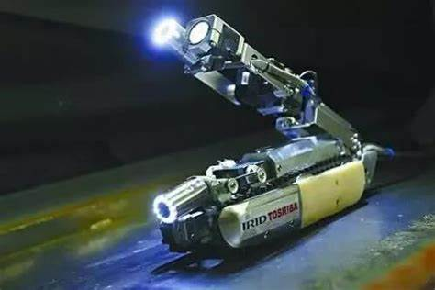

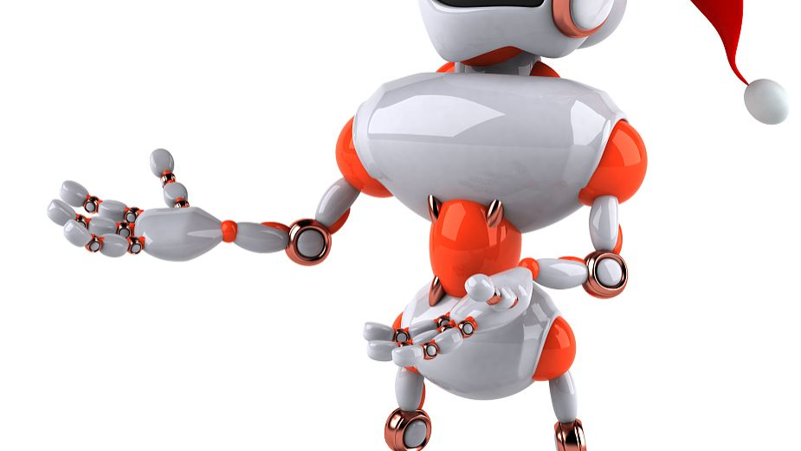
D 篇
检查核武器的机器人

Slide 25
In the risky world of nuclear arms control, Princeton student Lepowsky is exploring how robots can make inspections more accurate and acceptable to host nations worried about invasive (侵入的)traditional methods. His latest research has led to a robot performing inspections without saving sensitive information.
“The host nation likely won't want a human inspector poking their nose around,” said Lepowsky.“But even a robot has memory and sensors acquiring data.” The goal is to have high-confidence inspections without the robot saving information. For example, the robot would not save radiation measurements or create floor plans of sensitive areas.
The new prototype(样机) is built on an iRobot Create 3 platform, an educational robot. Robots offer advantages over human inspectors: they can tolerate higher radiation levels, are more consistent, and can be cheaper. They also can be programmed to generate trust, such as not using cameras to avoid seeing unwanted details. The idea for the robot started with Lepowsky's adviser, Glaser, who was curious about creating a “forgetful robot” that could perform highly accurate nuclear arms inspections but forget everything afterward. This led to an even more interesting idea: “Rather than forgetting, we' re not even remembering in the first place,” Lepowsky said. He believes this feature can reassure hosts concerned about privacy.
Lepowsky likes the interdisciplinary nature of his work - - - drawing on both his robotics and policy expertise —— and he likes that it requires a breadth of knowledge, not just depth. He values that his research is grounded in real-life applications for global security and nuclear nonproliferation(防扩散).
Predicting when the robot might be used in the field is difficult. “It's easy to say, today, it's not very realistic, but you have to be ready for if and when it becomes possible,” said Lepowsky. Research into this problem is very active. Because arms control is changing, the specific objectives of future agreements are hard to predict. “But we can hope they will be positive, and we need to be ready, technically.”
A latest research
advantage
design mechanism
Lepowsky’s opinion
challenges and prespect

Slide 26
D 篇：说明文
主题语境--人与社会
(Para. 2) “The host nation likely won't want a human inspector poking their nose around,” said Lepowsky.“But even a robot has memory and sensors acquiring data.” The goal is to have high-confidence inspections without the robot saving information. For example, the robot would not save radiation measurements or create floor plans of sensitive areas.
点击添加标题
32. In which aspect is Lepowsky's robot different from human inspectors?
Data security. B. Memory capacity.
C. Social acceptance. D. User friendliness.
细节理解题

Slide 27
（ Para. 3) The new prototype(样机) is built on an iRobot Create 3 platform, an educational robot. Robots offer advantages over human inspectors: they can tolerate higher radiation levels, are more consistent, and can be cheaper. They also can be programmed to generate trust, such as not using cameras to avoid seeing unwanted details. The idea for the robot started with Lepowsky's adviser, Glaser, who was curious about creating a “forgetful robot” that could perform highly accurate nuclear arms inspections but forget everything afterward. This led to an even more interesting idea: “Rather than forgetting, we' re not even remembering in the first place,” Lepowsky said. He believes this feature can reassure hosts concerned about privacy.
点击添加标题
归纳概括题
33. What is said about the robot in paragraph 3?
A. Its accurate system. B. Its privacy risks.
C. Its design mechanism. D. Its operational problems.

Slide 28
（ Para. 4) Lepowsky likes the interdisciplinary nature of his work - - - drawing on both his robotics and policy expertise —— and he likes that it requires a breadth of knowledge, not just depth. He values that his research is grounded in real-life applications for global security and nuclear nonproliferation(防扩散).
点击添加标题
34. What does Lepowsky like about his work?
Scientific research data.
B. Real-time technical cooperation.
C. In-depth theoretical studies.
D. Integrated knowledge across fields.
细节理解题

Slide 29
（ Para. 1) In the risky world of nuclear arms control, Princeton student Lepowsky is exploring how robots can make inspections more accurate and acceptable to host nations worried about invasive(侵入的)traditional methods. His latest research has led to a robot performing inspections without saving sensitive information.
点击添加标题
主旨概括题
35. Which would be the best title for this passage?
A. Princeton's “Forgetful” Robots in Global Security
B. No-Memory Robots: The Future of Nuclear Checks?
C. Nuclear Arms Control: Robots or Human Inspectors?
D. Lepowsky's “Curious” Robots for Radiation Detection

Slide 30
1. nuclear arms 核武器
2. inspector 检查员 inspection 检查
3. create floor plans of sensitive areas
绘制敏感区域的平面图
4. tolerate higher radiation levels
容忍较高的辐射水平
5. generate trust 产生信任
6. robotics and policy expertise
机器人技术和政策专业知识
7. a breadth of knowledge 广博的知识
8. be grounded in real-life applications
以实际应用为基础
9. the specific objectives 具体目标
10. Memory capacity 存储容量
11. design mechanism 设计机制
D 篇 语料库

Slide 31
PART 2
七选五

Slide 32

首先观察选项设置的特点：
主题语境与语篇分析-- 七选五
A. Decide acceptable purchases.
B. What is a no-spend challenge?
C. There should be no quick-fix approach.
D. When will you start your no-spend challenge?
E. Why not treat it as more of a lifestyle change?
F. Sometimes the best way is to go on a spending freeze.
G. A no-spend challenge can be a boost to your financial situation.
应急方法
B、 D两个选项句式一致，都是问句且均有消费冻结，可能会产生冗余选项；

Slide 33
The less you spend, the more you save. It sounds simple in theory, but in practice, it's much more complicated. Spending is built into our daily habits, which sometimes can get us addicted to buying stuff. F36 It's kind of like a crash diet, but in a good way!
B37
Despite the name, a no-spend challenge doesn't mean you sit on your hands and spend no money whatsoever. After all, you don't want to fall behind on your bills, and there are some necessities you simply can't do without. The basic premise(前提) of a no-spend challenge is to cut out non-essential spending for a certain amount of time. It could be for a week, a month or even an entire year.
What can you spend money on during a no-spend challenge?
If you need to purchase something during your no-spend challenge, it should be something that's necessary and you absolutely can't do without. So groceries, yes. Candy bar in the checkout line, no.Also, no new iPhone, even if you' ve been dreaming about an upgrade. No new shoes, even if they' re on a huge sale. This is not the time to make excuses to buy staff you don't really need. 38 The goal of this challenge isn't to make life harder on yourself by cutting out spending on essential expenses.
37 B. What is a no-spend challenge?
D. When will you start your no-spend challenge? （该选项为冗余选项）
解释说明no-spend challenge的含义
36 F. Sometimes the best way is to go on a spending freeze.
( 空格后it = a spending freeze. 且the best way = a good way )

Slide 34
What can you spend money on during a no-spend challenge?
If you need to purchase something during your no-spend challenge, it should be something that's necessary and you absolutely can't do without. So groceries, yes. Candy bar in the checkout line, no. Also, no new iPhone, even if you' ve been dreaming about an upgrade. No new shoes, even if they' re on a huge sale. This is not the time to make excuses to buy stuff you don't really need. 38 The goal of this challenge isn't to make life harder on yourself by cutting out spending on essential expenses.
38 A. Decide acceptable purchases.
acceptable purchases 可接受的购买物
39. G. A no-spend challenge can be a boost to your financial situation.

Slide 35
The financial benefits of a no-spend challenge
39 G You can use the extra money you normally would have spent to build up your emergency fund. Or you might want to put the money toward other financial goals, like saving for a new car or an upcoming vacation.
While no-spend challenges are designed to be temporary, you can always extend your challenge. 40 E
39. G. A no-spend challenge can be a boost to your financial situation.
40. C. There should be no quick-fix approach. （ 提出消费冻结的做法来达到攒钱的目的，可见该选项与文章主旨背离；故为冗余选项。）
E. Why not treat it as more of a lifestyle change?

Slide 36
PART 3
完形填空
父亲带我去爷爷曾经带他去游泳的冰水里游泳

Slide 37
When my dad planned out a trip to La Mina Falls in the El Yunque National Rainforest, I was not really into it, and I went along 41 .
I've never been fond of cold water. If the 42 isn't to my liking, I'm not going to 43 myself from the pool's edge like a missile(导弹). I'm the type of person who 44 their time easing into the water, lowering myself step-by-step, and 45 my body to get used to the icy depths.
My complicated relationship with water is 46 my dad, who I don't think has ever looked 47 he dived. I wasn't raised on the river like he was. Shortly after I was born, we 48 to central Florida, far away from the rapids of my father's youth.
When we finally made it to the La Mina Fails, I was worn out. My dad was already knee-deep in the water and 49 fast, while I was resting on a rock: He paused, looking over at me and 50 .perhaps for the first time, that I had 51 him into the forest. He waved his hand at me, and I 52 my shoes. I knew if I touched the water with my toe in the first place, I wouldn't get in. So, I jumped into the 53 water, not completely without hesitation, where a 54 combination of accomplishment and regret washed over me.
When I broke the surface, I 55 my dad staring at me. “Your grandfather brought me here once when I was a kid.” His voice faded away into the water.
Dad’s plan
My feeling for cold water
reason & my dad’s different feeling for cold water
My first experience in the freezing water
Significance for my Dad

Slide 38
When my dad planned out a trip to La Mina Falls in the El Yunque National Rainforest, I was not really into it, and I went along 41 .
I've never been fond of cold water. If the 42 isn't to my liking, I'm not going to 43 myself from the pool's edge like a missile(导弹). I'm the type of person who 44 their time easing into the water, lowering myself step-by-step, and 45 my body to get used to the icy depths.
41. A. anxiously B. hesitantly C. curiously D. enthusiastically
42.A. time B. Coach C. Sport D. temperature
43.A. keep B. launch C. excuse D. rescue
44.A. measures B. saves C. takes D. kills
45.A. allowing B. controlling C. examining D. risking
launch发射
take one’s time 慢慢来

Slide 39
My complicated relationship with water is 46 my dad, who I don't think has ever looked 47 he dived. I wasn't raised on the river like he was. Shortly after I was born, we 48 to central Florida, far away from the rapids of my father's youth.
in opposition to = contrary to
in response to 响应…
at the mercy of…任凭…摆布
on behalf of 代表
46. A. in opposition to B. in response to C. at the mercy of D. on behalf of
47. A. once B. before C. because D. if
48. A. escaped B. journeyed C. relocated D. returned
relocate 搬迁

Slide 40
When we finally made it to the La Mina Falls, I was worn out. My dad was already knee-deep in the water and 49 fast, while I was resting on a rock. He paused, looking over at me and 50 perhaps for the first time, that I had 51 him into the forest. He waved his hand at me, and I 52 my shoes. I knew if I touched the water with my toe in the first place, I wouldn't get in. So, I jumped into the 53 water, not completely without hesitation, where a 54 combination of accomplishment and regret washed over me.
49. A. floating B. withdrawing C. breathing D. sinking
50.A. realizing B. regretting C. admitting D. agreeing
51. A. challenged B. forced C. accompanied D. guided
52. A. stared at B. reached for C. kicked off D. dusted down
53. A. flooding B. appealing C. flowing D. freezing
54. A. confusing B. regular C. similar D. simple
kick off 踹掉、踢掉； 开始
dust down 清楚灰尘

Slide 41
When I broke the surface, I 55 my dad staring at me. “Your grandfather brought me here once when I was a kid.” His voice faded away into the water.
catch sb doing sth 发现某人正在做某事
55. A. left B. pictured C. stopped D. caught

Slide 42
PART 4
语法填空

Slide 43
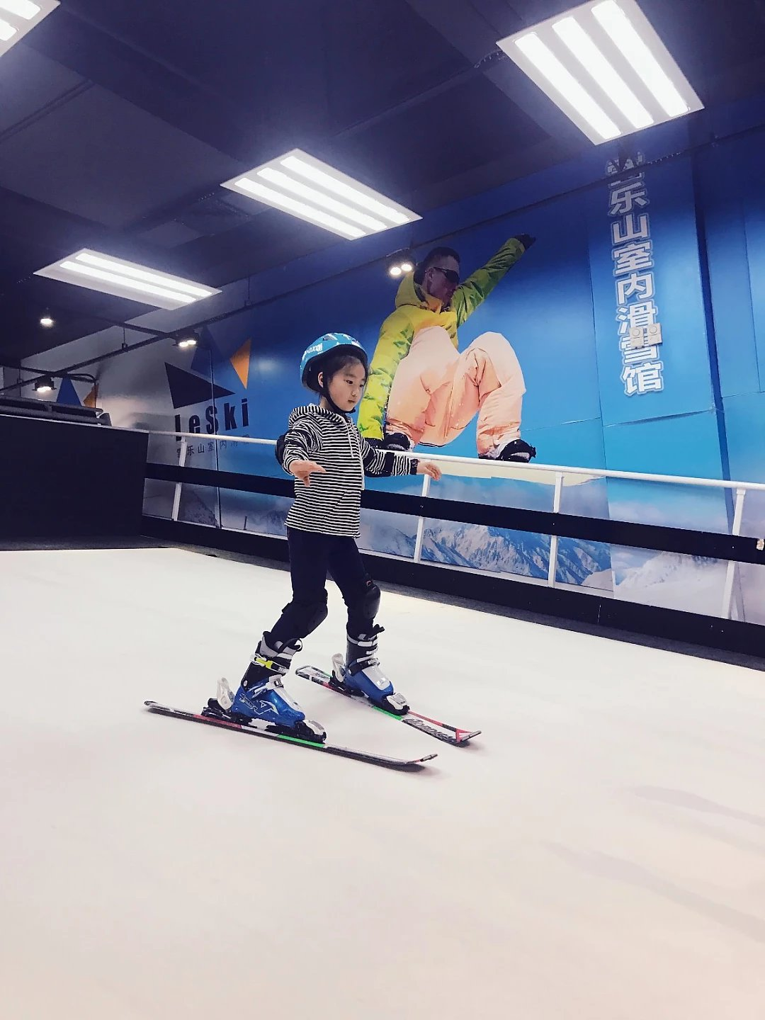
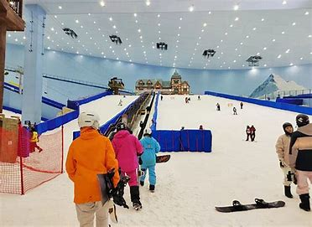
主题语境：人与社会
主旨大意：中国室内滑雪市场的爆发式增长以及相关装备的销售激增
设空类型：有提示词6，无提示词4

Slide 44
考查时态，一般现在时 be packed with 表状态:
At the National Alpine Skiing Center of China, ski instructor Xin Dawei is welcoming the busiest snow season in his 9-year career. “My schedule 56 (pack) with classes each day. The number of instructors here has grown by about a third this year to meet the fast-rising demand, 57 hiring is still going on,” he told China Economic Net (CEN) reporter.
In 2024, on JD.com , 58 go-to e-commerce platform for Chinese device buyers, sales of ski-related equipment 59 (record) impressive growth, with sales of ski goggles(护目镜),snowshoes and snowboards all 60 (rise) by more than 80% year-on-year.
be packed
考查并列句
and
考查定冠词，表初次提及某物,其后整个名词短语为JD.com的同位语
a
考查时态，in 2024 一般过去时
recorded
rising
考查非谓语with 结构表伴随状态

Slide 45
Out of the top ten most rapidly growing ski related equipment markets in China over the past year, eight are southern cities. In these warm regions, enthusiasts turn indoors to experience 61 (familiar) snow fields they rarely saw before, or even make 62 part of their post-work fitness routine.
China has become the world's largest indoor ski market, home to over half of world's total and six out of the ten biggest ones 63 (global). Daniel, Founder of iCeMonster, a startup high-tech snow goggles seller, said that he is shifting his focus 64 international market to China. “We' re a late 65 (come), but business is going on well,” he said.
考查词的变形，需要根据下文的定语从句来确定逻辑意义
unfamiliar
it
考查词的变形
考查代词 it 指代ski 需要考生理解上下文的意思。
globally
考查介词 from A to B
from
考查词的变形
comer

Slide 46
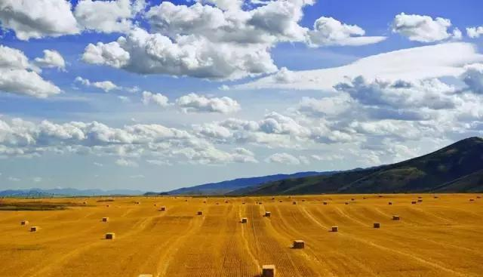
BEST WISHES!

