Slide 1


感恩遇见，相互成就，本课件资料仅供您个人参考、教学使用，严禁自行在网络传播，违者依知识产权法追究法律责任。
更多教学资源请关注
公众号：溯恩英语
知识产权声明

Slide 2
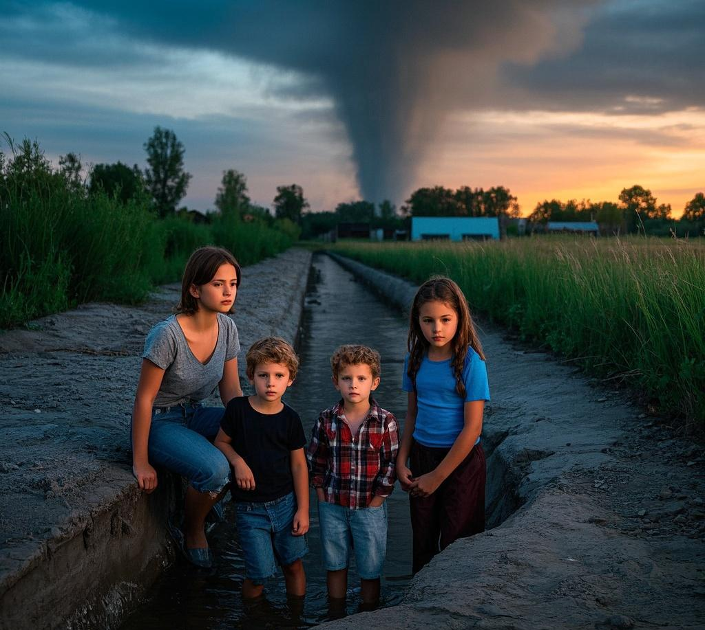
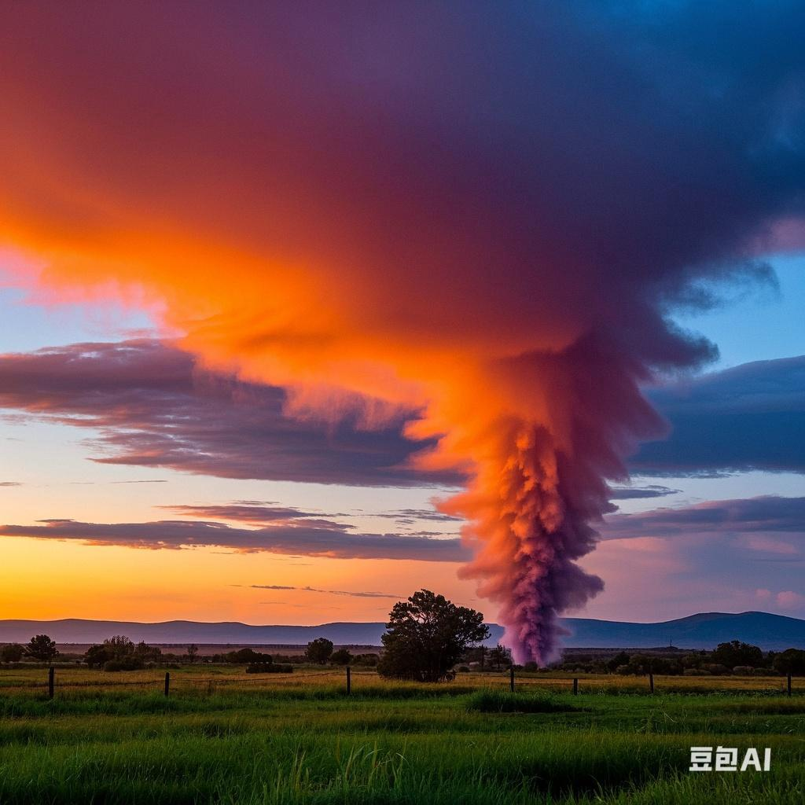
2025读后续写备考策略：
关注：
灾难中人物
动作和心理的描写
厦门第二次质量检测为例
龙卷风中的守护
刘艳

Slide 3
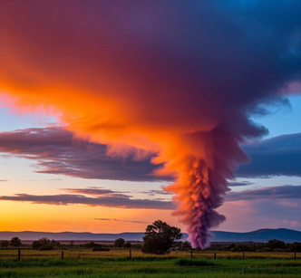
灾难中人物动作和心理描写的思维指导
tip1:具象化思维：用 "五感观察法" 构建场景
动作和心理的描写
tip2: 动态化思维（动作链构建）：使用路径变化，时间轴梳理动作逻辑
tip3: 情感化思维（心理层次挖掘）运用 “洋葱模型” 逐层剖析 （心理表层情绪--深层动机--感认知变化）
tip4: 隐喻化思维（象征手法）

Slide 4
厦门二检
①A This morning, I asked Mom to take me to the pool. But she reminded me I'd watch kids for her as she got a job interview at the radio station. Still, I asked, “Couldn't Julie watch them instead?”
②“She can help, Jess, but she's only ten. I'll feel better with a fifteen-ycar-old in charge, honey." Mom gave me a hug and off she went.
③So there I was, stuck watching my five year-old sister Lyssa and three-year-old brother Dougie. I usually don't mind watching the kids, but the problem was our little rented trailer house(拖车房屋).It's like living in a barbecue cooker in hot days. Well, as is said, “What is, is." and I decided to make the best of it.
④We moved out into the front yard and I filled a paddling pool for the kids. I noticed that the sky looked a little strange greenish-yellow, with gray clouds rising for miles-but I didn't think anything of it. As kids jumped in the pool, I settled down to read my magazine. I put on headphones and turned the volume up loud enough to block out their noise. Before long I got lost in a cool story.
⑤I was almost at the end when Julie came over to me, dropping water on my article. I took my headphones off, "Hey, what's wrong with you?" She pointed upwards. That's when I saw the sky and about fell off my chair. Not only had the clouds moved toward us, they were swirling (打旋). I hadn't realized how much the wind had picked up. A huge, gray-black funnel (漏斗) snaked down from the sky to the ground-a real, live tornado! And it headed our way at a high speed!
⑥Though I had learned about tornado safety, at that moment, the only thing I could remember was that a tornado develops fast and that trailer houses are the worst place to take shelter. I tried hard to remember other safety tips. Get low. Yeah. If you're caught outside, find the lowest spot. Scanning around, my eye stopped on a line of bushes.
注意: 续写词数应为150个左右;
Para1 There was a ditch (沟渠) there for shelter, a hundred yards off.
Para2 But in a couple of minutes, the tornado was over.

Slide 5
记叙文要素
Time | A summer night.
Place | Home (a rented trailer house) and the front yard.
Characters | Jess, who is 15 years old and in charge of taking care of her younger siblings; Julie, 10 years old; Lyssa, 5 years old; Dougie, 3 years old; and their mother.
Contradiction | While the mother goes for a job interview and Jess is looking after the kids, a tornado approaches. The trailer house is not a safe place to take shelter, and Jess urgently needs to find a secure location.
Responsibility and quick thinking turn ordinary teens into heroes. When disaster strikes, the courage to act with clarity of mind can rewrite survival stories.

Slide 6
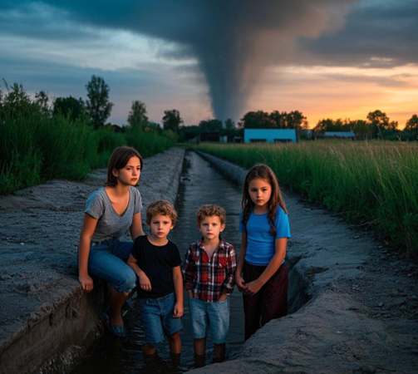
Para1 ：There was a ditch (沟渠) there for shelter, a hundred yards off.
tip: 动态化思维（动作链构建）：使用时间轴梳理动作逻辑
情节搭建
How did they reach the ditch?
（动作+语言+感受+ 五感）
What were their thoughts and feelings during the tornado in the ditch ?
难点+重点1：动作描写:转移的路径+转移动作（飓风中的前行）
难点+重点2：在ditch避难中的动作行为+心理活动
tip: 情感化思维（心理层次挖掘）运用 “洋葱模型” 逐层剖析 （心理表层情绪--深层动机--感认知变化）
Para2： But in a couple of minutes, the tornado was over.

Slide 7
P 2 ： But in a couple of minutes, the tornado was over.
1 What were their thoughts and feelings as they walked out of the ditch?
2 How did they react when the tornado finally passed?
3 What kind of growth and realizations did Jess and her siblings have during the tornado?
tip:具象化思维：用 "五感观察法" 构建场景
tip: 情感化思维（心理层次挖掘）运用 “洋葱模型” 逐层剖析 （心理表层情绪--深层动机--感认知变化）
tip: 隐喻化思维（象征手法）

Slide 8
Para1 ：There was a ditch (沟渠) there for shelter, a hundred yards off.
难点+重点1：动作描写:转移的路径+转移动作（飓风中的前行）
视觉 + 动作：
我死死盯着百米外的沟渠，像溺水者抓住浮木。“Julie！抱紧 Dougie，跑！” 话音被狂风卷走。
I fixed my eyes on the ditch a hundred yards away, like a drowning person clutching a driftwood. “Julie! Hold Dougie tight and run!” My voice was swept away by the wind.
听觉 + 动作：
狂风发出刺耳的尖叫，还混着远处铁皮被吹飞的声音。我用力拉着莱萨的手，感觉手都快拉断了，大声喊道：“跟上！别停下！”
The strong wind let out a sharp scream, mixed with the unpleasant sound of tin sheets being blown away in the distance. I pulled Lyssa's hand so hard that I felt my hand was almost broken, and shouted loudly, “Keep up! Don't stop!”
tip:具象化思维：用 "五感观察法" 构建场景

Slide 9
Para1 ：There was a ditch (沟渠) there for shelter, a hundred yards off.
触觉 + 动作：
沙砾如子弹般打在裸露的皮肤上，生疼。我弓着背，用身体挡住弟妹，脚步在狂风中踉跄，每一步都像踩在棉花上。
Gravel hit our bare skin like bullets, hurting a lot. I bent over, protecting my brothers and sisters with my body. My steps were unsteady in the wind, as if I was walking on cotton.
综合动作细节：
Julie 抱着 Dougie，被风推得左摇右晃，我扑过去用手臂环住他们，三人跌跌撞撞向沟渠冲。“快！再坚持！”
Julie, holding Dougie, was pushed staggeringly by the wind. I lunged to wrap my arm around them, and the three of us stumbled toward the ditch. “Faster! Hold on!”
tip:具象化思维：用 "五感观察法" 构建场景

Slide 10
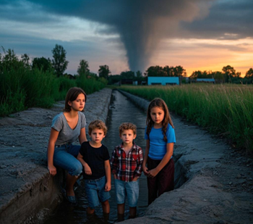
Para1 ：There was a ditch (沟渠) there for shelter, a hundred yards off.
冲刺瞬间动作：
最后几步，风几乎要将我们掀翻。我咬牙冲刺，一脚迈进沟渠边缘，整个人栽进去，却死死护住怀里的 Lyssa。
In the last few steps, the wind nearly blew us over. I gritted my teeth and sprinted, stepping into the ditch’s edge—plunging in, yet holding Lyssa tightly in my arms.
难点+重点1：动作描写:转移的路径+转移动作（飓风中的前行）
tip: 动态化思维（动作链构建）：使用路径变化，时间轴梳理动作逻辑

Slide 11
Para1 ：There was a ditch (沟渠) there for shelter, a hundred yards off.
我紧紧地把弟弟妹妹们压在自己身下，用自己的身体保护他们
I pressed my younger brother and sisters firmly under my body, using my own body to protect them.
触觉 + 心理（升级版）
我的双臂像铁钳般死死箍住 Lyssa 和 Dougie，指甲几乎要嵌进他们汗湿的衣服里。泥土的腥味混着雨水的冰凉钻进鼻腔，我听见自己急促的心跳声震耳欲聋。
My arms clamped around Lyssa and Dougie like iron shackles, my nails almost digging into their sweaty clothes. The earthy smell of mud mixed with the coldness of rain filled my nostrils, and I heard my own rapid heartbeat thundering in my ears.

Slide 12
Para1 ：There was a ditch (沟渠) there for shelter, a hundred yards off.
综合心理刻画：
我的左肩突然一阵剧痛 —— 大概是被碎石击中了。但我甚至不敢哼一声，生怕动摇了此刻的脆弱平衡。妈妈临行前的拥抱还残留着香水味，我在心里疯狂默念：“我必须带他们活着回去...”
A strong pain suddenly hit my left shoulder—maybe from flying debris. But I didn't even make a sound, scared to break the delicate balance. The smell of Mom's perfume still hung in the air from her hug, and I kept repeating in my mind: "I have to save them..."
tip: 情感化思维（心理层次挖掘）运用 “洋葱模型” 逐层剖析 （心理表层情绪--深层动机--感认知变化）

Slide 13
词汇升级：stagger 和 unsteady 的替换
stagger [ˈstæɡə(r)]：蹒跚，摇晃着走
The drunk man staggered down the street.（那个醉汉摇摇晃晃地沿街走去）
lurch [lɜːtʃ]：突然倾斜着移动，蹒跚而行。强调行走时身体不稳定、突然的晃动。
The ship lurched in the storm, and the passengers had difficulty walking.（船在暴风雨中摇晃，乘客们行走困难）
plod [plɒd]：沉重缓慢地走，尤指因疲倦或负重。侧重于描述步伐沉重、缓慢且费力：
He plodded wearily along the path.（他沿着小路疲惫地缓慢前行）
trudge [trʌdʒ]：跋涉，吃力地走。常表示在艰难的路况（如泥泞、雪地等）或因疲惫而艰难地行走。
They trudged through the deep snow.（他们在深雪中艰难跋涉）
drag one's feet：拖着脚走，磨蹭。形象地表达出走路时不情愿、费力的状态。例如：The tired child dragged his feet as he walked home.（那个疲惫的孩子拖着脚走回家）

Slide 14
P 2 ： But in a couple of minutes, the tornado was over.
风停了，曾经震耳欲聋的呼啸声彻底消失了。此刻，只剩下一片怪异的寂静。有时，我们能听到从远处传来一些轻微的撞击声。那些被龙卷风摧毁的建筑物仍在一点一点地慢慢倒塌。
The wind stopped, and the once really loud howl disappeared completely. Now, there was only a strange silence. Sometimes, we could hear some soft crashing sounds from far away. The buildings that the tornado had destroyed were still slowly falling down little by little.
弟弟妹妹们的呼吸逐渐平稳，我也长舒了一口气。在这片寂静中，这口气显得格外清晰。 My younger brother and sisters' breathing got calmer, and I let out a long breath. This breath was very clear in this quiet.

Slide 15
P 2 ： But in a couple of minutes, the tornado was over.
经历龙卷风后，我有一种劫后余生的强烈感觉。我非常欣慰自己成功救下了弟弟妹妹。内心深处，我甚至有点骄傲，因为我在如此危险的情况下保护了他们。
After experiencing the tornado, I have a strong feeling of surviving a disaster. I am very glad that I successfully saved my younger brother and sister. Deep in my heart, I am even a bit proud because I protected them in such a dangerous situation.
tip: 情感化思维（心理层次挖掘）运用 “洋葱模型” 逐层剖析 （心理表层情绪--深层动机--感认知变化）

Slide 16
P 2 ： But in a couple of minutes, the tornado was over.
龙卷风的肆虐在短短九十秒内就摧毁了我们的世界，但它带来的教训却永远刻在了我的心底。这时我明白了，有些东西是课本教不了的 —— 真正的保护不是靠完美的计划，而是在混乱来袭时，能挺身而出成为家人的勇气和智慧。这场龙卷风也是我成长的龙卷风！
The tornado's wild attack destroyed our world in just ninety seconds, but the lesson it brought was forever engraved in my heart. At this moment, I realized that there are some things textbooks can't teach. True protection doesn't depend on perfect plans. Instead, it means having the courage and wisdom to step forward and protect your family when chaos strikes. This tornado was also my "growth storm"!
tip: 隐喻化思维（象征手法）

Slide 17
Judy 下水作文
There was a ditch (沟渠) there for shelter, a hundred yards off. I fixed my eyes on the ditch a hundred yards away, like a drowning person clutching a driftwood. “Julie! Hold Dougie tight and run!” My voice was swept away by the wind. I pulled Lyssa‘s hand so hard that I felt my hand was almost broken. In the last few steps, the wind nearly blew us over. In the ditch, I pressed my younger brother and sisters firmly under my body, using my own body to protect them. A strong pain suddenly hit my left shoulder—maybe from flying debris. But I didn't even make a sound, scared to break the delicate balance.
But in a couple of minutes, the tornado was over. The wind stopped, and the once really loud howl disappeared completely. Now, there was only a strange silence. Sometimes, we could hear some soft crashing sounds from far away. The buildings that the tornado had destroyed were still slowly falling down little by little. After experiencing the tornado, I have a strong feeling of surviving a disaster. I am very glad that I successfully saved my younger brother and sister. At this moment, I realized that there are some things textbooks can't teach. True protection doesn't depend on perfect plans. Instead, it means having the courage and wisdom to step forward and protect your family when chaos strikes. This tornado was also my "growth storm"!
tip1:具象化思维：用 "五感观察法" 构建场景
tip2: 动态化思维（动作链构建）：使用路径变化，时间轴梳理动作逻辑
tip: 情感化思维（心理层次挖掘）运用 “洋葱模型” 逐层剖析 （心理表层情绪--深层动机--感认知变化）
tip4: 隐喻化思维（象征手法）

Slide 18
参考范文
There was a ditch (沟渠) there, a hundred yards off. “Julie,” I yelled, “Get Dougie and follow me.” As she picked Dougie, I grabbed Lyssa. We took off for the ditch. Just before we fell over the edge of it, I looked back. The tornado towered behind our house like a mountain. “Get down!” I shouted. I made everyone lie flat, arms protecting them. The tornado pulled up everything like a hungry monster, taking the breath almost out of our lungs. I thought we were goners for sure.
But the next moment, the tornado was over. I lifted my head and saw the funnel rushing away. Soon all that was left was an unnatural quiet. I crawled off kids, legs trembling like a leaf in the wind. One minute we had a home. The next, all we had was the clothes we’re wearing. I took a deep breath as Mom’s car appeared and came to a stop. Jumping out, she saw us and waved like she’ d won first prize. We lost the house, but we’ve still got each other.

Slide 19
参考范文填空默写练习
There was a ditch (沟渠) there, a hundred yards off. “Julie,” I ____ (大喊), “Get Dougie and follow me.” As she ____ (抱起 Dougie), I ____ (抓住 Lyssa). We ____ (出发前往沟渠). Just before we fell over the edge of it, I looked back. The tornado towered behind our house like a mountain. “Get down!” I shouted. I made everyone lie flat, arms protecting them. The tornado ____ (像饥饿的怪物一样卷起所有东西), taking the breath almost out of our lungs. I ____ (以为我们肯定死定了).
But the next moment, the tornado was over. I lifted my head and saw the funnel rushing away. Soon all that was left was an unnatural quiet. I ____ (从孩子们身上爬下来), legs ____ (像风中的叶子一样颤抖). One minute we had a home. The next, all we had was the clothes we’re wearing. I took a deep breath as Mom’s car appeared and came to a stop. Jumping out, she saw us and ____ (像中了头奖一样挥手). We lost the house, but we’ve still got each other.

Slide 20
经典英文文学作品中灾难，人物动作和心理
《热爱生命》杰克・伦敦
"His knees had become raw meat like his feet, and though he padded them with the shirt from his back, it was a red track he left behind him on the moss and stones. The wolf’s coughing echoed in the silence, its breath hot on his neck. He turned suddenly, his hands grabbing for the wolf’s throat, but his fingers closed on empty air as the creature staggered away."
他的膝盖像双脚一样磨得血肉模糊，尽管用后背的衬衫裹住，苔藓和岩石上仍留下一道触目惊心的血痕。狼的咳嗽声在寂静中回荡，温热的呼吸喷在他颈后。他猛然转身，双手掐向狼的喉咙，但指尖只抓到虚空 —— 病狼踉跄着退开。
《白鲸》赫尔曼・麦尔维尔
"The harpoon flew true, burying itself deep in the whale’s side. A geyser of blood erupted, drenching the deck in crimson. The whale thrashed, its tail smashing the mast like kindling. The men clung to the rigging, salt spray blinding them as the ship tilted dangerously. The air reeked of iron and death.“
鱼叉精准刺入鲸侧，殷红的血柱冲天而起，将甲板染成血色。巨鲸疯狂翻腾，尾鳍将桅杆击得粉碎。船员们死死抓住索具，咸涩的浪花模糊了视线，船身剧烈倾斜。空气中弥漫着铁锈与死亡的气息。

Slide 21
经典英文文学作品中灾难，人物动作和心理
《鲁滨孙漂流记》丹尼尔・笛福
"The waves crashed over the hull, splintering the wood like matchsticks. I clung to the broken mast, my fingers numb with cold. Lightning illuminated the churning sea, revealing sharks circling the wreckage. The taste of bile rose in my throat as the ship sank lower, each wave dragging me closer to the abyss."
海浪拍打着船体，将木板撕得粉碎。我紧紧抱住断裂的桅杆，手指冻得失去知觉。闪电照亮了翻涌的海面，映出鲨鱼在残骸周围游弋。随着船身不断下沉，每一个浪头都将我拖向深渊，胃里泛起阵阵苦涩。
《后天》小说版
"The blizzard howled, ice crystals lacerating exposed skin. I pressed my face into the crook of my arm, gasping for breath. The temperature plummeted past -50°F, my breath freezing mid-air. Trees cracked like gunshots under the weight of ice. Every step felt like wading through quicksand, muscles screaming in protest."
暴风雪呼啸，冰晶割破裸露的皮肤。我将脸埋进臂弯，艰难喘息。气温骤降至零下 50 度，呼出的气瞬间凝成冰雾。树木在冰层重压下爆裂如枪响。每一步都像在流沙中跋涉，肌肉发出痛苦的抗议。

