Slide 1


感恩遇见，相互成就，本课件资料仅供您个人参考、教学使用，严禁自行在网络传播，违者依知识产权法追究法律责任。
更多教学资源请关注
公众号：溯恩英语
知识产权声明

Slide 2
广东省2025届高三一模英语试卷
阅读部分分析
北师大嘉兴附中 吴晨华

Slide 3
题型 | 话题 | 体裁 | 词数 | 题型分布
阅读A | 人与自然：A volunteer project on protecting endangered sea turtles in Sri Lanka | 说明文 | 242 | 主旨1 细节2
阅读B | 人与社会： Steve Bagmanyan and the last repair shop | 记叙文 | 349 | 细节1 主旨1 推理1词义猜测1
阅读C | 人与自我：Look at the stick with different eyes –a great introduction to the concept of Umwelt | 说明文 | 339 | 细节2 推理1 主旨1
阅读D | 人与社会：An introduction to Stanford Duck Syndrome | 说明文 | 328 | 细节1 推理2 主旨1
七选五 | 人与自我： About the Formation of Body Image during Adolescence | 说明文 | 263
完形填空 | 人与社会： Changes in My Personal Consumption Values | 记叙文 | 240 | 动词5 名词5 副词1 形容词3 短语1
语法填空 | 人与自然： Introduction to Rock Climbing | 说明文 | 225 | 副词1 形容词1 名词2 动词3 介词1 连词1 冠词1

Slide 4

A篇
人与自然：A volunteer project on protecting endangered sea turtles in Sri Lanka

Slide 5
Turtle Rescue Mission: Volunteering in Sri Lanka
Join a meaningful mission to protect endangered sea turtles on the beaches of Ambalangoda, Sri Lanka. This project focuses on caring for injured turtles and giving baby turtles a safe start in the ocean. Volunteers work closely with about 30 turtles currently housed at the center. These turtles were injured by fishing nets, ocean trash, or other human activities. The center also plays a key role in hatching（孵化） and releasing hundreds of turtle eggs every season to restore the turtle population.
Details:
Start Date: Every Saturdayor Sunday
Duration:Minimum 2 weeks
Age Requirement: 16+
Accommodation: Shared rooms in the volunteer house
Orientation: All volunteers must complete a protection training week in Kandy before joining the project. This week introduces key knowledge about turtle conservation and prepares volunteers for their tasks.
Volunteer Tasks:
Care for the turtles: Clean their tanks, prepare food, and feed the turtles.
Monitor nests and populations: Keep track of turtle nests, collect data on turtle numbers, and learn how to identify different species.
Release baby turtles: Assist in releasing newly hatched turtles safely into the ocean.
Raise community awareness: Work with local fishermen and residents to promote the importance of turtle conservation.
Important Note:
Volunteers should avoid risky social situations, such as visiting bars or pubs on the beach. The organization will not be responsible for any incidents that happen during interactions with locals or tourists in these places.
Join a meaningful mission to protect endangered sea turtles on the beaches of Ambalangoda, Sri Lanka. This project focuses on caring for injured turtles and giving baby turtles a safe start in the ocean. Volunteers work closely with about 30 turtles currently housed at the center. These turtles were injured by fishing nets, ocean trash, or other human activities. The center also plays a key role in hatching（孵化） and releasing hundreds of turtle eggs every season to restore the turtle population.
21.What is the main goal of the project?
A. To promote local tourism along the beach.
B. To explore ocean environments in Sri Lanka.
C. To ensure sea turtles recover and stay healthy.
D. To stop human activities from polluting the ocean.
22. What is a requirement for new volunteers?
A. Guided shifts during the first week.
B. A minimum stay of one month.
C. Basic conservation training in Kandy.
D. A safety briefing at the volunteer house.
23. Which behavior is discouraged during the project?
A. Staying out late in social settings.
B. Eating food beside the turtle tanks.
C. Taking photos of the injured turtles.
D. Talking to fishermen about their work.
Orientation: All volunteers must complete a protection training week in Kandy before joining the project. This week introduces key knowledge about turtle conservation and prepares volunteers for their tasks.
轮班
简报
Volunteers should avoid risky social situations, such as visiting bars or pubs on the beach. The organization will not be responsible for any incidents that happen during interactions with locals or tourists in these places.
劝阻

Slide 6
文本词句分析与积累
closely
housed
Volunteers work _________(close) with about 30 turtles currently _______(house) at the center. These turtles were injured by fishing nets, ocean trash, or other human activities.
The center also plays a key role in hatching（孵化） and releasing hundreds of turtle eggs every season __________(restore) the turtle population.
Accommodation: _______(share) rooms in the volunteer house
Release baby turtles: Assist in releasing newly _________ (hatch) turtles safely into the ocean.
Raise community _________(aware): Work with local fishermen and residents to promote the importance of turtle conservation.
Volunteers should avoid ________(risk) social situations, such as visiting bars or pubs on the beach.
The organization will not be responsible for any incidents _____ happen during interactions with ______(local) or tourists in these places.
to restore
Shared
hatched
awareness
risky
that
locals

Slide 7
一词多义
release:
The center also plays a key role in hatching（孵化） and releasing hundreds of turtle eggs every season to restore the turtle population. (A篇)
She felt the sudden sweet release of her own tears.
He stopped and faced her, releasing her wrist.
They're not releasing any more details yet.
Since the release of the film, public support has soared.(B篇)
Of the new releases that are out there now, which do you think are really good?
shift:
Guided shifts during the first week. (A篇)
He stopped, shifting his cane to his left hand.
Public attitudes towards marriage have shifted over the past 50 years.
He tried to shift the blame for his mistakes onto his colleagues.
v. 释放
n. 释放
v.放开
v.发放
n.发行
n.发行物
n.轮班
v.移动
v.变化
v.推卸（责任）

Slide 8
一词多义
brief:
A safety briefing at the volunteer house. (A篇)
In a brief statement, he concentrated entirely on international affairs.
For a few brief minutes we forgot the anxiety and anguish.
A Defense Department spokesman briefed reporters.
discourage:
Which behavior is discouraged during the project? (A篇)
It may be difficult to do at first. Don't let this discourage you.
She was determined not to be too discouraged.
A poorly maintained instrument can discourage a child from learning. (B篇)
n.情况介绍会；简报
adj. 简短的
adj.短暂的
v. 介绍; 提供 (信息)
v.阻拦
v.使气馁
adj.气馁的，沮丧的
V.阻止，劝阻

Slide 9

B篇
人与社会： Steve Bagmanyan and the last repair shop

Slide 10
Steve Bagmanyan found his calling in a workshop filled with broken instruments. But every year, the shop brings both joy and heartbreak. Due to budget cuts, the number of technicians has dropped from 60 to just 11,leaving them to repair instruments for more than half a million students in Los Angeles public schools.
“The work we do is important and needs to be preserved, but it's becoming a dying craft,” said Bagmanyan, 60, who runs the shop and handles piano repairs. “Children are our future, yet music programs are being cut across the country.”
However, there is hope for the shop. The Last Repair Shop, a short documentary featuring Bagmanyan and three other technicians, recently won an Oscar for best documentary short film. The film combines their personal stories with reflections from students who have found comfort and joy in music.
Few people even knew the shop existed before the documentary's release. This workshop, in operation since 1959, is believed to be the last of its kind in the country. Bagmanyan and his team provide free instruments and repairs across the school district, often serving children from low-income families. For many of these children, public schools are their only source of musical instruments, which wealthier families can more easily afford.
Since the release of the film, public support has soared. Donations have been made to fund more repairs and strengthen school music programs in Los Angeles. “People are inspired by what we do and want to support a dying art form,” said Ben Proudfoot, who co-directed the documentary.
Bagmanyan knows that a poorly maintained instrument can discourage a child from learning. “If an instrument doesn't work properly, a child might give up on music,” he said. “But when you know the instrument is going to a student who loves it, it's impossible not to smile.”
After 21 years of service, Bagmanyan says his cup is full, knowing that children may carry a love of music with them for a lifetime. “I was planning to retire,” he admitted. “But now I'll rebuild the shop to what it once was and keep going a little longer.”
The challenge and importance of the shop
The documentary and its influence on the shop
The future of Bagmanyan and his shop

Slide 11
Steve Bagmanyan found his calling in a workshop filled with broken instruments. But every year, the shop brings both joy and heartbreak. Due to budget cuts, the number of technicians has dropped from 60 to just 11, leaving them to repair instruments for more than half a million students in Los Angeles public schools.
“The work we do is important and needs to be preserved, but it's becoming a dying craft,” said Bagmanyan, 60, who runs the shop and handles piano repairs. “Children are our future, yet music programs are being cut across the country.”
Steve Bagmanyan found his calling in a workshop filled with broken instruments. But every year, the shop brings both joy and heartbreak. Due to budget cuts, the number of technicians has dropped from 60 to just 11,leaving them to repair instruments for more than half a million students in Los Angeles public schools.
“The work we do is important and needs to be preserved, but it's becoming a dying craft,” said Bagmanyan, 60, who runs the shop and handles piano repairs. “Children are our future, yet music programs are being cut across the country.”
However, there is hope for the shop. The Last Repair Shop, a short documentary featuring Bagmanyan and three other technicians, recently won an Oscar for best documentary short film. The film combines their personal stories with reflections from students who have found comfort and joy in music.
Few people even knew the shop existed before the documentary's release. This workshop, in operation since 1959, is believed to be the last of its kind in the country. Bagmanyan and his team provide free instruments and repairs across the school district, often serving children from low-income families. For many of these children, public schools are their only source of musical instruments, which wealthier families can more easily afford.
Since the release of the film, public support has soared. Donations have been made to fund more repairs and strengthen school music programs in Los Angeles. “People are inspired by what we do and want to support a dying art form,” said Ben Proudfoot, who co-directed the documentary.
Bagmanyan knows that a poorly maintained instrument can discourage a child from learning. “If an instrument doesn't work properly, a child might give up on music,” he said. “But when you know the instrument is going to a student who loves it, it's impossible not to smile.”
After 21 years of service, Bagmanyan says his cup is full, knowing that children may carry a love of music with them for a lifetime. “I was planning to retire,” he admitted. “But now I'll rebuild the shop to what it once was and keep going a little longer.”
Due to budget cuts
24. What is the challenge faced by Bagmanyan?
A. Old instruments.
B. Declining number of students.
C. Low profitability.
D. Shortage of skilled technicians.
25. What is paragraph 4 mainly about?
A. The career achievements of Bagmanyan.
B. The popularity of the documentary.
C. The unique history of the school district.
D. The importance of the repair shop.
26. How does the documentary impact the shop?
A. It enhances the shop's public image.
B. It attracts new business opportunities.
C. It helps sustain the shop's operation.
D. It provides education to the community.
27. What do the underlined words “his cup is full” in the last paragraph mean?
A. He is ready to retire.
B. He feels deeply satisfied.
C. He is tired of the spotlight.
D. He has become very wealthy.
Few people even knew the shop existed before the documentary's release. This workshop, in operation since 1959, is believed to be the last of its kind in the country. Bagmanyan and his team provide free instruments and repairs across the school district, often serving children from low-income families. For many of these children, public schools are their only source of musical instruments, which wealthier families can more easily afford
Since the release of the film, public support has soared. Donations have been made to fund more repairs and strengthen school music programs in Los Angeles. “People are inspired by what we do and want to support a dying art form,” said Ben Proudfoot, who co-directed the documentary.
After 21 years of service, Bagmanyan says his cup is full, knowing that children may carry a love of music with them for a lifetime. “I was planning to retire,” he admitted. “But now I'll rebuild the shop to what it once was and keep going a little longer.”

Slide 12
文本词组积累
找到自己的使命
带来欢乐和伤心事
由于预算削减
濒临失传的手艺
保养不善的乐器
一生对音乐的热爱
低盈利能力
缺乏熟练的技术人员
提升公众形象
维持运作
深感满足
厌倦聚光灯下的生活
find one’s calling
bring both joy and heartbreak
due to budget cuts
a dying craft
a poorly maintained instrument
carry a love of music for a lifetime
low profitability
shortage of skilled technicians
enhance the public image
sustain the operation
feel deeply satisfied
be tired of the spotlight

Slide 13
文本词句分析
filled
Steve Bagmanyan found his calling in a workshop ______(fill) with broken instruments.
Due to budget cuts, the number of technicians has dropped from 60 to just 11, ______ (leave) them to repair instruments for more than half a million students in Los Angeles public schools.
“The work we do is important and needs______________(preserve), but it's becoming a dying craft,” said Bagmanyan, 60, who runs the shop and handles piano______(repair).
The Last Repair Shop, a short documentary ________(feature) Bagmanyan and three other technicians, recently won an Oscar for best documentary short film.
Since the release of the film, public support __________(soar).
If you're lucky, a splendid golden eagle may soar into view.
The building soared above us.
Donations have been made _______(fund) more repairs and strengthen school music programs in Los Angeles.
The hospital is trying to raise funds for a new kidney machine.
a fund of knowledge
People are inspired by ______ we do and want to support a dying art form.
leaving
to be preserved
repairs
featuring
has soared
v.猛涨，急升，猛增
v.翱翔
v.耸立
to fund
v.为…提供资金；拨款给
n.资金；现款
丰富的知识
what

Slide 14
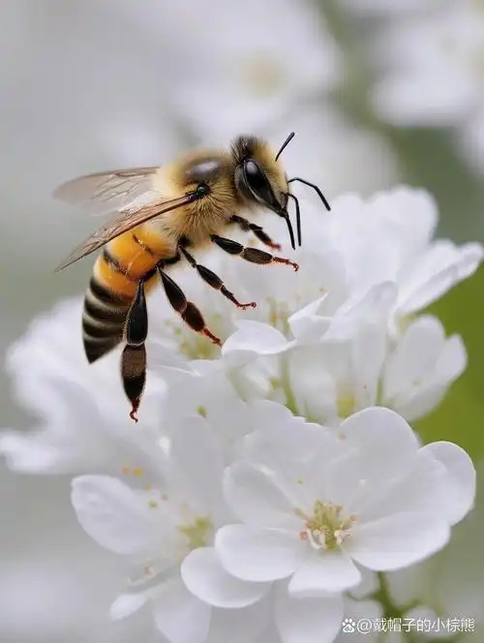
C篇
人与自我：Look at the stick with different eyes –a great introduction to the concept of Umwelt

Slide 15
When I was 14, I found myself in trouble for not doing my homework, which led me to Room E for school punishment. My teacher, Mr. McDonald, placed a stick on my desk and told me, “Think of as many ways to use this stick as you can.” When I looked puzzled, he smiled and gave me a tip: “Imagine you are someone or something else-a baby, a dog,or a bird-and look at the stick again.”
That moment stuck with me. To this day, I consider it the best punishment I ever received. Mr. McDonald's advice- “Look at the stick with different eyes”-is a great introduction to the concept of Umwelt, developed by German biologist Jakob von Uexküll.
Uexküll's Umwelt refers to the idea that every living creature perceives the world differently, based on its biological makeup and how it interacts with its environment. There is no “one” objective world; instead, every creature experiences its own version of reality. Take bees, for example. To a human, a flower is just a beautiful object with pleasant colors and fragrances. However, for a bee, flowers are much more than that. Bees can see ultraviolet (UV) light, which humans cannot. In a bee's world, flowers reveal intricate UV patterns that act as road signs，leading them to nectar（花蜜）.This UV-rich environment helps bees find food and pollinate（授粉）flowers, ensuring both their survival and that of plants.
Similarly, humans also experience the world through their own perspectives（视角）, shaped by what they care about and find meaningful. Imagine sitting through a dull presentation, barely paying attention. Suddenly, the speaker mentions a topic that directly interests you, and you become fully engaged. Uexküll's idea teaches us that people, like bees, connect with the world in unique ways. The key takeaway for presenters is to craft their messages to appeal to different interests. By doing so, they have a better chance of reaching and engaging a diverse audience.
Introduce the topic
The explanation of the topic with examples
Reflection and suggestion

Slide 16
When I was 14, I found myself in trouble for not doing my homework, which led me to Room E for school punishment. My teacher, Mr. McDonald, placed a stick on my desk and told me, “Think of as many ways to use this stick as you can.” When I looked puzzled, he smiled and gave me a tip: “Imagine you are someone or something else-a baby, a dog, or a bird-and look at the stick again.”
When I was 14, I found myself in trouble for not doing my homework, which led me to Room E for school punishment. My teacher, Mr. McDonald, placed a stick on my desk and told me, “Think of as many ways to use this stick as you can.” When I looked puzzled, he smiled and gave me a tip: “Imagine you are someone or something else-a baby, a dog, or a bird-and look at the stick again.”
That moment stuck with me. To this day, I consider it the best punishment I ever received. Mr. McDonald's advice- “Look at the stick with different eyes”-is a great introduction to the concept of Umwelt, developed by German biologist Jakob von Uexküll.
Uexküll's Umwelt refers to the idea that every living creature perceives the world differently, based on its biological makeup and how it interacts with its environment. There is no “one” objective world; instead, every creature experiences its own version of reality. Take bees, for example. To a human, a flower is just a beautiful object with pleasant colors and fragrances. However, for a bee, flowers are much more than that. Bees can see ultraviolet (UV) light, which humans cannot. In a bee's world, flowers reveal intricate UV patterns that act as road signs，leading them to nectar（花蜜）.This UV-rich environment helps bees find food and pollinate（授粉）flowers, ensuring both their survival and that of plants.
Similarly, humans also experience the world through their own perspectives（视角）, shaped by what they care about and find meaningful. Imagine sitting through a dull presentation, barely paying attention. Suddenly, the speaker mentions a topic that directly interests you, and you become fully engaged. Uexküll's idea teaches us that people, like bees, connect with the world in unique ways. The key takeaway for presenters is to craft their messages to appeal to different interests. By doing so, they have a better chance of reaching and engaging a diverse audience.
28. What advice did Mr. McDonald give to the author for using the stick?
A. Think from new angles.
B. Discuss ideas with others.
C. Write down quick thoughts.
D. Observe the stick closely.
29. What mainly shapes the way bees perceive flowers?
A. The patterns on the flowers.
B. Their ability to detect UV light.
C. The environment where they live.
D. Their experience of finding nectar.
30. What should presenters do to engage their audience?
A. Keep presentations short.
B. Focus on just one topic.
C. Use fewer technical terms.
D. Adapt to different interests.
31. Which of the following is the best title for the text?
A. Shifting Perspectives: The Power of Seeing Differently
B. Uexküll's Umwelt: How Reality Defines Living
Beings
C. UV Vision and Beyond: How Bees Experience the World
D. Learning from McDonald: A Lesson of Boosting Creativity
Look at the stick with different eyes
every living creature perceives the world differently
Take bees, for example. To a human, a flower is just a beautiful object with pleasant colors and fragrances. However, for a bee, flowers are much more than that. Bees can see ultraviolet (UV) light, which humans cannot. In a bee's world, flowers reveal intricate UV patterns that act as road signs，leading them to nectar（花蜜）.This UV-rich environment helps bees find food and pollinate（授粉）flowers, ensuring both their survival and that of plants.
every creature experiences its own version of reality
Imagine sitting through a dull presentation, barely paying attention. Suddenly, the speaker mentions a topic that directly interests you, and you become fully engaged. Uexküll's idea teaches us that people, like bees, connect with the world in unique ways. The key takeaway for presenters is to craft their messages to appeal to different interests. By doing so, they have a better chance of reaching and engaging a diverse audience.
experience the world through their own perspectives
people connect with the world in unique ways

Slide 17
文本词句分析
Mr. McDonald's advice- “Look at the stick with different eyes”-is a great introduction ___ the concept of Umwelt, _________(develop) by German biologist Jakob von Uexküll.
Uexküll's Umwelt refers to the idea ____ every living creature perceives the world differently, _______(base) on its biological makeup and how it interacts with its environment.
In a bee's world, flowers reveal intricate UV patterns that act ___ road signs, ______ (lead) them to nectar（花蜜）.
This UV-rich environment helps bees find food and pollinate（授粉）flowers, _____ (ensure) both their _______(survive) and that of plants.
_________(similar), humans also experience the world through their own _______ (perspective), ______(shape) by _____ they care about and find meaningful.
Suddenly, the speaker mentions a topic that directly interests you, and you become fully ______(engage).
By doing so, they have a better chance of reaching and ________ (engage) a diverse audience.
His _________(engage) personality made him popular with his peers.
to
developed
that
based
as
leading
ensuring
survival
Similarly
perspectives
shaped
what
engaged
感到对某件事情或活动非常投入和参与
engaging
吸引
engaging
迷人的

Slide 18
一词多义
1. makeup:
Uexküll’s Umwelt refers to the idea that every living creature perceives the world differently, based on its biological makeup and how it interacts with its environment. (C篇)
Normally she wore little makeup, but this evening was clearly an exception.
There was some fatal flaw in his makeup.
In some ways the social makeup of the two parties was similar.
2. takeaway:
The key takeaway for presenters is to craft their messages to appeal to different interests.
Let's have a takeaway tonight.
3. craft:
The key takeaway for presenters is to craft their messages to appeal to different interests.
the arts and crafts of the North American Indians
the craft of writing
original, hand-crafted bags at affordable prices
n.构成
n.化妆，化妆品
n. 性格
n. 组成，构成
n. 要点
n. 外带食物
v. 精心制作
n. 工艺
n. 职业
adj. 精心制作的

Slide 19

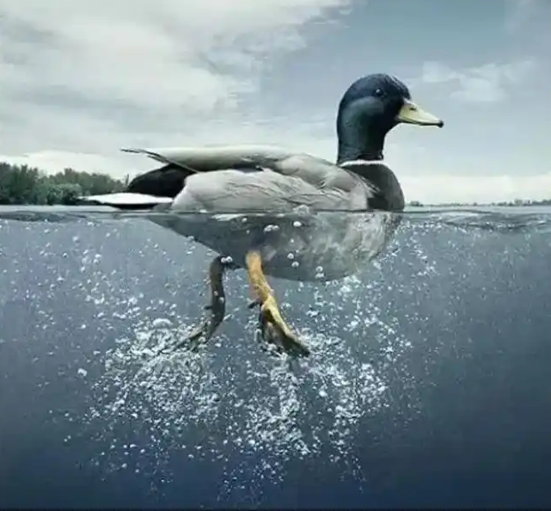
D篇
人与社会：An introduction to Stanford Duck Syndrome

Slide 20
At top universities, there’s a phenomenon known as “Stanford Duck Syndrome（综合征）”. Like ducks, students appear to move gracefully（优雅地）. However, beneath the surface, they're kicking desperately to keep up.
Experts from Stanford's Health Services uncovered this troubling trend: during the day, many Stanford students are seen socializing in cafés, seemingly without any stress or the need to study. However, at night, they start studying, sometimes for the entire night, trying to maintain the image of effortless success. This comes at a high price: tiredness and anxiety are widespread. Furthermore, it leads to a common misconception: true geniuses achieve success with ease, while those working hard are less capable.
In an effort to challenge this misconception, researchers designed an experiment. Participants were asked to observe a series of colors carefully while scientists tracked their brain activity throughout the process. The experiment was divided into two parts: one with easily distinguishable colors and the other with colors that were quite similar, requiring more effort to differentiate. As the difficulty of the task increased, there was a noticeable increase in brain activity, particularly in areas linked to memory and abstract reasoning.
The study reveals that as tasks require more effort, more areas of the brain become engaged. Growth doesn't come from talent alone but from the consistent application of effort. Our brain functions like a muscle. Without effort, even our inborn talents will fade over time.
This pushes us to reconsider the underlying culture that might lead to this phenomenon. Instead of focusing too much on outcomes or singing high praise for inborn talents, we should emphasize the learning process and continuous improvement. By encouraging a culture that values effort, we can help students realize that intelligence is not fixed but grows through hard work. Such a shift would not only reduce the pressures associated with the “Stanford Duck Syndrome”, but also have a profound impact on personal development and the future of education.
Introduce the topic
Study process
Study result
Influnence and suggestion

Slide 21
At top universities, there’s a phenomenon known as “Stanford Duck Syndrome（综合征）”. Like ducks, students appear to move gracefully（优雅地）. However, beneath the surface, they're kicking desperately to keep up.
Experts from Stanford's Health Services uncovered this troubling trend: during the day, many Stanford students are seen socializing in cafés, seemingly without any stress or the need to study. However, at night, they start studying, sometimes for the entire night, trying to maintain the image of effortless success. This comes at a high price: tiredness and anxiety are widespread. Furthermore, it leads to a common misconception: true geniuses achieve success with ease, while those working hard are less capable.
In an effort to challenge this misconception, researchers designed an experiment. Participants were asked to observe a series of colors carefully while scientists tracked their brain activity throughout the process. The experiment was divided into two parts: one with easily distinguishable colors and the other with colors that were quite similar, requiring more effort to differentiate. As the difficulty of the task increased, there was a noticeable increase in brain activity, particularly in areas linked to memory and abstract reasoning.
The study reveals that as tasks require more effort, more areas of the brain become engaged. Growth doesn't come from talent alone but from the consistent application of effort. Our brain functions like a muscle. Without effort, even our inborn talents will fade over time.
This pushes us to reconsider the underlying culture that might lead to this phenomenon. Instead of focusing too much on outcomes or singing high praise for inborn talents, we should emphasize the learning process and continuous improvement. By encouraging a culture that values effort, we can help students realize that intelligence is not fixed but grows through hard work. Such a shift would not only reduce the pressures associated with the “Stanford Duck Syndrome”, but also have a profound impact on personal development and the future of education.
32. What phenomenon does the “Stanford Duck Syndrome” probably describe?
A. Prioritizing effort over well-being.
B. Relieving stress through social activities.
C. Displaying graceful images to attract others.
D. Hiding hard work to appear naturally gifted.
33. How does the experiment in paragraph 3 challenge the misconception?
A. By showing effort fuels the brain activity.
B. By proving focus enhances brain function.
C. By linking color recognition to intelligence.
D. By associating careful observation with talent.
34. What is the author's main concern about “Stanford Duck Syndrome”?
A. It values the learning process over outcomes.
B. It causes stress and false ideas about success.
C. It prevents students from recognizing their talents.
D. It makes students prioritize socializing over studying.
35. Which of the following might the author agree with?
A. Fortune favors those with a clear vision.
B. Sweat is the ink that writes a masterpiece.
C. Work in silence and let success make the noise.
D. Keep moving forward even when no one sees it.
Experts from Stanford's Health Services uncovered this troubling trend: during the day, many Stanford students are seen socializing in cafés, seemingly without any stress or the need to study. However, at night, they start studying, sometimes for the entire night, trying to maintain the image of effortless success. This comes at a high price: tiredness and anxiety are widespread. Furthermore, it leads to a common misconception: true geniuses achieve success with ease, while those working hard are less capable.
tiredness and anxiety are widespread
leads to a common misconception: true geniuses achieve success with ease, while those working hard are less capable.
In an effort to challenge this misconception, researchers designed an experiment. Participants were asked to observe a series of colors carefully while scientists tracked their brain activity throughout the process. The experiment was divided into two parts: one with easily distinguishable colors and the other with colors that were quite similar, requiring more effort to differentiate. As the difficulty of the task increased, there was a noticeable increase in brain activity, particularly in areas linked to memory and abstract reasoning.
This pushes us to reconsider the underlying culture that might lead to this phenomenon. Instead of focusing too much on outcomes or singing high praise for inborn talents, we should emphasize the learning process and continuous improvement. By encouraging a culture that values effort, we can help students realize that intelligence is not fixed but grows through hard work. Such a shift would not only reduce the pressures associated with the “Stanford Duck Syndrome”, but also have a profound impact on personal development and the future of education.
reduce the pressures
have a profound impact on personal development and the future of education

Slide 22
文本词组积累
uncover this troubling trend
effortless success =achieve success with ease
come at a high price
widespread tiredness and anxiety
lead to a common misconception
in an effort to
differentiate similar colors
abstract reasoning
the underlying culture
sing high praise for inborn talents
have a profound impact on
relieve stress
prioritize effort ____ well-being
value the learning process ____ outcomes
link color ________ to intelligence
associate careful observation ____ talent
effort _____ the brain activity
揭示这一令人烦恼的趋势
不费吹灰之力的成功
代价高昂
普遍的疲劳和焦虑
导致一个常见的误解
为了
区分相似的颜色
抽象推理
潜在文化
高度赞扬天生的才能
有深远的影响
缓解压力
努力优先于幸福
重视学习过程而非结果
将颜色识别与智力联系起来
将细心观察与天赋相联系
努力促进大脑活动
over
over
recognition
with
fuels

Slide 23
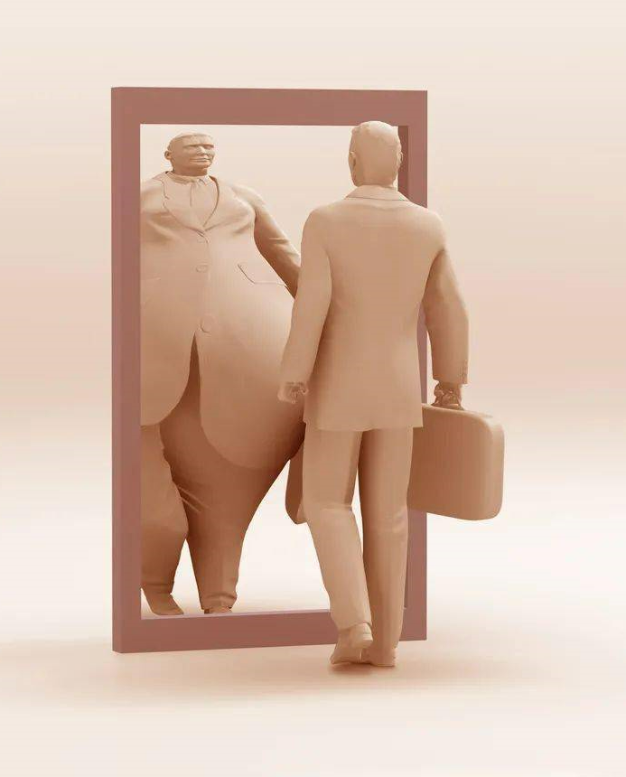
七选五
人与自我： About the Formation of Body Image during Adolescence

Slide 24
Step1 读文本大意、理篇章结构
During puberty（青春期）, your body goes through many changes, and you start forming a body image-how you see, think , and feel about your body's size, shape, and weight , or specific features like your nose. 36 For instance, you may believe your nose is too big or too small, even though it looks perfectly normal.
37 One major influence is peer（同龄人）pressure. Your friends might make casual jokes about your appearance , or you might compare yourself to them and feel they look better. Such experiences can harm the way you view yourself. Another powerful influence is the media, which often promotes a narrow, ideal body type. For example, if fair skin is portrayed as beautiful, you may feel insecure if you don't match that ideal.
Developing a negative body image can lead to unhealthy behaviors, such as extreme dieting, overexercising, or even risky plastic surgeries. 38 When you focus too much on appearance, you may forget to appreciate other great things about yourself, such as your talents and personality.
To build a positive body image, it's essential to remember that no perfect body exists, as beauty standards are always changing. Models and celebrities may appear flawless in the media, but much of their appearance is due to makeup, angles, lighting,and editing. 39
Rather than focusing on appearances, value people for their true selves. By surrounding yourself with positive influences and avoiding comments on looks, you can redirect your attention from self-criticism. 40 Over time, you'll build inner confidence and develop a healthier, more accepting relationship with your body.
theme
problem
analysis
influencing factors
analysis negative results
solution suggestions

Slide 25
Step2 读选项，抓关键
A. Many factors shape your body image.
B. It also lowers your overall life satisfaction.
C. However, your true beauty lies within your heart.
D. External judgement can be a double-edged sword.
E. Without these tricks, they are just as “imperfect” as everyone else.
F. Surprisingly, body image is shaped more by your thoughts than by reality.
G. This shift enables you to recognize and celebrate your talents and strengths.
句间衔接
指代、代词
关键词

Slide 26
Step3 逐一分析、聚焦上下文
During puberty（青春期）, your body goes through many changes, and you start forming a body image--- how you see, think , and feel about your body's size, shape, and weight , or specific features like your nose. 36 For instance, you may believe your nose is too big or too small, even though it looks perfectly normal.
转折 36 F 例证 承上启下
A. Many factors shape your body image.
B. It also lowers your overall life satisfaction.
C. However, your true beauty lies within your heart.
D. External judgement can be a double-edged sword.
E. Without these tricks, they are just as “imperfect” as everyone else.
F. Surprisingly, body image is shaped more by your thoughts than by reality.
G. This shift enables you to recognize and celebrate your talents and strengths.

Slide 27
Step3 逐一分析、聚焦上下文
37 One major influence is peer（同龄人）pressure. Your friends might make casual jokes about your appearance , or you might compare yourself to them and feel they look better. Such experiences can harm the way you view yourself. Another powerful influence is the media, which often promotes a narrow, ideal body type. For example, if fair skin is portrayed as beautiful, you may feel insecure if you don't match that ideal.
主旨 37 A 总分
A. Many factors shape your body image.
B. It also lowers your overall life satisfaction.
C. However, your true beauty lies within your heart.
D. External judgement can be a double-edged sword.
E. Without these tricks, they are just as “imperfect” as everyone else.
F. Surprisingly, body image is shaped more by your thoughts than by reality.
G. This shift enables you to recognize and celebrate your talents and strengths.

Slide 28
Step3 逐一分析、聚焦上下文
Developing a negative body image can lead to unhealthy behaviors, such as extreme dieting, overexercising, or even risky plastic surgeries. 38 When you focus too much on appearance, you may forget to appreciate other great things about yourself , such as your talents and personality.
代词 并列 38 B 例证
A. Many factors shape your body image.
B. It also lowers your overall life satisfaction.
C. However, your true beauty lies within your heart.
D. External judgement can be a double-edged sword.
E. Without these tricks, they are just as “imperfect” as everyone else.
F. Surprisingly, body image is shaped more by your thoughts than by reality.
G. This shift enables you to recognize and celebrate your talents and strengths.

Slide 29
Step3 逐一分析、聚焦上下文
To build a positive body image, it's essential to remember that no perfect body exists, as beauty standards are always changing. Models and celebrities may appear flawless in the media, but much of their appearance is due to makeup, angles, lighting , and editing. 39
代词 39 E 意义一致
A. Many factors shape your body image.
B. It also lowers your overall life satisfaction.
C. However, your true beauty lies within your heart.
D. External judgement can be a double-edged sword.
E. Without these tricks, they are just as “imperfect” as everyone else.
F. Surprisingly, body image is shaped more by your thoughts than by reality.
G. This shift enables you to recognize and celebrate your talents and strengths.

Slide 30
Step3 逐一分析、聚焦上下文
Rather than focusing on appearances, value people for their true selves. By surrounding yourself with positive influences and avoiding comments on looks, you can redirect your attention from self-criticism. 40 .Over time, you'll build inner confidence and develop a healthier, more accepting relationship with your body.
代词 词汇一致 主旨+例证 40 G 顺承结果
A. Many factors shape your body image.
B. It also lowers your overall life satisfaction.
C. However, your true beauty lies within your heart.
D. External judgement can be a double-edged sword.
E. Without these tricks, they are just as “imperfect” as everyone else.
F. Surprisingly, body image is shaped more by your thoughts than by reality.
G. This shift enables you to recognize and celebrate your talents and strengths.

Slide 31
文本词句分析与积累
9.模特和名人 ，网红
Models, celebrities and influencers
10.看起来完美无瑕
appear flawless
11.随着时间的推移
over time
12. 内在的自信
inner confidence
13.降低整体生活满意度
lower overall life satisfactions
14.存在于/源自
lie within
15.双刃剑
double-edged sword
16.才能和优势
talents and strengths
1.经历许多变化
go through many changes
2.形成/建立/塑造 负面的/积极的身体形象认知
form/build/shape a negative/positive body image
3.特定特征
specific features
4.例如
for instance / for example / such as/ like
5.同伴（同龄人）压力
peer pressure
6.随意拿…开玩笑
make casual jokes about sth
7.宣扬单一的、理想化的体型
promote a narrow, ideal body type
8.极端节食、过度锻炼,或有风险的整形手术
extreme dieting, overexercising, or even risky plastic surgeries

Slide 32
文本词句分析与积累
长难句理解及语法填空
17.Rather than focusing on appearances, __________(value )people for their true selves. By surrounding yourself with positive influences and ____________(avoid) comments ______looks, you can redirect your attention from self - criticism.”(译)
与其关注外貌，不如看重人的真实内在。让自己置身于积极的影响中，避免对外表评头论足，你就能将注意力从自我批评上转移开
18. If fair skin is portrayed as beautiful, you may feel insecure if you don‘t match that ideal. (译)
如果白皙的皮肤被描绘为美，而你不符合那种标准，你可能会感到不自信。
value
avoiding
on

Slide 33
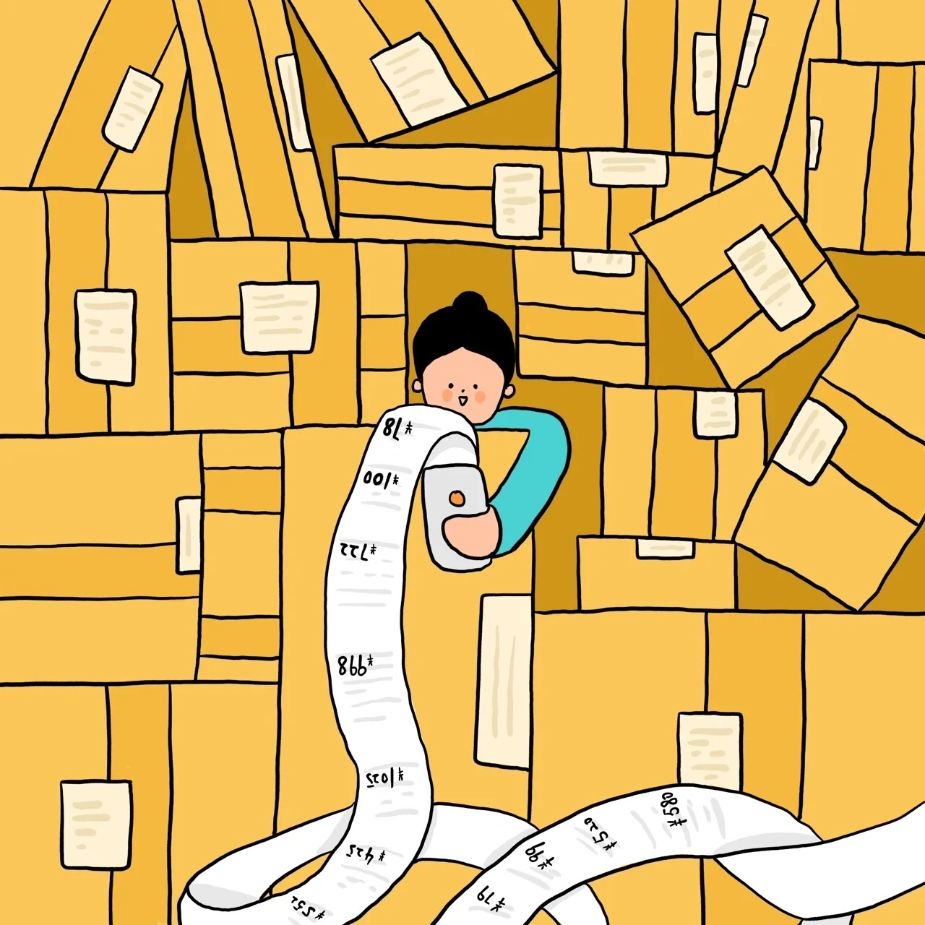
完形填空
人与社会： Changes in My Personal Consumption Values

Slide 34
Step1: 选项全击破
41. A . upset B. blessed C. content D . bored
42. A. complaint B. reservation C. restriction D . approval
43. A. introduce B. compare C. explain D. prove
44. A. confident B. proud C. envious D. suspicious
45.A.specific B. simple C. unusual D. unnecessary
46. A. reflect on B. benefit from C. continue with D. build up
47. A. shame B. happiness C. optimism D . anxiety
48. A. forget B. accept C. repeat D. change
49. A. materialism B. minimalism C. formalism D. realism
50. A. initially B. suddenly C. secretly D. previously
51. A. purchasing B. keeping C. replacing D. cleaning
52. A. interesting B. liberating C. convincing D. inviting
53. A. pretended B. agreed C. resolved D. failed
54. A. remember B. predict C. comprehend D. ignore
55. A. capabilities B. reflections C. experiences D. opportunities
幸运的
限制
预订;保留意见
嫉妒的
怀疑的
反思
乐观主义
物质主义
极简主义
形式主义
最初
解放的;使人自由的
诱人的
决心
理解
能力
反思

Slide 35
Step2: 首尾定主题
Changes in the Personal Consumption Values in My Life
not materialistic
materialistic
Growing up in a large family, I wasn't a particularly materialistic person. I was 41 with the few toys I had and wore hand-me-downs without 42 . However, upon reaching adolescence , I began to 43 myself to peers with the latest trends and felt 44 of what they owned. As an adult, my shopping addiction for temporary pleasure led to an accumulation（堆积）of 45 stuff and stressed me out．
It wasn't until I faced a serious illness that I began to 46 my relationship with material possessions. When reading about the benefits of living with less, I realized that the very things I'd tirelessly pursued were the source of my 47 in my life. This was a turning point for me; I needed to 48 .
I started my journey to 49 by decluttering（清理）my wardrobes. It was slow going 50 , but I soon got into the swing of things. I went through my wardrobes, only 51 the items that I loved and had worn recently and donating the rest to the local charity shop. And it felt so 52 !
From then on, I 53 to shift my mindset towards shopping and buy essentials only. And I started spending my money on the things I would 54 for years to come. I travelled to new places and went to concerts with friends, finding these 55 more rewarding than buying stuff.
content
complaint
compare
envious
unnecessary
resolved
remember
experiences

Slide 36
Step3: 主体找线索
Changes in the Personal Consumption Values in My Life
Growing up in a large family, I wasn't a particularly materialistic person. I was 41 with the few toys I had and wore hand-me-downs without 42 . However, upon reaching adolescence, I began to 43 myself to peers with the latest trends and felt 44 of what they owned. As an adult, my shopping addiction for temporary pleasure led to an accumulation（堆积）of 45 stuff and stressed me out．
It wasn't until I faced a serious illness that I began to 46 my relationship with material possessions. When reading about the benefits of living with less, I realized that the very things I'd tirelessly pursued were the source of my 47 in my life. This was a turning point for me; I needed to 48 .
I started my journey to 49 by decluttering（清理）my wardrobes. It was slow going 50 , but I soon got into the swing of things. I went through my wardrobes, only 51 the items that I loved and had worn recently and donating the rest to the local charity shop. And it felt so 52 !
From then on, I 53 to shift my mindset towards shopping and buy essentials only. And I started spending my money on the things I would 54 for years to come. I travelled to new places and went to concerts with friends, finding these 55 more rewarding than buying stuff.
content
complaint
compare
envious
unnecessary
initially
resolved
remember
experiences

Slide 37
Step3: 主体找线索
Changes in the Personal Consumption Values in My Life
Growing up in a large family, I wasn't a particularly materialistic person. I was 41 with the few toys I had and wore hand-me-downs without 42 . However, upon reaching adolescence, I began to 43 myself to peers with the latest trends and felt 44 of what they owned. As an adult, my shopping addiction for temporary pleasure led to an accumulation（堆积）of 45 stuff and stressed me out．
It wasn't until I faced a serious illness that I began to 46 my relationship with material possessions. When reading about the benefits of living with less, I realized that the very things I'd tirelessly pursued were the source of my 47 in my life. This was a turning point for me; I needed to 48 .
I started my journey to 49 by decluttering（清理）my wardrobes. It was slow going 50 , but I soon got into the swing of things. I went through my wardrobes, only 51 the items that I loved and had worn recently and donating the rest to the local charity shop. And it felt so 52 !
From then on, I 53 to shift my mindset towards shopping and buy essentials only. And I started spending my money on the things I would 54 for years to come. I travelled to new places and went to concerts with friends, finding these 55 more rewarding than buying stuff.
content
complaint
compare
envious
unnecessary
reflect on
anxiety
change
minimalism
initially
keeping
liberating
resolved
remember
experiences

Slide 38
Step4 逻辑关系
Changes in the Personal Consumption Values in My Life
Growing up in a large family, I wasn't a particularly materialistic person. I was 41 with the few toys I had and wore hand-me-downs without 42 . However, upon reaching adolescence, I began to 43 myself to peers with the latest trends and felt 44 of what they owned. As an adult, my shopping addiction for temporary pleasure led to an accumulation（堆积）of 45 stuff and stressed me out．
It wasn't until I faced a serious illness that I began to 46 my relationship with material possessions. When reading about the benefits of living with less, I realized that the very things I'd tirelessly pursued were the source of my 47 in my life. This was a turning point for me; I needed to 48 .
I started my journey to 49 by decluttering（清理）my wardrobes. It was slow going 50 , but I soon got into the swing of things. I went through my wardrobes, only 51 the items that I loved and had worn recently and donating the rest to the local charity shop. And it felt so 52 !
From then on, I 53 to shift my mindset towards shopping and buy essentials only. And I started spending my money on the things I would 54 for years to come. I travelled to new places and went to concerts with friends, finding these 55 more rewarding than buying stuff.
content
complaint
转折关系
compare
envious
unnecessary
意义相关
reflect on
意义相关
anxiety
change
转折关系
minimalism
同义表达
initially
keeping
liberating
resolved
意义相关
remember
experiences
上下义

Slide 39
文本词句分析与积累
be contrasted with
与…… 形成对比
2.hand - me - downs
旧衣服
3.without complaint
毫无怨言地
4.compare... to.
把…… 和…… 比较
5.be envious of
嫉妒
6.shopping addiction
购物成瘾
7.turn to
转向；开始做
8.reflect on
反思
9.get into the swing of things
逐渐适应并习惯做某事
10.go through
仔细检查；翻找
11.resolve to
决定，决心做
11. As an adult, my shopping addiction for temporary pleasure led to ____ accumulation of unnecessary stuff and ____________(stress) me out.
12.It was _______reading about the benefits of living with less that I realized _________ I'd tirelessly pursued _______ the source of my anxiety in my life.
13.And I started spending my money on________ I would remember for years____________
(come), like travelling to new places and ______________(go) to concerts with friends, _______(find) these experiences more rewarding than buying stuff.”
an
stressed
when
what
was
what
to come
going
finding
成年后，我为了短暂的愉悦而购物成瘾，导致堆积了很多不必要的东西，这让我压力很大。

Slide 40
文本词句运用
在大家庭长大的我，并非过度物质 (前缀+主句）。青少年时期，我羡慕赶时髦的同龄人，这致使成年后购物成瘾（主句+后缀）。一场重病成为转折点，我意识到我一直不懈追求的东西正是我生活中不快乐的根源（主句+后缀 allow）。我重新审视对物质的态度，接受极简主义，转向只购买必需品（连续动作）。如今，比起买东西，我更看重和朋友旅行和听音乐会等有意义的经历（more than)。
Growing up in a big family, I wasn’t overly materialistic. As a teen, I envied trendy peers, leading to shopping addiction as an adult. A serious illness was a turning point, allowing me to realize what I tirelessly pursued was actually the source of my unhappiness in my life. I reevaluated my attitude to possessions, embraced minimalism, and shifted to buying only essentials. Now, I value rewarding experiences like traveling and concerts more than buying stuff.

Slide 41
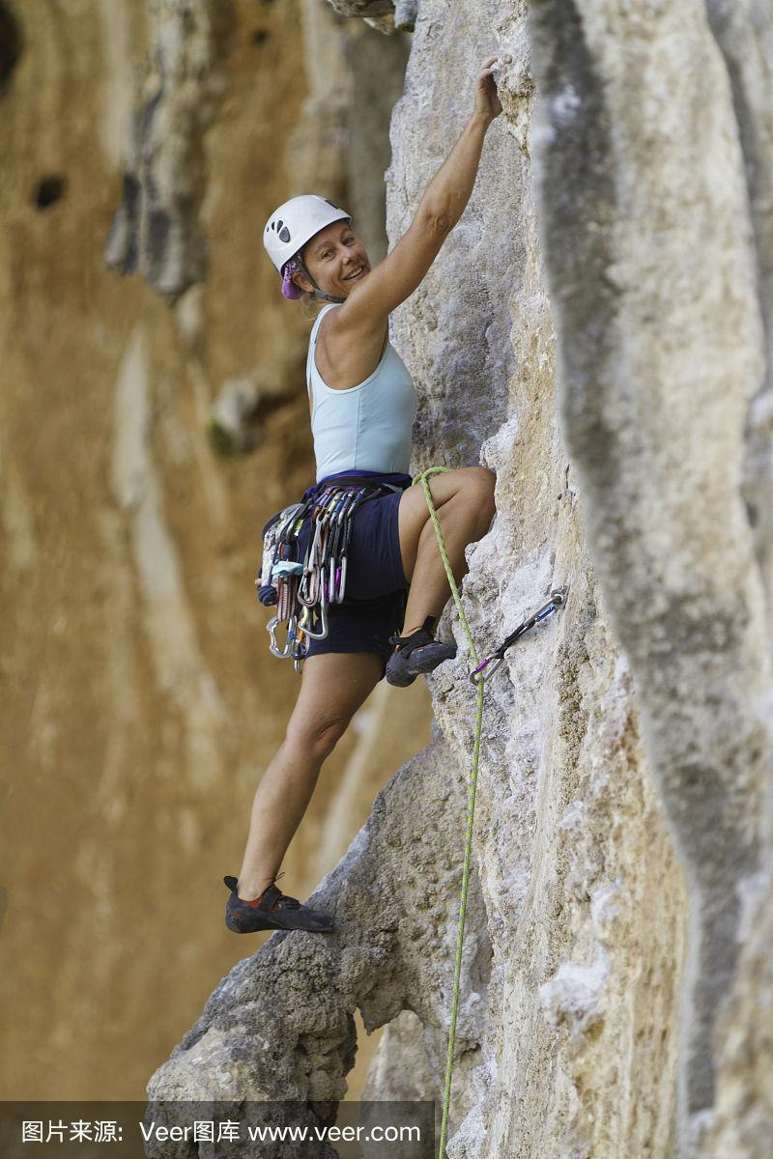
语法填空
人与自然： Introduction to Rock Climbing

Slide 42
Since the Paris Olympics, interest in rock climbing has grown across China. Climbing gyms nationwide have reported 56._______ significant rise in bookings, especially during weekends and after work on weekdays. 57._______ (meet) the increased demand, more climbing gyms are being established.
The appeal of rock climbing lies in the sense of freedom it represents, as well as the 58.___________(combine) of physical strength, flexibility, mental focus, and problem-solving skills it requires. Bouldering, a popular form of indoor climbing, illustrates this well. The same route can 599.____________ (complete) in multiple ways, varying in movements, speed, and energy use. Solving these challenges feels like completing a puzzle and 60.___________(bring) a strong sense of achievement. As Leo, a climbing enthusiast, puts it, “Figuring out how to deal with new challenges is part of 61._______ I enjoy. I'm not into repetitive exercises, and climbing keeps things fresh with every new route.”
The 62.__________(welcome) and supportive atmosphere at climbing gyms adds to the positive experience. While climbers usually focus on their own routes, they often receive encouragement 63.___________(enthusiastic) offered by those in the rest area when facing challenging moments. “Climbing can be an individual pursuit or a shared activity,” said Chen, manager of a gym in Shanghai. “It can accommodate different social 64._______ (preference).”
Experts believe that 65._______ a trendy and youthful activity, climbing's popularity will continue to grow.
Since the Paris Olympics, interest in rock climbing has grown across China. Climbing gyms nationwide have reported 56._______ significant rise in bookings, especially during weekends and after work on weekdays. 57._______ (meet) the increased demand, more climbing gyms are being established.
The appeal of rock climbing lies in the sense of freedom it represents, as well as the 58.___________(combine) of physical strength, flexibility, mental focus, and problem-solving skills it requires. Bouldering, a popular form of indoor climbing, illustrates this well. The same route can 599.____________ (complete) in multiple ways, varying in movements, speed, and energy use. Solving these challenges feels like completing a puzzle and 60.___________(bring) a strong sense of achievement. As Leo, a climbing enthusiast, puts it, “Figuring out how to deal with new challenges is part of 61._______ I enjoy. I'm not into repetitive exercises, and climbing keeps things fresh with every new route.”
The 62.__________(welcome) and supportive atmosphere at climbing gyms adds to the positive experience. While climbers usually focus on their own routes, they often receive encouragement 63.___________(enthusiastic) offered by those in the rest area when facing challenging moments. “Climbing can be an individual pursuit or a shared activity,” said Chen, manager of a gym in Shanghai. “It can accommodate different social 64._______ (preference).”
Experts believe that 65._______ a trendy and youthful activity, climbing's popularity will continue to grow.
56. a
泛指,修饰可数名词rise
57. To meet
非谓语，做目的状语
58.combination
词性转化，定冠词后用名词
59.be completed
谓语动词，情态动词后被动（route与complete)
60.brings
谓语动词Solving主语 用第三人称单数
61.what
介词of 后面宾语从句，缺宾语，指物
62.welcoming
形容词修饰名词welcoming“友好的”
63.enthusiastically
副词修饰动词offer
64.preferences
名词复数形式
65.as
介词“作为”
a
To meet
combination
be completed
brings
what
welcoming
enthusiastically
preferences
as

Slide 43
文本词句分析与积累
关于”攀岩“主题词汇
“活动意义”主题词汇
其它词汇
1. 攀岩
rock climbing
2.攀岩馆
climbing gyms
3.一项时尚且充满青春活力的运动
a trendy and youthful activity
4....的热度不断攀升
interest in … has grown
5.见证 预约人数的显著增加
witness a significant rise in bookings
6. ...的受欢迎程度将持续上升
popularity of sth will continue to grow
7. 为了满足不断增长的需求
to meet the increased demand
8. 就像是完成一个拼图
feel like completing a puzzle
9. 带来强烈的成就感
bring a strong sense of achievement
10. 用...带来新鲜感
keep things fresh with ...
11.顺应，适应不同的社交偏好 (为…提供住宿）
accommodate different social preferences
12....的魅力在于它所代表的自由感，以及它对体力、灵活性、精神专注力和解决问题能力的综合要求
The _______of sth ______the sense of freedom it represents, as well as the _____________(combine)
of_________________, flexibility, _____________
and _________________________it requires.
13. 热情友好、相互支持的氛围
the welcoming and supportive atmosphere
14.个人的追求 或一种共享（社交）活动
an individual pursuit or a shared activity
15.正如攀岩爱好者 Tom所说
As Tom, a climbing enthusiast, puts it
16. 不喜欢重复的训练
be not into repetitive exercises
appeal
lies in
combination
physical strength
mental focus
problem -solving skills

Slide 44
文本再填空
Since the Paris Olympics, interest in rock climbing _________(grow) across China. Climbing gyms nationwide have reported a significant rise in bookings, especially during weekends and after work on weekdays. To meet the ________(increase) demand, more climbing gyms are being established.
The appeal of rock climbing lies in the sense of freedom it represents, as well as the combination of physical strength, _________(flexible), mental focus, and problem-solving skills it requires. Bouldering, ____ popular form of indoor climbing, illustrates this well. The same route can be completed in multiple ways, ________(vary) in movements, speed, and energy use. Solving these challenges feels like completing a puzzle ______ brings a strong sense of achievement. As Leo, a climbing enthusiast, _____(put) it, “Figuring out how to deal with new challenges is part of what I enjoy. I'm not into repetitive exercises, and climbing keeps things fresh with every new route.”
The welcoming and _________(support) atmosphere at climbing gyms adds to the positive experience. _______ climbers usually focus on their own routes, they often receive encouragement enthusiastically offered by those in the rest area when facing challenging moments. “Climbing can be an individual _______(pursue) or a shared activity,” said Chen, manager of a gym in Shanghai. “It can accommodate different social preferences.”
Experts believe that as a trendy and youthful activity, ___(climbing) popularity will continue to grow.
has grown
increased
flexibility
a
varying
and
puts
supportive
While
pursuit
climbing's

Slide 45
THANK YOU

