Slide 1



感恩遇见，相互成就，本课件资料仅供您个人参考、教学使用，严禁自行在网络传播，违者依知识产权法追究法律责任。
更多教学资源请关注
公众号：溯恩英语
知识产权声明

Slide 2
读处思续评改
—读后续写之六环法
礼泉县教育局教研室 高小聪

Slide 3
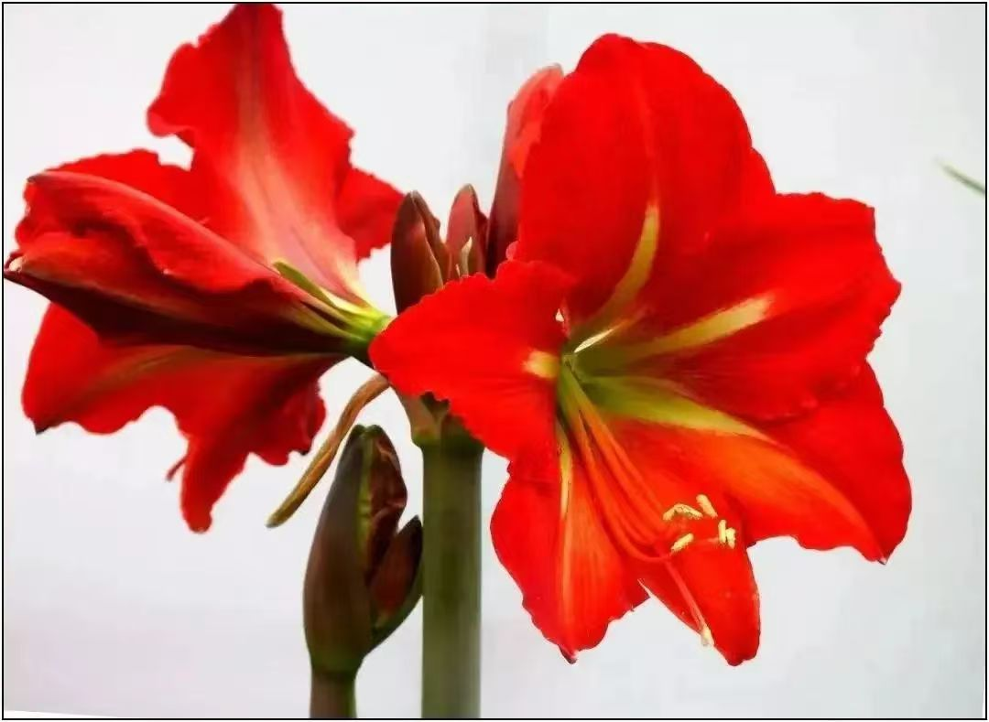
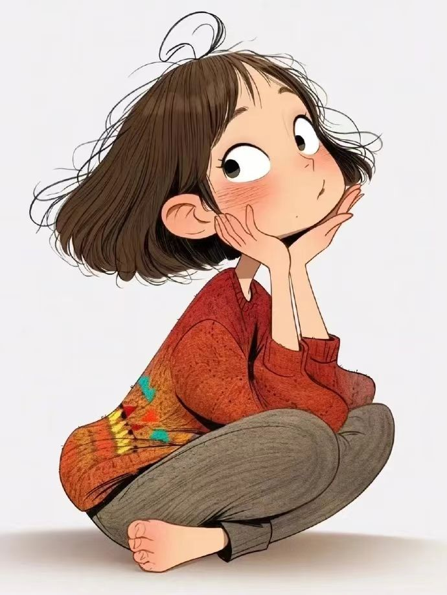
Contents
01
Teaching Principle
02
Learning about Continuation Writing
03
Taking on the Writing Task
Reading
Processing
04
Teaching procedures
Thinking
Continuing
05
Summary
Evaluating
Improving

Slide 4
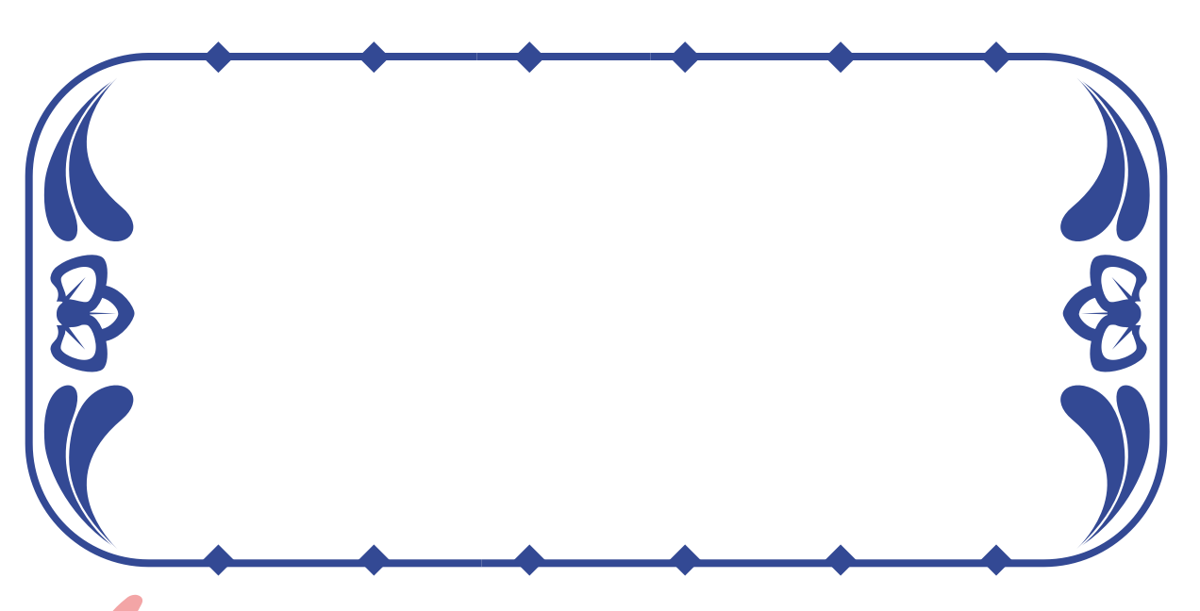
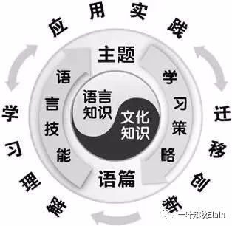
Teaching Principle
英语学习活动观
英语学习活动观强调，语言学习活动的主体是学生，语言学习活动的过程是学习者发现、获取、概括和探究意义的过程，也是学生主动参与、获取和学习新知的过程。英语学习活动观的核心思想是：在体验中学习，在实践中运用，在迁移中创新。
—程晓堂教授

Slide 5
Learning about Continuation Writing
读后续写特点:
读后续写考查考生
四个方面的能力:
03
将阅读与写作紧密结合的考查形式,提供的语言材料以故事类记叙文为主。
02
①把握短文关键信息和语言特点的能力。
②语言运用的准确性和丰富性的能力。
③上下文的衔接能力。
④对语篇结构把控的能力。
⑤ 创造性思维的能力。
01
读后续写的要求:
提供一段350词左右的语言材料,要求考生依据该材料内容、所给段落开头语进行续写(150词左右)。

Slide 6
Taking on the writing task
Teaching procedures：
《高中同步测控优化设计》人教版英语必修第三册U5SectionⅣ Writing （读后续写）
第二节（满分25分）
阅读下面材料，根据其内容和所给段落开头语续写两段，使之构成一篇完整的短文。
P1. 1_____ 80-year-old man was sitting on the sofa in his house along with his 45-year-old highly 2__________ (educate) son. Suddenly a crow 3________ (perch) on the tree near their window. The father asked his son,“What is this? The son replied,"It is a crow.”
P2. After a few minutes, the father asked his son the second time,“What is this?" The son said,“Father, I have just now told you. It's a crow.”
After a little while, the old father again asked his son the third time,“What is this?”
StepI. Reading
Read the original story carefully to finish the tasks below.
1.Fill in the blanks with the given words in the blanks.
2. Acquire the key lexical chunks，summarize its main idea and grasp the theme.
An
educated
perched

Slide 7
Taking on the writing task
Teaching procedures：
P3. At this time some 4_____________ (express) of irritation(恼怒)was felt in the son's tone when he said to his father 5___________(willing).“It's a crow, a crow.” A little while after, the father again asked his son the fourth time,“What is this?”
P4.This time,the son 6 _________ (shout) at his father,“Why do you keep 7_______ (ask) me the same question again and again, although I have told you so many times‘IT IS A CROW'? Are you not able 8________________ (understand) this?
P5.Later the father went to his room and came back with an old tattered(破旧的)diary, which he 9_____________(maintain) since his son was born. On opening a page, the father asked his son to read that page. When the son read it, the following words 10______________(write) in the diary:
expression
StepI. Reading for main idea
unwillingly
Main idea:
The original text narrates a highly-educated son aged 45 got__________with his 80-year-old father at the same question_____times. __________, when he was young he asked the same question ___________ times, Father responded to it _________ every time, which made the son __________and emotional. Then what would happen?
shouted
asking
irrigated
to understand
four
However
twenty-three
maintained
patiently
ashamed
were written

Slide 8
Taking on the writing task
Teaching procedures：
P6.“Today my little son 11______(age) three was sitting with me on the sofa, when a crow sat on the window. My son asked me 23 times 13_______ it was, and I replied to him all 23 times that it was a crow. I 14_______ (hug) him lovingly each time he asked me the same question. I did not feel 14_________ (irritate) at all but I rather felt 15_________ (affect) for my innocent son.”
注意：
1.续写词数应为150左右。
2.请按如下格式作答。
After reading the diary, the son's eyes were filled with tears.____________________________________
Feeling ashamed, the son held his father’s hands gently.____________________________________
StepI. Reading
for theme
aged
what
1.Family affection lies in small _________—a warm greeting, an accompany and a chat. We should treat parents as patiently and affectionately as they do us.
2. Father’s repeating the same question is not a sign of forgetfulness but a reflection of patience and affection Father showed him.
hugged
actions
irritated
affection

Slide 9
Teaching procedures：
StepI. Reading for Lexical Chunks
序号 | 描述 | 英文
1 | 一位80岁的老人
2 | 受过高等教育的
3 | 飞落在树上
4 | 生气的表情
5 | 不乐意的
6 | 朝某人大吼
7 | 反复做某事
8 | 能够做某事
9 | 记/写日记
10 | 疼爱地拥抱某人
11 | 感觉很生气
12 | 感觉很爱某人
an 80-year-old man
highly-educated
perch on the tree
expression of irritation
unwillingly
shout at sb.
keep doing sth.
be able to do sth.
maintain a diary
hug sb. lovingly
feel irritated
feel affection for sb.

Slide 10
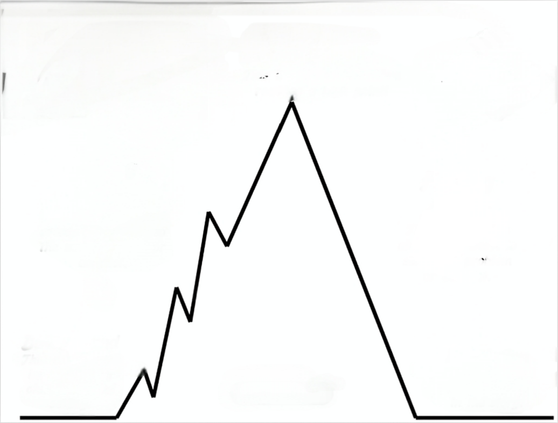
Step II. Processing the information
Extract the key clues, filter out the useful information
Settings:
Father and Son was sitting on the sofa when a crow perched on a tree/ the window during the two different periods.
The same Question and answer:
—What is this?
—It’s a crow.
Climax:Father’s diary read Son’s funny thing—twenty-three asking-and-answering activities
Father: patient, affectionate, loving
Son: innocent
Falling action:
After reading the diary, the son's eyes were filled with tears. ... ?
Rising action：The third and fourth asking-and-answering activities
Father: interested ,
Persistent
Son: impatient,
a little irrigated,
fly into a rage(angry)
Ending:
Feeling ashamed, the son held his father’s hands gently. ... ?
Beginning: They began his first two question-answer activities
Father and Son:
Peaceful and happy

Slide 11
StepIII. Thinking
续写Para1.
1.Why were Son’s eyes filled with tears？
2.What would the son do and say?
3.How would he feel about what Father maintained in the diary?
续写Para2.
1.Why did Son feel ashamed?
2.What would Father react to Son’s changeable behaviors?
3.What inspiration does this story gives us?
Predict the story’s ending and highlight the theme.
续写 P1. After reading the diary, the son's eyes were filled with tears.______________________
续写P2. Feeling ashamed, the son held his father’s hands gently._____________________

Slide 12
StepIV. Continuing StepV. Evaluating StepVI. Improving
After reading the diary, the son's eyes were filled with tears. He turned the diary with his finger slightly, a flood of father’s unspoken affection overwhelmed his body and mind. The happy scenes described in the diary brought him to childhood. However nonsensical his questions were, father was always explaining to him the answers patiently.Compared with his father, the knowledgeable son realized that repeated question and answer didn’t matter. It matters that Father’s strongly attached to him, Just like when he was young.
Feeling ashamed, the son hugged his father tightly. He whispered, “Daddy, looking out the window, the crow is still settling on the tree!” A smile of relief and pleasure was dancing on the corners of the old man’s mouth. At the moment, Son really felt pleasure from Father. The story draws on us that family love lies in small actions—a warm greeting, an accompany and a chat. We should treat parents as patiently and affectionately as they do us.
作品 1 机评+师评
档次：第六档（18-21 分）
内容：
续写合理，通过对比父子对待同一问题的相反态度（patient impatient)，突出主题，结尾升华亲情，但情感转折稍显突兀。
语言：
词汇较丰富（如“overwhelmed” “nonsensical”），句式多样（无灵主语句、让步状语从句、宾语从句、主语从句、非谓语动词、拟人等）。
结构：
段落衔接自然，但第二段结尾说教感较强，可通过细节描写替代直接总结。
建议：
调整结尾，用具体动作（如拥抱、重复童年互动）、环境描写等替代抽象总结。
无灵主语句
让步状语从句
非谓语动词
宾语从句
主语从句

Slide 13
StepIV. Continuing StepV. Evaluating StepVI. Improving
After reading the diary, the son's eyes were filled with tears. He turned the diary with his finger slightly, a flood of father’s unspoken affection overwhelmed his body and mind. The happy scenes described in the diary brought him to childhood. However nonsensical his questions were, father was always explaining to him the answers patiently. Compared with his father, the knowledgeable son realized that repeated question and answer didn’t matter. It matters that Father’s strongly attached to him, Just like when he was young.
Feeling ashamed, the son hugged his father tightly. He whispered, “Daddy, looking out the window, the crow is still settling on the tree!” A smile of relief and pleasure was dancing on the corners of the old man’s mouth. At the moment, Son really felt pleasure from Father. The story draws on us that family love lies in small actions—a warm greeting, an accompany and a chat. We should treat parents as patiently and affectionately as they do us.
Father's unspoken affection overwhelmed me with warmth.
Feeling ashamed, the son held his father’s hands gently. He 1_________(look) into father’s eyes, 2___________(whisper) , “ Dad, please forgive me for 3____________ (patient) and rudeness. Thank you for your endless love and 4__________ (tolerant) !” Looking up at the crow on the tree, A smile of 5________________(understand) was dancing on the corners of the old man’s mouth. In reality, family love lies in small actions—a warm greeting, an accompany and a chat. We should treat parents as patiently and 6________________(affection) as they do us.
looked
whispering
impatience
tolerance
understanding
affectionately

Slide 14
StepIV. Continuing StepV. Evaluating Step.VIImproving
After reading the diary, the son's eyes were filled with tears. He was lost in thought—Father’s patience and affection echoed the repetition of the same question while his impatience and rudeness responded to it. Therefore, a deep sense of shame enveloped him. Meanwhile, he realized why his father took out the diary and it dawned on him that his father's babbling(絮絮叨叨）was not a sign of forgetfulness, but a reflection of patience and love that his father had ever shown him.
Feeling ashamed, the son closed the diary and looked at his father. The old man was sitting quietly, his eyes welling up a quiet understanding. The son whimpered, "I'm sorry, Dad. Thank you for unconditional love, patience and tolerance!” The old father comforted his son, "Darling, It doesn't matter. Cherish love and patience we shared and pass it on to your own children.” Since then, the knowledgeable son has been patient and understanding with his father, cherishing every moment with his father.
作品 2 机评+师评
档次：第六档（18-21 分）
内容：
续写逻辑清晰，通过父子对话深化主题，但父亲的台词稍显直白，缺乏情感张力。
语言：
词汇准确（如 “echoed”“reflection”），句式较多样，但个别地方语言不精炼（the repetition of the same question ）。
结构：
段落连贯，过渡自然，结尾点明传承爱的主题，但细节描写不足，情感表达较平淡。
建议：
增加具体场景描写（如父亲抚摸日记的动作、儿子的细微表情）。
优化对话，使其更符合人物性格（如父亲用沉默代替说教）。
the repeated question
并列句，表对比

Slide 15
StepIV. Continuing StepV. Evaluating StepVI. Improving
After reading the diary, the son's eyes were filled with tears. He was lost in thought—Father’s patience and affection echoed the repetition of the same question while his impatience and rudeness responded to it. Therefore, a deep sense of shame enveloped him. Meanwhile, he realized why his father took out the diary and it dawned on him that his father's babbling(絮絮叨叨）was not a sign of forgetfulness, but a reflection of patience and love that his father had ever shown him.
Feeling ashamed, the son closed the diary and looked at his father. The old man was sitting quietly, his eyes welling up a quiet understanding. The son whimpered, "I'm sorry, Dad. Thank you for unconditional love, patience and tolerance!” The old father comforted his son, "Darling, It doesn't matter. Cherish love and patience we shared and pass it on to your own children.” Since then, the knowledgeable son has been patient and understanding with his father, cherishing every moment with his father.
The son whimpered, "I'm sorry, Dad. I’ve been so busy with work all day that I_______________(neglect) your feelings really.” Father 2_________(stroke) the diary, looking out of the window— The crow on the tree is 3________ (merry) merrily jumping up and down. Father petted son on 4_____ shoulder, “ Such is family love!” Father and son smiled from the bottom of their 5_________(heart). Since then, the knowledgeable son has been patient and understanding with his father and other family, 6____________(cherish) every moment with them.
have neglected
stroked
merrily
the
hearts
cherishing

Slide 16
StepIV. Continuing V. Evaluating VI. Improving
After reading the diary, the son's eyes were filled with tears. His shaking hands touched the worn-out diary again and again. Unbelievably, father was so loving and patient while he was rude and impatient, faced with the same situation. The son called to mind how patiently his father treated him. On the contrary, he shouted at father just because of the repeated question. The son looked up, finding his father watching him with a smile, still a warm expression father showed him many years ago.
Feeling ashamed, the son held his father's hands gently. Knowledgeable as he is, he didn't realize that his elderly father also needs to be treated patiently. On thinking of his carelessness and rudeness, the son turned and hugged his father tightly, tears streaming down his face, " I beg your forgiveness, Dad", “I never blamed you, Darling," said the father. The son found his chest was warm because of his father's tears
作品 3 机评+师评
档次：第五档（15-17 分）
内容：
续写情感真挚，通过细节描写（如颤抖的手、拥抱）增强感染力，但部分情节（如父亲流泪），情绪渲染过渡。
语言：
用词简单恰当，如（loving, impatient, worn-out,Knowledgeable, tears streaming），但句式较单一。
结构：
段落衔接合理，句与句之间衔接自然，但第二段后半部分逻辑跳跃，需加强过渡。
建议：
修正语法错误，丰富句式结构（如使用复合句）。
调整父亲流泪的情节，使其更自然。
“ I beg your 1____________ (forgive), Dad”, “I won’t 2_______ (blame) you, Darling”, said father calmly. Aged father, middle-aged son and happy crow on the tree 3 _____________ (bathe) in the warm sunlight. How 4 _____________(harmony) and joyful everything was!
forgiveness
blame
were bathing
harmonoius

Slide 17
Summary
06
Continuation Writing
05
04
03
02
Improving
01
Evaluating
Continuing
Enhance their own writings according to the machine’s and teacher’s suggestions and improve writing skills.
Thinking
Based on the scoring criteria of continuation writing, conduct machine-based evaluation and teacher-based evaluation on students’ works
Processing
According to the story-mountain, write out the ending and highlight the theme
Reading
Considering the given information, predict what would happen next？
Sort out the information, extract the key clues and filter out the useful information,
laying the foundation for continuation writing
Get the main idea and grasp the theme

Slide 18
Concluding Remark:
阅读是吸收，写作是倾吐，倾吐能否合于法度，显然与吸收有密切的关系。
— 叶圣陶

