Slide 1


感恩遇见，相互成就，本课件资料仅供您个人参考、教学使用，严禁自行在网络传播，违者依知识产权法追究法律责任。
更多教学资源请关注
公众号：溯恩英语
知识产权声明

Slide 2
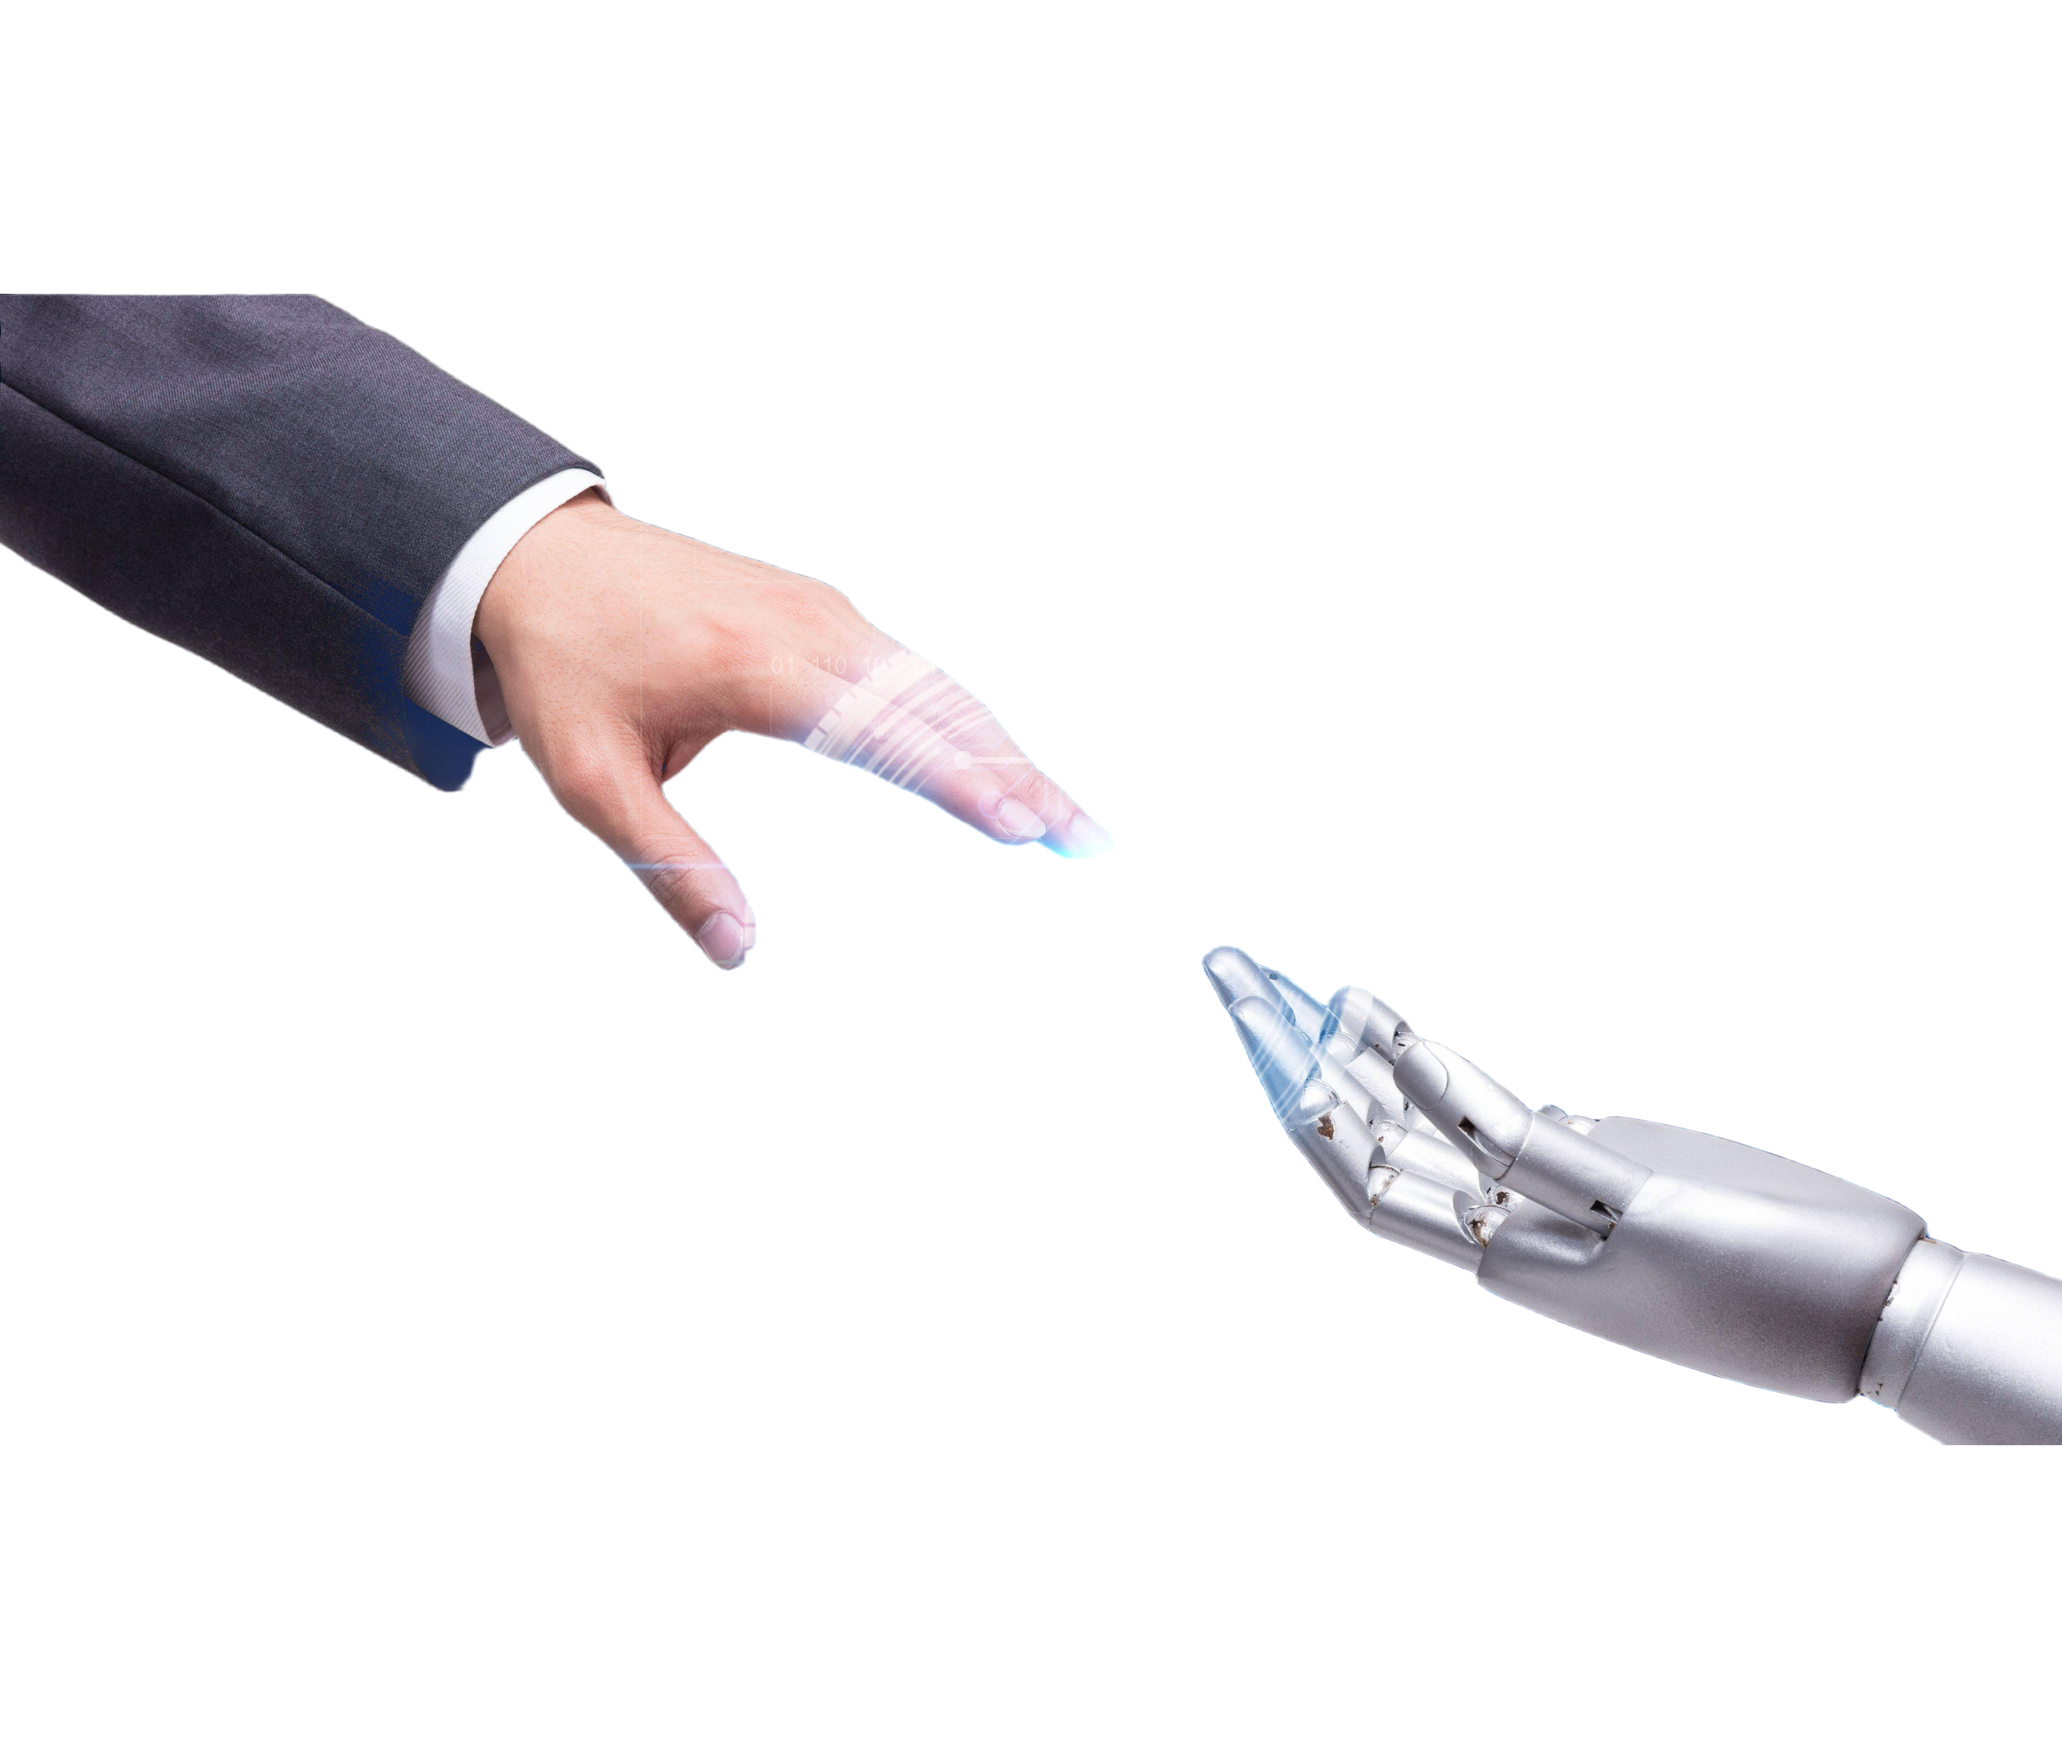
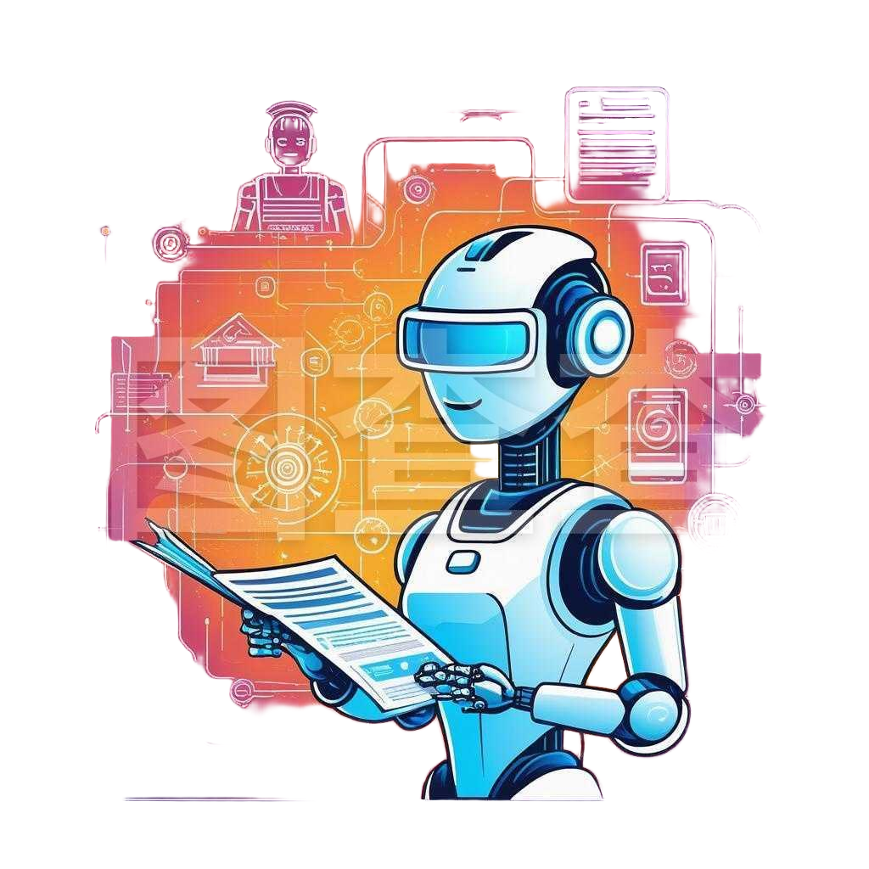

回帖建议信
2025年3月山东济宁高三一模应用文
杭州二中树兰高级中学：郭合英

Slide 3
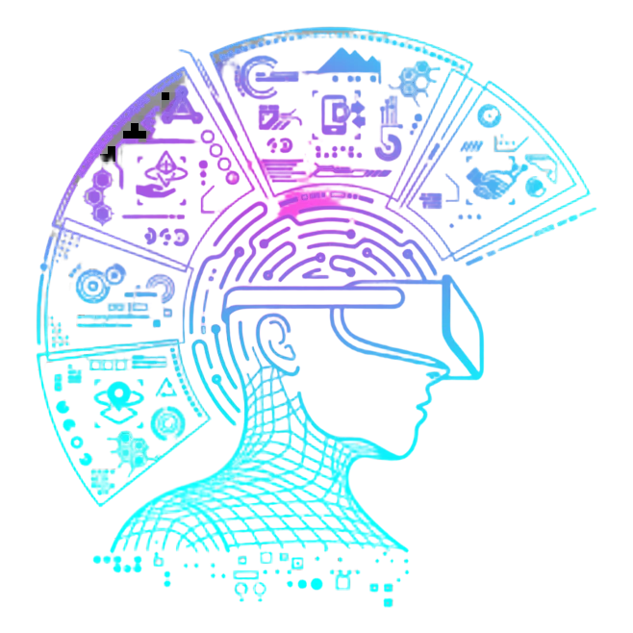
1. To exam the topic carefully (认真审题)
2. To analyze the structure (分析结构)
contents
3. To build up relevant vocabulary (积累词汇)
4. To appreciate the model essays (欣赏范文)

Slide 4


Enjoy a short video

Slide 5

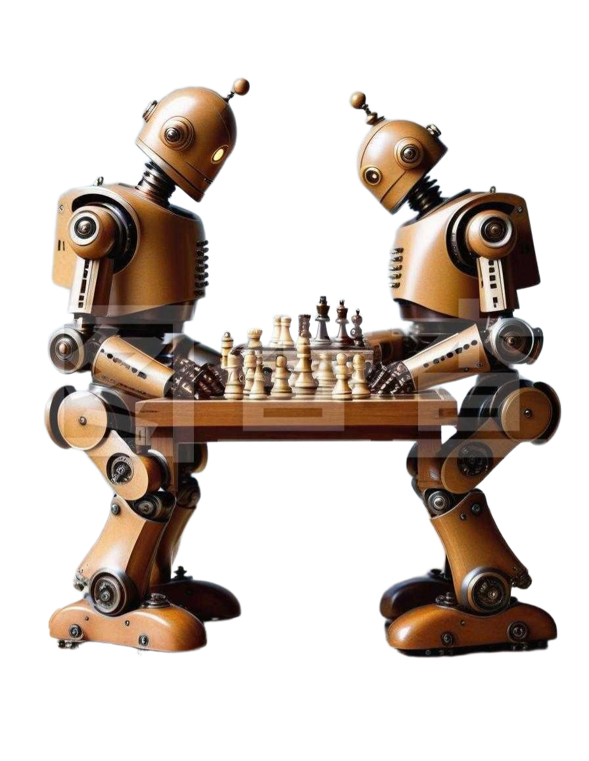
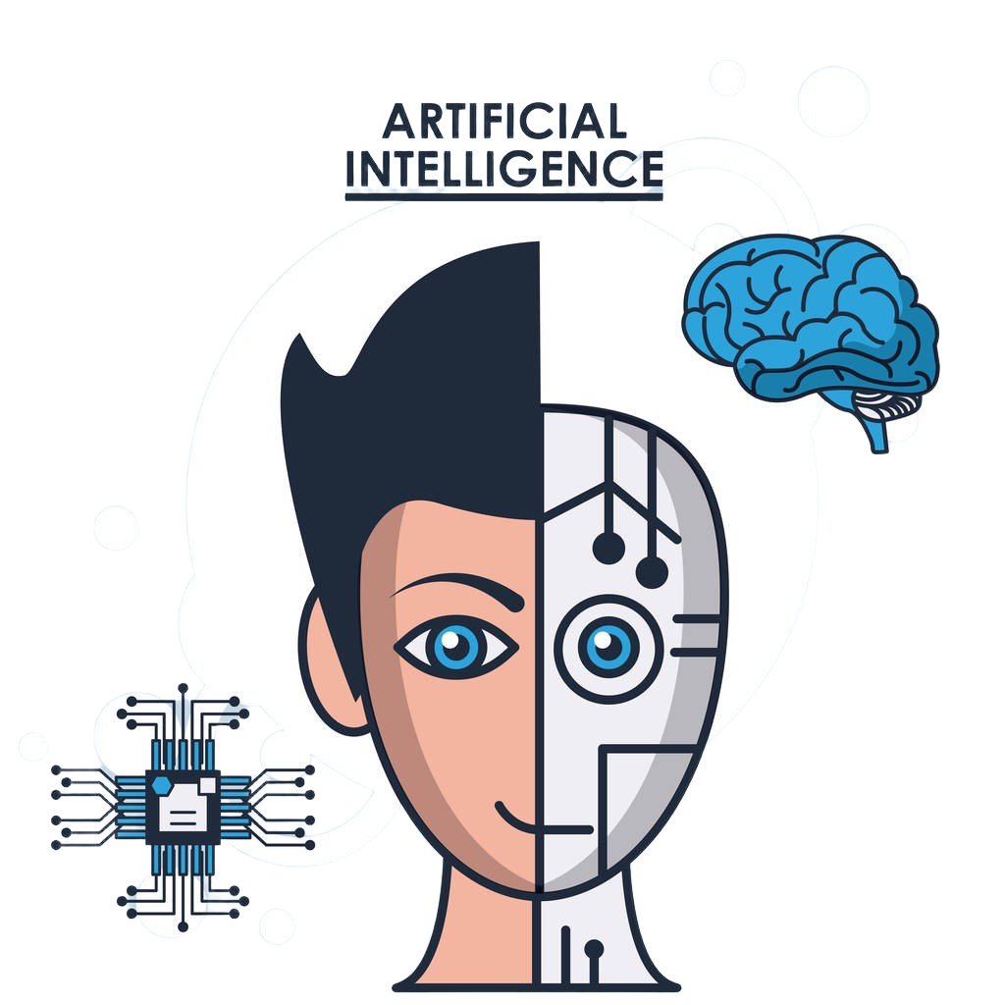
What does AI stand for?
AI是Artificial Intelligence的缩写，意为人工智能。

Slide 6
Discuss: Benefits and drawbacks of AI
Enhanced Efficiency
Improved Healthcare
AI - driven recommendation systems are widely used in
e - commerce and media platforms.
AI can handle and analyze large amounts of data in scientific research.
Robots can carry out complex operations , reducing errors and saving time.
AI is used for diagnosing diseases, helping doctors make more accurate decisions .
Benefits
Personalized Experience
Advanced Research

Slide 7
Discuss: Benefits and drawbacks of AI
Job Displacement
Privacy Issues
As AI becomes more integrated into critical systems. Hackers may attempt to steal data to destroy these systems.
The widespread adoption of AI may lead to the replacement of certain jobs.
AI systems rely on large amounts of data.So ensuring the privacy and security of this data is a major concern.
AI-based interactions may lack the human touch and empathy.
Drawbacks
Lack of Human Touch(人文关怀)
Security Threats

Slide 8

Discuss: Will AI replace humans?
YES, because…
NO, because…

Slide 9

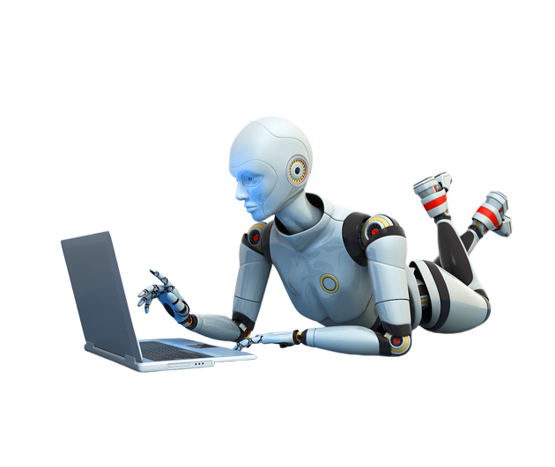

Part 1
To exam the topic carefully (认真审题)

Slide 10
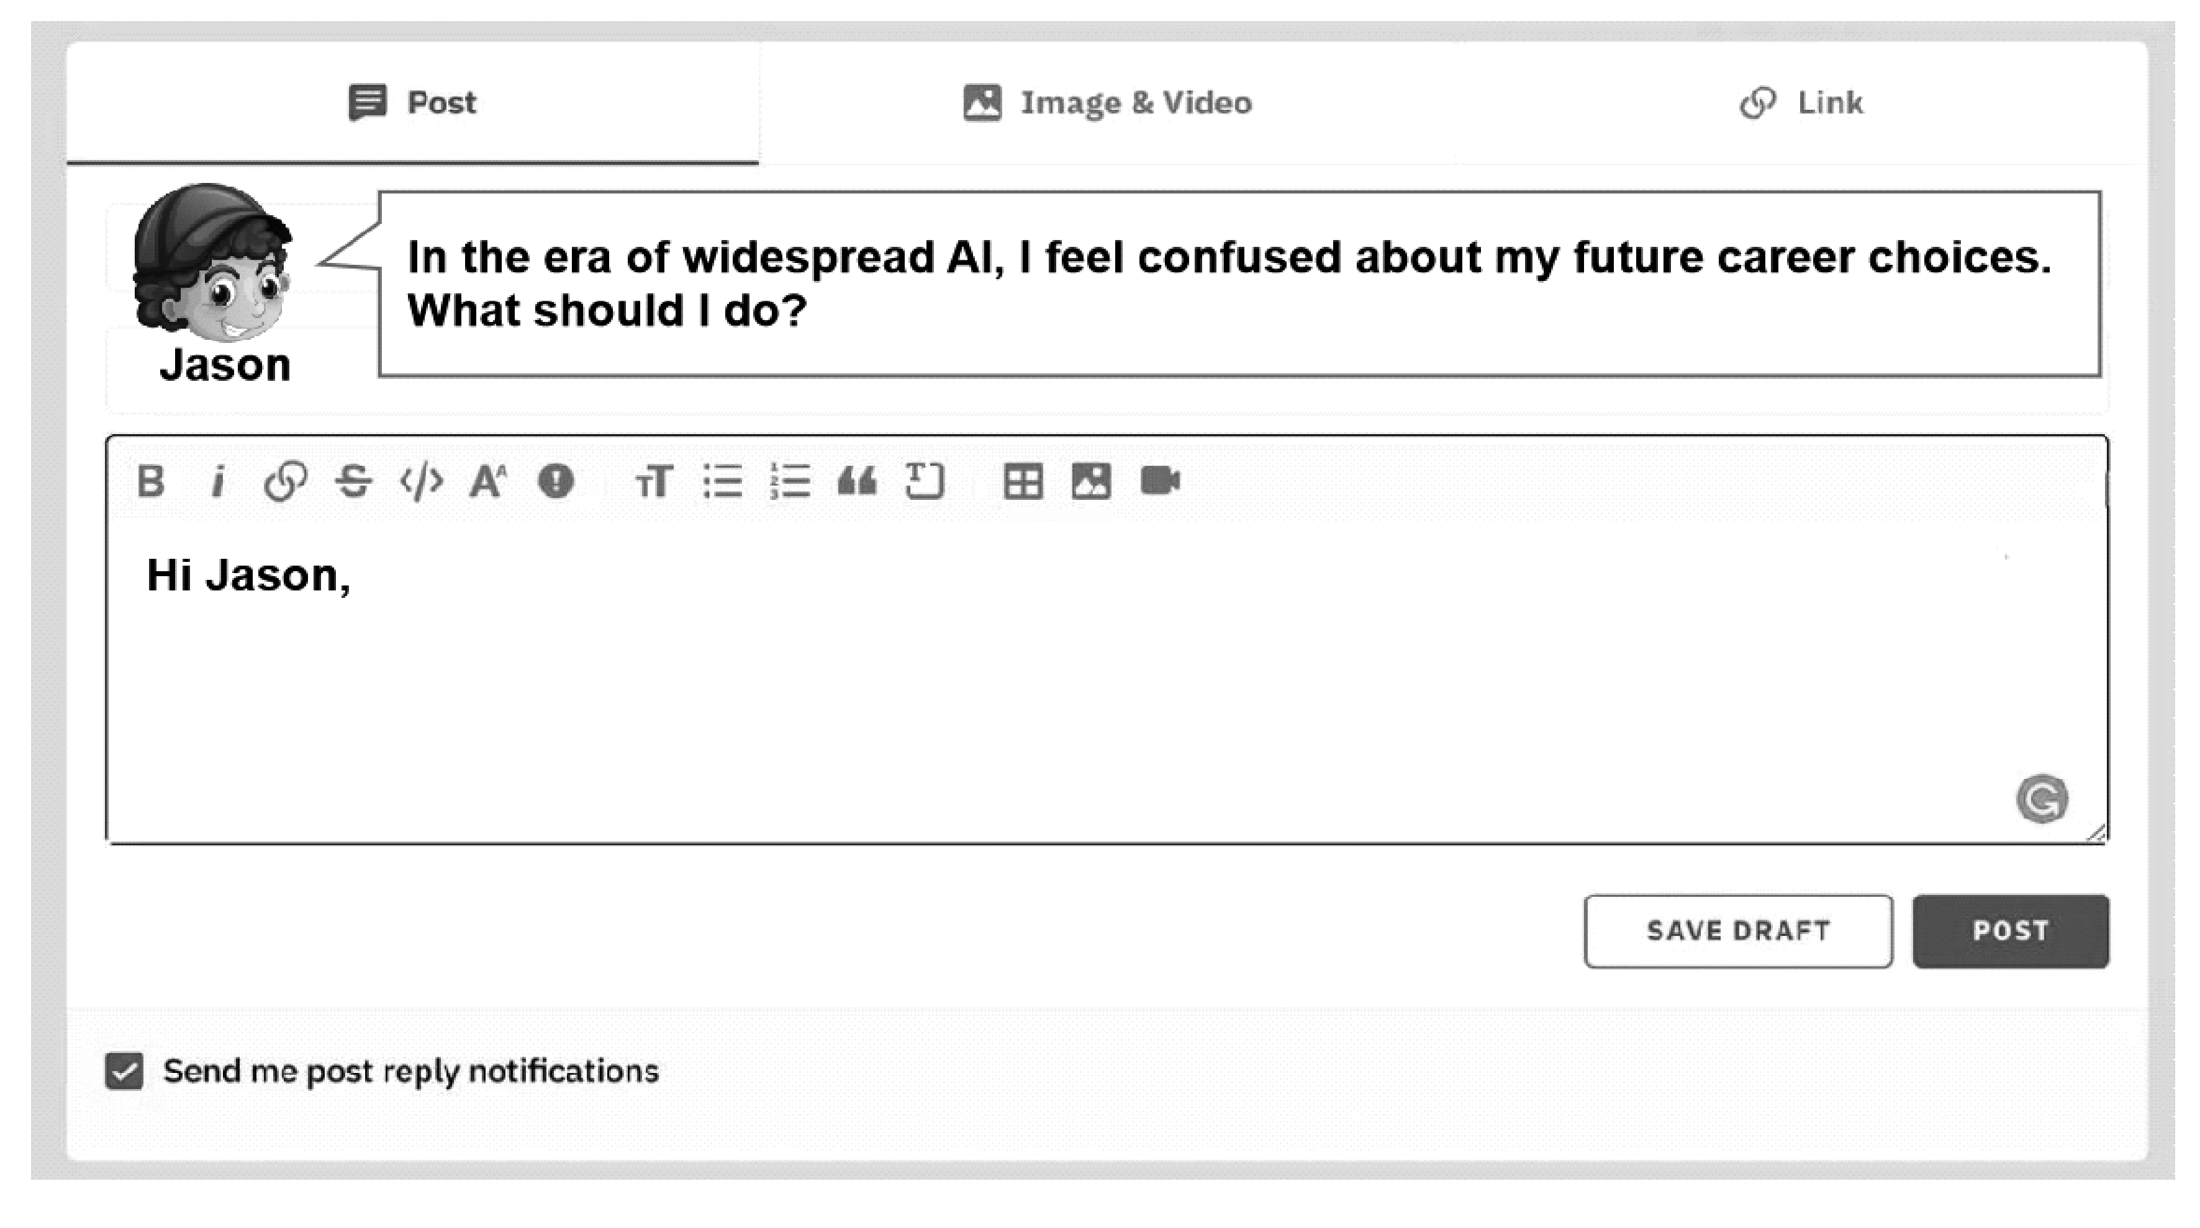
认真审题
假定你是李华,你在 GlobalForum上看到了Jason的求助帖。请给他回帖,内容如下: (1)你的看法； (2)你的建议。
Discuss: 回帖和信件一样吗？
看法包括正反两方面的观点，但要有侧重点。
在提建议时，要角色带入，考虑对方感受，语气要温和、友善，避免使用命令式或指责式的语言，以免让对方感到被批评或贬低。
信件一般是个人之间通过邮政、e-mail或其它方式传递的书面交流内容，格式较为正式，常包含寄件人和收件人的地址等信息 。
回帖是在网络论坛、社交平台等线上交流场景中，针对他人发布的帖子内容进行的回复，虽然和信件一样都是书面交流，但在使用场景、格式规范上有明显区别, 不如信件那么正规，如开头语可以用“hi” 等。
注意:
(1)写作词数应为80个左右； (2)请在答题卡的相应位置作答。

Slide 11
Part 2
To analyze the structure (分析结构)

Slide 12
主体段
Para 2: 围绕对方的提问展开回答或讨论，并提出合理性建议。（注意逻辑清晰，条理清楚）
结尾段
Para 3: 表达希望和祝福。
注意格式，语气和建议的可操作性。尤其要考虑对方感受，即使你觉得对方的想法不太对，也不能强行将自己的观点灌输给对方，要尊重对方的个性、价值观和选择。
开头段
Para 1: 表明自己看到对方帖子的感受及自己的看法。

Slide 13
Part 3
To build up relevant vocabulary (积累词汇)

Slide 14
回帖格式
开头称呼
顶格写
Hi Jason,
I’ve read your post and understand your confusion. AI does bring changes, but it also offers new chances...
Best regards,
Li Hua
常用 “Dear + 对方名字” ，如 “Dear Jason” 。也可以直接用 “Hi + 对方名字” ，像 “Hi Jason” 。
内容一般先表明看到对方帖子的感受，注意有效交际，礼貌得体，然后有针对性地围绕对方提问展开回答或讨论。可以从表达理解、提出具体建议、分享经验等角度来构思。阐述时要逻辑清晰，分点阐述会更有条理。
正文
正文：可以空几个字符，也可以顶格写（顶格写时，段落之间一般会空一行）
结尾祝福语
和署名
写在正文下一行，可左对齐或靠右 ；
另起一行写上自己的名字，如 “Li Hua”。

Slide 15
语言积累
表达理解与同情
1.很遗憾听到你遭遇的麻烦。你有这种感受完全可以理解。
I’m sorry to hear about the trouble you’ve been having. It’s completely understandable that you’re feeling this way.
2.我完全能理解你正在面临的问题。这对你来说肯定很艰难。
I can totally relate to the issue you’re facing. It can be really tough for you.

Slide 16
回帖表达看法的表达
从不同的句式结构入手，让表达更丰富、更贴合情境
1.在我看来，人工智能确实对某些工作构成了一些威胁，但同时也创造了新的职业道路。
To my view, AI does pose some threats to certain jobs, but it also creates new career paths at the same time.
2.我认为对人工智能取代工作的担忧被夸大了。人类拥有不可替代的技能。
From my perspective, the fear of AI replacing jobs is overblown. Humans possess irreplaceable skills.

Slide 17
回帖表达看法的表达
从不同的句式结构入手，让表达更丰富、更贴合情境
3.俗话说，“黑暗中总有一线光明。” 同样，虽然人工智能带来了挑战，但也带来了机遇。
As the saying goes, “Every cloud has a silver lining.” Similarly, although AI brings challenges, it also brings opportunities.
4.我认为对人工智能取代工作的担忧被夸大了。人类拥有不可替代的技能。
From my perspective, the fear of AI replacing jobs is overblown. Humans possess irreplaceable skills.

Slide 18
回帖表达看法的表达
从不同的句式结构入手，让表达更丰富、更贴合情境
5.很多人担心人工智能会取代工作。然而，我持有不同的观点。
Many people are worried about AI taking over jobs. However, I hold a different view.
6.人工智能真的能完全取代人类吗？绝对不能。我认为人类有一些
固有的技能是人工智能永远无法复制的。
Can AI really replace humans completely? Absolutely not. I think there are inherent human skills that AI can never copied.

Slide 19
提出具体建议
1.你有没有考虑尝试一下 ……？我在类似情况下用这个方法效果
很好。
Have you considered trying…？ It worked really well for me when I was in a similar situation.
2.我觉得……可能是个好主意。这有可能解决你提到的问题。
In my opinion, it might be a good idea to…, which could potentially solve the problem you mentioned..

Slide 20
个人经验分享
1.我曾经也有类似的经历，对我有帮助的是……。你不妨试试。
I once had a similar experience, and what helped me was…. You might as well give it a shot.
2.就我而言，当我面临……时，我采取了……的办法。这种方法对
我来说真的很有效果。
In my case, when I faced …, I adopted a solution to …, which really made a difference to me.

Slide 21
鼓励与安慰
1.别太担心。每个问题都有解决办法，我相信你能解决这个问题。
振作起来！）
Don’t worry too much. Every problem has a solution, and I’m sure you'll figure this one out. Keep your chin up!
2.这只是暂时的挫折。保持积极的心态，事情肯定会好转的。
This is just a temporary setback. Stay positive, and things will definitely get better.

Slide 22
提供资源或联系方式
1.在 ……网上有一篇关于相关……的很棒的文章。你可以去看看
获取更多信息。
There’s a great article about (相关主题) on (网站名称). You can check it out for more information.
2.如果你需要更深入的建议，你可以联系(专家姓名/机构名称)。他们在这个领域非常专业。
If you need more in-depth advice, you might want to contact (专家名/机构名称). They’re really knowledgeable in this area.

Slide 23
尝试与灵活性
1.我们试试这个，看看效果如何。如果不行，我们随时可以调整。
Let’s give this a try and see how it goes. If it doesn’t work, we can adjust it at any time.
2.也许我们可以尝试…… 并保持足够的灵活性，根据结果调整我们
的计划。
Chance is that we can have a go at... and be flexible enough to adjust our plan according to the results.

Slide 24
观点的得体表达
in my considered opinionin
I am of the view that
经过深思熟虑，在我看来
我持这样的观点
in one’s opinion/view
as far as I’m concerned
In my humble submission
观点
表达
在我看来
恕我冒昧地提出
从我的分析角度来看
在我看来，依我之见
from my perspective of analysis
to my way of thinking

Slide 25
With kindest regards
用于商务或官方，体现对对方的尊重和忠诚。
用于较为正式的场合,
表达真诚的态度
With best wishes
Kind regards
Yours sincerely
Yours faithfully
半正式结尾，简洁又不失礼貌
(All the) best
回帖结尾的得体表达
Take care
Best regards
Cheers
非正式结尾
Regards
Warm regards
比 “Best regards” 更具亲和力，能传达出友好的情感。
适用于不太熟悉的人之间的交流。

Slide 26
Part 4
To appreciate the model essays (欣赏范文)

Slide 27
Original works
Hi Jason,
I’ve read your post and totally relate to the issue you’re facing, which can be really tough for you to choose future career. However, as the saying goes, “Every cloud has a silver lining.” Similarly, although AI does bring challenges, it also brings new opportunities.
What tops my advice is to pursue emerging AI-related Fields, which is perfectly in line with current employment prospects, making it easy for you to find a suitable job. Additionally, you should focus on “AI-Complementary” Skills, which can create more job opportunities for you. Eventually, it is a fantastic idea to reinvent traditional professions. Not only does it promote personal growth, but also drives industry innovation.
There’s some great articles about how to choose future career on XXX websites. You can check it out for more information.
Best regards,
Li Hua

Slide 28
A possible answer
Hi Jason,
I totally get your concerns about planning a future career in this AI-driven era. The fast-paced tech changes can make it tough to see a clear way ahead. Indeed, the swift pace of technological progress can sometimes seem overwhelming, but viewing AI as a helpful tool rather than a barrier is a truly wonderful way to approach it.
My advice starts by thinking about what you’re good at, and what you’re passionate about. Personally, our deepest interests and enthusiasms form the cornerstone of a fulfilling career. Then, look into how AI connects with those things. Luckily, there are lots of AI-powered platforms and online resources, which can give you personalized career advice based on your skills and dreams. Don’t be afraid to try new things and stay open to opportunities. This way, you’ll not only adapt but also thrive in this evolving world.
With AI on your side, you can create a unique and rewarding career path that fits you perfectly.

Slide 29



