Slide 1


感恩遇见，相互成就，本课件资料仅供您个人参考、教学使用，严禁自行在网络传播，违者依知识产权法追究法律责任。
更多教学资源请关注
公众号：溯恩英语
知识产权声明

Slide 2

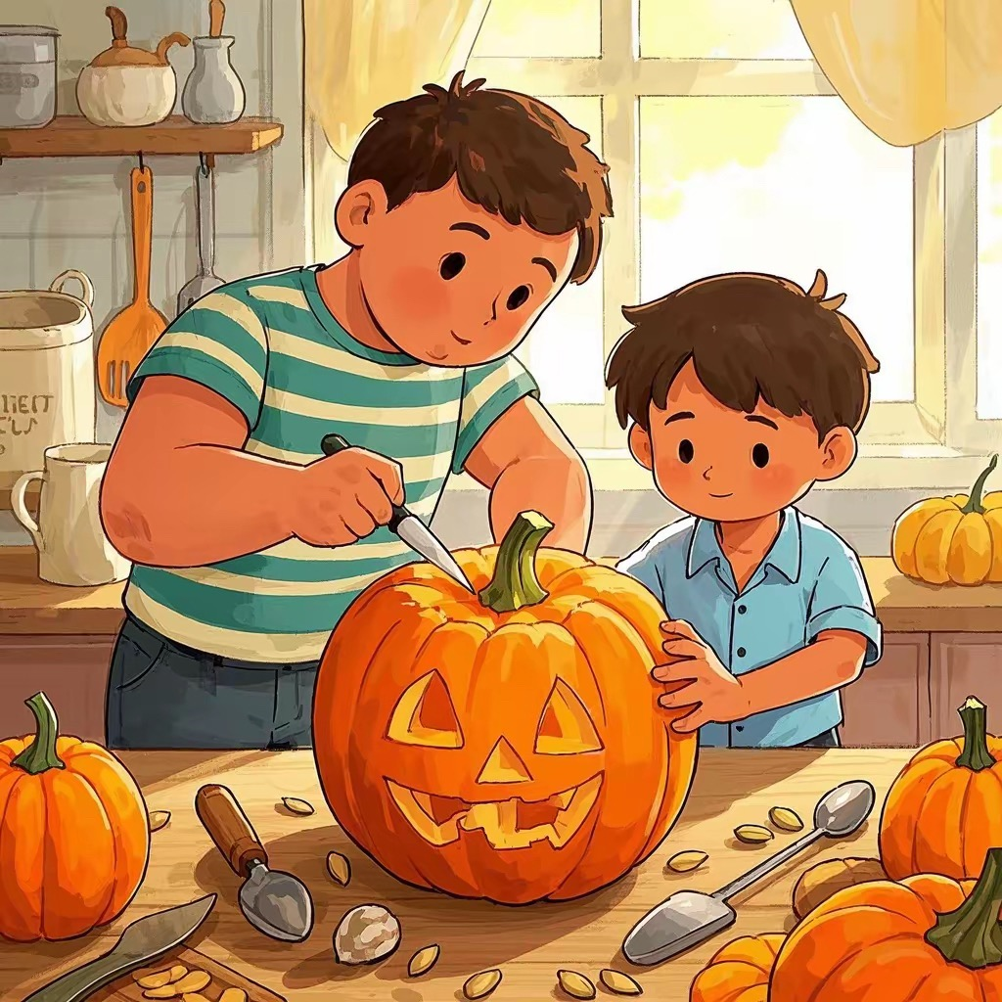

2025届首考备考冲刺：
读后续写极简构思
温州市普通高中高三第二次适应性考试
北师大嘉兴附中 吴晨华

Slide 3
01
原文呈现
I’d always been told to take care of my older brother, Brian, who was born weak and small. I’d often tie his shoes or prepare another glass of water for him. My mom saw my larger size and strong body as a sign that I was to be a kind of guardian angel(守护天使) for Brian. However, that was not the case.
One day our school sponsored a pumpkin-carving contest. First prize was $100, and I knew just how I would spend it. There was a brand-new game I was dying to own. So I decided the first place bonus definitely had to land in my pocket.
When I had to carve the perfect pumpkin I’d picked out, it dawned on me that with my big clumsy fingers I'd surely screw it up(搞砸). I thought of Brian's smaller, delicate hands and knew he was the man for the job. I immediately begged Brian. Unexpectedly, he asked for a cut. That was fifty-fifty. Quickly doing the math in my head, I figured out even if I split (分摊) the first prize, I'd still have enough cash for the game. So I gave in to Brian’s demands. With skillful hands Brian carved the perfect face, and now we had the best pumpkin ever.
Then the unexpected happened: We came in second. Unfortunately, second prize was only $50, and I needed every penny of that to buy the game. The day of the awards ceremony, the principal handed over the money to me because Brian was home, sick with cold.
If he really wanted to win, he would have been here today, I thought to myself, justifying stealing the cash from under poor Brian's runny nose. With hardly a thought, I ran to the store and bought my dream game. That night when Brian asked if we had won, I denied, afraid to look into his eyes.
The whole thing was never mentioned again until the day when Brian was packing for college. I played my usual role in helping him pack when I came across an old album filled with photos he had taken as the school photographer.
Para.1 I was enjoying the photos when one caught my eye.
Para.2 “You actually knew and didn't say anything?” I was shocked.

Slide 4
02
语篇分析及存在的问题
本文主题为人与社会，主要涉及家人亲情层面。
主人公“我”因自己强壮的身材自小被赋予看照顾瘦弱哥哥Brian的责任。在一次南瓜雕刻比赛中，两人合作的作品并未如愿获得一等奖，但为了实现自己购买游戏的私心，“我”偷拿了全部奖金，并隐瞒了获得二等奖的事实。多年后，在帮哥哥整理行李时，“我”偶然翻到了一本相册及里面的照片……
学生习作存在的问题：
1）主题定位不准，如认为是“个人成长”类，侧重“我”从自私走向不再被利益和欲望左右，以及成长中关于道德、良心和选择。
2）原文矛盾冲突未把握。即，当奖金不够买游戏这一问题出现时，表面其解决方式是偷拿全部奖金买了游戏，看似解决了矛盾，但未从深层解决“我”的心虚，而这恰是本文续写部分需要解决的矛盾。
3）文本中的伏笔和线索未正确使用，导致所写与原文缺乏协同性，甚至存在前后矛盾。

Slide 5
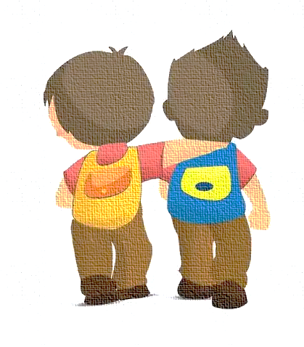
03
读后续写解题步骤
Step1 要素抓取：锁定文本大意
Step2 脉络梳理：确定主题升华
Step3 情节构思：连贯文本主线
Step4 场景拓展：丰内容美语言

Slide 6
Step1 要素抓取：锁定文本大意
Who?
When?
Where?
What?
How?
I: larger size and strong body; big clumsy fingers
Brian: weak and small; smaller, delicate hands
a pumpkin-carving contest
before the contest
during the contest
after the contest (the day of the awards ceremony/ the night)
the day when Brian was packing for college
I bought my dream game with $50 half of which should have belonged to Brian. And I lied to him that no prize we had got.
guilty: “afraid to look into his eyes”

Slide 7
Step2 脉络梳理：确定主题升华
I’d always been told to take care of my older brother, Brian, who was born weak and small. I’d often tie his shoes or prepare another glass of water for him. My mom saw my larger size and strong body as a sign that I was to be a kind of guardian angel(守护天使) for Brian. However, that was not the case.
One day our school sponsored a pumpkin-carving contest. First prize was $100, and I knew just how I would spend it. There was a brand-new game I was dying to own. So I decided the first place bonus definitely had to land in my pocket.
When I had to carve the perfect pumpkin I’d picked out, it dawned on me that with my big clumsy fingers I'd surely screw it up(搞砸). I thought of Brian's smaller, delicate hands and knew he was the man for the job. I immediately begged Brian. Unexpectedly, he asked for a cut. That was fifty-fifty. Quickly doing the math in my head, I figured out even if I split (分摊) the first prize, I'd still have enough cash for the game. So I gave in to Brian’s demands. With skillful hands Brian carved the perfect face, and now we had the best pumpkin ever.
Then the unexpected happened: We came in second. Unfortunately, second prize was only $50, and I needed every penny of that to buy the game. The day of the awards ceremony, the principal handed over the money to me because Brian was home, sick with cold.
If he really wanted to win, he would have been here today, I thought to myself, justifying stealing the cash from under poor Brian's runny nose. With hardly a thought, I ran to the store and bought my dream game. That night when Brian asked if we had won, I denied, afraid to look into his eyes.
The whole thing was never mentioned again until the day when Brian was packing for college. I played my usual role in helping him pack when I came across an old album filled with photos he had taken as the school photographer.
what
how
clue
echo

Slide 8
Step2 脉络梳理：确定主题升华
Theme：
Conflict：
Ending:
人与社会 →
家庭亲情：兄弟情
second prize was only $50 vs need every penny to buy the game
guilty about his lie vs shocked at Brian’s knowing the truth
Brian’s love relieved my guilt
兄弟情的真正意义在于互相理解、照顾与宽容
Thinking:
Who was the guardian angel?
Why did Brian ask for a cut?

Slide 9
Step3 情节构思：连贯文本主线
 | 主 要 情 节 | 原文回应/线索
P1 | I was enjoying the photos when one caught my eye.
 | S1
 | S2
 | S3
P2 | “You actually knew and didn't say anything?” I was shocked.
 | S4
 | S5
 | S6
Describe the photo
“With skillful hands Brian carved the perfect face, and now we had the best pumpkin ever.”
“The day of the awards ceremony, the principal handed over the money to me ”
My feelings
“With hardly a thought, I ran to the store and bought my dream game. That night when Brian asked if we had won, I denied, afraid to look into his eyes”
Ask Brian about the photo
“Brian was home, sick with cold.”
“If he really wanted to win, he would have been here today”
Brian’s explanation
“Unexpectedly, he asked for a cut. That was fifty-fifty.”
“an old album filled with photos he had taken as the school photographer ”
My feelings and Brian’s response
Brian’s love relieved my guilt
(主题：兄弟情的真正意义在于互相理解、照顾与宽容)
“My mom saw my larger size and strong body as a sign that I was to be a kind of guardian angel(守护天使) for Brian. However, that was not the case.”

Slide 10
Step3 情节构思：连贯文本主线
 | 主 要 情 节 | 拓 展
P1 | I was enjoying the photos when one caught my eye.
 | S1
 | S2
 | S3
P2 | “You actually knew and didn't say anything?” I was shocked.
 | S4
 | S5
 | S6
Describe the photo
In the photo was I, handed over the money by the principal for the perfect pumpkin we had made. Below the photo was even a note written by Brian.
My feelings
Recalling what I did, I was overcome by guilt and shock.
Ask Brian about the photo
I couldn’t help asking Brian about the photo.
Brian’s explanation
Brian took over the photo and explained to me.
My feelings and Brian’s response
Noticing my guilt and regret, Brian comforted and forgave me. And I was relieved eventually.
Brian’s love relieved my guilt
(主题：兄弟情的真正意义在于互相理解、照顾与宽容)
Brian, who was once weak and small, can also be my guardian angel.

Slide 11
Step4 场景拓展：丰内容美语言
读后续写的最后一步是根据梳理的情节脉络，拓写内容、丰富语言表达。
常见语言结构（三元素法）
前缀+主句+后缀
优秀句式表达
1）非谓语结构、with结构、独立主格结构
2）倒装、强调、虚拟语气、无灵主语
3）动作链、真实对话
常见描写方式
1）动作描写
2）心理描写（想法、回忆）
3）表情外貌描写（情感、情绪）

Slide 12
Step4 场景拓展：丰内容美语言
读后续写的最后一步是根据梳理的情节脉络，拓写内容、丰富语言表达。
原文就地取材
1）内容类：
I was to be a kind of guardian angel
→ ________ can be my guardian angel?
afraid to look into his eyes
→ look into his eyes with _______?
Brian was weak and small
→ Brain was ____?
2）语言类：
When…, it dawned on me that….
If he really wanted to win, he would have been here today, I thought to myself, justifying stealing the cash from under poor Brian’s runny nose.

Slide 13
Step4 场景拓展：丰内容美语言
Paragraph 1: I was enjoying the photos when one caught my eye.
S1 Describe the photo + feelings (所见所感结合写)
关于“所见”：
线索: “With skillful hands Brian carved the perfect face, and now we had the best pumpkin ever.”
“The day of the awards ceremony, the principal handed over the money to me ”
照片内容: In the photo was I, handed over the money by the principal for the perfect pumpkin we had made. Below the photo was even a note written by Brian/ reading “By official photographer, Brian”.
A1.在照片中，我站在舞台上，手里拿着(紧紧攥着)奖品信封，我们雕刻的南瓜(骄傲地摆)在身旁，校长面带微笑。（倒装句+独立主后缀）
In the picture, I stood on stage, the prize envelope clutched tightly in my hand and our beautifully carved pumpkin proudly displayed beside as the principal smiled.
A2.我皱着眉头，把照片翻了过来，在那儿，整齐地印着 “照片由Brian，官方摄影师拍摄”。
Frowning, I flipped the photo over and froze. There, printed neatly beneath the corner, was “Photo by Official Photographer Brian”.

Slide 14
Step4 场景拓展：丰内容美语言
Paragraph 1: I was enjoying the photos when one caught my eye.
S2 My feelings （感受）
关于“所感”：Recalling what I did, I was overcome by guilt and shock.
线索： “With hardly a thought, I ran to the store and bought my dream game. That night when Brian asked if we had won, I denied, afraid to look into his eyes”
“Brian was home, sick with cold.”
“If he really wanted to win, he would have been here today”
Feelings: disbelief /shock and shame/embarrassment /self - reproach自责/ guilt / doubt
Facial expressions: face flushed /eyes widened/ throat tightened/ breath choke/ frown
Mental activities: He knows everything _______________________________(设问增加代入感）
My secret gave away _____________________________________________(虚拟）
___________________________________（虚拟） I had thought Brian was absent that day
A3. a) 盯着这张照片，我的心狂跳不止，手指紧张地颤抖，呼吸在喉咙处猛地一滞。（前缀+主句+后缀）他是不是一直都知道，却只是选择了沉默？
Staring at the image, my heart pounded wildly, my fingers trembled nervously, and my breath caught sharply in my throat. Had he known all along and simply chosen silence?
A3. b)我刚看了一眼，一股难以置信和羞愧的情绪/震惊和愧疚(以排山倒海之势)就将我淹没了/在我心中涌起/涌上心头（一..就）
Hardly had I glanced/ glimpsed at it/laid my eyes on it when a rush/wave of disbelief and self-reproach/shock and guilt (with overwhelming force), overwhelmed me/ welled up within me/ surged through me.

Slide 15
Step4 场景拓展：丰内容美语言
Paragraph 1: I was enjoying the photos when one caught my eye.
S2 My feelings （感受）
关于“所感”：Recalling what I did, I was overcome by guilt and shock.
线索： “With hardly a thought, I ran to the store and bought my dream game. That night when Brian asked if we had won, I denied, afraid to look into his eyes”
“Brian was home, sick with cold.”
“If he really wanted to win, he would have been here today”
Feelings: disbelief /shock and shame/embarrassment /self - reproach自责/ guilt / doubt
Facial expressions: face flushed /eyes widened/ throat tightened/ breath choke/ frown
Mental activities: He knows everything _______________________________(设问增加代入感）
My secret gave away _____________________________________________(虚拟）
___________________________________（虚拟） I had thought Brian was absent that day
A4. a) 要不是这张照片，我还会一直以为我的秘密被妥善地掩埋着。但真相就摆在那里，用Brian那清晰可辨的字迹回望着我。（虚拟）
Had it not been for this photo, I would have continued believing my secret was safely buried. But there it was, the truth, staring back at me in Brian's unmistakable handwriting.

Slide 16
Step4 场景拓展：丰内容美语言
Paragraph 1: I was enjoying the photos when one caught my eye.
S2 My feelings （感受）
关于“所感”：Recalling what I did, I was overcome by guilt and shock.
线索： “With hardly a thought, I ran to the store and bought my dream game. That night when Brian asked if we had won, I denied, afraid to look into his eyes”
“Brian was home, sick with cold.”
“If he really wanted to win, he would have been here today”
Feelings: disbelief /shock and shame/embarrassment /self - reproach自责/ guilt / doubt
Facial expressions: face flushed /eyes widened/ throat tightened/ breath choke/ frown
Mental activities: He knows everything _______________________________(设问增加代入感）
My secret gave away _____________________________________________(虚拟）
___________________________________（虚拟） I had thought Brian was absent that day
A4. b) 要不是这张照片，我还会一直误以为Brian当时不在场。但其实他一直都在，捕捉着每一个我以为他错过的瞬间。（虚拟）
Had it not been for this photo, I would have remained in my delusion（错觉） that Brian was absent. But he had been there all along, capturing every moment I thought he'd missed.

Slide 17
Step4 场景拓展：丰内容美语言
Paragraph 1: I was enjoying the photos when one caught my eye.
S2 My feelings （感受）
关于“所感”：Recalling what I did, I was overcome by guilt and shock.
线索： “With hardly a thought, I ran to the store and bought my dream game. That night when Brian asked if we had won, I denied, afraid to look into his eyes”
“Brian was home, sick with cold.”
“If he really wanted to win, he would have been here today”
Feelings: disbelief /shock and shame/embarrassment /self - reproach自责/ guilt / doubt
Facial expressions: face flushed /eyes widened/ throat tightened/ breath choke/ frown
Mental activities: He knows everything _______________________________(设问增加代入感）
My secret gave away _____________________________________________(虚拟）
___________________________________（虚拟） I had thought Brian was absent that day
A4. c) 不是因为感冒在家，也没有错过那个时刻，而是他就在现场，捕捉着每一个我曾发誓他没看到的瞬间。（陈述）
Not home with a cold, not missing the moment—he was just right there, capturing every moment I thought he hadn't witnessed.

Slide 18
Step4 场景拓展：丰内容美语言
Paragraph 1: I was enjoying the photos when one caught my eye.
S3 (衔接) confronting Brian I couldn’t help asking Brian about the photo.
A5. a) 我的手颤抖着，转过身面向他，声音几乎低得像耳语。
With my hands trembling, I turned to face him, voice barely a whisper.
A5. b) 我转向他时，双手颤抖，声音几乎无法保持平稳。
My hands trembled as I turned to him, my voice barely steady.
(s2,s3中间可增加环境描写对比）
阳光透过布满灰尘的窗户洒进来，照亮了这张照片，仿佛在嘲讽我的无知。
Sunlight streamed through the dusty window, shedding light on / lighting up the image as if mocking my ignorance.

Slide 19
Step4 场景拓展：丰内容美语言
Para.2 “You actually knew and didn't say anything?” I was shocked.
S4. Brian’s explanation Brian took over the photo and explained to me.
How to explain: “language”, “facial expressions”, “actions” and “feelings”
线索：“Unexpectedly, he asked for a cut. That was fifty-fifty.”
“an old album filled with photos he had taken as the school photographer ”
B1. a) Brian只是对我笑了笑，点了点头，“因为这从来不是钱的问题。我要一半只是为了证明我能像你一样有用。更重要的是，我们一起创造了美好的东西，这就足够了。”他的声音很低，但每一个字都像锤子一样敲打着我。
Brian merely beamed on me and nodded his head, “Because it was never about money. I asked for half only to prove I could be useful just like you. And more importantly, we created something beautiful together, and that was enough.” His voice was low, yet each word hit me like a hammer.
B1. b) Brian看着我，唇角泛起一丝淡淡的微笑。“我看得出你有多渴望那场比赛，” 他轻声说道。“我不能把它从你身边夺走”。他的话久久回荡在我耳畔。
Brian looked at me, a faint smile playing on his lips. “I saw how much you wanted that game,” he said softly. “And I couldn't take that away from you.” His words echoed in my ears.
B1. c) Brian站在他的行李箱旁（照应pack），午后的阳光在他脸上投下柔和的阴影，他的眼中满是戏谑而非责备。他轻声笑了笑，轻轻合上相册，然后说道：“你向来都不是个很会说谎的人，知道吗。”
Brian stood near his suitcase, the afternoon sunlight casting soft shadows on his face, his eyes filled with amusement rather than blame. He beamed/chuckled softly, gently closing the album, and said, “You were never a great liar, you know.”

Slide 20
Step4 场景拓展：丰内容美语言
Para.2 “You actually knew and didn't say anything?” I was shocked.
S5 My feelings Guilt and regret gave way to deep relief and appreciation.
Guilt and regret 虚拟表达: If only I had seen through his kindness earlier/ I had told him the truth!
情绪转变表达: The previous … faded away, replaced by/giving way to …
B2. a) 我的心仿佛被一只看不见的手紧紧地攥着。我从没想过Brian其实需要我的支持和肯定。曾经吞噬我的贪婪现在看起来如此荒谬——真正重要的是我的哥哥，那个一直爱我、容忍我的人。
It was as if my heart was being clenched by an invisible hand. It never occurred to me that Brian actually needed my support and affirmation. The greed that once consumed me now seemed so ridiculous - what truly mattered was my brother, the one who had always loved and tolerated me.
B2. b) 在那一刻，我突然明白，这些年来我一直被愧疚所累，而Brian早已选择让它淡去。多年来，我一直认为自己是他的守护者，但实际上是Brian，他默默地扛起了我秘密的重担，用我不配得到的宽容保护着我。
At that moment, it dawned on me that while I had been burdened by guilt for years, Brian had long ago chosen to let it go/fade away. For years, I had believed myself his guardian, but it was Brian who had quietly shouldered the weight of my secret, shielding/protecting me with forgiveness I never deserved.
B3. 要是我早点看出他的慷慨大度/告诉他事实就好了！之前的愧疚感渐渐消散，取而代之的是深深的感激，钦佩和理解。
If only I had seen through his kindness and generosity earlier! If only I had told him the truth earlier!
The previous guilt faded away, replaced by /giving way to a deep sense of gratitude, appreciation and understanding.

Slide 21
Step4 场景拓展：丰内容美语言
Para.2 “You actually knew and didn't say anything?” I was shocked.
S6 Brian’s love relieved my guilt 学习续写故事结尾+主旨提炼
线索：“My mom saw my larger size and strong body as a sign that I was to be a kind of guardian angel(守护天使) for Brian. However, that was not the case.”
主旨：Brian, though weak and small, can also be my guardian angel.
主旨提炼1 ：兄弟情的真正意义在于互相理解、照顾与宽容
B4. a) 这些年来，我一直以为自己是那个扮演保护者角色的人。我压根没想到，那个曾经被我认为弱小的Brian，一直在默默地守护着我。
All these years, I had assumed I was the one in the role of protector. Never in my wildest dream had I thought it was Brian, weak and small as I once thought, that silently safeguarded me.
B4. b) 这段经历在我的生命中留下了不可磨灭的印记，让我懂得兄弟情与个子大小，力量强弱无关，而关乎互相理解、照顾与宽容。
This experience has left an indelible mark on my life, teaching me that/allowing me to understand that brotherhood has nothing to do with size, age and strength, but rather with mutual understanding, care and tolerance

Slide 22
Step4 场景拓展：丰内容美语言
Para.2 “You actually knew and didn't say anything?” I was shocked.
S6 Brian’s love relieved my guilt 学习续写故事结尾+主旨提炼
线索：“My mom saw my larger size and strong body as a sign that I was to be a kind of guardian angel(守护天使) for Brian. However, that was not the case.”
主旨：Brian, though weak and small, can also be my guardian angel.
主旨提炼2：自然点题
B5. a) 倘若未曾发现这张照片，我永远不会意识到看似柔弱的Brian，用他的方式默默地守护着我，成为我真正的守护者。自那以后，我们兄弟俩分享秘密，互相守护，彼此越来越合拍（默契）了（grow in tune with each other)。
Had I not come across this photo, I would never have realized the seemingly weak and small Brian, (who seemed delicate and weak), had been watching over me in his own way, being my true guardian angel. Ever since then, Brian and I have shared everything, protected each other, and grown increasingly in tune with each other.
B5. b)我深吸一口气，凝视着他的眼睛(与前文不敢直视呼应)，终于鼓起勇气说：“对不起，Brian。我欠你一个第一名。对我来说，你永远是最好的哥哥。”
Drawing a deep breath, peering into his eyes, I finally mustered the courage, “I’m sorry, Brian. I owe you a real first place. To me, you are always the best brother.”

Slide 23
Step4 场景拓展：丰内容美语言
Para.2 “You actually knew and didn't say anything?” I was shocked.
S6 Brian’s love relieved my guilt 学习续写故事结尾+主旨提炼
线索：“My mom saw my larger size and strong body as a sign that I was to be a kind of guardian angel(守护天使) for Brian. However, that was not the case.”
主旨：Brian, though weak and small, can also be my guardian angel.
主旨提炼3：画面定格
B6. a) 我一言不发，把相册放到一边，走上前去，紧紧地拥抱了他，发誓从今往后要做一个更好的兄弟。
Without a word, I set the album aside, stepped forward and pulled him into a tight hug/embraced him tightly, vowing to be a better brother since then.
B6. b) 我凝视着他，渐弱的阳光在他苍白的脸上洒下柔和的光，让他看起来更小了，却又不知为何，显得更强大了。
I stared at him, the fading sunlight casting a soft glow over his pale face, making him seem smaller —and yet somehow, stronger.

Slide 24
04
下水作文1（简约版）
I was enjoying the photos when one caught my eye. In the picture, I stood on stage, the prize envelope clutched tightly in my hand and our beautifully carved pumpkin proudly displayed beside as the principal smiled. Frowning, I flipped the photo over and froze. There, printed neatly beneath the corner, was “Photo by Official Photographer Brian”. Staring at the image, my heart pounded wildly, my fingers trembled nervously, and my breath caught sharply in my throat. Not home with a cold, not missing the moment—he was just right there, capturing every moment I thought he hadn't witnessed. I pulled out the photograph and turned to face him, voice barely a whisper.
“You actually knew and didn’t say anything?” I was shocked. Brian merely beamed on me and nodded his head, “Because it was never about money. I asked for half only to prove I could be useful just like you. And more importantly, we created something beautiful together, and that was enough.” His voice was low, yet each word hit me like a hammer. It never occurred to me that Brian actually needed my support and affirmation. The previous guilt faded away, giving way to a deep sense of gratitude, appreciation and understanding. Had I not come across this photo, I would never have realized the seemingly weak and small Brian had been watching over me in his own way, being my true guardian angel.

Slide 25
04
下水作文2（语言积累版）
I was enjoying the photos when one caught my eye. In the picture, I stood on stage, the prize envelope clutched tightly in my hand and our beautifully carved pumpkin proudly displayed beside as the principal smiled. Frowning, I flipped the photo over and froze. There, printed neatly beneath the corner, was “Photo by Official Photographer Brian”. Staring at the image, my heart pounded wildly, my fingers trembled nervously, and my breath caught sharply in my throat. Had he known all along and simply chosen silence? Not home with a cold, not missing the moment—he was just right there, capturing every moment I thought he hadn't witnessed. Sunlight streamed through the dusty window, shedding light on the image as if mocking my ignorance. With my hands trembling, I turned to face him, voice barely a whisper.
“You actually knew and didn’t say anything?” I was shocked. Brian merely beamed on me and nodded his head, “Because it was never about money. I asked for half only to prove I could be useful just like you. And more importantly, we created something beautiful together, and that was enough.” His voice was low, yet each word hit me like a hammer. It was as if my heart was being clenched by an invisible hand. It never occurred to me that Brian actually needed my support and affirmation. The greed that once consumed me now seemed so ridiculous -what truly mattered was my brother, the one who had always loved and tolerated me. If only I had seen through his kindness and generosity earlier! If only I had told him the truth earlier! The previous guilt faded away, giving way to a deep sense of gratitude, appreciation and understanding. Had I not come across this photo, I would never have realized the seemingly weak and small Brian had been watching over me in his own way, being my true guardian angel. Drawing a deep breath, peering into his eyes, I finally mustered the courage, “I’m sorry, Brian. I owe you a real first place. To me, you are always the best brother.”

Slide 26
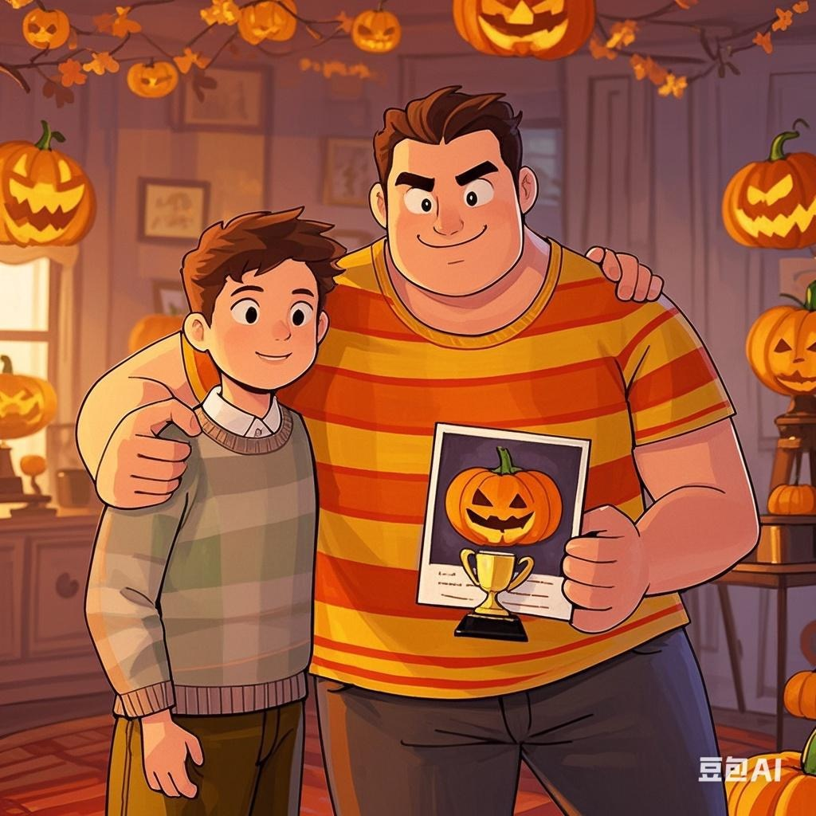
Thanks for your attention

