Slide 1


感恩遇见，相互成就，本课件资料仅供您个人参考、教学使用，严禁自行在网络传播，违者依知识产权法追究法律责任。
更多教学资源请关注
公众号：溯恩英语
知识产权声明

Slide 2

2025高考备考冲刺：
基于NeedS情节构思法的英语读后续写教学设计
NeedS for
Continuation Writing
浙江省衢州二中 熊丽琪

Slide 3

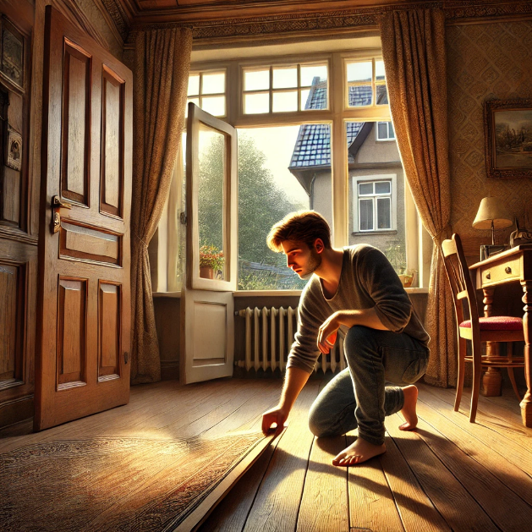
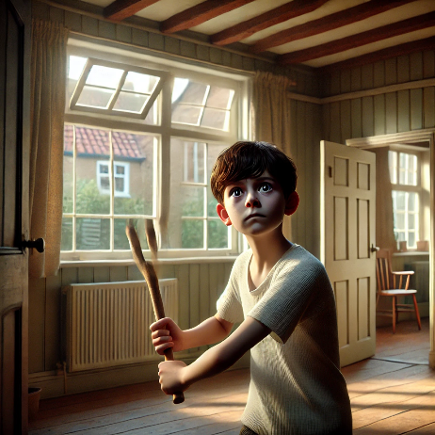
Simple, Stable, Compact > Rich, Complex > Storytelling从
Lead in: Is the man a real thief in your continuation writing?
Kevin, a 12-year-old boy, is left in the care of Mrs. Hill while his parents are away. He sees a man jump into the Green’s window and calls the police. Fearing the man might escape, Kevin rushes in to confront him. The man claims he used to live there and tried to find his father’s watch, but the police arrived to arrest him after his trying to lift a floorboard. Kevin later questions whether the man tells the truth or not.
A common mistake in plot design:
miss out or misunderstand story settings
times & places
When & Where
Two given sentences in continuation:
·When Mr. and Mrs. Green got home, Kevin went to
talk to them
· Kevin and Mr. Green took the watch they had found
to the police station.
Notes:
红色图改蓝色

Slide 4
Simple, Stable, Compact > Rich, Complex > Storytelling从
Method: NeedS
The essence of a short story’s development is to meet main characters’ Needs with Solutions短故事发展的本质是主角通过解决问题来满足需求。
plot design in continuation writing
NeedS 需求法 | 线索常见出处
Needs (需求) | 1. 重点看:首尾段+P1/P2给定句
Solutions (解决) | 1. 角色characters（actions& feelings） 2. 环境settings (times & places) 3. 意象 symbolic items
Needs 主角有需求 Solutions 利用原文信息 （角色环境意象） 需求满足
Kevin needs to know the truth :
If 1)the man lived in the Green’s house and 2) wants to get father’s watch
Characters: the Greens;
Setting: the floorboard
Symbolic item: the watch
Kevin use solutions to find the truth
Notes:
先说，这是一个10个拼图，十句话，

Slide 5


Practice NeedS：
d
Read and Mark the passage according to the tips
Old Jim was without doubt the best hair stylist I'd ever known. He designed every haircut so artistically that it would be an understatement (低估）to say the magics created by him were “beautiful”. But there was one strange thing about his shop: there was no mirror in it, so customers were kept in suspense (悬念）until they reached home. I entered Old Jim's hairdresser's, sad and disappointed, having just been rejected a role in the school play. I was ordinary-looking and boring, and that's why they didn't want me — I was convinced. “I want to be beautiful,” I said to Old Jim, tears almost dropping. After having a haircut, I thanked him again and walked out through the door, his words remaining in my head: “There’s magic in your new hair. Now start your journey to beauty.” Sunlight dropped down through the overlapping leaves above my head as I walked on the street. I shook my head but didn't feel a difference. I could only slightly feel that something was different, like a little voice that had long been suppressed (抑制）that desired to be heard. Suddenly, I heard someone calling out to me. | “Susan! Susan” I turned around. It was Jennifer, the most popular girl in the whole school. “It really is you, Susan. You look great today!” 'Thanks.” Jennifer was everything I wanted to be. What a sweet victory to get such admiration from a girl like her! We had a conversation on school and parted at a crossing, where she turned left and I right. As I walked, I could see a boy walking toward me. We went to the same school but hadn't talked to each other much. If it weren't for the new hair, I would have looked down and pretended not to see him. I had always been shy.
 | P1:But at that point, I intended to test out Old Jim’s magic. P2: At the sight of home, I started to go faster, desperate to see my new hair in the mirror in my room.
阅读文本时使用不同的符号做笔记，提高写作时提取信息的效率
Read the passage:
1)circle all Characters ; mark actions and feelings with
2) double underline all Settings (time and place)
3) mark symbolic Items with

Slide 6
Practice NeedS
Plot design step1: Find Needs and set the story frame
d
What do “I” want to do? what do “I” really need?
主要角色需求,重点看:首尾段+P1/P2给定句;
Old Jim was without doubt the best hair stylist I'd ever known. He designed every haircut so artistically that it would be an understatement (低估）to say the magics created by him were “beautiful”. But there was one strange thing about his shop: there was no mirror in it, so customers were kept in suspense (悬念）until they reached home. I entered Old Jim's hairdresser's, sad and disappointed, having just been rejected a role in the school play. I was ordinary-looking and boring, and that's why they didn't want me — I was convinced. “I want to be beautiful,” I said to Old Jim, tears almost dropping. After having a haircut, I thanked him again and walked out through the door, his words remaining in my head: “There’s magic in your new hair. Now start your journey to beauty.” Sunlight dropped down through the overlapping leaves above my head as I walked on the street. I shook my head but didn't feel a difference. I could only slightly feel that something was different, like a little voice that had long been suppressed (抑制）that desired to be heard. Suddenly, I heard someone calling out to me. | “Susan! Susan” I turned around. It was Jennifer, the most popular girl in the whole school. “It really is you, Susan. You look great today!” 'Thanks.” Jennifer was everything I wanted to be. What a sweet victory to get such admiration from a girl like her! We had a conversation on school and parted at a crossing, where she turned left and I right. As I walked, I could see a boy walking toward me. We went to the same school but hadn't talked to each other much. If it weren't for the new hair, I would have looked down and pretended not to see him. I had always been shy.
 | P1:But at that point, I intended to test out Old Jim’s magic. P2: At the sight of home, I started to go faster, desperate to see my new hair in the mirror in my room.
P1: But at that point, I intended to test out Old Jim’s magic. ①_______________________ ② _______________________ ③ _______________________ ④_______________________ ⑤_______________________
P2：At the sight of home, I started to go faster, desperate to see my new hair in the mirror in my room.. ①_______________________ ②_______________________ ③_______________________ ④_______________________ ⑤ _______________________
Solution1:
Need: find confidence
Solution2
Need: test out Old Jim’s magic: beautiful?

Slide 7
ccc
step1: Find Needs and set the story frame
Check list
Check if the outline concludes necessary characters; settings; symbolic items
Make sure ① and② are coherent within the context.
对于角色和行为采用策略：
负转正，正强化
消极行为改积极，
正面行为复现，增强，赞扬
Plot design step2 Find solutions to fill in the story fame
Practice：
Simple, Stable, Compact > Rich, Complex > Storytelling从
充分利用原文信息解决（角色环境意象）
Task1: use marked words to fill in the outline ①~⑤ in P1
1)👥Group Work: write down the complete outline
2)✅ Use the Checklist: check your outline
marked words
Characters
actions &feelings
Settings
Items
Old Jim; Jennifer; the boy; I
P1: But at that point, I intended to test out Old Jim’s magic. ①_______________________ ② _______________________ ③ _______________________ ④_______________________ ⑤_______________________
At the sight of home, I started to go faster, desperate to see my new hair in the mirror in my room.
Need1 :
sad and disappointed; ordinary-looking and boring; shy; get admiration; had a conversation on school and parted; looked down and pretended not to see
Solution1
Under sunshine
I greet the boy
I get admiration; We have a conversation on school; laugh
magic of hair works. not shy, beautiful ; What a sweet victory
I feel happy and satisfied; just like Jennifer
go fast on the street to go home
Places: Old Jim’s hairdresser’s;
school; on the street; at a crossing; home; my room; Time: sunshine
mirror; magic; haircut; hair
Notes:
When, where, how的思路去添加细节

Slide 8
step1: Find Needs and set the story frame
Check list
Check if the outline concludes necessary characters; settings; symbolic items
Make sure ① and② are coherent within the context.
Plot design step2 Find solutions to fill in the story fame
Practice：
Simple, Stable, Compact > Rich, Complex > Storytelling从
充分利用原文信息解决（角色环境意象）
Task2: use marked words to fill in the outline ①~⑤ in P2
1)✍️Individual Work: Complete the outline on your own
2)✅Use the Checklist: check your outline
marked words
Characters
My actions &feelings
Settings
Items
Old Jim; Jennifer; the boy; I
P1: But at that point, I intended to test out Old Jim’s magic. ①_______________________ ② _______________________ ③ _______________________ ④_______________________ ⑤_______________________
At the sight of home, I started to go faster, desperate to see my new hair in the mirror in my room. ①_______________________ ②_______________________ ③_______________________ ④_______________________ ⑤ _______________________
I greet and talk with the boy
sad and disappointed; ordinary-looking and boring; shy; get admiration; had a conversation on school and parted; looked down and pretended not to see
Solution1:
Under sunshine
I greet the boy
I get admiration; We have a conversation on school; laugh
Magic of hair works. not shy, beautiful ; What a sweet victory
I feel happy and satisfied; just like Jennifer
Need1: test out Old Jim’s magic
go fast on the street to go home
Places: Old Jim’s hairdresser’s;
school; on the street; at a crossing; home; my room; Time: sunshine
Solution2
Get home; Rush in my room, excited
look and check the new hair in the mirror
But no big difference; confused
Recall encounters with Old Jim& Jennifer & the boy
Need2: find confidence
Makes one beautiful
mirror; magic; haircut; hair

Slide 9



Summary
How to design plot in continuation writing?
Plot
Read Mark
Need
Solution
Tip1: modifiers(adj; adv; clause)
1.主角需求重点看:首尾段+P1/P2给定句
2.确定故事框架
1. 标记：1）角色（actions& feelings）
2）环境 (times & places) 3）意象
2. 检查大纲
3. 负转正,正强化
Tip2: Echoes ⭐
Tip3: rhetorical devices (litotes曲言法)
Notes:
学生的角度，let me give you an example.
老师的角度：学生过于关注语言，但是不注意文章的主旨，和教育意义——why？

Slide 10
d
Finish the first paragraph, according to your outline
P1: But at that point, I intended to test out Old Jim’s magic. ①_______________________ ② _______________________ ③ _______________________ ④_______________________ ⑤_______________________
P2：At the sight of home, I started to go faster, desperate to see my new hair in the mirror in my room.. ①_______________________ ②_______________________ ③_______________________ ④_______________________ ⑤ _______________________
P1:But at that point. I intended to test out Old Jim‘s magic. ① 打招呼With butterflies in my stomach, I waved at the boy bathed in the glittering sunshine.②赞美聊天 Hearing my greeting, he waved back, a slightly surprised smile crossing his lips. “Wow, Susan! You look awesome today! ” Like magic, the admiration dispelled all my deeply-rooted shyness. Then we continued our conversation naturally on the school play and interesting subjects, our laughter echoing in the bright street. ③ 我的感受及评价For the first time, I didn’t feel the urge to hide, just shining like Jennifer. ④测试魔法生效 “I do look better with this new hair.” I thought joyfully, a content smile growing on my face. ⑤继续走回家As I walked on briskly, my ears were filled with mellifluous songs from birds and rhythmic sounds of leaves dancing in the summer breeze.

Slide 11
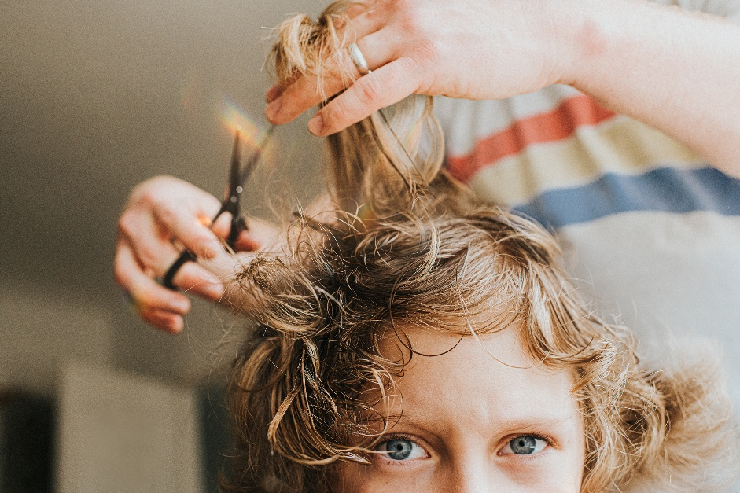
d
Homework: Finish P2 according to your outline
P1: But at that point, I intended to test out Old Jim’s magic. ①_______________________ ② _______________________ ③ _______________________ ④_______________________ ⑤_______________________
P2：At the sight of home, I started to go faster, desperate to see my new hair in the mirror in my room.. ①_______________________ ②_______________________ ③_______________________ ④_______________________ ⑤ _______________________

Slide 12
d
Finish the P2, according to your outline
P1: But at that point, I intended to test out Old Jim’s magic. ①_______________________ ② _______________________ ③ _______________________ ④_______________________ ⑤_______________________
P2：At the sight of home, I started to go faster, desperate to see my new hair in the mirror in my room.. ①_______________________ ②_______________________ ③_______________________ ④_______________________ ⑤ _______________________
P2: However, bursting into my room, my first glance left me in utter bewilderment—I looked, and looked, and looked again, with my gaze carefully scanning every inch of my “new” haircut, only to find no difference at all. A few dumbfounded minutes later, rays of the setting sun started filtering through the window, outlining my figure in gold. Like a kind hint, it revealed the answer right in that mirror: ME. I’m the answer to my magically-acquired beauty! There’s no magic in Old Jim’s imaginary haircut at all, for I had always been beautiful. Instead, the true magic is the confidence it gifted me, which managed to bring out the genuine beauty inside me.
动词的拟人用法：wash over me; put a huge grin on; cocoon my heart
环境描写的妙用：(原文倒二段) Sunlight dropped down (cascaded) through the overlapping leaves above my head ; a gush of crisp autumn breeze; rays of the setting sun started filtering through the window

