Slide 1


感恩遇见，相互成就，本课件资料仅供您个人参考、教学使用，严禁自行在网络传播，违者依知识产权法追究法律责任。
更多教学资源请关注
公众号：溯恩英语
知识产权声明

Slide 2

Creative Class Uniform Design for the Annual School Sports
—广东省一模应用文
介绍校运动会创意班服

Slide 3
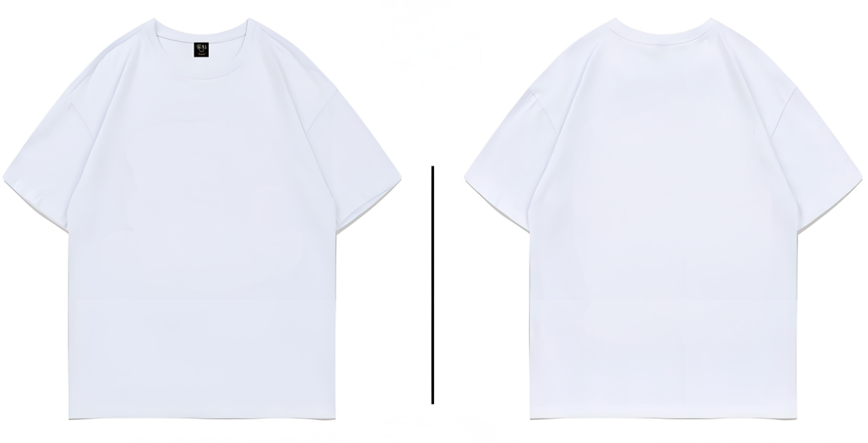
Brainstorm
What do want to add to the creative class uniform for sports meeting? Why?
theme
color scheme
silhouette
patterns
slogans
symbolic elements
...
Front
Back

Slide 4

Lead in
What’s most challenging for you in this writing assignment?
Possible difficulties:
1.How to describe design features ？
2.How to present features logically？
3.What can be inspiration sources？
4.What are possible design purposes？
...

Slide 5
Analyze
学校委托校英文报开展“校运会班服最佳创意设计”评比活动。请你写一篇短文，介绍你们班的班服，内容包括：
1．作品特点；
2．灵感来源；
3．设计目的。
Genre
Receiver
Background
Writing Puporse
Topic
Content
Tense
Person
short essay
the editor of school English newspaper
“School creative uniform design for the annual school sports” Contest
win the contest
show the appeal of the uniform
introduce the uniform
specifc design,inspiration,motivaiton
simple present tense, future tense
first person

Slide 6

design features
Overall
01
theme,
color scheme配色,
silhouette轮廓...
02
Details(Front-Back)
patterns, slogans, symbolic elements...
On the front, our class number and a clenched fist demonstrate our solidarity and strength, while the back features a powerful slogan"We are the best!",surrounded by everyone’s signiture that motivates us to go all out and never give up.
Where+What+Why

Slide 7



inspiration sources
Class/School/
Olympic Motto
Pop Culture & Trends
Cultural /Natural
Elements
Our design was inspired by the class motto ‘Never Give Up,’ blending sportsmanship with our core values.
The mountain silhouette echoes our school badge, symbolizing ‘reaching new heights.’ The sunrise reflects our potential, just like a rising sun."
Sci-fi film The Wandering Earth inspired us: galaxy embodies ‘exploring the unknown,’ mirroring athletes pushing boundaries."

Slide 8
design purpose
Enhance
Collective Pride
Express Youthful Energy
Embody
Sportsmanship
Honor School Heritage
Showcase Class Identity & Unity
design purpose

Slide 9





Practice
The class uniform design is aimed at reflecting our unique class identity, fostering a strong sense of unity and teamwork among students.
The design serves as a symbol of collective pride, and builds students' sense of belonging and shared achievement.
By integrating the school emblem, motto, the design pays tribute to our institutional heritage.
The design seeks to encourage perseverance and competitive spirit during the sports meet.
Vibrant colors and dynamic patterns are intentionally used to mirror the participants’ youth, energy and enthusiasm during the sports meet .

Slide 10





Expressing Hope
We sincerely hope this vibrant design will inspire unity and excellence during the sports meet.
Acknowledging Purpose
Conclusion
Highlighting Impact
Through this design, we aim to celebrate both individuality and collective strength.
May this symbolic uniform become a beacon of our class’s identity and passion.
Gratitude
Encouraging Participation
We extend our gratitude to everyone who contributed to bringing this vision to life.
Let us wear this uniform proudly and strive together for unforgettable memories!

Slide 11
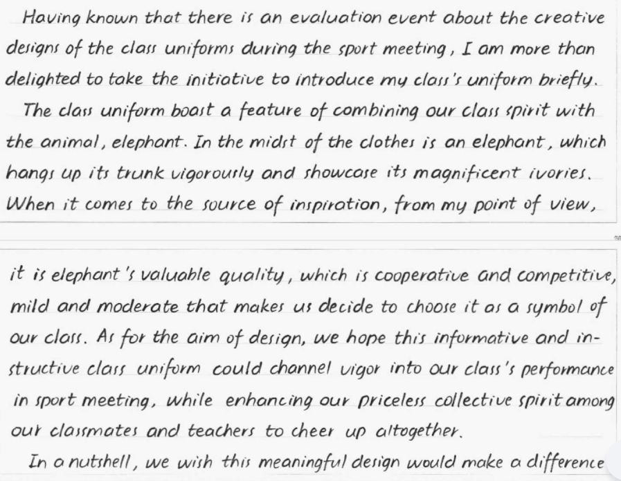

(13分)
高分考场作文评析
Content:文章覆盖了所有题目要求要点
班服设计元素（大象图案、象鼻与象牙的细节）
灵感来源（大象的合作性与竞争性特质）
设计目标（激励运动表现、增强集体精神）
表述清晰合理。
Vocabulary: 多样且恰当的词汇表达
“boast a feature of combining”“channel vigor into”“enhance collective spirit”）
Sentence:丰富多样
状语从句（“Having known that…”）
动名词作主语（“combining our class spirit with the animal, elephant”）
强调句型（“it is… that…”），
Grammar:语法整体准确，仅个别动词形式需修正（如“showcase”应为“showcases”）。
衔接手段使用恰当（“When it comes to…”“As for…”“In a nutshell”）.
总评：段落过渡自然，行文流畅，结构清晰。卷面整洁，无拼写或格式混乱问题。文章语言正式得体，通过象征手法将班级精神与动物特质巧妙结合，充分体现了学生的优秀语言能力，有效传达了设计理念与集体价值观，完全达到了预期的写作目的。

Slide 12
Adapted Text
Translation
Having known that there is an evaluation event about the creative design of the class uniforms during the sports meeting, I am more than delighted to introduce our class uniform briefly.
The class uniform boasts a feature of combining our class spirit with the animal, the elephant. In the midst of the clothes is an elephant, which raises its trunk vigorously and showcases its magnificent ivories. When it comes to the source of inspiration, it is the elephant’s valuable qualities—cooperative yet competitive, mild yet moderate—that led us to choose it as a symbol of our class. As for the aim of the design, we hope this informative and instructive class uniform will channel vigor into our class’s performance at the sports meeting, while enhancing our priceless collective spirit among classmates and teachers, cheering together as one.
In a nutshell, we wish this meaningful design would make a difference.
得知运动会期间将举办关于族服创意设计的评选活动，我无比欣喜，愿主动简要介绍我班的服装。
族服的特点在于将班级精神与大象这一动物相结合。服装中央是一头大象，它昂扬地扬起象鼻，讲述着宏伟的故事。关于灵感来源，我认为正是大象可贵的品质——既团结协作又勇于竞争，温和而适度——促使我们选择它作为班级的象征。至于设计目的，我们希望这套富有教育意义的班服能为班级在运动会上的表现注入活力，同时增强同学与老师之间宝贵的集体精神，齐心协力、共同喝彩。
简而言之，我们期盼这一富有意义的设计能带来积极的影响。

Slide 13
Official Sample Writing
Our school uniform design for the annual school sports day stands out with its vibrant colors and a unique logo that symbolizes energy and unity. The design features a running relay athlete surrounded by five colorful lines, representing teamwork, speed, and vitality.
The inspiration for our design comes from the Olympic rings, which are not only a symbol of the five continents but also promote friendship, respect, and excellence. By embracing these values, we hope to inspire our classmates to perform their best and share the joy of sports.
The motivation behind this design is to boost class spirit and create a strong sense of belonging. By wearing the uniform, we will proudly showcase our unity and enthusiasm in the much-anticipated event.
我们为一年一度的校运会设计的校服以鲜艳的色彩和独特的标志脱颖而出，象征着活力和团结。这个设计的特点是一个接力运动员被五条彩色线条包围，代表团队合作、速度和活力。
我们的设计灵感来自奥运五环，它不仅是五大洲的象征，也代表着友谊、尊重和卓越。通过拥抱这些价值观，我们希望激励我们的同学发挥出最好的水平，分享运动的乐趣。
这个设计背后的动机是提升班级精神，创造强烈的归属感。穿上制服，我们将自豪地展示我们的团结和热情，在期待已久的活动。

Slide 14
结合传统文化龙、书法
下水作文 1
Why does our class uniform stand out in the 'Best Class Uniform Design' competition? Let me briefly unveil its essence and symbolic power.
Our uniform centers around a majestic golden dragon, symbolizing strength and ambition, coiled around the bold calligraphic class number "Class 1" in traditional ink brush style.The dragon, a respected symbol in Chinese culture, stands for leadership and good fortune, matching our class’s goal to succeed. The calligraphic class number honors China’s artistic traditions, blending order with creativity.
This design aims to instill cultural pride and unity. By wearing it, we declare that tradition fuels our teamwork and perseverance, empowering us to shine at the sports meet.
Let this dragon-guided uniform ignite our fire to conquer challenges and soar as one!
为何我们的班服能在“最佳班服设计”评选中脱颖而出？请容我简要揭示其精髓与象征力量。
班服以威严的金龙为核心，龙身盘绕书法字体的“1班”，笔触遒劲，尽显力量与雄心。龙在中国文化中是备受尊崇的象征，代表着领导力与好运，与班级追求卓越的目标完美契合；书法班号则致敬中华艺术传统，将规范与创新巧妙融合。
这一设计旨在激发文化自豪感与团结精神。身着班服，我们宣告：传统为团队协作注入坚韧之力，助我们在运动会上绽放光芒。
愿这身以龙为魂的班服，点燃我们的斗志，携手征服挑战，团结一心，腾飞夺冠！

Slide 15
结合跑道图案、签名
下水作文 2
Having known the "Best Creative Class Uniform Design"contest launched by the school’s English newspaper, I’m thrilled to showcase our entry.
Our uniform features a dynamic running track pattern encircling the bold class number "Class 1" at the center. Surrounding the design are individual signatures of all classmates, embodying our unity.The inspiration of running track is chosen to reflect the spirit of the sports meet—speed, teamwork, and perseverance.This uniform aims to celebrate both individuality and teamwork.
Wearing it, we believe this design will not only inspire excellence but also leave a lasting impression of our shared dreams and efforts.
得知校英文报发起的“最佳创意班服设计”比赛后，我很高兴为大家展示我们的参赛作品。
班服以醒目的“1班”班级号为中心，周围环绕动感跑道图案，象征青春活力。设计四周布满了全班同学的亲笔签名，彰显个性与团结的融合。跑道元素的灵感源于运动会精神——速度、协作与坚持。
这套班服旨在传递“个性与团队并存”的理念。我们相信，穿上它不仅会激励卓越表现，更将铭刻我们携手逐梦的拼搏印记！

Slide 16
Word Bank
boast a feature of
raise its trunk vigorously
showcase its magnificent ivories
channel vigor into our class’s performance
enhance our priceless collective spirit
cheer together as one
choose it as a symbol of our class.
in a nutshell
center around a majestic golden dragon
symbolize strength and ambition
coil around
the bold calligraphic class number "Class 1" in traditional ink brush style
stand for leadership and good fortune
match our class’s goal to succeed
symbolize /feature/represent/embody/showcase
以…为特色
昂扬扬起象鼻
展示宏伟象牙
为班级表现注入活力
增强宝贵的集体精神
携手共同喝彩
选择它作为班级象征
简言之
以威严的金龙为核心
象征力量与雄心
盘绕
传统水墨笔触书写的醒目班级编号“1班”
象征领导力与好运
与班级追求成功的目标契合
象征 / 以…为特色 / 代表 / 体现 / 展示

Slide 17
aim to instill cultural pride and unity
fuel our teamwork and perseverance
empower us to shine at the sports meet
ignite our fire to conquer challenges
soar as one
feature a dynamic running track pattern
encircle the bold class number "Class 1" at the center
individual signatures of all classmates
embody our unity
reflect the spirit of the sports meet—speed, teamwork, and perseverance
celebrate/embrace both individuality and teamwork.
inspire excellence
leave a lasting impression of our shared dreams and efforts
旨在激发文化自豪感与团结
为团队协作与坚持注入动力
助力我们在运动会上绽放光芒
点燃征服挑战的斗志
团结一心，腾飞
以动感跑道图案为特色
环绕中央醒目的班级编号“1班”
全班同学的亲笔签名
体现我们的团结
反应运动会精神——速度、协作与坚持
颂扬/拥抱个性与团队协作
激励卓越表现
留下共同梦想与努力的深刻印记

Slide 18
Word Bank
句型
为何我们的班服能在…中脱颖而出？
请容我简要揭示其精髓
得知…发起的比赛后，我满怀欣喜地展示我们的参赛作品。
服装中央是…
环绕设计的是…
关于灵感来源，正是…促使我们…
至于设计目的，我们希望…
跑道元素的灵感源于…
受到...的启发
Why does our class uniform stand out in...
Let me briefly unveil its essence
Having known ...contest launched by ..., I’m thrilled to showcase our entry.
in the midst of the clothes is
Surrounding the design are...
when it comes to the source of inspiration, it is ...that led us to
as for the aim of the design, we hope...
The inspiration of running track is ...
Inspired by...,we...

Slide 19

Thank you!

