Slide 1


感恩遇见，相互成就，本课件资料仅供您个人参考、教学使用，严禁自行在网络传播，违者依知识产权法追究法律责任。
更多教学资源请关注
公众号：溯恩英语
知识产权声明

Slide 2
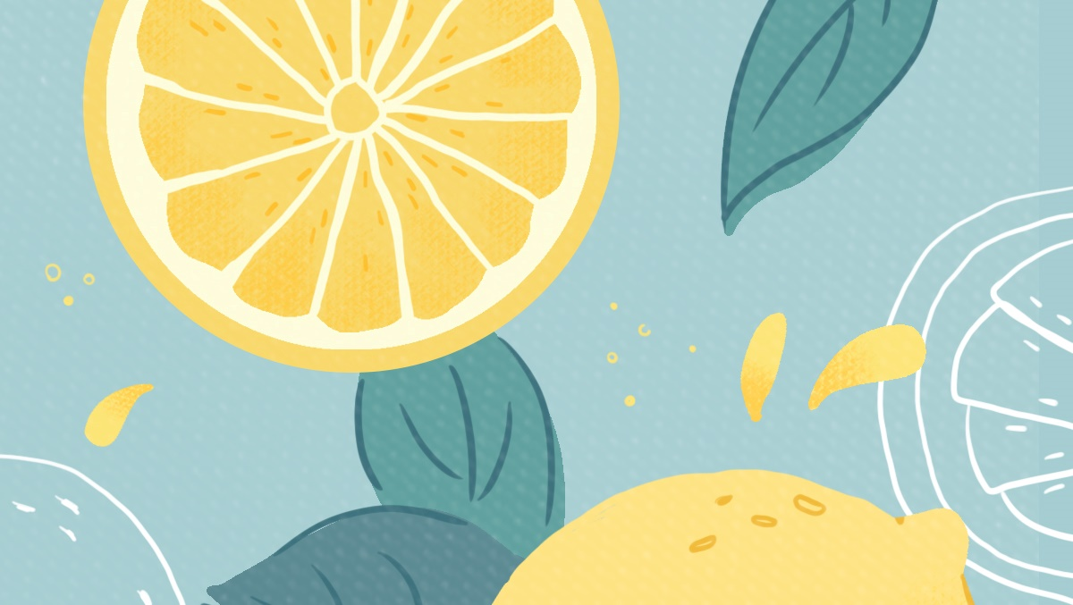
Book2 Unit5 Expanding your world
Samovar— the Special Teapot

Slide 3
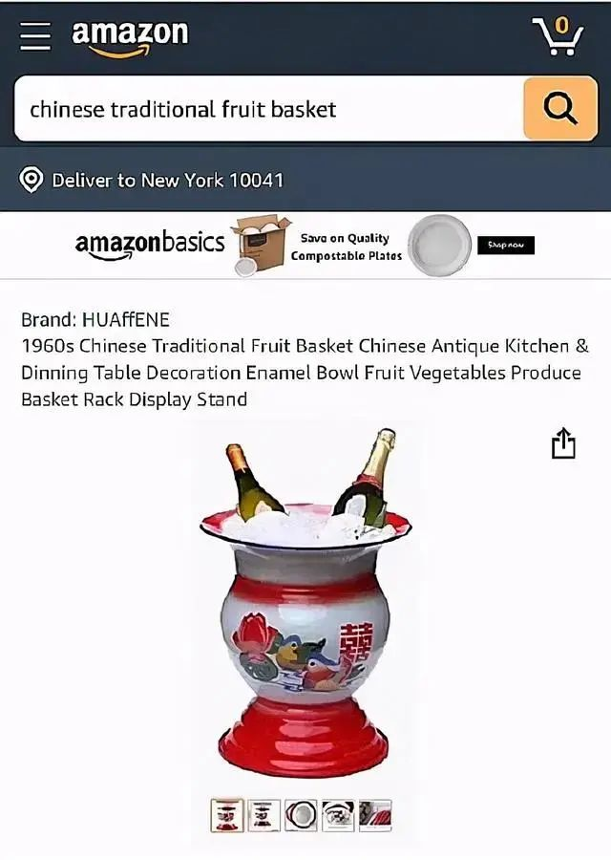
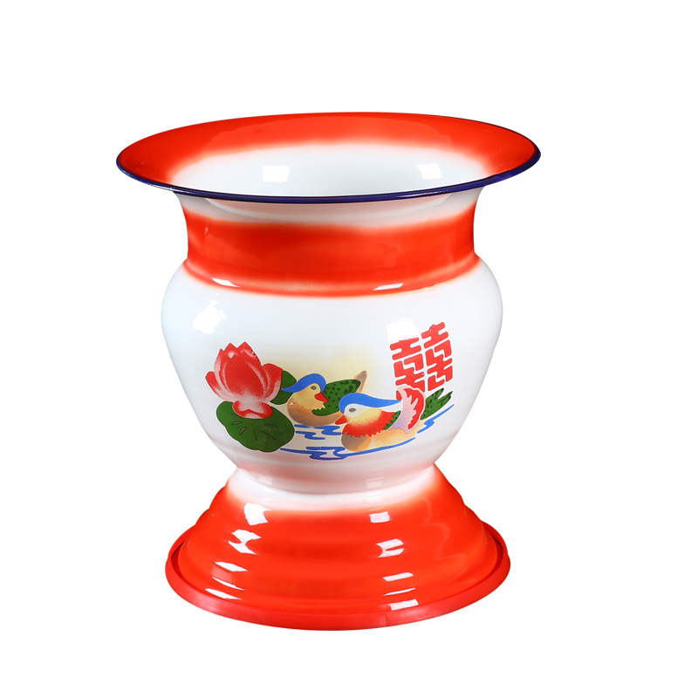
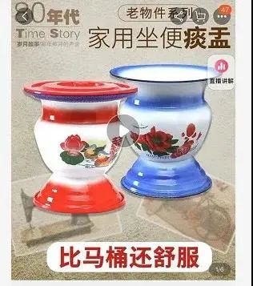
What is this? How to use it?
Spittoon (痰盂)
Portable potty
The antique Chinese traditional fruit baskets of 1960s have beautiful colors and it is suitable for gifts for elegant weddings.
62 dollars- 400 yuan

Slide 4
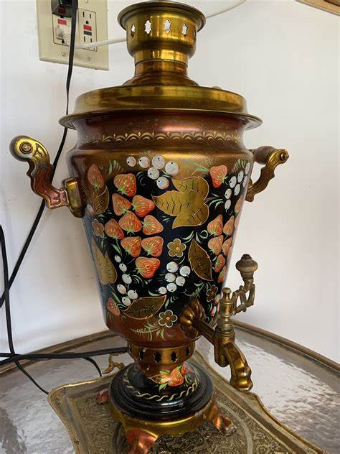
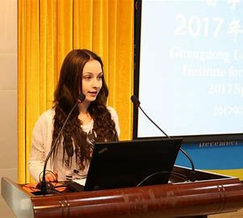
Samovar— the Special Teapot
What questions do you have about it?
Notes:
What questions do you want to ask the writer? For example : What is Samovar? Who does it belong to? Where to get? When to get? How to use it? Why is it special? Why does the writer want to introduce Samovar?

Slide 5
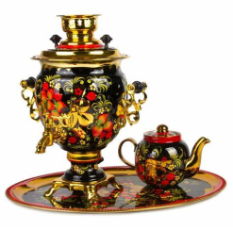
Hello, my speech today is about a very special teapot--the samovar! It’s a traditional Russian water boiler that can also brew tea. It played a big part in Russian history and was a central part of Russian family life for a very long time. I know this because there is a very old samovar in my home that we treasure dearly. It belonged to my great-grandmother’s great-grandmother, and the story of how she bought it has been passed down from generation to generation along with the samovar. So let me tell you how this samovar became part of our family.
transitional sentence
Notes:
What is a Samovar? (a traditional Russian water boiler) Who does it belong to?
Definition of it Owner （great-grandmothers’ great-grandmother to next gereration.)
As for when & where & why did the want to buy the Samovar we can find it in para.2 How do you know that ?

Slide 6
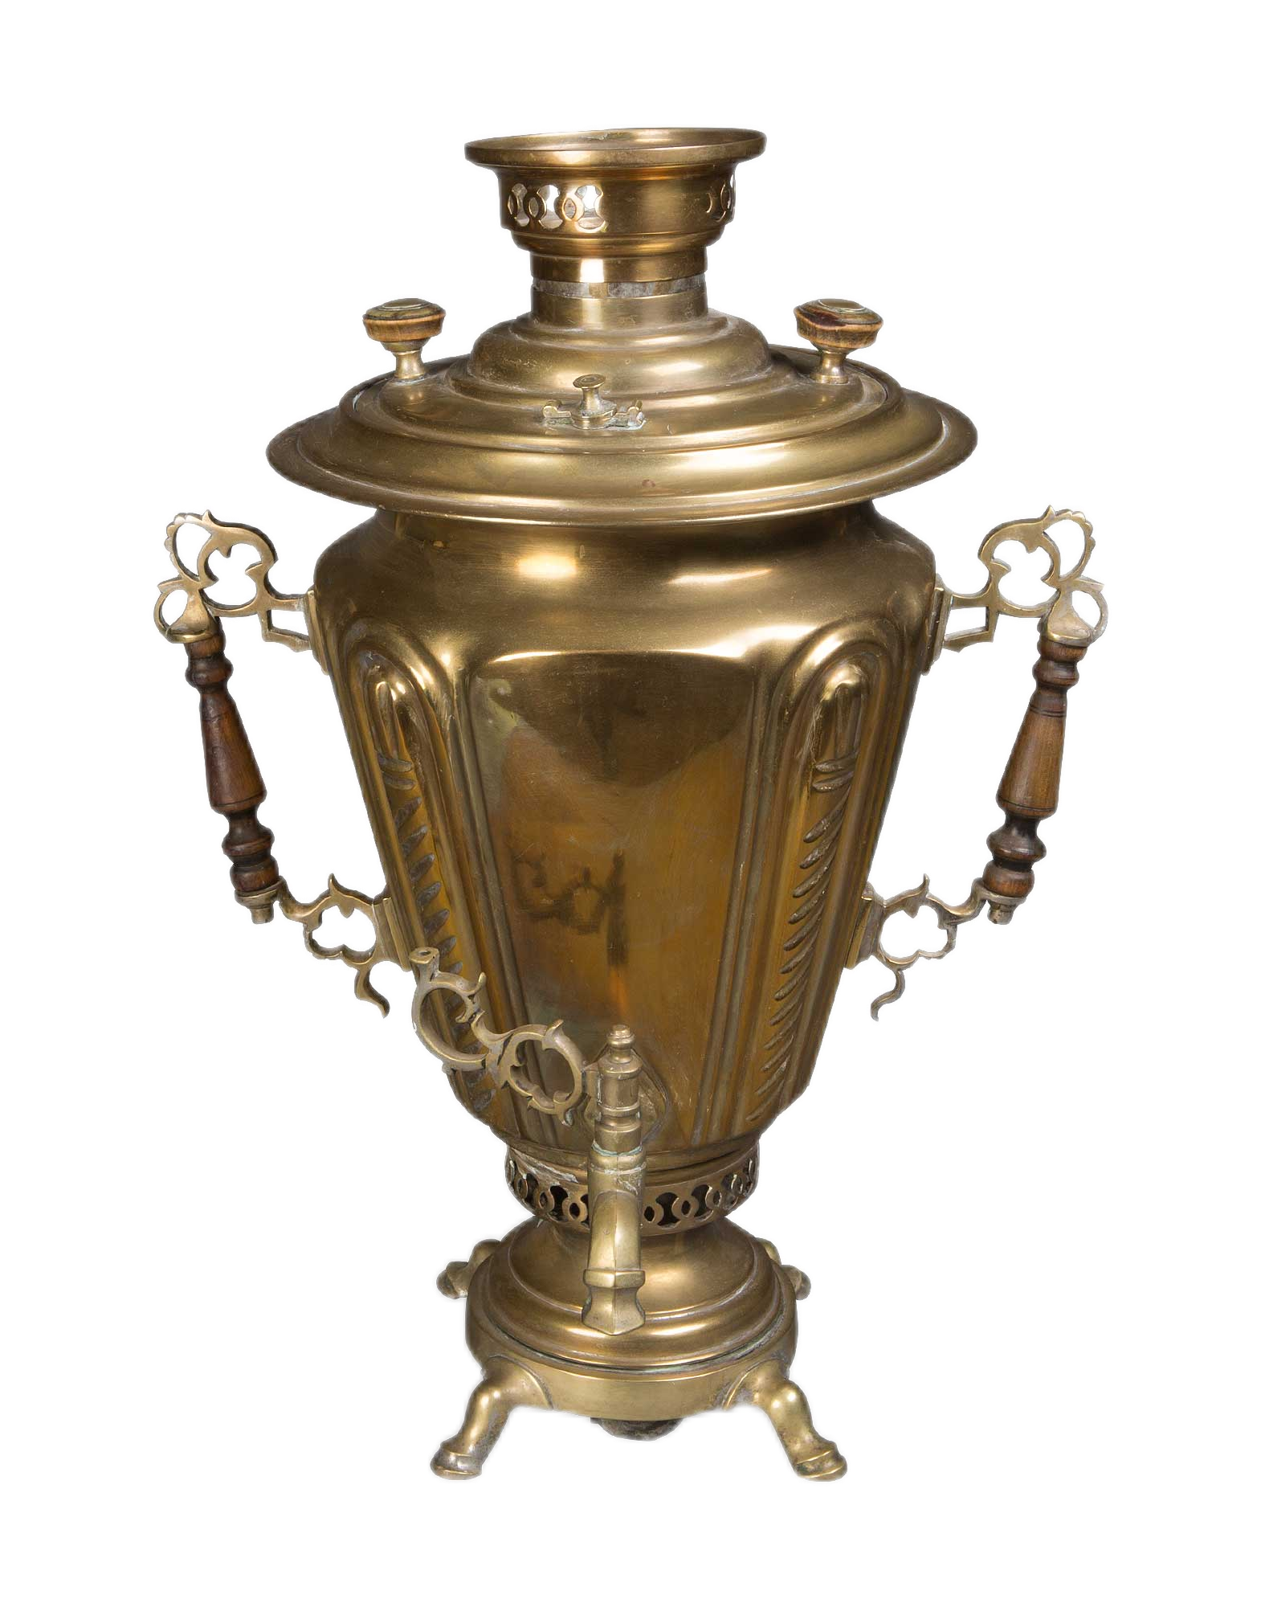
Beginning
Definition &
Owner

Slide 7
What is author’s great-grandmother’s great-grandmother attitude to the Samovar?
How do you know that?
Almost 200 years ago, my great-grandmother’s great-grandmother was trying to survive yet another freezing Russian winter when she heard about a new invention called a “samovar”, which means “self-boiler” in Russian. In her family, they could only boil water on their big stove. The new samovar could make hot water much easier and could be transported anywhere, not to mention that it required much less fuel. Although they were poor, they decided to use their savings to invest in a samovar. So early one cold winter morning, she set out to a distant town. After four hours of struggling through snow, she found the town and quickly bundled her new samovar into her sack and hurried home. The samovar was then proudly placed in her main room and has been in use by my family ever since.
Why?
A sense of satisfaction of overcoming difficulties to get it.
The delight of surviving the freezing winter by using it.
When | Where | How | Why
Almost 200 years ago
A distant town
set out… struggle through… found… bundled… bundled…
be portable; save fuel
Notes:
A sense of satisfaction of getting it; the delight of surviving freezing winter by using it

Slide 8
The story of the Samovar
Almost 200 years ago, my great-grandmother’s great-grandmother was trying to survive yet another freezing Russian winter when she heard about a new invention called a “samovar”, which means “self-boiler” in Russian. In her family, they could only boil water on their big stove. The new samovar could make hot water much easier and could be transported anywhere, not to mention that it required much less fuel. Although they were poor, they decided to use their savings to invest in a samovar. So early one cold winter morning, she set out to a distant town. After four hours of struggling through snow, she found the town and quickly bundled her new samovar into her sack and hurried home. The samovar was then proudly placed in her main room and has been in use by my family ever since.
What can you infer from “has been in use ever since”?
It has become an
inheritance（传承物）.
past
now
future
Notes:
A sense of satisfaction of getting it; the delight of surviving freezing winter by using it

Slide 9
Beginning
Definition &
Owner
A sense of satisfaction of overcoming difficulties.
The delight of surviving.
Body
Story of owning Samovar
An inheritance

Slide 10
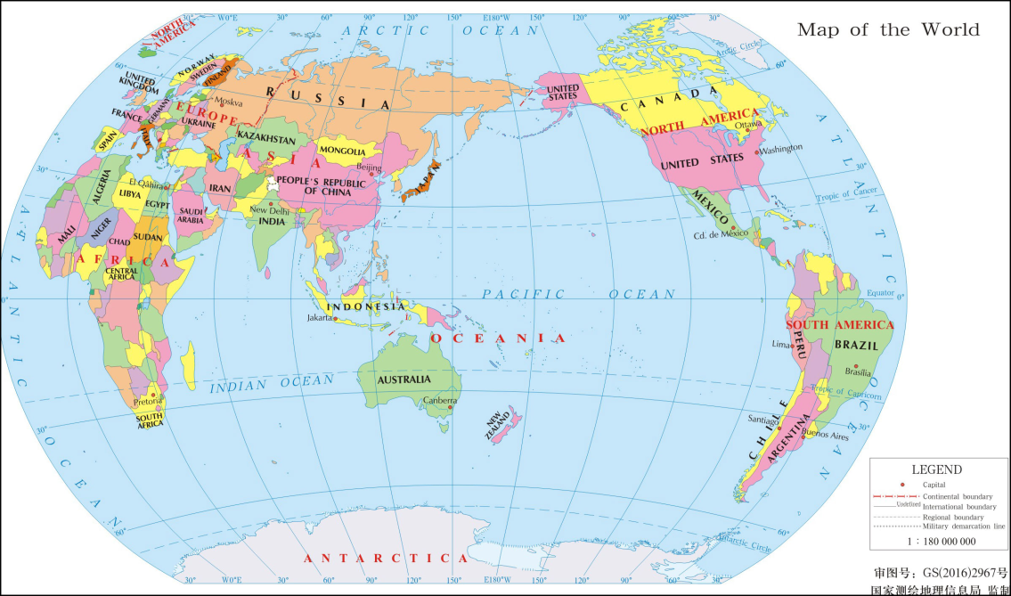
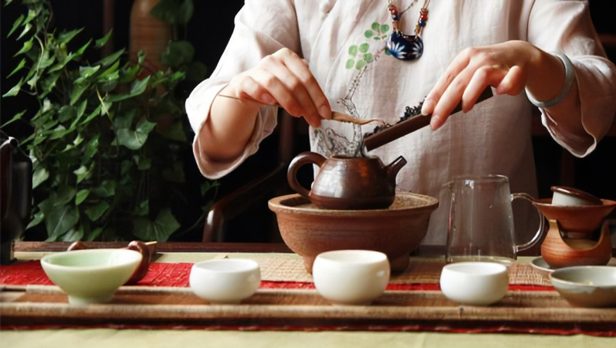
What is special about its tea-making process?
Special tea-making process
Special tea-drinking process
The samovar tea-making process is quite special and has two stages. First, a teapot containing lots of tea leaves and a little water is placed on top of the samovar. As the concentrate is poured into cups, after which water from inside the samovar is added by using the tap. In contrast to special tea ceremonies that can be found in countries like China, the samovar is much less reserved and is traditionally enjoyed with a few sweet snacks. This is a little similar to the British tradition of an informal cup of tea served with snacks. However, with the samovar, tea is usually taken without milk, and sugar is not placed in the cup but rather in the drinker’s mouth, to be slowly melted away by the warm tea.
less reserved;
enjoyed with sweet snacks
Special tea ceremonies
Notes:
Special tea-making process Special tea-drinking process Samovar 又影响了 伊朗和中东的国家

Slide 11
Beginning
Definition &
Owner
A sense of satisfaction of overcoming difficulties.
The delight of surviving.
Body
Story of owning Samovar
An inheritance
Special tea-making & tea-drinking process

Slide 12
What is the meaning of Samovar？
In closing, in my opinion, regardless of how it is made, one thing is for sure: Tea makes the world go round! Invented in China, it breaks through cultural barriers and provides great relief after a hard day’s work. Every time we have a special occasion in my family, out comes the family samovar. The samovar symbolizes happiness, and that’s one thing that I want to keep in my family forever.
Notes:
As for when & where & why did the want to buy the Samovar?

Slide 13
Beginning
Definition &
Owner
A sense of satisfaction of overcoming difficulties.
The delight of surviving.
Body
Story of owning Samovar
An inheritance
Special tea-making & tea-drinking process
Ending
meaning
Happiness
Notes:
Special tea-making and tea drinking process; This is the outer special aspect. What about its inner special aspect? Why is it special? Read the text again try to find it? Discussion

Slide 14
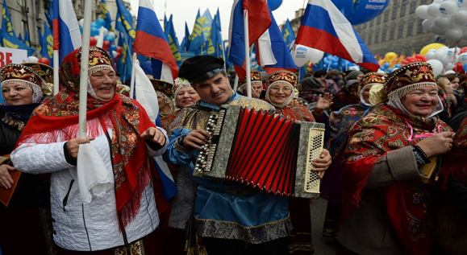
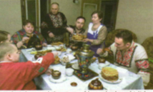

Group Discussion: Except its special tea-making & tea-drinking process, what else makes the Samovar special? Read the text again and try to find the supporting evidence.
To Russians
An indivisible part of ethnic culture and customs
Inner “Special” aspect
To the writer & family
To the world
A symbol of happiness
A part of family tradition
The adaptation and cultural inheritance
Every time we have a special occasion in my family, out comes the family samovar.
An essential inheritance of spirit
Inverted sentences(倒装句)
A crucial witness of prosperity
Notes:
A symbol of happiness
A crucial witness of family prosperity
An essential inheritance of family spirit

Slide 15
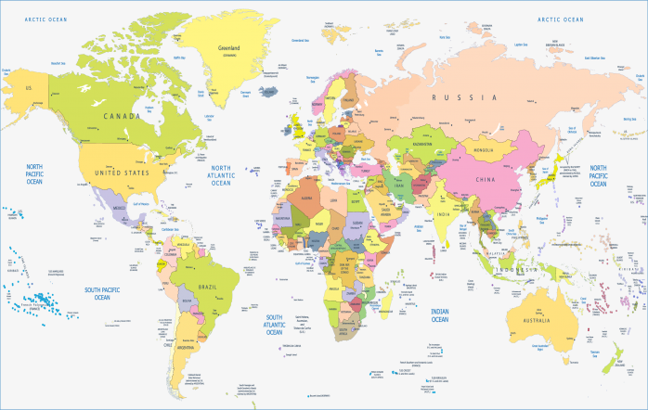
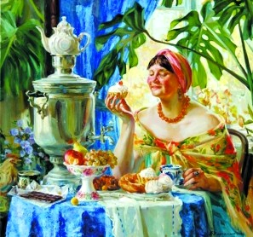
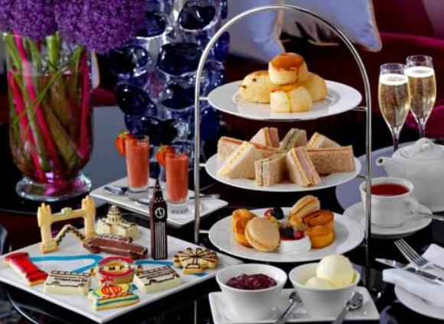
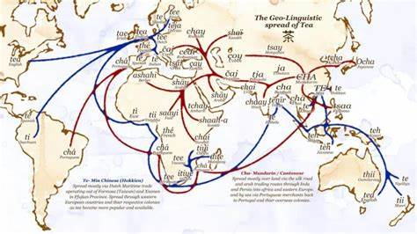

Tea makes the world go round! Invented in China, it breaks through cultural barriers and provides great relief after a hard day’s work.

Slide 16
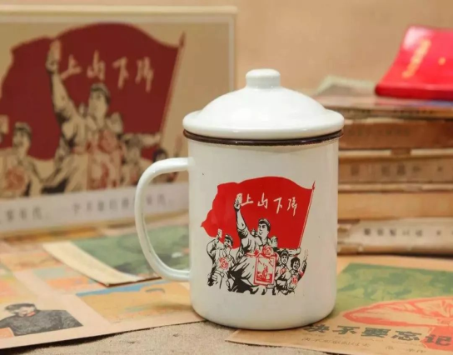
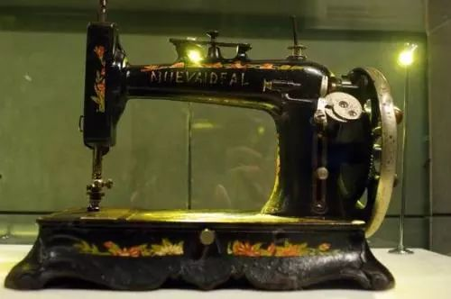
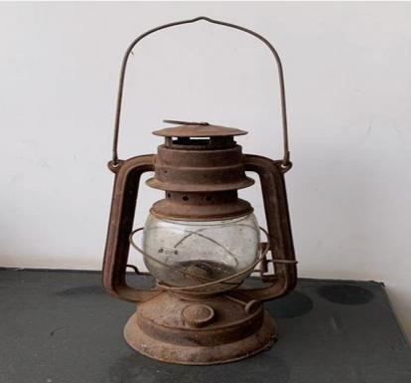
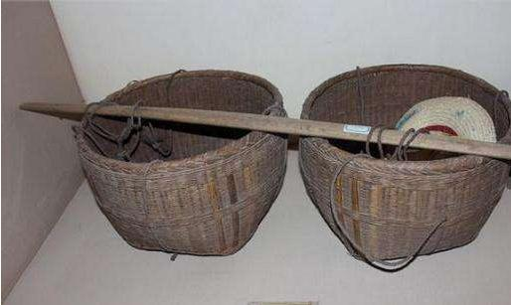
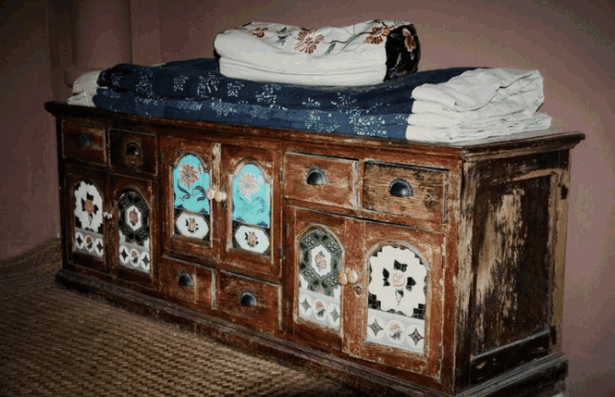
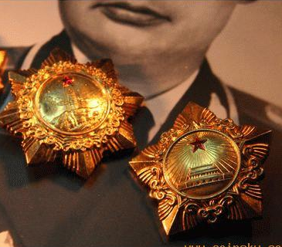
Share your family treasure and traditions
My Special ______
sewing machine
Outer special aspects: What & Who & Story
Inner special aspects：Meaning (to you/your family; to Chinese…)
lamp
It’s a _________________. It belonged to ____ and has been passed down from generation to generation. ______________（outer special aspects ) _____________________（story/function)
In my opinion, (inner special aspects) ___________________________________
___________________________________
carrying pole
cupboard
medals

Slide 17
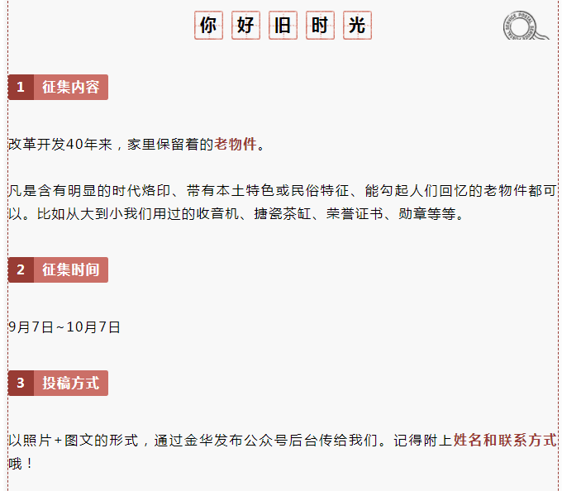
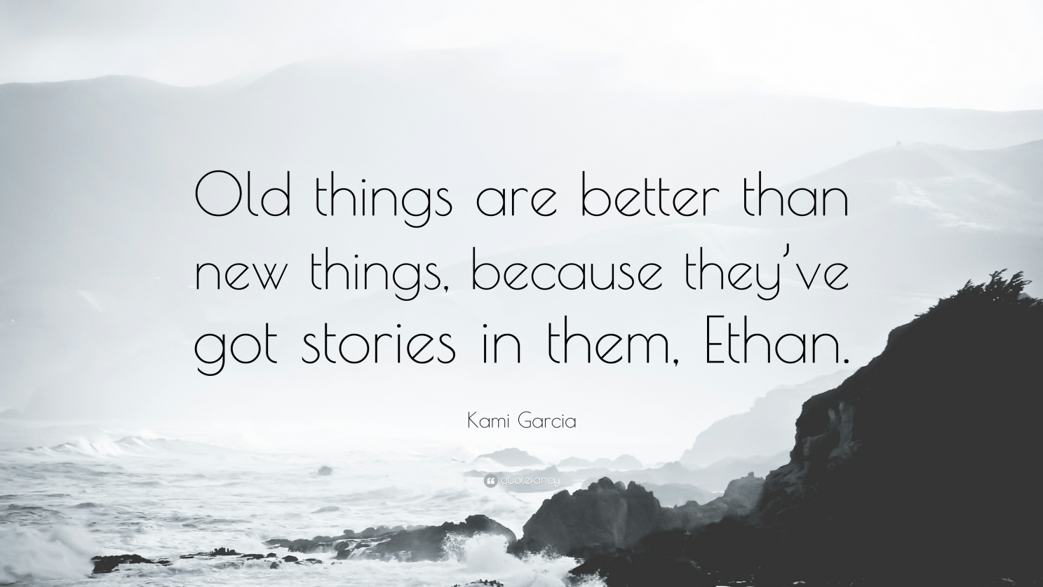
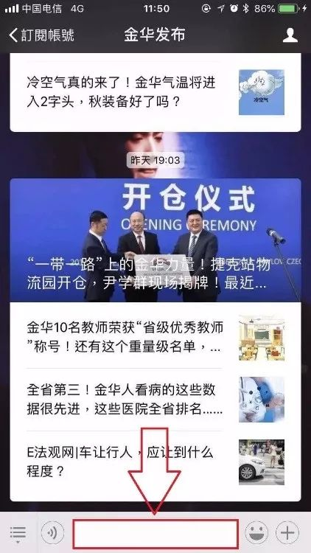
Assignment
1. Take a picture of your family treasure and share your
story on Jinhua Wechat plateform.

