Slide 1


感恩遇见，相互成就，本课件资料仅供您个人参考、教学使用，严禁自行在网络传播，违者依知识产权法追究法律责任。
更多教学资源请关注
公众号：溯恩英语
知识产权声明

Slide 2

活用教材词汇，靶向高考写作
B4U2单词拓展
武汉开发区汉阳三中：廖英

Slide 3

persuade/pəˈsweɪd/ vi.劝说;说服
1.不用说，汤姆成功地说服了伯纳德挨家挨户卖爆米花。^{2020年新高考Ⅰ卷读后续写“制作爆米花帮助别人”}
Needless to say, Tom managed to persuade Bernard to sell/into selling popcorn from door to door.
2.我设法说服大卫不要放弃比赛，因为他为此刻苦训练了好久。2^{022新高考全国卷I读后续写“脑瘫学生参加跑步比赛”}
I managed to persuade David not to give up the competition, for he had practised so hard for it.
3.孩子们竭尽全力使这个家庭相信这个计划的好处。^{2020年新高考Ⅰ卷读后续写“制作爆米花帮助别人”}
The children did everything they could to persuade the family of the plan's benefits.
4.首先，你可以试着说服你的父母，向他们解释这次旅行对你有多重要以及在旅途中你将会多么有责任心。
Firstly, you could try to persuade your parents by explaining how much this trip
means to you and how responsible you will be during the trip.
5.她赞成这个提案并提出了强有力的观点。
She presented a persuasive/convincing argument in favor of the proposal.

Slide 4

switch/swɪtʃ/ v.转换;交换 n.开关;转换器
switch on/swɪtʃ ɒn/ 开(电灯、机器等)
switch off/swɪtʃ ɒf/ 关(电灯、机器等)
switches
1.啪嗒一声，等灯亮起来，照耀着观景窗，他睁开了眼睛。
He opened his eyes as the snap of the switch turned on the lights
that surrounded the picture window.
2.由于下大雨，运动会的日期改变了。
As a consequence of the heavy rain, the date of the sports meeting was switched.
3.我可以远程打开烤箱用这个新的家庭设备。
I can switch on my oven remotely using the new home device.
4.甚至是简单的事情都有所帮助,比如使用再生纸,或者当你离开房间的时候关上灯。
Even simple things like using recycled paper or switching off the light when you leave
a room can help.
5.就我个人而言，是时候跟手机说再见了。应当转移你的注意力到学习上。
Personally, it’s high time to say goodbye to mobile phones and switch your attention
and efforts to school work.

Slide 5

distant/ˈdɪstənt/ a.遥远的;远处的;疏远的
1.在遥远的过去，人类住在洞穴里。
In the distant past, humans lived in caves.
2.她眼神恍惚，她的心思在别处。
There was a distant look in her eyes from time to time,
her thoughts elsewhere.
3.她快乐的童年变成了一种模糊的和遥远的记忆。
Her happy childhood became a dim and distant memory.
4.他们隔着田野叫喊着，远距离的交流着。
Hollering across the field, they communicated from a distance.
5.面对这四个强壮的人，狼可能会感到受到威胁，开始撤退。很快，它跑进了森林里，消失在远处。^{2017浙江卷读后续写“骑自行车遇狼袭击”}
Facing the four strong men, the wolf might feel threatened, starting to withdraw.Soon it ran off into the forest and disappeared in the distance.

Slide 6

secure/sɪˈkjʊə(r)/ a.安全的;安心的 vt.获得
1.这些智能家居将使我们安全，节省我们的能源，并提供更舒适生活的环境。
These smart homes will keep us secure, save us energy, and provide
a more comfortable environment to live in.
2.理想是指路明灯。没有理想，就没有坚定的方向，
没有方向就没有生命。
Ideal is the light tower. Without ideal , there is
no secure direction ; without direction , there is no life .
3.她把绳子牢牢地系在汽车后面。
She secured the rope firmly to the back of the car.
4.郑钦文没有气馁，并逐渐扳平比分，最终以7-5获胜，获得了胜利。
Zheng Qinwen was not discouraged by the defeat and equalized the score gradually, eventually winning the set 7-5 to secure the victory.

Slide 7
appliance/əˈplaɪəns/ n.电器;器具
1.电灯灭了,因线路上电器超负荷把保险丝烧断了。
The light fused because the system is overloaded with electrical appliance.
2.他还可以学习使用真空吸尘器，洗衣机等家用电器。
He could also learn to use the vacuum cleaner,
the washing machine and other household appliances.
3.智能家电，比如智能手机，智能电视、智能空调等智能产品已经进入千家万户，并逐渐让每个人的日常生活发生变化。
Intelligent appliances, such as smart phones, smart TVs, smart air
conditioners and other smartproducts have found their way into thousands of
households, and have gradually changed everyone’s daily life.
4.其中最引人注目的是互动展示，游客可以通过声音或智能手机来体验控制电器。
What it highlighted was the interactive displays,where visitors could experience controlling appliances with just their voices or through smart phones.

Slide 8
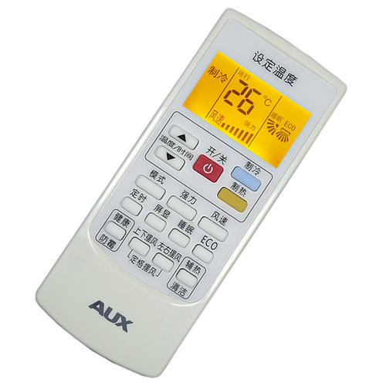
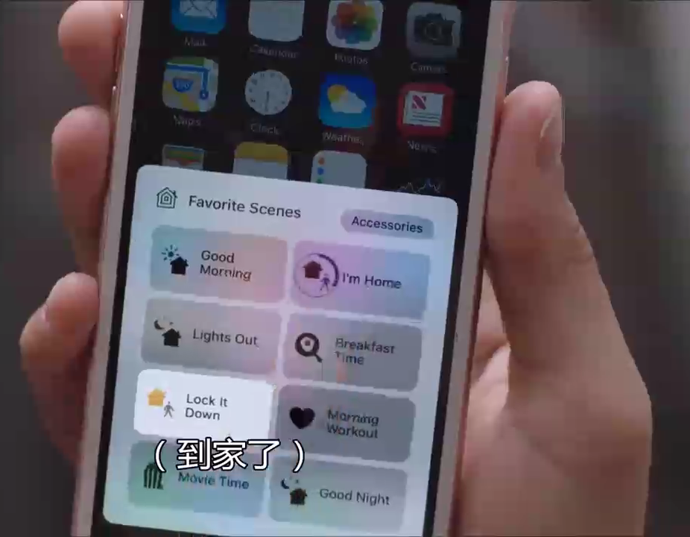
remote/rɪˈməʊt/ a.远程的;偏远的
remote control/rɪˈməʊt kənˈtrəʊl/ 遥控器;遥控
1.毕业后，他在一个偏僻的小镇当高中老师。
After graduation, he became a high school teacher in a remote town.
2.尽管有他的远程指导,我还是花了很多精力独自完成这个项目。^{2022年浙江1月高考读后续写“傲娇学霸与迷糊学渣”}
It did take me hard work to finish the project alone despite his remote guidance.
3.他伸手去拿遥控器，打开了电视。
He reached for the remote control and switched on the television.
a remote control

Slide 9

automatic/ˌɔ:təˈmætɪk/ a.自动的
1.在未来，我们每天都会使用先进技术对家中几乎所有东西进行自动化控制。
In the future, we will be using advanced technology every day for automatic
control of just about everything in our home.
2.当发动机关闭时，这个装置会自动断开点火装置。
The device automatically disconnects the ignition
when the engine is switched off.
3.上周末我体验了一次无人驾驶出租车。
我通过手机APP叫车后，没几分钟车就稳稳停在
我面前。车门自动打开，上车后我简单输入了
目的地，车子就安静地启动了。
Last weekend witnessed my experience in a driverless taxi.A taxi came to me
within minutes after I ordered one on my smartphone. The door opened
automatically, allowing me to input my destination before the taxi started
its journey.

Slide 10
integrated/ˈɪntɪgreɪtɪd/ a.各部分密切协调的;综合的
integrate/ˈɪntɪgreɪt/ v.(使)合并;成为一体
1.未来的家庭将使用集成的传感器来告诉你每天早上什么时候离开家，然后自己进入节能模式。目睹科技如此轻易地融入我们的日常生活，真是令人惊叹。
The future home will use integrated sensors to tell when you leave home each
morning, and then go into an energy-efficient mode all by itself.It is breathtaking to witness how technology can easily integrate into our daily lives.
2.要让自己融入一个文化与自己截然不同的社会是非常困难的。
It is very difficult to integrate yourself into a society whose culture is so different from your own.
3.总的来说，结果很有趣，表明语言学习可以与个人爱好和娱乐相结合。2022全国乙卷图表类应用文“针对课外英语学习调查结果的短文投稿”
Overall, the results are quite interesting, indicating that language learning can be integrated with personal hobbies and entertainment.

Slide 11


integrated/ˈɪntɪgreɪtɪd/ a.各部分密切协调的;综合的
integrate/ˈɪntɪgreɪt/ v.(使)合并;成为一体
4.我们建议学校将定期的眼部锻炼和休息时间纳入每天的日程，以减少学生近视的风险。
We propose that schools incorporate regular eye exercises and breaks into their daily schedule to reduce the risk of myopia
among students.
5.将这样一项重要的新活动融入你的日常生活显然需要决心和时间。
Weaving a significant new activity such as this into your
regular routine obviously takes determination and time.

Slide 12

efficient/ɪˈfɪʃnt/ a.效率高的;有功效的
1.我认为这种方法在促进语言学习方面可能不是很有效，因为一些学生可能最终会与不同水平或不同学习风格的伙伴合作。^{2023年全国卷I应用文“外教随机分组反馈信”}
I believe that this method may not be efficient in promoting language learning as some students may end up with
partners who are not at the samelevel or have different learning styles.
2.虽然人工智能有许多潜在的好处，比如提高效率和便利性，
但人工智能也带来了取代人力的挑战。
While there are many potential benefits of AI, such
as increased efficiency and convenience there are also
challenges posed by the replacement of human workers.

Slide 13
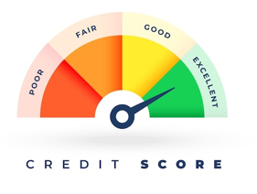
efficient/ɪˈfɪʃnt/ a.效率高的;有功效的
3.此外，一些学生可能有不同的熟练程度，这使得他们很难有效地与他们的同伴练习。^{2023年全国卷I应用文“外教随机分组反馈信”}
Additionally, some students may have different levels of
proficiency, making it difficult for them to practice effectively with their partner.
4.这一事实限制了教师和学生个体之间的互动，自然就会影响学生看待他们的老师的有效性。^{2023年全国卷I应用文“外教随机分组反馈信”}
That fact limits the interaction between the teacher
and individual students and automatically influences how
students will perceive the effectiveness of their teacher.

Slide 14

mode/məʊd/ n.模式;方式;风格
1.你知道这台机器是什么模式吗?
Do you know what kind of mode the machine is in?
2.她在考虑换一种不同的交通工具——骑自行车。
She is thinking of switching to a different
mode of transport---a bicycle.
3.这个世界给他提供了一种“困难模式”，比我的生活更具挑战性，但这个男孩能够在像花朵这样被忽视的东西中发现美。
The world had offered him a "HARD MODE", which was far more challenging than mine, yet the boy was capable of finding beauty in something as neglected as the flower.

Slide 15

mode/məʊd/ n.模式;方式;风格
1.他们试图把房子恢复到原貌。
They tried to restore the house to its original state.
2.这个农场已经荒废了几十年，状况很差。
The farm has been deserted for decades and is in a poor condition.
3.宇宙飞船正处于飞行状态。
The spacecraft is in a flying mode.
4.他发现自己处于尴尬的境地。
He found himself in an embarrassing situation.
5.1949年以来，中国妇女的社会地位有了很大提高。
The social status of women in China has been greatly enhanced since 1949.
state指人或物在某一特定时间或阶段内存在的情况。
condition指食物或人所处的环境或由其他原因产生的特殊情况。
mode指特定的正在起作用的安排或状态。
situation指一个特定时期内的形势或局面，这种状况一般由相关的综合环境条件决定。
status指与同类的人或物相比的状况。指人时可指重要地位或身份。

Slide 16
routine/ru:ˈti:n/ n.常规;正常顺序 a.常规的
daily routine/ˈdeɪli ru:ˈti:n/ 日常生活
1.故障是在例行检查中发现的。
The fault was discovered during a routine check.
2.通过将跳绳融入我们的日常生活，我们可以充满活力、保持健康并且精神焕发，活力满满的迎接我们的学术挑战。^{2024年浙江1月高考应用文“校园课间体育项目推荐征文投稿”}
By incorporating Jump Rope into our daily routine, we can stay active, healthy, and refreshed, ready to tackle our academic challenges with renewed energy.
3.为了体验医生的生活，我打算在暑假期间去医院做志愿者，学习更多医护人员的日常工作和急救知识。
In order to experience the life as a doctor, I intend to work as a volunteer in a hospital during the summer vacation to learn more about the routine of medical staff and knowledge of first aid.
4.实际上，我们每个人都可以成为一个改变者，通过对我们的日常生活做一些简单的调整，在我们的日常生活中做一些小小的改变，这可以带来很大的不同。^{2024新高考天津卷应用文“低碳校园倡议信”}
Actually, each of us can be a change-maker by making these simple adjustments to our daily lives and small changes in our daily routines, which can make a great difference.

Slide 17

preference/ˈprefrəns/ n.爱好;偏爱
1.因此，我认为按学生的个人喜好分组将是一个更好的选择。
Therefore, I believe that grouping by students’
personal preference would be a better choice.
2.大多数学生，也就是说，65%的人喜欢英语歌曲，一半的学生喜欢看英语电影。2022全国乙卷图表类应用文“针对课外英语学习调查结果的短文投稿”
Most students, that is to say 65%, have a preference for English songs, with half of the students keen on watching English movies.
3.设身处地为他人着想也是可取的，这样可以减少误解。
It is also preferable to put ourselves in others’ shoes, which will minimize misunderstandings.
4.最近进行了一项关于缓解压力方法的调查。绝大多数学生——确切地说，是80%的学生喜欢看视频，65%的学生喜欢听音乐。还有一些学生更喜欢运动和聊天，分别占30%和40%。
Recently a survey was carried out about ways to relieve stress. An overwhelming number of students -- 80 percent, to be exact -- have a preference for watching videos, and listening
to music is favored by another 65 percent. Some students prefer playing sports and chatting,
accounting for 30% and 40% respectively.

Slide 18
instant/ˈɪnstənt/ n.瞬间;片刻 a.立即的
1.令我惊讶的是，我的视频成为大家关注的焦点，让我一炮而红。_{2021年浙江1月高考读后续写 “万圣节南瓜趣事”}
Much to my surprise, my video became the focus of attention, making me an instant hit.
2.“跟我来!”乔希喊道。紧接着，他就打着灯跑上楼去了我赶紧跟着他进了阁楼，在那里我们开始了彻底的搜查。
“Come with me!” Josh called out. The next instant , he raced upstairs with the lighting
speed.I hurried to follow him into the attic, where we began a thorough search.
3.你一进家门,灯就会亮起,还有你最喜欢的音乐或电视节目会自动播放,而且你会发现晚餐已为你准备好了。
Your lights will come on the instant you enter the door along with your favourite music or TV programmes, and you will find your dinner already prepared for you.
4.随着夜幕的降临，他卖光了爆米花，赚了一笔钱。他立刻和朋友们分享了这一激动人心的成就，他们都笑得合不拢嘴。_{2020年新高考Ⅰ卷读后续写“制作爆米花帮助别人”}
As night descended gradually, he sold out all the popcorn and earned a sum of money. He
shared this exciting achievement with his friends instantly and they all smiled from ear to ear.

Slide 19

instant/ˈɪnstənt/ n.瞬间;片刻 a.立即的
时间快：
1.他一听到这个意外的消息，惊讶得哭了起来。
As soon as he heard of the unexpected news, he was so surprised that he burst into tears.
2.妈妈一看到早餐,就觉得很幸福。_{2021年全国卷I读后续写“母亲节惊喜”}
The instant/minute she saw the breakfast, the mother felt a wave of happiness welling up
within her.
3.一听到我的话，大卫给了我一个大大的笑容，站了起来，走向了起跑线。_{2022新高考全国卷I读后续写“脑瘫学生参加跑步比赛”}
Upon/On hearing my words,David beamed a big smile,stood up and moved towards the
starting line.
4.他刚到，她就开始了抱怨。
Hardly had he arrived when she started complaining.
5.我一踏进这个熟悉的地方，我就看见我的老师坐在一堆作业中间。_{2023新高考I卷读后续写“参加写作比赛”}
No sooner had I stepped into this familiar room than I saw my teacher sitting among piles
of papers.

Slide 20
instant/ˈɪnstənt/ n.瞬间;片刻 a.立即的
时间快：
6.我保证，一拿到钱我就还你。
I will pay you back, I promise, the moment I get paid.
7.在一刹那/在一瞬间/在一瞬间/在一眨眼间，他趁人不注意快速溜进了房间。
In a split second/In an instant/In a flash/In the blink of an eye, he slipped into the room without notice.
8.简立刻跑到岩石上，爬了上去，然后疯狂地摇晃着她的黄色上衣。^{2016年浙江卷高考读后续写 “夫妻吵架森林迷路”}
In no time did Jane rush to the rock, climb onto it and waver her yellow blouse madly.
9.一听到这个好消息后，同学们爆发出欢呼和庆祝。
Almost immediately/shortly after/at once after receiving the good news, the students
erupted in cheers and celebration.
10.一看到这个懂得感恩的小家伙，我感到一阵宽慰和敬畏。
I felt a surge of relief and awe at the sight of this grateful creature.

Slide 21

instant/ˈɪnstənt/ n.瞬间;片刻 a.立即的
时间慢：
1.听当地人聊天，时间过得很慢。
Time goes slower when listening to the natives chatting.
2.对安妮来说，这一天剩下的时间过得很慢。
The rest of the day went very slowly for Anne.
3.为什么物理课总是那么漫长?
Why do physics lessons always seem to drag?
4.但似乎过了一个世纪那么久，什么都没有发生。
But after what seemed a century, nothing happened.

Slide 22


command/kəˈmɑ:nd/ n.指令;命令;控制 vt.命令
1.指挥官命令我离开教室前把空调关掉。
The commander commanded me to switch off the air conditioner
before leaving the classroom.
2.所有控件都将响应语音指令。你只要大声说出你的需求，你的家居系统就会响应。
All controls will respond to voice commands.You just say aloud what
you want and the home system will obey.
3.我精通英语,因此我能与参观者毫无困难地交流。
_{2019年全国卷应用文“伦敦美术馆志愿者申请信”}
Besides, I have a good command of English, which can make it
easy to communicate with foreigners.

Slide 23
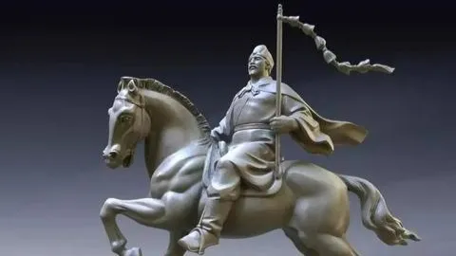
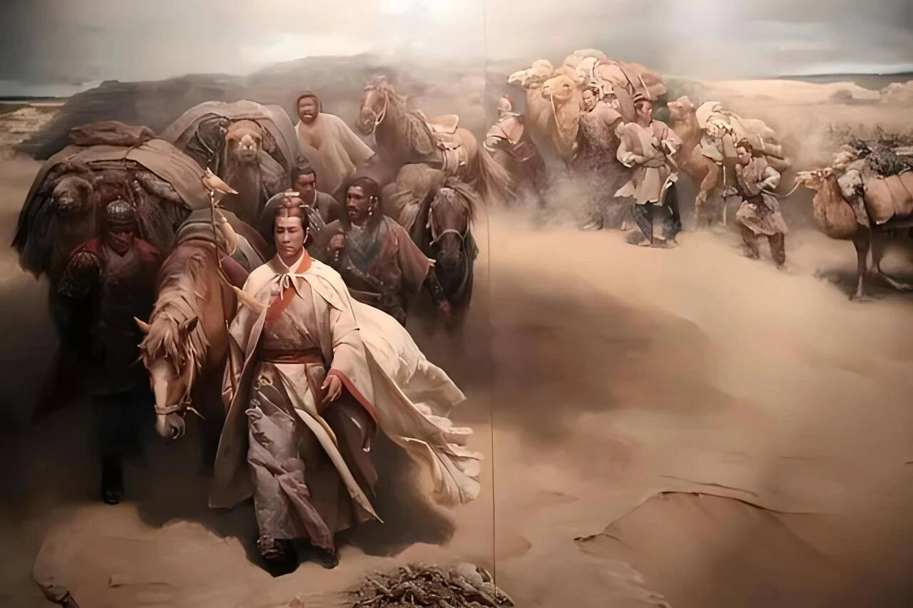
command/kəˈmɑ:nd/ n.指令;命令;控制 vt.命令
4.有了丈夫的陪伴，她逐渐感到快乐，并能控制自己。
With her husband keeping her company, she gradually felt happy and in command of herself.
5.西汉时，张骞奉皇帝之命出征西域。他销售茶叶、丝绸等中国传统产品，进口各种商品，打开了中国与中亚许多国家友谊的大门。通过他的旅行，丝绸之路诞生了。
_{2023全国甲卷应用文“介绍中国历史人物征文稿”}
In the Western Han Dynasty, following the emperor’s command, Zhang Qian made his journey to the Western Regions. Selling traditional Chinese products like tea and silk and importing a variety of items, he opened the door to the friendship between China and many countries in Central Asia.Through his traveling, the Silk Road came into being .

Slide 24

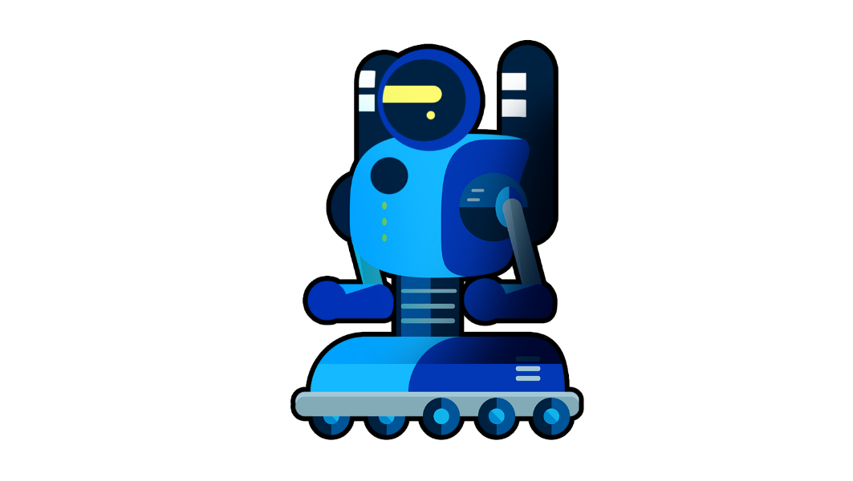
obey/əˈbeɪ/ v.服从;遵守
1.我们的父母经常要求我们要遵守交通规则。
Our parents often command that we (should) obey traffic rules.
2.机器人必须服从人类的命令，除非这些命令与第一定律相冲突。
A robot must obey orders given by human beings except where such orders would conflict with the first law.
The Three Laws of Robotics:
1.A robot may not injure a human being, or, through inaction.
2.A robot must obey the orders given it by human beings except where such orders would conflict with the First Law.
3.A robot must protect its own existence as long as such protection does not conflict with the First or Second Law.

Slide 25

warning/ˈwɔ:nɪŋ/ n.警告;警示;先兆
1.我警告他不要在这么薄的冰上滑冰，但他不理会我的警告。
I warned him not to skate on such thin ice, but he ignored my warning.
2.他身体的每一根神经都警告他不要这么做再往前走。
Every nerve in his body warned him not to go any further.
3.尽管事实上我们总是被警告气候变化可能带来的危险，但我们几乎没有采取任何应对措施来面对这些严峻的形势。
In spite of the fact that we are always warned of the possible danger the climate
change is likely to bring us, little has been done to deal with the severe situation.
4.如有变动，请提前通知我们，以便我们作出进一步安排。
Please give us a warning of any changes in advance so that we can make further arrangements.

Slide 26

constant/ˈkɒnstənt/ a.不断的;重复的 n.常数
1.滴水穿石。
Constant dripping wears away the stone.
2.感谢您不断的指导，这三年见证了我的巨大成长。
Thanks to your constant guidance, these three years
have witnessed my tremendous growth.
3.智能马桶也会持续跟踪你的健康状况。
Smart toilets will be keeping constant track of your health as well.
4.从我的滑雪经历中，我了解到没有人是完美的，但是通过不断的练习，每个人都可以在学习一项新技能方面变得出色。_{2023全国乙卷应用文“暑假新技能学习征文投稿”}
From my skiing experience, I learn that no one is perfect, but with constant practice everyone can become excellent at learning a new skill.
5.如果通过作弊获得一个证书，对我来说，那个证书将会是时刻提醒我诚信方面污点的警示。
If the cheating results in being awarded a certificate, to me, that certificate would
represent a constant reminder of the stain on my integrity.

Slide 27


critical/ˈkrɪtɪkl/ a.严重的;关键的;批判性的
1.我们永远不会忘记他们在比赛中所表现出的批判性思维和人文素养。
We will never forget the critical thinking and humanistic qualities
they displayed in the competition.
2.在科技引领的世界中，获得数字素养技能是至关重要的。
Acquiring digital literacy skills is critical for navigating the
technology-driven world.
3.如果有什么不正常的情况，或者你得了癌症等严重的疾病，它们可以在早期警告你，并可能挽救你的生命。
They can warn you early on if there is something abnormal or if
you have a critical illness, such as cancer and potentially save your life.

Slide 28

critical/ˈkrɪtɪkl/ a.严重的;关键的;批判性的
4.通过教授如何清晰地表达自己的想法，倾听反对的观点和进行批判性地思考，参与辩论能提升人们的沟通技能。
Participating in a debate can help improve communication
skills by teaching individuals how to articulate their thoughts
clearly, listen to opposing viewpoints, and think critically.
5.她不理会这些批评，继续说着她的创意项目。
Shrugging off the criticism, she continued with her
creative project.
6.被老师批评后，我低垂着脑袋，脸因内疚而涨得通红。
Criticized by my teacher, I lowered my head
and flushed with guilt.

Slide 29
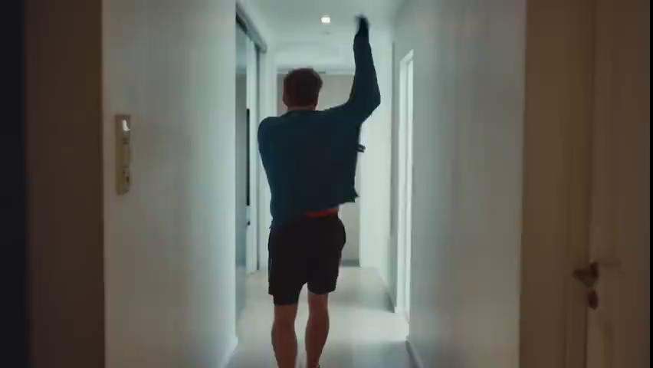
Critical thinking
What might be some of the disadvantages of smart homes?
➢ technical failures （rely on the voice and power too much)
➢ energy-consuming and costly
➢ difficult to cover every household
➢ not easy and accessible for the elderly
insecure in private information

Slide 30
potentially/pə'tenʃəlɪ/ ad.潜在地;可能地
potential/pəˈtenʃl/ a.可能的;潜在的 n.潜力
1.武则天的故事说明了女性在领导方面的潜力，并挑战了传统的性别角色。^{2023全国甲卷应用文“介绍中国历史人物征文稿”}
Wu Zetian’s story illustrates the potential of women in leadership and challenges
traditional gender roles.
2.没错，随机配对学生可以在某种程度上促进更多的互动，但也可能存在一些不可忽视的潜在问题。^{2023年全国卷I应用文“外教随机分组反馈信”}
True as it is that randomly pairing up students can contribute to more interaction to some
extent,there may also be some potential problems that cannot be ignored.
3.它可以提供一个充分发挥你潜力的机会。
It can offer an opportunity to bring your potential into full play.
4.他又露出了咧嘴的笑容。令我印象深刻的是，他克服了自己的恐惧，发挥了自己的潜力，而他不懈的努力是值得的。^{2022新高考全国卷I读后续写“脑瘫学生参加跑步比赛”}
His big toothy smile occurred again. I was impressed that he overcame his fear and
fulfilled his potential, and the unremitting effort was worth it.

Slide 31

electrical/ɪˈlektrɪkl/ a.电的;用电的
1.如果电线短路，你的智能家居会检测到它，并为你提供相关信息。
If there is a short in the electrical wiring, your smart home will
detect it and provide you with the relevant information.
2.同样重要的是我们应该最小化减少大功率电器的使用，比如空调、微波炉。
Equally important is that we should minimize the use of high
power electrical appliances, such as air conditioners, microwave ovens.
3.减少汽车使用，改用电动汽车车辆和尽量减少飞机旅行则不仅有助于阻止气候变化，还将减少空气污染。
Reducing car use, switching to electrical vehicles and minimizing plane travel will not
only help stop climate change, it will reduce air pollution too.

Slide 32
detect/dɪˈtekt/ vt.发现;查明
1.我们建议学校采取定期为学生进行眼部检查的政策，以早期发现近视并采取适当措施。
We recommend that schools adopt a policy of regular eye exams for students to detect
myopia early and take appropriate measures.
2.每个有需要的人都来找我。我给了他们满满一勺沙拉，微笑着说:“祝你们吃得愉快。”。我可以很容易地察觉到他的震惊以及他们眼中的感激。
Everyone in need approached me. I gave them a full scoop of salad and beamed “enjoy
your food”. I could easily detect a mixture of shock and gratitude in their eyes.
3.为了解决这个问题，我们建议学校为学生和家长提供关于健康的眼部习惯和近视风险的教育，以及早期检测和治疗的资源。
To address this issue, we suggest that schools provide education for students and parents
about healthy eye habits and the risks of myopia, as well as resources for early detection
and treatment.

Slide 33

relevant/ˈreləvənt/ a.有关的;有意义的
1.这里将有各种各样的文化活动，包括与中国文化相关的讲座。
There will be a wide variety of cultural activities including lectures
that are relevant to Chinese culture.
2.从你的上一封信中得知你对我的假期安排很好奇，我便写信来告诉你一些相关细节。
Knowing from your last letter that you are curious about my vacation
schedules and my college major, I am writing to inform you of some
relevant details.
3.此外，由于缺乏相关规定，一些不文明的人故意破坏共享单车，例如，把它们扔进河里或随意堆放。
Furthermore, for lack of relevant regulations, some uncivilized people
deliberately damage shared-bikes, for example, by throwing them into rivers or piling them up randomly.

Slide 34

catch fire/kætʃ ˈfaɪə(r)/ 着火
1.森林里有一层厚厚的树叶，很容易着火。
There is a thick covering of leaves in the forest, which are easy to catch fire.
2.山顶上的木屋因为被闪电击中而着火了。
The wooden house on top of the hill caught fire because it was hit by lightning.
3.我们花了很长时间才用火柴生火。
It took us a long time to make a fire with matches.
4.警方认为有人故意放火烧了工厂。
Police believe someone set the factory on fire on purpose.
5.没过多久消防队员就把火扑灭了。
It didn’t take long before the firefighters put out the fire.

Slide 35


innovation/ˌɪnəˈveɪʃn/ n.创新;创造
1.我写信的目的是向您介绍我们即将举行的以“科技改变生活”为主题的校园科技创新大赛项目的最新情况，并向您征求建议和帮助。
I am writing to give you an update on our project for the upcoming Science and Technology Innovation Competition on campus, themed “Technology Changes Life”, for which I’m asking you for advice and help.
2.通过探索尖端机器人技术领域，让自己沉浸式体验创新精神。
Immerse yourself in the spirit of innovation by exploring
cutting-edge technologies in the field of robotics.

Slide 36

innovation/ˌɪnəˈveɪʃn/ n.创新;创造
3.近年来，创新已成为一个流行词。因为它在推动各个领域的进步和成功方面发挥着至关重要的作用。为了跟上当今快节奏和不断变化的世界，我们必须创新。
华南师大附中2024届高三综合测试“创新改变未来主题活动周投稿”
Innovation has become a buzzword in recent years, as it plays a
crucial role in driving progressand success across various fields.
We must innovate in order to keep up with today’s
fast-paced and ever-changing world.
4.诸葛亮以其忠诚、智慧和创新的军事战术而闻名，例如使用心理战和独特的武器。_{2023全国甲卷应用文“介绍中国历史人物征文稿”}
Zhuge Liang is celebrated for his loyalty, intelligence, and
innovative military tactics, such as the use of psychological
warfare and unique weaponry.

Slide 37

available/əˈveɪləbl/ a.可获得的;可购得的
1.但是很遗憾，我不能去，因为我刚刚被告知那段时间我必须代表学校参加辩论赛。
But much to my regret, I will not be available because I was
informed just now that I would have to participate a debate
competition on behalf of my school during that time.
2.我写信是想告诉你，我有一张文物展览会的票，我想送给你。
I am writing to inform you that I have a ticket available for an
exhibition of cultural relics in the City Museum and that I’d like
to give it to you.
3.我建议我们可以把会议改到下周。我会随时通知你我的情况，我们可以决定一个对我们双方都方便的具体日期和时间。
I suggest we can reschedule our meeting to next week. I will keep you updated on my availability and we can decide on a specific day and time convenient for us both.

Slide 38
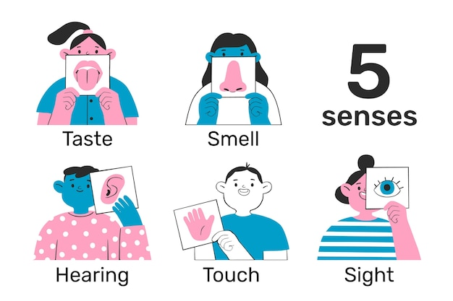
in this sense/ɪn ðɪs sens/ 从这种(某种}意义上来讲
1.我的父母来自这个地区，所以从这种意义上说，来这里就像回家一样。
My parents come from this area, so in this sense it is like coming home.
2.从某种意义上说，我认为他刚才所说的与这篇文章无关。
In a sense, I don’t think what he said just now was relevant to the essay.
3.我感觉到他的担心，就向他保证不会让他失望。
Sensing his concern, I assured him I would not let him down.
4.在医生的努力下，他终于恢复了理智。
With the great effort of the doctors, he finally came to his senses.
5.他五岁时失去了听觉。
He lost the sense of hearing when he was five years old.
6.不用说，这是充满创造力和平静感的一天。_{2024新高考I卷应用文“公园美术课体验告知信”}
Needless to say, it was a day filled with creativity and a sense of peace.

Slide 39

……来说
1.一般来说，兼职者从事地位低、工资低的职业。
Generally, part-timers work in low-status, low-wage occupations.
2.诚然，薪水不高，但责任很轻。
Admittedly, the salary was not wonderful but the duties are light.
3.毫无疑问，这幅画象征性地揭示了我们日常生活中的一个严重问题:父母对独生子女的溺爱。
Undoubtedly, the drawing have symbolically revealed a serious problem in our daily life:parents’ spoiling towards the only children in family.
4.毫不奇怪，如今这种现象在中国人中并不罕见。
Not surprisingly, the kind of phenomenon is not uncommon nowadays among the Chinese people.

Slide 40
……来说
5.总的来说，随着过度捕捞的解决，鱼类的未来将是光明的。
Overall, the future for fish will be bright with the solution of over-fishing.
6.起初，他认为这个概念是无稽之谈。
Initially, he thought the concept was nonsense.There is seemingly
nothing we can do to stop the plans go ahead.
7.我们似乎无法阻止这些计划继续进行。
Strictly speaking, parents shouldn’t turn a blind eye to the side effects of computer games on their children.
8.严格地说，父母不应该对孩子们玩电脑游戏的副作用视而不见。
8.说实话，我很怕他，每次跟他说话，我的声音都会不由自主地颤抖。
To be honest, I was so frightened of him that my voice would tremble uncontrollably whenever speaking to him.

Slide 41

nevertheless/ˌnevəðəˈles/ ad.尽管如此;不过;然而
1.我们遭受了严重的挫折。然而，我们不应气馁。
We have suffered a serious setback. Nevertheless, we must not be discouraged.
2.我在这两个艰难的选择之间左右为难，完全不知所措。然而，在内心深处，我能感受到我对亚历克斯的爱。是的!我决定做做正确的事。
Torn between the two tough choices, I was totally at a loss. Nevertheless,
deep down, I could feel my affection to Alex. Yep! I resolved to do the right thing.
3.当然，当新技术改变了我们的生活方式，这可能是一个可怕的前景。然而，我将永远看到变化所带来的积极一面，接受而不是抗拒它。
Of course, when new technology changes the way we live,
it can be a scary prospect. Nevertheless, I will always
look on the positive side of change and accept it rather than resist it.

Slide 42

security/sɪˈkjʊərəti/ n.保护措施;安全工作
1.智能家居展旨在让市民的生活更方便和高效，展示家居自动化和科技的最新进展，从智能闪电、安保系统到声控设备。
Aimed at making people’s lives more convenient and efficient, the Smart Home Exhibition showcased the latest advancements in home automation and technology,ranging from smart lightning,security systems to voice-controlled devices.
2.然而，网络安全意识不应该下降。只有这样，
我们才能享受到网络带来的便利。
However, consciousness of cybersecurity
should not decline. Only in this way, we just
enjoy the convenience brought by the network.
3.当保安走近那个淘气的男孩时，他跑掉了。
The naughty boy ran away when the security guard
approached him.

Slide 43

combine/kəmˈbaɪn/ v.(使)结合;混合
1.这部电影结合了喜剧和戏剧元素，呈现出一个温馨而搞笑的故事…
The film combines elements of comedy and
drama, resulting in a heartwarming and hilarious story…
2.体操是一项涉及力量、柔韧性和协调性的动态运动。^{2024年浙江1月高考应用文“校园课间体育项目推荐征文投稿”}
Gymnastics is a dynamic sport that involves a combination of strength, flexibility and coordination.
3.美丽的风景结合宜人的气候和美味的食物,使我们的旅行更加愉快。
In combination with pleasant climate and tasty food, the beautiful scenery made our visit more enjoyable.

Slide 44
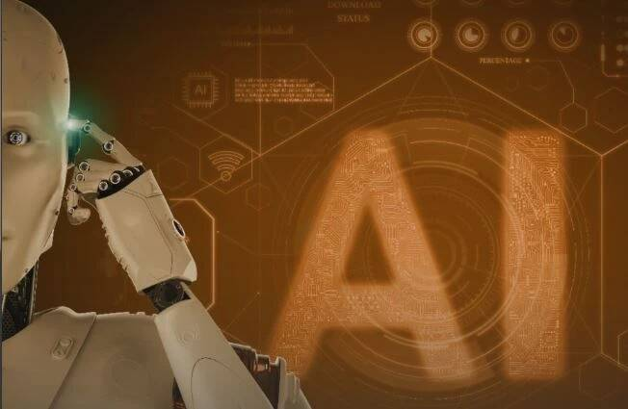
artificial/ˌɑ:tɪˈfɪʃl/ a.人工的;人造的;假的
artificial intelligence/ˌɑ:tɪˈfɪʃl ɪnˈtelɪdʒəns/ 人工智能
1.人造灯光照亮了黑暗的房间。
Artificial lights brightened the dark room.
2.她在晚会上始终带着不自然的假笑。
She wore an artificial smile throughout the party.
3.当前，人们正生活在一个人工智能的时代。因此可以很平常的看到许多人使用智能设备，如自动车辆，无人机和智能机器人。由于人工智能设备，人们日常生活的方方面面都发生了相当大的变化。
At present, people are living in an era of artificial intelligence,
therefore it is a common phenomenon for a host of people to use AI
devices, such as automatic vehicles, unmanned aerial vehicles(UAVs), and
AI robots.Many aspects of people’s daily life have undergone considerable
changes because of artificial intelligence devices.

Slide 45
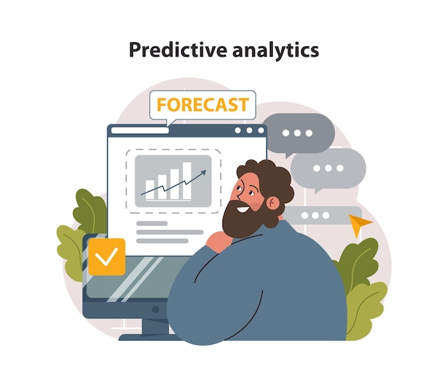
predict/prɪˈdɪkt/ vt.预测;预言;预料
prediction/prɪˈdɪkʃn/ n.预测;预言
1.正如彼得·德鲁克所说，预测未来的最可靠方法就是创造未来。
大家加油!
Just as Peter Drucker ever said, the most
reliable way to predict the future is to create it. Go for it, everyone!
2.我预感到他会要求我把辛苦工作挣来的钱交上去，无法忍受
的怨恨在内心涌起。
Predicting he would require me to submit the money I earned form
the tiring work, I felt a surge of intolerable resentment swell up inside me.
3.夏天的天气难以预测。刚才天气晴朗。刹那间，电闪雷鸣，暴风雨开始下起来了。
The weather in summer is unpredictable. Just now it was sunny. In a flash, lighting and thunder broke out, and the storm began to rain.

Slide 46
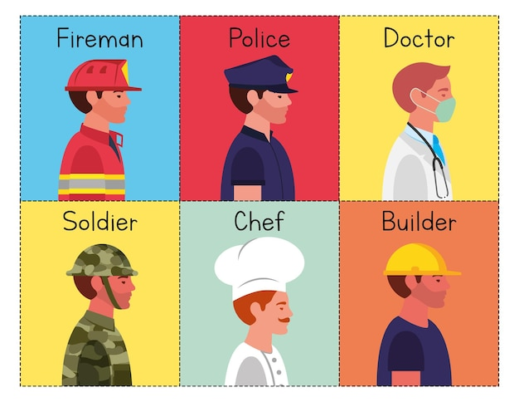
occupation/ˌɒkjuˈpeɪʃn/ n.职业;占领
1.每个学生在大学毕业时都面临着选择职业的问题。
Every student faces the problem of choosing an occupation when graduating from university.
2.他在公司担任要职，忙于各种各样的活动。
He occupied an important position in a company and is occupied with all kinds of activities.
3.由于忙于准备高考，我很抱歉没能尽快给您回信。
Occupied in preparing the College Entrance Examination,
I am terribly sorry not to reply to your last letter as soon
as possible.

Slide 47

oppose/əˈpəʊz/ vt.反对;抵制;阻挠
1.有些人反对没有明确目标的去记录体重。
Some people oppose recording weight without specific aim.
2.我父亲不给我钱，反对我买新设备。
Opposed to my buying the new device, my father didn’t give me any money.
3.他不顾家人的反对，辞去了教师工作，成为一名兼职演员。
Despite opposition from his family,he quit teaching and became a part-time actor.
4.互联网使交友成为可能。即使他们在世界的两端，也能很容易地保持联系。
The Internet has made it possible for friends and family to keep in touch easily even if they
are on opposite sides of the world.
5.武术是中国的一项传统体育运动。这意味着你用武力来保护自己或攻击对手。
Martial Arts are a traditional sport in China. It means that you defend yourself or
attacking your opponents by using force.

Slide 48

hence/hens/ ad.因此;由此
1.干旱已持续了三个月，因此收成不好。
The drought had lasted three months, hence the poor harvest.
2.计算机已经变得不那么昂贵了，因此学生们更容易使用。
The computer has become less expensive, and hence
more available to students.
3.他出城了，因此不能来。
He is out of town, and therefore he cannot come.
4.珍妮学习非常认真，因此在学校表现很好。
Jenny worked very conscientiously and, consequently, did well at school.
5.从后门进来，这样就没人会注意到你了。
Come in by the back door, then no one will notice you.

Slide 49

hence/hens/ ad.因此;由此
6.因此，我呼吁你们每一个人加入我的努力。让我们主动减少碳足迹，使我们的校园成为可持续发展的灯塔。^{2024新高考天津卷应用文“低碳校园倡议信”}
Thus I appeal to each and every one of you to join me in this endeavor.Let’s take the initiative to reduce our carbon footprint and make our campus a beacon of sustainability.
hence更强调前因的重要性，其后不跟从句。
therefore强调前因的必然后果是后面发生的事情。
consequently可以指合理的推论，也可以用来连接表示影响或结果的陈述句。
then在指逻辑顺序时，主要用于结论句或条件句的结论中。

Slide 50
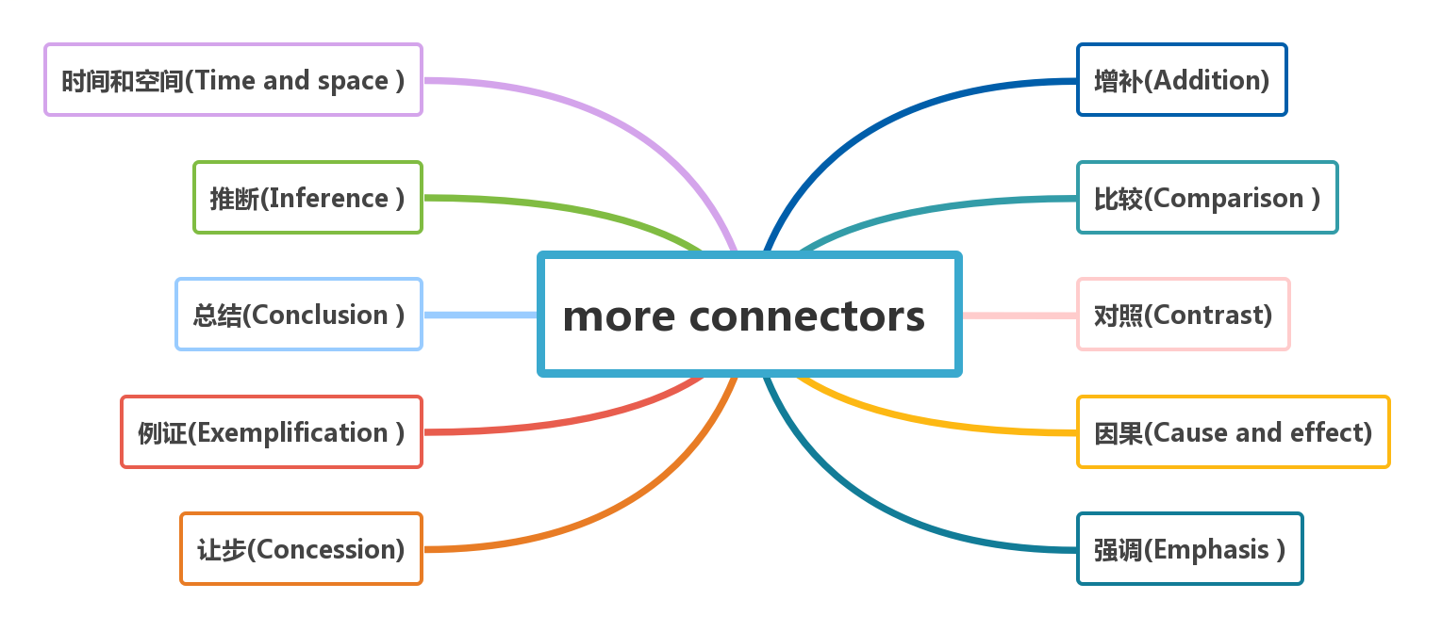
afterwards, after, first, later
furthermore, also, besides, moreover
consequently, accordingly, so, otherwise
similarly, equally, just as
in a word, in short, in brief
instead, however, unlike, nevertheless
that is, namely,
such as,
in this case
for, since, due to, owing to
although, though, after all, in spite of
certainly, above all, indeed, surely

Slide 51
absence/ˈæbsəns/ n.不存在;缺乏;缺席
1.再次为我的缺席给您带来的不便表示歉意，祝您的比赛取得圆满成功。
Sorry again for any inconvenience caused by my absence and wish your competition a great success.
2.如果你经常缺课，你可能会落后于其他学生。
If you are constantly absent from school, you will potentially fall behind other students.
3.如果有/没有这样可爱又健忘的妈妈，我们就不会有一个有趣和快乐的的童年。
But for/Without such a loving but absent-minded and forgetful mother, we
wouldn’t have had an interesting and happy childhood.
4.丈夫不在，简吓得双膝跪地，泪水模糊了她的双眼。
In her husband’s absence, Jane was so frightened that she sank to her knees, with tears clouding eyes.
5.通过这次活动，我明白了，如果没有责任，我们就不能充分地享受生活。
Through the activity, I understand that we can’t enjoy our life to the fullest in the absence of responsibility.

Slide 52
rural/ˈrʊərəl/ a.乡村的;农村的
1.得知你正在写一篇关于中国农村生活的报道，我真诚地邀请你来我的家乡度过即将到来的寒假。
Knowing that you are writing a report about Chinese rural life, I sincerely invite you to my hometown to spend the coming winter vacation.
2.这些数据表明近视在城市地区比农村地区更为普遍，早期干预对于防止其进展至关重要。
The figures provide evidence that myopia is more prevalent in urban areas compared to
rural areas, and early intervention is crucial to prevent its progression.
3.路遥是一位现实主义小说家，他的《生活》和《平凡的世界》生动地描述了20世纪70年代至80年代变化中的中国，反映了现代中国城市和农村的真实生活。更重要的是，他在作品中记录了普通人的工作与爱情、挫折与追求、悲欢离合。
As a realistic novelist, Lu Yao vividly described a changing China from 1970s to 1980s his
Life and The Ordinary World, reflecting real modern Chinese life in both urban and rural areas. More importantly, he gave an account of common people’s work and love, setbacks and pursuits, sorrows and joys in his works.

Slide 53


advocate/ˈædvəkeɪt/ vt.提倡;支持 n.提倡者
1.屈原出生于楚国的一个贵族家庭，担任大臣职位，提倡改革和对皇帝的忠诚。
Born into a noble family in the Chu state, Qu Yuan served as a
minister, advocating for reforms and loyalty to the king.
2.你是我们社区的积极分子吗?那么我们希望你能加入社区急救宣传团队。这样，你将有助于提高人们的急救意识，并增加他们获得信息的机会。
Are you enthusiastic about our local community? Then we'd love you to join the team of First Aid Community Advocates. That way, you'll help to raise people's awareness of giving first aid and increase their access to the information.

Slide 54


advocate/ˈædvəkeɪt/ vt.提倡;支持 n.提倡者
3.随着世界环境日的临近，我提倡我们为保护环境尽自己的一份力量。
With World Environment Day approaching, I advocate doing our part to protect the environment.
4.我们学校呼吁我们建设一个低碳校园。
Our school advocates that we should
commit ourselves to building a low-carbon campus.
5.有人主张学校应为学生组织更多的活动,通过减少学生的家庭作业,让学生有更多的时间参加活动。
It is advocated that schools (should) organize more activities for students and leave students more time for activities by giving them less homework.

Slide 55

advocate/ˈædvəkeɪt/ vt.提倡;支持 n.提倡者
1.我们呼吁家长、教师和医疗保健提供者共同努力，应对学龄儿童近视的不断增加。
We call on parents, teachers, and healthcare providers to work together to
address the growing epidemic of myopia among school-aged children.
2.是我们将预防和治疗近视作为公共卫生问题，特别是在儿童和年轻成年人中优先考虑的时候了。
It is high time that we should prioritize the prevention and treatment of
myopia as a public health issue, especially among children and young adults.
3.随着高考临近，我们的学校呼吁高三学生积极参加体育活动，旨在有效备考并改善我们的身心健康。
With the College Entrance Examination approaching, our school is
appealing to us Senior Three students to participate in sports activities
actively with the aim of making preparations for the exams efficiently and
improving our physical and mental health.

Slide 56


emphasis/ˈemfəsɪs/ n.强调;重视;重要性
1.他们提倡简单的生活,强调努力工作、重视家庭和社区。
We advocate a simple life with an emphasis on hard work, family,
and community.
2.高中应重视培养学生的人际交往能力。我们再怎么强调保护眼睛的重要性都不为过。
High schools should lay emphasis on the cultivation of students'
interpersonal communication skills.
3.开展一场文化保护运动迫在眉睫。应该更加重视传统工艺和节日。
It’s urgent to launch a campaign for the culture conservation. More
emphasis should be laid on traditional craft and festivals.

Slide 57

emphasis/ˈemfəsɪs/ n.强调;重视;重要性
4.孔子相信教育和道德价值的重要性。他强调尊重、诚实和善良在生活中的重要性。^{2023全国甲卷应用文“介绍中国历史人物征文稿”}
Confucius believed in the importance of education and moral values.
He emphasized the importance of respect, honesty, and kindness in all
aspects of life.
5.保护我们的眼睛的重要性再怎么强调也不为过。
We cannot emphasize the importance of
protecting our eyes too much.
6.这部纪录片强调了保护濒临灭绝物种对于地球健康的重要性。
The documentary highlights/stresses the importance of protecting endangered
species for the health of our planet.

Slide 58

keep in touch with/ki:p ɪn tʌtʃ wɪð/ 与…保持联系;了解(…情况)
1.此外,互联网使朋友和家人能够很容易地保持联系,即使他们在世界的两端。
Moreover, the Internet has made it possible for friends and family to keep in touch easily even if they are on opposite sides of the world.
2.我们已经将近十年没有联系了，因此，我们很难再联系上对方。
We have been out of touch for almost ten years, and hence, it is quite difficult for us to get in touch with each other again.

Slide 59

career/kəˈrɪə(r)/ n.职业;事业
1.许多人通过寻求找一份符合他们价值观和兴趣的工作来获得职业成就感。
Many people seek career fulfillment by finding a job that aligns with their
values and interests.
2.对于你所咨询的高中是否应该开设职业规划课程的问题，
我坚信这是有必要的。
Regarding your inquiry about whether high schools should
offer a career planning course, I firmly believe it’s necessary.
3.职业规划课程以工作坊、研讨会和演讲嘉宾的形式，帮助学生更好地了解自己的兴趣和优势。它还使他们能够在自己的学术道路和潜在的职业生涯中做出明智的决定。
Career planning courses in the form of workshops,seminars and guest speakers helps students understand their interests and strengths better.It also enables them to make informed decisions on their academic path and potential careers.

Slide 60

resist/rɪˈzɪst/ v.抵制;反抗;抵挡
resistance/rɪˈzɪstəns/ n.抵制;反对;抗拒
1.健康的饮食结合经常锻炼有助于你的身体抵抗感染。
A healthy diet combined with regular exercise can help your body resist infection.
2.学生应该抵制诱惑，把注意力集中在考试上。
Students should resist the temptation to focus on the exams.
3.一个说:“南瓜好大啊!我迫不及待地想看看瓜里的脸。”
我能想象出这家伙忍不住偷笑的样子。
^{2021年浙江1月高考读后续写 “万圣节南瓜趣事”}
One remarked,“What a great pumpkin! I can’t wait to see
the face in it.” I could picture this guy couldn’t resist chuckling.
4.人们认为老年人总是抗拒改变。
It is believed that elderly people are always resistant to change.
5.引起感冒的病毒不仅种类繁多，而且转化迅速，这意味着它们可以迅速产生抗药性。
Cold -causing viruses are not only of multiple kinds, they also transform rapidly, meaning they can quickly develop resistance to medicine.

Slide 61


essay/ˈeseɪ/ n.文章
1.我想知道你写完关于环境保护的英语作文了吗?
I wonder if you have finished your English essay on environmental protection.
2.我们很高兴地宣布，我们学校的英语报社正在组织一场以“携手拯救粮食”为主题的征文比赛。
We are excited to announce that our school's English newspaper is organizing an essay competition with the theme "Join Hands, Save Food."

Slide 62
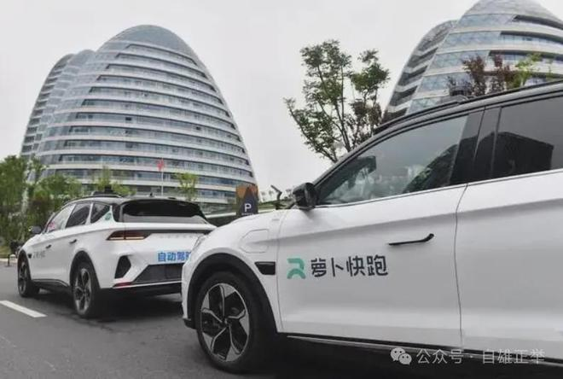
accurate/ˈækjərət/ a.精确的;准确的
1.他作为目击者对事故作了准确的描述。
He gave an accurate account of the accident as an eyewitness.
2.一路上，它准确地识别红绿灯，礼让行人，甚至在复杂的路口
也能做出恰当的判断，让我这个“乘客”倍感安心。
During the ride, the accurate identification of traffic signals, the
yielding to pedestrians, as wellas the precise judgments even under
complex circumstances, put my mind at ease as a passenger.
3.岗位工作职责包括按时完成任务，与同事有效沟通，认真精准
地完成交办工作。
Examples of responsibilities at work include meeting deadlines,
communicating effectively with colleagues, and completing assigned
tasks with diligence and accuracy.

Slide 63


http://www.sunedu.com
Thank You!

