Slide 1



感恩遇见，相互成就，本课件资料仅供您个人参考、教学使用，严禁自行在网络传播，违者依知识产权法追究法律责任。
更多教学资源请关注
公众号：溯恩英语
知识产权声明

Slide 2
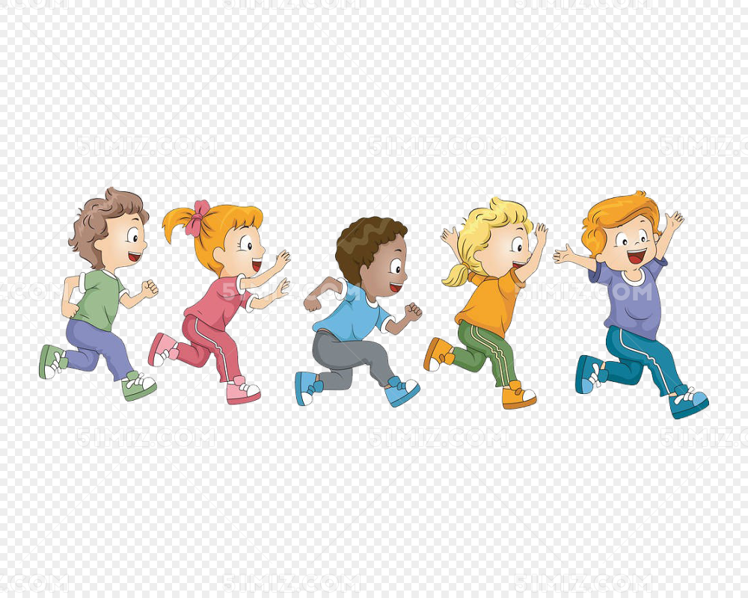

2025-4 杭州二模
基于“人与自我 ” 之比赛失利成长篇的读后续写讲评
郑素红

Slide 3
原文本
The crowd roared as I took off from the starting line in The Big Race. Through the cheers, I heard Mom shouting, “Run, Sammy, run!” I knew without looking that she was smiling from ear to ear and clapping her hands for me.
I kept my eyes straight ahead, running as fast as I could. “Run, run, run,” I chanted to myself in my mind as I passed my friend Justin. I saw Justin's red face out of the corner of my eye and wondered if my own face was that red too.
“Run, run, run.” I was on fire, passing Sarah, leaving her in my dust.
The coach was waiting for me at the finish line, holding the medal for the fastest runner in kindergarten. I would wear that blue and white ribbon around my neck when we go out for ice cream to celebrate and then hang it in my room. Last night I took the collection maps off my wall, leaving it ready for my shiny new medal. I couldn't wait to see it every day when I woke up.
Dad was there in the crowd also and would pick me up and put me on his shoulders to carry me around. “My son!” He would tell the other fathers, “My son won the race!”
I was going to win! Faster than Sarah, I came up behind Mikey, giving my legs that extra burst of energy to pass him by. The winner, Sammy! All that running in the park was worth it!
Just as I heard the roar of the crowd welcoming me to the finish line, I saw a blur out of the corner of my eye. What? There was Justin with his tomato cheeks running as fast as humanly possible, huffing and puffing like he was going to blow the house down. And then he was in front of me. I was behind tomato-face Justin. Crossing the finish line, I heard the voice over the loudspeaker say, “Congratulations to the winner, Justin!”
Congratulations to Justin?
Congratulations to Justin.
注意：(1) 续写词数应为 150 左右；(2) 请按如下格式在答题卡的相应位置作答。
Paragraph 1: I stood there frozen as Justin was handed his medal.
Paragraph 2: Suddenly, strong hands lifted me onto Dad's shoulders.

Slide 4

Read for information
characters： I ( leading )
Dad , Mom, Justin, coach, Sarah, Mikey & crowd ( audience)( supporting)
2. narrative perspective: first -person
3. time： when I was in kindergarten
place： the race venue
Event : I competed in The Big Race and tried my best but I lost the medal to Justin.

Slide 5
故事人物很多如何处理
主角：I
配角：Dad , Mom, Justin, coach, Sarah, Mikey & crowd
本文主角 I ，构建续写故事情节需要考虑合理运用原故事中的人物；
思路1：侧重于父亲的言传身教，则可以进行父子对话，让我学会正确面对失败，做事要倾尽全力；亦可以加上母亲的赞许与因我而骄傲；
思路2：第一段可侧重写Justin 赢得比赛后和我比赛失利的鲜明对比；第二段骑在父亲的肩膀上，可以清楚地看到Sarah, Mikey 等坦然地面对失利，我因此也改变了对比赛结果的看法，并由衷地向Justin 道贺。
思路3：第二段也可以发挥一下教练的作用，教练首先肯定我的拼搏精神，并点明体育比赛的意义。我由此获得了成长。
思路4：比赛现场会有观众，观众对比赛结果的反应可以渲染赛场的气氛。
总之合理利用原文人物，可以让故事内容丰富，有利于情节构建符合逻辑，考生容易产出内容充实的续写文本。

Slide 6


5.story line
Climax
I was inspired by the letter and decided to change my routine , my life and even the world around me.
However, Justin, with his tomato cheeks was running as fast as humanly possible. And then he surpassed me, crossing the finishing line.
Para1: I stood there frozen as Justin was handed his medal.
I kept my eyes straight ahead, running as fast as I could， passing my friend Justin ,Sarah and Mikey!
Para2:Suddenly, strong hands lifted me onto Dad's shoulders.
I competed in The Big Race, eager to win the medal, and even made some room for it on the wall of my bedroom.
background
Ending
Beginning

Slide 7
5.story line
Climax
I was inspired by the letter and decided to change my routine , my life and even the world around me.
However, Justin, with his tomato cheeks was running as fast as humanly possible. And then he surpassed me, crossing the finishing line.
Para1: I stood there frozen as Justin was handed his medal.
I kept my eyes straight ahead, running as fast as I could， passing my friend Justin ,Sarah and Mikey!
Para2:Suddenly, strong hands lifted me onto Dad's shoulders.
I competed in The Big Race, eager to win the medal, and even made some room for it on the wall of my bedroom.
background
Ending
Beginning

Slide 8
Read for clues and echoes
clues | echoes
The crowd roared as I took off from the starting line in The Big Race. Through the cheers, I heard Mom shouting, “Run, Sammy, run!” I knew without looking that she was smiling from ear to ear and clapping her hands for me.
Deafening cheers/ roars and thunderous applause erupted over the race venue. They were for Justin’s victory/ win!

Slide 9
Read for clues and echoes
clues | echoes
The coach was waiting for me at the finish line, holding the medal for the fastest runner in kindergarten. I would wear that blue and white ribbon around my neck when we go out for ice cream to celebrate and then hang it in my room. Last night I took the collection maps off my wall, leaving it ready for my shiny new medal. I couldn't wait to see it every day when I woke up.
2. My dream of hanging it on the wall in my room was completely shattered/ ruined.

Slide 10
Read for clues and echoes
clues | echoes
Dad was there in the crowd also and would pick me up and put me on his shoulders to carry me around. “My son!” He would tell the other fathers, “My son won the race!”
3. Dad held me tightly, walking
through the crowd and telling
other fathers proudly, “ This is my
son Sammy. He did his best!”

Slide 11
Read for clues and echoes
clues | echoes
The coach was waiting for me at the finish line, holding the medal for the fastest runner in kindergarten. I would wear that blue and white ribbon around my neck when we go out for ice cream to celebrate and then hang it in my room. Last night I took the collection maps off my wall, leaving it ready for my shiny new medal. I couldn't wait to see it every day when I woke up.
4. The medal that should be
hung on the wall of my
bedroom now belonged to
Justin!

Slide 12
clues | echoes
Just as I heard the roar of the crowd welcoming me to the finish line, I saw a blur out of the corner of my eye. What? There was Justin with his tomato cheeks running as fast as humanly possible, huffing and puffing like he was going to blow the house down. And then he was in front of me. I was behind tomato-face Justin. Crossing the finish line, I heard the voice over the loudspeaker say, “Congratulations to the winner, Justin!” Congratulations to Justin? Congratulations to Justin.
Read for clues and echoes
5. Still huffing and puffing,
Justin held the shining
medal, kissed it and raised it
high in the sky, pride etched
on his tomato face.

Slide 13
clues | echoes
Just as I heard the roar of the crowd welcoming me to the finish line, I saw a blur out of the corner of my eye. What? There was Justin with his tomato cheeks running as fast as humanly possible, huffing and puffing like he was going to blow the house down. And then he was in front of me. I was behind tomato-face Justin. Crossing the finish line, I heard the voice over the loudspeaker say, “Congratulations to the winner, Justin!” Congratulations to Justin? Congratulations to Justin.
Read for clues and echoes
6. My coach came over and
ruffled my hair, saying,
“ You gave it all, Sammy.
That’s the spirit of a true
athlete.” Hearing that, I
breathed a sigh of relief,
turned my head to Justin and
shouted to Justin, “ Justin,
congratulations to you!”

Slide 14
心理描写
神态描写
动作描写
外貌描写
环境描写
对话描写
语言
无灵主语
动作链
分词作状语
With 复合结构
独立主格
从句
倒装句
虚拟语气
强调句
长短句结合
本文对话描写可以适当多一点，考虑到我的年龄特点。

Slide 15
Plot the continuation story
Para1: I stood there frozen as Justin was handed his medal.
Para2: Suddenly, strong hands lifted me onto Dad's shoulders.
Link1: How did I feel? What was the atmosphere like?
Body: What did I think of and see?
Link2: What did I do?
Link3: How did I feel and what did Dad say?
Body: How did Dad and I interact?
Ending: ① What changes did I make at the end of the story?
② What lesson did I learn from the experience?

Slide 16
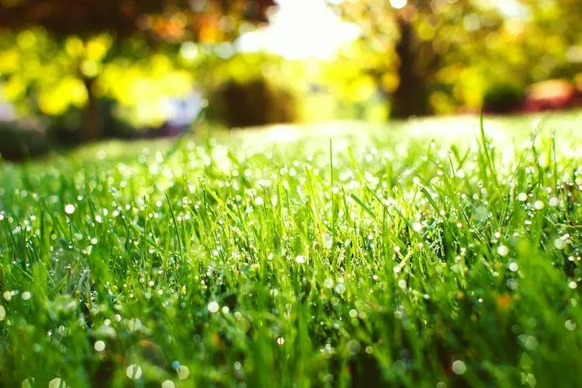
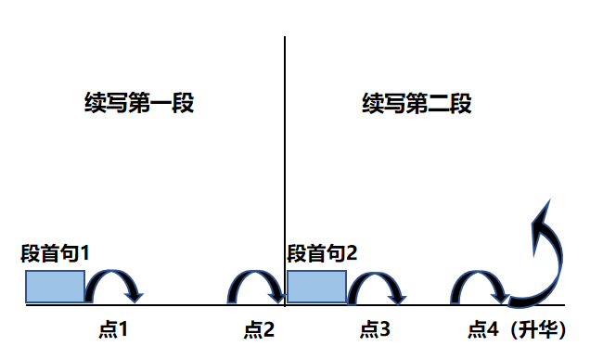
Plot Continuation
点1：位于续写第一段段首，流畅衔接前面的故事（常与原文最后一段呼应）和第一段段首语；
点2：位于续写第一段段尾，流畅衔接第二段段首句；
点3：位于续写第二段段首，续写衔接第二段段首语；
点4：文章结尾升华，给予读者正能量，揭示和强调主题。

Slide 17
Design link1
Para1: I stood there frozen as Justin was handed his medal.
Link1A: (颁奖环境渲染+获奖者Justin的喜悦表现) Deafening cheers and thunderous applause from the crowd echoed over the race venue. Still huffing and puffing, Justin held the shining medal, kissed it and raised it high in the sky, pride etched on his tomato face.
Link1B: : (以“我” 为叙事对象—没有成为赢家） My eyes widened in disbelief and my mouth hung open. I couldn't believe that blue-and white ribbon was being placed around Justin’s neck!

Slide 18
Design link2
Para1: I stood there frozen as Justin was handed his medal.
Para2: Suddenly, strong hands lifted me onto Dad's shoulders.
Link2 A: (胜者与我鲜明对比) With tearful eyes, I watched numbly and blankly as Justin grinned from ear to ear, his face still red from the tough race but now glowing with his ultimate victory. My heart literally broke.
Link2B: ( 我沮丧难过想哭）The medal that should be hung on the wall of my bedroom now belonged to Justin! A flood of frustration washing over me, I was on the verge of crying bitterly.

Slide 19
Design link3
Para2: Suddenly, strong hands lifted me onto Dad's shoulders.
Link3A: ( 父亲的力量与安慰） No sooner had I sat on dad's shoulders than I sensed a burst of warmth, comfort, power and energy conveyed through his strong arms. “You did great, son!” Dad boomed/ exclaimed , his voice full of pride as if I were the champion.
Link3B: ( 父亲骄傲地向别的父亲介绍我） Dad held me tightly, walking through the crowd and telling other fathers proudly, “ This is my son Sammy. He did his best!” Never had I expected that Dad treated me like a real winner!

Slide 20
Design ending
Para2: Suddenly, strong hands lifted me onto Dad's shoulders.
Ending A: (拉长时间线到作者的当下，以感悟到的哲理结尾) Time flies but The Big Race in kindergarten is still carved in my mind, serving as a reminder that whatever I do, I will give it my best.
Ending B: (情景+当时的感悟作结尾) As dad carried me around, I felt a different kind of victory, one that came from knowing I had given it my best though/ although I didn’t win.
Ending C: (以教练的点题指明何为体育精神，回扣原文最后一句，向胜者致以真正的祝贺。) My coach came over and ruffled my hair, saying, “ You gave it all, Sammy. That’s the spirit of a true athlete.” Hearing that, I breathed a sigh of relief, turned my head to Justin and shouted to Justin, “ Justin, congratulations to you!”

Slide 21
Version 1: “基于父亲言传身教仍是年幼的我”范文赏析：
Para1: I stood there frozen as Justin was handed his medal. Deafening cheers and thunderous applause from the crowd echoed over the race venue. Still huffing and puffing, Justin held the shining medal, kissed it and raised it high in the sky, pride etched on his tomato face. Eyes fixed on the blue-and-white ribbon around his neck, a wave of disappointment crashed me like a big cold wave at the beach. I just couldn't believe my eyes. Never had I expected that Justin was the dark horse in the race. With tearful eyes, I watched numbly and blankly as Justin grinned from ear to ear, his face still red from the tough race but now glowing with his ultimate victory. My heart literally broke.

Slide 22
Para2: Suddenly, strong hands lifted me onto Dad's shoulders. No sooner had I sat on dad's shoulders than I sensed a burst of warmth, comfort, power and energy conveyed through his strong arms. “You did great, son!” Dad boomed, his voice full of pride as if I were the champion. Guilty and ashamed, I rubbed my eyes, lowering my head. Heart aching, I murmured softly, “ But I didn't win, Dad.” “You give it all and that's what matters. You should be proud of yourself.” Dad said in a firm tone, patting my legs gently. Time flies but The Big Race in kindergarten is still carved in my mind, serving as a reminder that whatever I do, I will give it my best.
或者结尾2：As dad carried me around, I felt a different kind of victory, one that came from knowing I had given it my best though/ although I didn’t win.

Slide 23
Version 2: “基于彰显体育精神向胜者道贺”范文赏析：
Para1: I stood there frozen as Justin was handed his medal. My eyes widened in disbelief and my mouth hung open. I couldn't believe that blue-and white ribbon was being placed around Justin’s neck! My dream that I would wear the blue and white ribbon with the shiny medal around my neck when we go out for ice cream to celebrate and then hang it in my room was completely shattered. A wave of frustration flooding over me, tears welled up in my eyes. I watched as Justin held up his medal, smiling from ear to ear. All the other kids were cheering for him, but I just felt sad and left out. The medal that should be hung on the wall of my bedroom now belonged to Justin! A flood of frustration washing over me, I was on the verge of crying bitterly.

Slide 24
Para2: Suddenly, strong hands lifted me onto Dad's shoulders. Dad held me tightly, walking through the crowd and telling other fathers proudly, “ This is my son Sammy. He did his best!” Never had I expected that Dad treated me like a real winner! I sniffled and looked down at Dad. “But I didn't win,” I said in whisper. Dad laughed. “Winning isn't everything, Sammy. You ran your best, and that's what matters.” Wrapping my arms around Dad’s chin and looking around , I saw Mom giving me a thumbs-up while mouthing “I’m proud of you, Sammy!” My coach came over and ruffled my hair, saying, “ You gave it all, Sammy. That’s the spirit of a true athlete.” Hearing that, I breathed a sigh of relief, turned my head to Justin and shouted to Justin, “ Justin, congratulations to you!”

Slide 25
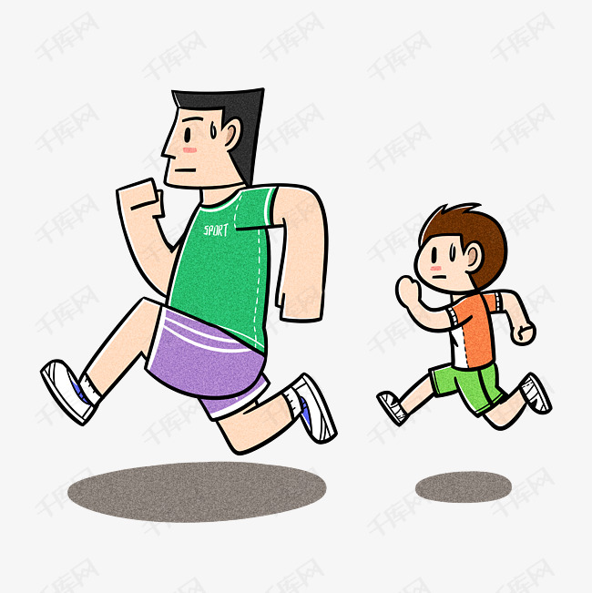
本文与2023年11月的杭州一模的读后续写 《父子越野跑》有类似之处，探讨比赛失利，父亲对待失败的方式言传身教儿子如何对待失败，助力孩子健康成长！胜利固然值得庆贺，但失败未尝不是成长。父亲是孩子成长道路上的明灯。

