Slide 1


感恩遇见，相互成就，本课件资料仅供您个人参考、教学使用，严禁自行在网络传播，违者依知识产权法追究法律责任。
更多教学资源请关注
公众号：溯恩英语
知识产权声明

Slide 2

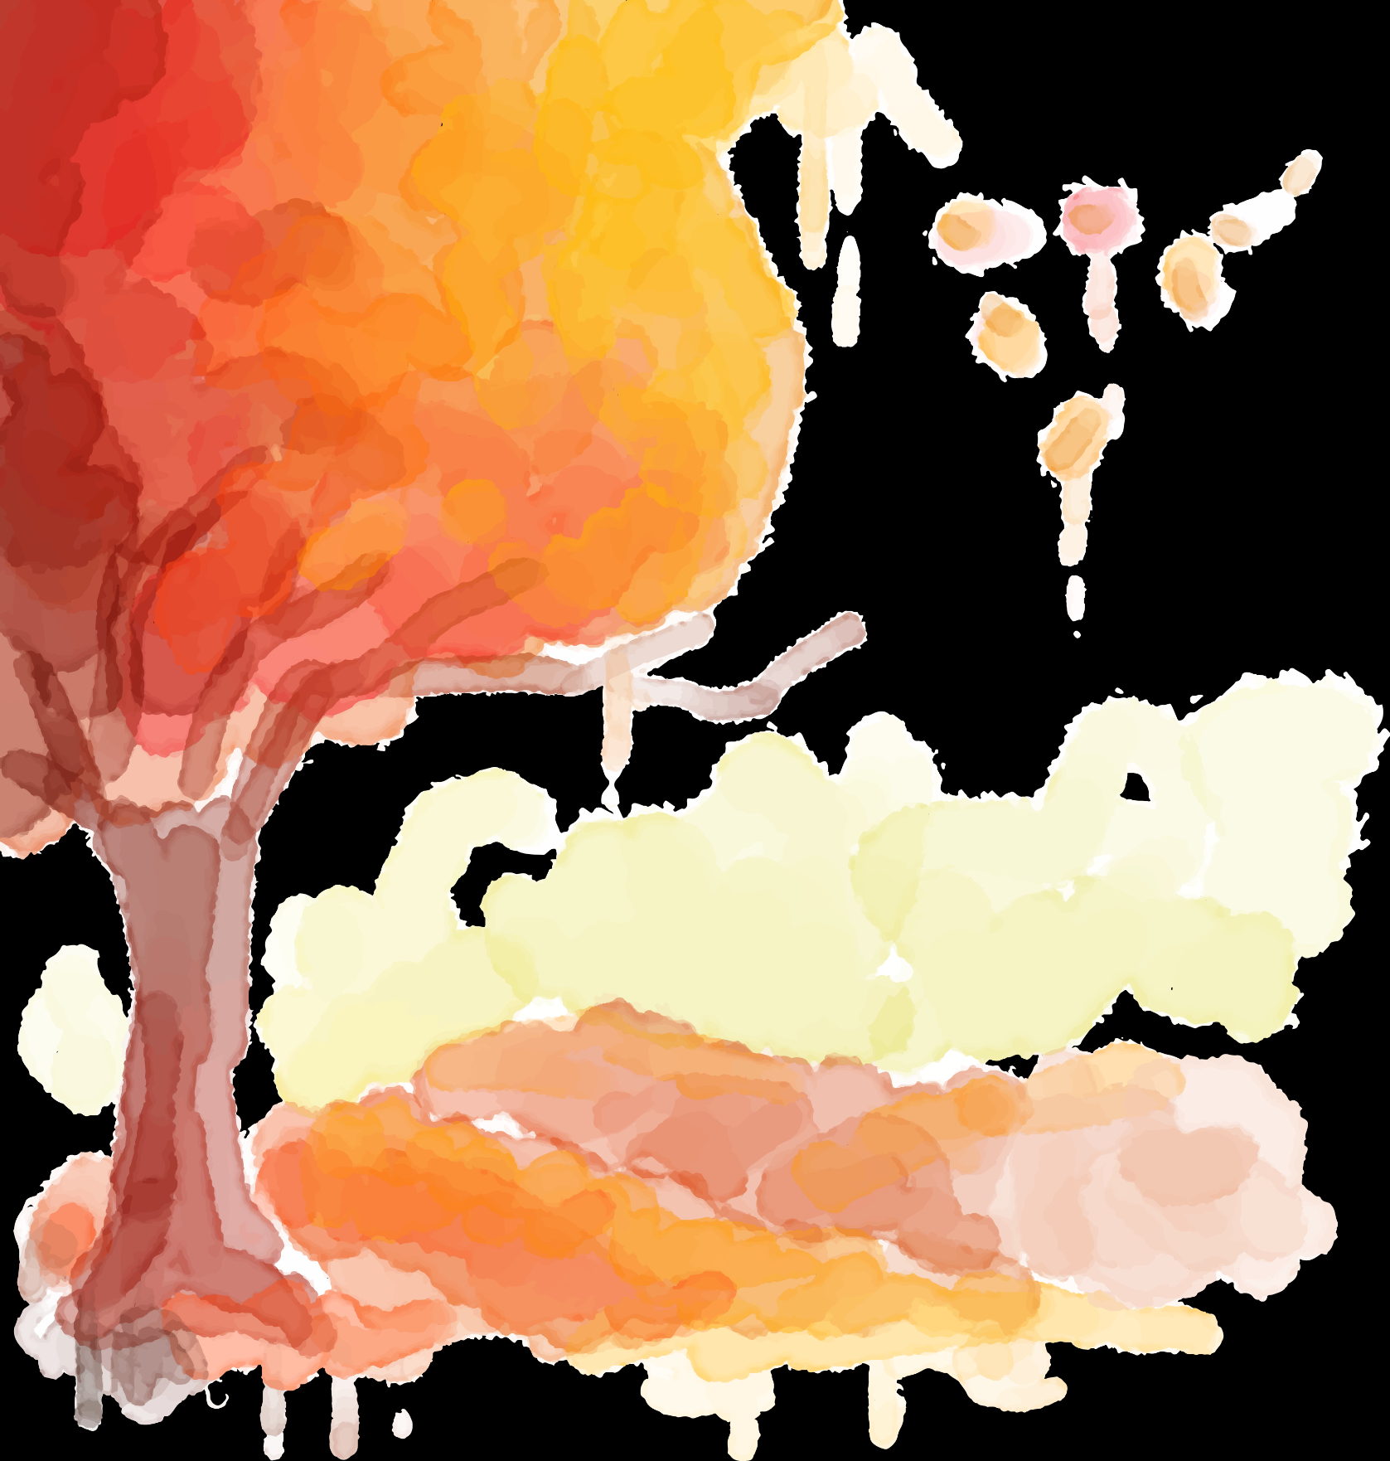
2025年嘉兴高三教学测试
（阅读部分）
北师大嘉兴附中 吴晨华

Slide 3
题型 | 话题 | 体裁 | 词数
阅读A | 人与社会：LARPing: a way to live out your fantasies | 说明文 | 259
阅读B | 人与自我： My experience of quitting mail-checking habit | 记叙文 | 348
阅读C | 人与自然：Soil microbes: essential for sustaining life on the earth | 说明文 | 326
阅读D | 人与社会：The secret of time: a state of mind | 议论文 | 341
七选五 | 人与自我： Strategies to develop emotional intelligence | 说明文 | 243
完形填空 | 人与社会： Parkes and her project: I Wanna See Project | 记叙文 | 265
语法填空 | 人与社会： A study on paper book reading | 说明文 | 203

Slide 4
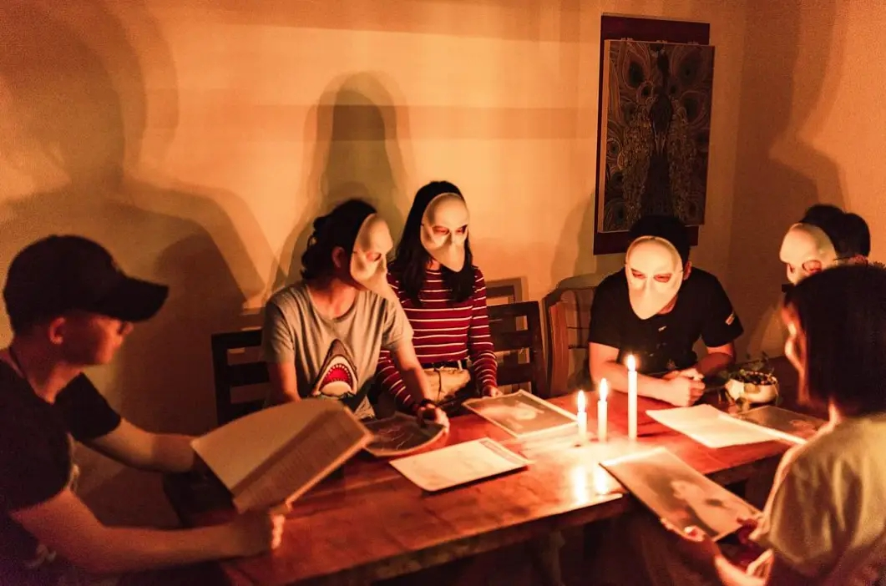
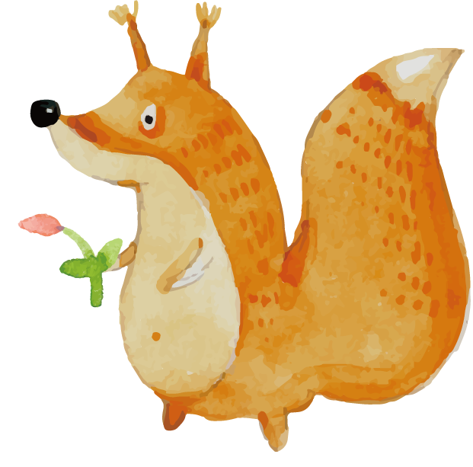
A
人与社会：LARPing: a way to live out your fantasies

Slide 5
Need a break from reality? Don’t we all! Life gets tough, but we can fight back with the right kind of attitude. We can win the battle within ourselves by Live-Action-Role-Playing(LARPing) in Louisiana! We’re here to brief you on the basics and help you live out your fantasies.
Louisiana LARPing Basics
Imagine fighting battles as a hero. Or dress up as a cyberpunk princess(公主). In many ways, you can become who you want, and that’s the obvious attraction of LARPing. Most groups for LARPing in Louisiana have registration pages on their websites, and some have private groups on Facebook.
Louisiana LARPing Groups
LarpWorks is a large community with 3 different games for you to play. Depending on your interests, you can choose to be a part of medieval(中世纪) times, a historical fantasy, or a sci-fi thriller. It's a kind of active storytelling to play out the narratives as your own character with your own storyline.
Echoes of Athus is a fantasy group that gathers in various campgrounds around Louisiana. They have a website full of fun resources for members to explore. A lot of work has been put into their history and tales. You can really get wrapped up in creating your own background story.
Final Words
LARPing in Louisiana could be the escape you're looking for! At the very least, it's an opportunity to meet new people and learn about a new subculture. The possibilities are endless—you could rule your own kingdom one day!
21. What is the main attraction of Louisiana LARPing?
A. It develops your imagination.
B. It makes you more competitive.
C. It provides you with a fictional identity.
D. It helps change your attitude towards life.
22. What can you do in LarpWorks and Echoes of Athus?
A. Act out stories.
B. Play online games.
C. Learn about science.
D. Create fun resources.
23. What can Louisiana LARPing bring to you?
A. A high position in society.
B. A getaway from reality.
C. A sense of cultural protection.
D. An opportunity for promotion.
虚构的身份

Slide 6
文本语言分析与运用
brief:
We’re here to brief you on the basics and help you live out your fantasies.
A safety briefing at the volunteer house.
In a brief statement, he concentrated entirely on international affairs.
For a few brief minutes we forgot the anxiety and anguish.
v. 介绍; 提供 (信息)
n.情况介绍会；简报
adj. 简短的
adj.短暂的
2. escape:
LARPing in Louisiana could be the escape you're looking for! At the very least, it's an opportunity to meet new people and learn about a new subculture.
The pilot escaped death by seconds./ He narrowly escaped being killed.
n.逃避现实；解脱；消遣
v.避免避开
本次春游(spring outing)可以让你暂时从繁重的学业中解脱出来，去欣赏春日的美景。它也是一个你亲近大自然的同时又能和同学们一起玩耍放松的机会。
The spring outing could be an escape from the heavy academic burden for you to appreciate the fantastic scenery. It’s also an opportunity to get close to nature and play with your classmates for relaxation.

Slide 7
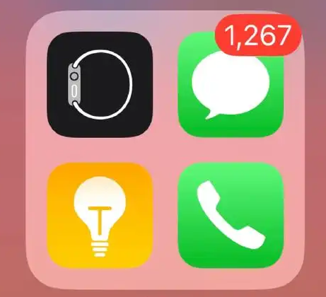
B
人与自我： My experience of quitting mail-checking habit

Slide 8
As a freelance(自由职业的) writer, the structure of my workday can often vary wildly. Sometimes, it feels as if I have too much to do—other days, too little. Yet no matter the shape of my 9 to 5, one thing remains constant: emails.
About a year ago, I found my email - checking habit had become more distracting(分心的) than usual. When working on my computer, I found myself nervously checking my phone for unread emails whenever hitting a mental block. Even worse, during lunch or walks, that habit of checking would come with me, making my breaks an extension of the workday.
The little red dot on my Gmail app had become a marker of my professional image: the more unread emails, the more I felt I was failing. By quickly responding to everyone, I convinced myself I was seen as reliable by my paymasters and therefore worthy of the work I needed to pay my electricity bills, so I could charge my phone, read my emails and carry on the endless cycle.
However, speed doesn't always mean quality. I was always contactable—but at what cost? I took on too much work, not allowing myself space to reflect on the value of my work. The content machine kept running and I was busy, producing “word salad” onto the internet. Something needed to change. After a particularly crazy week of nonstop emailing, I deleted the email app.
The difference was immediately noticeable. I began to rest better. Now, my workdays remain unpredictable, but I've realised that a lack of structure needn't stop me setting boundaries(边界) for myself. Uninterrupted breaks help me focus when I get back to work. Taking a few hours to respond to messages—instead of just minutes—often makes no difference to the sender and allows me to digest the content properly.
I am still surviving as a freelancer in a fast - paced industry, but now I can spend my time endlessly checking my phone for Instagram stories instead.
problem
analysis
solution
result

Slide 9
As a freelance(自由职业的) writer, the structure of my workday can often vary wildly. Sometimes, it feels as if I have too much to do—other days, too little. Yet no matter the shape of my 9 to 5, one thing remains constant: emails.
About a year ago, I found my email - checking habit had become more distracting(分心的) than usual. When working on my computer, I found myself nervously checking my phone for unread emails whenever hitting a mental block. Even worse, during lunch or walks, that habit of checking would come with me, making my breaks an extension of the workday.
The little red dot on my Gmail app had become a marker of my professional image: the more unread emails, the more I felt I was failing. By quickly responding to everyone, I convinced myself I was seen as reliable by my paymasters and therefore worthy of the work I needed to pay my electricity bills, so I could charge my phone, read my emails and carry on the endless cycle.
However, speed doesn't always mean quality. I was always contactable—but at what cost? I took on too much work, not allowing myself space to reflect on the value of my work. The content machine kept running and I was busy, producing “word salad” onto the internet. Something needed to change. After a particularly crazy week of nonstop emailing, I deleted the email app.
The difference was immediately noticeable. I began to rest better. Now, my workdays remain unpredictable, but I've realised that a lack of structure needn't stop me setting boundaries(边界) for myself. Uninterrupted breaks help me focus when I get back to work. Taking a few hours to respond to messages—instead of just minutes—often makes no difference to the sender and allows me to digest the content properly.
I am still surviving as a freelancer in a fast - paced industry, but now I can spend my
time endlessly checking my phone for Instagram stories instead.
24. How did the email - checking habit affect the author?
A. It caused him mental disorder.
B. It made his breaks less relaxing.
C. It kept him extremely impatient.
D. It changed the structure of his workday.
25. Why did the author feel the need to respond to emails quickly?
A. He wanted to avoid long working hours.
B. He sought high pay to cover electricity bills.
C. He desired to maintain a professional image.
D. He believed multitasking ensured employment.
26. What does the author imply by mentioning “word salad” in paragraph 4?
A. He was far from productive.
B. He valued quality over quantity.
C. His work was creative and tasteful.
D. His work lacked meaningful content.
27. What does the author learn after deleting the email app?
A. Email senders prefer thoughtful replies.
B. Social media is more important than email.
C. Setting boundaries can improve work efficiency.
D. Freelancers should get used to a fast - paced lifestyle.

Slide 10
文本语言分析与运用
变化幅度很大
保持不变
思维障碍
职业形象
被看做是
值得
反思；思考
删除应用
没有影响
消化内容
一个快节奏的行业
vary wildly
remain constant
a mental block
professional image
be seen as …
be worthy of …
reflect on
delete the app
make no difference to …
digest the content
a fast-paced industry

Slide 11
文本语言分析与运用
hitting
I found myself nervously checking my phone for unread emails whenever ________ (hit) a mental block.
Even worse, during lunch or walks, that habit of checking would come with me, making my breaks an ________ (extend) of the workday.
The difference was immediately ____________ (notice).
_________ (take) a few hours to respond to messages—instead of just minutes—often makes no difference to the sender and _______ (allow) me to digest the content properly.
the more ___________(not read) emails, the more I felt I was failing.
Now, my workdays remain _____________(not predict).
______________(not interrupt) breaks help me focus when I get back to work.
By quickly responding to everyone, I convinced myself I was seen as reliable by my paymasters and therefore worthy _____ the work I needed to pay my electricity bills, so I could charge my phone, read my emails and carry ____ the endless cycle.
I took ____ too much work, not allowing myself space to reflect ____ the value of my work.
Taking a few hours to respond ____ messages—instead of just minutes—often makes no difference _____ the sender and allows me to digest the content properly.
extension
noticeable
Taking
allows
unread
unpredictable
Uninterrupted
of
on
on
on
to
to

Slide 12
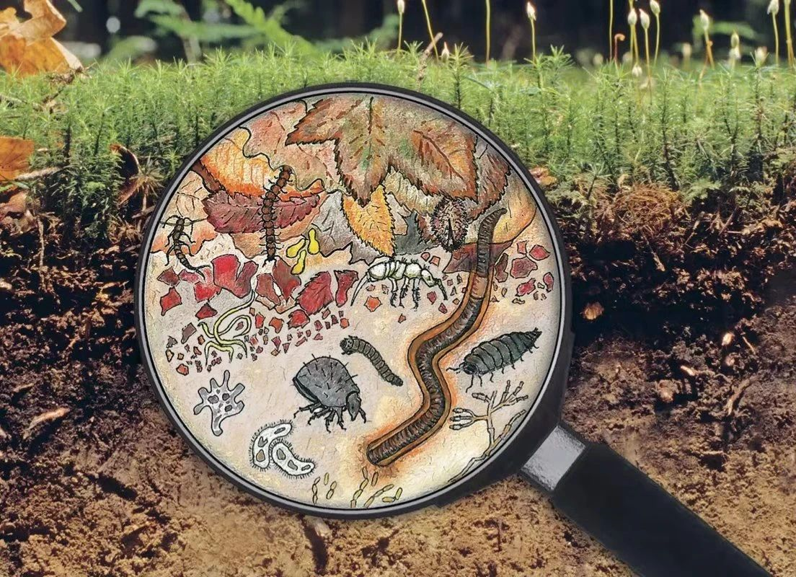
C
人与自然：Soil microbes: essential for sustaining life on the earth

Slide 13
Beneath the surface of the earth lies a lively, invisible ecosystem full of life, often referred to as the “living skin” of the earth. It is a hidden world where countless organisms(生物体) interact in complex ways, driving essential processes that enable life to survive. They are the unsung heroes of nutrient cycling, soil stability, and even climate balance.
Organisms in the soil are both copious and diverse. They range in size from the one-celled bacteria, to the more complex tiny bugs, and to the larger organisms such as insects and plants. Soil microbes(微生物) are too small to be seen with the unaided eye. Bacteria are the most plentiful microbes in soil, with a population of 10^{10}-10^{11} individuals and 6,000 - 50,000 species per gram of soil and a biomass of 40 - 500 grams per square metre.
If we are to understand the functions of soil microbes and the impact of management practices on soil quality, we need to analyze microbial community composition beyond just counting individuals. Traditional methods of studying microbes often rely on culturing techniques, which have significant limitations as they can only detect a small part of the microbial community. Advanced genetic(基因的) techniques, such as DNA sequencing and PCR, however, enable the detection and categorization of previously uncountable microbes. These methods enhance our ability to identify shifts in microbial communities, providing critical insights into soil health and functional dynamics.
Soil microbes play both beneficial and harmful roles as contributors to soil environmental problems such as climate change and groundwater pollution. The physical, chemical, and biological soil characteristics and their interactions with the resident community of soil microbes have a significant impact on the growth and activity of these microbes. As our understanding of these complex relationships develops, we should be able to develop soil management practices that are sustainable and can lead to preservation and improvement of soil quality.
The significance of organisms
Plenty and diversity of organisms
analysis techniques
Organisms’ both beneficial and harmful roles

Slide 14
Beneath the surface of the earth lies a lively, invisible ecosystem full of life, often referred to as the “living skin” of the earth. It is a hidden world where countless organisms(生物体) interact in complex ways, driving essential processes that enable life to survive. They are the unsung heroes of nutrient cycling, soil stability, and even climate balance.
Organisms in the soil are both copious and diverse. They range in size from the one-celled bacteria, to the more complex tiny bugs, and to the larger organisms such as insects and plants. Soil microbes(微生物) are too small to be seen with the unaided eye. Bacteria are the most plentiful microbes in soil, with a population of 10^{10}-10^{11} individuals and 6,000 - 50,000 species per gram of soil and a biomass of 40 - 500 grams per square metre.
If we are to understand the functions of soil microbes and the impact of management practices on soil quality, we need to analyze microbial community composition beyond just counting individuals. Traditional methods of studying microbes often rely on culturing techniques, which have significant limitations as they can only detect a small part of the microbial community. Advanced genetic(基因的) techniques, such as DNA sequencing and PCR, however, enable the detection and categorization of previously uncountable microbes. These methods enhance our ability to identify shifts in microbial communities, providing critical insights into soil health and functional dynamics.
Soil microbes play both beneficial and harmful roles as contributors to soil environmental problems such as climate change and groundwater pollution. The physical, chemical, and biological soil characteristics and their interactions with the resident community of soil microbes have a significant impact on the growth and activity of these microbes. As our understanding of these complex relationships develops, we should be able to develop soil management practices that are sustainable and can lead to preservation and improvement of soil quality.
28. What does the “living skin” of the earth mainly do?
A. Sustain life on the earth.
B. Control microbial population.
C. Protect the surface of the earth.
D. Monitor changes in the ecosystem.
29. What does the underlined word “copious” in paragraph 2 mean?
A. Small. B. Active.
C. Invisible. D. Plentiful.
30. Why are modern genetic techniques used in studying microbes?
A. To identify diverse microbes.
B. To simplify microbes.
C. To help culture more microbes.
D. To minimize microbial impact on soil.
31. What can help us to improve soil management practices?
A. Removing harmful microbes.
B. Distinguishing soil characteristics.
C. Understanding soil-microbe interactions.
D. Strengthening relationships among microbes.

Slide 15
文本语言分析与运用
invisible ecosystem
be referred to as
a hidden world
unsung heroes
nutrient cycling
soil stability
unaided eye
enhance one’s ability
provide critical insights into …
have a significant impact on …
看不见的生态系统
被当做是
一个隐秘的世界
无名英雄
养分循环
土壤稳定
肉眼
提高某人的能力
提供深入见解
有深远的影响

Slide 16
文本语言分析与运用
Beneath the surface of the earth _____(lie) a lively, invisible ecosystem full of life, often _________(refer) to as the “living skin” of the earth.
It is a ________(hide) world where countless organisms(生物体) interact in complex ways, _________ (drive) essential processes that enable life to survive.
They are the _________(not sing) heroes of nutrient cycling, soil________(stable), and even climate balance.
They range in size from the one-celled bacteria, to the more complex tiny bugs, and _____ the larger organisms such as insects and plants.
Soil microbes(微生物) are too small __________(see) with the ________(not aid) eye.
If we are to understand the functions of soil microbes and the impact of management practices ____ soil quality, we need to analyze microbial community composition beyond just counting individuals.
These methods enhance our ability to identify shifts in microbial communities, ___________(provide) critical insights into soil health and functional dynamics.
The physical, chemical, and biological soil characteristics and their _____________(interact) with the resident community of soil microbes have a significant impact on the ________(grow) and activity of these microbes.
As our understanding of these complex relationships_____________(develop), we should be able to develop soil management practices that are sustainable and can lead to ______________ (preserve) and improvement of soil quality.
lies
referred
hidden
driving
unsung
stability
to
to be seen
unaided
on
providing
interactions
growth
develops
preservation

Slide 17
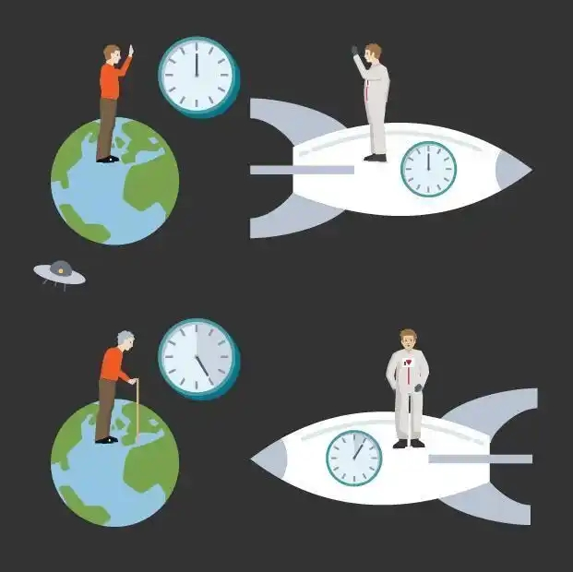
D
人与社会：The secret of time: a state of mind

Slide 18
The 18th century German philosopher Immanuel Kant lived very firmly in a world of time. He was so strict about routine that his fellow citizens of Koenigsberg could set their watches by his afternoon walk. However, in his philosophical work, Kant was doubtful about time. He believed time is created by the human mind. Out there beyond our minds, there is no time. It's simply a “category” of our minds that helps us to perceive objects and order our experience.
The flexibility of our time perception(感知) supports Kant's doubt. We all know time is not a fixed phenomenon but seems to pass at different speeds in different situations. For example, it seems to go slowly when we travel to unfamiliar places, or when we are bored or in pain. It seems to speed up when we're absorbed, such as when we play music or paint.
Our perception of time can change in a dramatic way. Perhaps, at least once in your life, you've had what is called a “Time Expansion Experience(TEE),” when seconds have stretched out into minutes. TEEs happen most frequently in accidents where perception becomes more intense than normal and thus people notice more details.
In accident situations, people are often surprised by the amount of time they have to think and act. In fact, many people are convinced that time expansion spared them from their serious injury, or even death. For example, a woman who reported a TEE in which she avoided a metal barrier falling on to her car said, “For me the slowing down of the moment allowed me to decide how to escape the falling metal on us.”
All of this suggests that Kant was right. Perhaps the reason why time is variable is because it doesn't really exist—at least, outside our minds. There is no objective time out there in the universe. What we experience as time is filtered (过滤) through our minds, and so varies according to our state of mind.
viewpoint
argument
conclusion
35. What can be a suitable title for the text?
A. The Secret of Time: A State of Mind B. Time Expansion: Real or Imaginary?
C. Time Perception: A Philosophical Exploration D. The Clockwork of the Mind: How to Measure Time?

Slide 19
The 18th century German philosopher Immanuel Kant lived very firmly in a world of time. He was so strict about routine that his fellow citizens of Koenigsberg could set their watches by his afternoon walk. However, in his philosophical work, Kant was doubtful about time. He believed time is created by the human mind. Out there beyond our minds, there is no time. It's simply a “category” of our minds that helps us to perceive objects and order our experience.
The flexibility of our time perception(感知) supports Kant's doubt. We all know time is not a fixed phenomenon but seems to pass at different speeds in different situations. For example, it seems to go slowly when we travel to unfamiliar places, or when we are bored or in pain. It seems to speed up when we're absorbed, such as when we play music or paint.
Our perception of time can change in a dramatic way. Perhaps, at least once in your life, you've had what is called a “Time Expansion Experience(TEE),” when seconds have stretched out into minutes. TEEs happen most frequently in accidents where perception becomes more intense than normal and thus people notice more details.
In accident situations, people are often surprised by the amount of time they have to think and act. In fact, many people are convinced that time expansion spared them from their serious injury, or even death. For example, a woman who reported a TEE in which she avoided a metal barrier falling on to her car said, “For me the slowing down of the moment allowed me to decide how to escape the falling metal on us.”
All of this suggests that Kant was right. Perhaps the reason why time is variable is because it doesn't really exist—at least, outside our minds. There is no objective time out there in the universe. What we experience as time is filtered(过滤) through our minds, and so varies according to our state of mind.
32. Which of the following would Immanuel Kant approve of?
A. Time is a basic quality of the world.
B. Time is a record of human experience.
C. Time is a situation measured by daily routine.
D. Time is a mental concept generated by humans.
33. What is the main idea of paragraph 2?
A. Time progresses at a constant speed.
B. Full attention affects people's sense of time.
C. Time perception varies depending on context.
D. People feel time slows down on special occasions.
34. What do people think of TEEs in accidents?
A. Inspiring. B. Beneficial.
C. Temporary. D. Painful.
35. What can be a suitable title for the text?
A. The Secret of Time: A State of Mind
B. Time Expansion: Real or Imaginary?
C. Time Perception: A Philosophical Exploration
D. The Clockwork of the Mind: How to Measure Time?

Slide 20
文本语言分析与运用
n. 哲学家/ adj. 哲学的
怀疑
加速
免去
以一种戏剧性的方式
v.变化 / adj. 易变的；多变的
philosopher /philosophical
be doubtful about
speed up
spare sb. from sth.
in a dramatic way
vary / variable
7. The ____________ (flexible) of our time ____________ (perceive) supports Kant's doubt.
8. TEEs happen most frequently in accidents where perception becomes ____________ (intense) than normal and thus people notice more details.
9. In fact, many people are convinced that time ___________ (expand) spared them from their serious injury, or even ________ (dead).
flexibility
perception
more intense
expansion
death

Slide 21
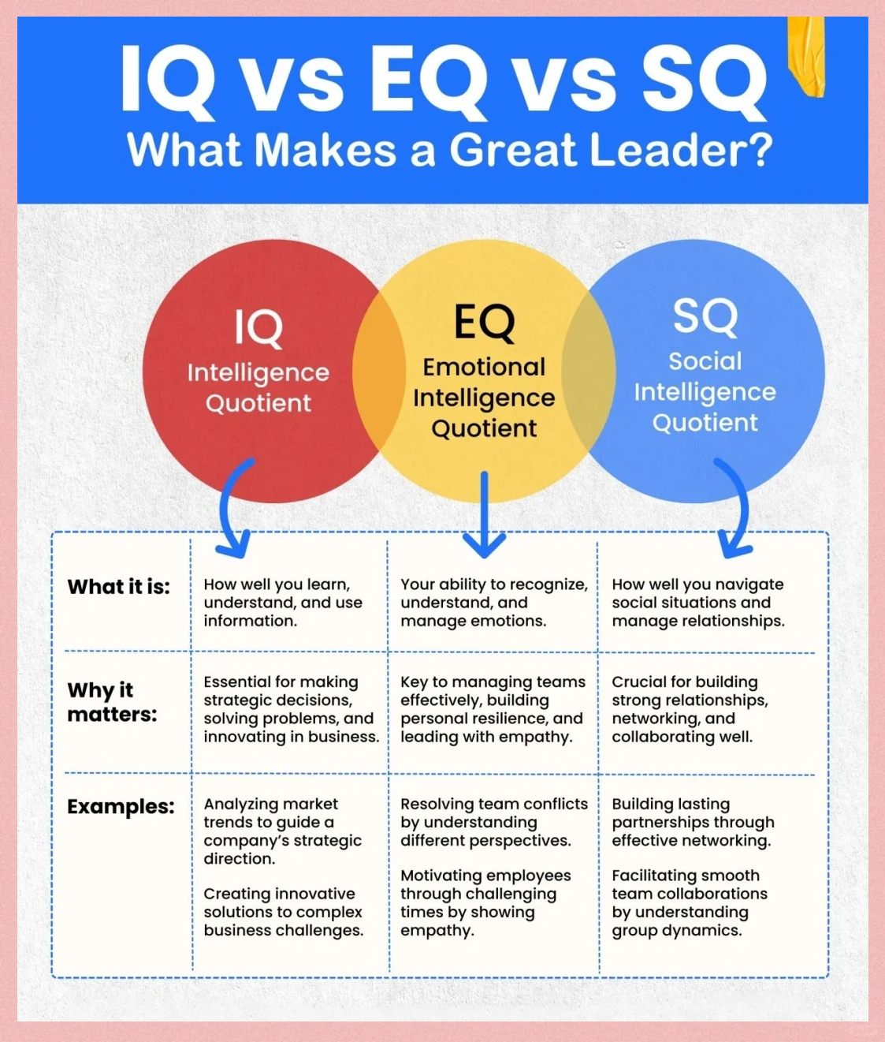
7选5
人与自我： Strategies to develop emotional intelligence

Slide 22
Step1 读文本大意、理篇章结构
General → Specific
significance of emotion controlling
Emotions can shape us in different ways. 36.__________ Taking responsibility of your emotions is how you stand out from the crowd. Let's explore some powerful strategies to help you on this journey.
● Accept others as they are.
37.__________ Keeping that in mind, remember you cannot change others. Even if you try changing others, you will only be hurting yourself in the process. The best course of action would be to change yourself. This is how you will become emotionally intelligent and happier.
● Try using “I” statements.
Hiding your emotions can harm relationships. When your feelings are hurt, it's good to voice it straightforward. 38.__________ The best way to do this is by using “I” statements. For example, say, “I feel heart-broken.” instead of “You made me feel heart-broken.” This allows you to communicate your feelings without blaming others.
● 39.__________
Negative thoughts can cloud your judgment. However, in over 70% of cases, we let them take hold and this is completely wrong. Whenever the other person is behaving in an upsetting manner, ask yourself if you have done anything to make them feel like that. Self-reflection helps you respond thoughtfully rather than letting emotions take control.
● Mind your words and actions.
In emotional moments, especially during arguments, we often say or do things we later regret. When emotions run high, anger or impatience can take control of us. Instead of reacting without forethought, consider taking a moment to reflect before responding. 40.__________
four strategies

Slide 23
Step2 读选项，抓关键
A. Question your actions.
B. Avoid those negative thoughts.
C. Tell others how you feel in a nonjudgmental way.
D. Just like you, everyone else is entitled to their own beliefs.
E. Express your needs clearly and encourage others to do so.
F. During this moment, calm your emotions and respond sensibly.
G. To better yourself, it's essential to develop emotional intelligence.
句间衔接
指代、代词
关键词

Slide 24
Step3 逐一分析、聚焦上下文
significance of emotion controlling
36 G 承上启下
Emotions can shape us in different ways. 36.__________ Taking responsibility of your emotions is how you stand out from the crowd. Let's explore some powerful strategies to help you on this journey.
● Accept others as they are.
● Try using “I” statements.
● 39.__________
Negative thoughts can cloud your judgment. However, in over 70% of cases, we let them take hold and this is completely wrong. Whenever the other person is behaving in an upsetting manner, ask yourself if you have done anything to make them feel like that. Self-reflection helps you respond thoughtfully rather than letting emotions take control.
● Mind your words and actions.
four strategies
A. Question your actions.
B. Avoid those negative thoughts.
C. Tell others how you feel in a nonjudgmental way.
D. Just like you, everyone else is entitled to their own beliefs.
E. Express your needs clearly and encourage others to do so.
F. During this moment, calm your emotions and respond sensibly.
G. To better yourself, it's essential to develop emotional intelligence.

Slide 25
Step3 逐一分析、聚焦上下文
significance of emotion controlling
36 G 承上启下
Emotions can shape us in different ways. 36.__________ Taking responsibility of your emotions is how you stand out from the crowd. Let's explore some powerful strategies to help you on this journey.
● Accept others as they are.
● Try using “I” statements.
● 39.__________
Negative thoughts can cloud your judgment. However, in over 70% of cases, we let them take hold and this is completely wrong. Whenever the other person is behaving in an upsetting manner, ask yourself if you have done anything to make them feel like that. Self-reflection helps you respond thoughtfully rather than letting emotions take control.
● Mind your words and actions.
four strategies
祈使句 39 A 主旨 同义复现 思考B？
A. Question your actions.
B. Avoid those negative thoughts.
C. Tell others how you feel in a nonjudgmental way.
D. Just like you, everyone else is entitled to their own beliefs.
E. Express your needs clearly and encourage others to do so.
F. During this moment, calm your emotions and respond sensibly.
G. To better yourself, it's essential to develop emotional intelligence.

Slide 26
Step3 逐一分析、聚焦上下文
● Accept others as they are.
37.__________ Keeping that in mind, remember you cannot change others. Even if you try changing others, you will only be hurting yourself in the process. The best course of action would be to change yourself. This is how you will become emotionally intelligent and happier.
37 D 代词 意义一致
A. Question your actions.
B. Avoid those negative thoughts.
C. Tell others how you feel in a nonjudgmental way.
D. Just like you, everyone else is entitled to their own beliefs.
E. Express your needs clearly and encourage others to do so.
F. During this moment, calm your emotions and respond sensibly.
G. To better yourself, it's essential to develop emotional intelligence.

Slide 27
Step3 逐一分析、聚焦上下文
● Try using “I” statements.
Hiding your emotions can harm relationships. When your feelings are hurt, it's good to voice it straightforward. 38.__________ The best way to do this is by using “I” statements. For example, say, “I feel heart-broken.” instead of “You made me feel heart-broken.” This allows you to communicate your feelings without blaming others.
同义复现 38 C 例证
A. Question your actions.
B. Avoid those negative thoughts.
C. Tell others how you feel in a nonjudgmental way.
D. Just like you, everyone else is entitled to their own beliefs.
E. Express your needs clearly and encourage others to do so.
F. During this moment, calm your emotions and respond sensibly.
G. To better yourself, it's essential to develop emotional intelligence.

Slide 28
Step3 逐一分析、聚焦上下文
● Mind your words and actions.
In emotional moments, especially during arguments, we often say or do things we later regret. When emotions run high, anger or impatience can take control of us. Instead of reacting without forethought, consider taking a moment to reflect before responding. 40.__________
代词 同词复现 主旨一致 40 F
A. Question your actions.
B. Avoid those negative thoughts.
C. Tell others how you feel in a nonjudgmental way.
D. Just like you, everyone else is entitled to their own beliefs.
E. Express your needs clearly and encourage others to do so.
F. During this moment, calm your emotions and respond sensibly.
G. To better yourself, it's essential to develop emotional intelligence.

Slide 29
文本语言分析与运用
1. 以不同方式塑造我们
shape us in different ways.
2.从人群中脱颖而出
stand out from the crowd.
3.接受他人本来的样子
accept others as they are.
4.变得情商高的
become emotionally intelligent
5.直截了当地表达某事
Voice sth straightforward.
6.影响你的判断力(隐喻）
cloud your judgment.
7. let them take hold
任由它们占据（我们的思想）
8. question your actions.
审视自己的行为。
9. in a nonjudgmental way
以一种不带评判的方式
10. be entitled to one’s own beliefs.
有权拥有自己的信念
11.Self - reflection helps you respond thoughtfully
自我反思有助于你深思熟虑地做出反应
12. calm your emotions and respond ______ (sensible)
平复你的情绪并做出理智的回应。
13.要提升自我，培养情商至关重要。
To better yourself, it's essential to develop emotional intelligence.
14. When emotions run high, anger or impatience can take control of us. Instead of reacting without rethought, consider taking a moment to reflect before responding.
当情绪高涨时，愤怒或不耐烦可能会控制我们。与其不假思索地做出反应，不如在回应前花点时间反思一下。
sensibly

Slide 30

完形填空
人与社会： Parkes and her project: I Wanna See Project

Slide 31
Step1: 选项全击破
41. A. accessible易得到的 B. practical C. necessary D. helpful
42. A. financial B. mental C. visual D. academic
43. A. ran into撞到 B. stared at C. searched for D. moved around
44. A. medicine B. glasses C. surgery外科手术 D. examinations
45. A. puzzled B. amazed C. amused D. frightened
46. A. depend on B. care about C. suffer from D. go without没有(某物)
47. A. understood B. considered C. raised D. valued
48. A. treatment B. action C. budget预算 D. assessment
49. A. filled B. opened C. placed D. piled
50. A. aired播送，播放 B. adapted C. continued D. invented
51. A. quickly B. randomly随机地 C. frequently D. effectively
52. A. donate B. produce C. exchange D. distribute分发，分配
53. A. linking B. transporting C. expanding扩大,扩展 D. attaching附上
54. A. sympathy B. courage C. patience D. optimism乐观
55. A. suited B. addicted着迷的 C. related D. committed忠诚的

Slide 32
Step2: 首尾定主题
Parkes Long’s Vision Mission: Helping the Homeless See Clearly
Sixteen - year - old Parkes Long is on a mission to ensure unhoused people have healthy vision. Her project, the I Wanna See Project, makes free eye care and glasses 41._________ to them.
Parkes’ inspiration came from her own experience with 42._________ issues that began when she was 7. She struggled to see her friends on the playground and often 43._________ things at home. Her parents took her to hospital, where she was prescribed (开处方) 44._________.
“The first time I put them on, I was 45._________ at how clearly everything looked,” Parkes said. As she grew older and became more aware of social inequality, she became worried about those who 46._________ something as essential as clear vision. “What if people donate unused glasses so others could see clearly?” She 47._________ the idea. Her mother was supportive and helped her make a plan of 48._________.
They started with a drive to collect glasses through social media and 49._________ drop - boxes in their community, receiving 75 pairs of glasses. After her story was 50._________ on TV, the project gained more support. To ensure the donated glasses were 51._________ matched with the right individuals, Parkes carefully observed the process and even worked with doctors to 52._________ the glasses.
Looking ahead, Parkes envisions long - term goals for the I Wanna See Project, including 53._________ it to other states.
“The 54._________ she showed was really touching,” Parkes’ mother remarked. “Despite her tight schedule, she remains 55._________ to improving the life of many people.”
accessible
theme
origin
action
vision
sympathy
committed
assessment

Slide 33
Step3: 主体找线索
Parkes Long’s Vision Mission: Helping the Homeless See Clearly
Sixteen - year - old Parkes Long is on a mission to ensure unhoused people have healthy vision. Her project, the I Wanna See Project, makes free eye care and glasses 41._________ to them.
Parkes’ inspiration came from her own experience with 42._________ issues that began when she was 7. She struggled to see her friends on the playground and often 43._________ things at home. Her parents took her to hospital, where she was prescribed (开处方) 44._________.
“The first time I put them on, I was 45._________ at how clearly everything looked,” Parkes said. As she grew older and became more aware of social inequality, she became worried about those who 46._________ something as essential as clear vision. “What if people donate unused glasses so others could see clearly?” She 47._________ the idea. Her mother was supportive and helped her make a plan of 48._________.
They started with a drive to collect glasses through social media and 49._________ drop - boxes in their community, receiving 75 pairs of glasses. After her story was 50._________ on TV, the project gained more support. To ensure the donated glasses were 51._________ matched with the right individuals, Parkes carefully observed the process and even worked with doctors to 52._________ the glasses.
Looking ahead, Parkes envisions long - term goals for the I Wanna See Project, including 53._________ it to other states.
“The 54._________ she showed was really touching,” Parkes’ mother remarked. “Despite her tight schedule, she remains 55._________ to improving the life of many people.”
accessible
go without
expanding
sympathy
committed

Slide 34
Step3: 主体找线索
Parkes Long’s Vision Mission: Helping the Homeless See Clearly
Sixteen - year - old Parkes Long is on a mission to ensure unhoused people have healthy vision. Her project, the I Wanna See Project, makes free eye care and glasses 41._________ to them.
Parkes’ inspiration came from her own experience with 42._________ issues that began when she was 7. She struggled to see her friends on the playground and often 43._________ things at home. Her parents took her to hospital, where she was prescribed (开处方) 44._________.
“The first time I put them on, I was 45._________ at how clearly everything looked,” Parkes said. As she grew older and became more aware of social inequality, she became worried about those who 46._________ something as essential as clear vision. “What if people donate unused glasses so others could see clearly?” She 47._________ the idea. Her mother was supportive and helped her make a plan of 48._________.
They started with a drive to collect glasses through social media and 49._________ drop - boxes in their community, receiving 75 pairs of glasses. After her story was 50._________ on TV, the project gained more support. To ensure the donated glasses were 51._________ matched with the right individuals, Parkes carefully observed the process and even worked with doctors to 52._________ the glasses.
Looking ahead, Parkes envisions long - term goals for the I Wanna See Project, including 53._________ it to other states.
“The 54._________ she showed was really touching,” Parkes’ mother remarked. “Despite her tight schedule, she remains 55._________ to improving the life of many people.”
accessible
visual
ran into
glasses
amazed
go without
raised
action
placed
aired
distribute
expanding
sympathy
committed

Slide 35
Step3: 主体找线索
Parkes Long’s Vision Mission: Helping the Homeless See Clearly
Sixteen - year - old Parkes Long is on a mission to ensure unhoused people have healthy vision. Her project, the I Wanna See Project, makes free eye care and glasses 41._________ to them.
Parkes’ inspiration came from her own experience with 42._________ issues that began when she was 7. She struggled to see her friends on the playground and often 43._________ things at home. Her parents took her to hospital, where she was prescribed (开处方) 44._________.
“The first time I put them on, I was 45._________ at how clearly everything looked,” Parkes said. As she grew older and became more aware of social inequality, she became worried about those who 46._________ something as essential as clear vision. “What if people donate unused glasses so others could see clearly?” She 47._________ the idea. Her mother was supportive and helped her make a plan of 48._________.
They started with a drive to collect glasses through social media and 49._________ drop - boxes in their community, receiving 75 pairs of glasses. After her story was 50._________ on TV, the project gained more support. To ensure the donated glasses were 51._________ matched with the right individuals, Parkes carefully observed the process and even worked with doctors to 52._________ the glasses.
Looking ahead, Parkes envisions long - term goals for the I Wanna See Project, including 53._________ it to other states.
“The 54._________ she showed was really touching,” Parkes’ mother remarked. “Despite her tight schedule, she remains 55._________ to improving the life of many people.”
accessible
visual
例证关系
ran into
glasses
amazed
go without
raised
action
placed
例证关系
aired
effectively
distribute
expanding
常识判断
sympathy
committed

Slide 36
10.a drive to collect glasses through social media
通过社交媒体收集眼镜的积极性和驱动力
11.在社区放置投放箱
place drop - boxes in their community
12.be aired on TV
在电视上播出后
13.Be effectively matched with the right individuals
有效地配给合适的人
14.分发眼镜
distribute the glasses
15.look ahead
展望未来
16. envision long - term goals for
为 …设想了长期目标
17.tight schedule
繁忙的日程
18.be committed to__________(improve) the life of many people
致力于改善许多人的生活
文本语言分析与运用
1.on a mission
肩负使命
2.ensure unhoused people have healthy vision
确保无家可归者拥有健康视力。
3.make free eye care and glasses accessible to sb
为…提供免费的眼部护理和眼镜。
4.visual issues
视力问题
5.struggle to do
难以做某事
6.run into things
撞到东西
7.become aware of social inequality
意识到社会不平等
8.go without
没有…… 也应付过去；缺乏
9. go without something as essential as clear vision
缺乏清晰视力这样至关重要的东西
improving

Slide 37
文本语言分析与运用
16 岁的帕克斯・朗正在进行一项非凡的使命。受自己从 7 岁开始的视力问题启发，她发起了 “我想看见” 项目。该倡议旨在为无家可归者提供免费的视力检查和眼镜。随着她逐渐意识到社会不平等，并为那些视力不佳的人担忧，她想出了这个主意。通过社交媒体和社区投放箱，她收集捐助的眼镜。在她的故事登上电视后，支持如潮水般涌来。帕克斯致力于实现她的长期目标，比如拓展这个项目。她的同理心和行动真的意义重大。
Sixteen - year - old Parkes Long is on a remarkable mission. Inspired by her own vision/visual issues starting at 7, she launched the I Wanna See Project. This initiative aims to make free eye care and glasses accessible to the unhoused. As she grew aware of social inequality and worried about those lacking clear vision,she came up with/raised the idea . Through social media and community drop - boxes, she collected donated glasses. After her story was aired on TV, support poured in. Parkes is committed to her long - term goals, like expanding the project. Her empathy and action truly make a big difference.

Slide 38

语法填空
人与社会： A study on paper book reading

Slide 39
A Deakin University study surveyed 13,217 Australian teens (ages 12 - 18) and 56._________ (find) 73% prefer reading paper books, while only 15% read daily for fun. Nearly 30% 57._________ (rare) read outside schoolwork. Popular choices include fantasy and mystery novels, but interest drops as teens grow older, with girls reading more than boys.
Parents and friends play a 58._________ (big) role in book recommendations than schools. Teens explain that paper books “feel real,” cause less eye strain than screens, and avoid phone distractions. However, half spend most free time on social media or watching videos, 59._________ (leave) little space for reading.
Researchers link regular reading to better grades, mental health, and career success. With 60._________ (globe) literacy (识字) rates declining (shown in PISA tests), they urge action: 61._________ (family) should share book talks, schools should protect library time, 62._________ teachers could use apps to make reading interactive. They also group teens 63._________ seven reading types, from “daily bookworms” to “screen lovers,” suggesting 64._________ (tailor) solutions like book clubs or digital - storytelling projects.
Supported by Australian libraries and publishers, 65._________ study highlights the need to balance digital life with the timeless joy of reading.
A Deakin University study surveyed 13,217 Australian teens (ages 12 - 18) and 56._________ (find) 73% prefer reading paper books, while only 15% read daily for fun. Nearly 30% 57._________ (rare) read outside schoolwork. Popular choices include fantasy and mystery novels, but interest drops as teens grow older, with girls reading more than boys.
Parents and friends play a 58._________ (big) role in book recommendations than schools. Teens explain that paper books “feel real,” cause less eye strain than screens, and avoid phone distractions. However, half spend most free time on social media or watching videos, 59._________ (leave) little space for reading.
Researchers link regular reading to better grades, mental health, and career success. With 60._________ (globe) literacy (识字) rates declining (shown in PISA tests), they urge action: 61._________ (family) should share book talks, schools should protect library time, 62._________ teachers could use apps to make reading interactive. They also group teens 63._________ seven reading types, from “daily bookworms” to “screen lovers,” suggesting 64._________ (tailor) solutions like book clubs or digital - storytelling projects.
Supported by Australian libraries and publishers, 65._________ study highlights the need to balance digital life with the timeless joy of reading.
56. found
并列谓语，表示过去时、主动
57. rarely
副词修饰动词read
58.bigger
形容词比较级bigger…than
59.leaving
非谓语，表示主动进行
60.global
形容词修饰名词
61.families
并列句式，缺名词复数
62.and
并列连词
63.into
短语搭配group…into 把…分类
64.tailored
非谓语，表示被动完成
tailored solution定制解决方案
65.the
前文已提及，缺定冠词
found
rarely
bigger
leaving
global
families
and
into
tailored
the

Slide 40
文本词句分析与积累
book recommendations
eye strain
avoid phone distractions
take urgent action → urge action
group…into seven reading types
tailored solutions
highlight the needs
balance digital life with the timeless joy of reading
推荐书
眼疲劳
避免电话干扰
采取紧急行动
把……分成七种阅读类型
定制解决方案
突出需求
平衡数字生活和永恒的阅读乐趣
“group”
Plants are grouped into botanical "families" that have certain characteristics in common.
The trouble involved a small group of football fans.
Members of an environmental group are staging a protest inside a chemical plant.
n.群
n.集体; 团体
v. 把…归在一起; 形成一组

Slide 41
文本再填空
A Deakin University study surveyed 13,217 Australian teens (ages 12 - 18) and found 73% prefer reading paper books, ______ only 15% read daily for fun. Nearly 30% rarely read outside schoolwork. Popular choices include fantasy and mystery novels, but interest drops as teens grow older, with girls ________ (read) more than boys.
Parents and friends play a bigger role in book ________________(recommend) than schools. Teens explain that paper books “feel real,” cause less eye strain than screens, ____ avoid phone distractions. ___________, half spend most free time on social media or watching videos, leaving little space for reading.
Researchers link regular reading _____ better grades, mental health, and career success. With global literacy (识字) rates declining (_______(show) in PISA tests), they urge action: families should share book _______(talk), schools should protect library time, and teachers could use apps to make reading __________(interact). They also group teens into seven reading types, _______ “daily bookworms” to “screen lovers,” ____________(suggest) tailored solutions like book clubs or digital - storytelling projects.
__________(support) by Australian libraries and publishers, the study _________(highlight) the need to balance digital life with the timeless joy of reading.
while
reading
recommendations
and
However
to
shown
talks
interactive
from
suggesting
Supported
highlights

Slide 42
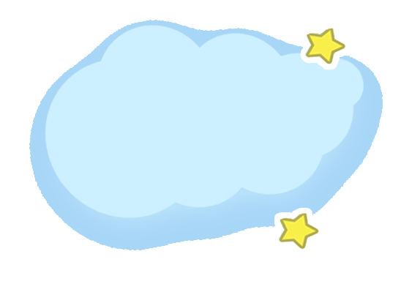

THANKS！

