Slide 1


感恩遇见，相互成就，本课件资料仅供您个人参考、教学使用，严禁自行在网络传播，违者依知识产权法追究法律责任。
更多教学资源请关注
公众号：溯恩英语
知识产权声明

Slide 2

读后续写之“伏笔回收”黄金法则
2025高考冲刺
2025年4月绍兴市高考适应性考试读后续写
海亮实验中学 陈虹

Slide 3
🔍 Find Foreshadowing
Step 1

Slide 4
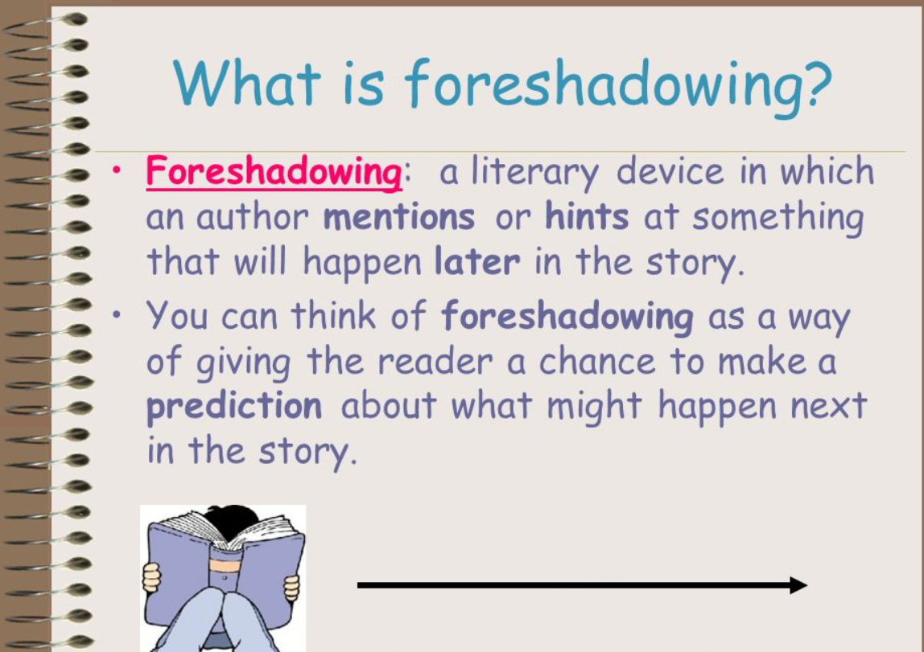
单击此处添加标题
单击此处添加文本
The examiner”s “Hidden Clues”
=
Foreshadowing

Slide 5
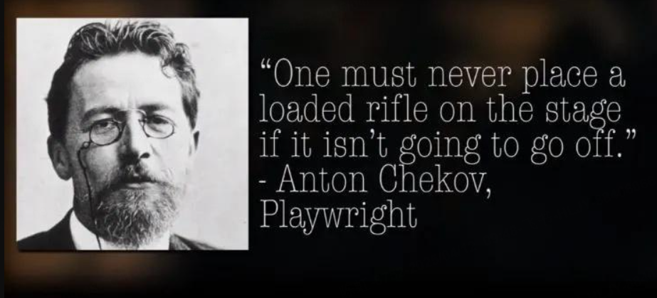
Chekhov’s Gun Theory
Adaptation:
Original details
Recycled in writing
"If there’s a gun in Act 1, it must fire by Act 3."

Slide 6

伏笔回收黄金法则
🔍
找（标出原文伏笔）
♻
收（用合理情节回收）
❤
升（情感共鸣点睛）

Slide 7
阅读下面材料，根据其内容和所给段落开头语续写两段，使之构成一篇完整的短文。
At a local high school in San Francisco.Mr.Adams was well-loved by his pupils.He taught music,something he was passionate about ever since he was a child.
Not all students were fond of playing musical instruments and singing,but because of Mr.Adams'fun and easy lessons,he instantly became every pupil's favorite teacher.He would teach them how to play instruments and have jamming sessions(即兴演奏)with them where they performed the students'favorite songs
“You know,the key to making the kids love your lessons is to make it relatable to them,”he told his fellow teachers."Once you catch their attention,it'llbe easier for them to absorb what you're trying to teach them."
Mr.Adams taught Grade 11 and 12 high school students.Thanks to his fun nature,his students respected him as a teacher but treated him like a friend.They went to him for advice and would hang out with him outside of class to play music and exchange stories.
One day,his students scheduled a day to spend time with him to make the playlist of their upcoming prom.It was such a formal dance that they would spend a lot buying dresses and suits. He was glad to help them and scheduled their session for Friday that week.
However,that Friday,Mr.Adams didn't show up to class for the first time.“I wonder if he's okay,"one student said,worried."He's never been absent before!"
The students waited inside the music room patiently.After a couple of minutes,though,the school director entered the room and said that Mr.Adams would not be returning any time soon.
"I know how much you all love Mr.Adams,so I'm disclosing this information.Last night,a forest fire burned down his house,and he was devastated.He worked hard to put up that house,but he couldn't save it.He was only able to retrieve a few items,but other than that,everything he owned is gone,"she revealed.The news saddened Mr. Adams'students.
注意：(1)续写词数应为150左右；(2)请按如下格式在答题卡的相应位置作答。
Paragraph 1:“We have to help him!”the student council president said._____________
Paragraph 2: When Mr:Adams finally made it to the prom,he was surprised to see everyone in casual wear instead of the formal clothes.____________________

Slide 8


Step 1 🔍 Find Foreshadowing
He taught music, something he was passionate about ever since he was a child.
Establishes music as a core theme and emotional anchor.
He would teach them how to play instruments and have jamming sessions with them.
Mr. Adams’ Profession & Passion for Music

Slide 9
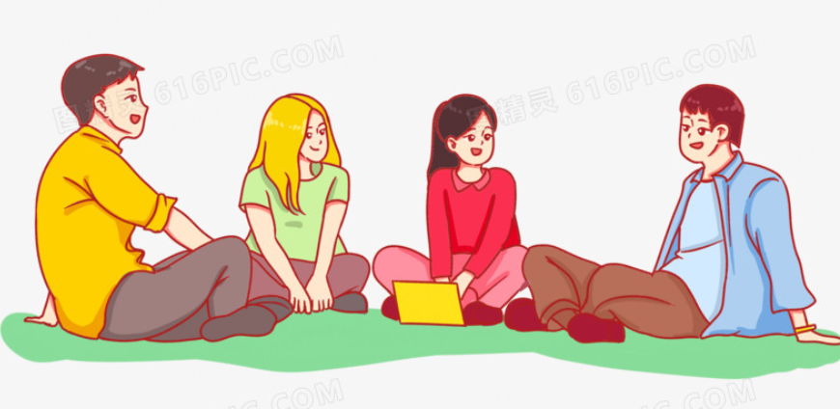
Step 1 🔍 Find Foreshadowing
They performed the students’ favorite songs during jamming sessions.
Highlights the informal, friendly dynamic between Mr. Adams
They hung out with him outside of class to play music and exchange stories.
Jamming Sessions & Student Bonding

Slide 10

Step 1 🔍 Find Foreshadowing
His students scheduled a day to spend with him to make the playlist for their upcoming prom."
Sets up the prom as a key emotional setting.
"t was such a formal dance that they would spend a lot buying dresses and suits.
Prom Playlist Planning

Slide 11

Step 1 🔍 Find Foreshadowing
They would spend a lot buying dresses and suits.
Foreshadows sacrifice (e.g., donating prom funds to help Mr. Adams).
Students’ Financial Donation in Prom

Slide 12
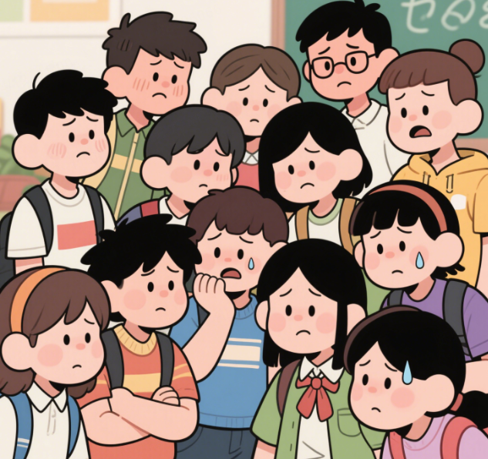
Step 1 🔍 Find Foreshadowing
Mr. Adams didn’t show up to class for the first time.
Lay the groundwork for students’concerns.
He’s never been absent before!
Mr. Adams’ Unexplained Absence

Slide 13
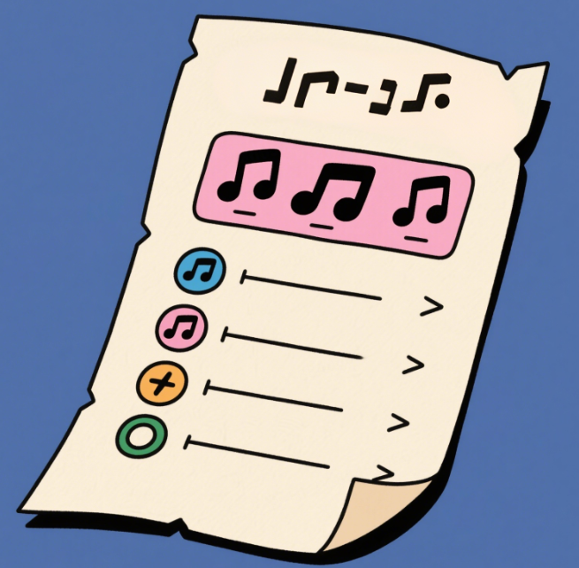
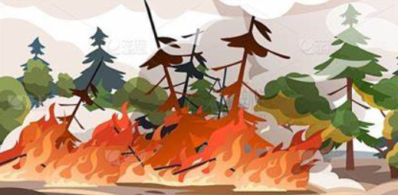
Step 1 🔍 Find Foreshadowing
A forest fire burned down his house... He was only able to retrieve a few items.
Symbolizes loss but also resilience(恢复力) and community support.
Implies sentimental value (could be music-related).
The House Fire & Salvaged Items

Slide 14
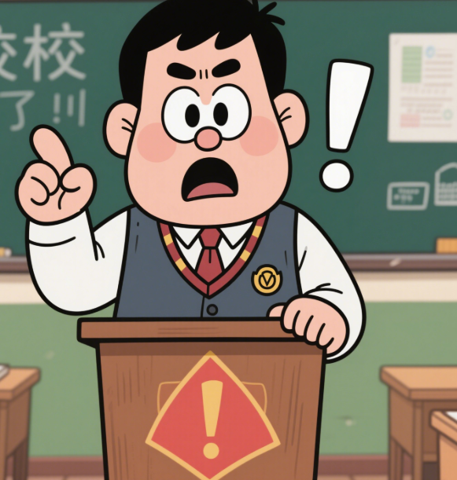
Step 1 🔍 Find Foreshadowing
The school director entered the room and said Mr. Adams would not be returning soon.
Confirms the severity of the situation, justifying student intervention.
The School Director’s Disclosure

Slide 15
Foreshadowing
Purpose
Recycling Method
Music Teacher
Establishes music as central to the story.
Students organize a music-themed fundraiser.
Jamming Sessions
Replay a song from sessions at prom.
Shows bond through music.
拆解所有的伏笔线索，体现了读后续写评分要求中的“细节呼应”原则
Prom Playlist Planning
Dedicate playlist to him or change its theme.
Sets prom as key emotional event.
Prom Clothes Spending
Highlights financial sacrifice potential.
Donate prom funds, wear casual clothes.
House Fire & Items
Suggests sentimental objects survived.
Salvaged item (e.g., guitar pick) as symbol.
Director’s Disclosure
Confirms severity, justifies intervention.
Director helps coordinate student efforts.

Slide 16
♻ Recycle Foreshadowing
Step 2

Slide 17
Music Element Foreshadowing
"He taught music, something he was passionate about ever since he was a child."
❌ Negative Example:
The students raised $5,000 and gave it to Mr. Adams.
Problem:
*Ignores the music elements; replaces emotional connection with a specific solution.
*Fails to use the "music teacher" identity.
✅ Positive Revision:
The student council announced a ‘Rebuild Through Music’ charity concert—entry tickets were photocopies of sheet music from their jamming sessions, with proceeds funding his new home’s reconstruction.

Slide 18
Prom Attire Foreshadowing
"They would spend a lot buying dresses and suits
❌ Negative Example:
The prom proceeded as usual, with everyone wearing glamorous outfits.
✅ Positive Revision:
On prom night, all attendees wore T-shirts printed with “Music & Fire” designs—the saved dress money became a “Music Recovery Fund” check.
Problem:
*Misses the opportunity for sacrifice.
*Disconnects the prom from the fire incident.

Slide 19
Salvaged Items Foreshadowing
"He retrieved only a few items from the fire."
❌ Negative Example:
The students bought Mr. Adams new furniture.
✅ Positive Revision:
The class president held up a charred metal box: ‘Firefighters found this in the wreckage...’ Inside lay the plsylist for the prom, still unfinished.
Problem:
*Replaces sentimental salvage with specific items
*Loses the "survival" symbolism.

Slide 20
Teacher-Student Bond Foreshadowing
"They hung out after class to play music and share stories."
❌ Negative Example:
The school director organized a fundraiser.
Problem:
*Students become passive; authority figure takes over.
*No personal connection shown.
✅ Positive Revision:
After school, familiar melodies drifted from the music room—20 students rehearsed What a Wonderful World, Mr. Adams’ signature jam song. They recorded a video to play on the prom."

Slide 21
错误类型
典型表现
优化方向
无视伏笔
直接捐款/校方出面
用职业特性解决问题（如音乐会）
回收生硬
突兀出现新道具（如新家具）
选择原文提过的物品延伸发展
伏笔回收三不要：不要无视、不要生硬、不要说教
情感直白
大量抒情对话"我们爱你"
用行动和物品传递情感
改变传统形式体现牺牲精神
场景割裂
舞会照常华丽举办

Slide 22
❤ Elevate Emotion
Step 3

Slide 23
将回收的伏笔转化为直击人心的瞬间，最大化情感冲击力
Type 1
具有多重含义的象征物
"He retrieved only a few items from the fire."
Elevated Version:
One student pressed the warped guitar pick into his palm—its edges melted into the shape of a heart. “It was stuck to Wonderwall’s sheet music,”she whispered. “The song you played when I failed my audition.”
Basic Recycling:
Students returned his salvaged guitar pick.
🔥 让物品成为情感载体——结合物理变化与共同记忆
→ Functional
but lacks depth.

Slide 24
Type 2
颠覆预期制造情感爆点
"It was such a formal dance taht ehy would spend a lot buying dresses and suits "
Elevated Version:
The gym doors opened to reveal a “Memory Lane” photo wall—pictures of every jamming session, taped beside burned guitar strings arranged like musical notes. At the center hung a T-shirt with ‘Best Teacher’ glittered across the chest.
Basic Recycling:
Students wore casual clothes to save money.
🎭 打破套路——用非常规致敬方式制造惊喜
→ Logical but predictable.

Slide 25
Type 3
无声行动＞直白对话
"...his students respected him as a teacher but treated him like a friend"
Elevated Version:
All the students crowded forward, and handed over a fat envelope, inside which was the money they had saved from the dance costumes. Their eyes shone with hope as they offered it silently.
Basic Recycling:
They said, ‘We’ll help you rebuild!’
→ Tells emotion directly.
✏用行动替代宣言——角色做什么比说什么更有力

Slide 26
Type 4
环境象征手法
"...a forest fire burned down his house,..."
Elevated Version:
They presented a sapling grown from a surviving oak branch, its pot lined with piano keys. “It’s from the woods behind your house,”said Li. “the fire skipped one tree—just like it skipped you.”
Basic Recycling:
Students planted a tree in his yard.
→ Literal but shallow
🌱 用环境映照情感—自然+艺术=最强象征

Slide 27

Possible versions
Step 4

Slide 28
Version 1
"We have to help him!"the student council president said. Instead of holding music class that day,the school director allowed the students to brainstorm ways they could help Mr.Adams out. After an hour,they concluded that they would not be wearing gowns and suits to prom this year, and instead,they'd go in T-shirts and jeans."Let's pool our budget for gowns and suits together and give the money to Mr.Adams,so he could rebuild his house and purchase essential items."the student council president announced.Everybody agreed to the idea.When the special night finally came,they all arrived at the function in matching T-shirts and jeans.Mr.Adams had yet to arrive, but he was scheduled to go because he couldn't help but fulfill his promise of being their DJ that night.
When Mr.Adams finally made it to the prom,he was surprised to see evervone in casual wear instead of the formal clothes."Did the theme change?"he asked,wearing a suit and tie."No,Mr. Adams,the theme didn't change,but we wanted to do something special for someone dear to us." the student council president said,raising an envelope for Mr.Adams to see.“We're sorry to hear about your house.We hope this amount can somehow help you rebuild what you've lost."she added.Mr.Adams was genuinely surprised and couldn't help but cry.“Thank you,kids.This means so much to me and my family."he said between tears.That night,Mr.Adams made sure to give his students a once-in-a-lifetime prom experience,He blasted all of their favorite songs and watched them happily dance the night away,which was something they did without regret because of the mutual love.

Slide 29
Version 2
"We have to help him!"the student council president said."Let's turn prom into something meaningful," suggested Lisa. Everyone agreed—instead of buying expensive dresses and suits, they would donate the money to help their teacher. The student council decided to keep the dance simple, with homemade decorations and student performances. Some wanted to cancel prom entirely, but most felt they should still celebrate—just differently. Posters went up announcing "Prom for a Purpose." By the night of the dance, the gym was decorated with handwritten notes and photos from music class instead of fancy lights.
When Mr.Adams finally made it to the prom,he was surprised to see evervone in casual wear instead of the formal clothes."We wanted you to have this instead," said Tom, handing him an envelope full of donations. The students explained how they'd sacrificed their prom budget to help him rebuild. Mr. Adams' hands shook as he opened it. Seeing their familiar faces in simple outfits rather than formal wear touched him deeply. "This...this is the most beautiful dance I've ever seen," he whispered. When the music started, students took turns sharing memories from class. In that moment, they weren't just his students—they were family who had turned tragedy into hope.

