Slide 1



感恩遇见，相互成就，本课件资料仅供您个人参考、教学使用，严禁自行在网络传播，违者依知识产权法追究法律责任。
更多教学资源请关注
公众号：溯恩英语
知识产权声明

Slide 2
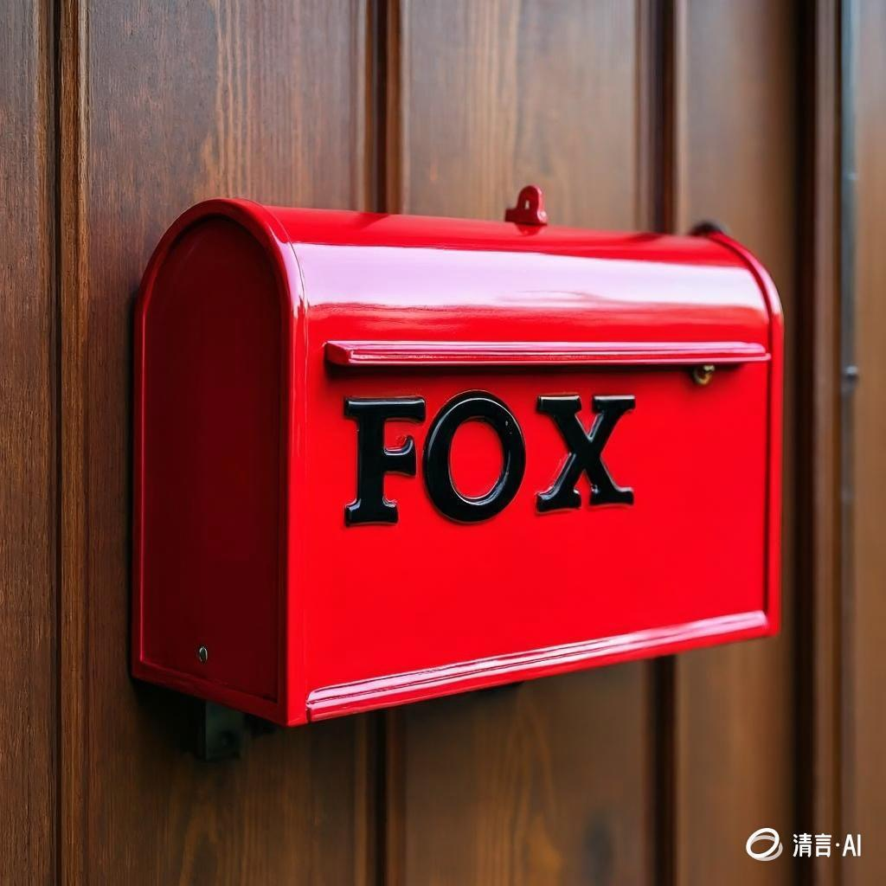
2025-4 金华十校
基于“人与社会 ” 之邻里情“尊老助老善举”篇的读后续写讲评
郑素红

Slide 3
原文本
In the neighborhood, my dad, Mr. Duane, is always referred to as "Collector Duane"， is an enthusiastic collector, who is always on the hunt for old items to repurpose, believing that with a bit of creativity, these forgotten objects can be transformed into something useful and new. Recently, he came across an old bicycle wheel, an old-fashioned metal milk box, an antique lamp, a dirty vase and some old clothes at a flea market, imagining all the possibilities they held.
My parents have a neighbor: Helen Fox. She is a 91-year-old widow(寡妇). My parents along with several other neighbors, look after Helen, ensuring she feels loved and supported.
Helen had long suffered from a problem: her mailbox. For some reason, the mailbox was placed insecurely down a somewhat steep(陡峭的) driveway off a busy highway, making it a daily danger for her to fetch her mail. Besides, it was old and rusty, as if it had suffered multiple violent impacts. Its once-bright red paint had faded to a dull pink. The door hung loosely. creaking(嘎吱作响)with every gust of wind. The letters on it had faded over the years. The 'F' was no longer clear, the O' had lost its shape, and the 'X was almost gone. Helen wanted to replace it with a new one and move it to a new location, but she had no idea where to start.
The minute my dad heard about it, he made it his mission to settle the problem. He began by contacting the local rural mail service, arranging to relocate Helen's mailbox. He also talked with Yancey, their shared rural postman, explaining the upcoming change. A relatively safe place was easy to find. But the real challenge was finding a perfect mailbox.
注意：
1．续与词数应为 150个左石；
2. 请按如下格式在答题卡的相应位置作答。
Para1: Then he remembered the old objects he had recently collected.
Para2: The next day, he showed up at Helen's house with a shiny new mailbox.

Slide 4

Read for information
characters： my Dad ( leading )
Helen Fox ; Yancey ; neighbors ( supporting)
2. narrative perspective: third -person
3. time： one day ( not specific)
place： our neighborhood ( my Dad’s workshop & Helen’s house )
Event : Helen’s old creaky mailbox placed down a steep driveway might pose a risk to Helen and badly needed to be replaced by a new one.

Slide 5


5.story line
Climax
I was inspired by the letter and decided to change my routine , my life and even the world around me.
My Dad decided to settle the problem. A safe place was easy to find but the real challenge was to fnd a perfect mailbox
Para1: Then he remembered the old objects he had recently collected.
Our neighbor, Helen Fox , a 91-year-old widow, had a old and creaking mailbox, which needed to be replaced and relocated
Para2: The next day, he showed up at Helen's house with a shiny new mailbox.
My Dad, “ Collector Duane” always hunted for old items to repurpose and recently came across some old stuff including a metal milk box.
background
Ending
Beginning

Slide 6
Read for clues and echoes
clues | echoes
In the neighborhood, my dad, Mr. Duane, is always referred to as "Collector Duane"， is an enthusiastic collector, who is always on the hunt for old items to repurpose, believing that with a bit of creativity, these forgotten objects can be transformed into something useful and new. Recently, he came across an old bicycle wheel, an old-fashioned metal milk box, an antique lamp, a dirty vase and some old clothes at a flea market, imagining all the possibilities they held.
Suddenly the old-fashioned metal milk box came into sight, which could be transformed to replace Helen’s weathered mailbox.

Slide 7
Read for clues and echoes
clues | echoes
Helen had long suffered from a problem: her mailbox. For some reason, the mailbox was placed insecurely down a somewhat steep(陡峭的) driveway off a busy highway, making it a daily danger for her to fetch her mail. Besides, it was old and rusty, as if it had suffered multiple violent impacts…. Helen wanted to replace it with a new one and move it to a new location, but she had no idea where to start.
2. Dad, with the help of the
rural postman Yancey,
securely installed the
mailbox in a new, safer
location, far away from the
steep driveway.

Slide 8
Read for clues and echoes
clues | echoes
Helen had long suffered from a problem: her mailbox. For some reason, the mailbox was placed insecurely down a somewhat steep(陡峭的) driveway off a busy highway, making it a daily danger for her to fetch her mail. Besides, it was old and rusty, as if it had suffered multiple violent impacts…. Helen wanted to replace it with a new one and move it to a new location, but she had no idea where to start.
3. Dad’s exquisite
craftsmanship breathed new
life into the once- rusty
metal milk container, which
couldn’t wait to embark on
its new journey with Helen
Fox.

Slide 9
clues | echoes
….The 'F' was no longer clear, the O' had lost its shape, and the 'X was almost gone. Helen wanted to replace it with a new one and move it to a new location, but she had no idea where to start.
Read for clues and echoes
4. With three big letters “ FOX’’ written on its front, a perfect mailbox was born/ created/ crafted.

Slide 10
clues | echoes
The minute my dad heard about it, he made it his mission to settle the problem. He began by contacting the local rural mail service, arranging to relocate Helen's mailbox. He also talked with Yancey, their shared rural postman, explaining the upcoming change. A relatively safe place was easy to find. But the real challenge was finding a perfect mailbox.
Read for clues and echoes
5. Staring at the brand new
mailbox, Dad breathed a sigh
of relief, happy to crack the
nut.

Slide 11
心理描写
神态描写
动作描写
外貌描写
环境描写
对话描写
语言
无灵主语
动作链
分词作状语
With 复合结构
独立主格
从句
倒装句
虚拟语气
强调句
长短句结合

Slide 12
Plot the continuation story
Para1: Then he remembered the old objects he had recently collected.
Para2: The next day, he showed up at Helen's house with a shiny new mailbox.
Link1: Which old object did my Dad think about and how did he feel?
Body: What did he do and how? ( steps of transformation of the milk box)
Link2: What was the mailbox like and how did my Dad feel now ?
Link3: How did Helen feel and what did she say?
Body: Where did Dad place it and how?
Ending: ① What does the mailbox demonstrate to readers?
② What lesson did my Dad learn from the experience?

Slide 13

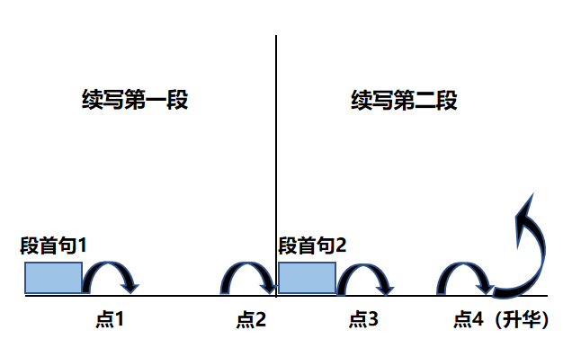
Plot Continuation
点1：位于续写第一段段首，流畅衔接前面的故事（常与原文最后一段呼应）和第一段段首语；
点2：位于续写第一段段尾，流畅衔接第二段段首句；
点3：位于续写第二段段首，续写衔接第二段段首语；
点4：文章结尾升华，给予读者正能量，揭示和强调主题。

Slide 14
Design link1
Para1: Then he remembered the old objects he had recently collected.
Link1A: (describe Dad’s facial expression ) His face lit up as he came up with a good solution.
Link1B: (Dad’s idea） A great idea flashed across his mind. Hardly had he entered the garage when he rummaged through all the old items.

Slide 15
Design link2
Para1: Then he remembered the old objects he had recently collected.
Para2: The next day, he showed up at Helen's house with a shiny new mailbox.
Link2 A: (the final creation of the milk box) With three big letters “ FOX’’ written on its front, a perfect mailbox was born/ created/ crafted. Dad’s exquisite craftsmanship breathed new life into the once- rusty metal milk container, which couldn’t wait to embark on its new journey with Helen Fox.
Link2B: ( Dad’s feeling for his creation）Staring at the brand new mailbox, Dad breathed a sigh of relief, happy to crack the nut.

Slide 16
Design link3
Para2: The next day, he showed up at Helen's house with a shiny new mailbox.
Link3A: ( Helen’s feeling shown through facial expression and eyes） As Helen’s eyes fell on the mailbox, a radiant smile cracked across her wrinkled face. Eyes sparkling with joy mingled with thrill, “ Thank you, Mr. Duane. It’s just incredible!” she exclaimed.
Link3B: ( Dad’s feeling） “ Good morning, Mrs. Fox!” my Dad greeted Helen Fox warmly, eager to find an ideal home for the newly-transformed mailbox.

Slide 17
Design ending
Para2: The next day, he showed up at Helen's house with a shiny new mailbox.
Ending A: (the symbol of the mailbox) From then on, Helen was able to fetch her mail within safe walking distance. The new mailbox not only connected Helen with her loved ones but also served as a silent testament to the care, warmth and kindness of the community.
Ending B: (the meaning of Collector Duane’s hobby) Relieved to free Helen from the potential risk and satisfied with his newly-repurposed masterpiece, “ Collector Duane” resolved to continue hunting for old items to repurpose and lend his helping hand to those in need.

Slide 18
Version 1: “基于彰显社区尊老助老体现关爱温暖善良”之范文赏析：
Para1: Then he remembered the old objects he had recently collected. His face lit up as he came up with a good solution. Hardly had he entered his workshop when he rummaged through all the old items. Suddenly the old-fashioned metal milk box came into sight, which could be transformed to replace Helen’s weathered mailbox. Lips curving into a smile, the project of repurposing the milk box kicked off. Dad cleaned the milk box, sanded off the rust and gave it a fresh coat of bright red paint. With three big letters “ FOX’’ written on its front, a perfect mailbox was born/ created/ crafted. Dad’s exquisite craftsmanship breathed new life into the once- rusty metal milk container, which couldn’t wait to embark on its new journey with Helen Fox. (117)
或者Staring at the brand new mailbox, Dad breathed a sigh of relief, happy to crack the nut.

Slide 19
Para2: The next day, he showed up at Helen's house with a shiny new mailbox. As Helen’s eyes fell on the mailbox, a radiant smile cracked across her wrinkled face. Eyes sparkling with joy mingled with thrill, “ Thank you, Mr. Duane. It’s just incredible!” she exclaimed. Dad, with the help of the rural postman Yancey, securely installed the mailbox in a new, safer location, far away from the steep driveway. Running her trembling fingers across the smooth surface of the mailbox, Helen was choked with tears of gratitude. From then on, Helen was able to fetch her mail within a safe walking distance. The new mailbox not only connected Helen with her loved ones but also served as a silent testament to the care, warmth and kindness of the community. (116)
或者：The creaky old mailbox was gone, but the kindness behind its replacement would last for ever.

Slide 20
Version 2:基于彰显“变废为宝乐于助人的精神且传承该精神”之范文赏析：
Para1: Then he remembered the old objects he had recently collected. A great idea flashed across his mind. Hardly had he entered the garage when he rummaged through all the old items. Suddenly the old-fashioned metal milk box came into sight. Lips curving into a smile, he launched the project of repurposing the milk box. The whole afternoon witnessed him cleaning, sanding, cutting, fixing and painting. Deeply touched by Dad’s dedication and innovation, I volunteered to join him, offering to write three big letters “ FOX’’ on its front. When night fell, the once-discarded rusty metal milk box, with our joint efforts, was transformed into a shining red mailbox, ready to serve Helen. (102)

Slide 21
Para2: The next day, he showed up at Helen's house with a shiny new mailbox. “ Good morning, Mrs. Fox!” my Dad greeted Helen Fox warmly, eager to find an ideal home for the newly-transformed mailbox. Dad, together with some neighbors, decided to place the mailbox in the front door porch, which was within a walking distance to fetch her mails. Admiring the bright red mailbox, Helen Fox was overwhelmed with the joy of being seen and cherished by the community, murmuring thanks to Dad. Relieved to free Helen from the potential risk and satisfied with his newly-repurposed masterpiece,” Collector Duane” resolved to continue hunting for old items to repurpose and lend his helping hands to those in need. (106)

Slide 22


