Slide 1


感恩遇见，相互成就，本课件资料仅供您个人参考、教学使用，严禁自行在网络传播，违者依知识产权法追究法律责任。
更多教学资源请关注
公众号：溯恩英语
知识产权声明

Slide 2

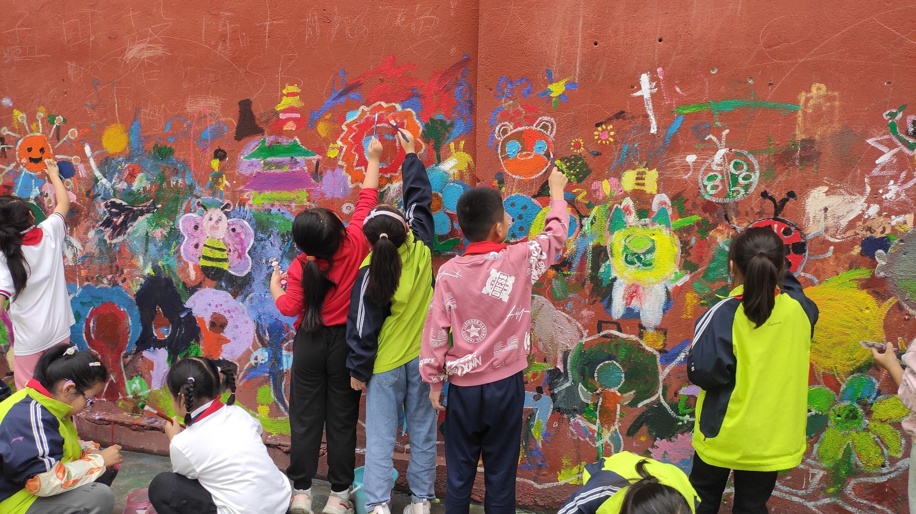
Should We Establish a Graffiti Wall?
2025.4嘉兴市高三英语测试 应用文分析
北师大嘉兴附中 吴晨华

Slide 3


01
审题与谋篇布局
02
分段构写
03
参考范文+下水范文
04
应用文题型拓展
05

Slide 4


01.审题与谋篇布局
主题
01
你校英文报“Campus Culture”栏目正在开展关于是否设立涂鸦墙（graffiti wall）的讨论，请你写一篇短文投稿，内容包括：
（1）你的见解；（2）你的建议。
话题类型：校园文化（自由表达+管理规范）
体 裁：观点类议论文+建议
语 气：沟通（投稿）
分段要点及内容
隐藏要点
思考：
在文章的哪里提出“你的见解”？
“你的见解”可以是中立吗？要既写好处又写弊端吗？
“你的建议”是文章主体部分吗？
建议与观点有没有逻辑关系？如果观点是负面的，如何建议？
考场上如何处理正方和反方观点？
什么句式又实用，又能增强语气和感染力？
Para.1
Para.2
Para.3
+ reasons
background + opinion
suggestions + reasons
summary +restate your opinion

Slide 5
02.分段构写
P1. 引出背景+明确观点
01
直接引出话题+直接表达观点
客观陈述背景+直接表达观点+引起下文
对比引出话题+委婉表达否定（让步状从）
鼓动性提出观点（祈使句）
When it comes to ______, people have taken/adopted different attitudes/opinions are divided. As far as I am concerned /From my perspective, I prefer _____based on the following reasons.
When it comes to/ In terms of…, I firmly believe/ I’m firmly convinced that it makes great sense/ it is of great significance.
Currently/Recently, there is a widespread/ growing concern over (the issue/phenomenon that …/heated discussion on (讨论议题). Personally, the answer is yes/no. Here are my reasons/ Reasons are as follows.
Recently the rise in the problem/phenomenon of...has caused /aroused/captured public/ popular/ wide/ worldwide concern. I believe/I hold the view (belief) that…/it makes great sense/ it is of great significance.
Beneficial and rewarding as it is, it would be unwise to …
Imagine working out every day, feeling refreshed and satisfied
Grab a sprayer, and color the Graffiti Wall.

Slide 6
02.分段构写
P1. 引出背景+明确观点
+列出理由
01
语料1：“设立涂鸦墙”的好处
一个展示创意的平台/作为一个创意的发泄途径
一种表达学生自我的方式
缓解学术压力
逃离学业奋斗
美化校园
用色彩和声音丰富校园文化
鼓励积极交流
a platform to showcase creativity/ serve as a creative outlet
a way to express students themselves
relieve academic pressure/
an escape /getaway from academic struggles
beautify the campus
enrich campus culture with colors and voices
encourage positive communication
语料2：“设立涂鸦墙”的弊端
pose a risk of introducing/ spreading offensive or harmful content
damage other school property/lead to potential damage
influence the harmony of school
lead to a loss of concentration on study
occupy some extra time
有引入/传播冒犯性或有害内容的风险
损坏学校其他财产/造成潜在损失
影响学校的和谐
导致学习时注意力不集中
占用一些额外的时间

Slide 7
02.分段构写
P1. 引出背景+明确观点
+ 列出理由
01
直接引出话题+直接表达观点
客观陈述背景+直接表达观点+引起下文
当谈到学校是否应该建立涂鸦墙时，我坚定地认为这是很有意义的。涂鸦墙通常包含各种风格的绘画和留言，它可以成为学生展示艺术才华的活力平台，或是帮助他们将压力转化为多彩设计的宣泄途径。 （主句+which从句并列）
When it comes to/ In terms of whether we should establish a Graffiti Wall , I firmly believe/ I’m firmly convinced that it makes great sense/ it is of great significance.
A graffiti wall usually contains various styles of paintings and messages, which could serve as a dynamic platform for students to showcase their artistic talents, or an outlet that helps them transform pressures into colorful designs.
最近，关于是否要建校园涂鸦墙的讨论引起广泛关注。从我的角度来看，答案是肯定的。学校里的涂鸦墙不仅能够可以成为学生自由表达的平台，而且（成为）从学业压力中解脱的途径，保障学生的心理健康。（主句并列+doing 后缀)
Recently a heated discussion on whether we should establish a Graffiti Wall has caused /aroused/captured popular/wide concern. From my perspective/standpoint, the answer is yes/no. A graffiti wall in school would not only serve as a platform for the students to express themselves freely, but also an escape from academic struggles, safeguarding their mental health .

Slide 8
02.分段构写
P1. 引出背景+明确观点
+列出理由
01
对比引出话题+委婉表达否定（让步状从）+ 理由
鼓动性提出观点（肯定）+ 理由
虽然在校园里设立涂鸦墙这个想法可能很有吸引力，但我认为这不是最佳选择/不是一个明智的选择。
While/Though/Although the idea of establishing a graffiti wall on campus may seem appealing, I believe it is not the best choice.
Appealing and popular as it is, it would be unwise/might not be a wise choice to establish a graffiti wall on campus.
涂鸦，即使本意是作为艺术，可能会出现冒犯他人的不当内容。此外，它还可能会促使学生在其他学校财物上作画，从而造成潜在破坏。
Graffiti, even intended as art, could lead to inappropriate messages offending others. It may also encourage students to paint on other school property, leading to potential damage and influence the beauty of campus .
1. 拿起喷漆，为涂鸦墙添彩，这不仅是一项活动，更是点燃学生热爱艺术和生活热情的重要一课。虽然这可能会占用一些额外时间，但它肯定会激发我们的想象力，并在长时间的学习过程中充当缓解压力的好帮手。
Grab a sprayer, and color the Graffiti Wall. It’s not just an activity, but a vital lesson to ignite students’ passion for embracing art and life. Though it may occupy some extra time, it will definitely kindle our imagination, and serve as a stress - reliever during our study marathons.
2.想象一下，你拿起画笔，在画布上快速挥动，（在上面）自由地表达他们的创造力和多样的观点，为原本单调的校园角落注入生机。
Imagine yourself grabbing a brush, waving it swiftly on the canvas, where you can freely express your creativity and diverse perspectives, breathing life into otherwise dull and boring campus corners.

Slide 9
02.分段构写
P2. 建议+理由
01
语料1：利用好衔接词: firstly, secondly, moreover, additionally...增强条理性
使用which非限定从和非谓语结构连词成句
常用表达：
Firstly, considering /given that…，主句.... ; What' s more/Additionally, not only......, but also…
中间拓展部分，常用which定语从句/ allowing sb. to do/ making it possible for sb. to do/ leading to/ contributing to/to do 等表达
关于“建议”：1）I suggest doing sth. 2）I strongly recommend that/ It’s strongly recommended that...
3）Doing sth. is a must 4） Why not…? 5）Were I you, I would …

Slide 10
02.分段构写
P2. 建议+理由
01
语料2 关于涂鸦墙建议的内容 + 原因（目的或结果）
组织 lay down some basic guidelines to prevent the use of impolite or negative words.
set restrictions to prevent the destruction of others’ graffiti
create a rotating display system giving students more opportunities to showcase their work.
内容 establish a clear content guideline to advocate a healthy campus culture
choose positive and inspiring themes to ensure both creativity and order
encourage positive content and prohibit
impolite words and patterns to create a healthy environment
avoid bullying, verbal fights, and disrespect to others to maximize the pros while minimize the cons .
场地 appeal to students to keep the graffiti area clean to beautify our campus.
be positioned near the canteen to create whole – heartedly.
时间 set specific time limits for graffiti creation to maintain order.
创意激发 combine different art forms allowing students to express ideas in a more positive and controlled way.
(where new artworks replace older ones monthly)
(where students have ample free time and a relaxed mind)

Slide 11
02.分段构写
P2. 建议+理由
01
1. 为确保涂鸦墙能良好运作，我建议我们学校制定一些基本准则。例如，我们可以为墙的不同区域设定指定主题。此外，应鼓励积极的内容，比如励志名言和令人振奋的艺术作品，以倡导健康的校园文化。
To ensure the graffiti wall functions well, I suggest our school lay down some basic guidelines. For instance, we could have designated themes for different sections of the wall. Furthermore, positive content, such as motivational quotes and uplifting artworks, should be encouraged to advocate a healthy campus culture.
2. 我建议将其设置在食堂附近，学生在那里有充足的空闲时间，心情放松，能够全身心投入创作。 同时，学校应该制定一些 规则，避免欺凌、言语冲突和对他人的不尊重。
I recommend that it be positioned near the canteen, where students have ample free time and a relaxed mind to create whole–heartedly. Meanwhile, it would be better for the school to lay down some rules to avoid bullying, verbal fights, and disrespect to others.
3.要建立一个美丽和健康的涂鸦墙，最好能制定一套明确的内容指导方针，由教师和学生代表共同制定，强调积极的主题，同时允许艺术创作上的灵活性。同样重要的是设定限制措施，防止他人的涂鸦被破坏，以及禁止使用不文明或负面的文字。
To establish a beautiful and healthy graffiti wall, it’s better to establish a clear content guideline, co-created by teachers and student representatives, emphasizing positive themes while allowing artistic flexibility. Equally important is setting restrictions to prevent the destruction of others’ graffiti and the use of impolite or negative words.

Slide 12
02.分段构写
P3. 重申观点
01
1. Hence/Accordingly/ In conclusion/To sum up, 再次阐明个人观点, which +意义(not only… but also…)
2. To sum up/In a word, we should….. Only in this way/through... can we …
+表结果：therefore, thus, as a result, so (that), consequently
1. 总之，通过精心设计和合适的策划，涂鸦墙一定会成为我们翱翔天际的艺术地标。
In conclusion, with careful design and proper plan, the graffiti wall is bound to be an artistic landmark where we soar into the sky.
2. 总之，建立涂鸦墙不仅能够激发创造力，而且能够丰富校园生活。让我们把它变成现实。
To sum up, not only does establishing a graffiti wall fuel creativity, but also it enriches campus life. Let's make it happen.
3. 希望，一旦这些问题得到解决，涂鸦墙的建立能为我们学校注入新的活力，成为我们丰富多彩、美好的青春的一个充满活力的地标。
Hopefully, the establishment of the graffiti wall will breathe new life into our school once the problems are solved, serving as a vibrant landmark of our dynamic and beautiful youth.

Slide 13
03.参考范文
01
Should We Establish a Graffiti Wall?
Establishing a graffiti wall on campus would be a fantastic idea. A graffiti wall usually contains various styles of paintings and messages. It could serve as a dynamic platform for students to showcase their artistic talents, or an outlet that helps them transform pressures into colorful designs.
To ensure the graffiti wall functions well, I suggest our school lay down some basic guidelines. For instance, we could have designated themes for different sections of the wall. Furthermore, positive content, such as motivational quotes and uplifting artworks, should be encouraged to advocate a healthy campus culture.

Slide 14
03.参考范文
01
Should We Establish a Graffiti Wall?
While the idea of establishing a graffiti wall on campus may seem appealing, I believe it is not the best choice. Graffiti, even when intended as art, could lead to inappropriate messages offending others. It may also encourage students to paint on other school property, leading to potential damage.
I suggest creating an art zone where students display pre-approved artworks, ensuring both creativity and order. Alternatively, organizing teacher-guided collaborative art projects, like painting on large canvases, could channel students’ energy into structured creations. These alternatives balance freedom and responsibility, fostering a vibrant yet orderly campus culture.

Slide 15
03. 下水范文
01
Should We Establish a Graffiti Wall?
Grab a sprayer, and color the Graffiti Wall. It’s not just an activity, but a vital lesson to ignite students’ passion for embracing art and life. Though it may occupy some extra time, it will definitely kindle our imagination, and serve as a stress-reliever during our study marathons.
To establish a beautiful and healthy graffiti wall, it’s better to establish a clear content guideline, co-created by teachers and student representatives, emphasizing positive themes while allowing artistic flexibility. Equally important is setting restrictions to prevent the destruction of others’ graffiti and the use of impolite or negative words, avoiding bullying, verbal fights, and disrespect to others.
To sum up, not only does establishing a graffiti wall fuel creativity, but also it enriches campus life. Let's make it happen.

Slide 16
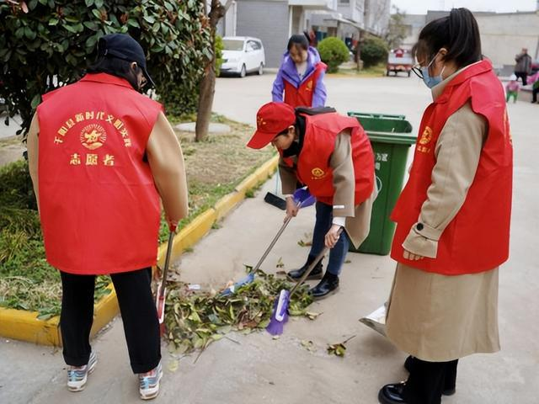
04.应用文题型拓展
01
（2025.3温州二模）
假定你是高中生李华，你校英语报正在开展关于“社区服务是否该列入毕业条件”的讨论，请你写一篇文章投稿，内容包括：
(1)你的观点；(2)你的理由

Slide 17
04.应用文题型拓展
When it comes to/ In terms of whether students should be required to complete community service to graduate, I firmly believe/ I’m firmly convinced that it makes great sense/ it is of great significance.
Firstly, community service offers students an opportunity to volunteer at homeless shelters or assist in nursing homes, which can raise their awareness of helping people in need, cultivate their empathy and foster their sense of social responsibility, aligning with educational goals. Additionally, activities in community service, such as organizing charity events or tutoring students, help students develop problem-solving abilities, interpersonal skills, and teamwork skills, paving the way for better social integration and career advancement.
In conclusion, making community service a graduation requirement better prepares us for life beyond high school, equipping us with skills and values, which will serve us well into the future.

Slide 18
04.应用文题型拓展
Beneficial and rewarding as it is, it would be unwise to make community service to a compulsory graduation requirement.
Making community service a requirement for graduation adds unnecessary academic pressure.
Struggling to balance exams, study and personal life, the students may find it more challenging to finish the community service, potentially harming their academic grades. True community contribution requires enthusiasm, rather than forced participation under pressure.
Therefore, schools should inspire students to get involved in community service instead of forcing them to participate. Only in this way will students be more likely to engage in community service, creating a more meaningful and lasting impact.

Slide 19



Thanks for your attention

