Slide 1


感恩遇见，相互成就，本课件资料仅供您个人参考、教学使用，严禁自行在网络传播，违者依知识产权法追究法律责任。
更多教学资源请关注
公众号：溯恩英语
知识产权声明

Slide 2
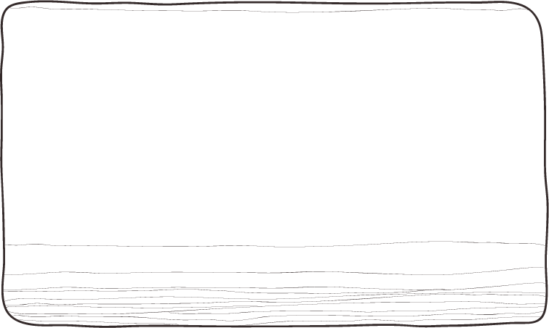
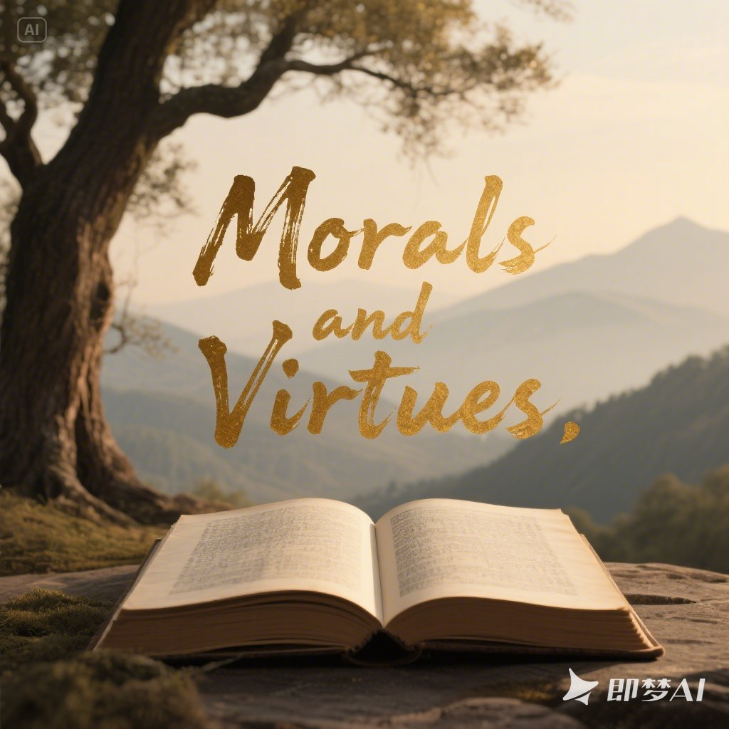
Unit 2 Morals and Virtues
Write a Review

Slide 3
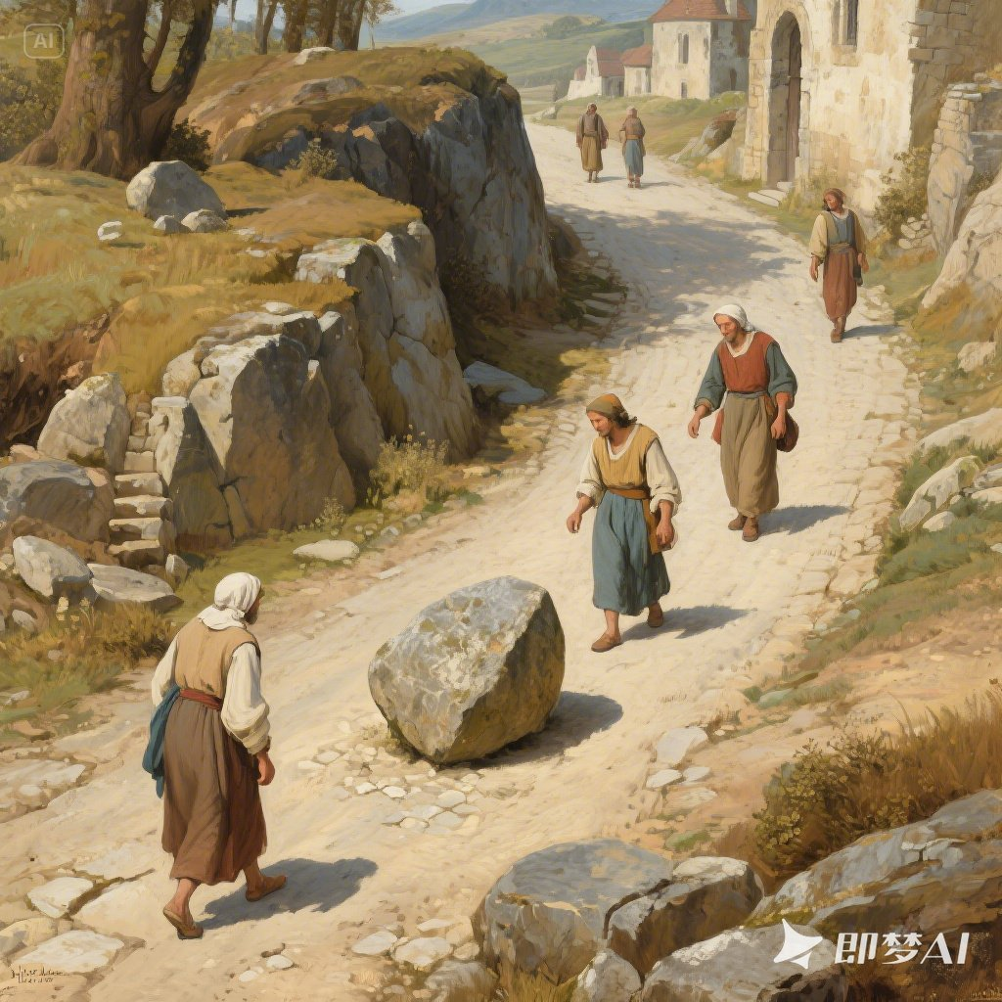
View and predict
The Stone in the Road
What questions come to your mind?
A fable
A biography
A short story
A guide book
a traditional short story that teaches a moral lesson
The genre of the text
when, where, who, what, why, how

Slide 4
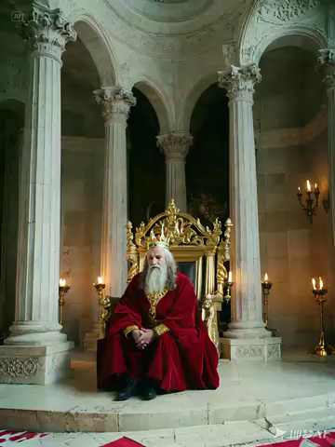
A king
Nothing good can come to a nation whose people only complain and expect others to solve their problem.
What did the king want to do?
He intended to teach his subjects a moral lesson.

Slide 5
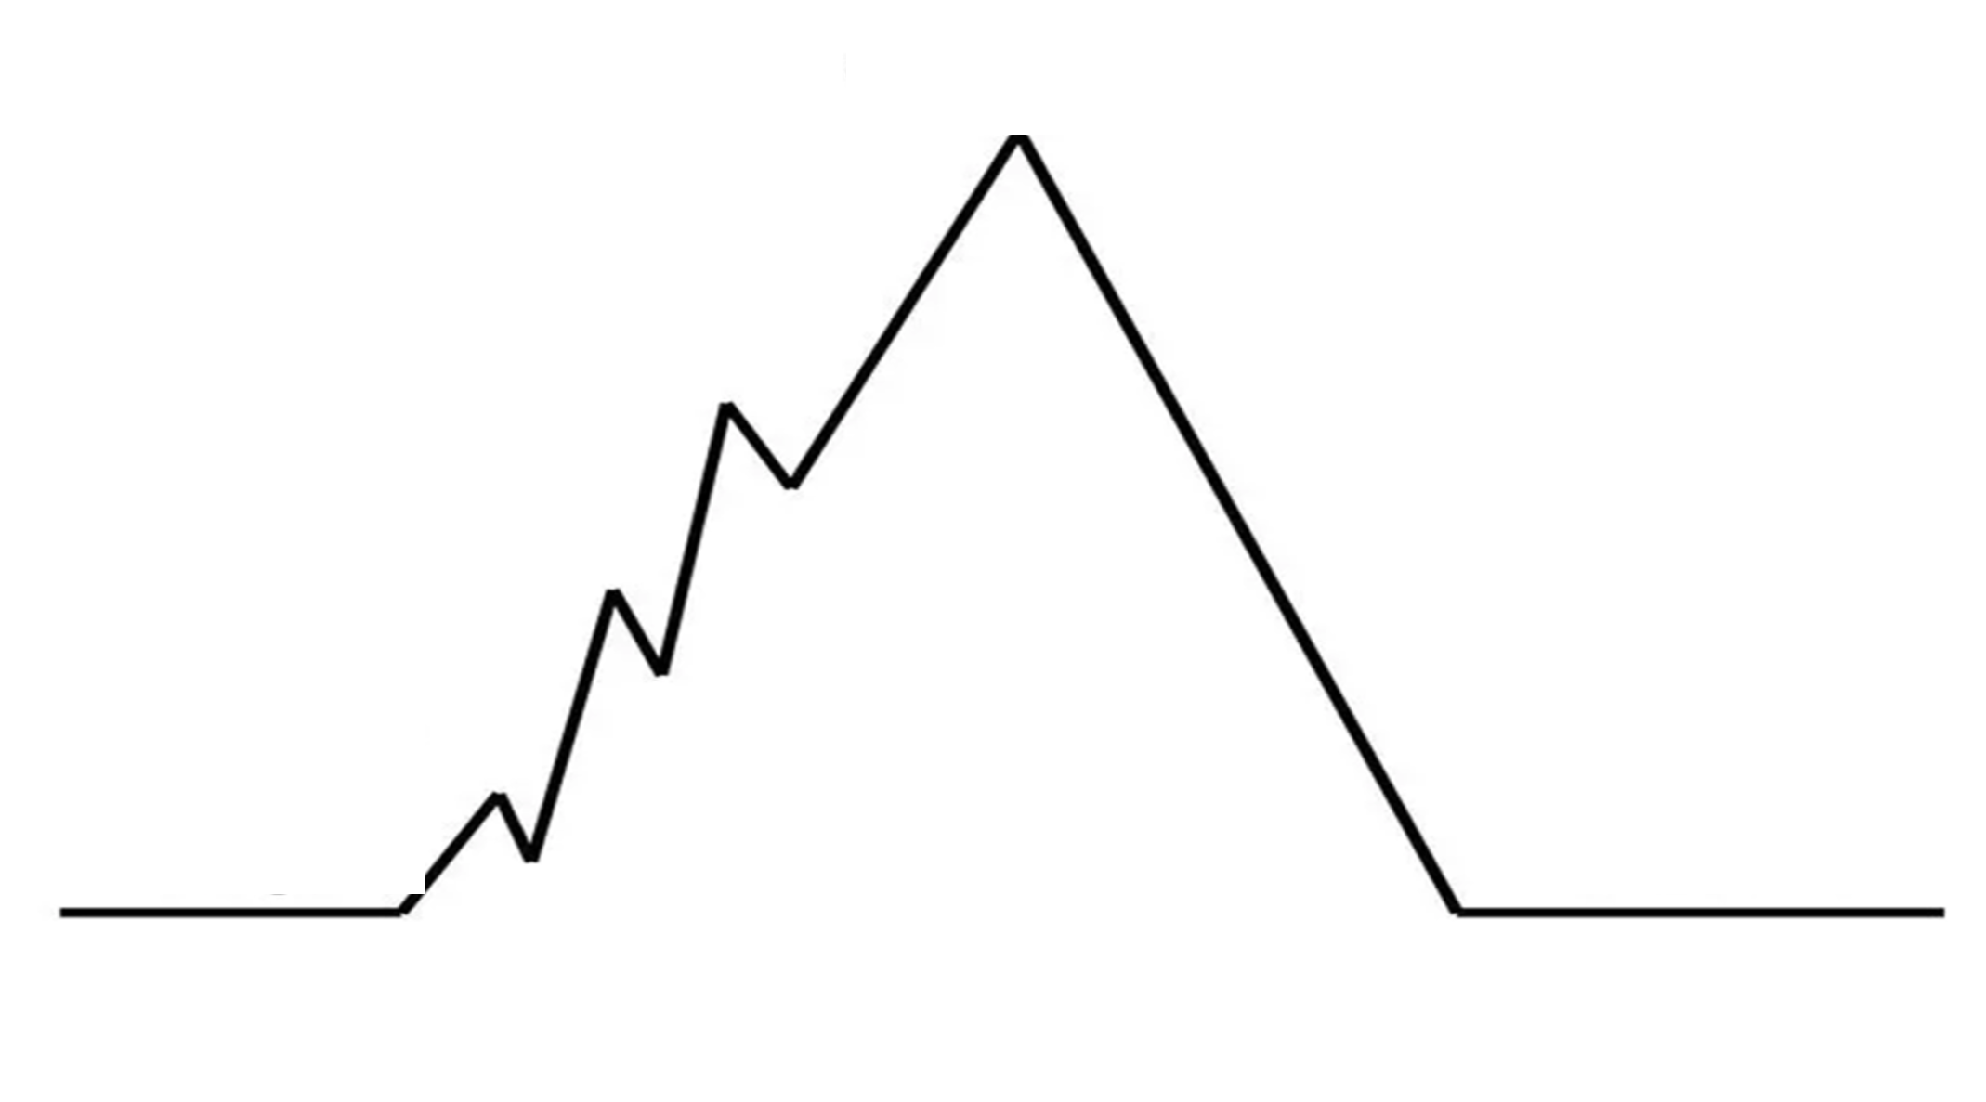
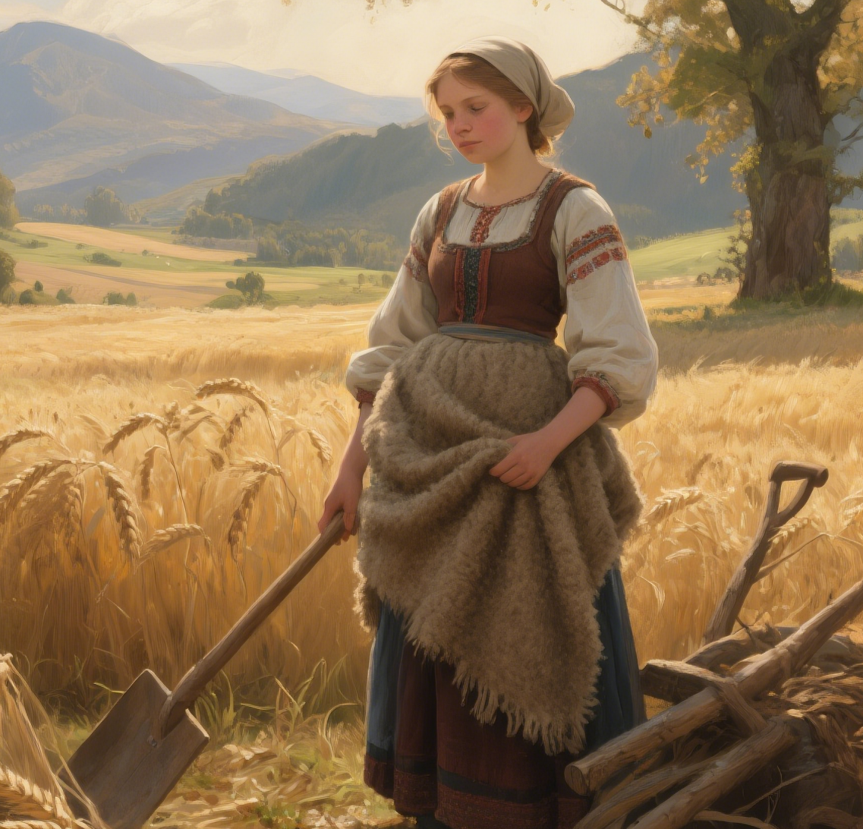
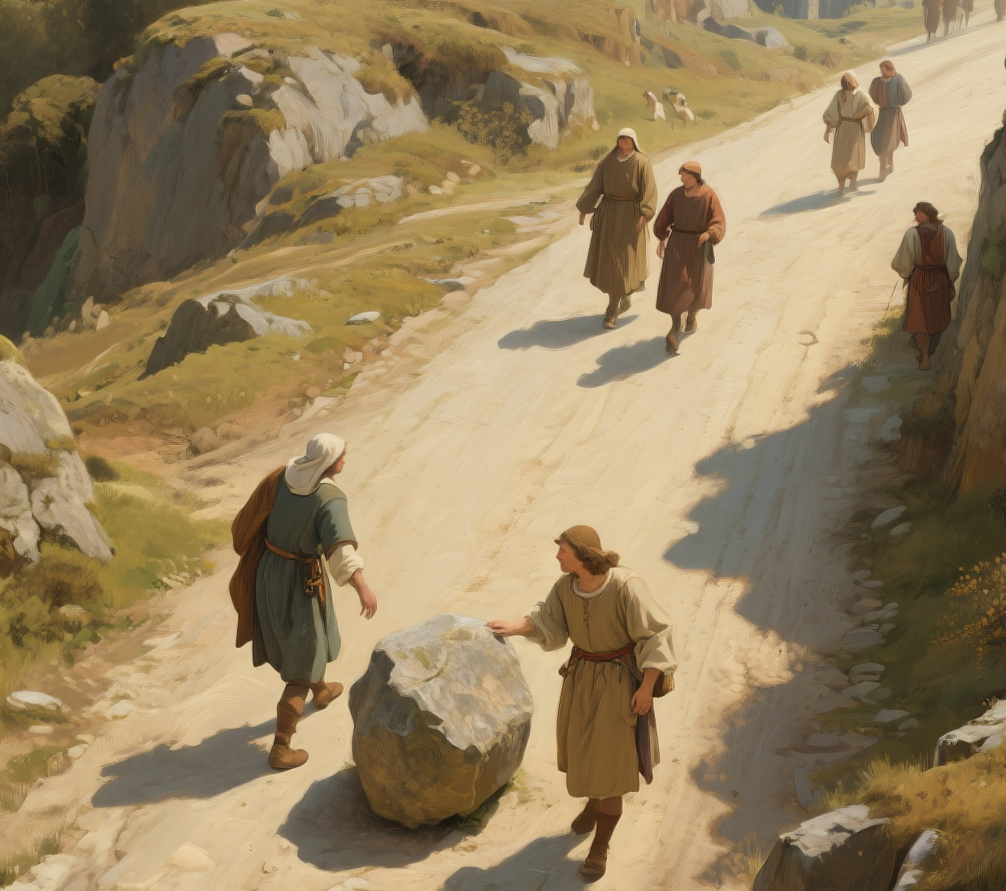
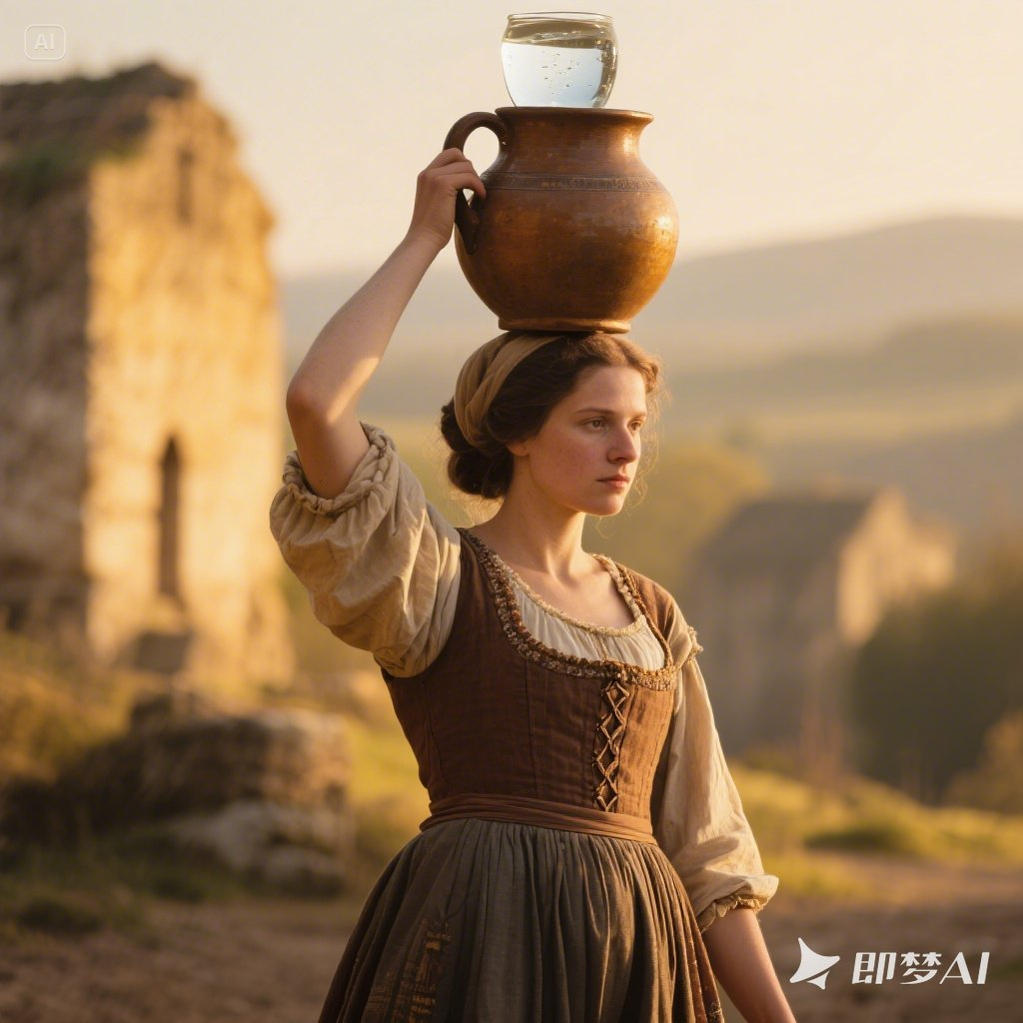
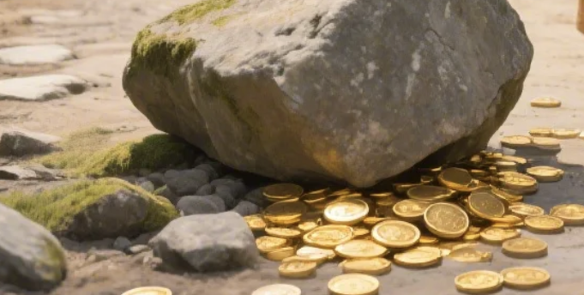
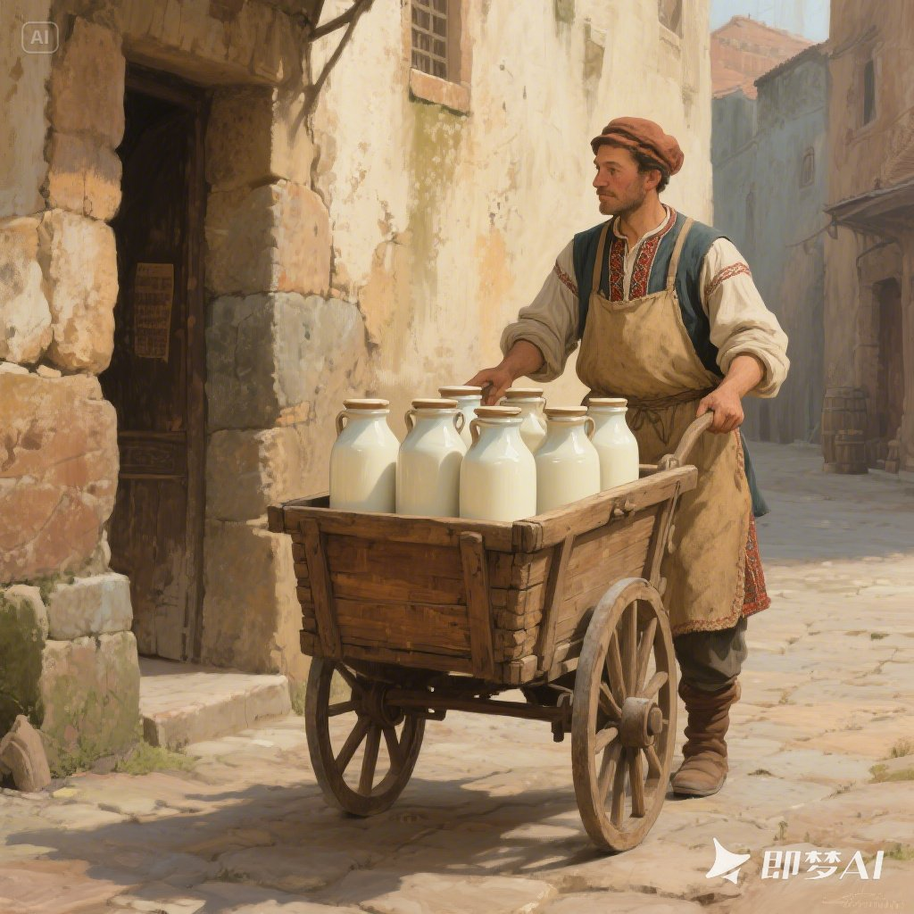
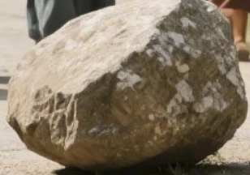
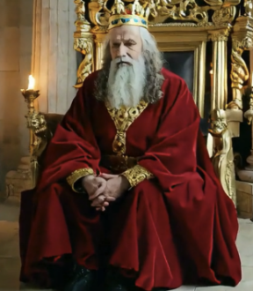
Read and summarize
*pushed the stone with her own m________
*s________ in m_______ it to the side of the street.
ight
ucceeded
oving
omplained
*c___________ about the stone
*made no a________ to move it
ttempt
ired
t_____and s_________
urprised
wanted to find the o_______ of the gold coins
ripped over
*t____________the stone
*l____________ in t_______
pset
imped away
u________
wner
ears
ad
s________
rashed
*c_________ into the stone and shouted
*p______________
and went away
ngry
icked himself up
a________
gave the gold to the girl as a reward for her deed.
p______a stone in the street, h______ gold coins and w_______
laced
id
atched
p________
roud

Slide 6
A short description of the story
A king placed a stone in a village road, hiding gold beneath it, to test his people. Many villagers complained about the obstacle but did nothing. Finally, a tired farmer’s daughter moved it aside, finding the coins. The king rewarded her, declaring her the only one who took responsibility instead of blaming others. (55 w)
One sample

Slide 7
Analyze and reflect
difficulties
challenges
What does “stone” refer to in life?
What kind of people do “milkman”, “woman” and “villagers” refer to in life?
passive, indifferent

Slide 8
responsible positive caring
What kind of people does “the girl” refer to in life?
Do you think the King in the story wise? why or why not?
I don’t think that the king was very wise, however, because no one learnt anything from his test. The milkman, the woman with her water pot, and the other villagers continued on their travels without having changed their attitudes at all. The king did find one responsible young girl, but she was already a responsible person before she encountered the stone in the road.
Yes | No
I think the king was wise, because…
I don’t think that the king was very wise, however, because…

Slide 9

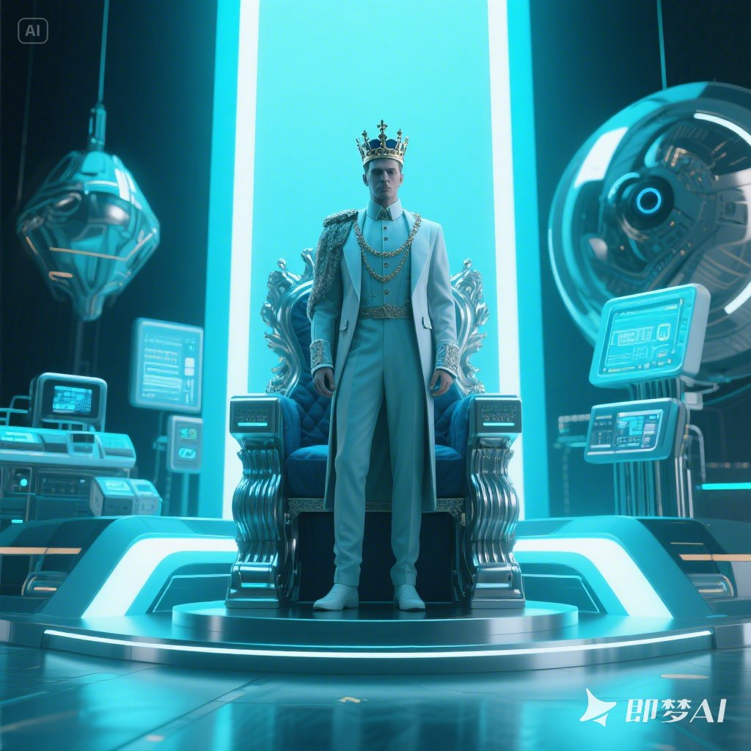

If you were a 21st-century king, what would you do to
teach your subjects a moral lesson?
A civic app
Road Hazzard Alert
hazard n. /ˈhæzəd/n. sth that cause damager）
alert n. /əˈlɜːt/ a warning of danger
The physical stone
gold coins
community credits (praises)
post the story of kindness on social
media
real-world injury
tracking who complains vs. acts via data analytics
Modern leadership isn’t about testing people, but empowering them.

Slide 10
Would you like to recommend this story to others? Why or why not?
I would certainly recommend this story to others, as …
Maybe I wouldn’t recommend this story to others, as …
Sample
I would certainly recommend this story to others, because it teaches timeless lessons in a simple yet powerful way. Its strength lies in how relatable the situation is—everyone has encountered a “stone” (a problem) and faced the choice to either complain or act.

Slide 11
Write a review
A short passage to give your opinion on a story
A fable review
give a short description of the writing
state your opinion and reasons clearly
Part 1
Basic information
title
type
main idea
Part 2
Story analysis
details
purpose
result
Part 3
Your opinion
like or not
reasons
recommend
or not

Slide 12
Checklist for Evaluation
Items | Stars | Criteria (标准)
Does the writer give a short description of the story? |  | 5★=Excellent 4★=Good 3★= Acceptable 2★=Needs Improvement
Does the description include the most important details of the story?
Does the writer give his/her opinion about the story?
Is the review well-organized?
Does the writer use the -ing as the adverbial in the review?
Are there any grammar, spelling, or punctuation errors?

Slide 13
Sample Writing
“The Stone in the Road” is a classic fable about a king who, believing his people are lazy, decides to test them by placing a large stone in the middle of a road. Hiding nearby, he observes as many passers-by simply walk around the obstacle, complaining about it but doing nothing. Finally, a young girl stops, struggling to push the stone aside, and discovers gold coins hidden by the king as a reward for his diligence (/ˈdɪlɪdʒəns/勤奋).
The author effectively uses this simple story to emphasize the importance of taking personal responsibility. Highlighting the indifference of most citizens, the fable contrasts their inaction with the girl’s willingness to solve a shared problem, reinforcing (/ˌriːɪnˈfɔːs/使...更强烈) its moral clearly.
While the message is meaningful, I find the king’s method questionable. Pretending to test his people, he never actually teaches them a lesson—only the reader learns from the girl’s example. Lacking character growth, the story feels more like a passive observation than a transformative (变化的) experience. Therefore, though the moral is valuable, I believe there are more engaging(interesting) tales that inspire responsibility through direct lessons rather than hidden tests.

Slide 14
Language study

Slide 15
1.指望别人解决他们的问题
2.乔装打扮
3. 撞上石头
4. 从地上爬起来
5. 被石头绊倒
6.一瘸一拐的走来
7.含着眼泪
8.尝试着做…
9.陷入绝望
10.让邻居免遭不测
11.从路上挪开它
12.使出全身力气
13.费了好大一番功夫
14.从树后面走出来
1.expect others to solve their problems
2. disguise oneself
3. crash into the stone
4. pick oneself up
5. trip over the stone
6. limp away
7. in tears
8. make an attempt to do sth.
9. in despair
10. keep their neighbors from harm
11. move it out of the way/road
12. with all one’s might
13. after a great deal of effort
14. step out from behind the tree

Slide 16
spilling
1. He ________ into the stone, _________ (spill) the milk everywhere.
crashed
-ing短语做结果状语
spill—spilled/spilt— spilled/spilt—spilling v.
to flow over the edge of a container by accident; to make liquid do this
（使）洒出，泼出，溢出
覆水难收。
It’s no use crying over spilt milk.
2) He opened the curtains, letting the morning light spill into the room.
2. pick oneself up: to stand up again after you have fallen
（跌倒后）爬起来
他爬起来继续跑。
He just picked himself up and went on running.

Slide 17
3. After a while, a group of women came along,
each _________(balance) a pot of water on her head.
balancing
独立主格结构作伴随状语
每个人头上都顶着一罐水
After a while, a group of women came along, and
each balanced a pot of water on her head.
balance v. to put your body or something else into a position where it is steady and does not fall 使（在某物上）保持平衡；立稳
After a while, a group of women came along, _________ (balance) pots of water on their heads.
balancing

Slide 18
4. The girl pushed the stone with all her might.
great strength, energy or power
强大力量；威力

Slide 19
5. After a great deal of effort, she finally succeeded _______ moving it toe the side of the street.
in
a great/good deal of+ 不可数名词= much
All of these people gave me a great deal of information I had never heard of.
a great/good deal = much/a lot 作状语，修饰动词或比较级
We can learn a great deal from each other.
effort 1) u.n
2) c.n

Slide 20
6. 几个从句
1） Nothing good can come to a nation _______ people only complain and expect others to solve their problems.
whose
先行词nation在从句中作定语
=the nation’s people
2) This stone is a danger to anyone______ comes down the street after dark.
who
定语从句，先行词为代词anyone, those，关系词只能用who指人

Slide 21
3) A. He hid gold coins under the stone.
B. Imagine her surprise when she saw the gold coins _______ the stone had been.
where
where 引导地点状语从句，做状语
After the war, a new school was put up in the town.
After the war, a new school was put up _______ there had once been a theatre.
where
I have kept the pictures on the wall of the bedroom.
I have kept the pictures _______ I can see it every day.
where

