Slide 1



感恩遇见，相互成就，本课件资料仅供您个人参考、教学使用，严禁自行在网络传播，违者依知识产权法追究法律责任。
更多教学资源请关注
公众号：溯恩英语
知识产权声明

Slide 2
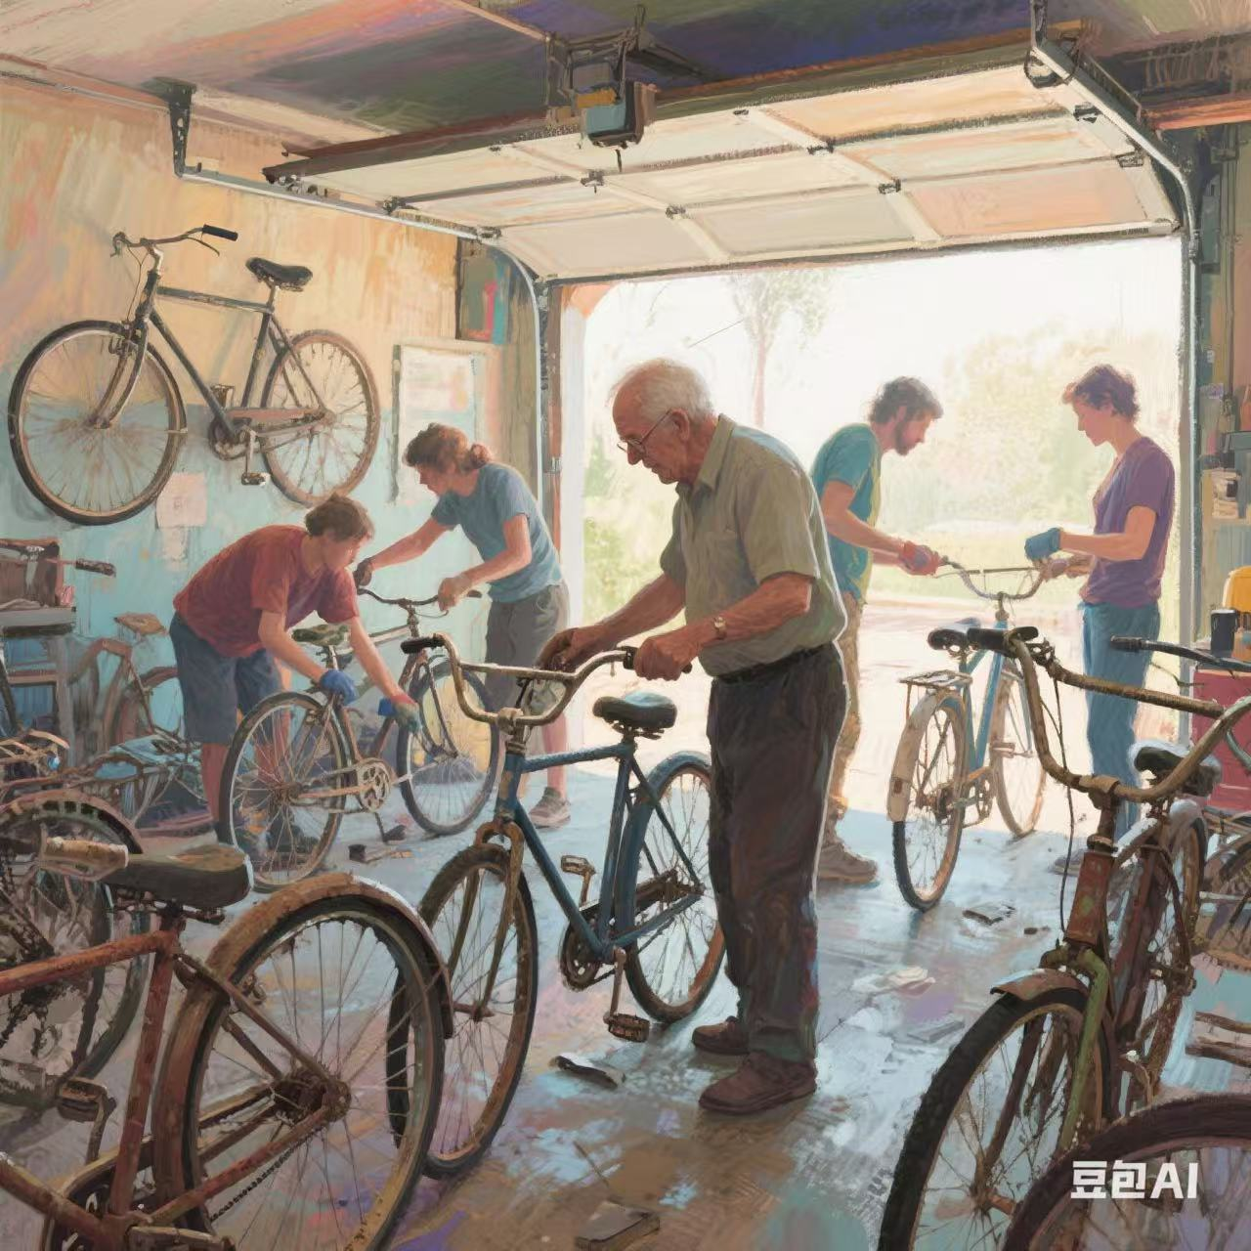

2025-4 台州二模
基于“人与社会 ” 之邻里情“助人善举”篇的读后续写讲评
郑素红

Slide 3
原文本
Harry Caine retired from a local power company. After his retirement, he just wanted to do something for his community. One day, he spotted many abandoned bikes, which were gathering dust in the neighbouring garages. "Why not fix them up and give them to those needy?" he thought. So he posted to an online group in his Alaska Homer, offering to fix people's bikes for free.
Soon some neighbors began to donate their abandoned bikes after their kids had outgrown them or adults had upgraded to new models. Then, in Harry's tidy little garage, he set about working. Its inner walls lined with tools, the garage held a workbench and repair stand. Classic rock music often drifted from its open doors, a sign that Harry was working hard. After Harry's highly skilled repairs, the donated bikes took on new looks and functioned very well.
One Saturday, Harry transported the first batch of six repaired bikes to a nearby food bank, a place that gave food to the poor. He camped out with his Free Bikes sign and waited to see whether the bikes were needed. Five minutes later, a little boy wearing worn-out clothes came up to Harry with a doubtful look, his eyes glued to a blue bike, "Is it really free?" the boy asked." Yes. If you like it, it's yours." Harry answered joyfully. The boy beamed a broad smile. He briskly walked towards the blue bicycle. Then he touched its handle, pressed its bell, and explained how he had dreamed of owning one bicycle. Grinning with delight, Harry watched him pedal away and disappear in the distance. The following 30 minutes saw the remaining bikes ridden away, which gave him a sense of satisfaction.
As word of Harry's project spread, neighbors admirably called him Uncle Harry, and they kept him busy with a steady supply of bikes, helmets and even locks. However, with more abandoned bikes flooding in, Harry had his hands full and the repairing work was more than he could deal with.
注意：(1)续写词数应为150左右；(2)请按如下格式在答题卡的相应位置作答。
Paragraph 1: Knowing Harry’s situation, a group of volunteers came to help him.
Paragraph 2: To match each bike with its new owner, Harry gathered their specific needs.

Slide 4
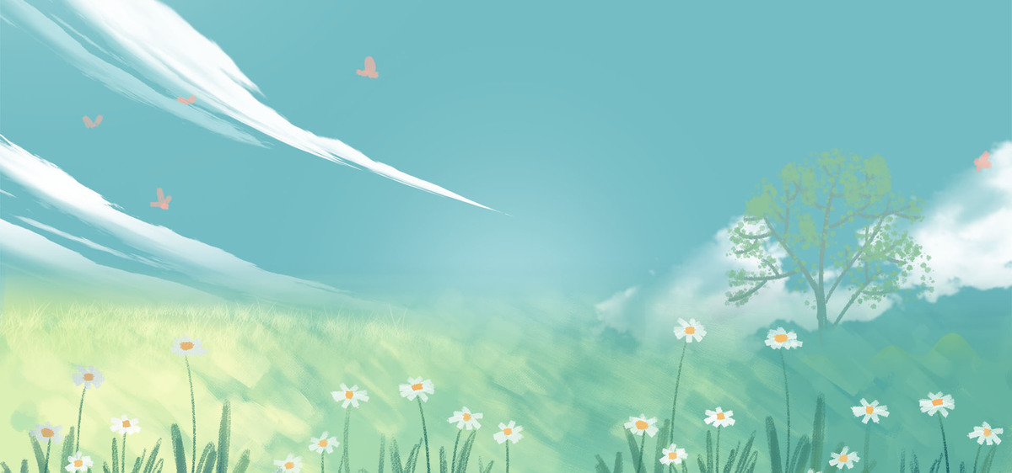
Read for information
characters：
Harry ( leading )
volunteers ( supporting) ; 根据情节构建需要可增加： residents in the community , people in need
2. narrative perspective: third -person
time： after his retirement
place： Harry’s neighborhood Alaska Homer & his garage
event : Harry repaired abandoned bikes and gave away them to those needy. With more and more bikes waiting to be restored, the repairing work was too much for him and volunteers came to his aid.

Slide 5


5.story line
Climax
I was inspired by the letter and decided to change my routine , my life and even the world around me.
More and more abandoned bikes accumulated in his garage and the repairing work was more than he could deal with.
Para1:Knowing Harry’s situation, a group of volunteers came to help him.
Neighbors donated their old bikes and Harry devoted himself to repairing work. After giving away the first batch of well-repaired bikes, he felt satisfied.
Para2: To match each bike with its new owner, Harry gathered their specific needs.
Harry retired , spotted many abandoned bikes in his neighborhood and offered to repair them for free.
background
Ending
Beginning

Slide 6
Read for clues and echoes
clues | echoes
Harry Caine retired from a local power company. After his retirement, he just wanted to do something for his community. One day, he spotted many abandoned bikes, which were gathering dust in the neighbouring garages. "Why not fix them up and give them to those needy?" he thought. So he posted to an online group in his Alaska Homer, offering to fix people's bikes for free.
1. Those once-abandoned
bikes couldn’t wait to
embark on their new
journey, ready to serve
those in need.

Slide 7
Read for clues and echoes
clues | echoes
Soon some neighbors began to donate their abandoned bikes after their kids had outgrown them or adults had upgraded to new models. Then, in Harry's tidy little garage, he set about working. Its inner walls lined with tools, the garage held a workbench and repair stand. Classic rock music often drifted from its open doors, a sign that Harry was working hard. After Harry's highly skilled repairs, the donated bikes took on new looks and functioned very well.
2. In Harry’s tidy small
garage, volunteers
dedicated themselves to
doing repairing work,
with classic rock music
on.

Slide 8
Read for clues and echoes
clues | echoes
One Saturday, Harry transported the first batch of six repaired bikes to a nearby food bank, a place that gave food to the poor. He camped out with his Free Bikes sign and waited to see whether the bikes were needed.
As batches of bikes found their new homes, the smiles on the faces of the people in the community grew wider and Harry's project became an even more integral part of the neighborhood, spreading joy and practical help to those in need.

Slide 9
clues | echoes
Five minutes later, a little boy wearing worn-out clothes came up to Harry with a doubtful look, his eyes glued to a blue bike, "Is it really free?" the boy asked." Yes. If you like it, it's yours." Harry answered joyfully. The boy beamed a broad smile. He briskly walked towards the blue bicycle. Then he touched its handle, pressed its bell, and explained how he had dreamed of owning one bicycle.
4. Wearing an excited look/
Beaming a warm smile, a
little shy girl approached
Harry, her eyes fixed on a pink
bike. She grabbed its handles,
mounted the bike, pedaled
away and exclaimed,“ It’s my
dream bike!”

Slide 10
clues | echoes
As word of Harry's project spread, neighbors admirably called him Uncle Harry, and they kept him busy with a steady supply of bikes, helmets and even locks. However, with more abandoned bikes flooding in, Harry had his hands full and the repairing work was more than he could deal with.
5. The once-overwhelming
repairing work became
manageable with their
combined efforts.

Slide 11
心理描写
神态描写
动作描写
外貌描写
环境描写
对话描写
语言
无灵主语
动作链
分词作状语
With 复合结构
独立主格
从句
倒装句
虚拟语气
强调句
长短句结合

Slide 12
Plot the continuation story
Para1: Para1:Knowing Harry’s situation, a group of volunteers came to help him
Para2: To match each bike with its new owner; Harry gathered their specific needs.
Link1: How did Harry feel? And what did he do?
Body: What were they and what did they do? ( steps of repairing bikes)
Link2: What happened to piles of abandoned bikes? How did they feel?
Link3: How did he gather their specific needs?
Body: What did Harry and his team do according to their specific needs? How did donees feel? Give an example .
Ending: What does the story demonstrate to readers?

Slide 13
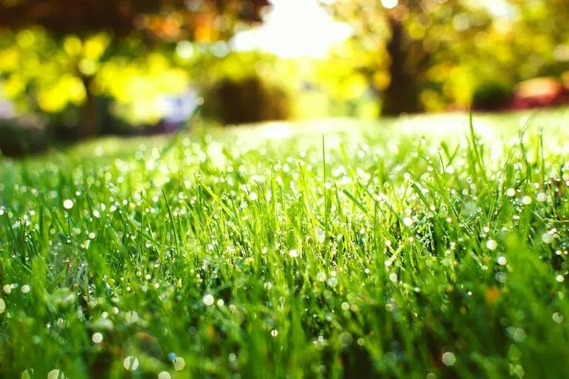
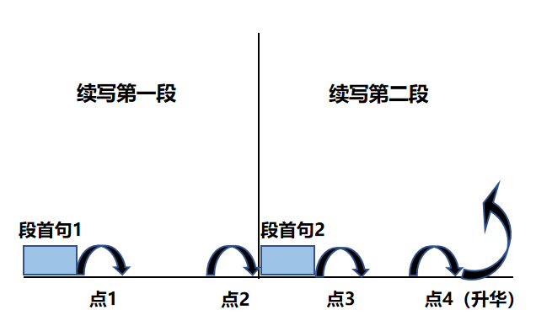
Plot Continuation
点1：位于续写第一段段首，流畅衔接前面的故事（常与原文最后一段呼应）和第一段段首语；
点2：位于续写第一段段尾，流畅衔接第二段段首句；
点3：位于续写第二段段首，续写衔接第二段段首语；
点4：文章结尾升华，给予读者正能量，揭示和强调主题。

Slide 14
Design link1
Para1: Knowing Harry’s situation, a group of volunteers came to help him.
Link1A: (describe volunteers) Inspired by Harry’s selfless and generous act, they were eager to join him and contribute to the meaningful cause.
Link1B: (Harry’s feeling） Seeing enthusiastic volunteers flooding into his tiny garage, Harry was literally moved to tears.

Slide 15
Design link1
Para1: Knowing Harry’s situation, a group of volunteers came to help him.
Link1A: (describe volunteers) Inspired by Harry’s selfless and generous act, they were eager to join him and contribute to the meaningful cause.
Link1B: (Harry’s feeling） Seeing enthusiastic volunteers flooding into his tiny garage, Harry was literally moved to tears.

Slide 16
Design link2
Para1: Knowing Harry’s situation, a group of volunteers came to help him.
.
Para2: To match each bike with its new owner, Harry gathered their specific needs.
Link2 A: (the final result of repairing work) Under Harry’s guidance, the volunteers quickly got the hang of fixing bikes. With their joint efforts, more and more well-repaired bikes piled up, ready to serve their new owners.
Link2B: ( distinct comparison to former Harry’s repairing work）The once-overwhelming repairing work became manageable with their combined efforts.

Slide 17
Design link3
Para2: To match each bike with its new owner, Harry gathered their specific needs.
Link3A: (one way to gather specific needs） He created/ designed a simple form asking for details like the rider’s height, preferred color or other special requirements, with which Harry and his team carefully crafted/ customized the most suitable bikes for their new owners.
Link3B: ( another way to gather specific needs） He started a database, noting details like age, height, and the purpose for which the bike would be used.

Slide 18
Design ending
Para2: To match each bike with its new owner, Harry gathered their specific needs.
Ending A: (the meaning of Uncle Harry’s project) Each time he saw the grateful and satisfied smiles on the faces of donees, his heart swelled with pride. The project not only provided free transportation but also strengthened the community bond, all thanks to the dedication of Harry and volunteers.
Ending B: (recipients’ response ) As the bikes found their new homes, the smiles on the faces of the people in the community grew wider, and Harry's project became an even more integral part of the neighborhood, spreading joy and practical help to those in need.

Slide 19
Version 1: “基于彰显社区邻里情”之助人善举范文赏析：
Para1: Knowing Harry’s situation, a group of volunteers came to help him. Inspired by Harry’s selfless and generous act, they were eager to join him and contribute to the meaningful cause. Some were experienced mechanics like Harry, while others were just enthusiastic learners with a kind heart. Upon their arrival, Harry’s garage became a hive of vigor and the once-overwhelming task became manageable. Tools clanked mixed with friendly chatter, which sounded like a harmonious symphony. Based on their skills, they divided the repairing tasks efficiently. Some focused on stripping down the bikes, others on sanding and painting, and the rest on reassembling. Under Harry’s guidance, the volunteers quickly got the hang of fixing bikes. With their joint efforts, more and more well-repaired bikes piled up, ready to serve their new owners. (112)
或者：The volunteers' dedication made a huge difference, allowing Harry to continue his noble project with new energy.

Slide 20
Para 2: To match each bike with its new owner, Harry gathered their specific needs. He created/ designed a simple form asking for details like the rider’s height, preferred color or other special requirements, with which Harry and his team carefully crafted/ customized the most suitable bikes for their new owners. A little shy girl, wearing an excited look, approached Harry, her eyes fixed on a pink bike tailored to her needs. She grabbed its handles, mounted the bike, pedaled away and exclaimed, “ It’s my dream bike!” Each time he saw the grateful and satisfied smiles on the faces of donees, his heart swelled with pride. The project not only provided free transportation but also strengthened the community bond, all thanks to the dedication of Harry and volunteers. (112)
或者：As batches of bikes found their new homes, the smiles on the faces of the people in the community grew wider and Harry's project became an even more integral part of the neighborhood, spreading joy and practical help to those in need.

Slide 21


