Slide 1


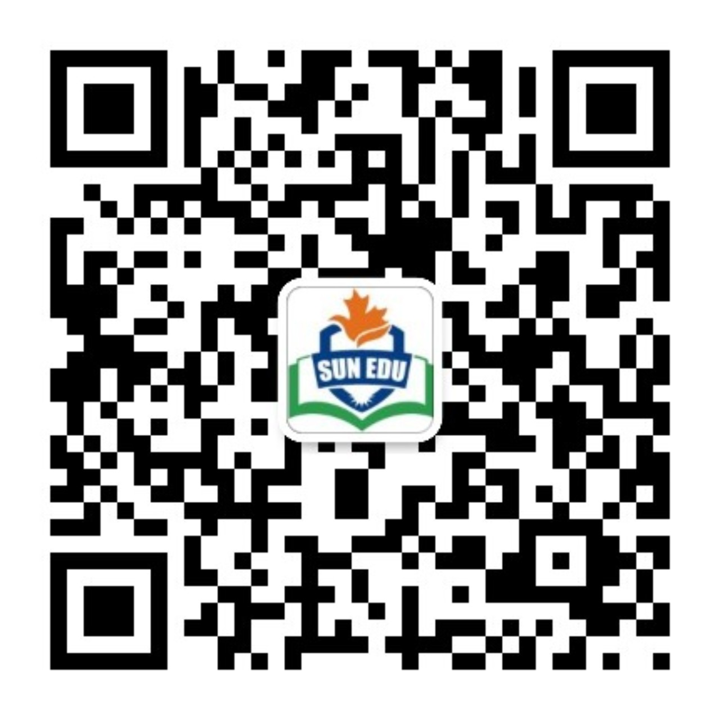
感恩遇见，相互成就，本课件资料仅供您个人参考、教学使用，严禁自行在网络传播，违者依知识产权法追究法律责任。
更多教学资源请关注
公众号：溯恩英语
知识产权声明

Slide 2
宁波高三二模
应用文写作评析
基于SDL模式的应用文写作
——帮助老年人跨越数字鸿沟

Slide 3
目录
写作存在的问题
SDL模式的运用
01
02
师生佳作分享
同类话题拓展
03
04

Slide 4

题目呈现
假定你是李华，上周你参加了志愿者社团组织的“帮助老人跨越数字鸿沟”活动，请你写一篇短文在班级英语展示角分享此次活动，内容包括：
1. 活动内容；
2. 你的体会。

Slide 5
写作存在的问题
01

Slide 6
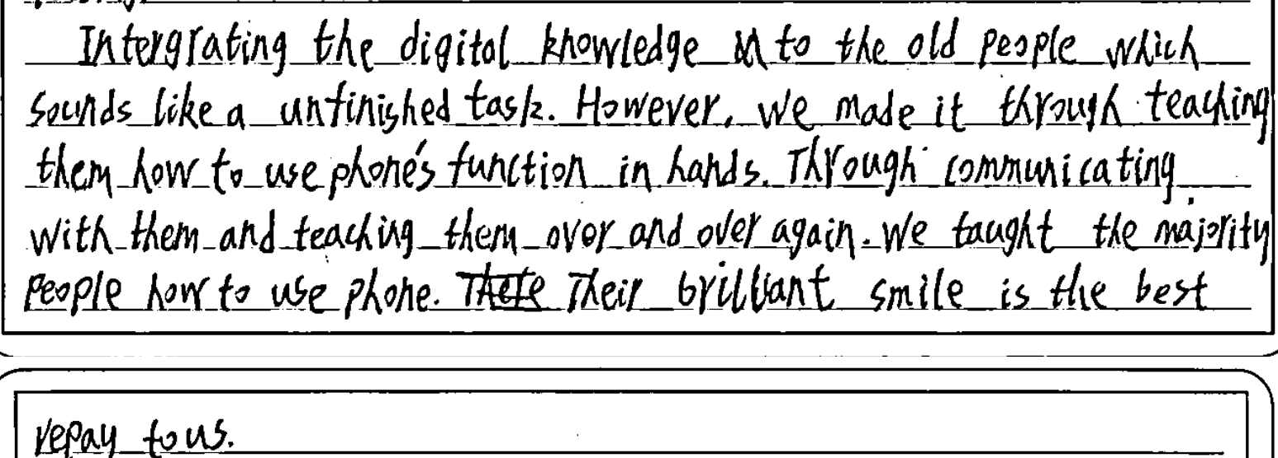
写作存在的问题1：未具体介绍活动内容

Slide 7
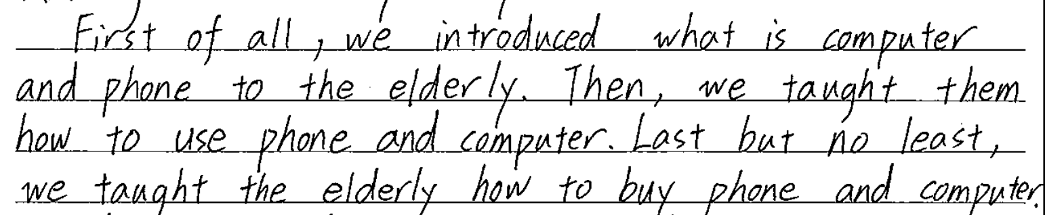
写作存在的问题2：活动内容不合理

Slide 8
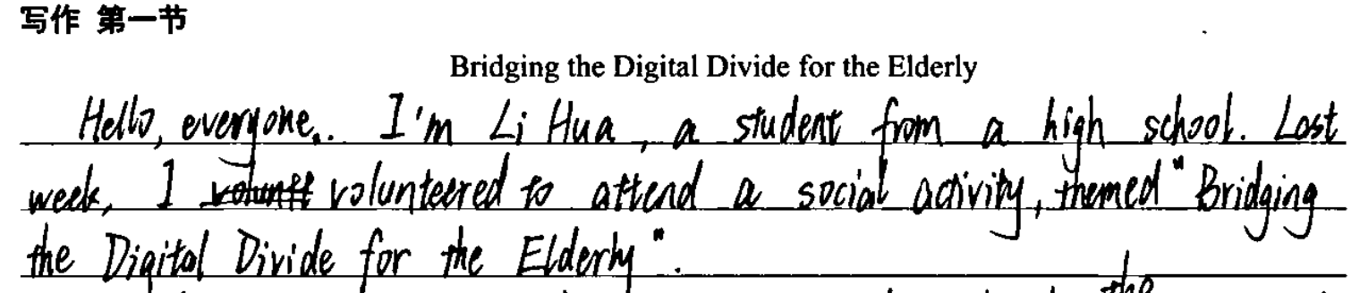
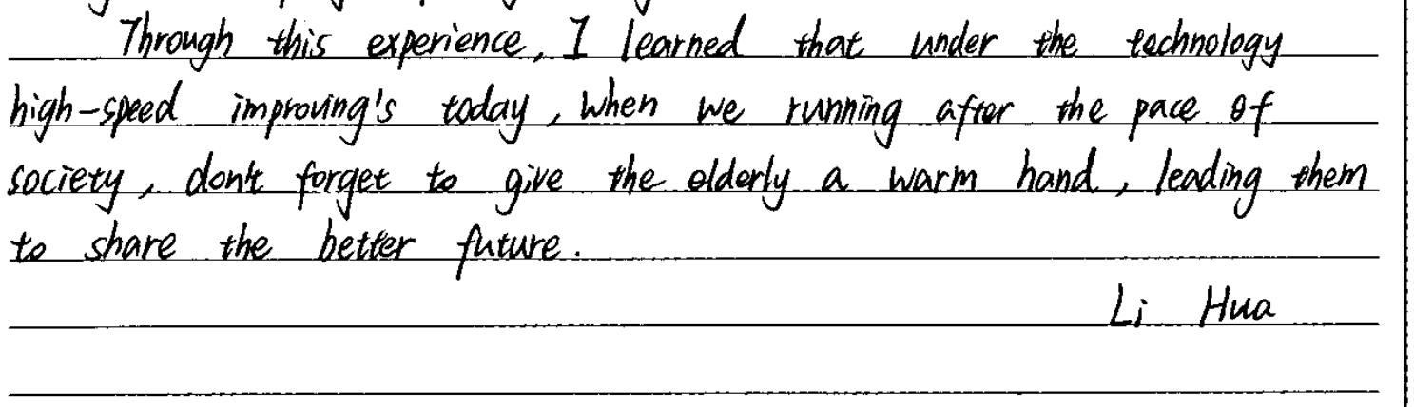
写作存在的问题3：体裁判断错误

Slide 9
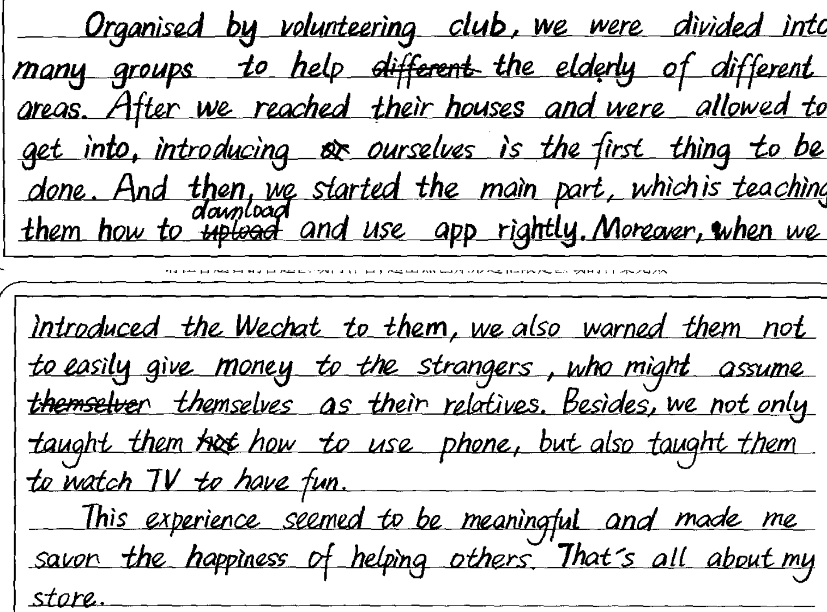
写作存在的问题4：要点内容比例失衡
活动内容
个人体会

Slide 10
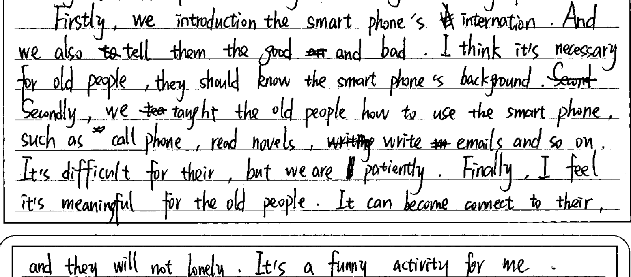
写作存在的问题5：要点衔接连词不当
要点内容衔接连词使用不当

Slide 11
SDL模式的运用
02

Slide 12
基于SDL模式的应用文写作步骤
根据话题
整合语料
(Language)
仔细审题拟定结构(Structure)
02
01
结合策略
巧用语料(Language)
研读要点
拓展细节 (Details)
04
03

Slide 13
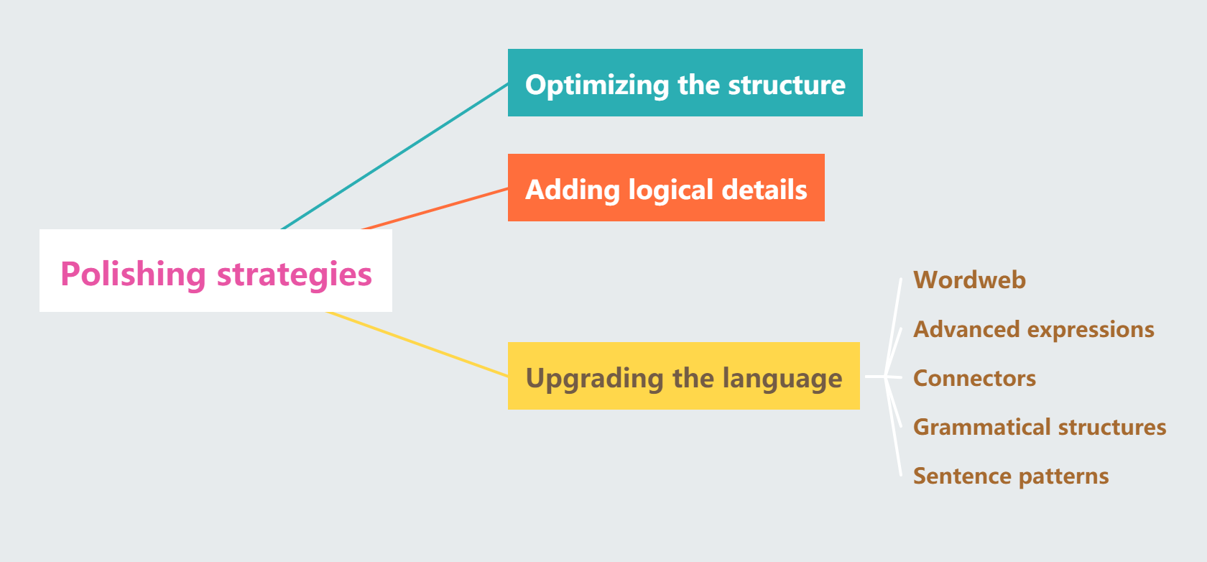
SDL模式在应用文写作修改过程的策略运用
单击此处添加文本

Slide 14
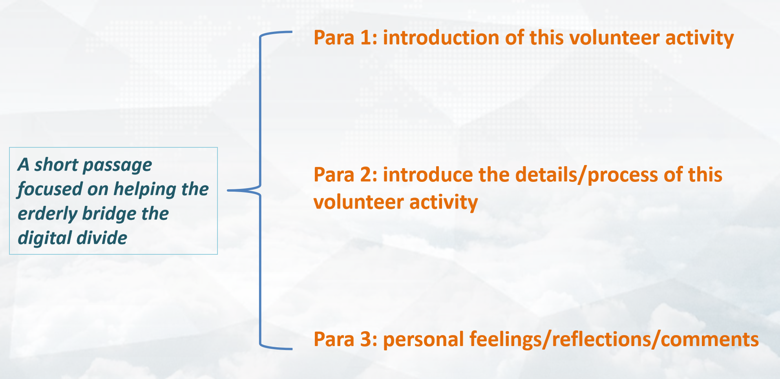
Step 1: 仔细审题，拟定结构(structure)
Genre | a short passage (narrative+feelings)
Background | an activity focused on helping the elderly bridge the digital divide
Writing purpose | 1. to introduce this activity 2. to express personal feelings&thoughts
Key points | 1. process/details of this activity 2. personal reflections/comments
Tense | past tense&present tense
Person
 | first perspn&third person

Slide 15
Step 2: 研读要点，拓展细节(details)
要点1：活动内容
tailored hands-on experience
elaborately-made leaflets
attend a lecture
paired insructions
step-by-step instructions
stimulate real-life scenarios
hesitant ones gained confidence
a broad smile crossed her face
expressed heartfelt gratitude
online communication
hospital appointments
cashless payments
make video calls
教学场景
具体教学动作
老人反应

Slide 16

Step 2: 研读要点，拓展细节(details)
要点2：你的体会
志愿者服务价值
1
strengthen community bonds
cultivate our sense of social responsibility
collective efforts to foster a harmonious community
数字时代责任感
bridge the digital gap
boost inter-generational communication
empower senior citizens to embrace new technology
commitment to technological inclusion
2
科技与人文结合
reflection on the essence of technology
human-centered interface design
digital dignity preservation
3

Slide 17
Step 3：结合教材，搭建语料(language)
aiming to.../aimed at.../with the aim of.../with the intention of.../with the purpose of.../in a bid to...
be commenced with.../ kick off with.../start with...
then.../be followed with.../after that,...
impart practical knowledge
provide hands-on guidance
craft user-friendly leaflets
instruct essential digital skills
stimulate real-life scenarios
encourage repeated practice

Slide 18
Step 3：结合教材，搭建语料(language)
This activity kicked off with a lecture where volunteers imparted essential digital skills to the elderly, after which volunteers were paired with senior citizens for step-by-step instructions, teaching them how to use apps for mobile payments, hospital appointments and online communication.
We even prepared elaborately-designed leaflets for better comprehension. When I saw Granny Li broke into a broad smile after having a video call with her families, I was deeply overwhelmed with a sense of fulfillment.

Slide 19
Step 3：结合教材，搭建语料(language)
strengthen my awareness of...
gain valuable insights into...
deepen my understanding of inter-generational communication
boost inter-generational understtanding
bridge the digital gap
establish a harmonious and inclusive society
foster a sense of social responsibility
empowet the senior citizens to embrace new technology
empower the erderly with tools for modern life
dissolve age barriers

Slide 20
Step 3：结合教材，搭建语料(language)
Witnessing elders navigate the digital world with courage, I realized bridging the generation gap requires not just technical guidance, but mutual understanding.
This journey taught me that technological empowerment isn't about fancy apps, but preserving human connections. Each repeated demonstration dissolved age barriers, reminding me that true progress lies in ensuring no one gets left behind in the digital marathon.

Slide 21
师生佳作分享
03

Slide 22
参考范文
Bridging the Digital Divide for the Elderly
In a world dominated by digital technology, the elderly often find themselves left behind. Considering this, our volunteer club launched an activity at Tianyi Community Center last week, focusing on helping them bridge the digital divide.
The activity began with group demonstrations on essential skills: making video calls, using mobile payments, and booking medical appointments online. Volunteers then provided personalized guidance. Through step-by-step instructions, even those hesitant with technology gradually gained confidence. One silver-haired lady, after successfully video-calling her granddaughter at college, kept thanking us with teary eyes.
This experience empowered the seniors to embrace the digital life. Despite their initial struggles, their eagerness to learn was inspiring. Every “I finally did it!” smile has reminded me that bridging this gap goes beyond goodwill – it’s a shared mission to build a future where technology unites, not divides.

Slide 23
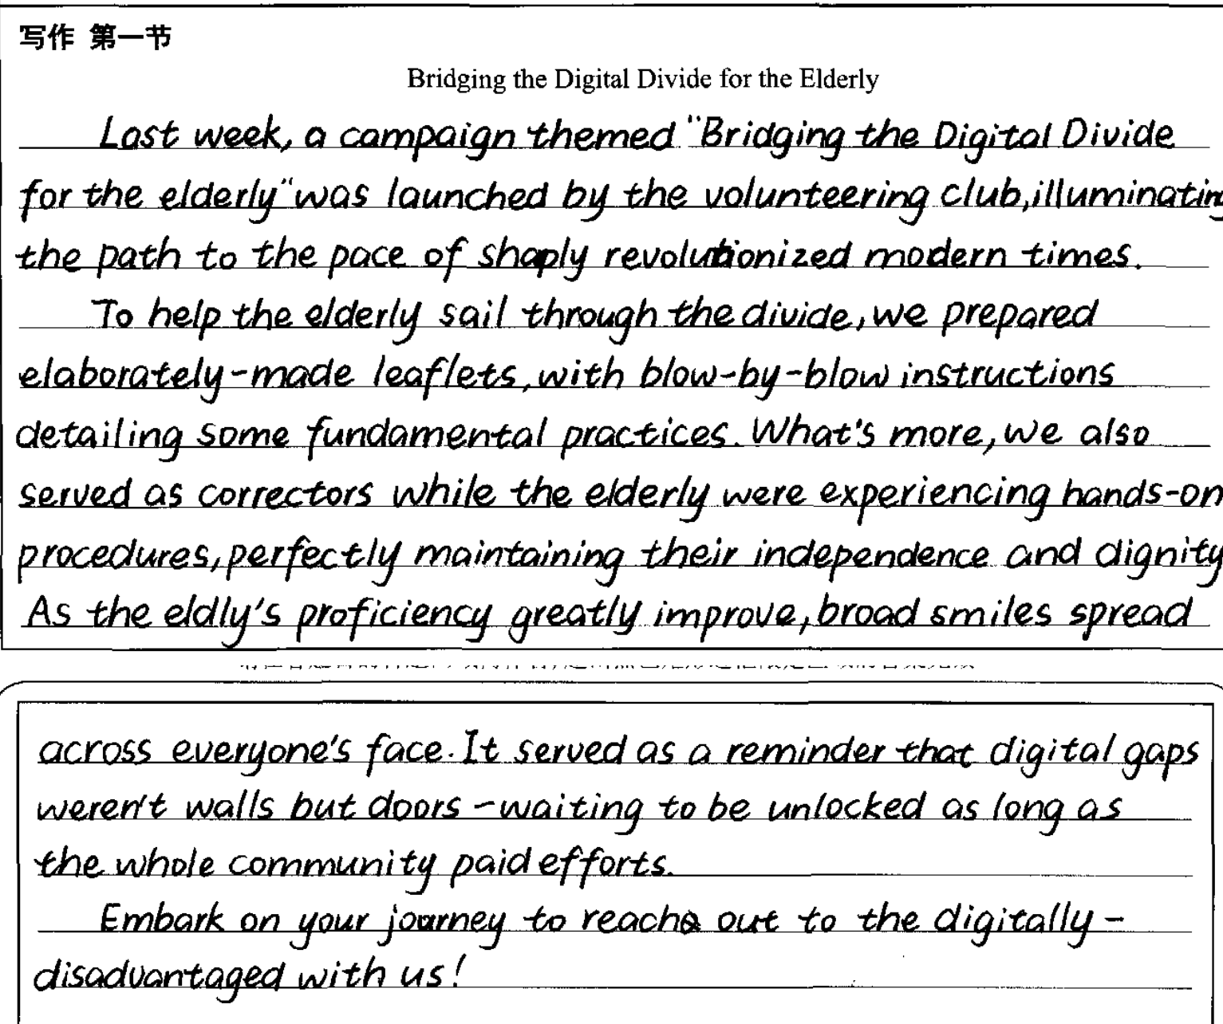
学生佳作
文章结构完整，条理清晰，涵盖所有要点
使用了丰富的词汇如elaborately-made leaflets/ hands-on procedures、语法结构如非谓语动词-ing形式、和高阶表达如 illuminate the path/ serve as/proficiency/embark on
要点内容衔接流畅，上下文连贯性强

Slide 24
教师下水作文
Bridging the Digital Divide for the Elderly
Last weekend witnessed a meaningful volunteer activity to help the erderly bridge the digital divide. As a participant of this activity, I felt greatly inspired and enlightened.
This activity kicked off with a lecture where volunteers imparted practical knowledge of essential digital skills to the elderly, after which volunteers were paired with senior citizens for hands-on learning experiences. During this session, volunteers patiently instructed how to apply basic mobile phone apps for daily usage, such as online communication, hospital appointment and cashless payments. What impressed us most was that some volunteers prepared user-friendly manuals with visual aid to foster comprehension. When Granny Li broke into a radiant smile after knowing how to chat with families online, I was overwhelmed with a deep sense of satisfaction.
This activity endows me with a new perspective of the essence of technology. Digital technology not only renders us convenience but also boosts inter-generational communication, thus helping create a harmonious and inclusive society.

Slide 25
同类话题拓展
04

Slide 26
2025.4杭州二模
你校英文报正在开展以“英语课外自主学习”为主题的征文活动。请你结合自身经历写一篇短文投稿，内容包括：
(1)介绍你的一种做法；
(2)说明其成效。
注意：
(1)写作词数应为80个左右；
(2)请按如下格式在答题纸的相应位置作答。
Effective Self-directed English Learning:My Experience

Slide 27
Deepseek版本
As a senior high school student, I have found that watching English TED Talks is an excellent way to improve my language skills independently. Every weekend, I select a talk on a topic I’m interested in, watch it with subtitles, and take notes on useful expressions and ideas. Later, I summarize the talk in my own words and practice speaking by imitating the speaker’s pronunciation and intonation.
This method has greatly enhanced my listening and speaking abilities. My vocabulary has expanded, and I can now understand native speakers more easily. Additionally, the exposure to diverse topics has broadened my knowledge and critical thinking. Self-directed learning through TED Talks has made English study both effective and enjoyable, proving that autonomy can lead to significant progress.

Slide 28
高考加油！

